Slide 1


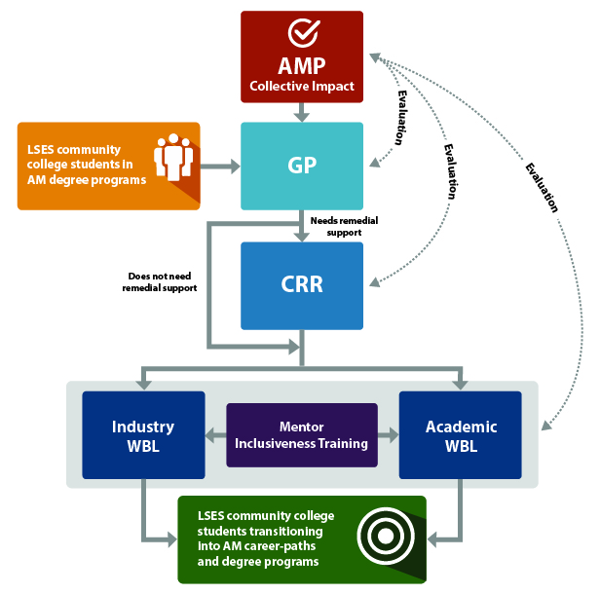
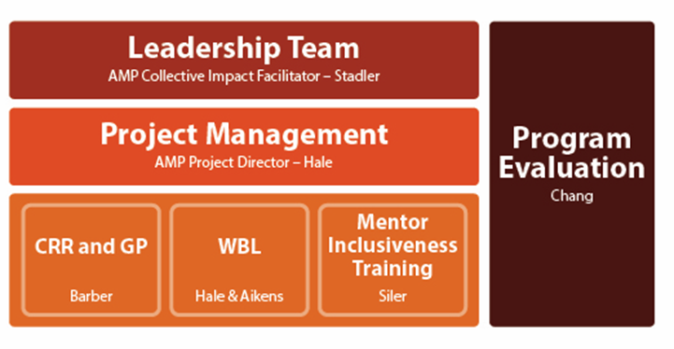
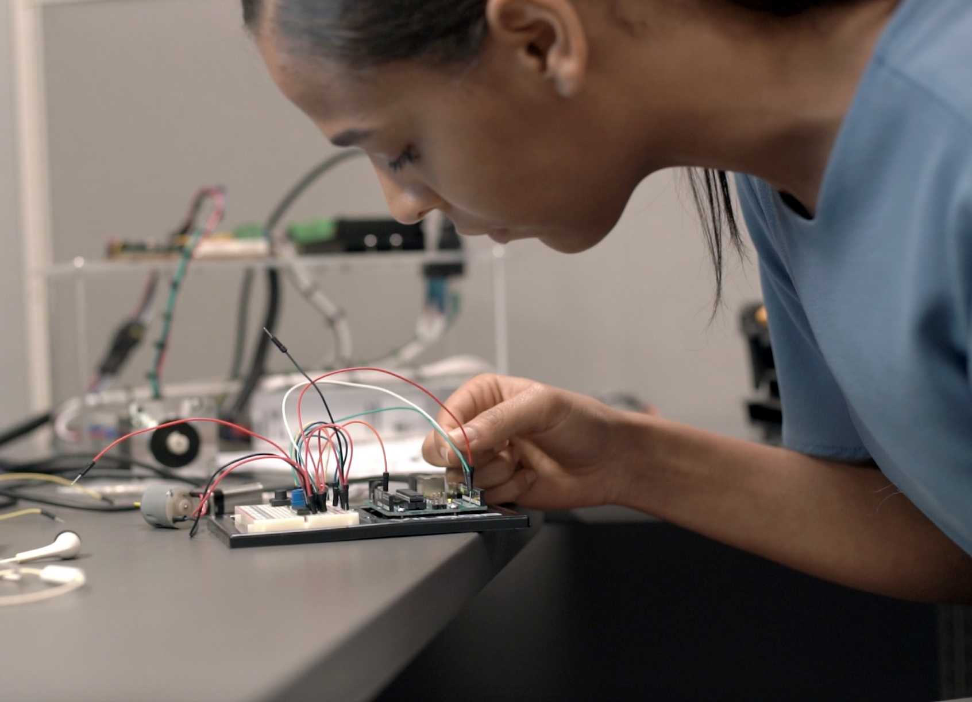
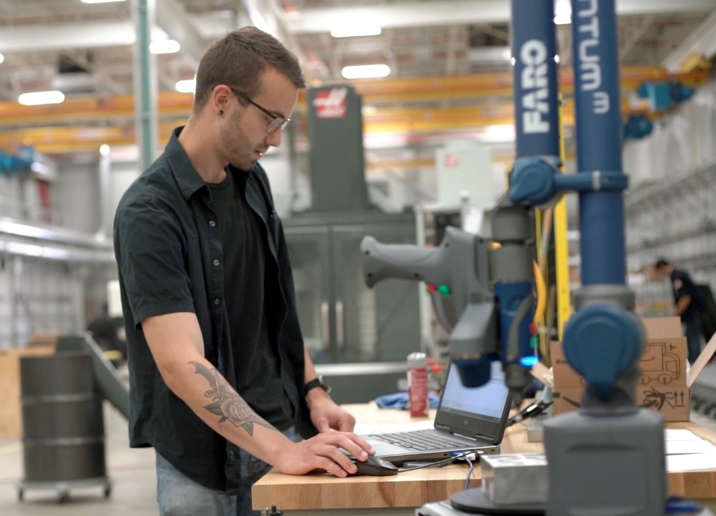
New Hampshire Advanced Manufacturing Partnership (NH-AMP)
NSF #174491; Cohort #2
PI: P. T. Vasudevan¹; Co-Is: M. Aikens¹, L. Barber², S. Hale¹, B. Kinsey¹
¹University of New Hampshire – Durham
²Community College System of New Hampshire
Vision
Goals and Metrics
Leadership and Communication
Pilot Goals: This pilot project addresses the following goals toward increasing LSES student retention in Advanced Manufacturing programs at NH community colleges
Central coordinating entity that ensures Collective Impact for all AMP participants.
Clear GP for LSES CC students to obtain AM placements in paid WBL.
Implement CRR strategies to promote retention in AM pathways.
Mentorship training for supervisors in private industry and UNH engineering labs
  5 in 2018, 7 in 2019
Paid Work-based Learning and Research Internships for LSES community college students
  5 in 2018, 7 planned in 2019
Increase AM student retention to 50% (from current 25%).
Pilot Metrics: Mixed-methods interviews, institutional data, student academic records, pre/post surveys, and program documentation review
Track and quantify AMP students’ intention to persist on AM pathway and impacting factors
Pre-survey/Post-survey
  Level of interest to remain on pathway
  Confidence in STEM abilities
  Intention to persist
Interviews/Focus Groups
  Challenges to persist
  Formative Feedback
Expansion, Sustainability, and Scale
NH-AMP Theory of Change
1) NSF Alliance Proposal
The NH-AMP collaboration model will be transferable and scalable to other states’ systems of community and junior colleges. NH AMP is working to make partnerships with other INCLUDES projects to submit Alliance Proposals in the future. This spring, NH AMP was a partner in the submission of an NSF INCLUDES Alliance proposal that will expand the use of the program’s Mentor Inclusiveness Training and Building Industry Partnership models. These models will be disseminated to other colleges and universities through training workshops and seminars.
2) NH EPSCoR – NH BioMade (#1757371)
Many of the NH AMP project team members are also members of the Education and Workforce Development team on the new NH EPSCoR Grant, NH BioMade. The AMP framework will be continued in this grant, building off of established industry and state partnerships to create Work-Based Learning experiences for community college students in biomaterials and biomanufacturing. The reach of the project will also be expanded to include high school career and technical education (CTE) students in having access to the same WBL experiences and mentorship.
Increase Low Socio-Economic Status (LSES) student retention through
Guided Pathways (GP) mentorship
Co-requisite Remediation (CRR)
Work-based Learning and Research Internships
Supervisor Mentorship Training
2018 Outcomes
5 LSES Students – 2 at WireBelt Intl. and 3 at UNH engineering labs
  4 males, 1 female
  2 Hispanics, 3 white
All 5 (100%) students retained in STEM career pathway, including
  Hispanic female with over 3.0 GPA after Year 1 in Mechanical Eng.
  Male with Veteran Status with job at Wire Belt Intl.
  Hispanic male with several job offers in Advanced Manufacturing Ind.
  White male was undecided before program – after program applied, admitted and doing well in Mechanical Eng.
  White male with over 3.5 GPA and continuing in Bioengineering major
Partnerships
Leadership Team Members
Sr. Vice Provost Academic Affairs, UNH
Chancellor, Community College System of New Hampshire
Director, NH Manufacturing Extension Partnership
Director, Economic Development, NH Dept. of Bus. and Econ. Affairs
Chief Workforce Officer, Advanced Regenerative Medicine Institute
Chair, Dept. Mechanical Engineering, UNH
Community College Alumni in Advanced Manufacturing
NH-AMP Community Colleges (blue)
Year 1 industry partners (yellow)
Year 2 industry partners (orange)

