Slide 1


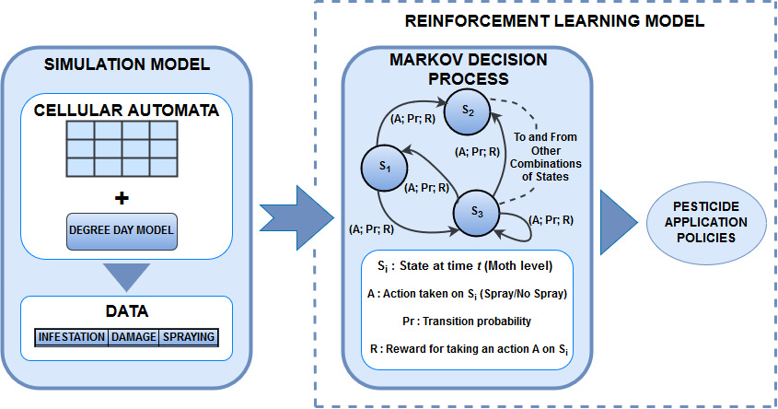
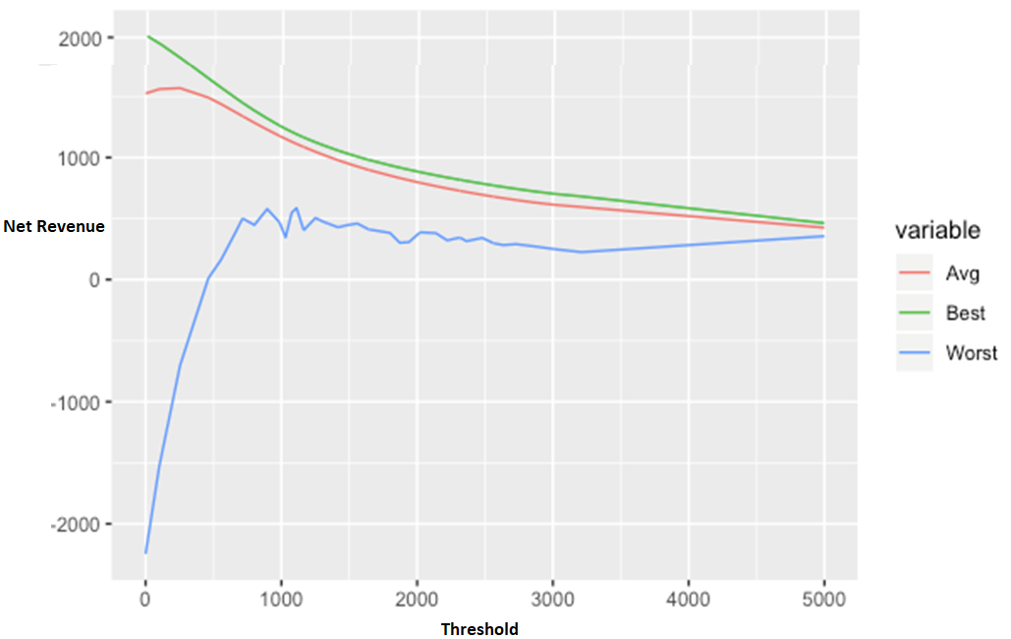
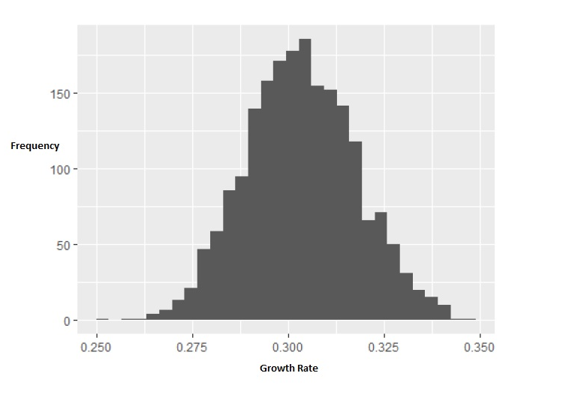


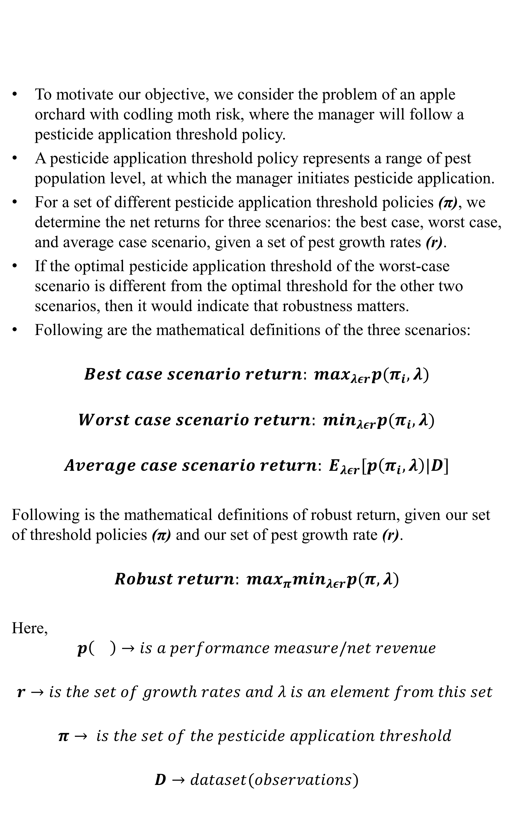
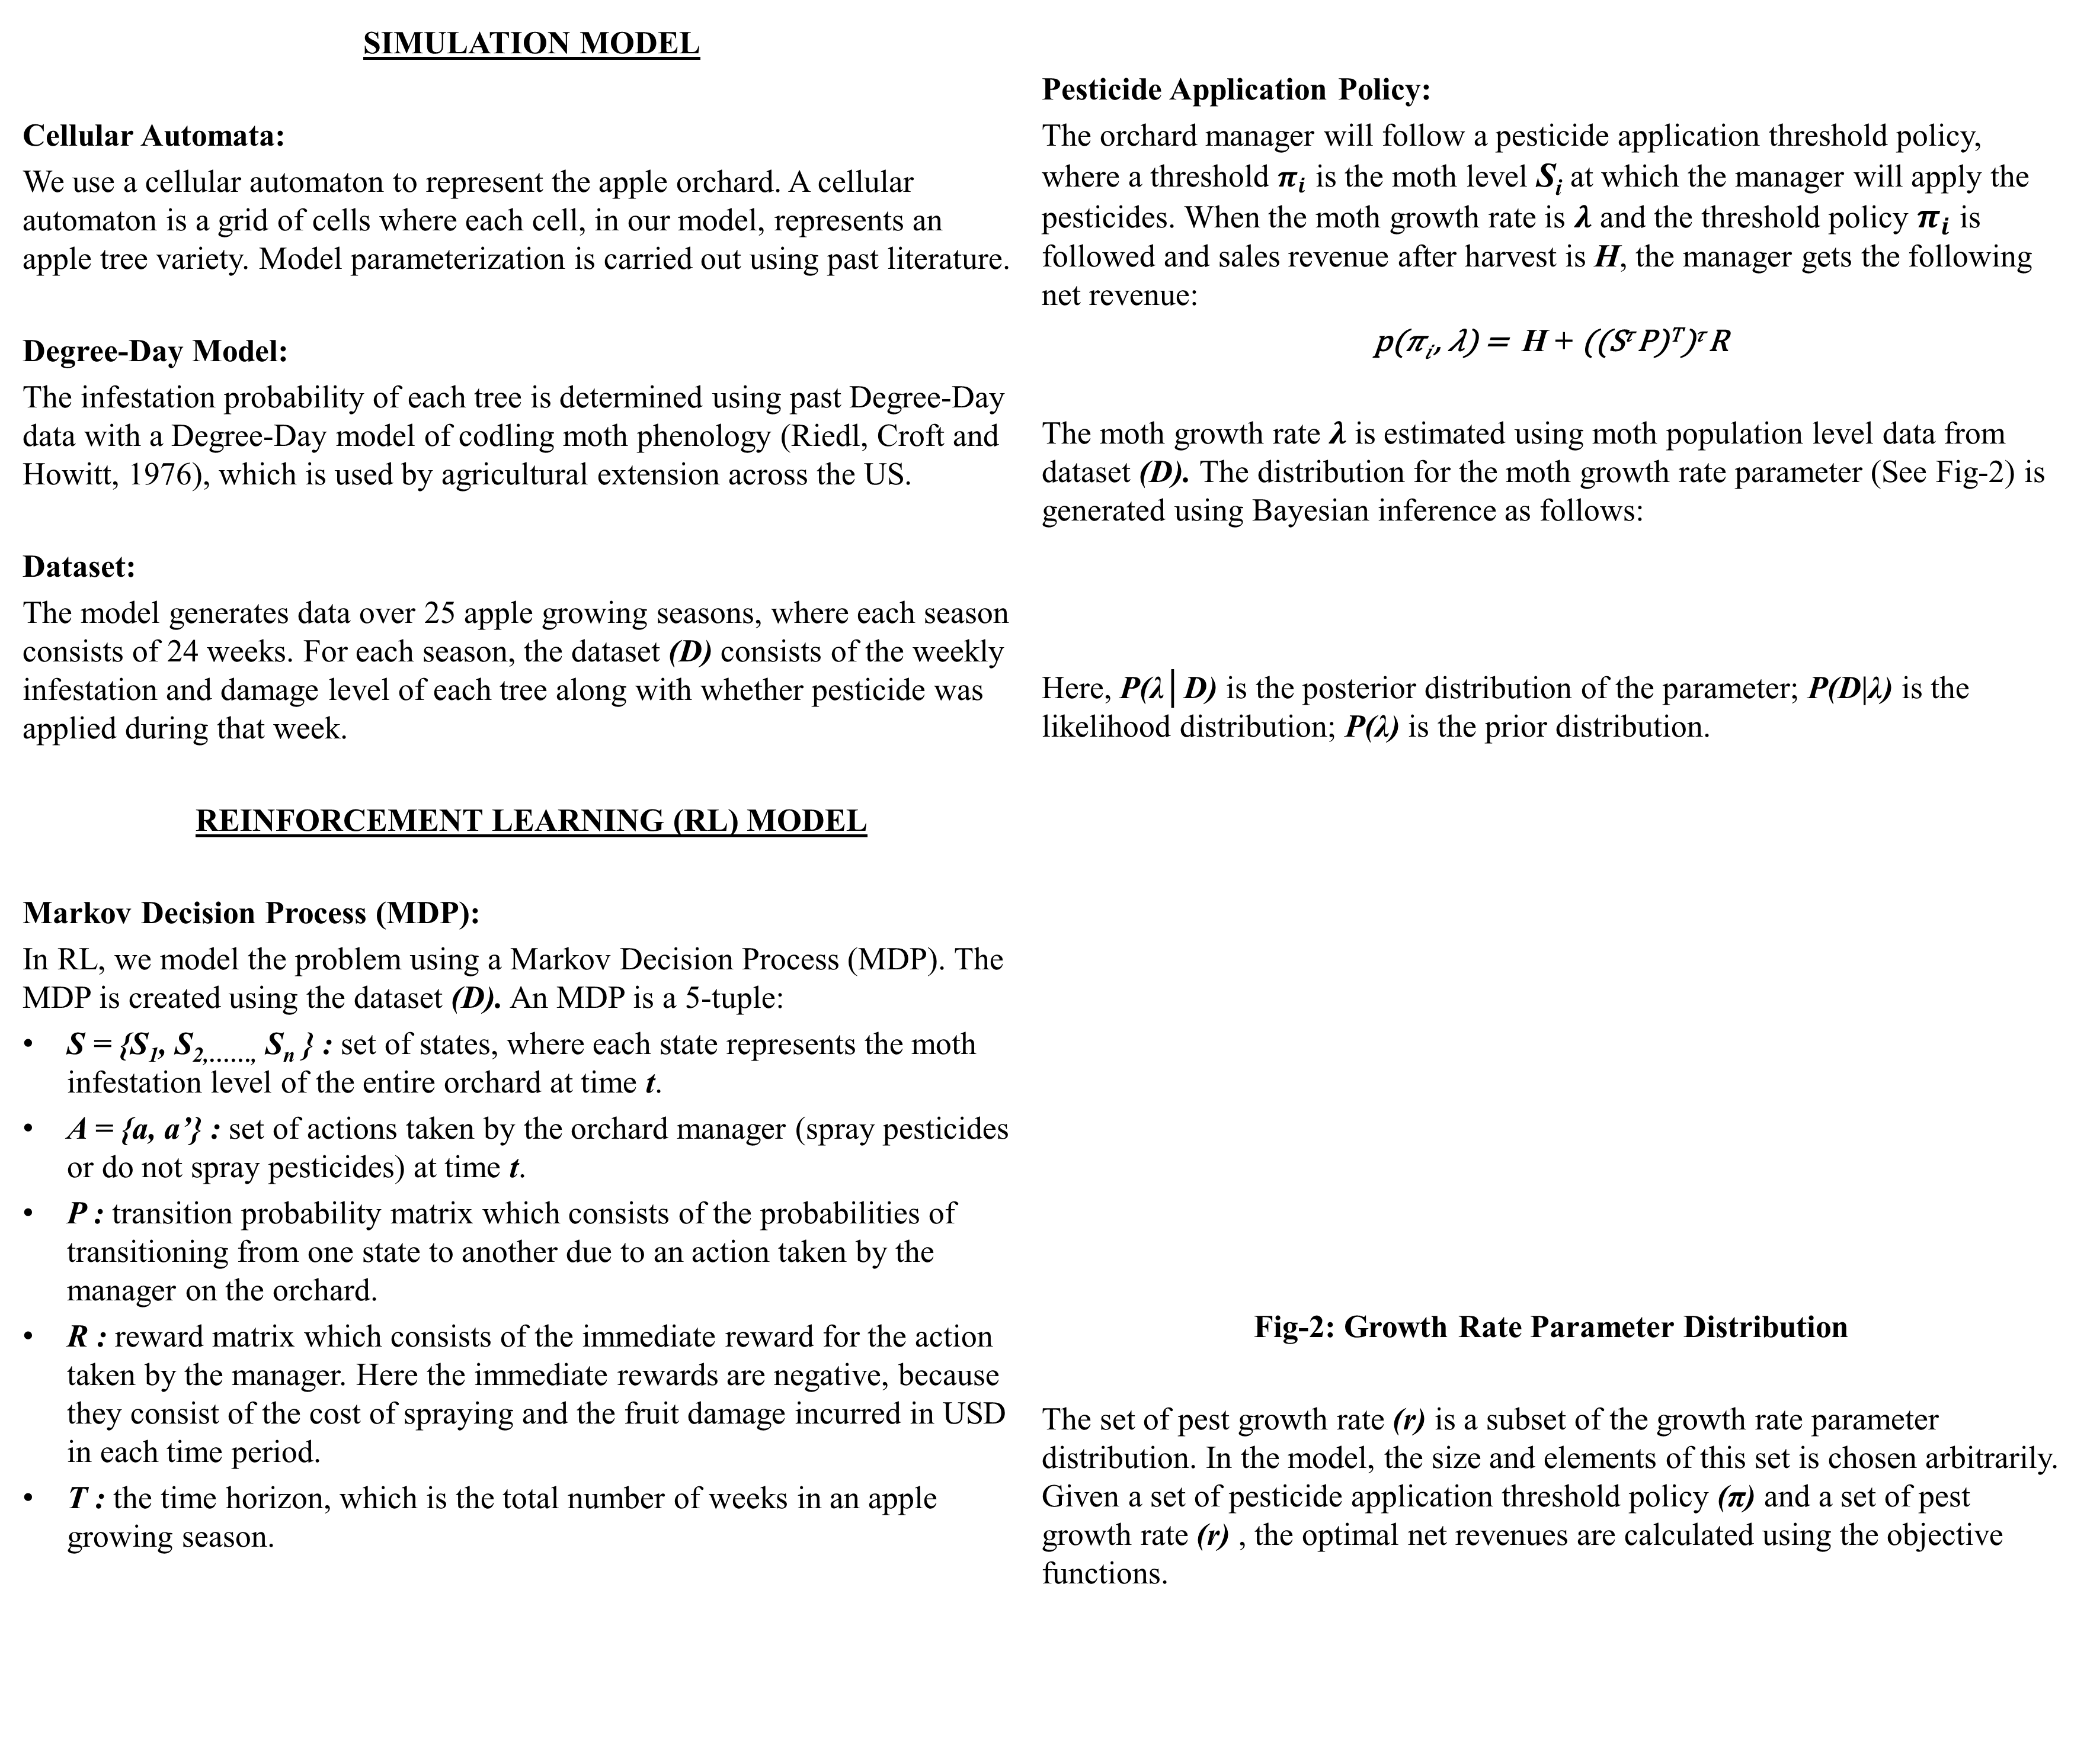
A Simulation-based Machine Learning Framework For Robust Optimization in Pest Management
Talha Siddique*, Shadi Atallah*, Marek Petrik**, Jia Hau**
*Department of Natural Resources, **Department of Computer Science
University of New Hampshire
ABSTRACT
METHODOLOGY
RESULTS
Identifying the optimal timing to spray reduces pesticide use, which can decrease negative impacts on the environment and reduce costs.
However, relatively small data uncertainties might cause a grower to wait too long after the pest is detected, which can lead to crop failure.
Existing frameworks for optimal control of pests and invasive species exist (Xiao et al. 2018, Kling et al. 2017; Meisner et al. 2016);
But their optimal solutions are often not robust, that is, they are highly sensitive to insufficient data and parameter uncertainty.
Given the risky nature of agriculture there is a need for models that can provide robust solutions.
To address this need, we use a machine learning technique, namely reinforcement learning (RL) and assess the trade oﬀs between the expected net returns of an optimal solution and robustness of that solution.
In RL, a software agent takes some form of action to maximize a reward or minimize a cost based, in order to find the optimal policy.
Fig-3: Net Revenue vs. Pesticide Application Threshold
To motivate our objective, we consider the problem of an apple orchard with codling moth risk, where the manager will follow a pesticide application threshold policy.
A pesticide application threshold policy represents a range of pest population level, at which the manager initiates pesticide application.
For a set of different pesticide application threshold policies (π), we determine the net returns for three scenarios: the best case, worst case, and average case scenario, given a set of pest growth rates (r).
If the optimal pesticide application threshold of the worst-case scenario is different from the optimal threshold for the other two scenarios, then it would indicate that robustness matters.
Following are the mathematical definitions of the three scenarios:
$$Best case scenario return: \max_{λεr}p(π_{i},λ)$$
$$Worst case scenario return: \min_{λεr}p(π_{i},λ)$$
$$Average case scenario return: E_{λεr}[p\left(π_{i},λ\right)|D]$$
Following is the mathematical definitions of robust return, given our set of threshold policies (π) and our set of pest growth rate (r).
$$Robust return: \max_{π}\min_{λεr}p(π,λ)$$
Here,
$$p\left(\right)→is a performance measure/net revenue$$
$$r→is the set of growth rates and λ is an element from this set$$
$$π→ is the set of the pesticide application threshold$$
$$D→dataset(observations)$$
Fig-1: Model Overview
The optimal threshold for worst-case scenario is different from its average or best-case counterpart.
This suggests that optimal solution robustness might matter in such a problem setting.
A risk averse farmer would prefer following the optimal threshold policy of worst-case scenario over the optimal policies of the other scenarios, to avoid any risk of failure due to parameter uncertainty.
However, worst-case scenario policies tend to be excessively conservative (a high degree of deviation from optimal solution).
The farmer would be better off following a robust optimal policy which lies somewhere between the average and worst-case scenario results.
Robustness comes with a trade-off: a solution with a higher degree of confidence (degree of robustness) will suffer from lower optimality.
In our case, the degree of solution confidence depends on the size of the growth rate set (r).
APPLICATION AND DEFINITION OF ROBUSTNESS
SIMULATION MODEL
Cellular Automata:
We use a cellular automaton to represent the apple orchard. A cellular automaton is a grid of cells where each cell, in our model, represents an apple tree variety. Model parameterization is carried out using past literature.
Degree-Day Model:
The infestation probability of each tree is determined using past Degree-Day data with a Degree-Day model of codling moth phenology (Riedl, Croft and Howitt, 1976), which is used by agricultural extension across the US.
Dataset:
The model generates data over 25 apple growing seasons, where each season consists of 24 weeks. For each season, the dataset (D) consists of the weekly infestation and damage level of each tree along with whether pesticide was applied during that week.
REINFORCEMENT LEARNING (RL) MODEL
Markov Decision Process (MDP):
In RL, we model the problem using a Markov Decision Process (MDP). The MDP is created using the dataset (D). An MDP is a 5-tuple:
S = {S₁, S_{2,……,} S_{n} } : set of states, where each state represents the moth infestation level of the entire orchard at time t.
A = {a, a’} : set of actions taken by the orchard manager (spray pesticides or do not spray pesticides) at time t.
P : transition probability matrix which consists of the probabilities of transitioning from one state to another due to an action taken by the manager on the orchard.
R : reward matrix which consists of the immediate reward for the action taken by the manager. Here the immediate rewards are negative, because they consist of the cost of spraying and the fruit damage incurred in USD in each time period.
T : the time horizon, which is the total number of weeks in an apple growing season.
Pesticide Application Policy:
The orchard manager will follow a pesticide application threshold policy, where a threshold $π_{i}$ is the moth level S_{i} at which the manager will apply the pesticides. When the moth growth rate is $λ$ and the threshold policy $π_{i}$ is followed and sales revenue after harvest is H, the manager gets the following net revenue:
p(𝜋_{𝑖} , 𝜆) = H + ((S^{𝜏} P)^{T})^{𝜏} R
The moth growth rate $λ$ is estimated using moth population level data from dataset (D). The distribution for the moth growth rate parameter (See Fig-2) is generated using Bayesian inference as follows:
Here, P(λ│D) is the posterior distribution of the parameter; P(D|λ) is the likelihood distribution; P(λ) is the prior distribution.
Fig-2: Growth Rate Parameter Distribution
The set of pest growth rate (r) is a subset of the growth rate parameter distribution. In the model, the size and elements of this set is chosen arbitrarily. Given a set of pesticide application threshold policy (π) and a set of pest growth rate (r) , the optimal net revenues are calculated using the objective functions.
FUTURE WORK
Confidence intervals of different levels can be applied on the growth rate distribution to obtain set r of varying size. This confidence interval is equivalent to the degree of solution robustness.
Given, the aforementioned trade-off, a graph of “Robust Return vs. Confidence Interval Level” will consist of a Pareto optimality curve. The points on the Pareto optimality curve will correspond to a set of solutions that are neither too risky or too conservative and these will be the policies or solution that the farmer would want to follow.
REFERENCES
Kling D.M., Sanchirico J.N., Fackler P.L. (2017). Optimal monitoring and control under state uncertainty: Application to lionfish management. Journal of Environmental Economics and Management 84
Meisner M. H., Rosenheim J.A., Tagkopoulos I. (2016). A data-driven, machine learning framework for optimal pest management in cotton. Ecosphere 7(3)
Riedl H., Croft B.A., Howitt A.J. (1976). Forecasting codling moth phenology based on pheromone trap catches and physiological time models. The Canadian Entomologist 108
Xiao Y., Greiner R., Lewis M.A. (2018). Evaluation of machine learning methods for predicting eradication of aquatic invasive species. Biological Invasion 20: 2485.
ACKNOWLEDGEMENT

