Slide 1



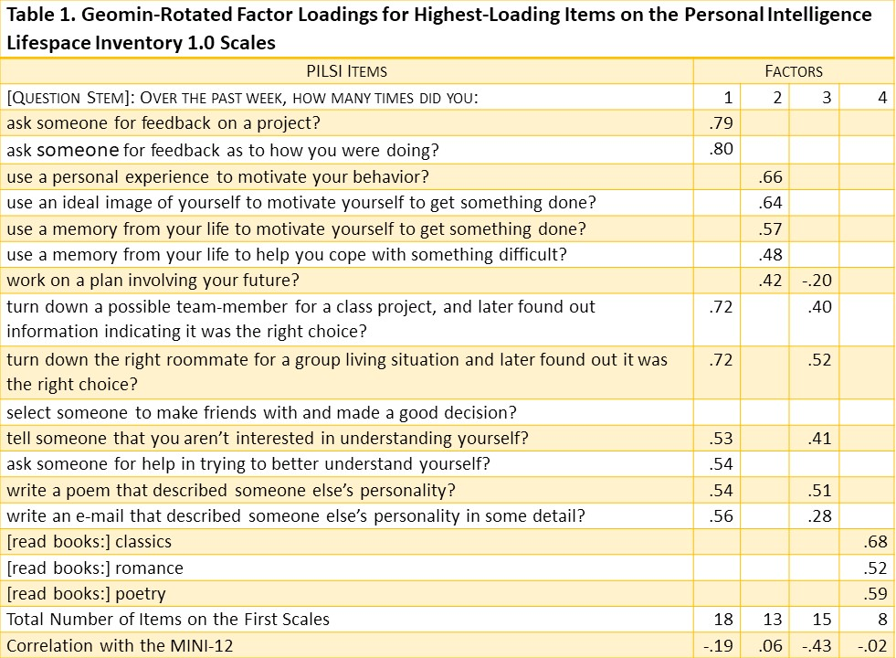
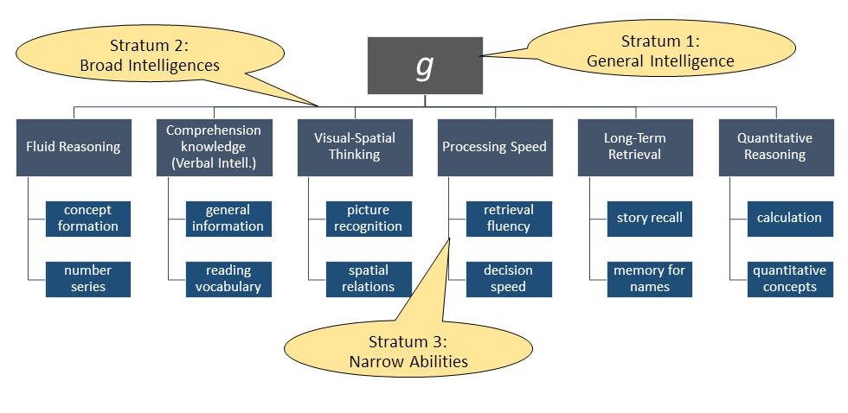
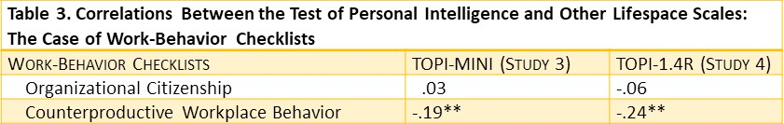
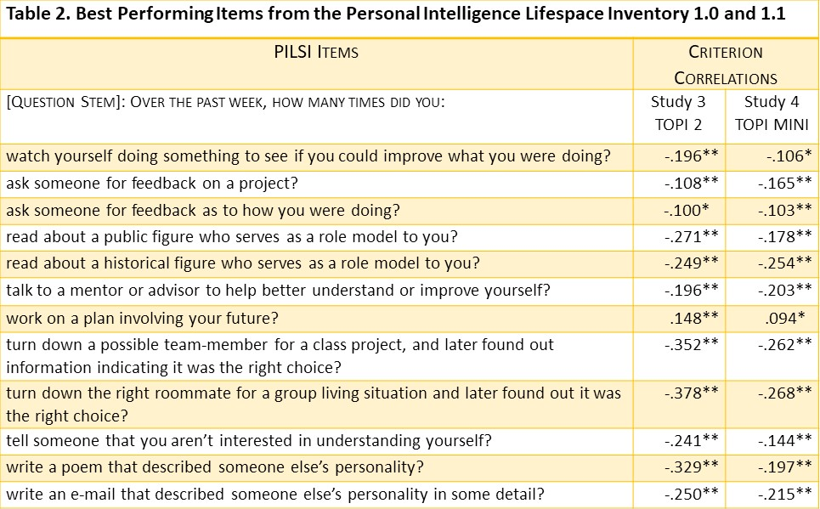
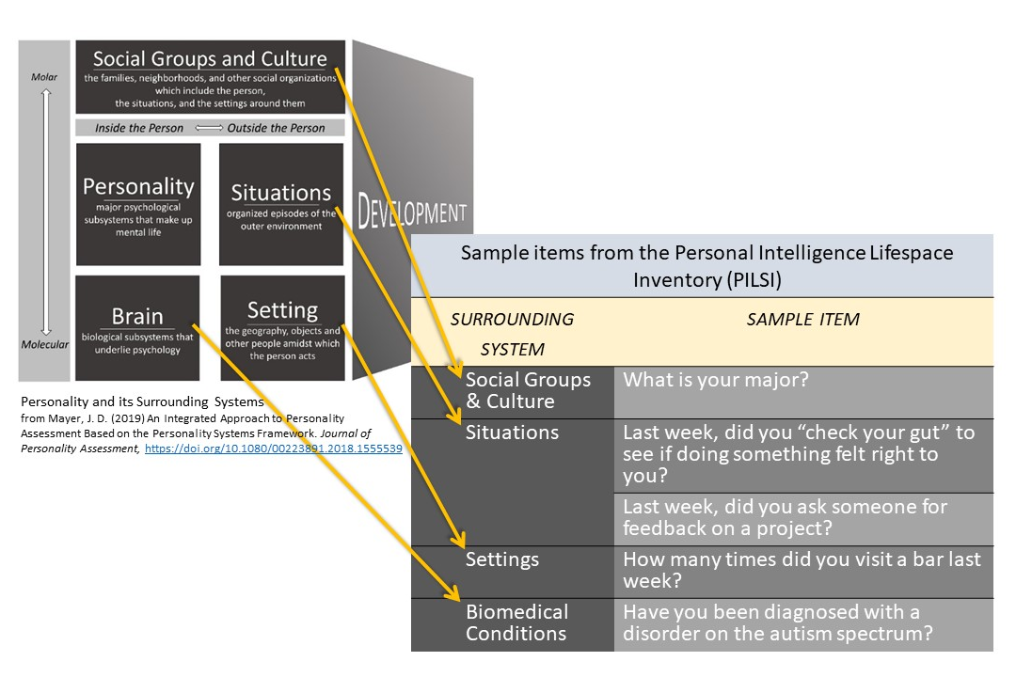
Life Expressions of People with High and Low Personal Intelligence: Initial Findings
John D. Mayer
University of New Hampshire
David R. Caruso
Yale University
A. T. Panter
University of North Carolina at Chapel Hill
Introduction
Overview of Studies
Results
Measures
Test of Personal Intelligence. Measures of the Test of Personal Intelligence were repeated: Study 3 with the TOPI-MINI, and Study 4 with a full-length version (the TOPI 4R).
Lifespace Measures. Rather than use our own lifespace scale, we employed two preexisting scales that consist of retrospective behavioral checklists to measure organizational behavior of employees. The 20-item Organizational Citizenship Behavior Checklist (OCB–C; Fox, Spector, Goh, Bruursema, & Kessler, 2012) and 32-item Counterproductive Work Behavior Checklist (Spector
et al., 2006) ask employees to check off the frequency of their behavior. Citizenship involves acts that benefit coworkers and organizations (e.g., finishing work for a coworker). Counterproductive acts involve abuse or aggressive behavior toward coworkers, non-adherence to rules, sabotage and theft.
Purpose
The purpose of this study was to examine a mental ability, personal intelligence (understanding personality), and its correlates with people’s reports of their social interactions and other aspects of their outer lives (i.e., lifespace data)
We conducted four correlational studies relating personal intelligence to lifespace data. We focus on the first two studies here. In a second set of studies, we included a lifespace scale of counterproductive work behavior—we also report that briefly.
We conducted a very exploratory factor analysis of the lifespace data and obtained four factors (see Table 1): (1) a first factor reflecting an interest in feedback, but not self knowledge; (2) self-motivating recall and goals; (3) confident, insensitive judgment; and (4) an “amount of reading” factor. Of those, the External Feedback and Confident Insensitivity correlated r = -.19 and -.43 with personal intelligence.
Participants
College students in a large New England university completed
Broad Intelligences and Prediction
In the Cattell-Horn-Carroll (CHC) model of intelligences, general intelligence (g) is at the top of a three-stratum hierarchy, with broad intelligences in the middle level and specific skills at the bottom. Figure 1 depicts the general outline of the CHC model.
a lifespace survey and measure of personal intelligence in Studies 1 and 2 (Ns = 384 and 356). Employees in organizations recruited through MTurk completed scales of personal intelligence and counterproductive work behavior (and other measures) in Studies 3 and 4 (Ns = 394 and 482; Mayer, Lortie, Panter & Caruso, 2018).
Key Hypotheses
People with high personal intelligence, relative to those lower in the ability, will exhibit more positive and fewer negative interactions with other people, as reflected in their lifespace-reported activities.
Lifespace reports that covary with personal intelligence may inform us as to styles of reasoning related to different levels of personal intelligence (e.g., overconfidence with low ability level).
Results. Personal intelligence predicted counterproductive work acts across both studies (see Table 3, abstracted from Mayer, Lortie, Panter & Caruso, 2018).
Figure 1. The Three-Stratum or Cattell-Horn-Carroll Model of Intelligence
Discussion and Conclusions
Methods
These studies provide a first examination of personal intelligence in relation to measures of the lifespace. We had mixed success: We found a number of relations in which, as personal intelligence decreased, negative behaviors increased, but very few instances of behaviors that rise with higher personal intelligence.
In Studies 1 and 2, lower personal intelligence covaried with more confident but insensitive judgments of others, and with asking for more feedback from others (rather than charting one’s own path, perhaps). In Studies 3 and 4, lower personal intelligence was related to higher counterproductive workplace behavior.
The present findings raise the question of what other relations with the lifespace might exist, and whether we can find positive, direct relationships, as opposed to inverse relations.
We have additional studies underway at present that expand our lifespace measures and search for more relationships.
Late 20th century researchers often focused on the contribution of general intelligence to academic and occupational success (Deary, 2012). Contemporary researchers have focused on sorting out the contributions of the broad intelligences beyond that of general intelligence, focusing on examples such as verbal, visual-spatial, and quantitative intelligences of the second stratum, shown in Figure 1, row 2 (McGrew, 2009; Ackerman, 2014; Schneider & Newman, 2015). In a review, Schneider and Newman found that broad intelligences incremented predictions over g alone of key outcomes such as grades and work performance, at levels of 2 to 6% of the variance (rs = .14 to 24).
Measures
The Tests of Personal Intelligence
The TOPI 4. The Test of Personal Intelligence is an ability-based
The same general pattern can be seen in the several items that replicated with the highest loadings over Studies 1 and 2. People low in personal intelligence, relative to those high in the ability, reported asking for feedback from others and engaging in confident, but insensitive judgments of others. The only item correlating positively with personal intelligence in both studies was “work on a plan involving your future.”
measure of reasoning about personality including inner experiences, traits, goals, and other qualities (Mayer, Panter, & Caruso, 2014).
Personal Intelligence Lifespace Inventory (PILSI) in Studies 1 and 2
To create the Personal Intelligence Lifespace Scale (PILSI), we copied the main areas of the lifespace into a table using the process depicted in Figure 2. We then wrote test items for each area of the lifespace potentially relevant to personal intelligence.
Personal Intelligence
Our focus here is on personal intelligence: the capacity to understand personality in oneself and in others (Mayer, Panter & Caruso, 2012). Personal intelligence shows partial correlations (controlling for g) for GPA in courses requiring understanding of people (e.g., English, psychology), and for the lack of counterproductive behavior at work (Mayer & Skimmyhorn, 2017; Mayer, Lortie, Panter & Caruso, 2018). These and other findings suggest people higher in personal intelligence have smoother relations with others relative to those lower in the skill set.
Figure 2. Personality and its surrounding lifespace
Key Sources
Ackerman, P. L. (2014). Adolescent and adult intellectual development. Current Directions in Psychological Science, 23(4), 246-251.
Deary, I. J. (2012). Intelligence. Annual Review of Psychology, 63, 453-482. doi:10.1146/annurev-psych-120710-100353
Fox, S., Spector, P. E., Goh, A., Bruursema, K., & Kessler, S. R. (2012). The deviant citizen: Measuring potential positive relations between counterproductive work behaviour and organizational citizenship behaviour. Journal of Occupational and Organizational Psychology, 85, 199–220. doi:10.1111/j.2044-8325.2011.02032.x
Mayer, J. D., Lortie, B., Panter, A. T., & Caruso, D. (2018). Employees high in personal intelligence differ in workplace perceptions and behavior from their colleagues. Journal of Personality Assessment, 100, 124-140. https://doi.org/10.1080/00223891.2018.1455690
Mayer, J. D., Panter, A. T., & Caruso, D. R. (2012). Does personal intelligence exist? evidence from a new ability-based measure. Journal of Personality Assessment, 94, 124-140. doi:10.1080/00223891.2011.646108
Mayer, J. D. & Skimmyhorn, W. (2017). Psychological predictors of cadet performance at West Point. Journal of Research in Personality,66, 14-26.doi: 10.1016/j.jrp.2016.10.012
McGrew, K. S. (2009). CHC theory and the human cognitive abilities project: Standing on the shoulders of the giants of psychometric intelligence research. Intelligence, 37(1), 1-10. doi:10.1016/j.intell.2008.08.004
Schneider, W. J., & Newman, D. A. (2015). Intelligence is multidimensional: Theoretical review and implications of specific cognitive abilities. Human Resource Management Review, 25(1), 12-27.
Spector, P. E., Fox, S., Penney, L. M., Bruursema, K., Goh, A., & Kessler, S. (2006). The dimensionality of counterproductivity: Are all counterproductive behaviors created equal? Journal of Vocational Behavior, 68, 446–460. doi:10.1016/j.jvb.2005.10.005
The Lifespace
One approach we use to studying outcomes is to assess a person’s description of their lifespace— i.e., the environment in which they function. According to our lifespace model (Figure 2, left-hand side), personality can be viewed as situated amidst the systems with which it interacts:
Brief Report of Studies 3 and 4
Studies 3 and 4 are drawn from Mayer, Lortie, Panter & Caruso (2018). We examined similar hypotheses: That personal intelligence would predict behavioral self-report of lifespace interactions.
the brain from which it emerges;
the setting which the person occupies;
the situations the person encounters; and
the groups and cultures to which the person belongs.
The scales used for Studies 1 and 2 were largely the same although some new items were added in Study 2.

