Slide 1

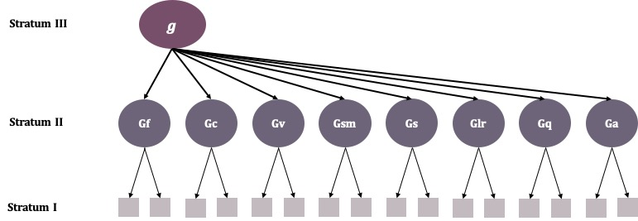
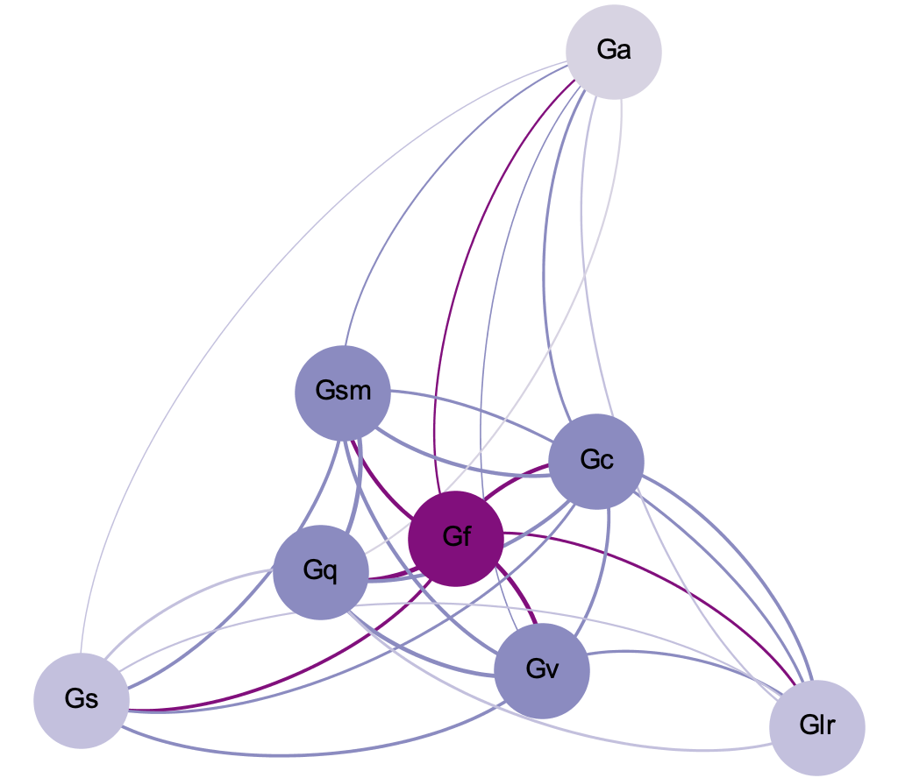
A Network Analytic Perspective on Human Intelligence
Victoria M. Bryan & John D. Mayer.
University of New Hampshire
Introduction
Table 1. Definitions of the Broad Intelligences
Broad Intelligence | Abbreviation | Definition
Fluid Intelligence | Gf | Ability to perform mental operations involved in tasks such as inductive reasoning, drawing inferences, and solving novel problems.
Comprehension Knowledge | Gc | A person’s acquired knowledge – often verbal and/or procedural – and the ability to apply that knowledge.
Visuospatial Processing | Gv | Ability to perform mental operations related to visual images, shapes, or objects.
Short-term Memory | Gsm | Ability to keep active in one’s mind a limited amount of information at any one time.
Processing Speed | Gs | Ability to perform mental tasks that require attention or focus relatively automatically and with a high degree of ease.
Long-term Retrieval | Glr | Ability to both consolidate information into long-term memory and then retrieve and use that information.
Quantitative Knowledge | Gq | A person’s acquired knowledge related quantitative and numerical information.
Auditory Processing | Ga | Ability to control and attend to specific auditory information.
Table adapted from McGrew (2009).
Results from our network analysis revealed that certain broad intelligences clustered more closely than others. Specifically, we see a tight cluster of fluid intelligence (Gf), comprehension knowledge (Gc), quantitative knowledge (Gq), and short-term memory (Gsm) toward the center of our model.
Other broad intelligences like processing speed (Gs), long-term retrieval (Glr), and auditory processing (Ga) were distributed further from the center of the graph.
Although all the nodes in our model were connected, the strength of these connections varied. Fluid intelligence (Gf) emerged to be the most central intelligence in our network model, with the highest average weighted degree among all broad intelligences.
Auditory processing had the lowest average weighted degree among the included broad intelligences, and was located furthest from the center of our network model.
Literature Review
One of the most widely accepted contemporary models of human intelligence is the Carroll-Horn-Cattell (CHC) model (Keith, Kranzler, & Flanagan, 2001; McGrew, 2009), which synthesizes general intelligence and broad intelligences such as verbal, auditory, and other mental abilities.
Using factor analysis, the CHC model creates a taxonomic structure for intelligence, dividing human cognitive abilities into three levels, or strata (Carroll, 1993).
One of the benefits of the CHC model of intelligence is the addition, of the broad intelligences at the second stratum, below general intelligence or g. The inclusion of the broad intelligences allow researchers to assess a wider range of mental abilities that draw on specific aspects of individual’s capacity to reason or apply their knowledge (Phelps, McGrew, Knopik, & Ford, 2005). An abridged version of the model in its usual depiction is indicated in Figure 1.
While the CHC model has proven useful in the field of intelligence, it is at best an approximation of breadth and structure of human intelligence (McGrew, 2009). Even Carroll went so far as to say that much work was still needed to understand the organization of human cognitive abilities (Carroll, 1993; Carroll, 2005).
Current Research
The current research aims to explore alternative organizations for human intelligence through the application of network theory.
Network analysis allows for the creation of visuospatial representations of individual items, as well as their relations to one another (Borgatti, Mehra, Brass, & Labianca, 2009).
We believe that applying network theory to the broad intelligences can provide a useful alternative for modeling human cognitive abilities. Surely, given what we know of the brain and its functions, intelligence is not entirely hierarchical in organization. Network theory may capture some of the non-hierarchical nuances of this construct.
With this in mind, we hypothesize that more highly related broad intelligences will cluster closer together. Less related broad intelligences will be spatially farther away.
Moreover, certain intelligences will be more central to the structure of human intelligence than others.
Results
Discussion
Creating a Network Model
of the Broad Intelligences
Sample sizes and correlations were read into a script created using the Psych package (Revelle, 2018) from the open-source software R, where we calculated the weighted average correlations among each broad intelligence.
The resulting weighted correlations were then imported into the open-source network software Gephi (Bastian, Heymann, & Jacomy, 2009). Following typical network analytic protocol (Borgatti, Mehra, Brass, & Labianca, 2009), each individual broad intelligence factor was treated as a node and the weighted correlations between each broad intelligence (nodes), were treated as edges.
Using ForceAtlas2 (Jacomy, Venturini, Heymann, & Bastian, 2014), we developed a network model for the correlations among broad intelligences. Using this algorithm, nodes repel one another, while the weights of the edges attract the nodes.
To our knowledge, the present research was one of the first to model the broad intelligences using network analysis.
Results from the study demonstrate that fluid intelligence (Gf), comprehension knowledge (Gc), quantitative knowledge (Gq), and short-term memory (Gsm) clustered more closely than other intelligences, suggesting that core intelligence may depend most on this highly integrated group.
The centrality of fluid intelligence may echo previous work on the Cattell-Horn-Carroll (CHC) model of human intelligence. Specifically, hierarchical models of the broad intelligences have shown near perfect correlations between fluid intelligence and g (Gustafsson, 1984; Niileksela, Reynolds, & Kaufman, 2013; Phelps, McGrew, Knopick, & Ford, 2005). Such findings may suggest the two are highly similar and that fluid intelligence may involve more general mental abilities.
By comparison, processing speed (Gs), long-term retrieval (Glr), and auditory processing (Ga) may be relatively independent of such core processing ability. Long-term retrieval, for example, may be a product of adult intellectual development and partly independent of core reasoning (e.g., Strumm & Ackerman, 2013).
Given the proliferation of broad intelligences currently being considered, future research may wish to consider the applicability of network models to the representation of such thinking abilities.
Figure 1. An Abbreviated Depiction of the Three-Stratum Model adapted from Carroll (1993).
What is the Spatial Distribution
of the Broad Intelligences?
The results from our network model can be found in Figure 2 below.
Figure 2. Network Model Depicting the Relation Among Broad Intelligences. More highly correlated broad intelligences are clustered close together in the center. Less correlated broad intelligences are distributed to the periphery of the model.
Method
References
The present research was part of a larger systematic review exploring the overall correlation among broad intelligences. We reviewed a selected sample of 21 peer-reviewed journal articles that reported the relation among broad intelligence factors.
All articles in the present research were published on or before June 28th, 2017 and are listed in Bryan & Mayer (2017).
From each article, we recorded the sample size as well as the correlation among broad intelligence factors.
We included in our analyses all broad intelligences that were present in two or more of our reviewed articles. See Table 1 for a list of broad intelligences and their abbreviations.
Bastian, M., Heymann, S., & Jacomy, M. (2009). Gephi: an open source software for exploring and manipulating networks.
Proc. ICWSM-09
Borgatti, S. P., Mehra, A., Brass, D. J., & Labianca, G. (2009). Network analysis in the social sciences. Science, 323(5916), 892-895.
Bryan. V.M., & Mayer, J.D. (2017). People versus thing intelligences? Presentation at the 2017 Meeting of the Association for Research in
Personality, June 8-10. Sacramento, CA.
Carroll, J. B. (1993). Human cognitive abilities: A survey of factor-analytic studies. New York, NY, US: Cambridge University Press.
doi:10.1017/CBO9780511571312
Carroll, J. B. (2005). The three-stratum theory of cognitive abilities. In D. P. Flanagan & P. L. Harrison (Eds.), Contemporary intellectual
assessment: Theories, tests and issues, 2nd Ed. (pp. 69−76). New York: Guilford.
Gustafsson, J. (1984). A unifying model for the structure of intellectual abilities. Intelligence, 8, 179-203.
Jacomy, M., Venturini, T., Heymann, S., & Bastian, M. (2014). ForceAtlas2, a continuous graph layout algorithm for handy network visualization
designed for the Gephi software. PloS one, 9(6), e98679.
Keith, T. Z., & Kranzler, J. H. (1999). The absence of structural fidelity precludes construct validity: Rejoinder to Naglieri on what the cognitive
assessment system does and does not measure. School Psychology Review, 28, 303-321.
McGrew, K. S. (2009). CHC theory and the human cognitive abilities project: Standing on the shoulders of the giants of psychometric intelligence
research. Intelligence, 37, 1-10. doi:10.1016/j.intell.2008.08.004
Niileksela, C. R., Reynolds, M. R., & Kaufman, A. S. (2013). An alternative Cattell–Horn–Carroll (CHC) factor structure of the WAIS-IV: Age
invariance of an alternative model for ages 70–90. Psychological Assessment, 25, 391- 404.doi:10.1037/a0031175
Phelps, L., McGrew, K. S., Knopik, S. N., & Ford, L. (2005). The general (g), broad, and narrow CHC Stratum characteristics of the WJ III and WISC- III tests: A confirmatory cross-battery investigation. School Psychology Quarterly, 20, 66-88.
Revelle, W. (2018, Oct. 24). Procedures for psychological, psychometric, and personality research. Retrieved from http://www.personality-
project.org/r/psych/psych-manual.pdf.
Strumm, S., & Ackerman, P.L. (2013). Investment and intellect: A review and meta-analysis. Psycholoigcal Bulletin, 139, 841-869.

