Slide 1

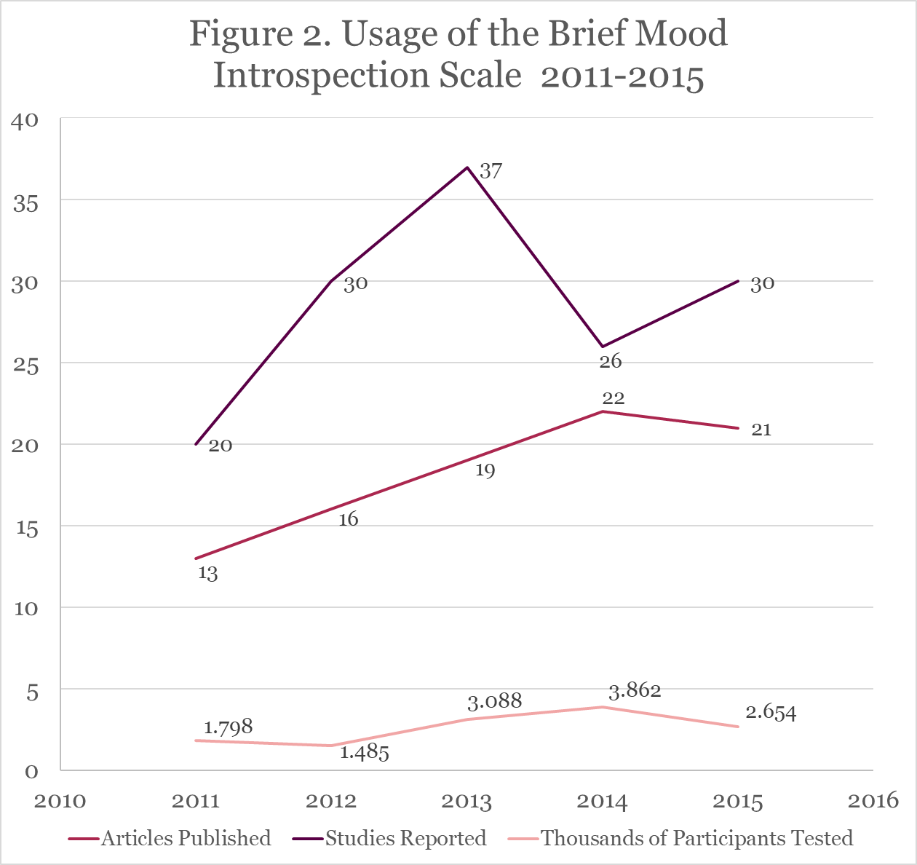
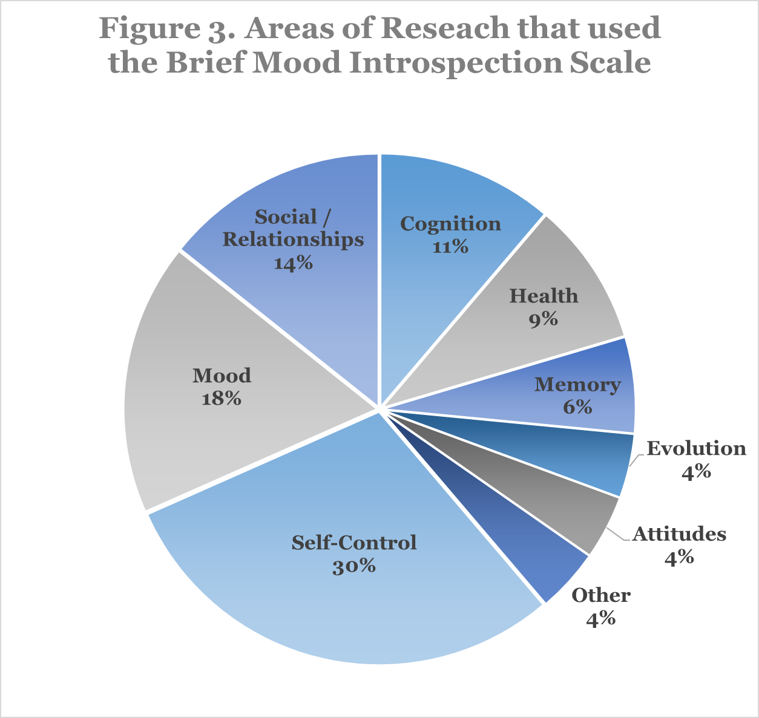
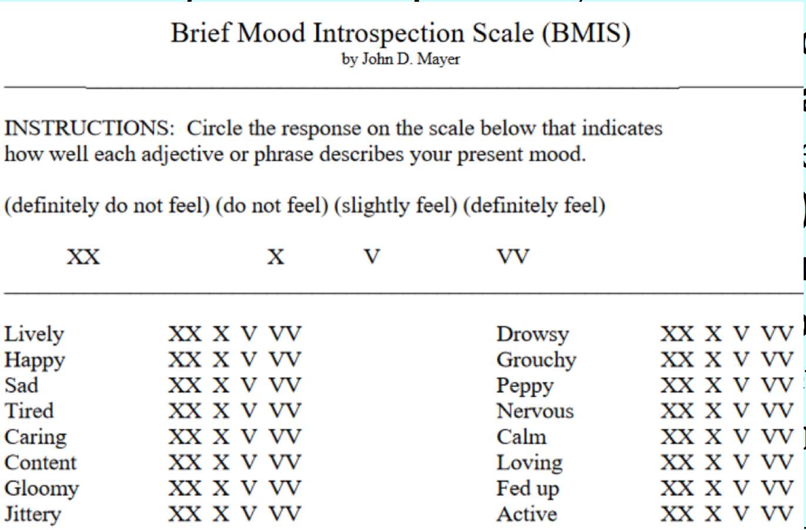

The Brief Mood Introspection Scale (BMIS) 30 Years Later:
Norms and Validity Evidence from a Meta-Analysis
.
Rachael M. Cavallaro, Victoria M. Bryan & Dr. John D. Mayer
.
Department of Psychology, University of New Hampshire, Durham NH
Background
Methods
Results Continued
The Brief Mood Introspection Scale (BMIS) is an open-source assessment tool that measures current mood (Mayer & Gaschke, 1988). The BMIS consists of 16 items: 8 positive and 8 negative mood adjectives. Consistent with other mood scales of the time (i.e. the PANAS; Watson, Clark, & Tellegen, 1988), factor analyzing the 16 BMIS adjectives yields two different two-factor solutions, depending on whether the solution is rotated or unrotated. From the unrotated solution emerges two factors, labeled Pleasant-Unpleasant (PU) and Arousal-Calm (AC) (also referred to as mood scales). Rotation of the two-factor solution resulted in the Negative-Relaxed (Negative Affect) and Positive-Tired (Positive Affect) factors.
When using the BMIS, participants are asked to circle a numerical response on either a 4- or 7-point Likert scale that indicates how well each adjective describes their present mood (Figure 1). In the original article, Mayer & Gaschke (1988) used a method called subtractive scoring to calculate the score for a specific mood scale, where the sum of the numerical responses of the negative adjectives was subtracted from the positive adjectives. However, it is now recommended to use reverse scoring, where negative mood adjectives are given the opposite numerical value (i.e. strongly agree = 1 instead of 7) and then all the adjectives are summed.
Despite the widespread use of the BMIS, its psychometric properties have been left largely unexplored since the original report. With this in mind, the scope of the present meta-analysis is to assess the BMIS over a five-year timespan (2011-2016).
Inclusion Criteria
The research must have been published between (a) January 1st, 2011 until July 31st, 2016, (b) in English, (c) in a peer-reviewed journal (i.e. books and theses were excluded), and (d) employed the BMIS. Based on the inclusion criteria, we identified a total of 98 articles and 203 studies within those articles. Out of those studies, 150 used the BMIS (Figure 2).
Participants
Regarding the 150 studies that fit the below mentioned inclusion criteria, there were 13,860 participants included in the meta-analysis. Specifically, 7,607 were women, 4379 were men and 32 identified as other. The participants’ average age was 22. 78.9% of participants were undergraduates, .4% were clinical patients, 9% were community members and 11.7% were from a miscellaneous sample.
Criterion Validity Evidence for the BMIS
When comparing the pre- and post-manipulation control means, the PU mood scale means were found not to be statistically different (t(1407)=1.77, p >.05, d=.10), but the AC mood scale means were statistically different (t(949)=7.14, p <.05, d=.47).
Further criterion validity evidence for the PU mood scale came from six studies that employed mood inductions: Scores rose when positive mood was induced (t(1160)=-8.88, d=-.62) and fell when negative mood was induced (t(1184)=15.32, d=-.89). Similarly, scores for the AC mood scale rose when positive arousal was induced (t(803)=-6.82, d=-.97) and fell when negative arousal was induced (t(799)=3.34, d=-.27). All p-values were less than .05.
The PU mood scale also correlated with criteria that supported its validity; for example, one study (N=1244) found positive mood negatively correlated with loneliness (r=.32) and positively correlated to perceived amount of personal control over one's social environment (.24) and self-esteem (.41). Negative mood positively correlated with loneness (.40) and negatively correlated with control (-.21) and self-esteem (-.49), (Greitemeyer, Mugge & Bollermann, 2014).
Discussion
Figure 1.
Over the 30 years the BMIS has been in use, the scale has developed into a tool to determine if mood is a covariate in studies where the main analysis does not involve mood.
The norms and reliabilities established in the meta-analysis agree with the original work conducted by Mayer & Gaschke (1988). AC mood scale’s reliability is low, but acceptable, because the maximum validity coefficient is 0.77.
The PU mood scale was found to be a reliable and valid assessment tool to measure current mood and is recommended for future use. The reliability and validity of the AC mood scale was found to be acceptable.
One major limitation of the meta-analysis was the vast multitude of researchers that did not report key information about the BMIS or did not use the BMIS properly.
Future studies are suggested to use the BMIS as recommended (4-point and reverse scoring) and to report this key information.
Results
Research Design and Research Area
Across the 98 articles that utilized the BMIS, it was found that the BMIS was almost exclusively used in experimental research (95%, N=93). Among these articles, 72% used the BMIS to check if mood was a covariant, 13%, used the BMIS to check if mood inductions were successful and 15%, used the BMIS to measure mood as part of the main analysis. In addition, the three most common areas of research where the BMIS was used were self-control (30%), mood (18%) and social/relationships (14%) (Figure 3).
Norms of the BMIS Mood Scales
It was found that the reported norms for the means did follow the possible range of scores for each mood scale, response scale and scoring method combination.
Reliabilities of the PU and AC Mood Scales
A Fisher z-transformation was conducted on the BMIS’s Cronbach Alphas (α) to correct for possible skewness in the data. Preliminary analysis suggests that the PU mood scale has high reliability (α >.80), but the AC mood scale’s reliability is lower than typically recommended (α=0.59/0.57).
Objectives
Determine how much the BMIS was utilized in research articles during a 5-year timespan, from 2011 to 2016.
Ascertain the common uses of the BMIS, including how it was employed (research designs) and the common research areas that employ the BMIS.
Calculate the norms of the BMIS to establish a standard of comparison for future use of the scale.
Compare the reliabilities reported in the reviewed research with the reliabilities reported in the original article by Mayer & Gaschke (1988).
Verify the validity of the BMIS as a mood assessment tool. The BMIS’s criterion validity will be assessed through examining its correlations with related measures and mean differences between experimental controls and mood inductions.
References
Acknowledgments
Greitemeyer, T., Mugge, D.O., & Bollermann, I. (2014). Having responsive Facebook friends affects the satisfaction of psychological needs more than having many Facebook friends. Basic & Applied Social Psychology, 36, 252-258.
Mayer, J. D., & Gaschke, Y. N. (1988). The experience and meta-experience of mood. Journal of personality and social psychology, 55(1), 102.
Watson, D., Clark, L. A., & Tellegen, A. (1988). Development and validation of brief measures of positive and negative affect: the PANAS scales. Journal of personality and social psychology, 54(6), 1063.
We would like to thank James Peters and the rest of the Personality Lab at the University of New Hampshire.
Notes:
In the 30 years since the BMIS was developed hundreds of articles have utilized the scale for a multitude of different purposes (mood assessment, manipulation check, etc.) and areas of research. Despite the apparent widespread use of the BMIS, its psychometric properties have been left largely unexplored since the original report. With this in mind, the scope of the present meta-analysis is to assess the BMIS over a five year timespan (2016-2011). In the 30 years since the BMIS was developed hundreds of articles have utilized the scale.
The BMIS itself consists of 16 adjectives, specifically 8 positive mood adjectives and 8 negative mood adjectives.
correlations between the BMIS and related measures. Criterion validity was also established by determining to assess mood change during experimental mood induction. If the BMIS did change over such mood inductions, it would reflect its sensitivity to mood. Controls
compared the correlational/survey (%,N) and psychometric studies (%, N).
(studies that reported means with subtractive scoring were converted into reverse scoring).
was it was determined that the primary use of the BMIS was in studies where the BMIS was used to check if mood was a covariant (%, N). %, N of the remaining experimental studies used the BMIS to check if mood inductions were successful and %, N used the BMIS to measure mood as part of the main analysis.
All values were reported in the metric of reverse-scoring.
ALL THE FREQ AND ANALYSES DON’T EXCLUDE OUTLIER STUDIES, EXPECT THE FREQ FOR PRE AND POST CLASS 1

