Slide 1

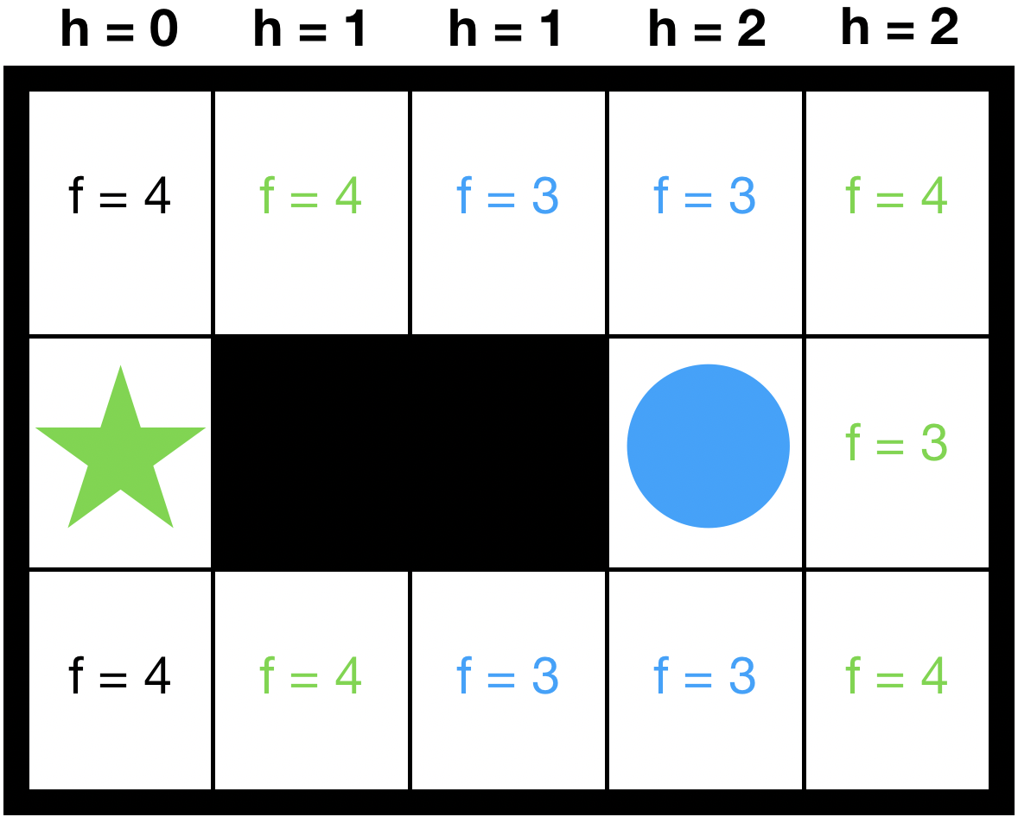
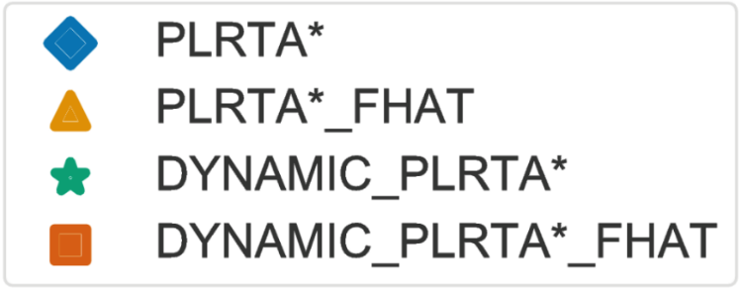
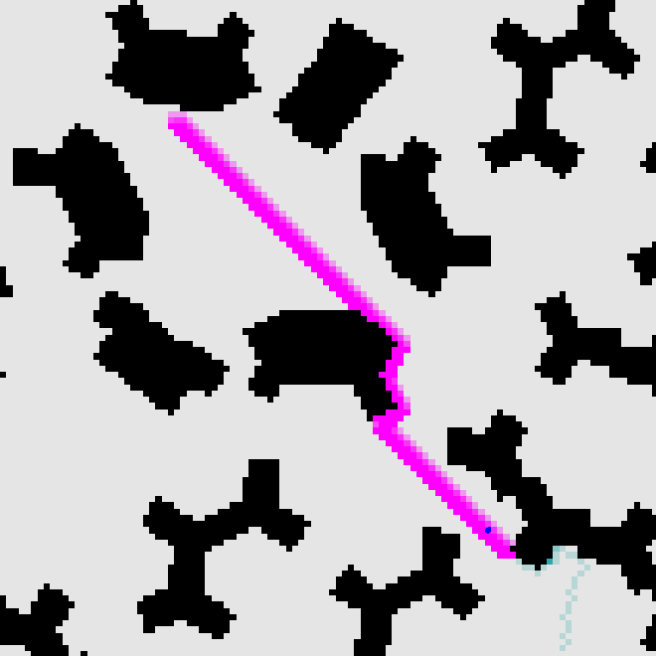
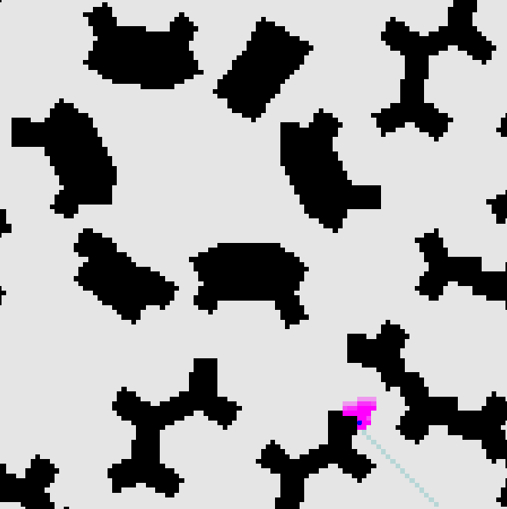

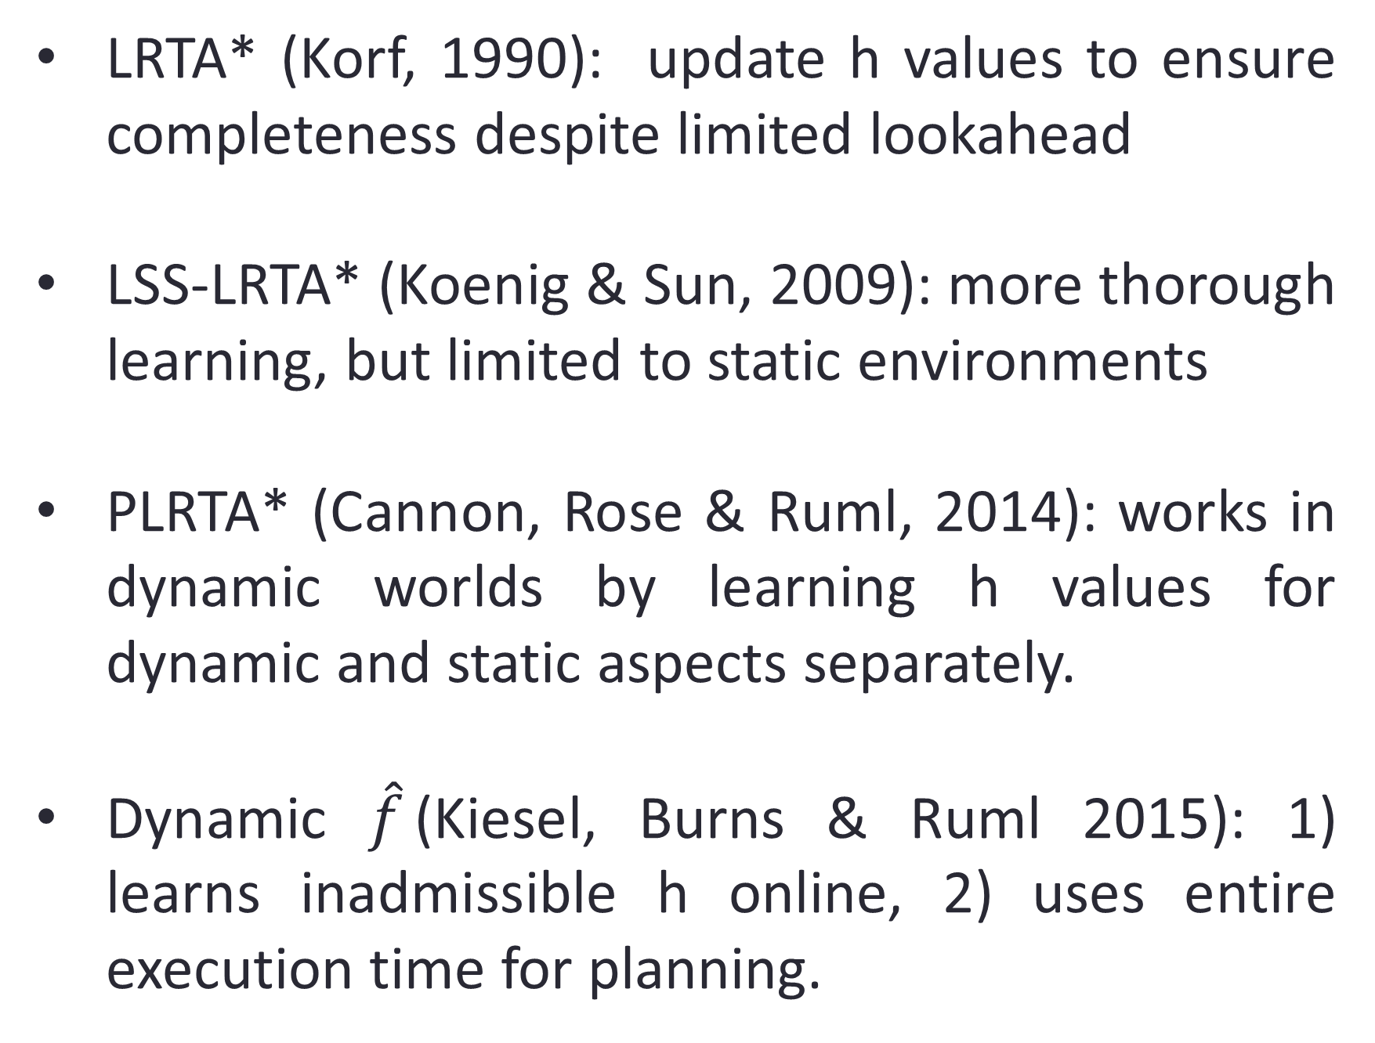

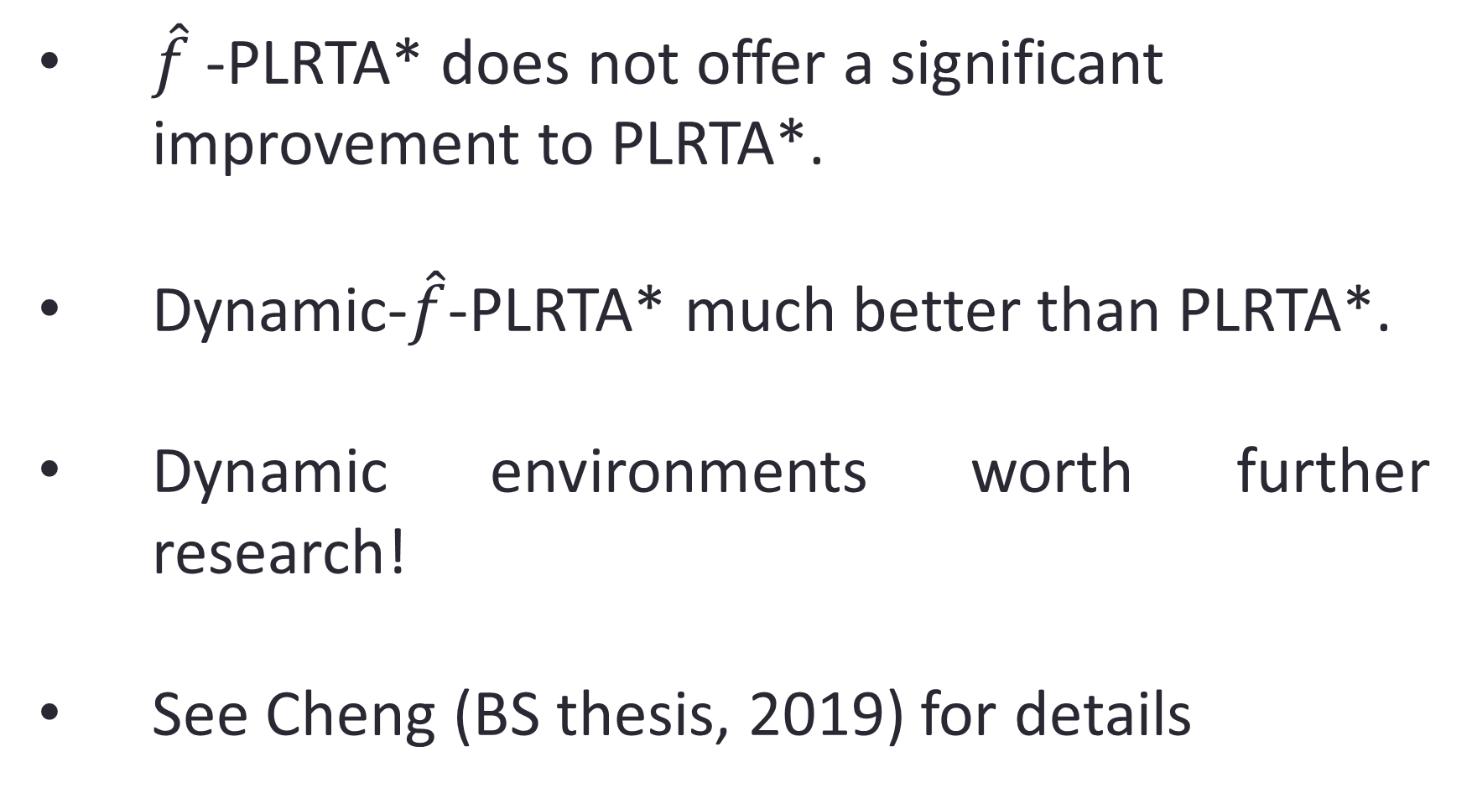

Real-time Heuristic Search In Dynamic Environments
Chao Chi Cheng and Wheeler Ruml
Problem
Algorithm 1: $\hat{f}$-PLRTA*
Result
Applications such as robotics often require real-time planning and feature dynamic environments.
Real-time: Planner must return next action within predefined time bound, regardless of total problem difficulty. Iterating this gives a form of receding-horizon control.
Want to minimize agent’s total trajectory cost.
Plan using predictions of dynamic elements, which are updated each iteration.
f values not appropriate for real-time search (example below)
Estimates inadmissible heuristic on-line
Used for lookahead expansion and action selection
Grid pathfinding on city maps and random maps with 20 dynamic obstacles
Previous Work
LRTA* (Korf, 1990): update h values to ensure completeness despite limited lookahead
LSS-LRTA* (Koenig & Sun, 2009): more thorough learning, but limited to static environments
PLRTA* (Cannon, Rose & Ruml, 2014): works in dynamic worlds by learning h values for dynamic and static aspects separately.
Dynamic $\hat{f}$(Kiesel, Burns & Ruml 2015): 1) learns inadmissible h online, 2) uses entire execution time for planning.
Algorithm 2: Dynamic-$\hat{f}$-PLRTA*
Commit to entire path up to lookahead frontier, rather than single action. (replan if dynamic obstacle invalidates path)
Use time during execution of multiple actions for larger lookahead (magenta below)
Often compounds over time!
Conclusions
$\hat{f}$-PLRTA* does not offer a significant improvement to PLRTA*.
Dynamic-$\hat{f}$-PLRTA* much better than PLRTA*.
Dynamic environments worth further research!
See Cheng (BS thesis, 2019) for details
Contribution
Add techniques from Dynamic $\hat{f} \text{to} \text{PLRTA}\text{∗}$
Evaluate in different benchmarks from PLRTA* paper

