Slide 1
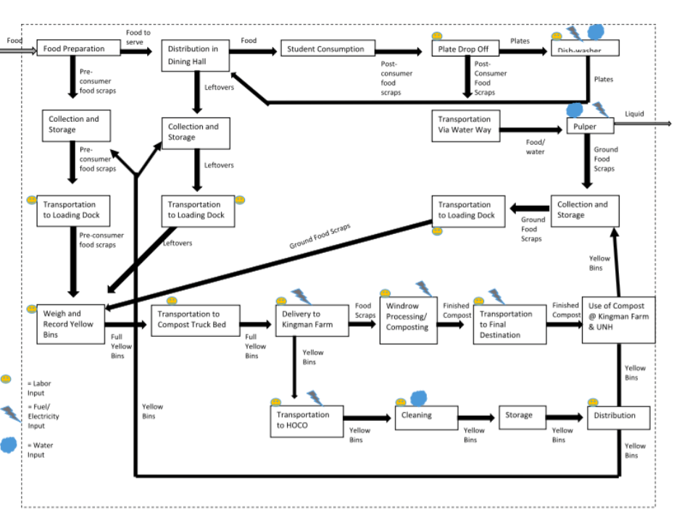
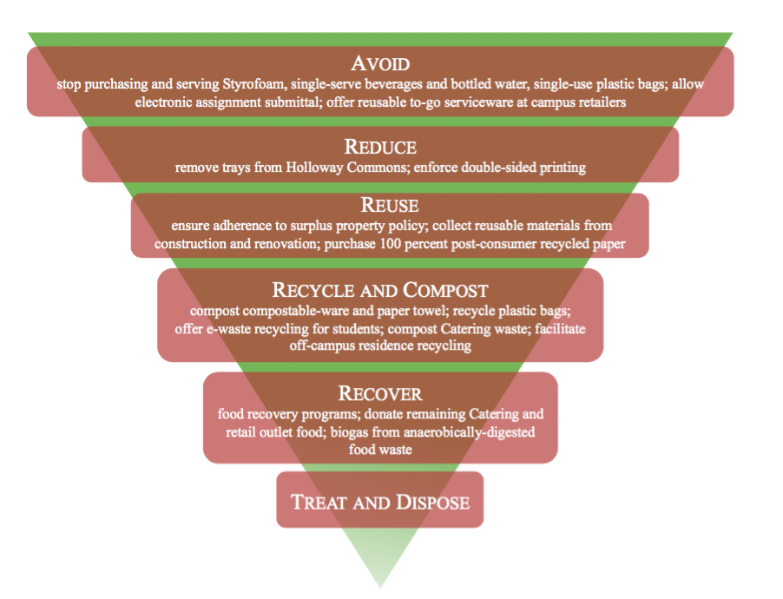
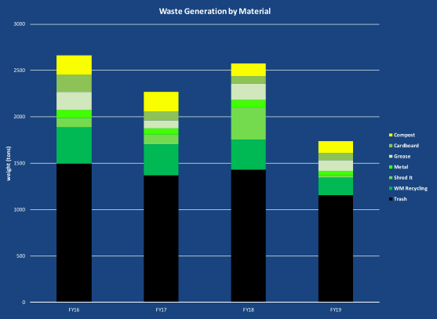
Campus Zero Waste Planning: Cost-Benefit Assessment
Kayla Conway, UNH Sustainability Fellow
Mentors: Jennifer Andrews, Alex Freid- Post Landfill Action Network
Intro:
The Campus Zero Waste Fellow will support the advancement of Zero Waste Infrastructure and Policy at the University of New Hampshire (UNH) campus; the research and analysis involved in this effort will also result in case studies and templates to benefit other campuses pursuing zero waste goals.
Deliverables
Data and analysis regarding the projected life-cycle costs and benefits for UNH – financial and social – for one or more of the needed investments identified in PLAN’s Zero Waste Atlas Stage 1 Recommendations Report for UNH
Synthesis of the analysis results in the form of a written report, infographics, Story-map, or other product that can be shared with key stakeholders, including the Zero Waste Task Force and Sustainability Task Force
Case Studies (including cost-benefit and ROI data) of best-in-class examples of such systems located on other campuses across the US
Presentation of finding to UNH Zero Waste Task Force
Methods
Understand PLAN’s Zero Waste Atlas Framework
Develop Comprehensive Framework To Assess UNH’s Discarded Material Management Systems
Draw Systems Diagram
Identify Inputs and Outputs
Establish Systems Boundaries
Build Financial Profile
Gather Necessary Data
Understand Current Costs Associated With System
Identify Recommendations
Create Template to Assess Recommendations
Collaborate with Stakeholders
Present Findings
Preliminary Results:
The majority of waste disposed of at UNH is landfill bound
Between July 2015 and March 2019, 6745.46 tons of waste have been disposed of at UNH, incurring an estimated $1,843,357 in costs related to handling and disposing of waste.
“You cannot manage what you don’t’ measure.”
The systems in place for waste on UNH’s campus are complex.
Systemic change in regards to waste, will require systemic collaboration.
Systems Diagram: Composting for UNH Dining Halls
“Sustainability is a key factor in giving UNH a competitive edge on institutions across the nation as we prepare students for meaningful careers.” – Former President, Mark Huddleston
Recommended waste-reduction action items for UNH, classified in a waste management hierarchy.
References
Leah Powley, A Zero-Waste Planning Guide UNH 2017
UNH Zero Waste Task Force Stakeholders
PLAN’s Zero Waste Atlas Stage 1 Recommendation Report for UNH
Paige McKibben, Mary Shotton

