Slide 1



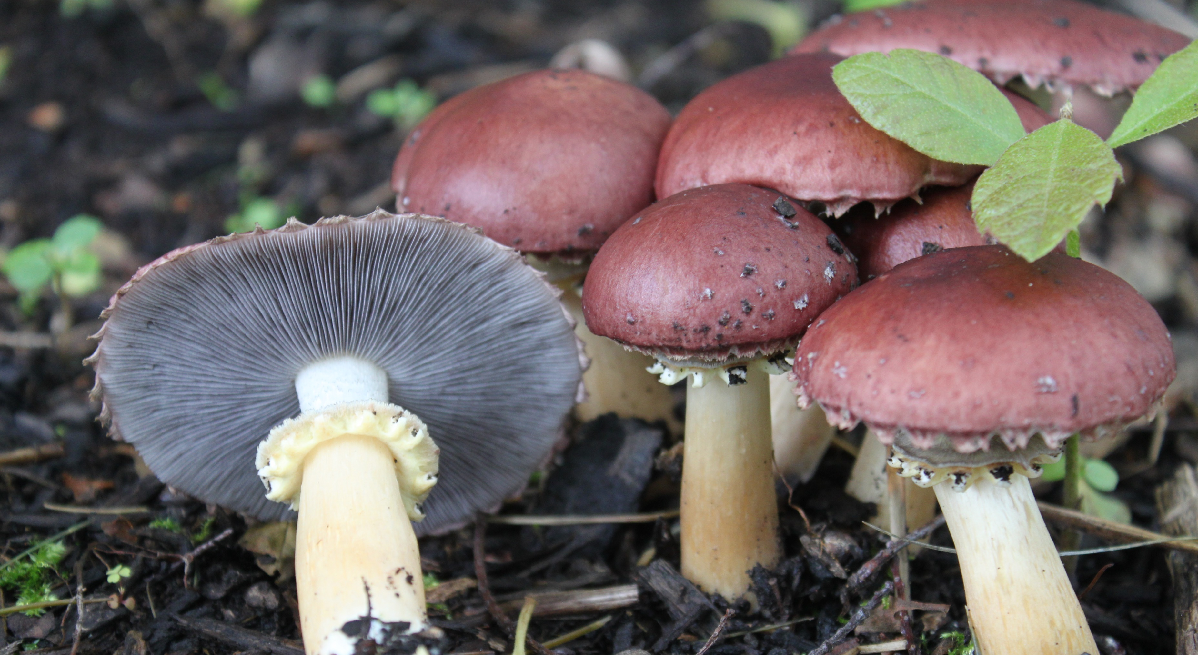
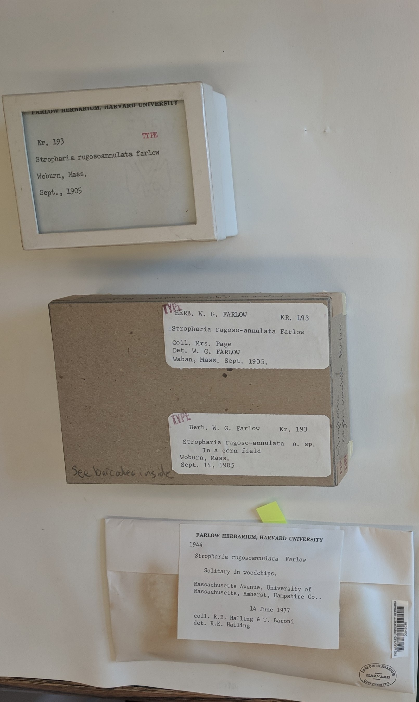
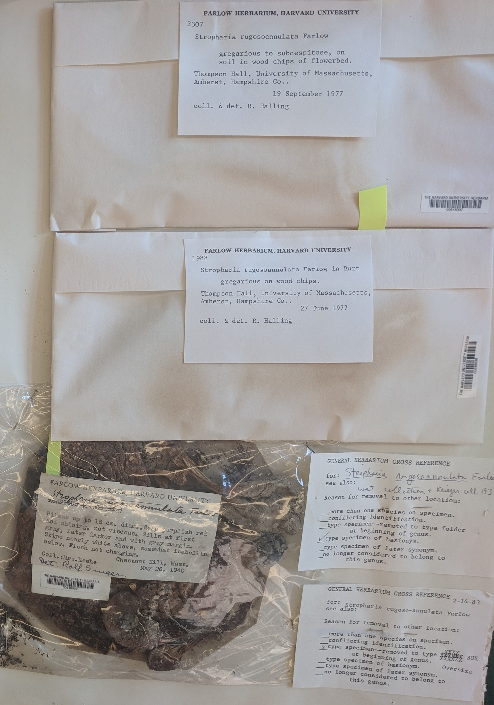
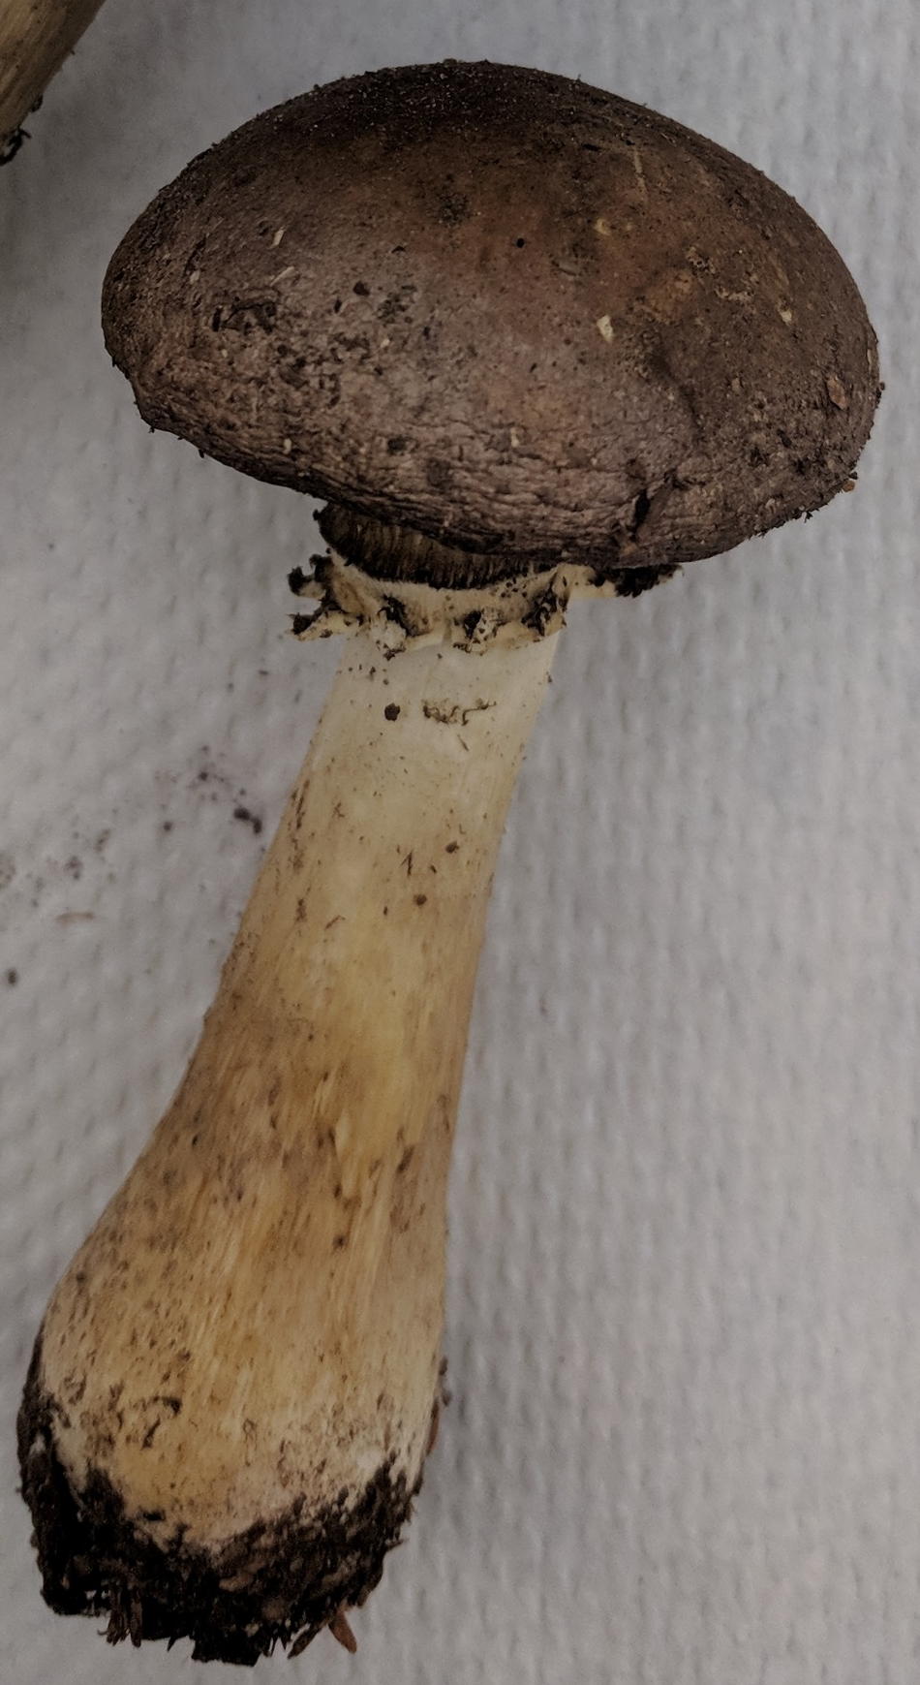
Fungal evolution in response to domestication
Adriana L. Romero-Olivares^{1*}, Jovani Catalán-Dibene², Donald H. Pfister^{3,4}, Katherine F. LoBuglio³, Serita Frey¹
¹University of New Hampshire, Department of Natural Resources and the Environment, Durham, NH, USA
²Mount Sinai, Immunology Institute, Icahn School of Medicine, New York, NY, USA
Harvard University, ³Farlow Library and Herbarium, ⁴Department of Organismic and Evolutionary Biology, Cambridge, MA, USA
*Adriana.RomeroOlivares@unh.edu @fungi_lover
Background
Methods
Stropharia rugosoannulata, a.k.a. wine cap
Whole-genome sequencing of commercial strain (as control), 1940 specimen, and 2018 specimen.
Assembly of genomes and creation of local databases.
Identification of genes of interest in characterized and annotated genome of sister species Hypholoma sublateritium.
Search for genes of interest in local databases.
Comparison of gene abundances and sequences among specimens.
Introduced from Europe in early 1900’s
Mushroom frequently found in bark and mulch across North America and in urban areas
Edible
Used in intercropping in corn fields
Immobilizes free-living nematodes
Important in gardening industry, small-farming agriculture, and mushroom-growers
Ecosystem genomics and evolution
Great model to study changes in the abundance of genes or changes in gene sequence of organic matter decomposition enzymes
Results
specimen | Average coverage | N50 (Kb) | L50 (no. of contigs) | Contigs (>5000 bp) | Largest contig (Kb)
Commercial | 85 | 4,451 | 2,980 | 2,567 | 151,342
1940 | 14 | 810 | 44,093 | 1,819 | 47,574
2018 | 76 | 47,560 | 211 | 1,178 | 411,173
Gene | H. sublateritium (# genes at MycoCosm) | Commercial (# genes in local database) | 1940 (# genes in local database) | 2018 (# genes in local database)
β-glucosidase | 5 | 1 | 1 | 1
Cellobiohydrolase | 4 | 2 | 2 | 2
Ligninase | 14 | No similarities | No similarities | No similarities
Ammonium transporter | 3 | 1 | 1 | 1
Amino acid permease | 1 | No similarities | No similarities | No similarities
Table 1. Detection of polymorphisms between 1940 and 2018 specimens
specimen | ammonium transporter (339 shared nucleotides)
commercial | GT | TT | GG | TT | CT
1940 | GT | TT | GA | TC | CC
2018 | GA | TC | GA | TC | CT
 | cellobiohydrolase gene 1 (395 shared nucleotides)
commercial | AC | AC | AC | AT | CC | TC | CT | AG | GG | GC | TC | AC
1940 | AT | AC | AC | AC | CT | TT | CT | AG | GA | GA | TC | AT
2018 | AC | AT | AT | AC | CC | TC | CC | AA | GG | GC | TT | AC
 | cellobiohydrolase gene 2 (425 shared nucleotides)
commercial | CC | CG | CT
1940 | CC | CG | CC
2018 | CT | CA | CC
At the Harvard Farlow Herbarium
Specimens from 1904, 1940,1970, and 2018. All from Cambridge and surrounding areas in MA.
β-glucosidase – no polymorphisms
Ammonium transporter – three polymorphisms
Cellobiohydrolase gene 1 – eleven polymorphisms
Cellobiohydrolase gene 2 – two polymorphism
Discussion, further questions, and future work
There are no changes in gene abundance but there are changes in gene sequence of organic matter decomposition enzymes and ammonium transporter protein for herbarium specimens in response to domestication.
Do these gene sequence differences affect the amino acid sequence and function of the enzyme/protein? Are these polymorphisms also found in 1904 and 1970 specimens?
What are the ecosystem-scale consequences of these polymorphisms?
Characterization and annotation of whole-genomes will reveal other differences between 1940 and 2018 specimens (work in progress).
Research questions
Are there changes in gene abundance or gene sequence of organic matter decomposition enzymes in response to domestication? And in nitrogen uptake proteins?
Acknowledgements
USDA for funding, Farlow herbarium at Harvard University for access to collections, and the Frey lab at the University of New Hampshire and the Pfister lab at Harvard University for comments and feedback on project.

