Slide 1


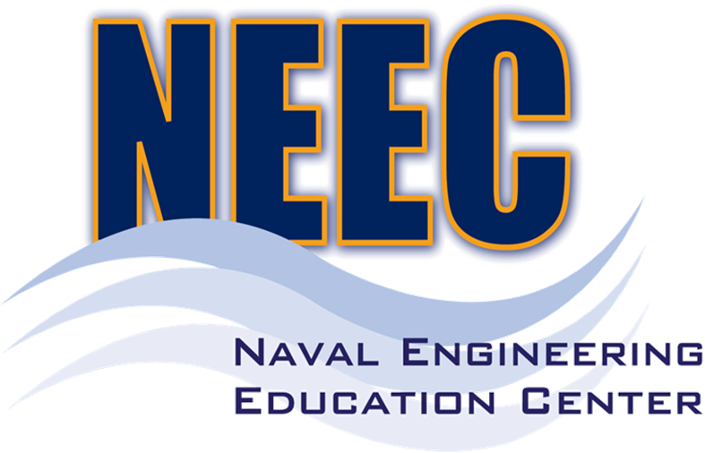
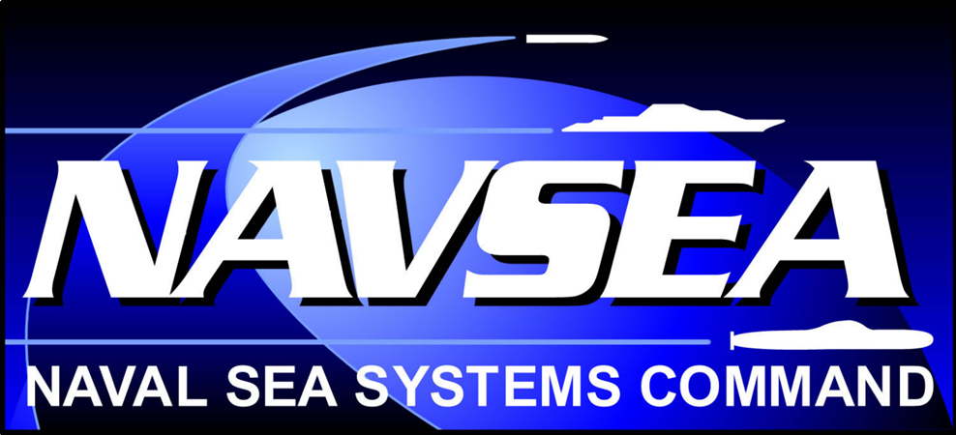
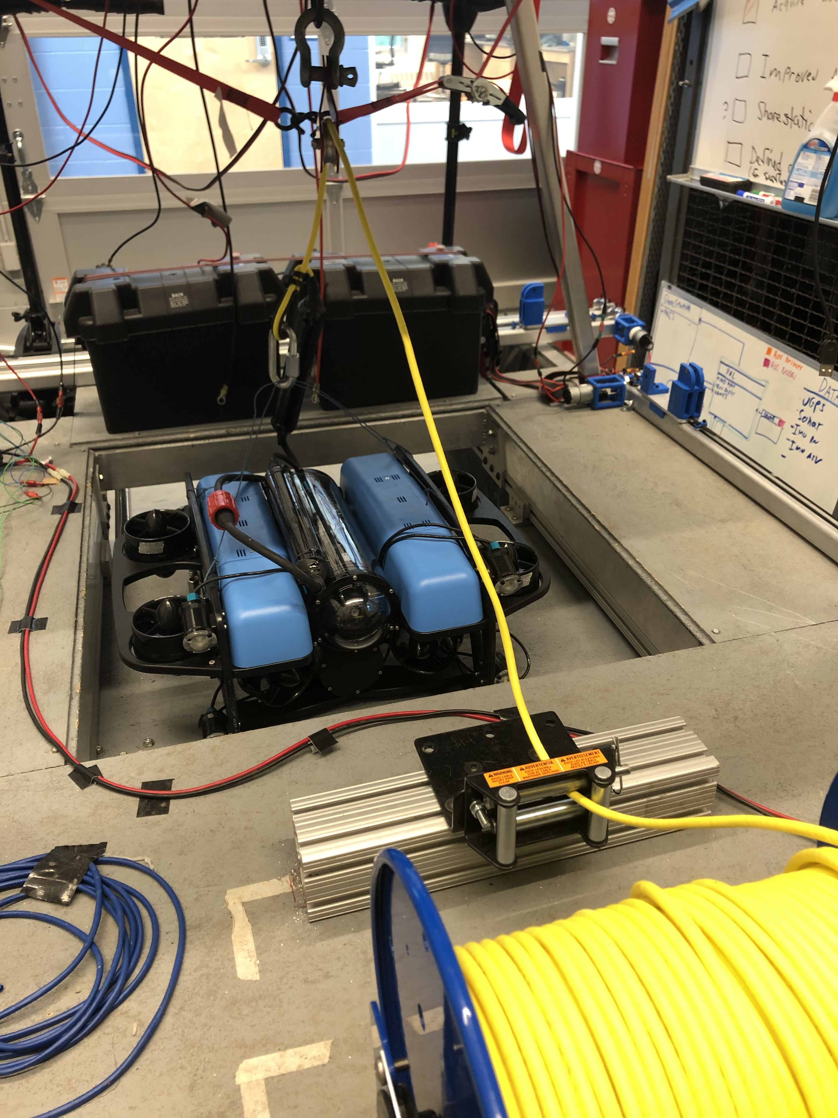
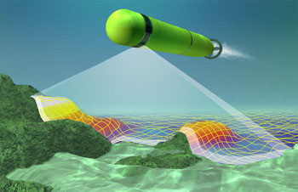
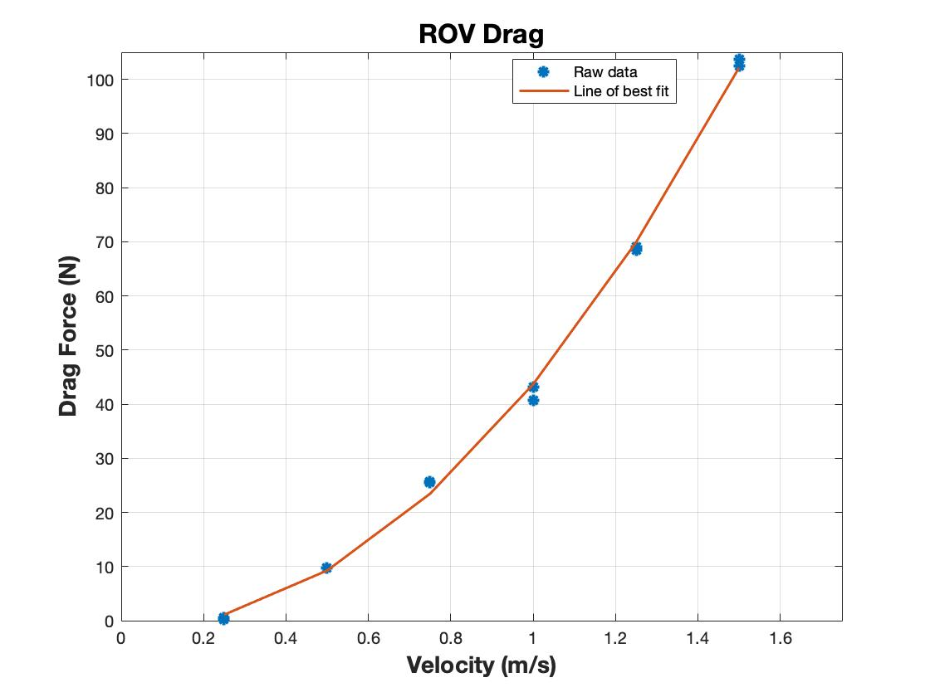
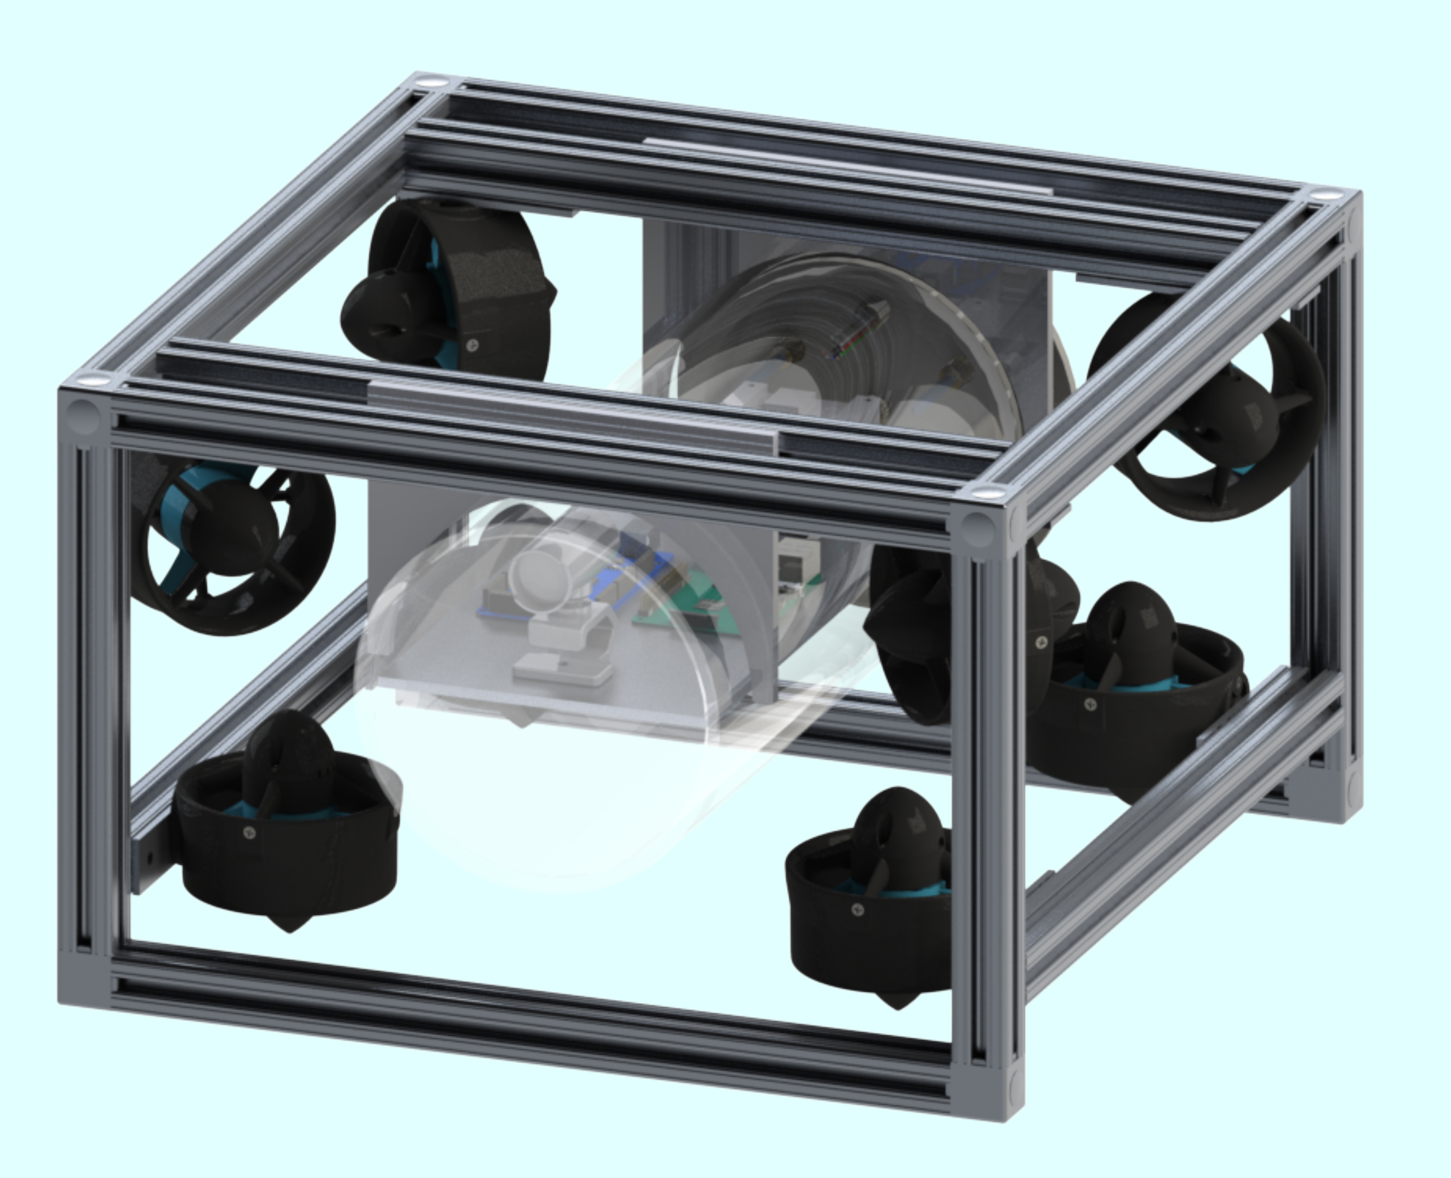
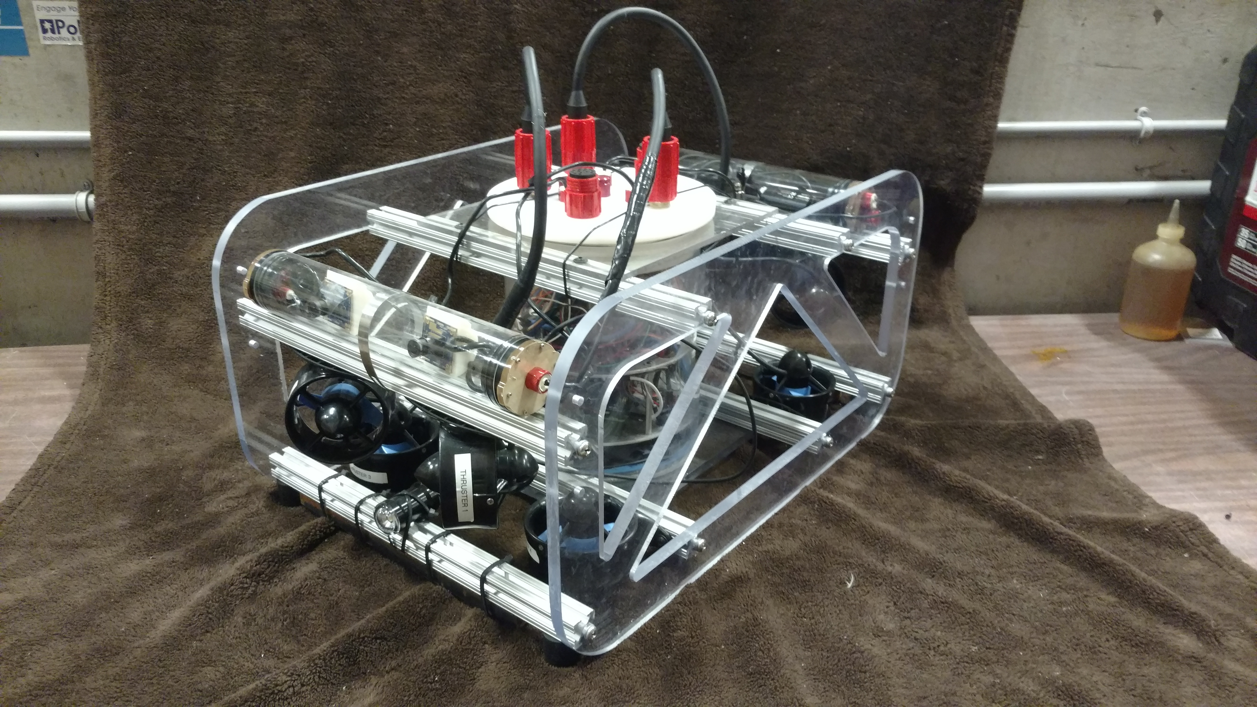
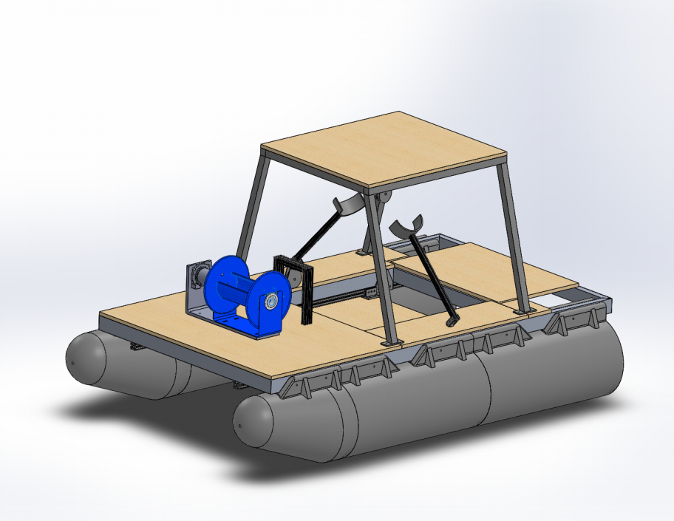
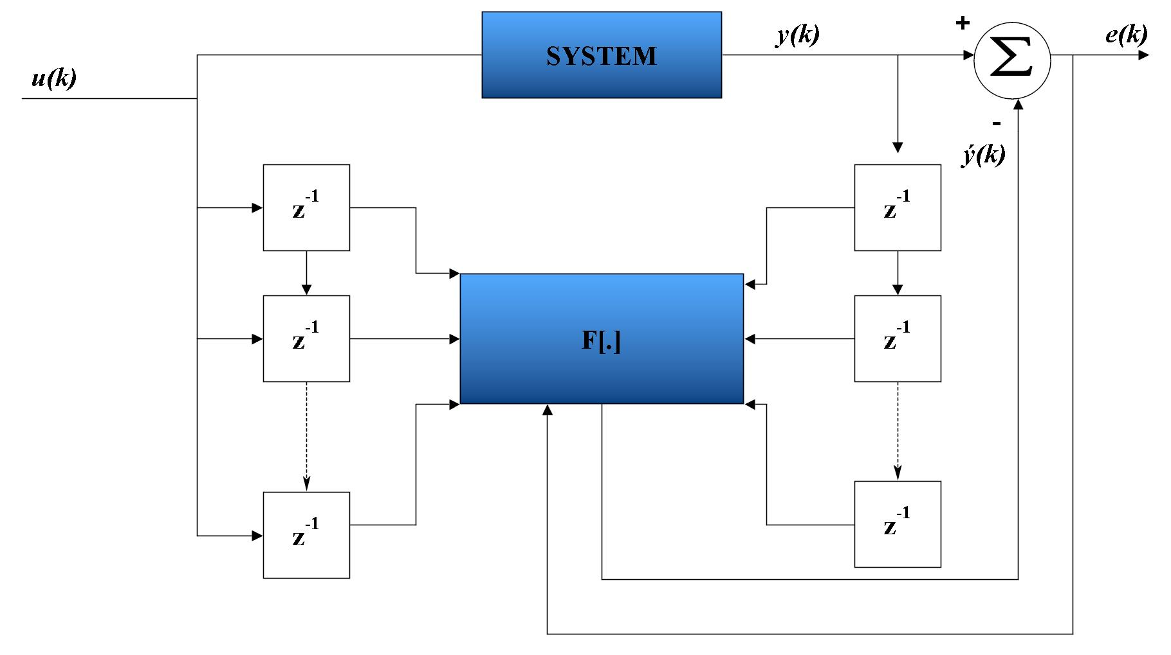
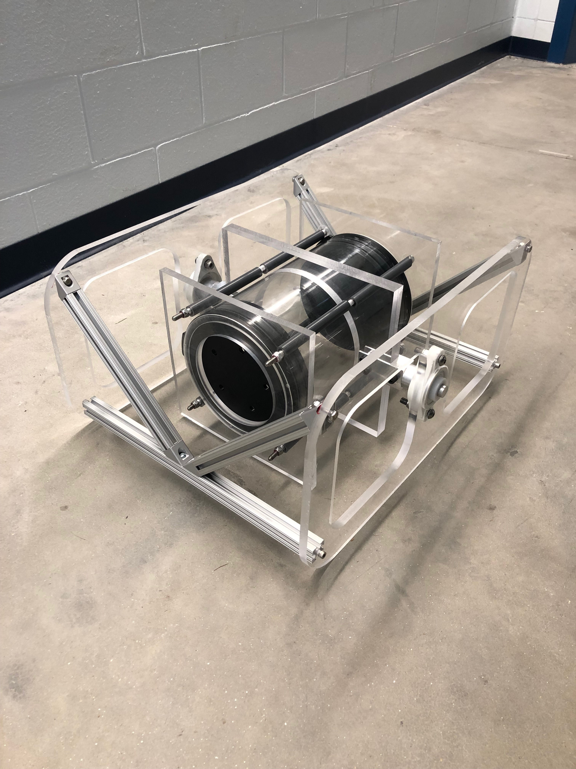
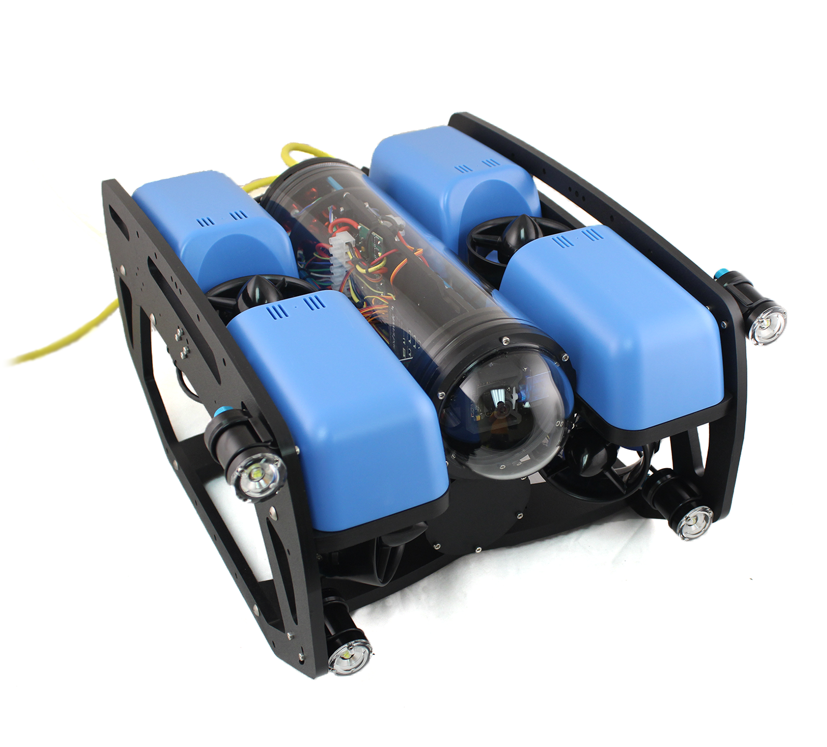
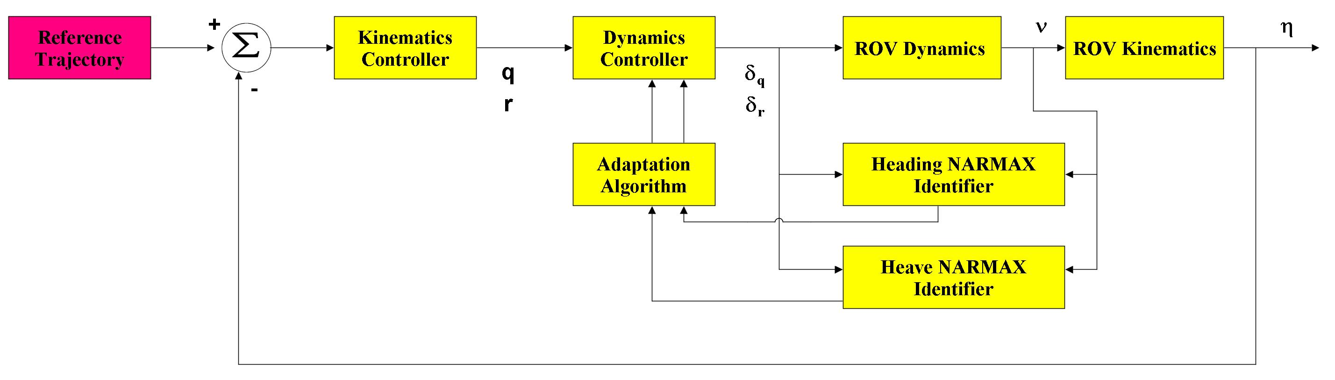
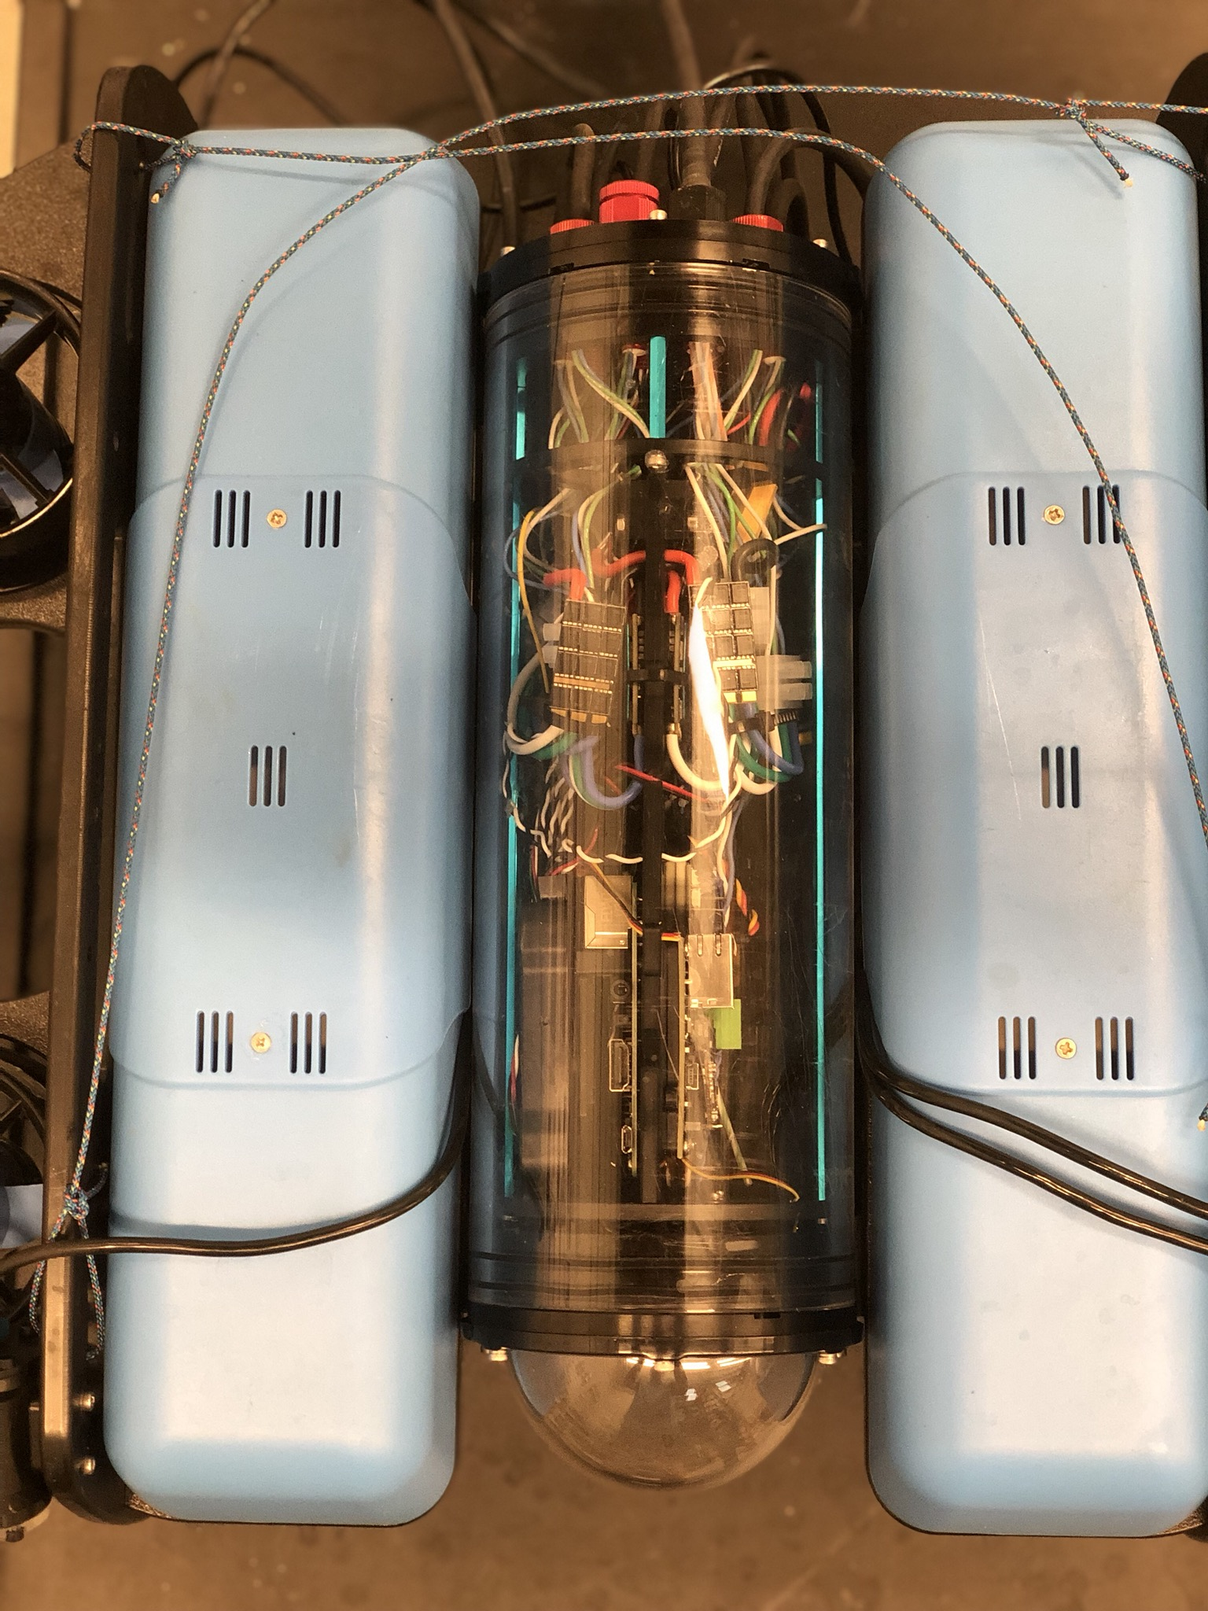


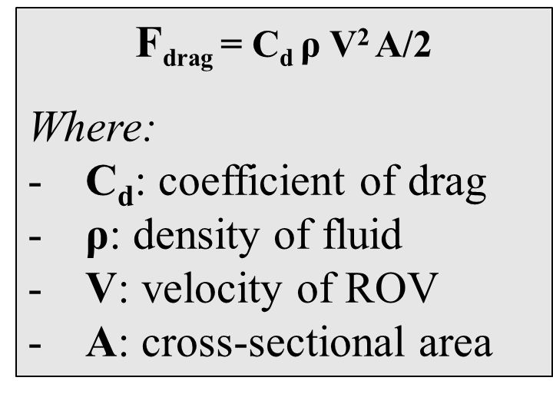
Underwater Remotely Operated Vehicle(ROV)
Team Members: Ian Lander, John Ross, Hunter Miller, Kevin Johnson, Trevor Lounsbury, Nicholas Arnold & Allisa Dalpe
Project Advisors: Dr. May-Win Thein & Dr. Yuri Rzhanov
Graduate Advisors: Allisa Dalpe, Alexander Cook, & Oguzhan Oruc
In collaboration with the UNH Remotely Operated Vehicle (ROV) project
Special Thanks to Dr. Martin Renken, the UNH Parents Association, John Ahern, Scott Campbell, Laura Gustafson, Sheri Millette & Tate Ellinwood (St. Paul’s School)
Interchangeable Tether System
UNH ROV Mission
Drag Study
Goal: To make one tether system that will work with all current and future ROVs
Each ROV has a female SubConn
connector, while the tethers has a male
SubConn connector
ROVs can switch between
tethers
Connections are inline (ROV 008)
or on the end cap (ROV 006 & 007)
The Remotely Operated Vehicle (ROV) in conjunction with the Autonomous Surface Vehicle (ASV) aims to complete a joint seafloor mapping mission. The main focus of this mission for the ROV is to autonomously investigate points of interest on the ocean floor identified by the ASV.
Goal: Determine a drag coefficient of ROV 008 to assist with creating a non-linear control model of the vehicle
Used the drag tank to drag the ROV
at varying velocities collecting drag data
Designed and fabricated an attachment
system so that the ROV could be secured
to the drag carriage
Collected Pylon data so that it can be
removed when dragging the ROV to isolate
the vehicle
Processed the drag data, re-arranging the
drag equation to determine the drag
coefficient
Estimated the Reynolds number and
plotted with the drag coefficient to
determine flow state
F_{drag} = C_{d} ρ V² A/2
Where:
$\text{C}\text{d}$: coefficient of drag
ρ: density of fluid
V: velocity of ROV
A: cross-sectional area
Goal for Autonomy: Having the ROV travel waypoint-to-waypoint to gather data on points of interest.
Using Direct Feedback from MavLink and our underwater GPS we are able to analyze and control our ROV’s position.
The figure above shows the tether connected to ROV 007.
Deployment
Goal: To autonomously deploy the ROV from the ASV
Strategy consists of custom built tether reel and guided spooling system to control the deployment process
Tether reel has been fabricated out of
a 2000 pound winch motor, a cable
reel, and a slip ring
12 wire slip ring enables the
connection between the ROV, the
tether reel, and the ASV
Rollers will be implemented around the
trapdoor in the deck of the ASV to
prevent the tether from snagging on the
ASV
A cable management system will be implemented to guide the tether onto the spool uniformly to prevent tangling and overflow
ROV 005
ROV 006
The figure above illustrates the drag on the ROV with respect to velocity.
Controls
NARMAX Model (right) allows for tuning of the model parameters based on error between output of the model compared with actual output
The model below will be applied based on nonlinear system identification methods
The figure above shows the ROV deployment system from the ASV. It is important to note that tether reel is shown in blue.
Underwater GPS
Electronics
Redesign of ROV 007 electronics, converted electronics from a stack design to a modular tray design
Gathered data pertaining to power draw of the system to understand battery life
  The goal was to determine average power draw in an attempt to increase overall run time
Confronted issue with inertial measurement unit (IMU) placement due to ROV 007’s rotating design
  Stationary tubes were installed on the side of the ROV to house, the IMU and camera
Blue Robotics "Ping Sonar Altimeter and Echosounder"
Benefits of this system include open source code, easy implementation with existing system, reasonably priced,
and the user interface displays data in an
effective manner
Goal: To locate the ROV underwater using four receivers listening for a set acoustic frequency and a single locater producing a desired acoustic frequency
ROV 007
ROV 008
ROV 008 Electronics Tube
WaterLinked Underwater GPS
Accuracy varies at +/- 1% of the distance between the Locator and the Receivers (assuming minimal reflection)
Using the underwater GPS along with controls developed, we are able to have the ROV travel autonomously from a starting location to a desired point of interest
Currently using the QGroundControl system we are able to manually select a point of interest and begin travel
Controls
The figure above shows the WaterLinked Underwater GPS MavLink.

