Slide 1


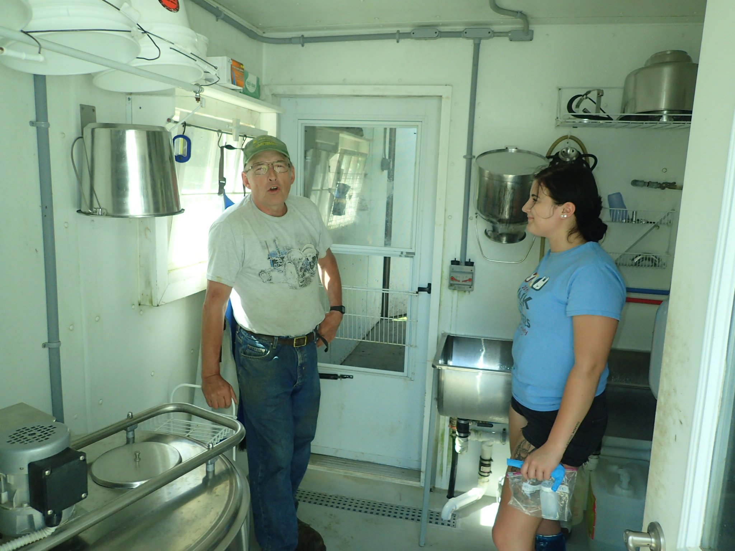
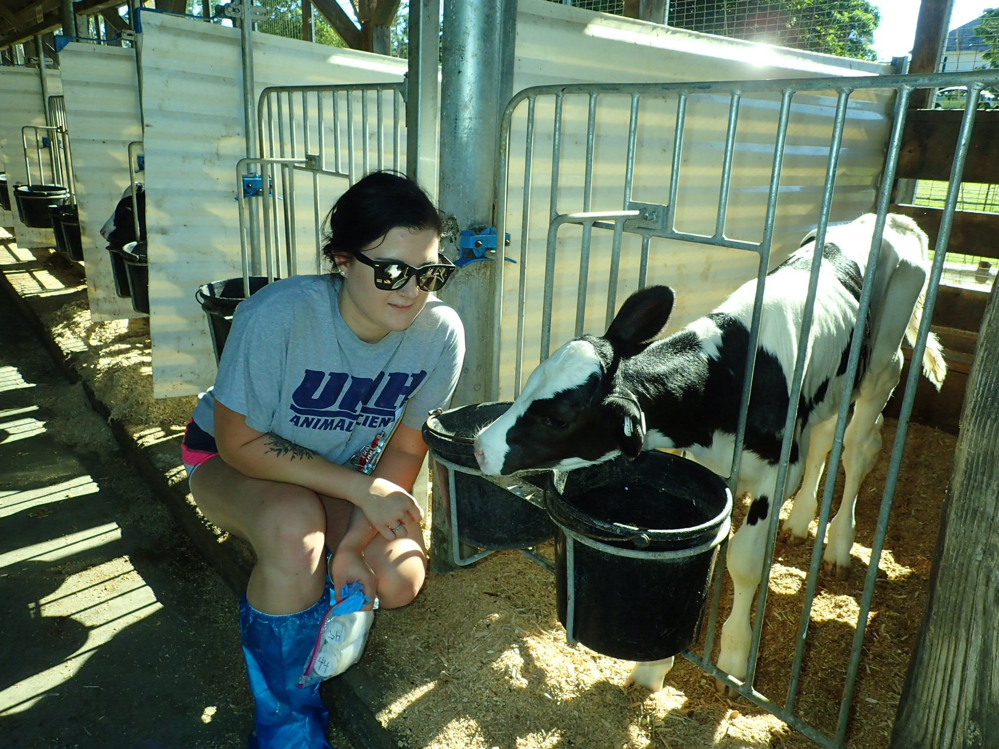
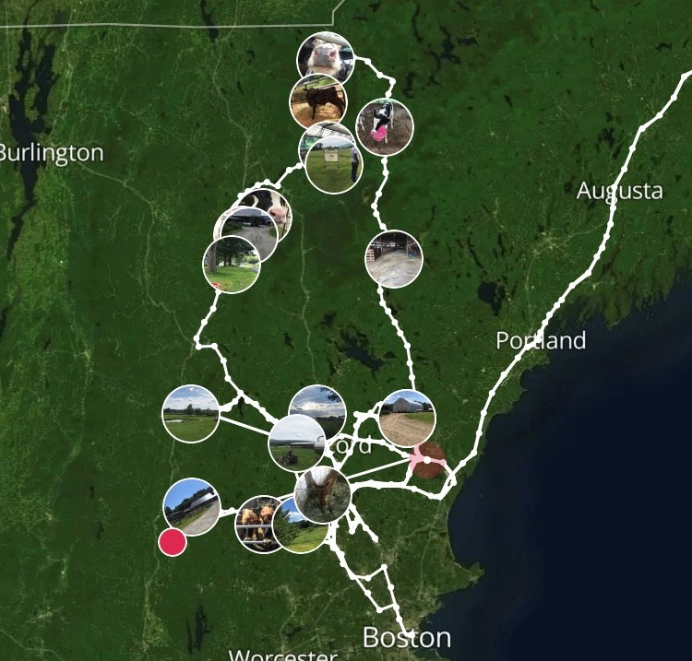
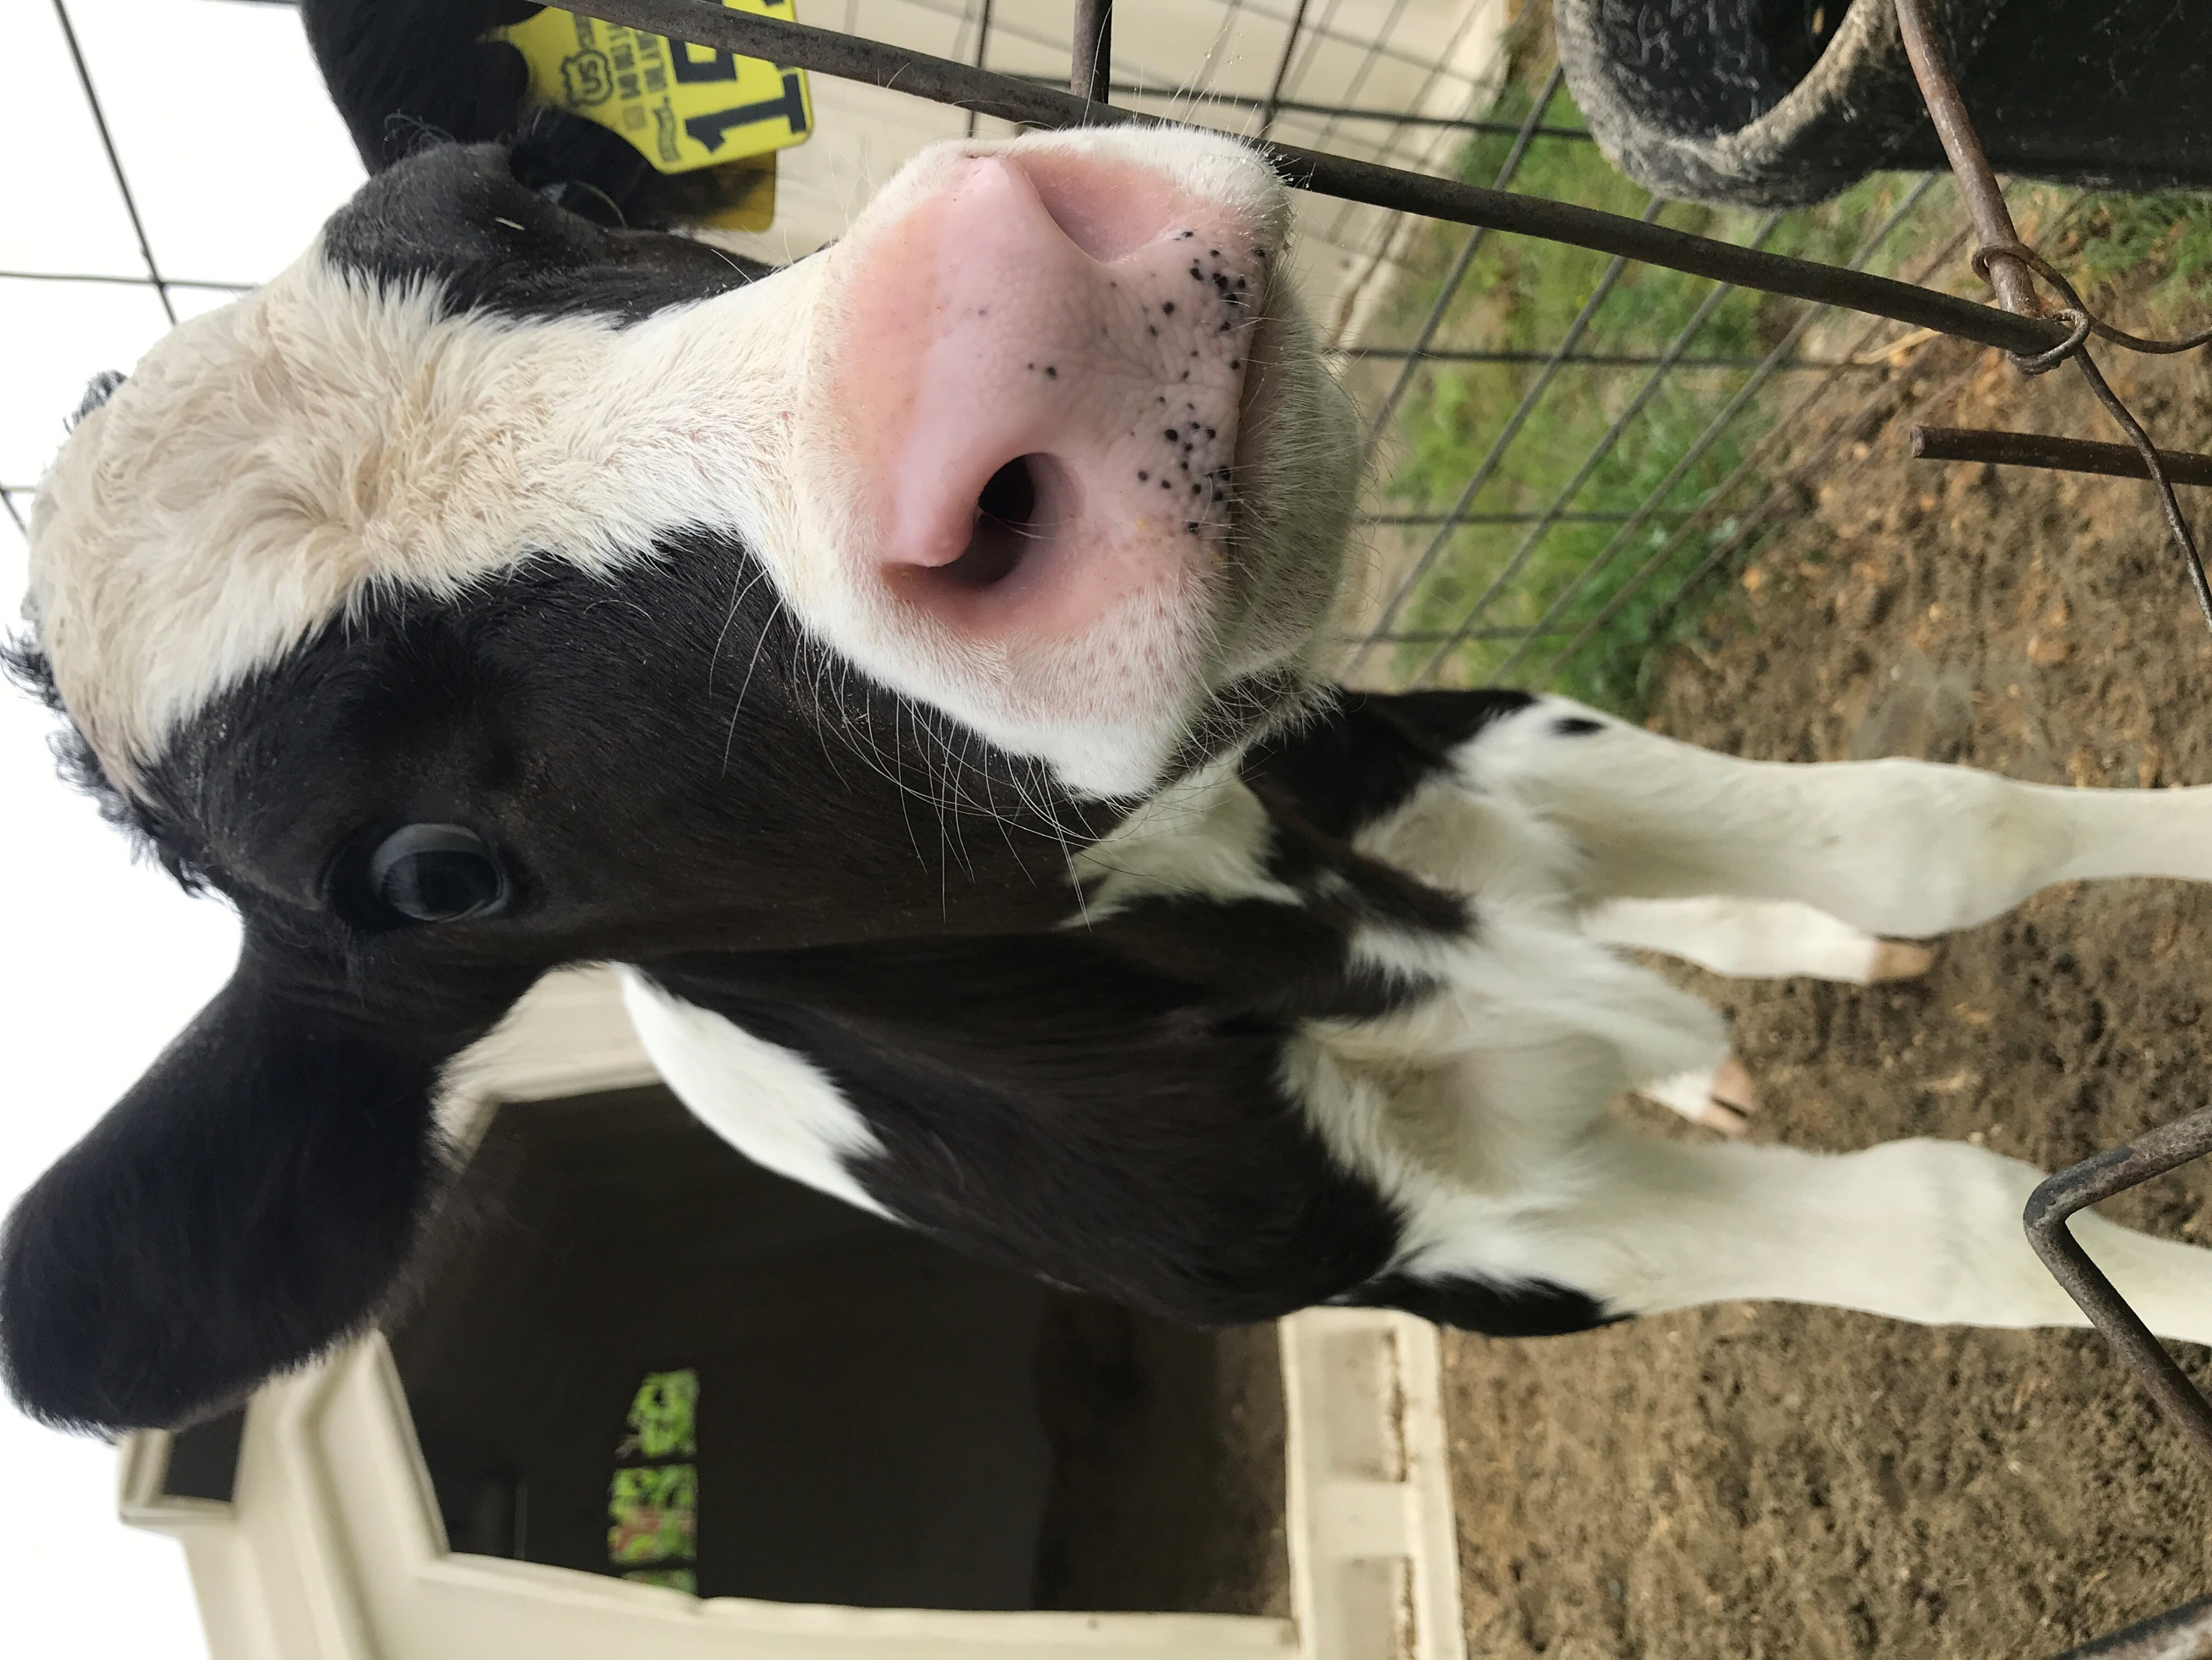
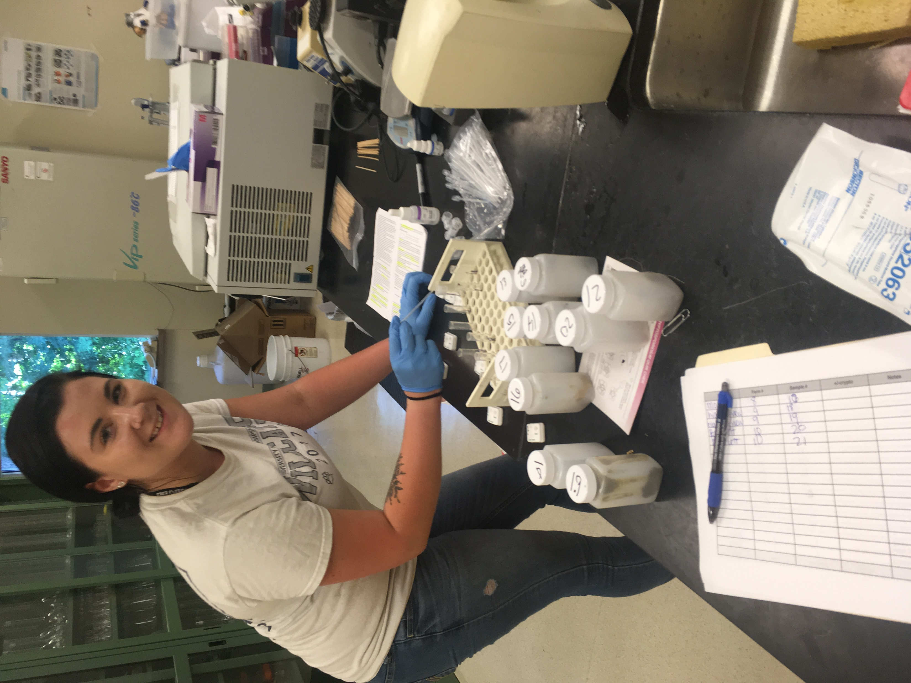
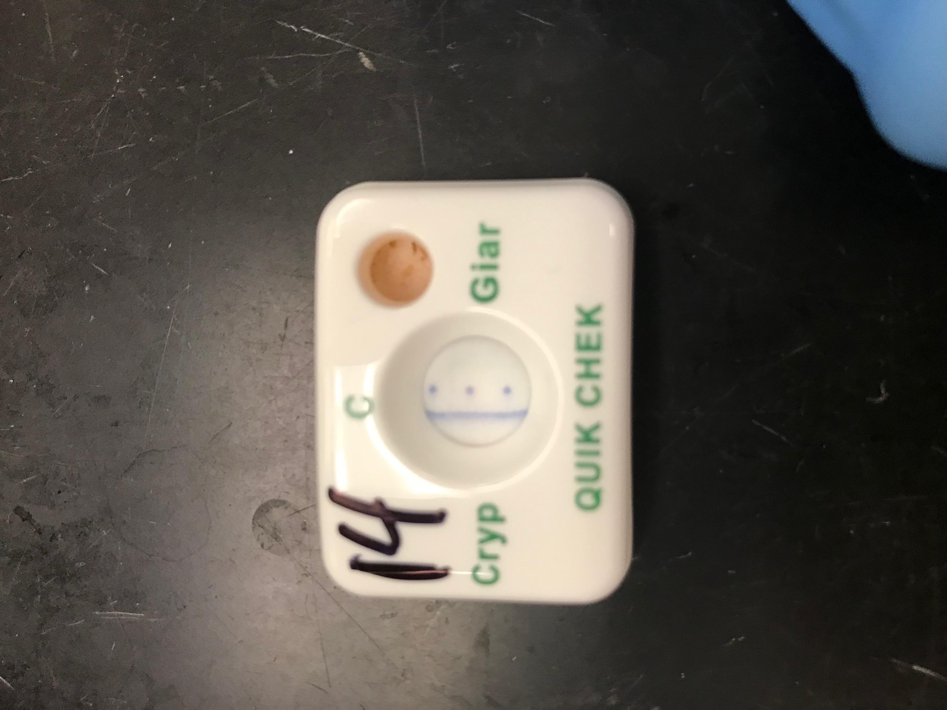
The Prevalence of Cryptosporidium Amongst
New Hampshire Dairy farms and Farmer Perceptions of Related Illness
Alexis Efraimson, Dr. Andrew Conroy
University of New Hampshire, Durham, NH, USA
Background
Methods
Preliminary Findings
Cryptosporidium:
Cryptosporidium (crypto) is a protozoan enteric parasite that infects humans, livestock, and various wildlife through fecal-oral transmission¹
A host infected with crypto is characterized by showing watery diarrhea for 2-10 days^{1,2}
This disease can be fatal in immunocompromised children, geriatric, and patients with HIV/AIDS. It is known to be detrimental to calf growth rates
There is currently no cure or vaccine for crypto in humans or animals
Highly resistant to chlorines or alcohols³
Giardia:
Giardia is a protozoan enteric parasite much like crypto, it also is a common cause of diarrhea in patients⁵
There are only two zoonotic strains of Giardia out of the four known strains⁴
it also is spread via fecal-oral transmission
Figure 3. Interviewing the farmer for the perceptions survey and learning about their farm
Out of 32 farms sampled; Cryptosporidium was present at 35% of all commercial New Hampshire Dairies
22% of calf fecal samples tested positive for crypto
Giardia was present at 53% of farms sampled
44% of the total samples tested positive for Giardia
18% of farmers did reported having GI problems and had crypto on their farm
GI Problems | Positive ELISA test for crypto | Negative ELISA test for crypto | Positive ELISA test For Giardia | Negative ELISA test For Giardia
Yes | 18% | 42% | 22% | 12%
No | 82% | 58% | 88% | 98%
Figure 4. Sampling of pre-weaned calf manure to then be brought to the Keener Dairy Research Facility for testing
Figure 7. Cross-tabulation chart that related the occurrence of GI problems in farmers and the prevalence of Cryptosporidium and Giardia on their farm
Figure 5. Running of the Fischer ELISA tests in the Keener Dairy Research Facility
Acknowledgements
Thank-you to the ANSF department chair Dr. Mortensen, and the McNair Scholars program for funding this research. Thank-you to Dr. Conroy, Dr. Erikson, Dr. Elder, and Rob Gibson for making this research possible.
Figure 1. (left) illustrates all of the farms that were visited during this study tracked from the app Polar steps. Figure 2. (right) is a picture of a pre-weaned calf; the sample age for the study
References
Purpose
Figure 6. Fisher ELISA test that appeared to be positive for Cryptosporidium
Cryptosporidium (Crypto) and Drinking Water from Private Wells | Wells | Private Water Systems | Drinking Water | Healthy Water | CDC. (2015, July 1.
Pumipuntu, N., & PirHarp, J. A., & Goff, J. P. (1998). Strategies for the control of Cryptosporidium parvum infection in calves. Journal of dairy science, 81(1), 289-294.
atae, S. (2018). Cryptosporidiosis: A zoonotic disease concern. Veterinary world, 11(5), 681.
Smith, H. V., Caccio, S. M., Cook, N., Nichols, R. A. B., & Tait, A. (2007). Cryptosporidium and Giardia as foodborne zoonoses. Veterinary parasitology, 149(1-2), 29-40.
Ryan, U., & Cacciò, S. M. (2013). Zoonotic potential of Giardia. International journal for parasitology, 43(12-13), 943-956.
The purpose of this study was to raise awareness of the severity and prevalence of Cryptosporidium to the public, especially to those hosts that have weakened immune systems in hopes to limit future illness in people and livestock
Notes:
Align
Do same font w same size
Methods: put pictures of farmers with figure
Make like flow chart: farmer then survey then phone call then visit

