Slide 1


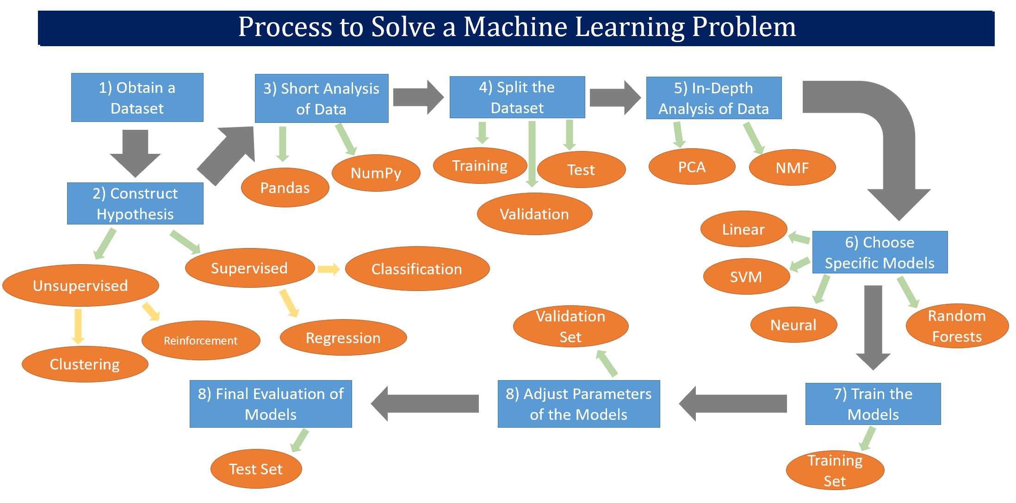
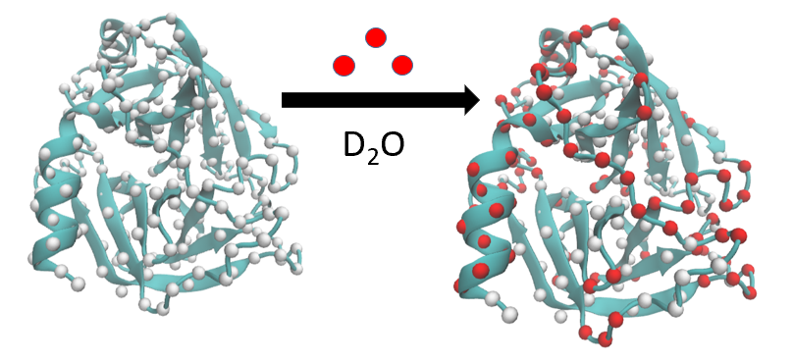
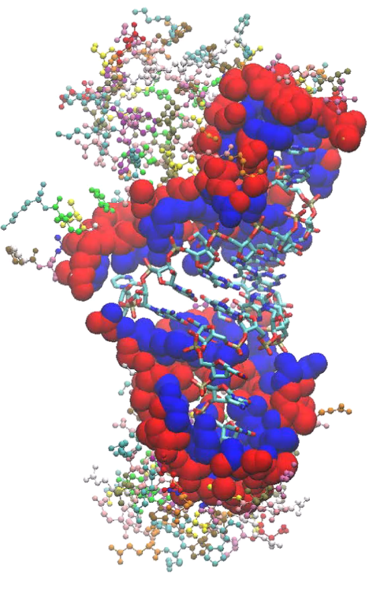
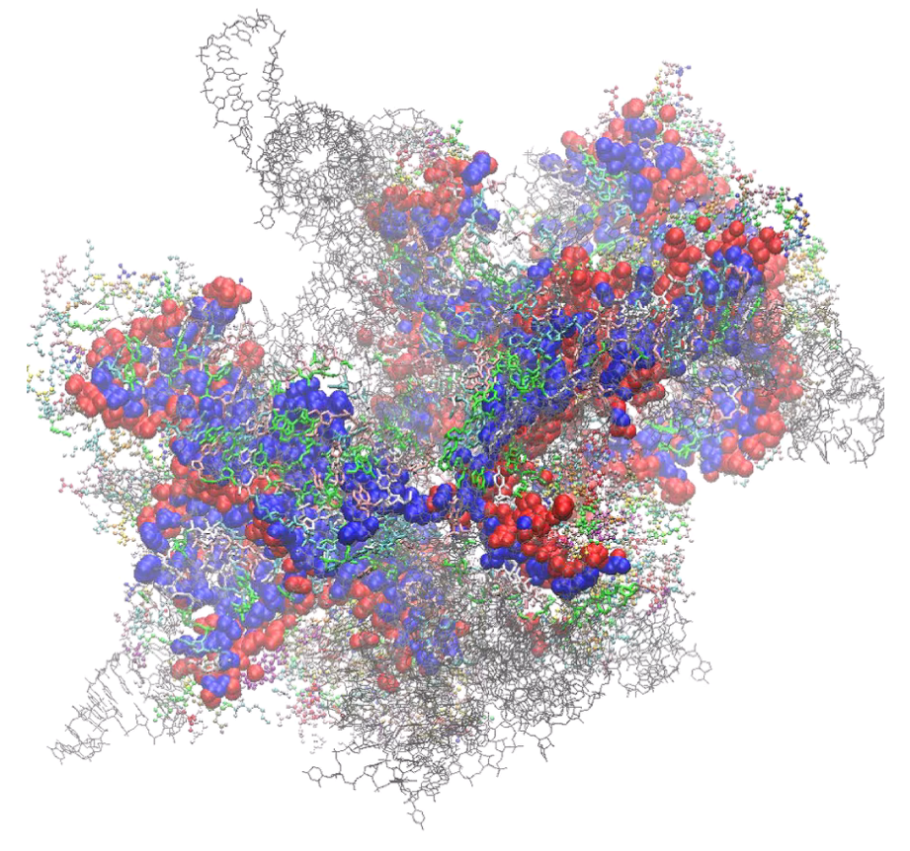
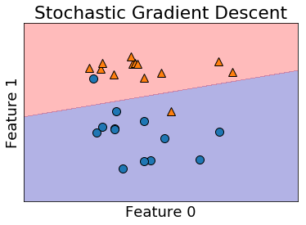
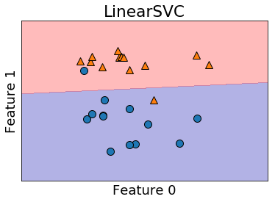
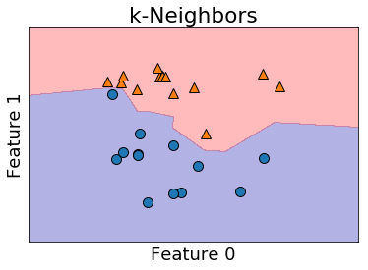
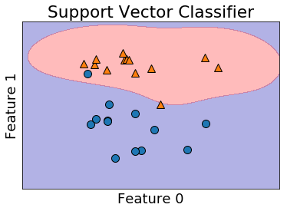
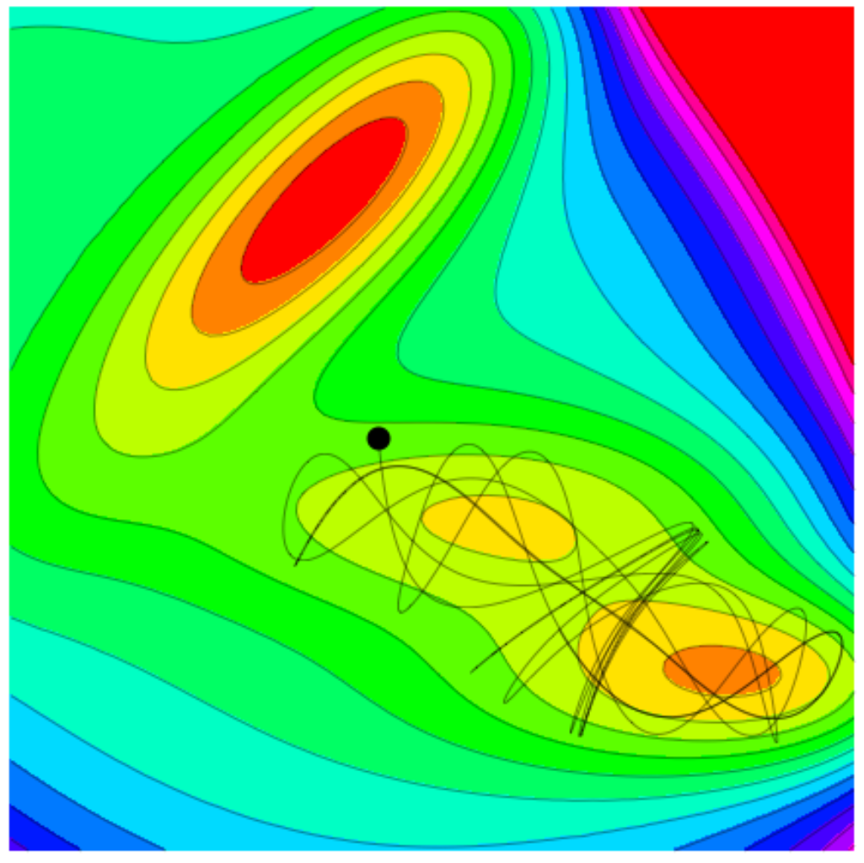
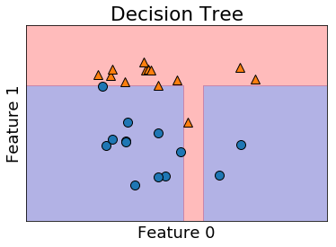
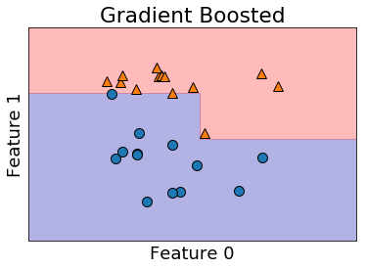
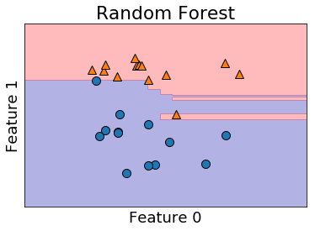
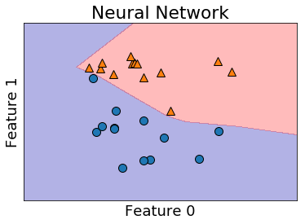
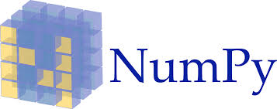




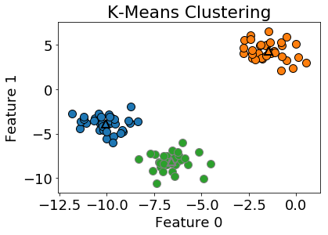
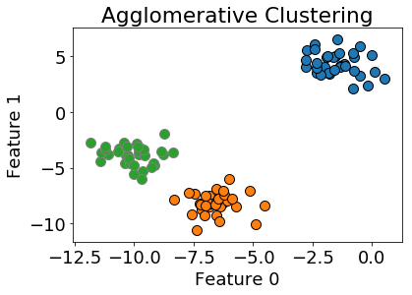
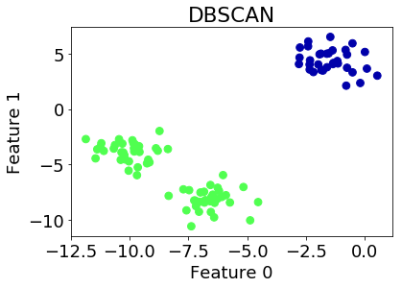
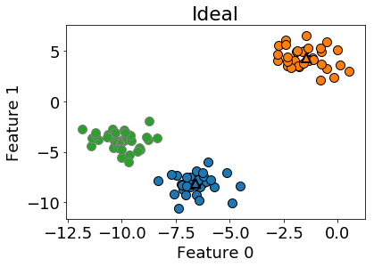



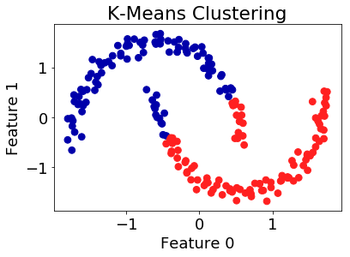
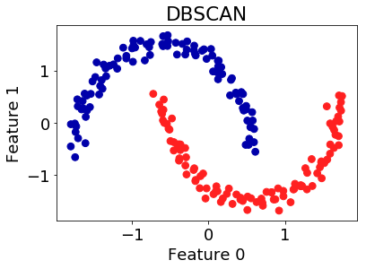
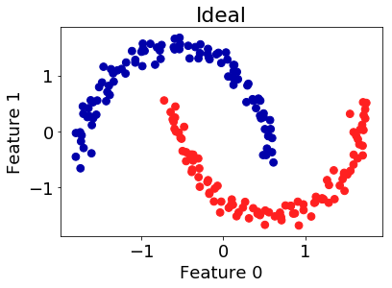
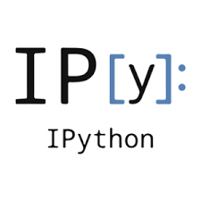
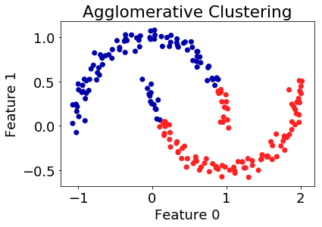
Machine Learning and Its Applications in Molecular Biophysics
Jacob Andrzejczyk and Harish Vashisth
Department of Chemical Engineering, University of New Hampshire, Durham, NH 03824
Introduction
Potential Projects
Machine Learning is the scientific study of algorithms and statistical models that computer systems use in order to perform a specific task effectively without having to use explicit instructions, relying on patterns and inference.
Computational Biophysics uses numerical algorithms to study the physical principles underlying biological phenomena and processes. Provides a means of approximating solutions for theoretical biophysical problems lacking closed-form solutions, and simulating systems for which experiments are deemed infeasible.
Predicting Hydrogen-Deuterium Exchange Patterns using Support Vector Machines
Predicting RNA-Protein Interactions using Homology Comparison Networks
Optimizing Multi-Dimensional Free Energy Surfaces Using Artificial Neural Networks
Machine Learning Tools
Linear
Stochastic Gradient Descent
K-Nearest Neighbors
Decision Trees
Random Forests
Support Vector Machines(SVMs)
Neural Networks
Principal Component Analysis(PCA)
Non-Negative Matrix Factorization(NMF)
DBSCAN
Agglomerative Clustering
K-Means Clustering
Classification Methods
These methods are a form of supervised learning in which the inputs/outputs are known.
Machine Learning Libraries
SciKit-Learn
NumPy
SciPy
Pandas
Matplotlib
Ipython
TensorFlow
Keras
Shogun
Clustering Methods
References
These methods are a form of unsupervised learning in which the inputs are known, and outputs are unknown.
Albon, Chris. Machine Learning with Python Cookbook. O'Reilly Media, 2018.
Guido, Sarah. Introduction to Machine Learning with Python. O'Reilly Media, 2016.
Kuriyan, John, et al. The Molecules of Life: Physical and Chemical Principles. Garland Science, Taylor & Francis Group, 2013.
Liu, Yong, et al. “Diffusion Network of CO in FeFe-Hydrogenase.” The Journal of Chemical Physics, vol. 149, no. 20, 2018, p. 204108., doi:10.1063/1.5054877.
Roy, Rahul. “Best Python Libraries for Machine Learning.” GeeksforGeeks, 19 Jan. 2019, www.geeksforgeeks.org/best-python-libraries-for-machine-learning/.
“Wolfram Demonstrations Project.” Trajectories on the Müller-Brown Potential Energy Surface, demonstrations.wolfram.com/TrajectoriesOnTheMullerBrownPotentialEnergySurface/.
Acknowledgements
We are grateful for financial support through US National Science Foundation (Award #CBET-1554558).

