Slide 1



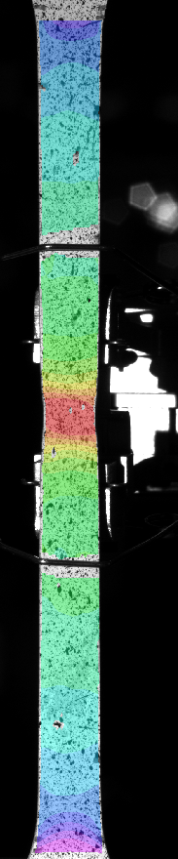
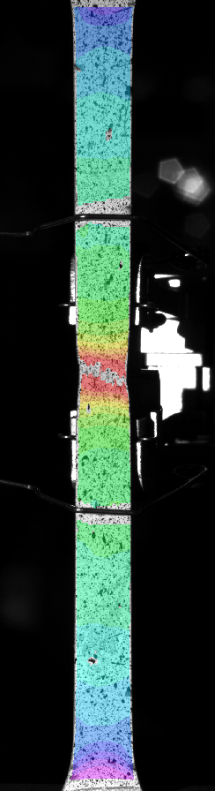
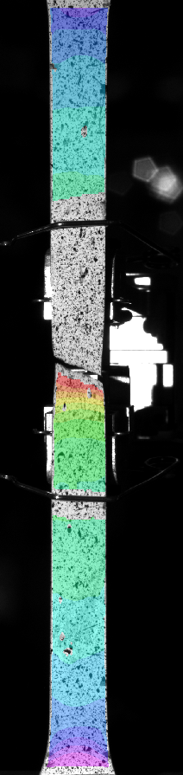
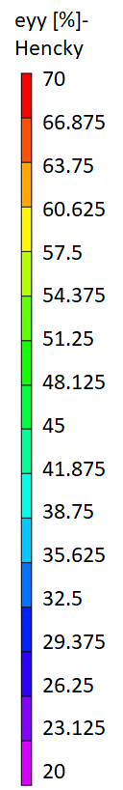
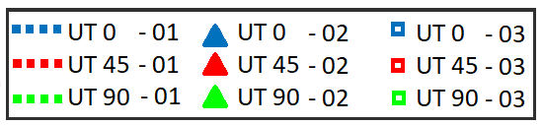
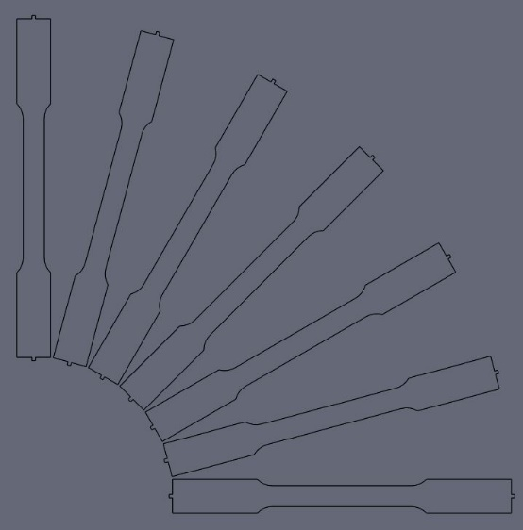
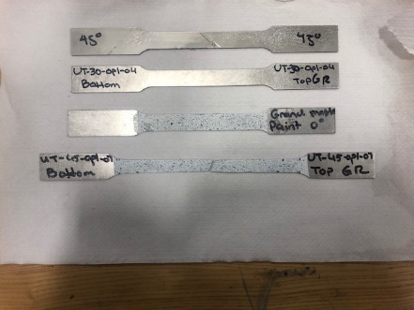
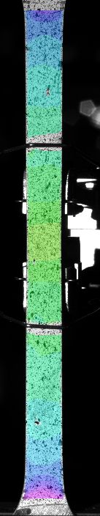
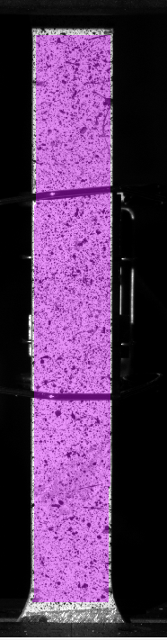
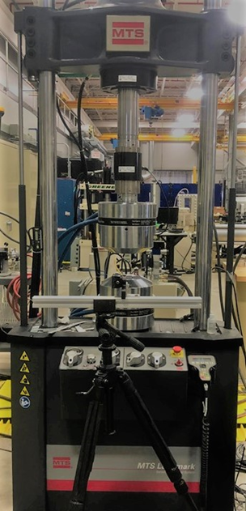
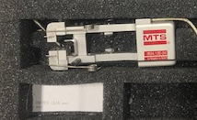
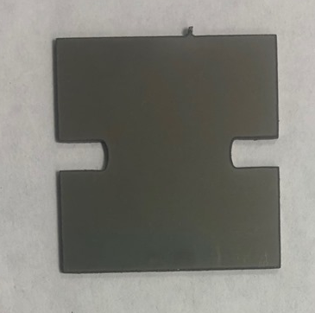

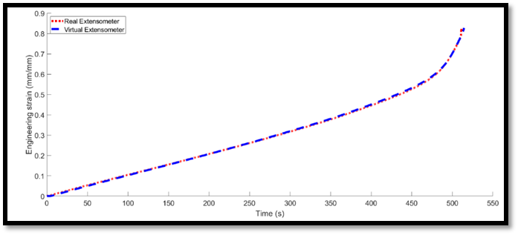

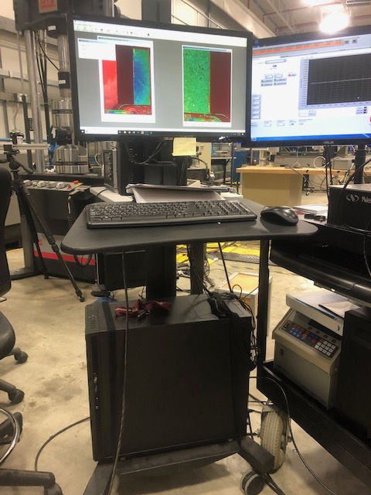
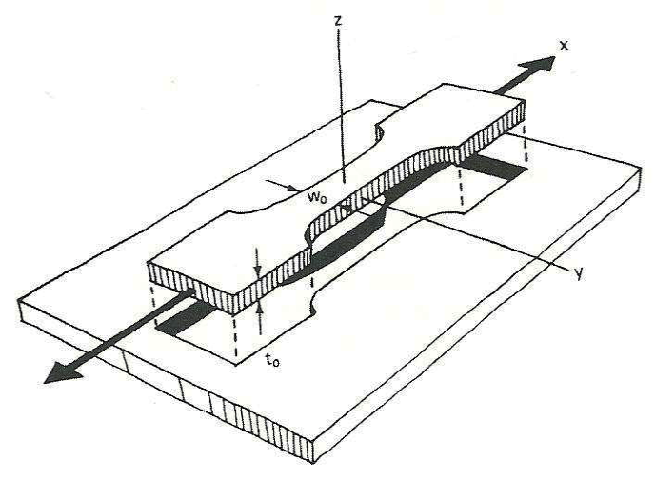

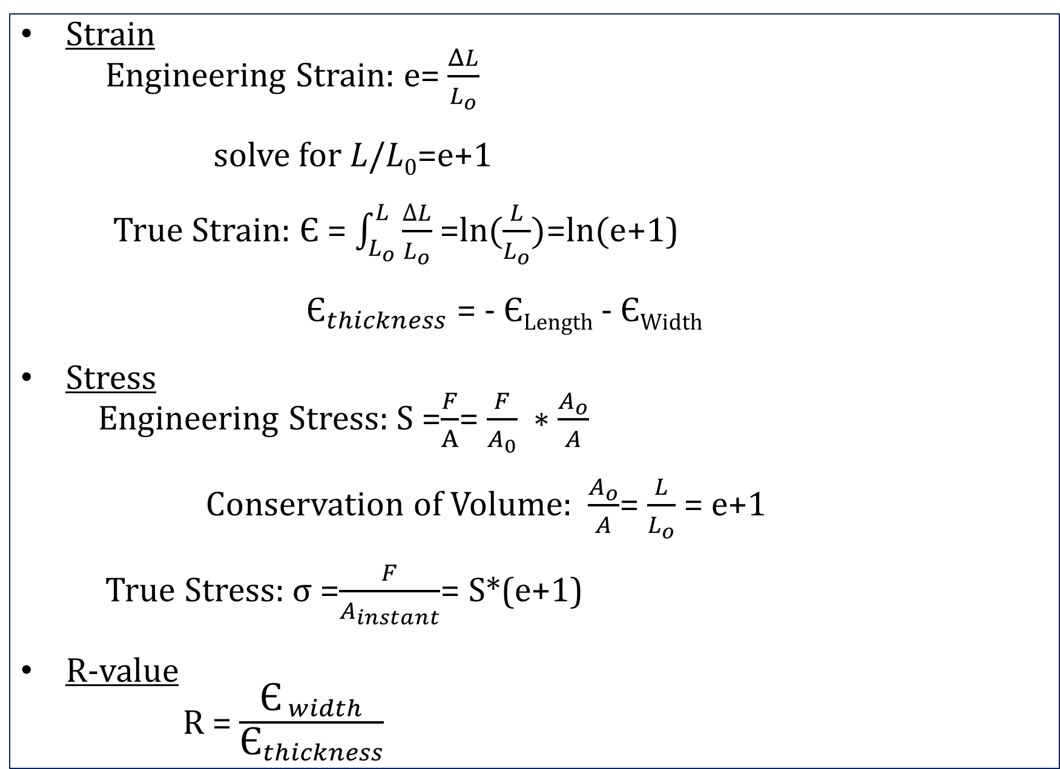
Determining Anisotropy of SS 316L
Marguerite Kennish
Department Mechanical Engineering, University of New Hampshire, Durham, NH 03824
Advisors: Dr. Mohammad Ali Davar Panah, and Dr. Brad Kinsey
Introduction
DIC Results
Results
When new materials are developed or used in a project, their properties, such as yield, fracture, anisotropy, etc., are unknown. These characteristics must be determined through testing to develop a profile for these materials for modeling purposes [1]. SS 316L is being used in a NH BioMade research project. It’s material properties, including anisotropy, must be assessed. Anisotropy is when a material’s properties change depending on the direction specimens are cut in relation to the rolling direction of the material. Rolling sheet metal causes material grains to become elongated and aligned. This alignment can potentially cause anisotropy [3].
Anisotropy is highly dependent on the crystalline structure of the material [3]. Previously tested stainless steel has been found to be isotropic due to its body centered structure. It is predicted that our SS 316L will also be isotropic.
Uniaxial Tensile Test
DIC Analysis
R-Values
Angle Orientation
45°
R-Value
Ali
Rolling Direction
Specimen alignment in comparison to the rolling direction , angles are labeled: UT## for the degree angle
Specimens throughout test procedure
True Strain along tension direction (mm/mm)
In an isotropic material, the R-value, i.e., ratio between strain in width of specimen to strain in thickness, is nearly 1 [5].
R-values for 0°, 45°, and 90° to the rolling direction are not 1 and vary considerably thus indicating an anisotropic material.
Specimen prepped and loaded into Uniaxial machine
Methodology
Data Collected
Conclusions and Future work
True vs. Engineering Stress – Strain
UT 45°
Sanity Test: Virtual Extensometer vs. Physical Extensometer
Test: UT-45-0p1-07
Strain-Sample#
True-01
True-02
True-03
Eng-01
Eng-02
Eng-03
Extensometer
1200
1000
800
600
400
200
0
0.9
0.8
0.7
0.6
0.5
0.4
0.3
0.2
0.1
0
Physical
Virtual
VIC Snap 8 program
Specimen prep:
Sanding
Measure
Paint
MTS Uniaxial Test:
Load specimen
Align for VIC Snap 8:
*Camera
*Lights
Attach extensometer
Begin test, add load in tension direction
Post Processing:
MATLAB program
Top Grip
Stress (MPa)
Engineering Strain (mm/mm)
Planar Strain Specimen
Camera
Bottom Grip
Uniaxial testing data has revealed that SS 316L demonstrated similar elastic yield stress, ultimate tensile strength, and fracture limits between different angle orientations. The R- values did not match the definition of an isotropic material. SS 316L is thus anisotropic. The R-values were close to unity, so we will consider the material slightly anisotropic.
Future metal forming tests are still required. These tests include: Plane Strain Tension and Disk Compression Tests, to determine the yield surface of the material, and Jump Tests, to assess the strain rate sensitivity of SS 316L .
Switch Board
0 0.2 0.4 0.6 0.8 1 1.2
0 50 100 150 200 250 300 350 400 450 500 550
Strain (mm/mm)
Time(s)
From uniaxial tension test, force measured from load cell and strain measured from Digital Imaging Correlation (DIC) and physical extensometer.
All data presented are from 45° specimens.
Since data matches, virtual extensometer from DIC can be used to provide full field strain measurements.
Uniaxial Machine
Digital Imaging Correlation
Acknowledgements
Calculations
True Stress vs. True Strain – UT All Angles
Strain
Engineering Strain: e= $\frac{ΔL}{L_{o}}$
solve for 𝐿/𝐿₀=e+1
True Strain: Є = $\int_{L_{o}}^{L}{\frac{∆L}{L_{o}}}$ =$ln⁡(\frac{L}{L_{o}})$=$ln⁡(\text{e}$+1)
${\text{Є}}_{thickness}$ = - Є_{Length} - Є_{Width}
Stress
Engineering Stress: S =$\frac{F}{A}$= $\frac{F}{A_{0}} ∗\frac{A_{o}}{A}$
Conservation of Volume: $\frac{A_{o}}{A}$= $\frac{L}{L_{o}}$= $\text{e}$+1
True Stress: σ =$\frac{F}{A_{instant}}$= S*($\text{e}$+1)
R-value
R = $\frac{{\text{Є}}_{ width}}{{\text{Є}}_{thickness}}$
Advisor: Dr. Mohammad Ali Davar Panah and Dr. Brad Kinsey
Special thanks to: Dr. Steven Hale and Allison Wasiewski
This project was funded through support from a National Science Foundation INCLUDES grant (#1744491)
Angle-Data Location-Sample#
UT 0 DIC Fracture Box- 01
UT 15 DIC Fracture Box- 01
UT 30 DIC Fracture Box- 02
UT 45 DIC Fracture Box- 02
UT 60 DIC Fracture Box- 01
UT 75 DIC Fracture Box- 02
UT 90 DIC Fracture Box- 01
For all of curves. elastic yield stress, ultimate tensile strength, and fracture limits occur roughly in the same region.
These are indications that the material may be isotropic.
Consistency during testing provided confidence in results.
Dogbone specimen with strain orientations [6]
True Stress (MPa)
References
ADMET Materials Testing System Manufacturing. Tension Testing / Tensile Testing. ADMET(1994). Available at: https://www.admet.com/testing-applications/test-types/tension-testing/#why-tensile-testing. (Accessed: 26th July 2019)
Citation Machine: Format & Generate Citations – APA, MLA, & Chicago. Citation Machine: Format & Generate Citations – APA, MLA, & Chicago (2000). Available at: http://www.citationmachine.net/. (Accessed: 26th July 2019)
Kalpakjian, S. in Manufacturing Processes for Engineering Materials89–144 (Addison Wesley Longman, Inc, 1997).
Mar, E. (2017, November 16). Tech Matters. Retrieved July 29, 2019, from http://www.baileymetalprocessing.com/techmatters/blog-category-1/2017/11/16/r-value-and-related-parameters
Shraddha. Plastic Deformation of Metals (With Diagram): Metallurgy. Engineering Notes India(2018). Available at: http://www.engineeringenotes.com/metallurgy/metal-deformation/plastic-deformation-of-metals-with-diagram-metallurgy/43469. (Accessed: 26th July 2019)
Salazar Alvarez, Tulio. (2012). Optimization for Stretch Bending Process of Aluminum Profile. Stretch-Grap Bending, Springback Optimization.
True Strain (mm/mm)

