Slide 1


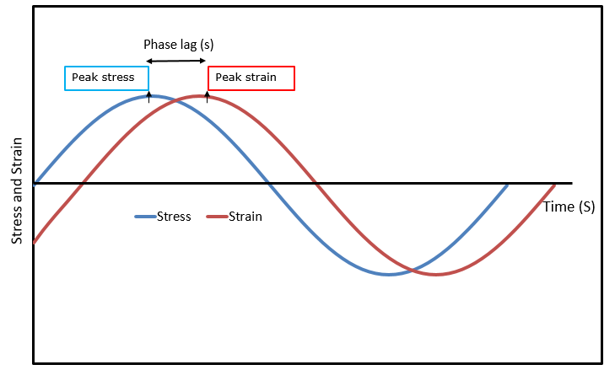
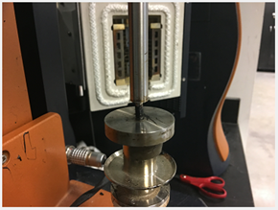
Evaluation of the Impact of Aging on the Linear Viscoelastic Property of Asphalt Binder
Aparajita Manchanda
Runhua Zhang, Department of Civil and Environmental Engineering, University of New Hampshire, Durham, NH
Introduction/Background
Methods (continued)
Results (Effect of Rejuvenator on Binder Property)
  Aging can significantly affect the performance of asphalt material. Volatilization (evaporation of the lighter fractions, short-term aging during production and placement of asphalt pavement) and oxidation (hydrocarbons in asphalt chemically react with oxygen, long-term aging during the pavement service life) are the two primary processes that cause aging.
  Linear Viscoelastic Property (LVE) is measured in form of complex modulus and phase angle.
  Complex modulus is a measurement of the stiffness of asphalt material, which is calculated using the peak stress divided by the peak strain.
  Phase angle represents the relative extent of elastic and viscous response, stands for the relaxation capability of the asphalt material. It is the lag between peak stress and peak strain.
  Presently, there is a trend towards increasing reclaimed asphalt pavement (RAP) content in asphalt pavement and recycle 100% RAP in asphalt mixes. However, RAP is already aged and used, stiffened material, causing high cracking susceptibility of the asphalt material.
  The addition of rejuvenators to RAP restores some of the original properties to asphalt binder. Rejuvenators are products designed to inverse the impact of aging.
  Time temperature superposition principle (TTSP) allows us to characterize the viscoelastic properties of a material at various temperatures over an experimentally convenient time or frequency range.
  With TTSP, data taken at various temperatures can be superimposed to a reference temperature to extend the time range of response. The curve created by superposition is called a master curve and represents the time (frequency) response of the material at the reference temperature.
  The amount of time or frequency shift is called the time temperature shift factor (aT). By combining the master curve with the shift factor, it is possible to predict LVE behavior of asphalt material over a wide range of frequency and temperature condition.
  Williams-Landel-Ferry (WLF) model is used to fit the aT-temperature relationship.
B1: 5.0% rejuvenator is added in the RAP material; B2: 6.6% rejuvenator is added; B3: 8.3% rejuvenator is added.
The addition of rejuvenator to RAP inverses the impact of aging, by decreasing the complex modulus and increasing the phase angle.
The modulus and phase angle values for B1, B2 and B3 are very close, because of the small difference in the percentage of rejuvenator content.
Results (Effect of Aging on Binder Property)
Example binder: PG 58-34; 20% RAP content.
The impact of aging on asphalt material is the change in its linear viscoelastic properties due to changes in chemical composition during construction and its service life period.
Complex modulus increases as the aging increases while phase angle decreases as asphalt materials age.
Aging causes asphalt material to stiffen and become more brittle which in turn affects the durability and becomes susceptible to cracking.
Conclusion/Summary
Aging can increase the modulus (stiffness) and decrease the phase angle (relaxation capability) of asphalt material. As a result, asphalt binders become more brittle and susceptible to cracking.
Rejuvenators inverse the impact of aging on binder properties and hence improve the cracking performance of asphalt material.
TTSP helps in characterization of the linear viscoelastic properties of asphalt binders in a wide time-temperature range.
Methods
  Aging Method:
    STA: Short term aging during production.
    LTOA: Long term aging condition
    5 and 12 days, 95ºC
    24 hours, 135ºC
Literature Sources
PavementInteractive.org
ScienceDirect.com
Hindawi.com/journals
Image: “3 Reasons Your Asphalt Pavement Is Cracking - Seal King Paving - Walden.” NearSay, nearsay.com/c/290483/233619/3-reasons-your-asphalt-pavement-is-cracking
Test: 4mm Dynamic Shear Rheometer (DSR) (MTE)
  Characterize stiffness and relaxation capability of binder (LVE)
  Temperature Range : -36ºC to 40ºC
  Frequency Range : 100 radian per second to 0.2 radian per second
  Test Output:
    Complex modulus mastercurve
    Phase angle mastercurve
Acknowledgements
This research was supported with funding from the National Science Foundation’s grant #1711781.
Thank you to Dr. E. Dave and Runhua Zhang for sharing your in-depth knowledge and guidance.
Special thanks to Dr. Stephen Hale and Alison Wasiewski in the UNH Leitzel Center for the opportunity to participate and for your support.

