Slide 1


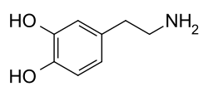
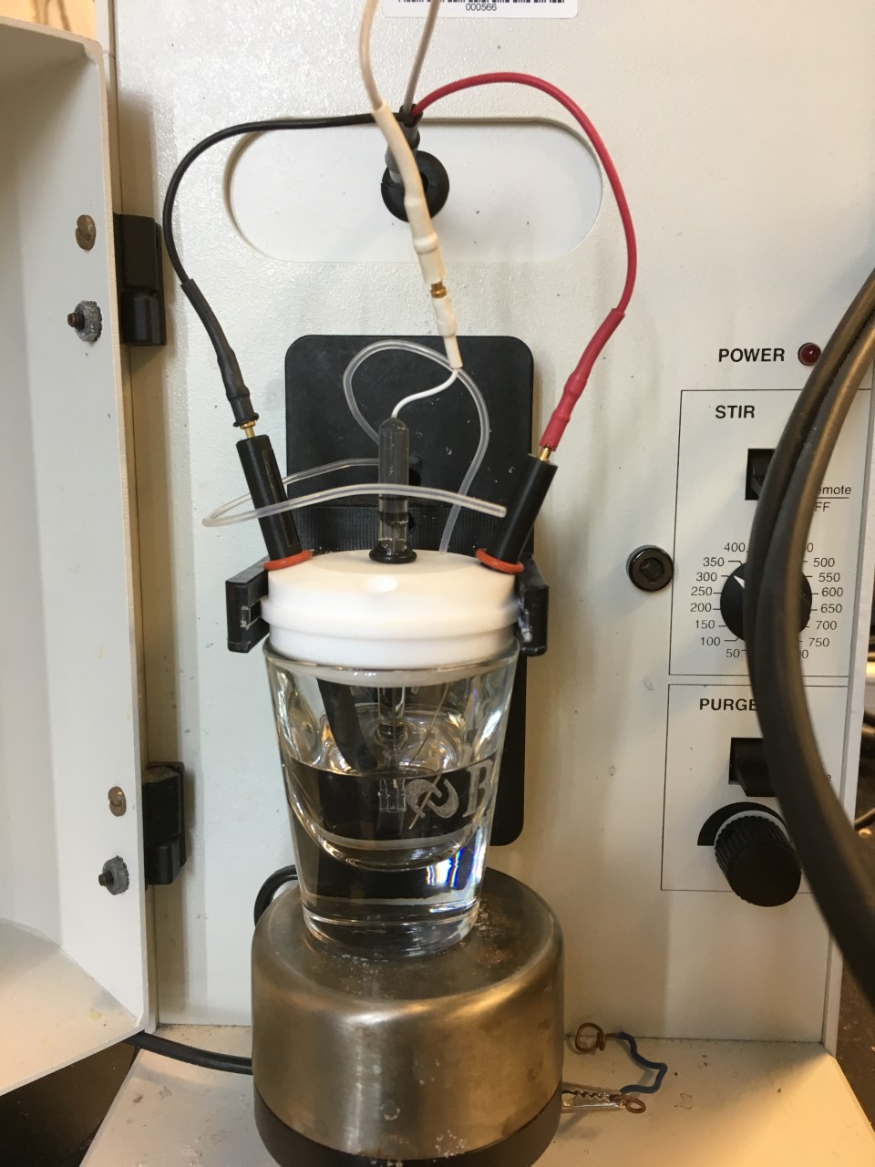
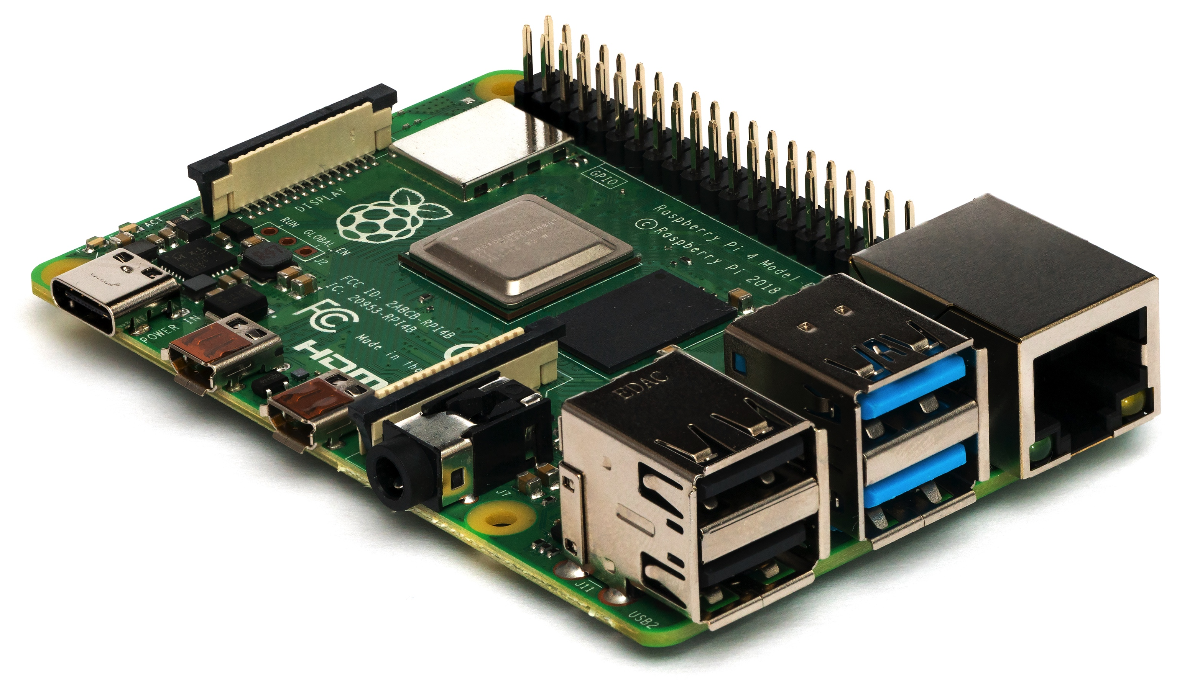

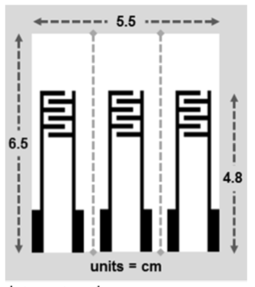
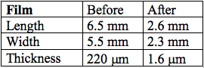
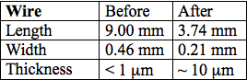
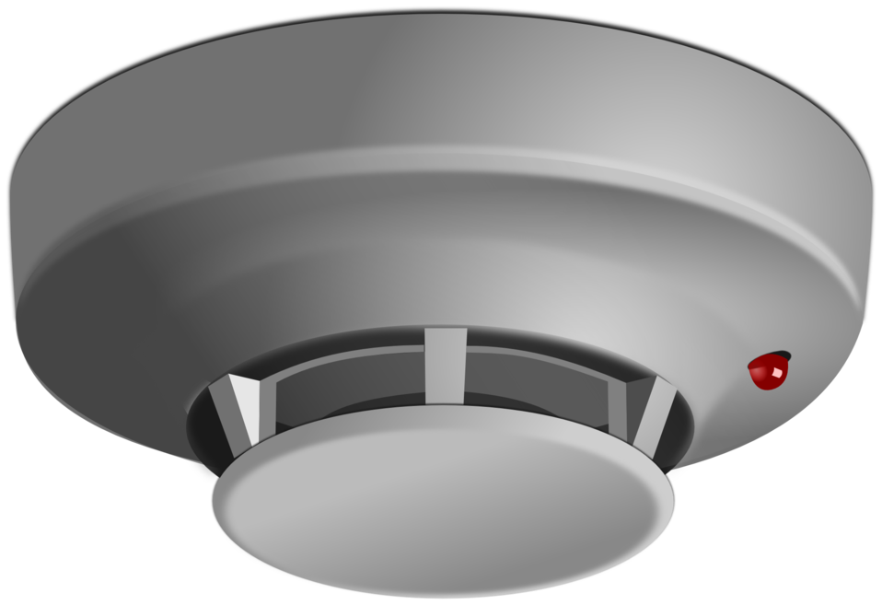
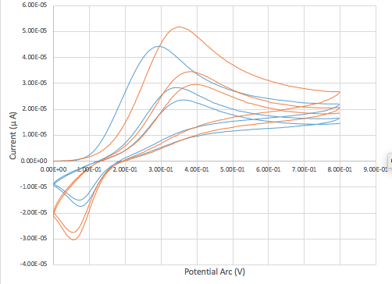
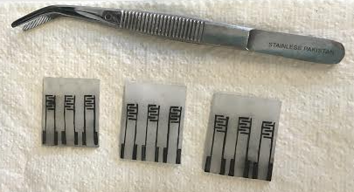
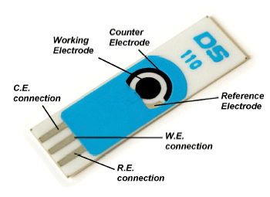
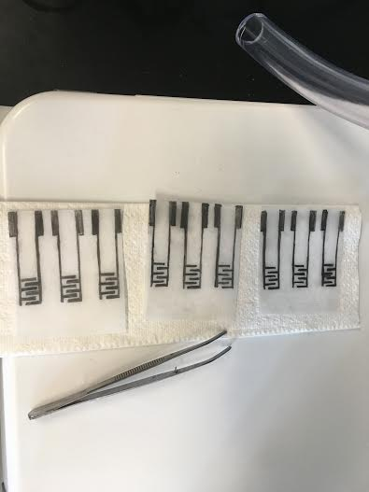

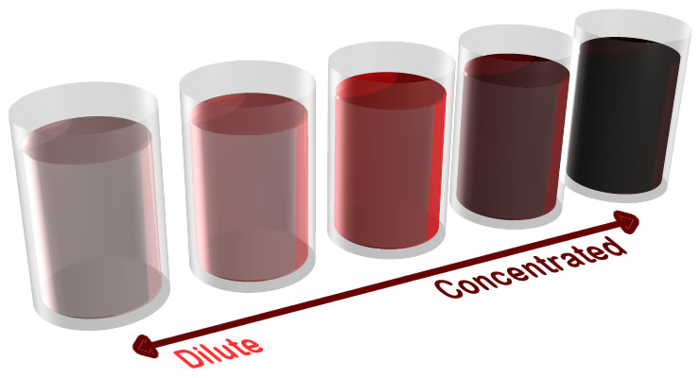
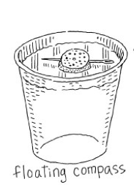
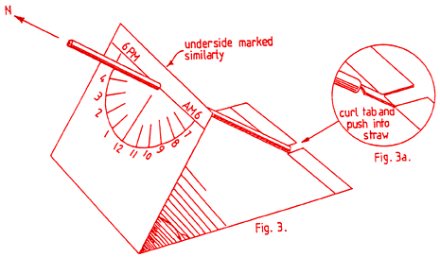
Integrating Sensor Technology into Middle School Mathematics
Brittany Langevin¹, Elizabeth England², Dr. Jeffrey M. Halpern³,
¹Noble Middle School, ²Winnasquam Regional High School, ³University of New Hampshire Department of Chemical Engineering
Introduction
Experimental Design of Sensor Labs
Inteins are auto-processing domains found in organisms from all domains of life. These proteins carry out a process known as protein splicing, which is a multi-step biochemical reaction comprised of both the cleavage and formation of peptide bonds.
Inteins are auto-processing domains found in organisms from all domains of life. These proteins carry out a process known as protein splicing, which is a multi-step biochemical reaction comprised of both the cleavage and formation of peptide bonds.
Raspberry Pi Sensors
xzjs
Mathematics in a classroom is traditionally made up of a sequence of facts and rules, treating mathematical matters as completely settled.¹
Middle School students should have the computational thinking to:
  Make predictions
  Understand patterns
  Interpret data
  Manipulate the world around them
Hands-on learning and laboratory experience in mathematics provides:
  Tangible connections to curriculum
  Real-world experience
  Higher-level thinking
Dopamine C₈H₁₁NO₂ Lab
Thermal Miniaturization Sensors
Why use Raspberry Pi at the Middle School Level?
Step 1: Making 150μM of C₈H₁₁NO₂ solution in Phosphate Buffer Solution (PBS)
Glassy Carbon Electrode
Commercial shrinkable polystyrene-based polymer films, known as Shrinky Dinks, were used to create electrodes for gaseous chemical testing.²
Low cost, small computer.
Students engage in all STEM aspects.
Utilized to expand the scope of sensors.
Limited only by students’ imagination.
Step 1: Trace electrode with HB graphite pencil
Step 2: Serial dilution of C₈H₁₁NO₂
Measure dimensions of film
Sand with 180 grit sandpaper
Using template, trace wires with graphite pencil.
0μM (baseline)
150μM (stock solution)
75μM (1:1 ratio stock solution/PBS)
50μM (1:3 ratio stock solution/ PBS)
10μM (1:15 ratio stock solution/PBS)
Dimensions
Sensors Can be Simple or Complex
Step 3: Testing C₈H₁₁NO₂ dilutions to observe oxidation
Cyclic Voltammetry (CV)
Mirica, 2017- Journal of Chemical Education ²
Raspberry Pi Labs for Middle School
Glassy Carbon Electrode (GSE)
  Working electrode
  Auxiliary electrode
  Reference electrode
Step 2: Shrink device at 163°C for 10 minutes
Mirica, 2017- Journal of Chemical Education ²
Show Me Your Muscles! - Flexi Force: Measures pressure and resistance.
What is the Weather? - Temperature and Humidity Data Logger ⁴: Integrates STEM practices in the classroom.
Take Out Your Phones - LED Light Detections ⁴: Measures intensity of LED light projected from students’ phones.
Easily translatable to middle school classrooms.
Specific to their functions and uses.
Important mathematical components.
Before
After
Step 4: Data examination
Source: "..:: Metrohm DropSens ::.. Screen-printed electrodes." ⁷
Using a Gamry potentiostat the oxidization & reduction of C₈H₁₁NO₂ was tested.
  Signal vs. Scan rate
  Signal vs. Concentration
Areas Of Potential Sensor Needs
Step 3: Measure resistance of device
Future steps
Agriculture
Automotive
Construction
Consumer products
Energy
Environment
Fishery
Food Technology
Forestry
Health
Manufacturing
Marine
Medical Care
Military
Oceanography
Security Systems
Space
Transportation
Waste Management
Other
Translating to the Middle School Mathematics Classroom
Future Work
Hands on Labs and Engineering Practices in the Mathematics Classroom
Promoting Blended Learning in the Science and Mathematics classroom.
Develop hands-on, Inquiry-Based Learning in the Mathematics classroom.
Encourage K-5 Mathematics and Science curriculum to incorporate engineering practices prior to Middle School.
Kool Aid Concentration– Intro to Molarity
Shrinky Dink Lab – Making an Electrode
Learning Objectives:
Students prepare kool-aid concentration in 100ml solution.
Students observe and record their serial dilution ratios.
Students graph their data.
Students predict the outcomes of an untested ratio concentration
Student Assignment:
Measure 12.5g Kool-aid in 100ml solution – stock solution.
Make serial dilutions in separate glasses
  1:1 (50ml solution/50ml water)
  1:2 (25ml solution/75ml water)
  1:4 (20ml solution/80ml water)
Observe data and record.
Graph data
  X = water/dilution
  Y = solution/concentration
Learning Objectives:
Students measure dimensions of electrode and prepare polymer film.
Students make predictions as to what their outcomes will be.
Students record, graph and analyze their data.
Student Assignment:
Measure and cut dimensions of Shrinky Dink film.
Sand and trace electrode. Weigh film before putting in the oven.
Place in the oven for 1, 2, 3, 4, 5, and 10 minutes at 163°C.
Record dimensions and weight for 1, 2, 3, 4, 5, and 10 minutes in the oven.
Graph data:
  Time vs. Length
  Time vs. Width
  Time vs. Weight
Calculate percent of decrease from initial to final.
Vetilini, 2011 – Introduction to Sensors ⁵
Source: https://getlocalhop.com/summer-of-space-stem/event/NdXeEAm7wp/
Sensors & Mathematics
References
Sensor applications and laboratories are perfect for Middle School Classrooms:
Used frequently in everyday life.
Further develop inquiry-based learning in mathematics.
Support hands-on learning in mathematics.
Provide real-life applications promoting a higher-level thinking.
1. Ellenberg, J. (2014). How not to be wrong: The power of mathematical thinking. New York: The Penguin Press.
2. Mirica, Katherine a., Smith, Merry K., Martin-Peralta, Daphne G., & Mpivok, Polina A.
Journal of Chemical Education 2017 94 (12), 1933-1938
DOI: 10.1021/acs.jchemed.6b00997
3. Janata, J. (2014). Principles of chemical sensors. Place of publication not identified: Springer.
4. Santos, R., & Santos, S. (2018). 20 easy raspberry Pi projects: Toys, tools, gadgets, and more! San Francisco: No Starch Press.
5. Vetelino, J., & Reghu, A. (2011). Introduction to sensors. CRC Press.
6. "..:: Metrohm DropSens ::.. Screen-printed electrodes." http://www.dropsens.com/en/screen_printed_electrodes_pag.html. Accessed 1 Aug. 2019.
http://techalive.mtu.edu/envengtext/ch02_mass.htm
Important Sensor Properties Critical to the Sensor Performance
Response time
Recovery time
Reproducibility
Aging
Stability (short term, long term)
Sensitivity
Resolution
Dynamic range
Selectivity
Size and weight
Cost
Ruggedness³
The Compass
The Sundial
Creating Additional Simple Sensors
Vetilini, 2011 – Introduction to Sensors ⁵
Source: https://lifestyle.howstuffworks.com
https://www.sundials.co.uk/projects
Acknowledgements
This research was supported with funding from the National Science Foundation’s Research Experience for Teachers in Engineering Grant (ENG-1711781). Special thanks to Steven Hale and Allison Wasiewski for all their help in and outside of the lab. Special thanks to the members of the University of New Hampshire Chemical Engineering SEEDs lab; Emily Ziino, Pryanka Nadar, Charlie Gasperoni, Zahra Panahi, for your guidance and time inside the lab. Thank you also to the Joan & James Leitzal Center for Science, Technology, Engineering, and Mathematics Education at University of New Hampshire for the opportunity to expand my knowledge as a Mathematics educator.

