Slide 1
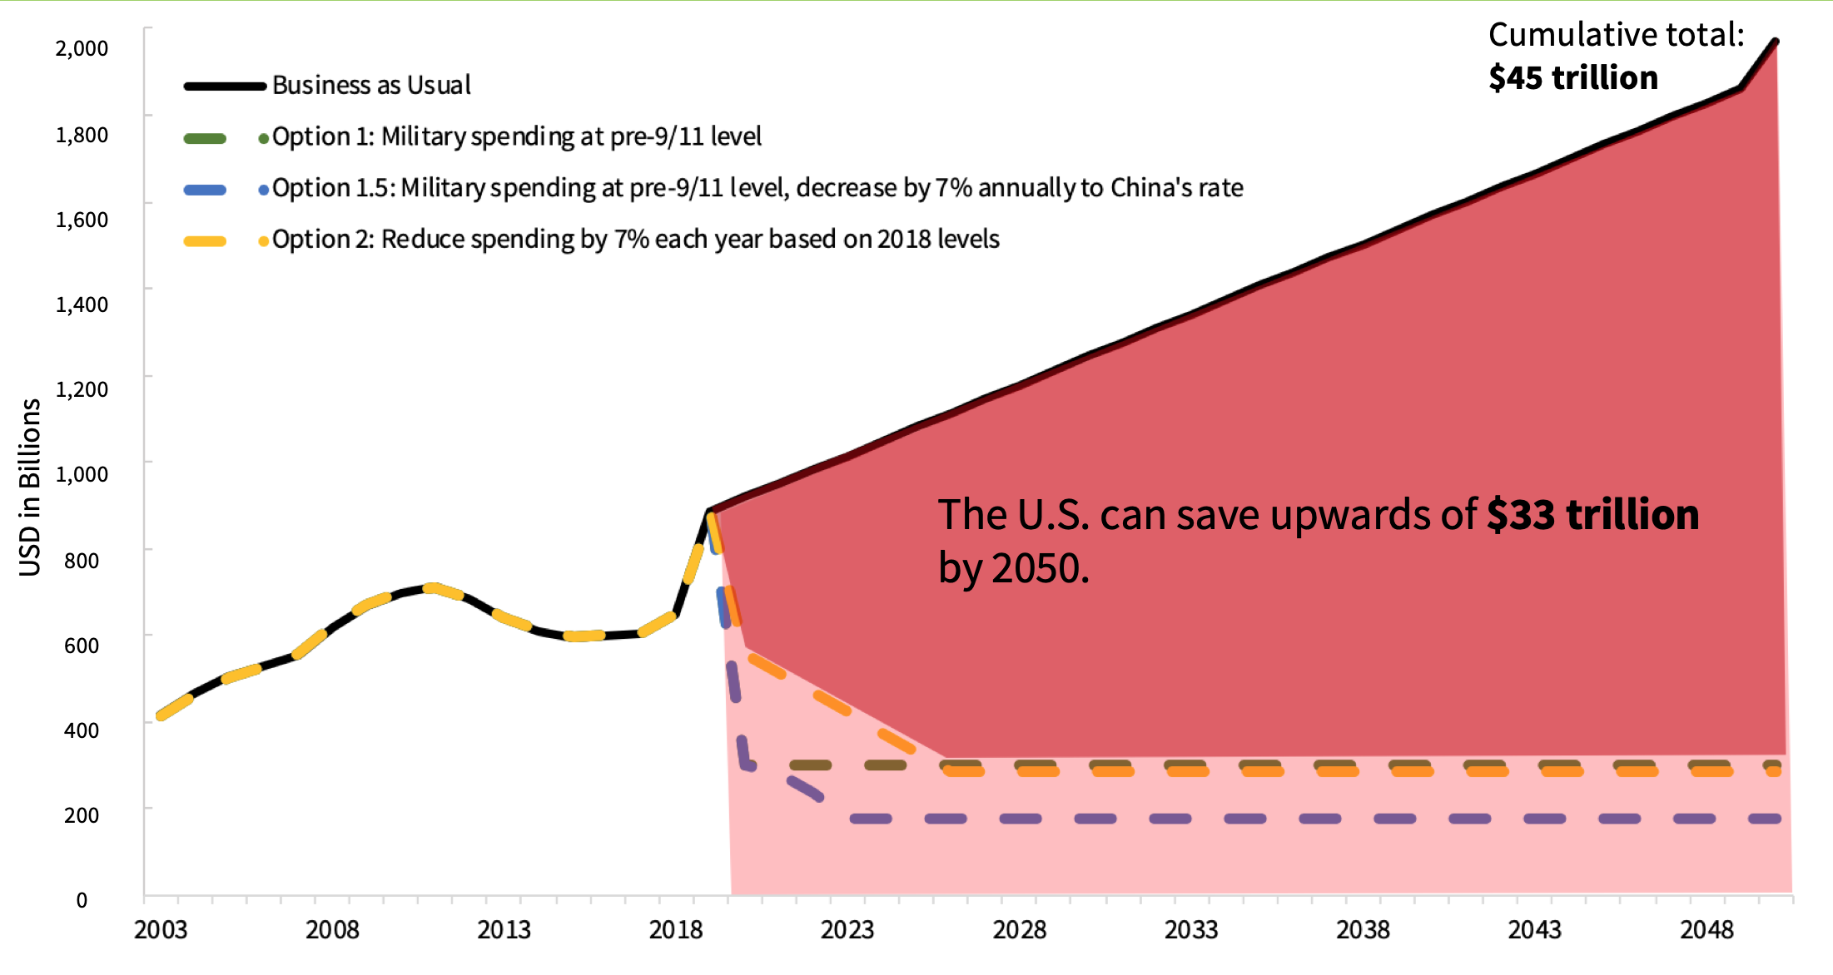
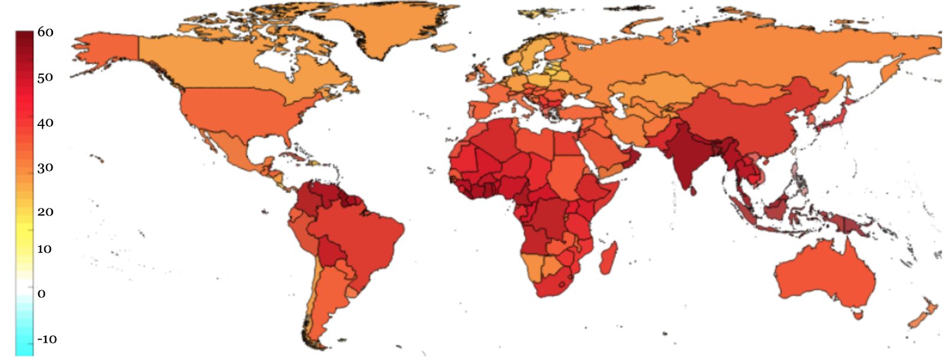


Foreign Policy for Conflict Prevention & Climate Stabilization
Celina Scott-Buechler, UNH Sustainability Fellow
Mentors: Amber Houghstow & Adam Hasz, Peace Rising
Climate Change is a Threat Multiplier
Climate change exacerbates conflict. Under business-as-usual, the world will be 50% more violent by 2050.
Sub-Saharan Africa, South Asia, and Latin America will be hit the hardest.
Option 1
FY 2020: cap military spending at pre-9/11 levels: $300 billion.
The difference is allocated to global sustainable development and capacity-building: $680 billion.
Remaining savings spent on mitigation, resilience, and adaptation at home.
US Foreign Policy is Inadequate
Since 9/11, military spending has sky-rocketed. The US is no safer for it.
Sustainable development can stabilize regions politically as well as global climate.
US must contribute $680 billion/year in sustainable development funding (People’s Policy Project).
Option 2
FY 2020: reduce military spending by 7% annually.
At this rate, meet the $680 billion annual funding goal by 2025.
Military funding frozen at pre-9/11 levels.
This incrementalistic approach provides less assurance of success.
If we don’t act immediately, global violence will increase precipitously…
Balance Funding for Key Players
Be a Part of the Solution
Call your congressional reps regularly. Demand they move legislation that addresses climate-driven conflict.
Look into which groups fund your representatives: Big Oil? Defense Contractors? Arms Manufacturers? Their profit margins rely on a hotter, more violent world.
Make climate-centered foreign policy a voting priority in 2020. Demand that candidates release comprehensive plans.
Canvass for candidates with strong platforms for climate-conflict prevention.
% increase in violent conflict by 2050
USAID: Project Implementation
State: Treaty Negotiation
Defense: Disaster Relief
Setting the Stage
Hsiang et al. (2013) found global incidence of violent conflict to increase by an average of 14% per standard deviation temperature increase.
By 2050, global violence containment will cost the US $45 trillion.
Establish the Subcommittee on Preventing Global Climate-Driven Conflict in the Senate Foreign Relations Committee.

