Slide 1
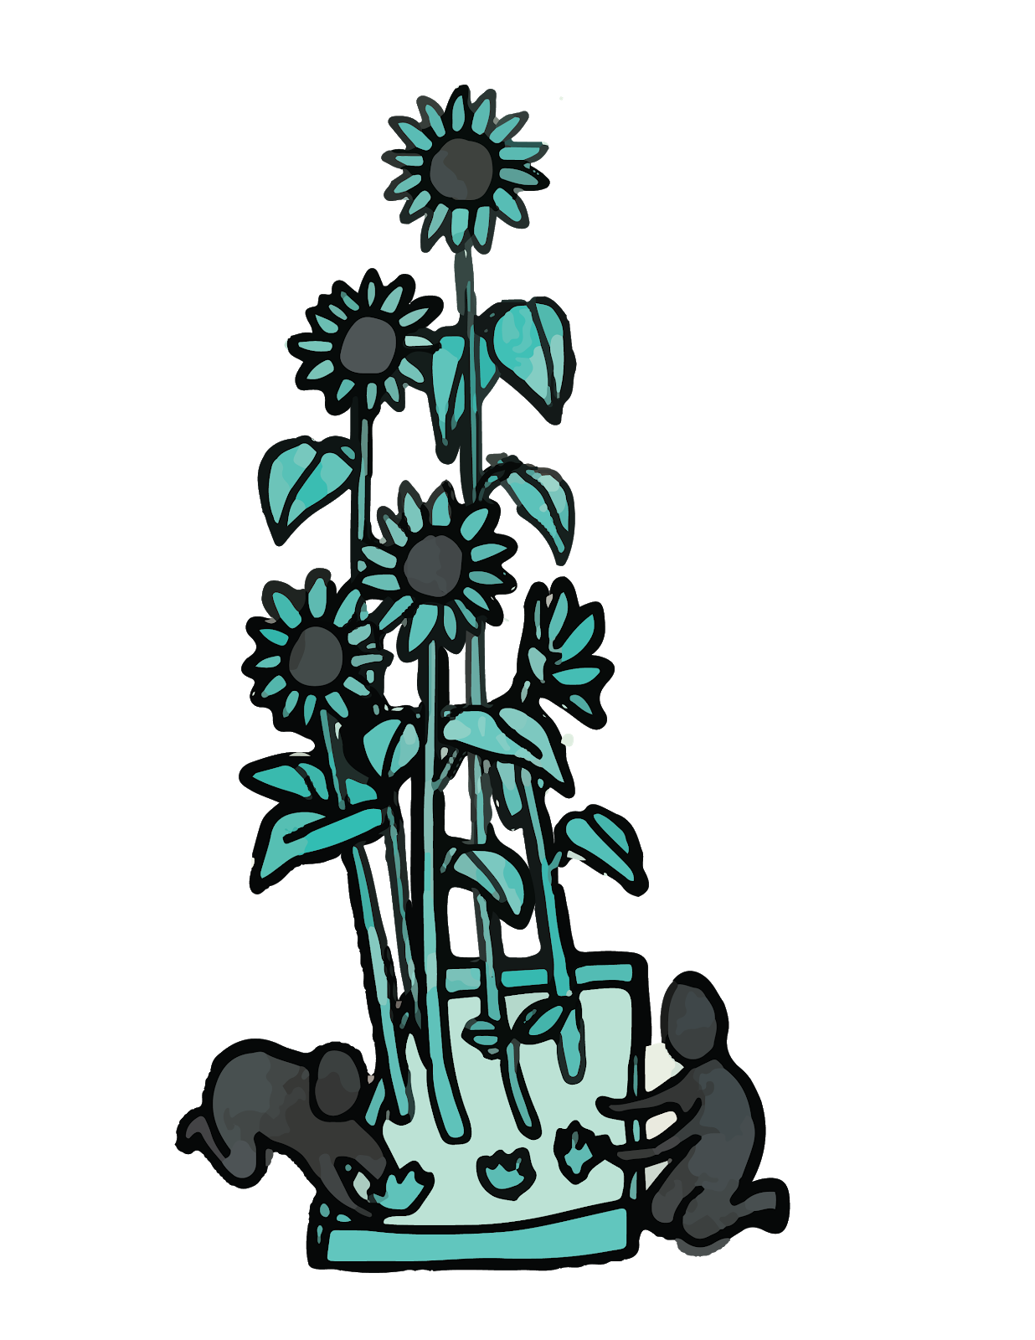
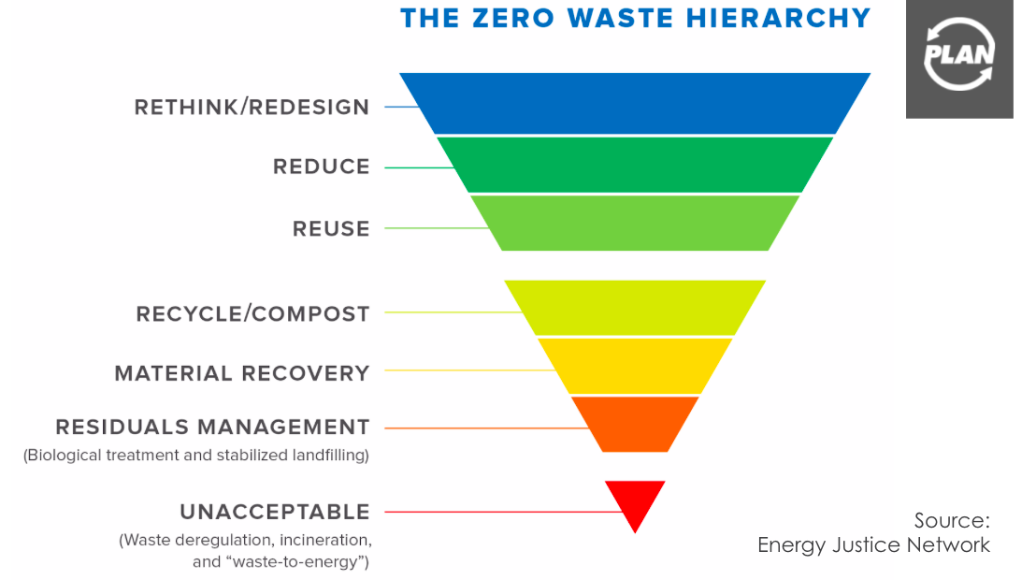


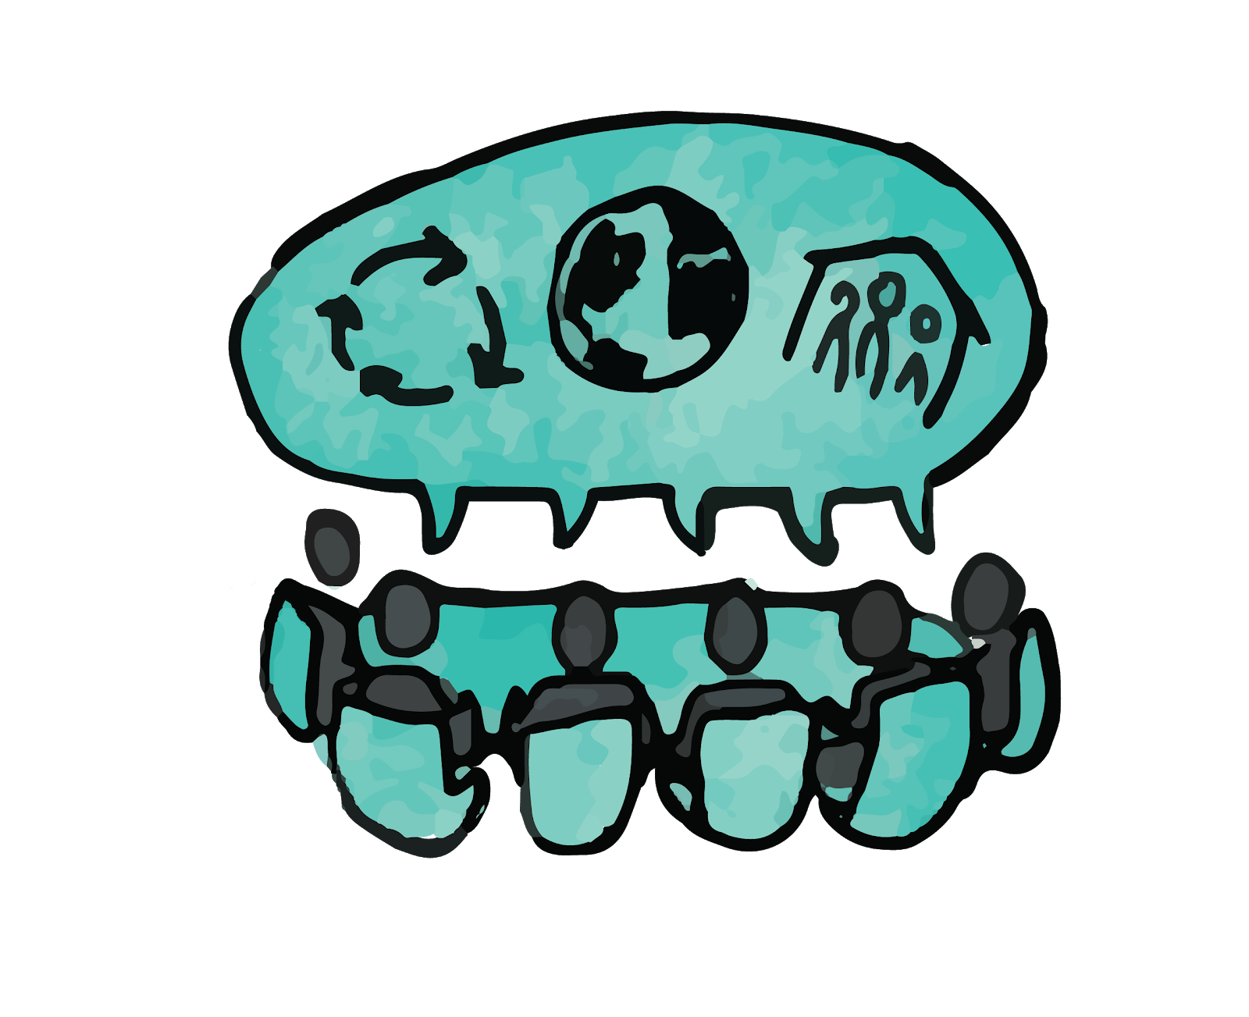
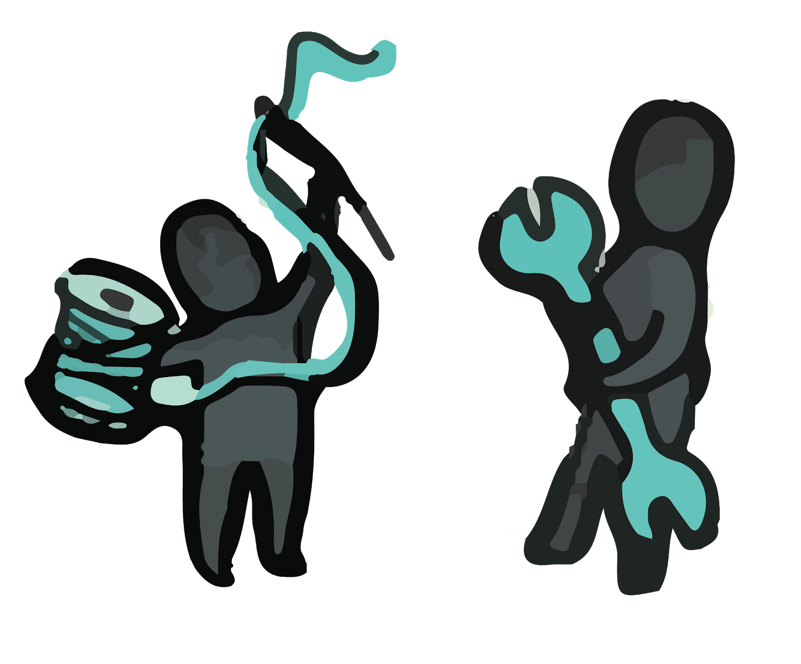
Campus Zero Waste Planning: Cost Benefit Assessment
Kayla Conway, UNH Sustainability Fellow, Summer 2019
Mentors: Alex Freid @ Post-Landfill Action Network, Jennifer Andrews @ UNHSI
Introduction
Tackling the challenges associated with waste requires a holistic solution; one that addresses both social and economic impacts
associated with changing the current
system. This fellowship explored
the possibilities related to
successfully navigating campus
bureaucracy to enact
systemic change.
Zero-Waste is defined in a place, by the people.
Discussion
Every material on a campus flows through the 4 phases below. In order to re-design waste systems, material consumption should be planned in this order:
Procurement
Use
Logistics: Collection and Consolidation
Disposal
Preliminary Results Zero-Waste: It’s Complicated
The majority of waste disposed of at UNH is landfill bound
“You cannot manage what you don’t’ measure.”
The systems in place for waste on UNH’s campus are complex.
Systemic change in regards to waste, will require systemic collaboration.
In order to develop an accurate CBA, a definition and road-map for zero-waste are required.
In order to move forward with zero-waste, it is essential that UNH hires a ZW Coordinator to facilitate all stakeholders and multi-faceted projects.
Identifying different scenarios the campus can take has impacts and benefits associated with each.
Objectives
We are going to present proposed solutions to the Zero Waste Task Force, Sustainability Task Force, and the President. The anticipated outcomes of this proposal will be:
Commitment to defining zero-waste
Stakeholder buy-in for long term vision
Agreed upon plan to achieve campus goals
Development of UNH’s Road-Map to Zero-Waste
Approach
Stakeholder Engagement
Systems Mapping
Case Studies
Data Collection and Analyses
Version 2 Visioning for the Atlas Project
References
Paige McKibben, Mary Shotton: UNHSI Zero-Waste Interns
UNH Zero Waste Task Force Stakeholders
PLAN’s Zero Waste Atlas Stage 1 Recommendation Report for UNH

