Slide 1
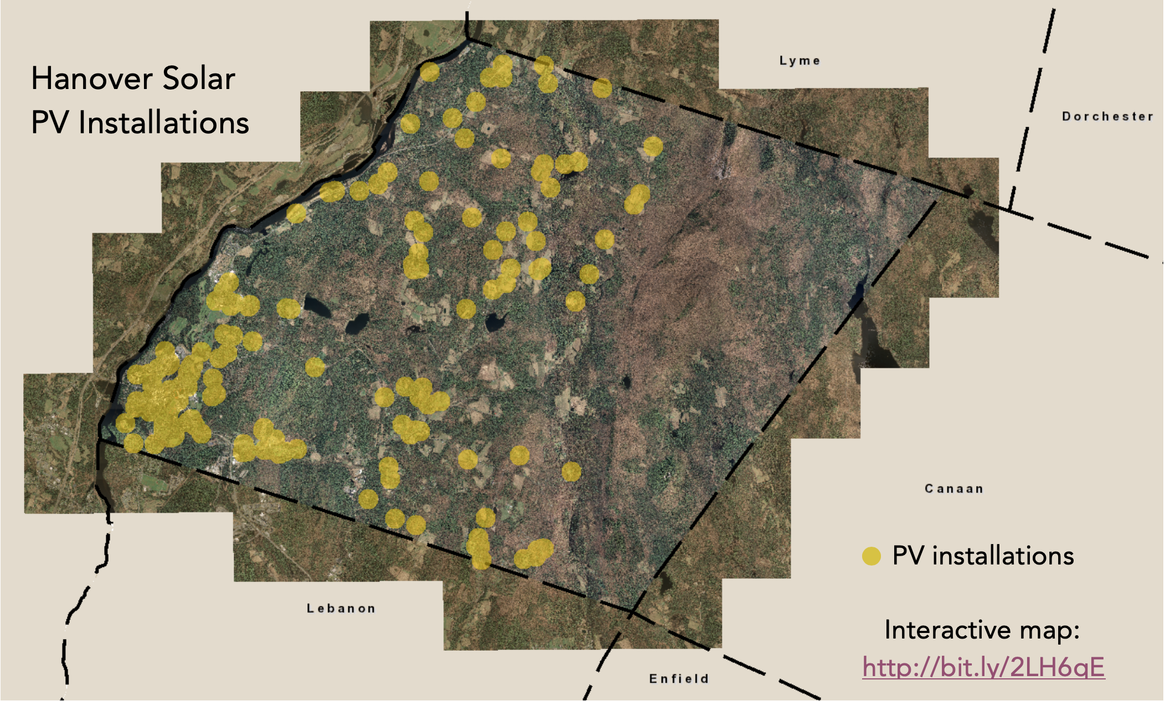
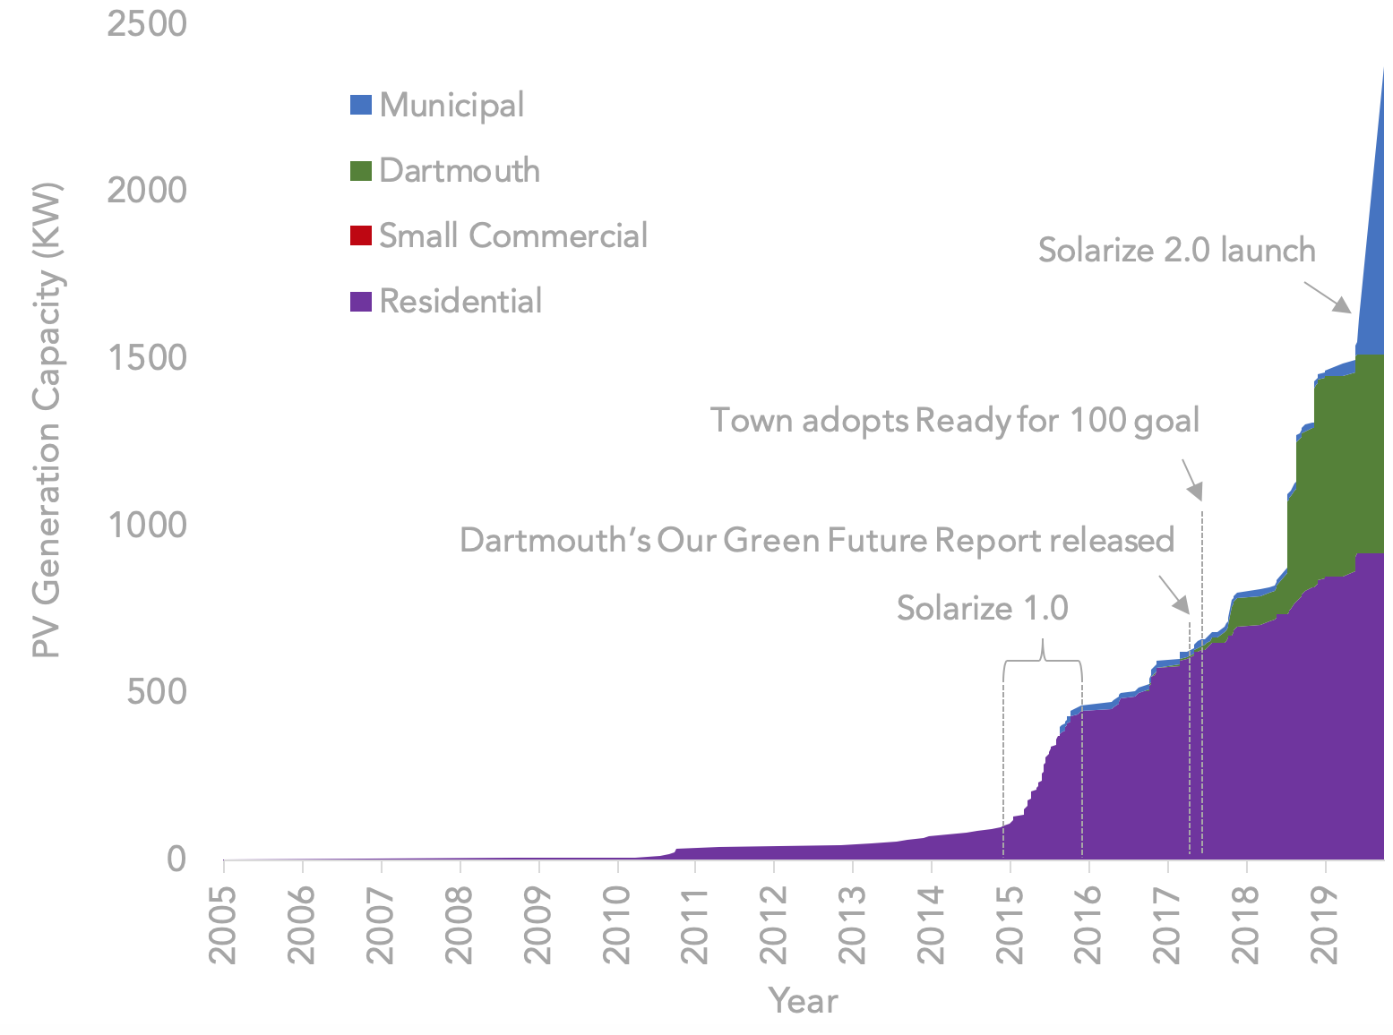

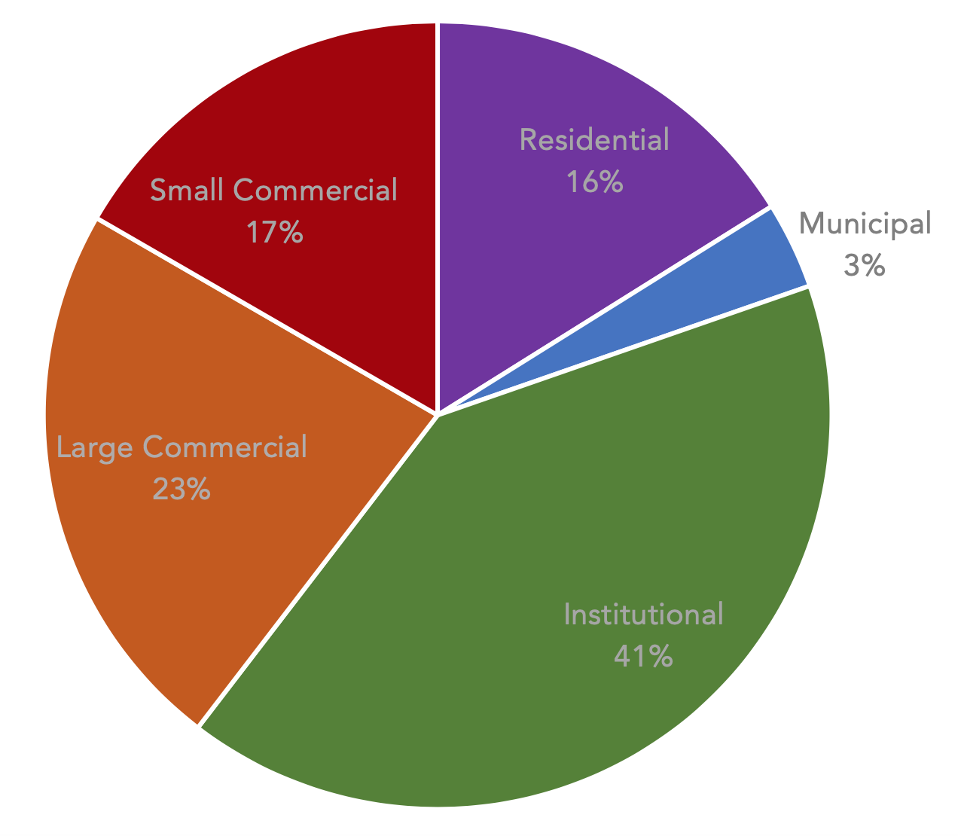

Solar Implementation Roadmap: Hanover, New Hampshire
Laura Hutchinson, UNH Sustainability Fellow, Summer 2019
Mentors: April Salas and Julia Griffin, Town of Hanover
Motivation
In 2017, Hanover became the first community in New Hampshire to commit to 100% renewable energy. The community is working towards a 2030 target for renewable electricity, and a 2050 target for all energy usage, including transportation and heating fuels\in endorsement of the Sierra Club’s RE100 campaign. The town is now crafting an equitable, cost-effective, and impactful strategy towards meeting these goals.
Onsite Solar Generation
Hanover already has over 1.6 MW of total installed solar PV capacity, with over 2.3 MW planned by the end of 2019. 132 solarized homes total 918 KW, or 38% of community-wide installed PV capacity. The town contributes 862 KW (36%), and Dartmouth contributes 598 KW (25%). These PV installations together generate over 3.1 GWh every year. Barring a significant increase in community electricity usage from a 2017 baseline, at least 2.4% of our annual community grid electricity usage will be sourced by behind-the-meter onsite solar by the end of 2019.
Figure 2. Hanover total installed PV capacity over time (KW)
Objectives
Analyze Hanover’s current community electricity usage and renewable energy generation capacity by consumer class, and outline a methodology for tracking changes in these metrics over time;
Draft a portfolio strategy for renewables integration by consumer class, informed by these data; and
Help develop a communications strategy to inform and involve the community in the town’s progress towards its goals.
Active Town Initiatives
Next Steps
Weatherize - residential-focused energy efficiency initiative
Green Power Purchasing – residential and small business-focused REC purchasing program (either town or third party-facilitated)
Municipal Aggregation – will enable the town to procure electricity on behalf of the community, effective in October
Community Solar – identify sites for potential community solar arrays in advance of enabling net metering and on-bill crediting legislation
This program connects residents with four local solar installers for a free site visit, with the aim to double current residential installations in three years.
PPA
The town is engaging in conversations with other large electricity users in Hanover about the possibility of aggregating our collective load in a power purchase agreement (PPA or VPPA), ideally within ISO-NE. Potential projects include offshore wind and local solar.
Electricity Baseline
In 2017, the Town of Hanover consumed 124 GWh of electricity from the grid. Each year since 2013, the community’s annual electricity consumption decreased by approximately 2 GWh, or 2%. Municipal electricity usage, which encompasses town facilities and the school district, only accounts for 3.5% of the community load. At almost 20 GWh, residential electricity usage makes up 16%. Dartmouth College makes up institutional load, which is 41% of the community total. Small and Large Commercial entities consume the remaining 40%.
Figure 1. Community Electricity Usage by Consumer Class
Portfolio Strategy Towards 100%
Each consumer class uses electricity in different ways, has a different set of goals and incentives that can incentivize their behavior change, and different available renewable energy procurement mechanisms as a function of scale, legal parameters, and risk tolerance to price volatility:
Actionable Insights
Hanover’s largest independent electricity consumers generate the least renewable energy onsite. Incentivizing large and small commercial onsite solar installations and other procurement opportunities could enable a significant renewables capacity increase;
The recent legalization of municipal aggregation opens up significant opportunity for the town to procure renewable electricity on behalf of the community; and
Residential and small commercial entities currently have the most limited access to renewable energy procurement strategies, and may need the most support and attention in preparation for 2030.
Consumer Class | Onsite Solar | Community Solar | Aggregated PPA | Municipal Aggregation | Efficiency | REC Purchasing
Residential
Municipal
Institutional
Large Commercial
Small Commercial
N/A
N/A
N/A
N/A
LEGEND: Active initiative Currently feasible Not-yet-feasible N/A – Not applicable

