Slide 1

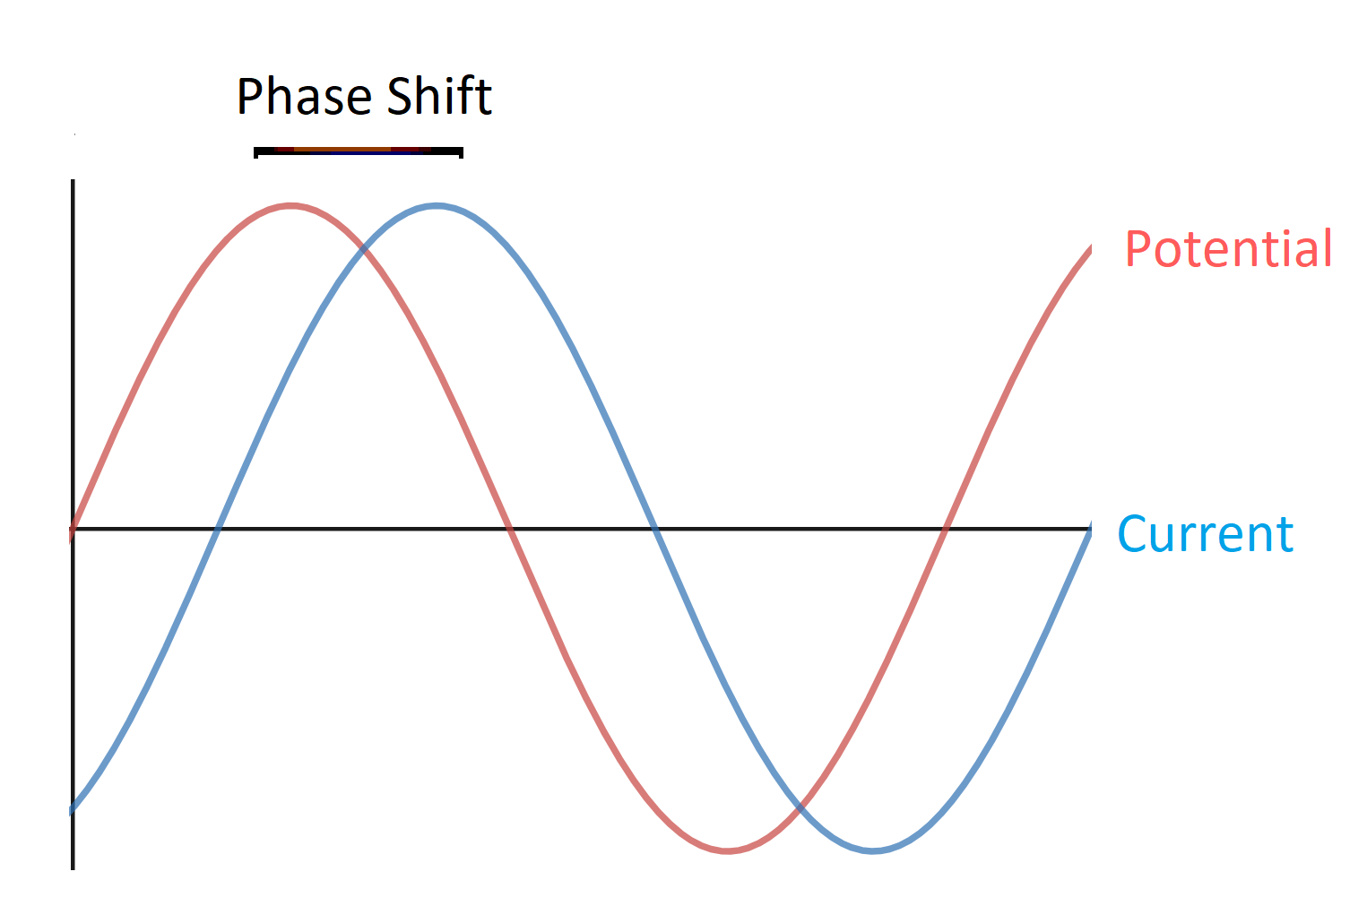
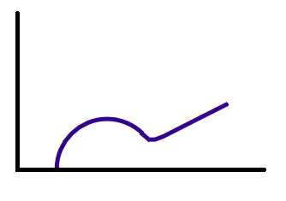
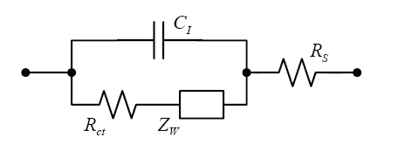
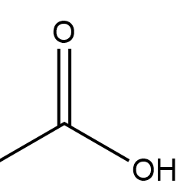


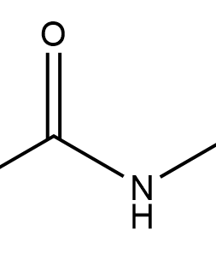
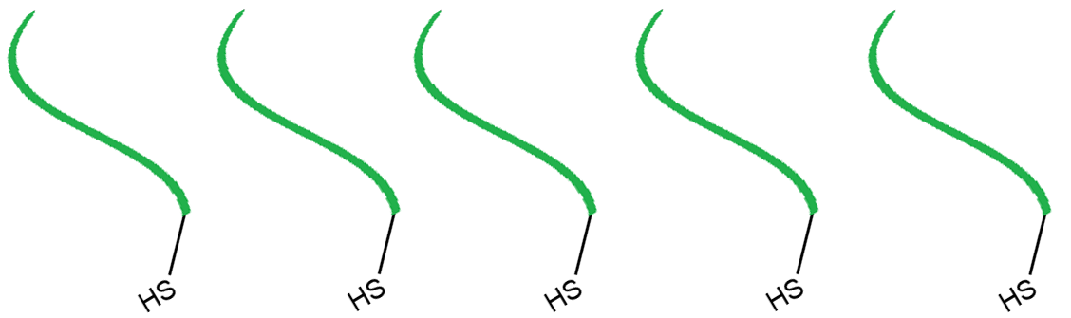
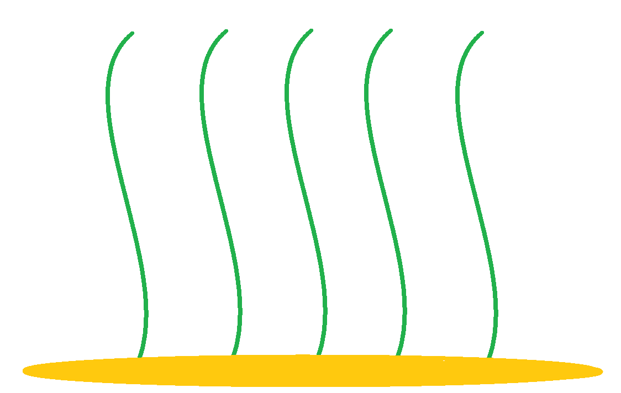


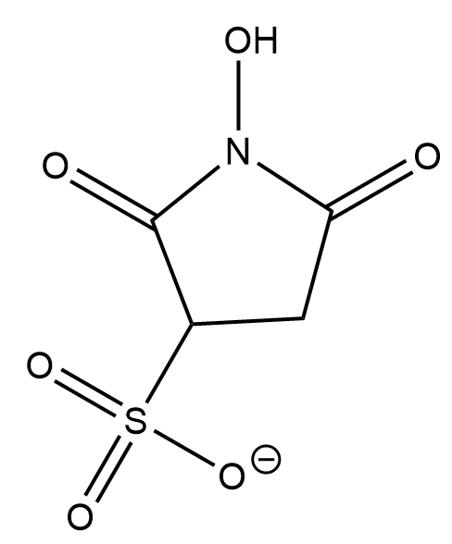
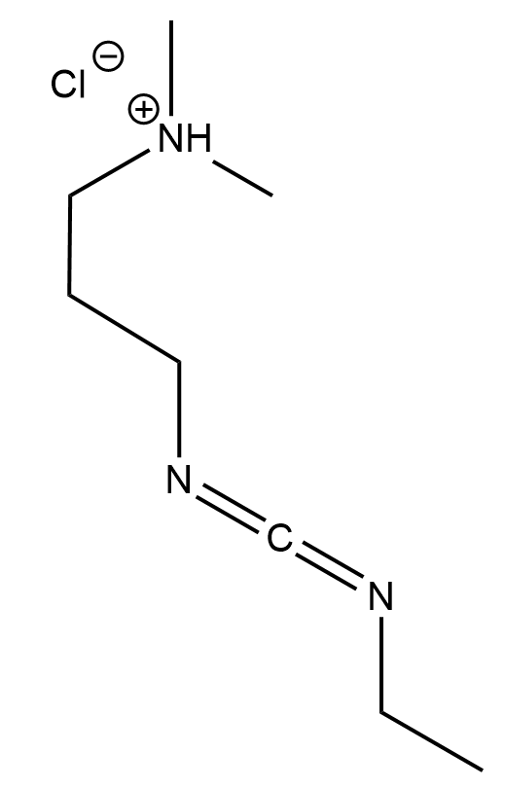
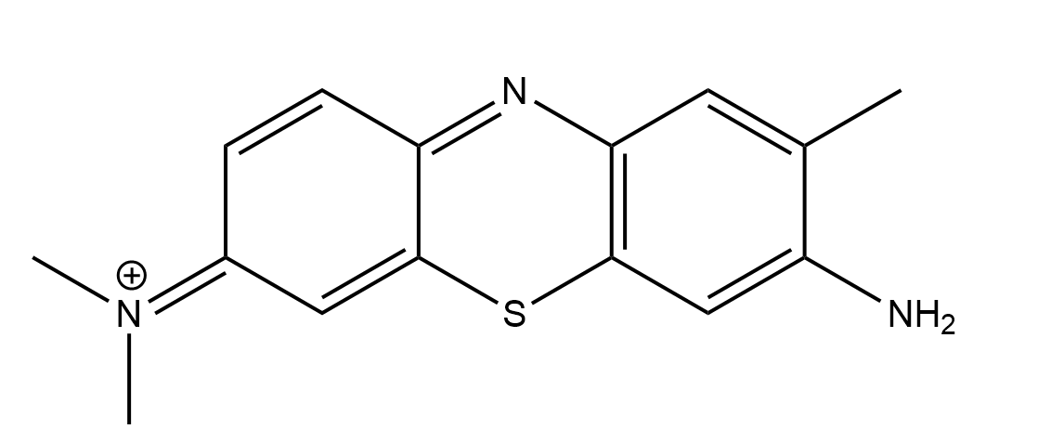
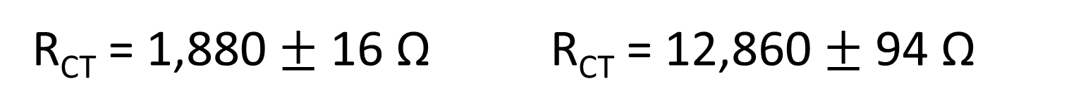

Surface Characterization and Determination of Surface Coverage of
Elastin-Like-Polymer-Modified Gold Electrodes
Charles H. Gasperoni¹, Priyanka M. Nadar², Marissa A. Morales¹, Eva Rose M. Balog³, Jeffrey M. Halpern¹
¹University of New Hampshire Department of Chemical Engineering, ²Drexel University College of Medicine, ³University of New England Department of Chemistry and Physics
Background and goals
Elastin-Like-Polymer (ELP) is a biopolymer that demonstrates stimulus responsive behavior
The ELP we use is I40
NH₃⁺ - AGCAG(VPGIG)₄₀VPASW - COO⁻
Our group has been investigating the stimulus response of I40 using a passive measurement, Electrochemical Impedance Spectroscopy
A faradaic tag on I40 would allow an active electrochemical signal that could be correlated to collapse
I40 surface coverage is unknown and an important parameter that could be studied via Cyclic Voltammetry
Future biosensors using surface-bound ELP will require an active signal and quantified surface coverage
Electrochemical Techniques
Electrochemical Impedance Spectroscopy (EIS) Cyclic Voltammetry (CV)
Excitation
Current vs Time
Cyclic Voltammogram
Z” (Imaginary Impedance)
Charge Transfer
Mass Transfer
Electrochemical Activity
FARADaic tagging
Z’ (Real Impedance)
Modification
Thiol decoupling
2 e⁻
0.0125 mg/mL I40 in 3.5 mM TCEP
4°C 30 min
Thiol – Gold bonds anchor ELP covalently
EDC/NHS Chemistry
Toluidine Blue
3.0 M NaCl
0.5 M KOH
-0.5V to -1.4 V
R_{CT} = 1,223 $±$ 16 Ω R_{CT} = 12,860 $±$ 94 Ω
R_{CT} = 1,880 $±$ 16 Ω R_{CT} = 12,860 $±$ 94 Ω
Higher Impedance associated with successful surface modification
Difference in collapsed Toluidine Blue versus extended
CV indicates that modification of carboxyl terminus was successful
Cyclic Voltammetry is reducing the Au-S bond
EIS data confirms thiol decoupling
ACKNOWLEDGEMENTs
The authors would like to acknowledge the Pilot Research Project of the Collaborative Research Excellence Initiative at University of New Hampshire, NSF EAGER CBET 1638896, and the Hamel Center of Undergraduate Research at University of New Hampshire for funding this work. The authors also would like to acknowledge the assistance of Dr. Balog’s laboratory and Dr. Halpern’s laboratory.

