Slide 1




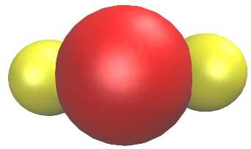
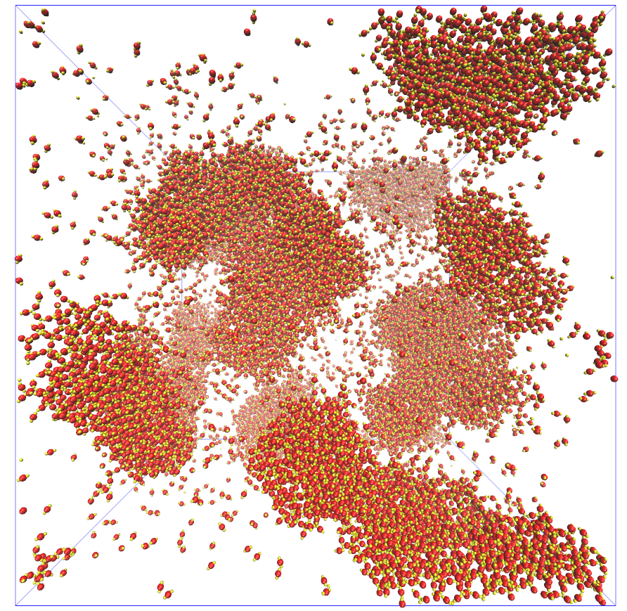
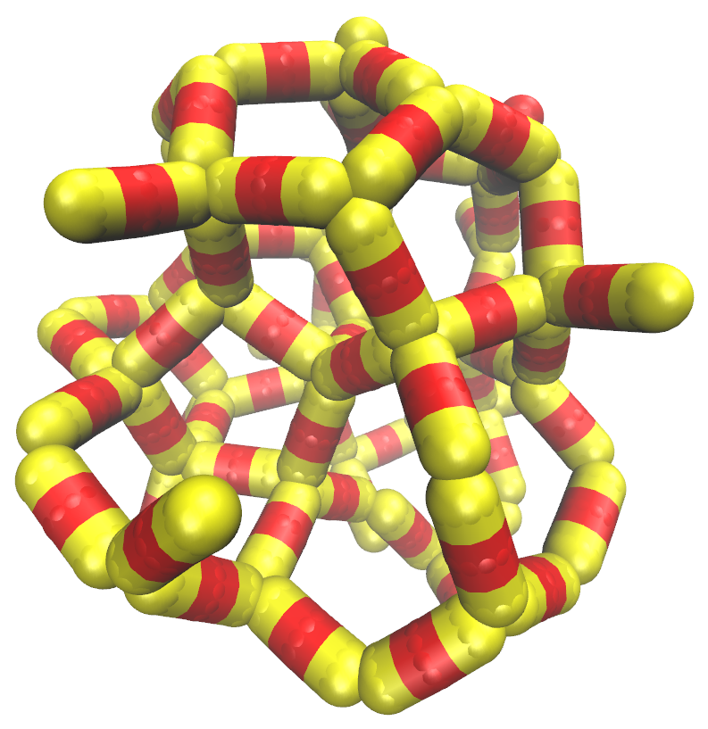
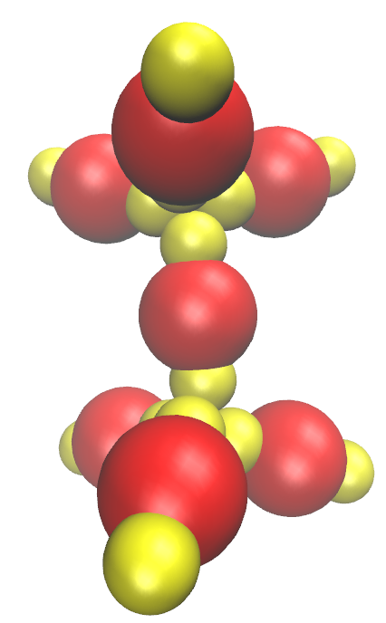
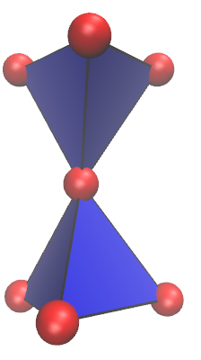
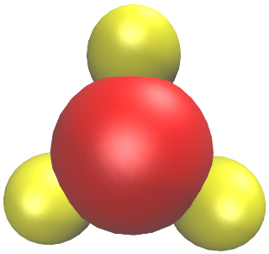
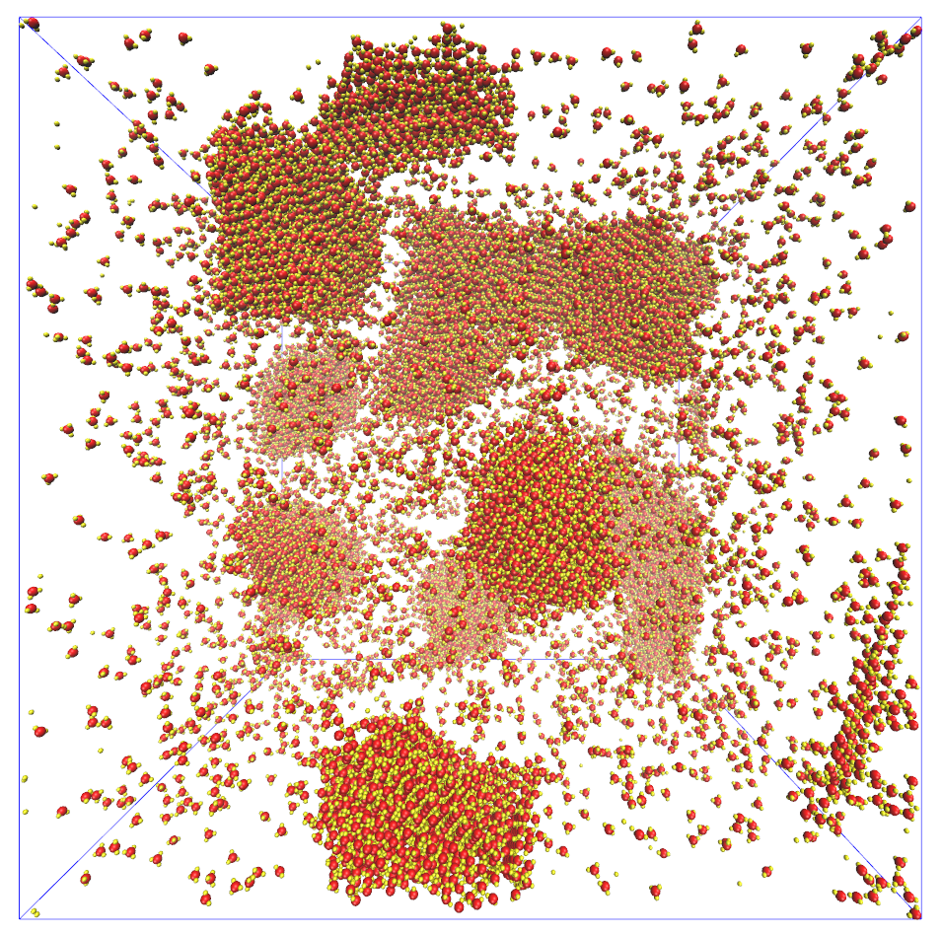
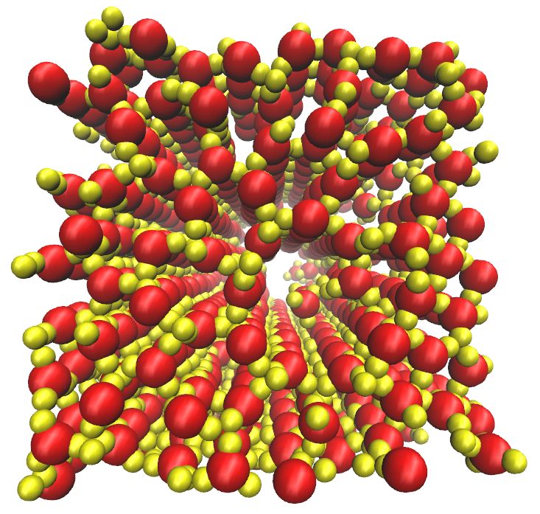
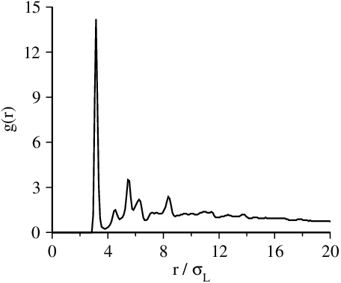
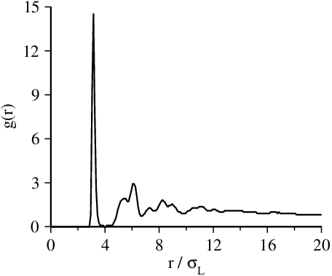
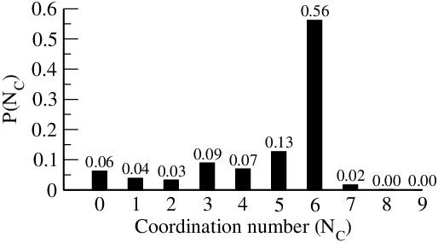
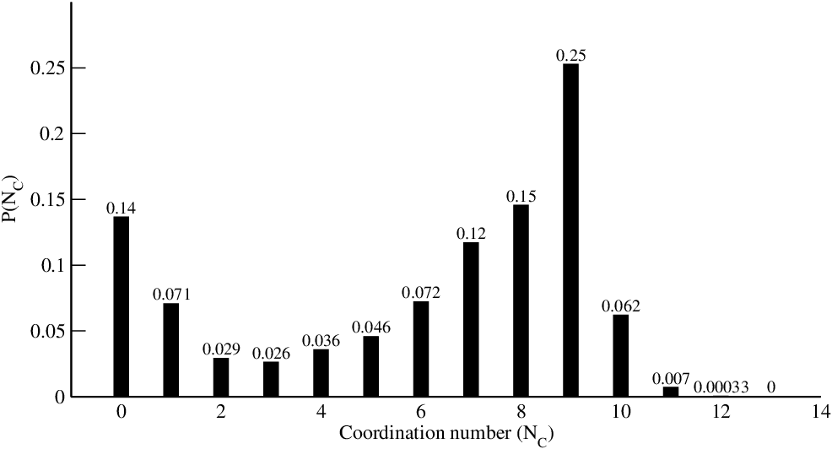
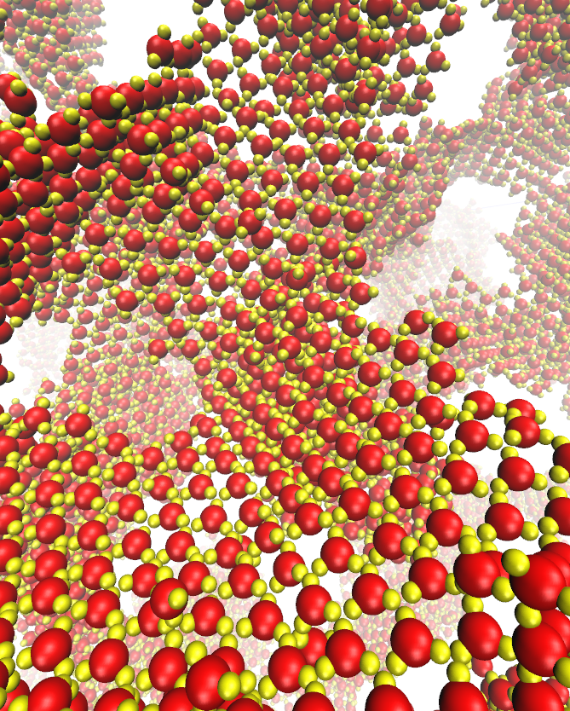
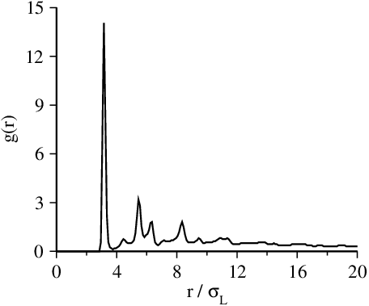
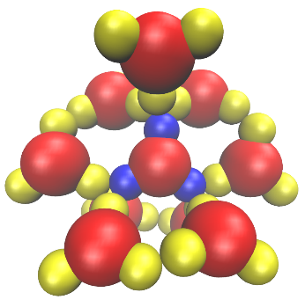
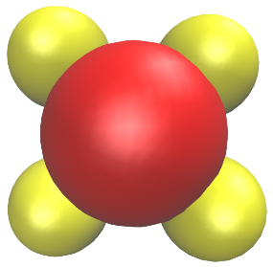
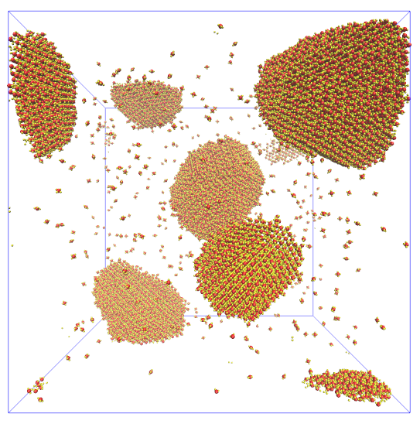
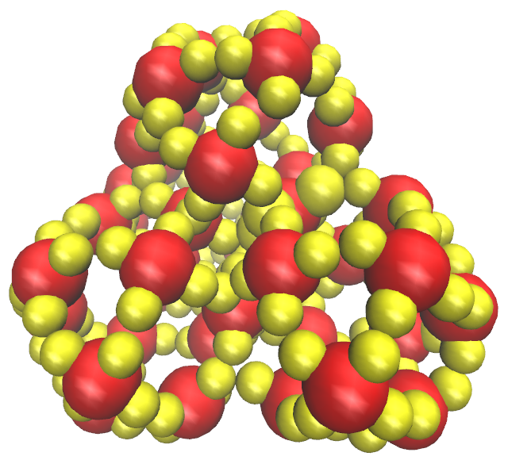
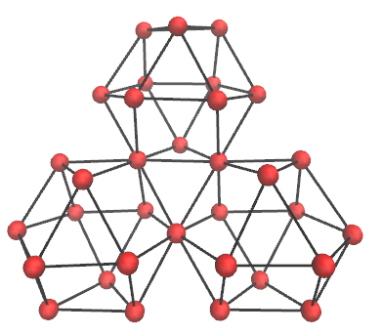
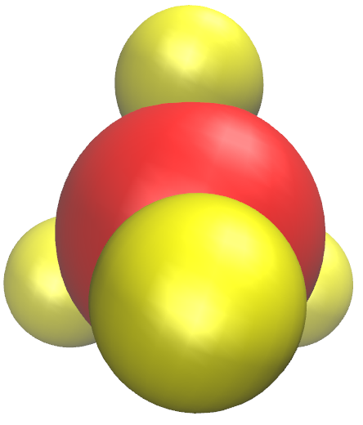
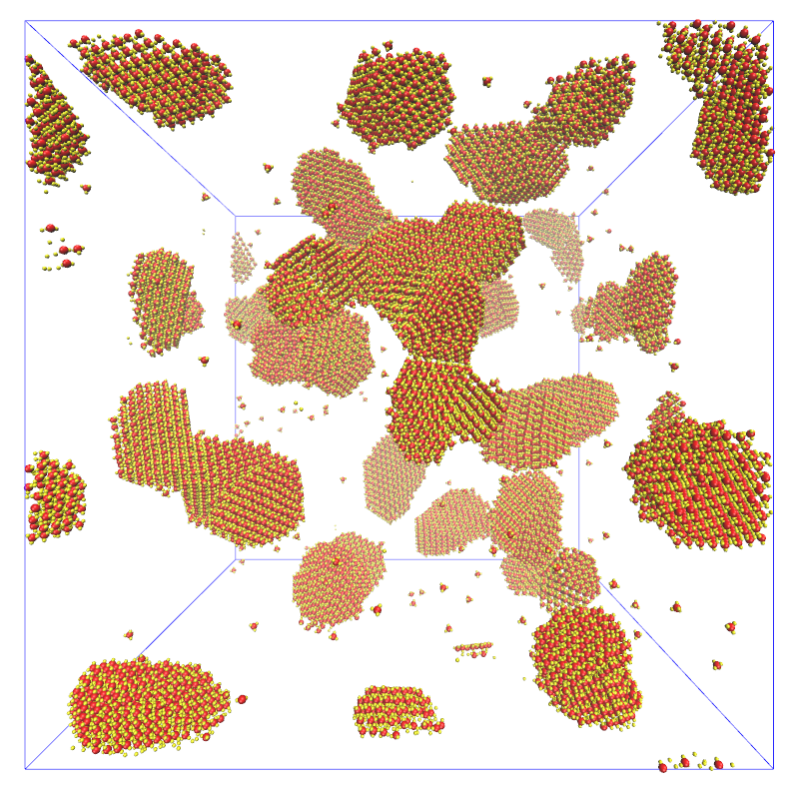
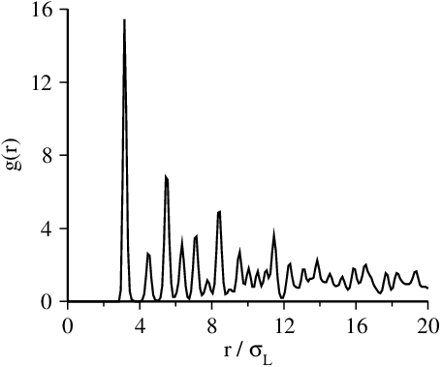
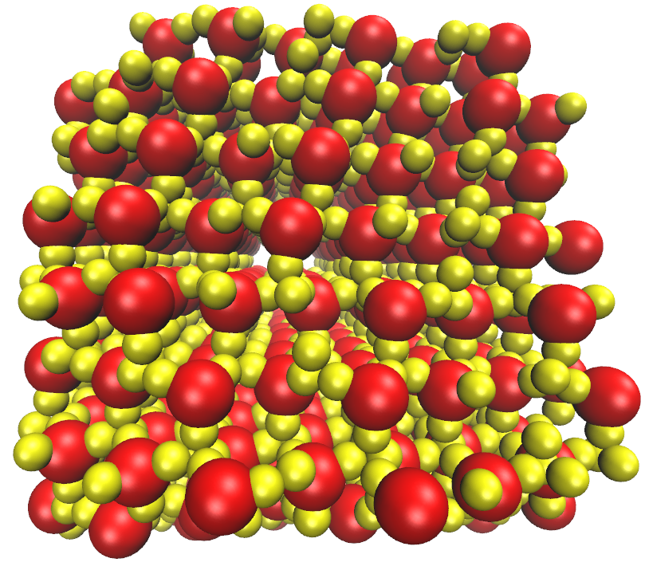
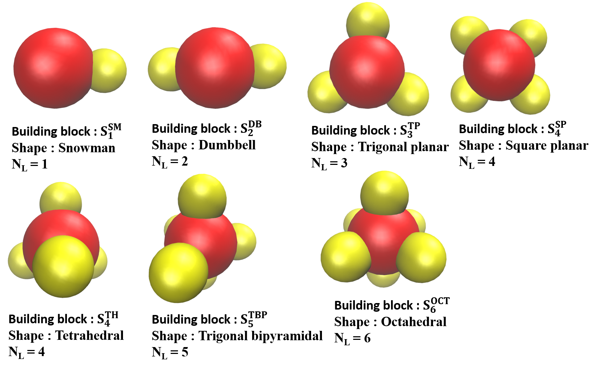
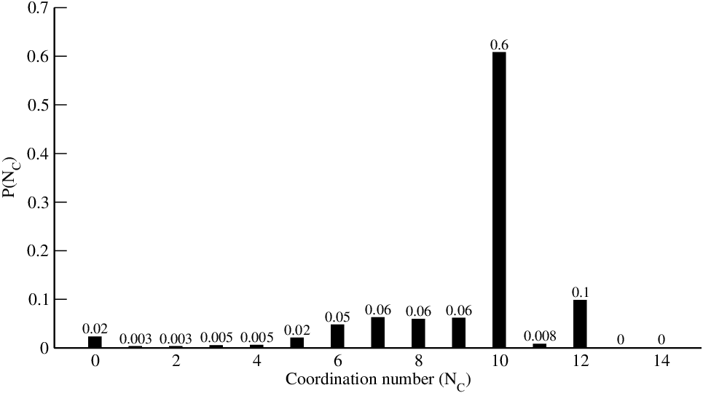
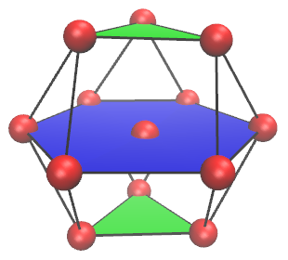
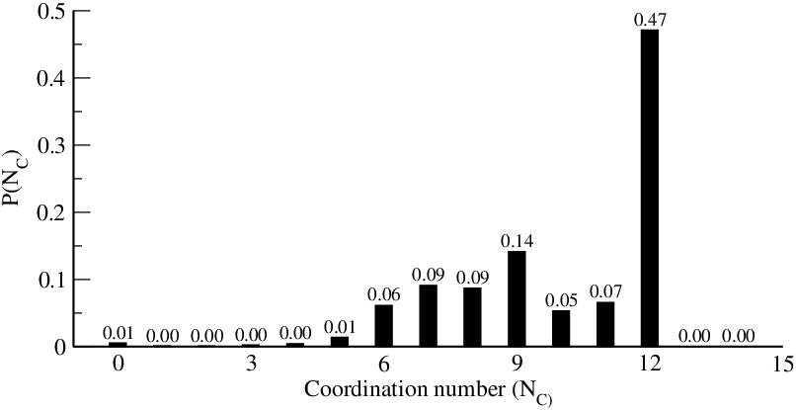
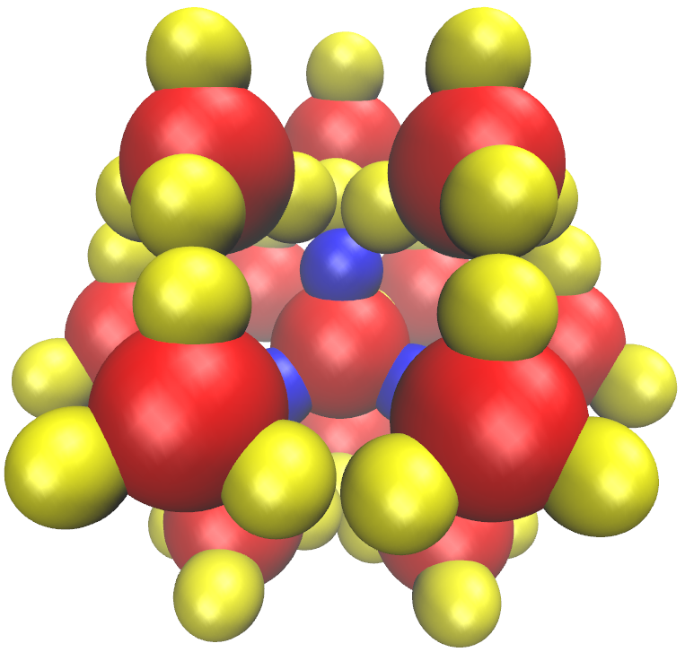
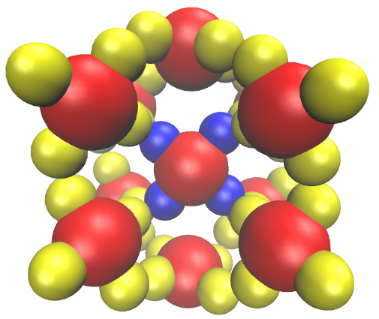
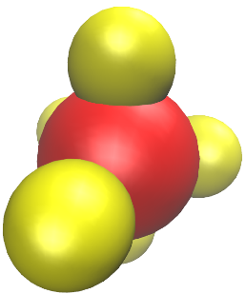
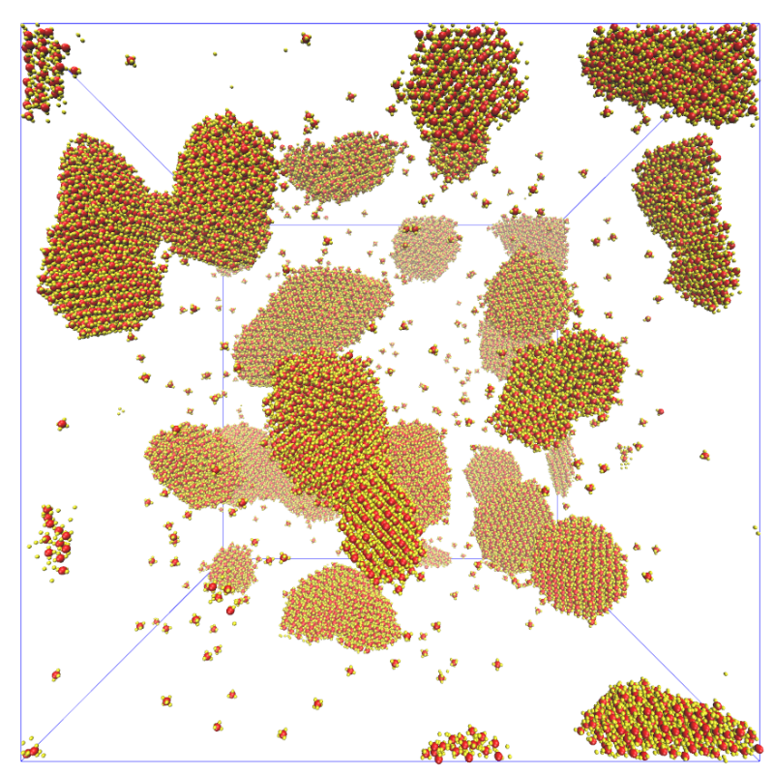
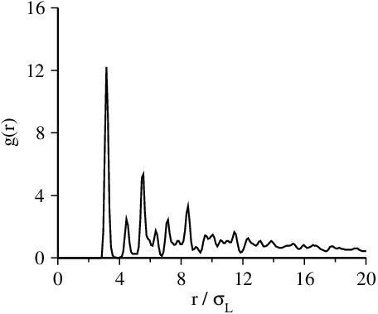
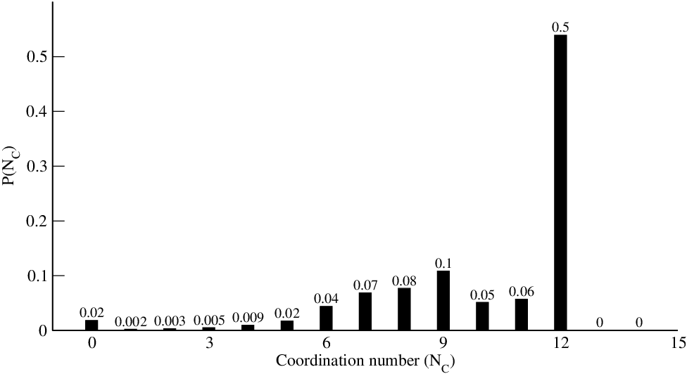
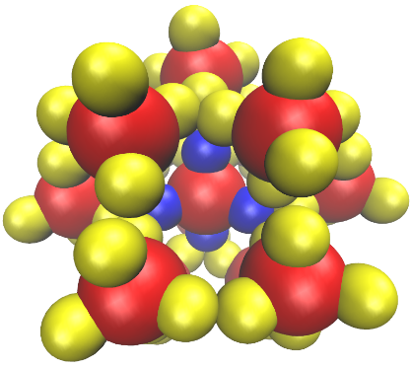
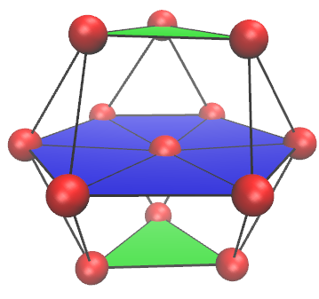
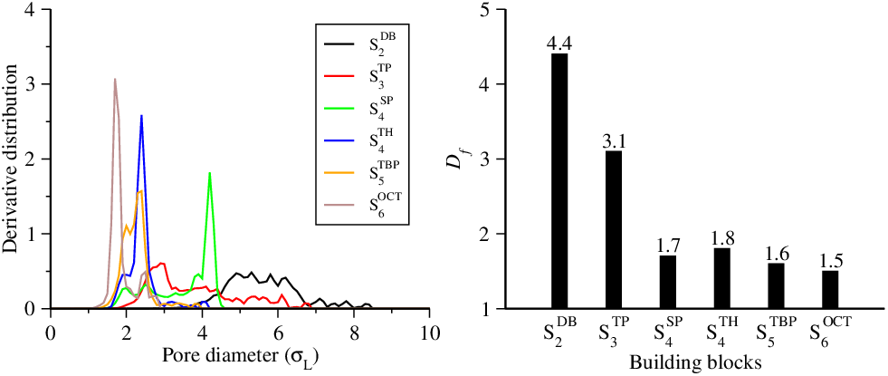
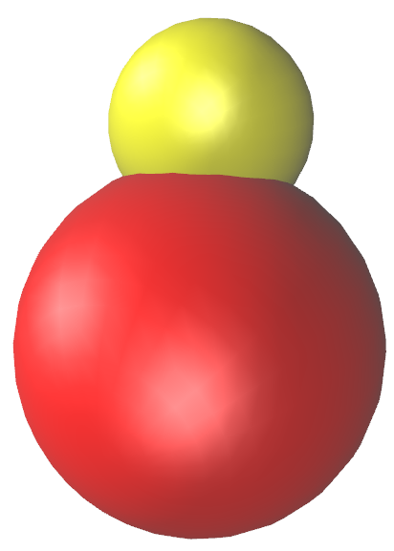
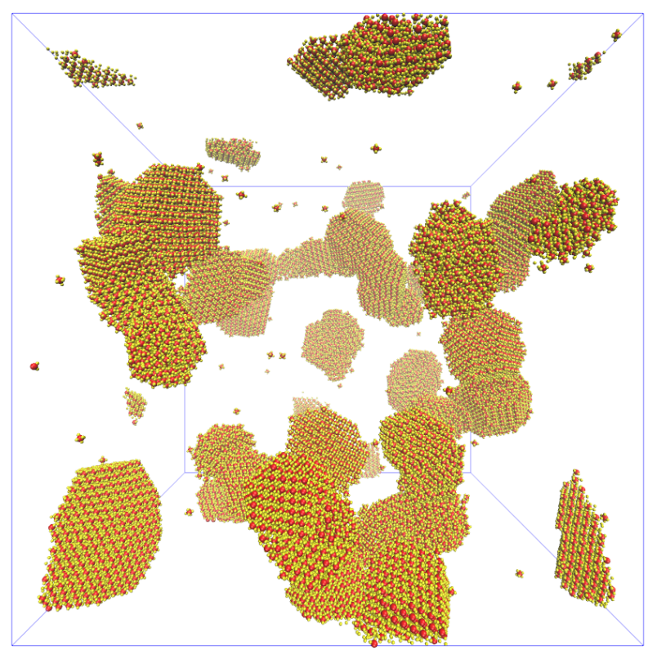
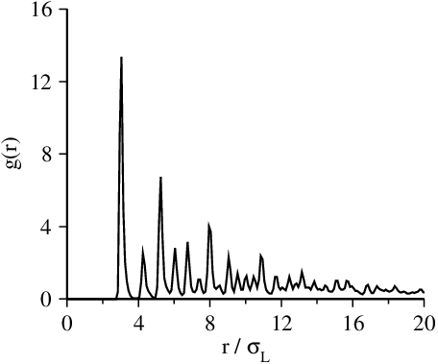
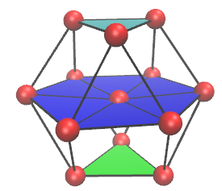
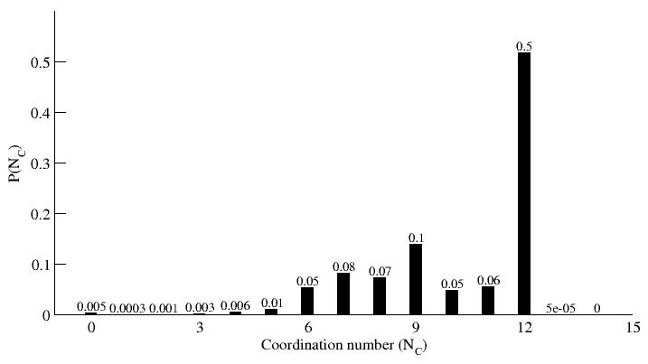
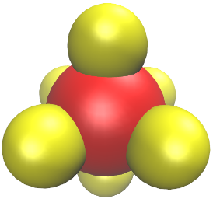
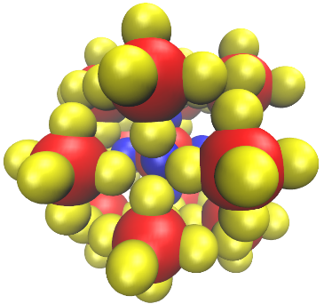

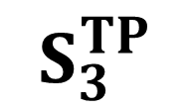

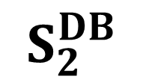
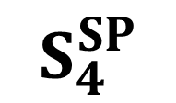
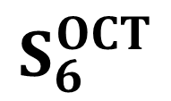
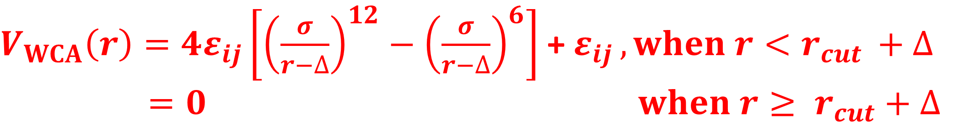




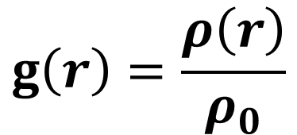

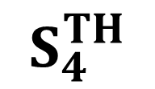



Self-assembly of Lobed Particles into Porous Morphologies
Sanjib Paul and Harish Vashisth
Department of Chemical Engineering, University of New Hampshire, Durham, NH 03824, USA
Introduction
Measure
Colloidal patchy particles have gained importance due to their ability to self-assemble into higher order structures dictated by their shapes and directional interactions [1]. Depending on the structures and chemical functionalities these self-assembled structures have various applications [2]. Although there has been a lot of progress in controlled synthesis of spherical and non-spherical patchy particles [3], systematic study on their self-assembly, mainly for non-spherical lobed particles is yet to be done. In this work, we study self-assembly of seven different shaped lobed particles and show that different higher order structures can be obtained by tuning the interactions between lobes [4].
Simulation box at t = 10⁸ step
Simulation box at t = 10⁸ step
Cylindrical tubes
Radial distribution function
$$S_{2}^{DB}$$
$$S_{3}^{TP}$$
$$\tilde{ε_{LL}}=7.5$$
$$\tilde{ε_{LL}}=6.0$$
Trigonal prismatic geometry
$$\tilde{ε_{LL}}=7.5$$
Radial distribution function
Distribution of number of particles in the first coordination shell
Distribution of number of particles in the first coordination shell
First coordination shell
$$g\left(r\right)=\frac{ρ\left(r\right)}{ρ_{0}}$$
Hypothesis
Spherical patchy particles can self-assemble into different higher order structures (chains, sheets, tetrahedra and icosahedra) based on the number and location of the patches [1]. Similarly, lobed particles can form different higher order structures. Moreover, directional interactions between non-spherical lobed particles will create more void space around each particle which will eventually lead to porous self-assembled structures
Sheets like structure
Simulation box at t = 10⁸ step
Spherical Clathrates
Close packed Cuboctahedron
Simulation box at t = 10⁸ step
Radial distribution function
Model
$$S_{4}^{SP}$$
$$S_{4}^{TH}$$
$$\tilde{ε_{LL}}=5.0$$
$$\tilde{ε_{LL}}=5.0$$
Systems of interest : Building blocks
Radial distribution function
Distribution of number of particles in the first coordination shell
First coordination shell
Distribution of number of particles in the first coordination shell
First coordination shell
Hexagonal close packed lattice
Simulation box at t = 10⁸ step
Radial distribution function
Distribution of number of particles in the first coordination shell
Characterization of pore diameters
Attractive
Non-bonded interactions
Pore size distributions
Diameters of the largest free spheres
$$V_{LJ}\left(r\right)=4ε_{LL}\left[{\left(\frac{σ_{L}}{r}\right)}^{12}−{\left(\frac{σ_{L}}{r}\right)}^{6}\right]$$
$$S_{5}^{TBP}$$
Repulsive
$$\tilde{ε_{LL}}=4.3$$
$V_{WCA}\left(r\right)=4ε_{ij}\left[{\left(\frac{σ}{r−∆}\right)}^{12}−{\left(\frac{σ}{r−∆}\right)}^{6}\right]$+ $ε_{ij }, when r<r_{cut }+∆$
$=0 when r≥ r_{cut}+∆$
$\tilde{ε_{LL}}$=$\frac{ε_{LL}}{k_{B}T}$ | 3.0 | 3.8 | 4.3 | 5.0 | 6.0 | 7.5
References
Acknowledgements
$$S_{6}^{OCT}$$
Face centered cubic lattice
Zhang, Z.; Glotzer, S. C. Nano Lett. 2004, 4, 1407-1413.
Xia, Y.; Gates, B.; Li, Z.-Y. Adv. Mater. 2001, 13, 409-413.
Wang, Y.; Wang, Y.; Breed, D. R.; Manoharan, V. N.; Feng, L.; Hollingsworth, A. D.; Weck, M.; Pine, D. J. Nature 2012, 491, 51.
Paul, S.; Vashisth, H.,2019 (Under Review).
This research is supported by a National Science Foundation EPSCoR award (#1757371).
Coarse-grained Langevin dynamics simulation
HOOMD-Blue Software
$$\tilde{ε_{LL}}=3.8$$
Anderson, J. A.; Lorenz, C. D.; Travesset, A. J. Comp. Phys. 2008, 227, 5342 - 5359.

