Slide 1


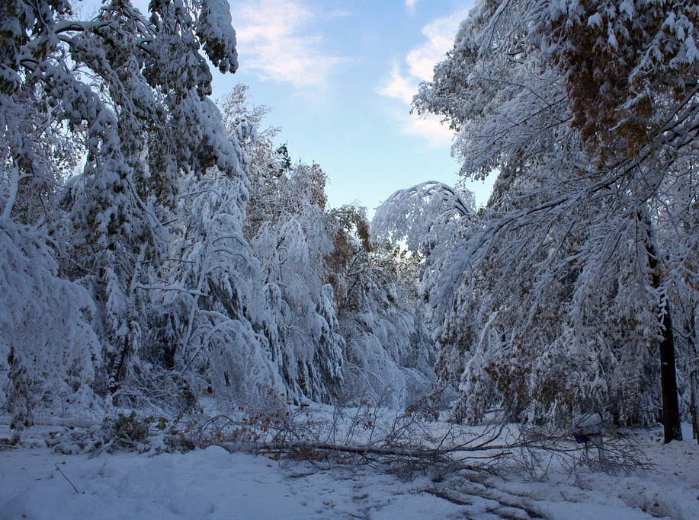
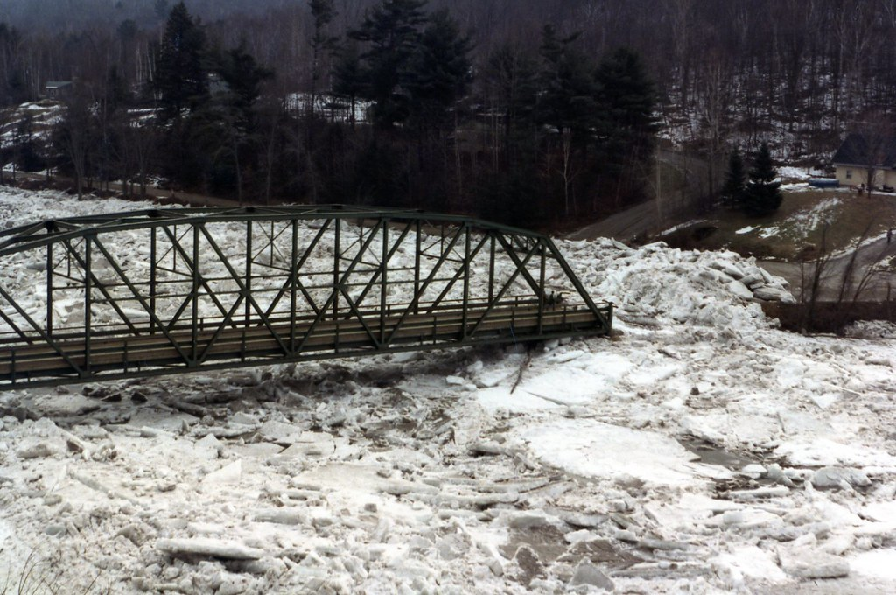
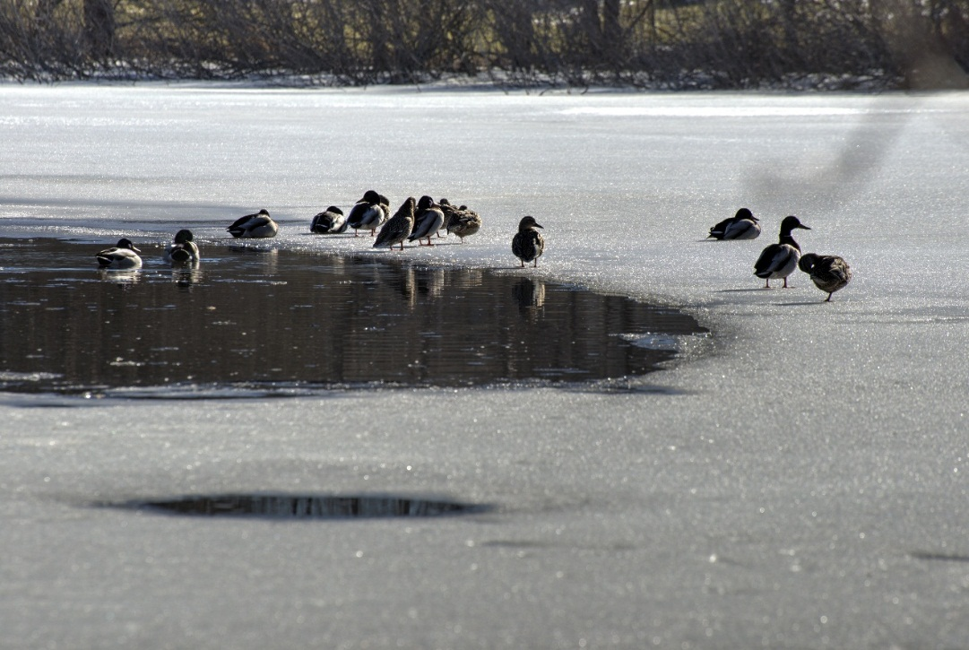
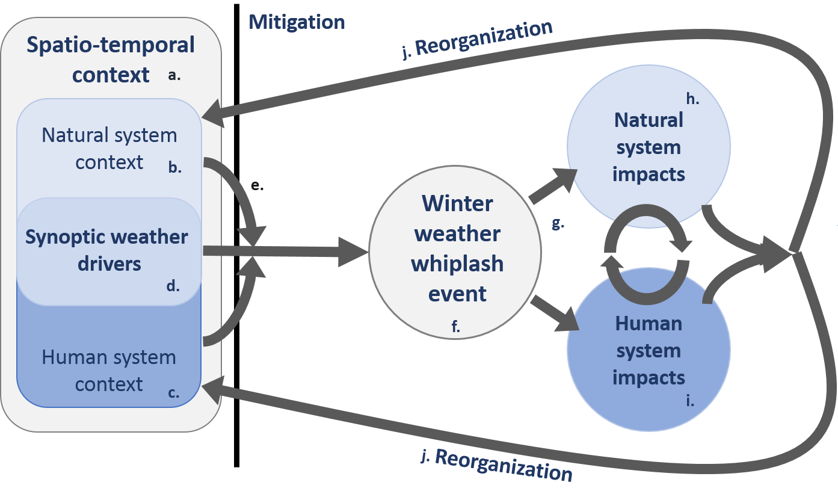
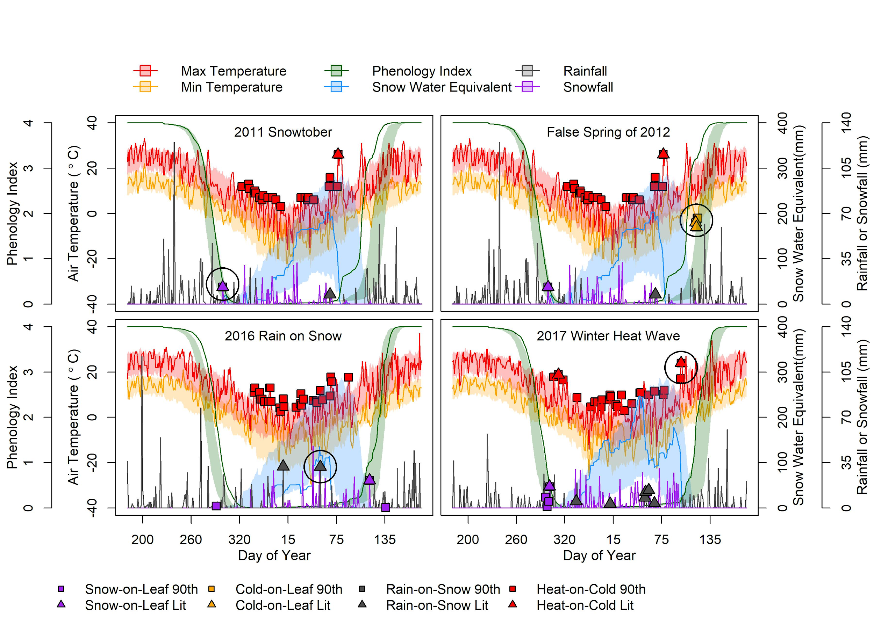
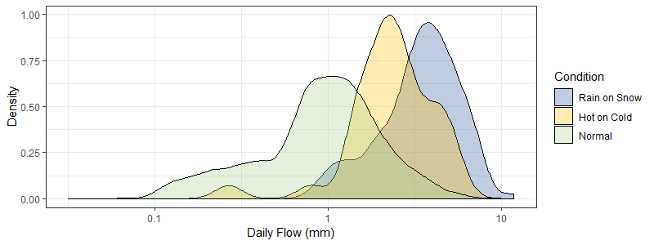
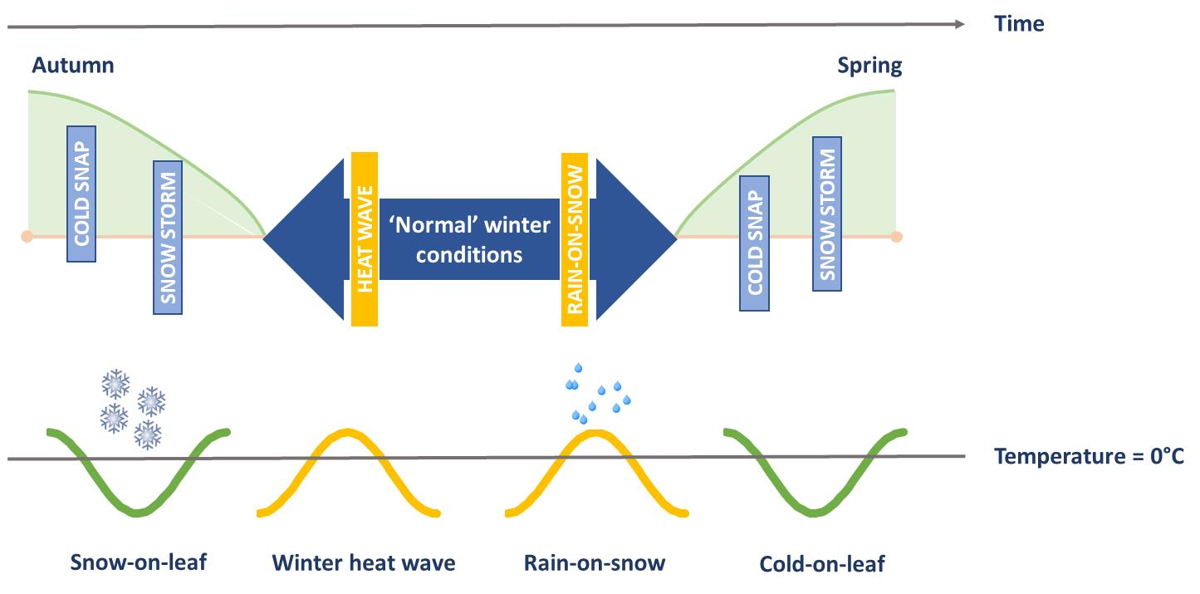
Winter weather whiplash: impacts of compound extreme
winter weather on coupled human and natural systems
Alix Contosta¹, Elizabeth Burakowski¹, John Campbell², Nora Casson³, Mindy Crandall⁴, Irena Creed⁵
Catherine Eimers⁶, Sarah Garlick⁷, David Lutz⁸, Anita Morzillo⁹, Sarah Nelson^{4,10}
This work was supported by the National Science Foundation Research Infrastructure Improvement Grant #1832970 and the National Socio-Environmental Synthesis Center under funding received from the National Science Foundation DBI-1052875.
¹University of New Hampshire ²United States Forest Service ³University of Winnipeg ⁴University of Maine ⁵University of Saskatchewan ⁶Trent University ⁷Hubbard Brook Research Foundation ⁸Dartmouth College ⁹University of Connecticut,¹⁰Appalachian Mountain Club
What is Winter Weather Whiplash?
A collision of unexpected conditions producing a forceful, rapid, back-and-forth change in winter weather that induces an unexpected impact on coupled human-natural systems
Research Goal:
Develop a quantitative framework for understanding the drivers and impacts of winter weather whiplash events in order to minimize their risks
© Dave Ginsberg/Flickr/CC-BY-2.0
© Vermont Agency of Transportation/Flickr/CC-BY-2.0
© Jack Holloway/Flickr/CC-BY-2.0
© Kent Landerholm/Flickr/CC BY-NC 2.0
How frequent are these events?
Figure 3: Notable winter weather whiplash events at the Hubbard Brook Experimental Forest identified by the crossing of percentile- or literature-based thresholds
What are the impacts?
Casson et al. (in press)
Figure 4. Kernel density plot of daily winter hydrological flows (mm) for Watershed 3 at Hubbard Brook from 1963 to 2015 under three conditions: rain-on-snow, winter heat wave, and ‘normal’ winter flows. Rain-on-snow events can cause higher flows than winter heat waves and normal conditions.
Casson et al. (in press)
Figure 1: Conceptual model of winter weather whiplash events
Impacts (f) depend on weather severity (d) and context (a-c)
Natural system impacts (h) include tree loss or flooding. Human system impacts (i) include property damage or power outages
Feedbacks may include tree branches falling on power lines
These events may reorganize the system context (j)
Mitigation strategies may be designed to reduce the future influence of synoptic weather conditions
Hubbard
Brook
Expanding to the northeastern U.S. and eastern Canada
Winter Weather Whiplash events can occur within and outside of winter
Study area and data sources
Data workflow
Is there a “strike zone” for events?
Weather station daily air temperature (min and max) and total precipitation
Simulate snowpack, snowfall, and rainfall
Simulate vegetation greenness by landcover
r² = 0.62
Modeled SWE (mm)
Estimated Greenness (%)
Example of snow model fit
Example of simulated greenness
Casson et al. (in press)
Figure 5: Location of 178 GHCN weather stations and 75 phenocams used in analysis. Landcover from MODIS MCD12Q1 IGBP product.
Flag winter weather whiplash occurrences based on the crossing of percentile and literature thresholds
Figure 7. Total number of occurrences (flagged when crossing a 90th-percentile threshold) for four different types of winter weather whiplash events over a 30-year period from 1989 to 2018.
Figure 2: Typology of winter weather whiplash events
Cold or snowy winter conditions during the shoulder seasons
Warm or rainy weather within winter
Figure 6: Conceptual diagram of preparing GHCN data for flagging winter weather whiplash events.
References: Casson et al. (in press) Earth’s Future

