Slide 1
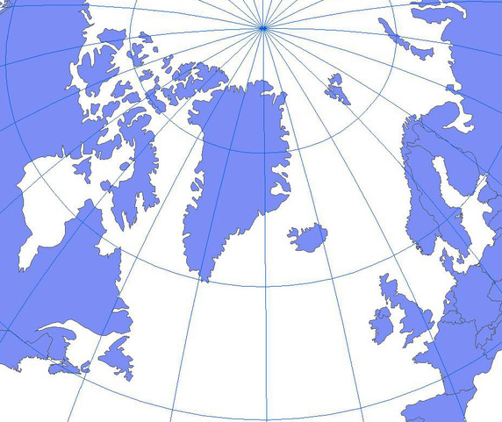
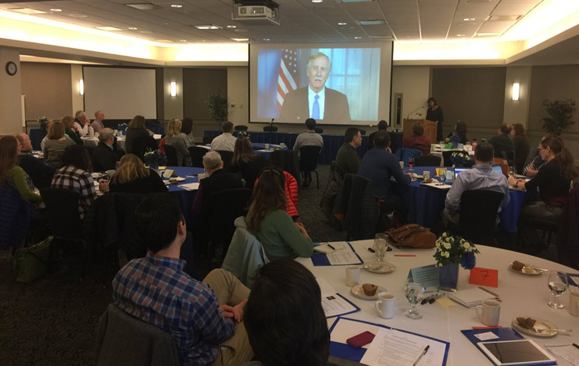
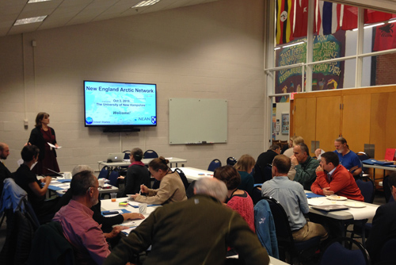
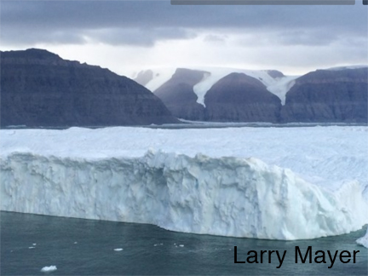
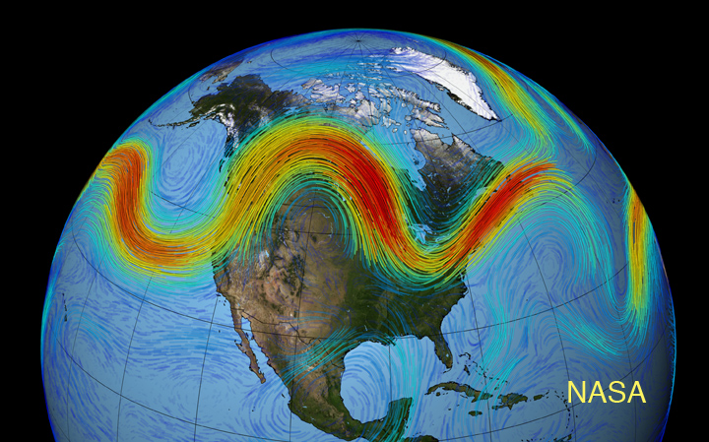
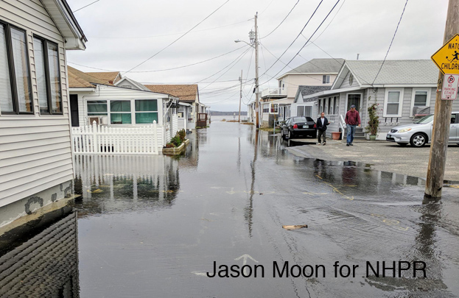
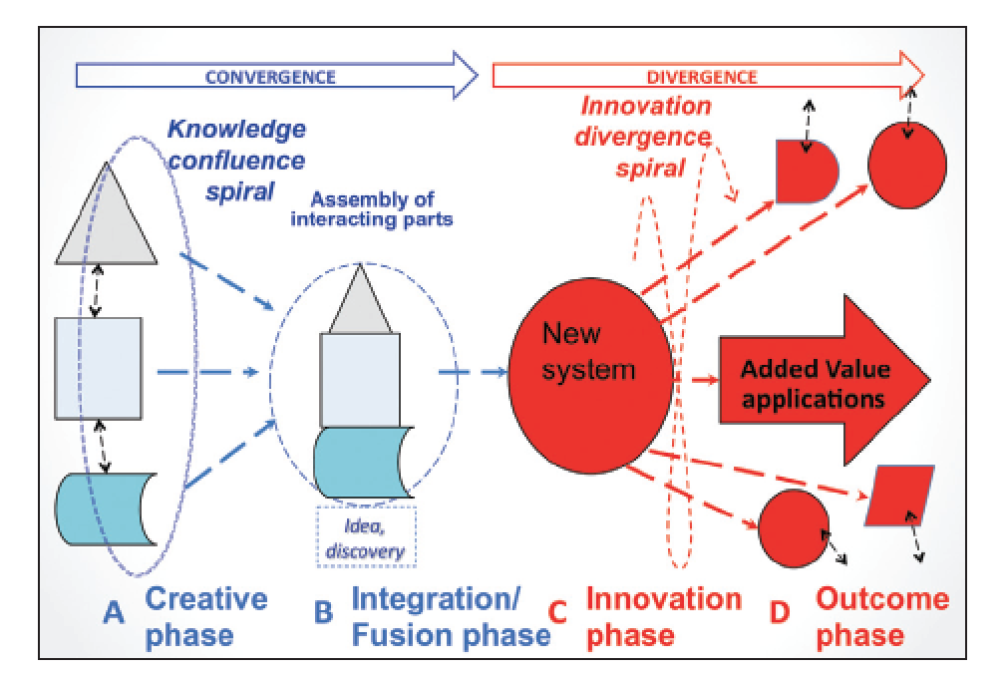
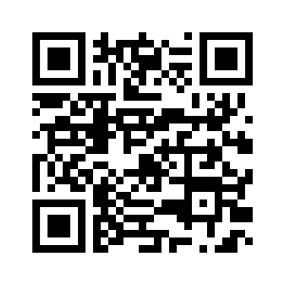




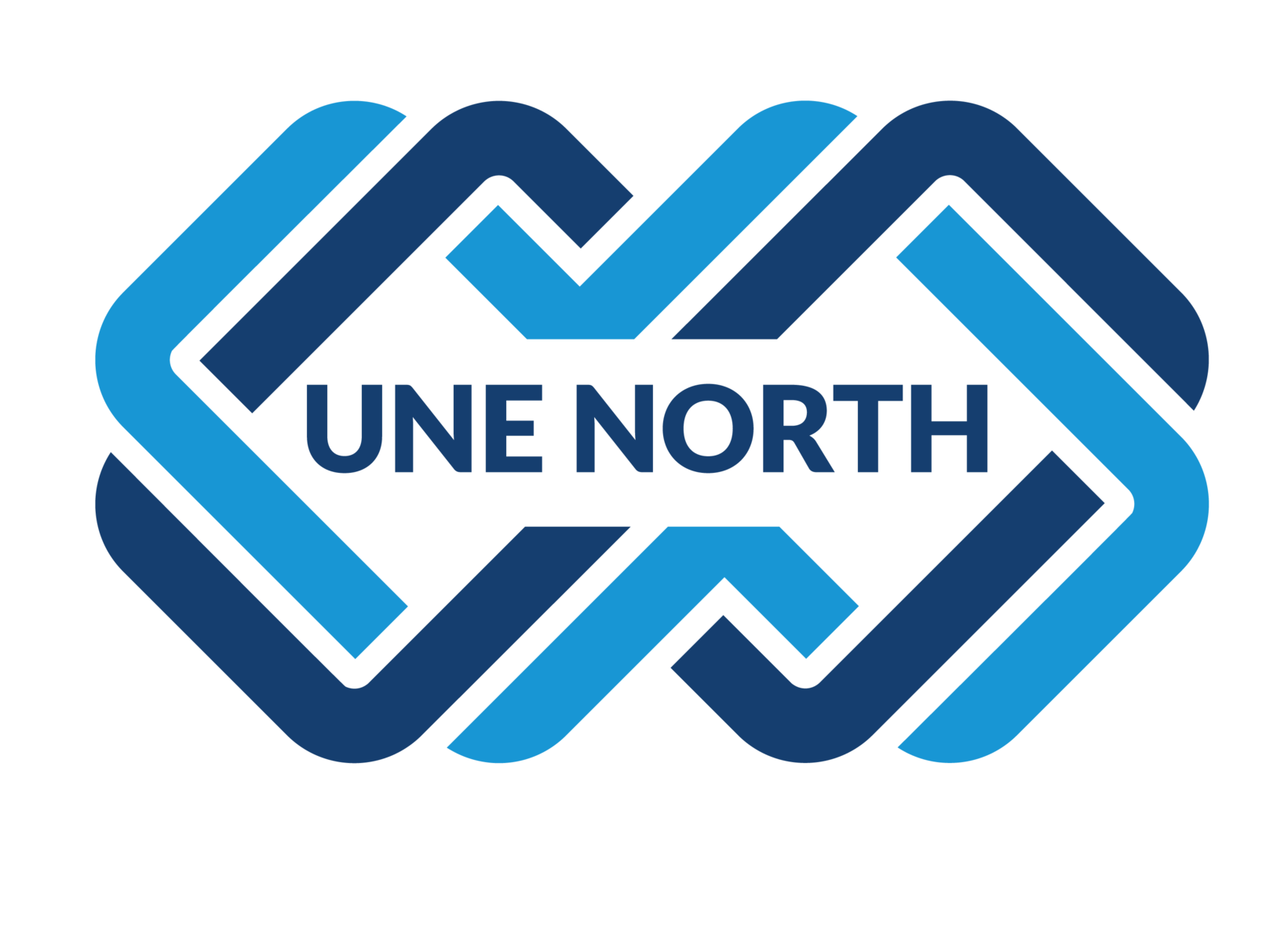
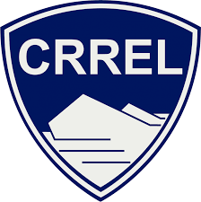

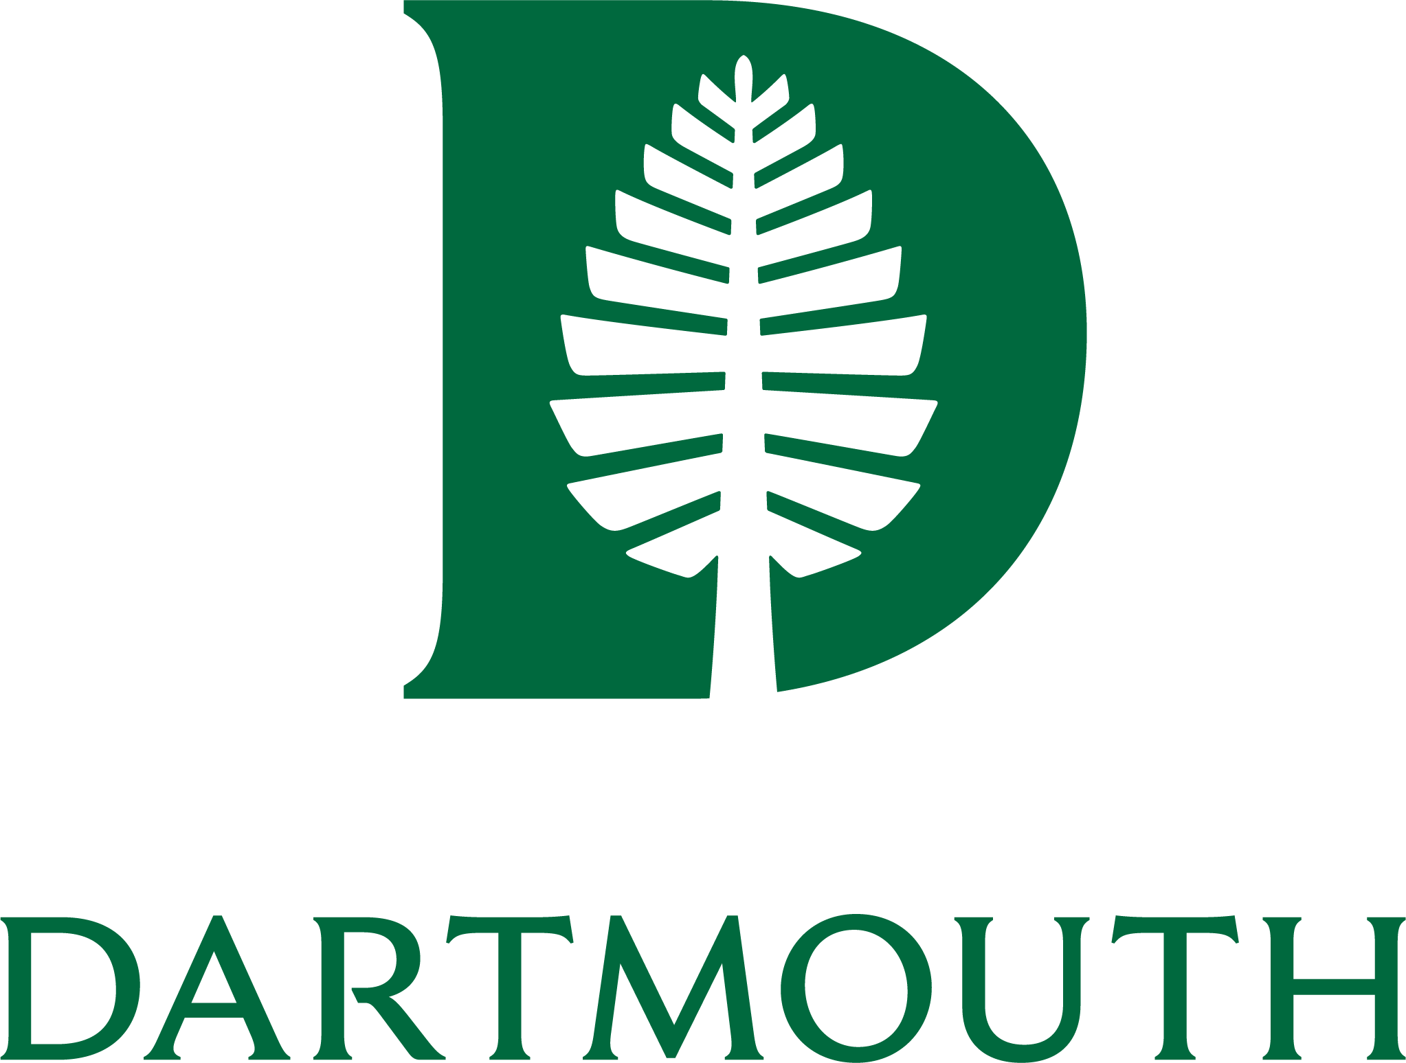
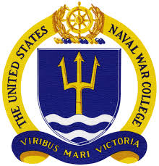
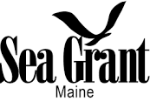
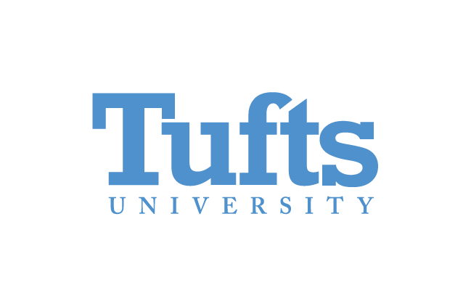
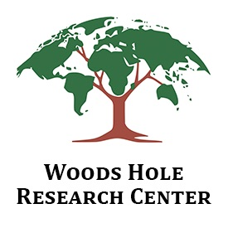


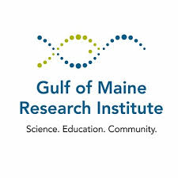

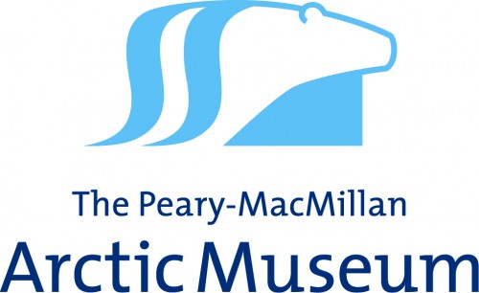

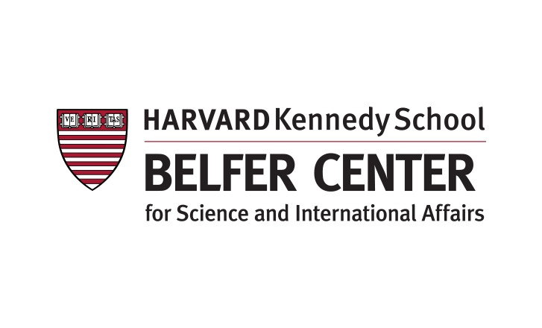
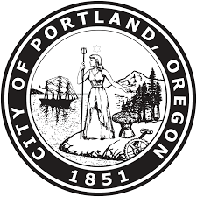

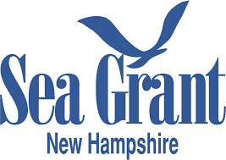
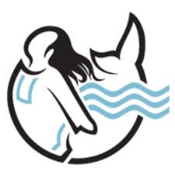
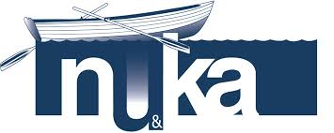


The New England Arctic Network
Katharine A. Duderstadt (UNH), Robin Alden (MCCF), Robyn A. Barbato (CRREL), Paul A. Berkman (Tufts), Jennifer F. Brewer (UNH), Cara J. Condit (USCGA), Jack E. Dibb (UNH),
Jessica Ernakovich (UNH), Christopher Gerbi (UMaine), Lawrence C. Hamilton (UNH), Susan A. Kaplan (Bowdoin), Larry A. Mayer (UNH), Erich C. Osterberg (Dartmouth),
Donald K. Perovich (Dartmouth), Rebecca Pincus (U.S. Naval War College), Terry Shehata (USM), Ruth K. Varner (UNH), Cameron P. Wake (UNH), Simone S. Whitecloud (CRREL).
Vision
Objectives
The Role of New England in Navigating the New Arctic
The New England Arctic Network (NEAN) is a regional, multi-institutional, inclusive collaboration that uniquely addresses links between Arctic change and the natural, social, and built systems within the North Atlantic Arctic.
Identify and coordinate convergent research and education efforts focused on the North Atlantic Arctic
Engage Arctic and other North Atlantic coastal communities
Communicate across the network and beyond
The New England Arctic Network combines the wealth of academic expertise in Arctic research across New England with researchers, stakeholders, and external partners concerned with environmental, economic, and social impacts, providing an ideal community for anticipating and responding to Arctic change and its impacts on the eastern coast of North America.
NEAN Kickoff 2018
Charting the Course for a
New England Arctic Network
October, 2018
Main Themes:
Links between Arctic change and infrastructure from New England to the Arctic.
Observing the physical and biological impacts of Arctic change on the Arctic Ocean, Western North Atlantic, and Gulf of Maine.
Relationships among Arctic warming, permafrost, hydrology, coastal processes, and communities.
Connections between Arctic and mid-latitude communities; Sharing lessons of learned and implications for environmental ethics and social justice.
Training the next generation of leaders in Arctic research, business, and diplomacy.
Preparing for a Northwest Passage:
A Workshop on the Role of New England in Navigating the New Arctic
April, 2018
Research
Motivation
Examples of Convergent Questions…
How can we better anticipate unexpected and abrupt responses of ecosystems to changing climate, northward shifts of species ranges, and human exploitation of natural and biotic resources?
How can traditional knowledge, citizen science, and fully engaging stakeholders in design and execution of research improve understanding of the scale and rate of change across all the inter-linked systems in the Arctic and connected regions?
Does education about risk-assessment for communities facing environmental change and development of contingency plans (including managed retreat) result in better outcomes? Are communities the appropriate focus or will collective/regional efforts be more effective? How can non-market valuation of ecosystem and cultural services be better factored into such risk assessment?
What is the economic impact across the North Atlantic region of projected changes in destination and trans-Arctic shipping, tourism, and resource extraction? Can ecosystem based management with public participation be balanced against this increased economic activity?
There is an urgent need to expand our nation’s focus to study and respond to changes in the North Atlantic Arctic, including links with the Gulf of Maine and New England
What happens in the Arctic….doesn’t stay in the Arctic.
Strategies for Success
The New England Arctic Network promotes convergence research, defined by the National Research Council as an “interdisciplinary and purpose-driven approach to problem-solving that tackles the technical, organizational, and logistical challenges to collaboration from the outset in order to develop deep and sustained integration across disciplines.”†
This deliberate form of interdisciplinary research values collaborations involving Western science, traditional knowledge, and stakeholder engagement to address vexing problems within our changing environment.
Acknowledgements
All are Welcome!
NEAN formed during a workshop supported by the National Science Foundation Growing Convergence Research at NSF and Navigating the New Arctic Big Ideas (NSF #1744346). NEAN activities are currently supported through the UNH Collaborative Research Excellence Initiative.
We are open to ideas for growing and sustaining the network.
Join the New England Arctic Network Community
#neanconvergence
  Website: nearctic.net
  Email: info@neartic.net
  facebook.com/neanconvergence
  @neanconvergence
Image adapted from Roco et al., 2013. Convergence of Knowledge, Technology and Society: Beyond Convergence of Nano-Bio-Info-Cognitive Technologies, Science Policy Reports. Springer.
† NRC, 2014. Convergence: Facilitating Transdisciplinary Integration of Life Sciences, Physical Sciences, Engineering, and Beyond. Washington, DC: The National Academies Press.
Participants in past NEAN events have come from the following institutions in New England…as well as many others throughout the nation and abroad.

