Slide 1

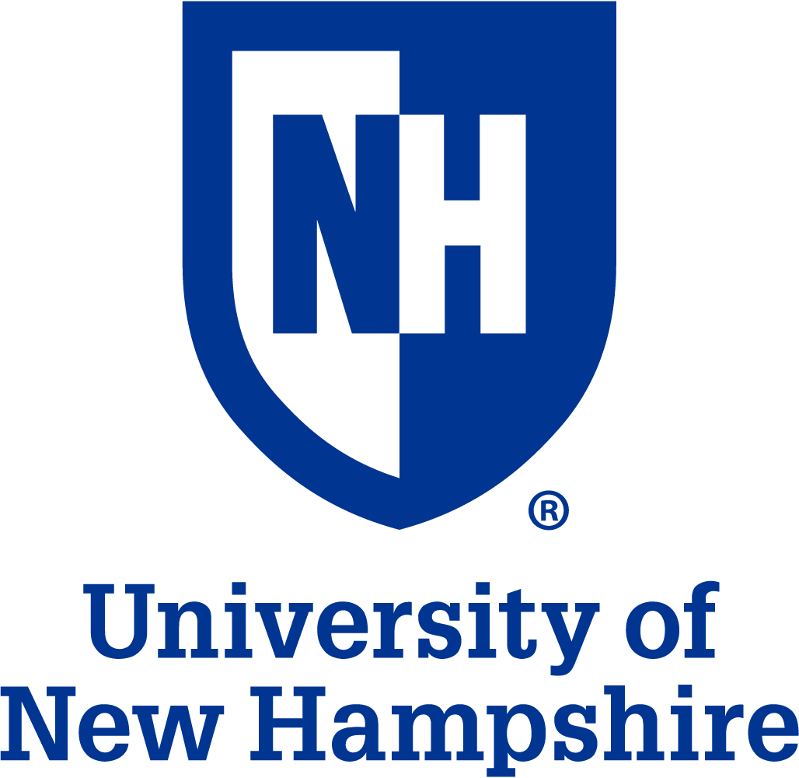
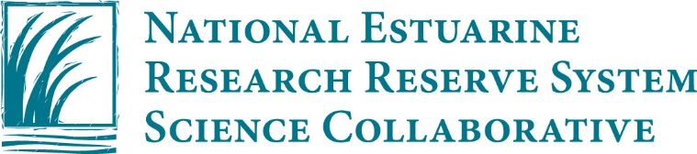

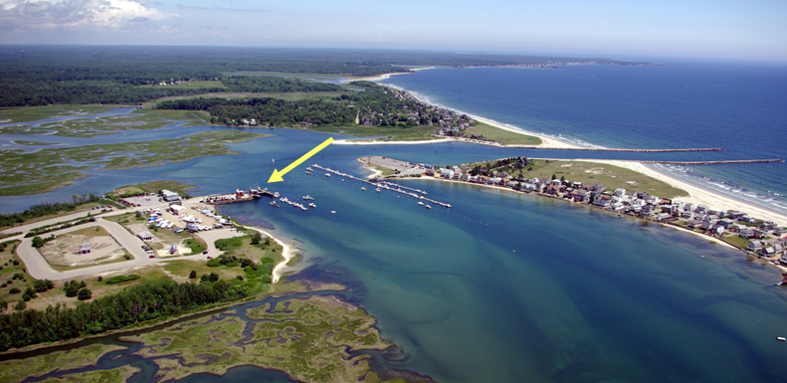
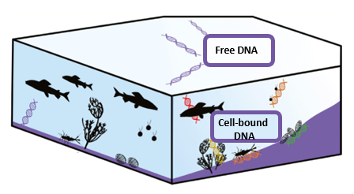
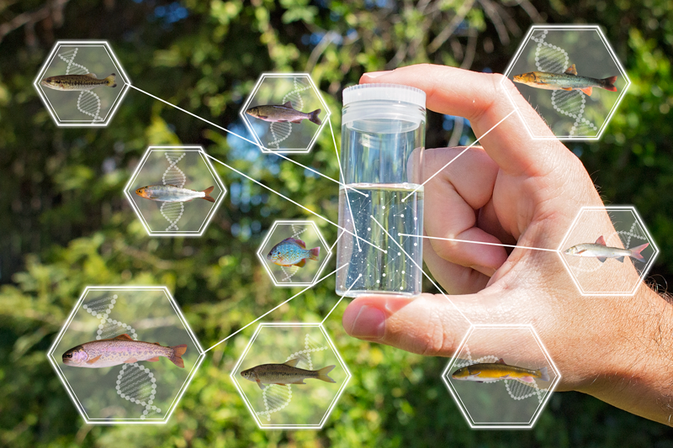
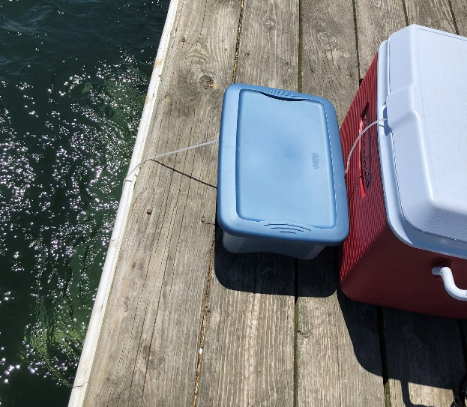
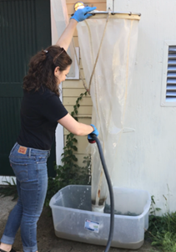
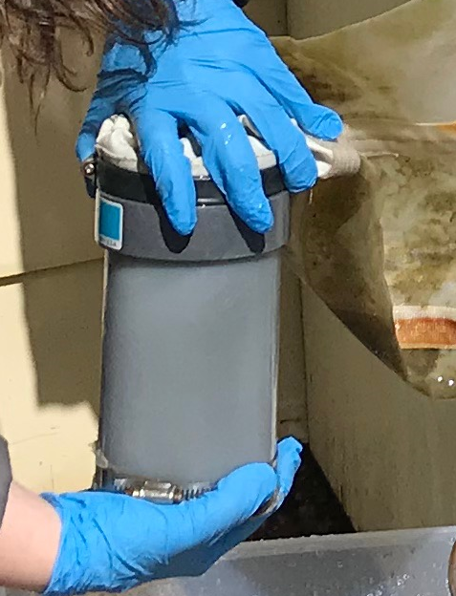
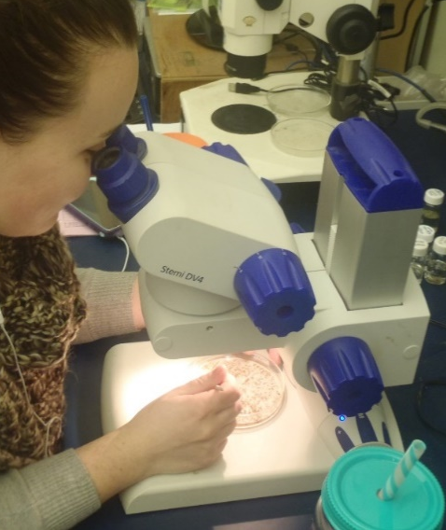
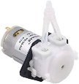

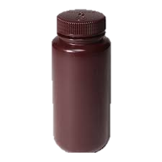
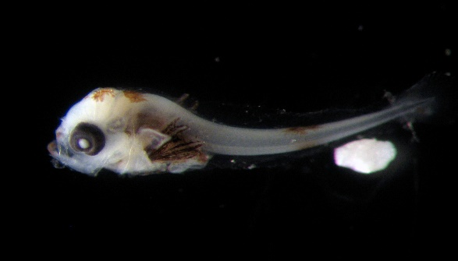
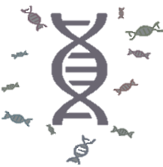
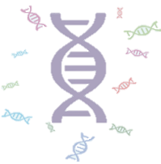
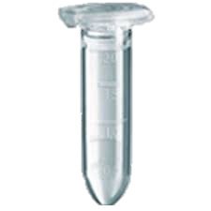
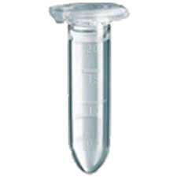
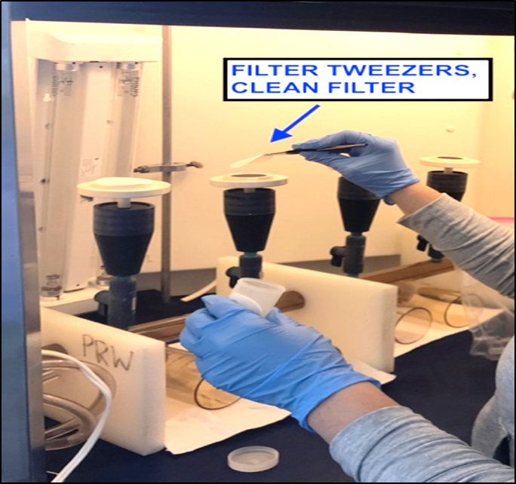
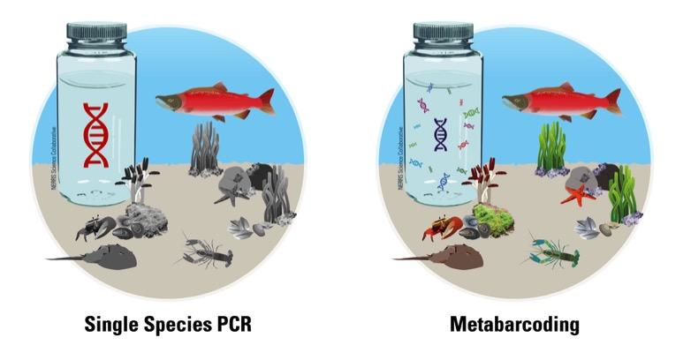
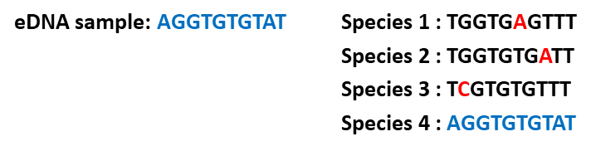
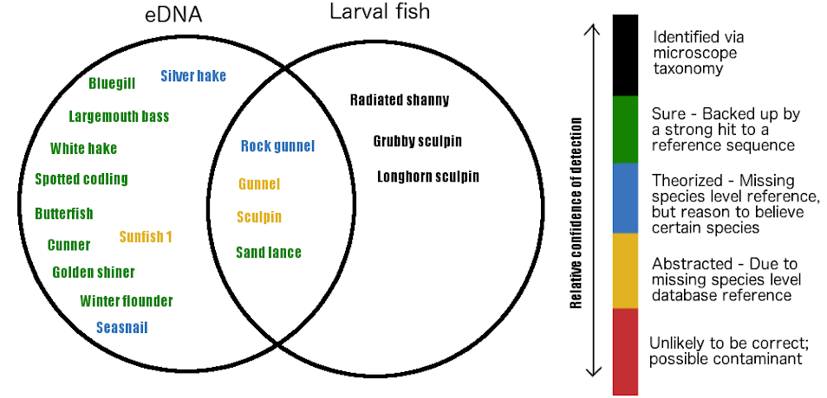
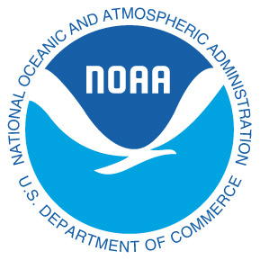


Environmental DNA (eDNA) Ecosystem Monitoring in the Gulf of Maine
Jason Goldstein¹, Laura Crane¹, Alison Watts², Devin Thomas^{2,3}, Kelley Thomas^{2,3}
¹Wells National Estuarine Research Reserve, Maine Coastal Ecology Center, Wells, ME
²University of New Hampshire, Dept. Civil & Environmental Engineering, Durham, NH
³University of New Hampshire, Hubbard Center for Genomic Studies, Durham, NH
Background
Environmental monitoring programs are essential for effective estuarine management, but they are often time-consuming, expensive, and subject to technical and resource limitations. Traditional monitoring methods may also miss early detection of newly-arrived invasive species or confirm losses of rare native species that occur in low densities or at locations that are difficult to survey. Environmental DNA (eDNA) refers to the DNA in an environmental sample, which comes from whole microorganisms, fragments of tissue, cellular material, or waste products.
eDNA methods allow resource managers to detect species present in an aquatic system without the need to capture and identify individual organisms.
Case Study: Fish Biodiversity in the Gulf of Maine
Goal: Compare fish species detected in Wells Harbor using traditional methods of capture (larval fish tow) and several different eDNA methods of collecting water samples.
Methods:
Sterilized all sampling gear using 10% bleach solution.
Deployed two plankton nets (monthly) from Wells Harbor dock for 1 hour.
Continuously pumped 2.6 L seawater into a sterile collection jug throughout the tow (continuous water sample).
Hosed down the “eDNA net” and collected 1 L of the net rinse water.
Blended the contents of the cod end of the “eDNA net” in a food processor. Collected two 1.5 mL samples (biomass blend).
Identified the fish species present in the “traditional net” under a dissecting microscope (traditional method).
Filtered all water samples at Wells NERR. DNA extraction, metabarcoding, and bioinformatics conducted at UNH to determine fish species present.
Preliminary Results:
Species detected in July 2019 samples: Species detected in August 2019 samples:
Species detected in all 2018 samples combined:
eDNA concept from fishbio.com
Overarching Project Goals
Researchers from several National Estuarine Research Reserves (NERRs) and the University of New Hampshire (UNH) are working collaboratively to:
Design and implement a pilot eDNA monitoring program at several NERR sites.
Identify estuarine target species of concern, with a focus on invasive invertebrates and migratory fish.
Develop eDNA sample collection and analysis protocols, with training materials and recommendations for the appropriate use of eDNA in estuarine monitoring.
Continuous Water Sample
Net Rinse Water
Biomass Blend
Traditional Method
2.6 L Sample
1 L Sample
Two 1.5 mL Samples
eDNA Methods
Step 1: Collect water and/or sediment samples with sterilized equipment
Step 2: Filter sample to capture eDNA
Step 3: Extract DNA
Step 4: Amplify and sequence DNA using PCR (detects only a single species) or Metabarcoding (detects multiple species in a sample)
Step 5: Assign taxonomy to the sequenced DNA to determine species present in the sample (Bioinformatics)
Method | Cunner | Menhaden | Silver Hake | Rock Gunnel | Northern Pipefish | Windowpane Flounder | Winter Flounder | Nine-Spine Stickleback
Net Rinse | TBD
Continuous |  | X |  | X
Biomass | X |  | X |  | X | X | X
Traditional | 5 |  |  |  |  |  | 1 | 1
Method | Cunner | Menhaden | Silver Hake | Red Hake | Northern Pipefish | Windowpane Flounder | Atlantic Halibut | Striped Bass | Atlantic Silverside | Grubby Sculpin | Fourbeard Rockling | Pacific Sandlance | Sea Raven | Atlantic Mackerel
Net Rinse | X | X | X | X | X | X | X | X | X | X | X | X | X | X
Continuous |  | X
Biomass | X |  | X | X
Traditional | No fish caught
(MIFISH Primer: Sato et al. 2015)
Lessons Learned
eDNA Methods Traditional Method
Advantages:
Lower cost than traditional methods
Reduced sampling effort
Results within days or weeks
Detect cryptic species
Repeatability
Non-destructive, non-invasive
Target multiple phyla in a single sequence run
Challenges:
Determines presence, not abundance
Cannot confirm absolute absence
Cannot determine life stage or condition
Samples easily contaminated
Other DNA sources (i.e. bait fish, runoff)
Methods (collection, processing, interpretation) will affect results
Team Members
University of New Hampshire
Great Bay NERR (New Hampshire)
Wells NERR (Maine)
South Slough NERR (Oregon)
He’eia NERR (Hawaii)
Apalachicola NERR (Florida)
Hudson NERR (New York)
Acknowledgements:
We thank the following individuals for their support and help in the field and lab: Claire Gottsegen, Michelle Furbeck, Jake Aman, Katrina Zarrella Smith, Kayla Rexroth, Kathryn Kissam, Lee Pollock, and Sylvia Pollock. This work is sponsored by the National Estuarine Research Reserve System Science Collaborative, which supports collaborative research that addresses coastal management problems important to the National Reserve System. The Science Collaborative is funded by the National Oceanic and Atmospheric Administration (NOAA) and managed by the University of Michigan Graham Sustainability Institute (NAI4NOS4190145).
For more information, visit our website at https://www.estuarydna.org/

