Slide 1

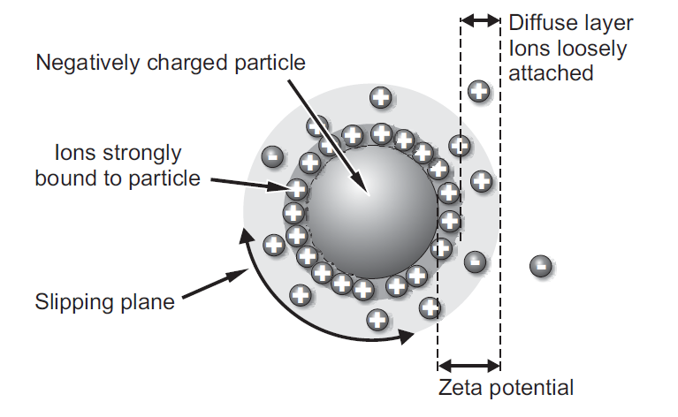
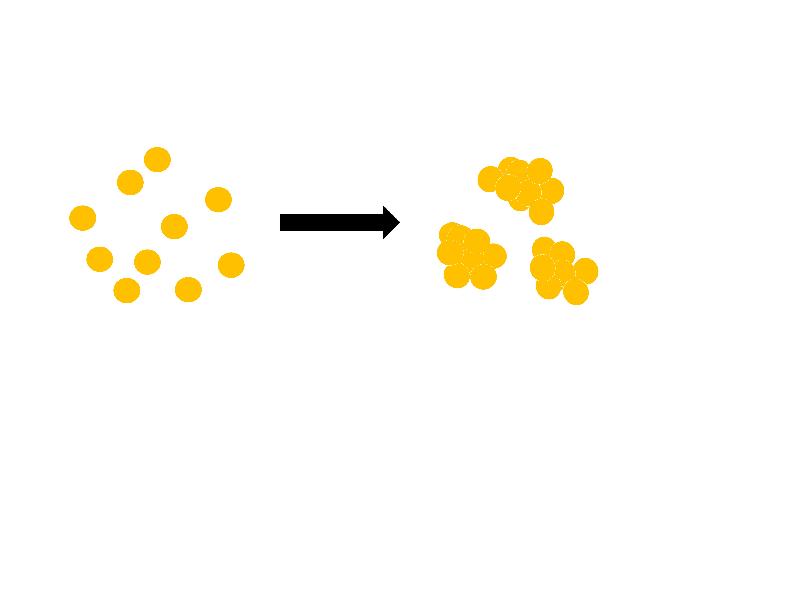
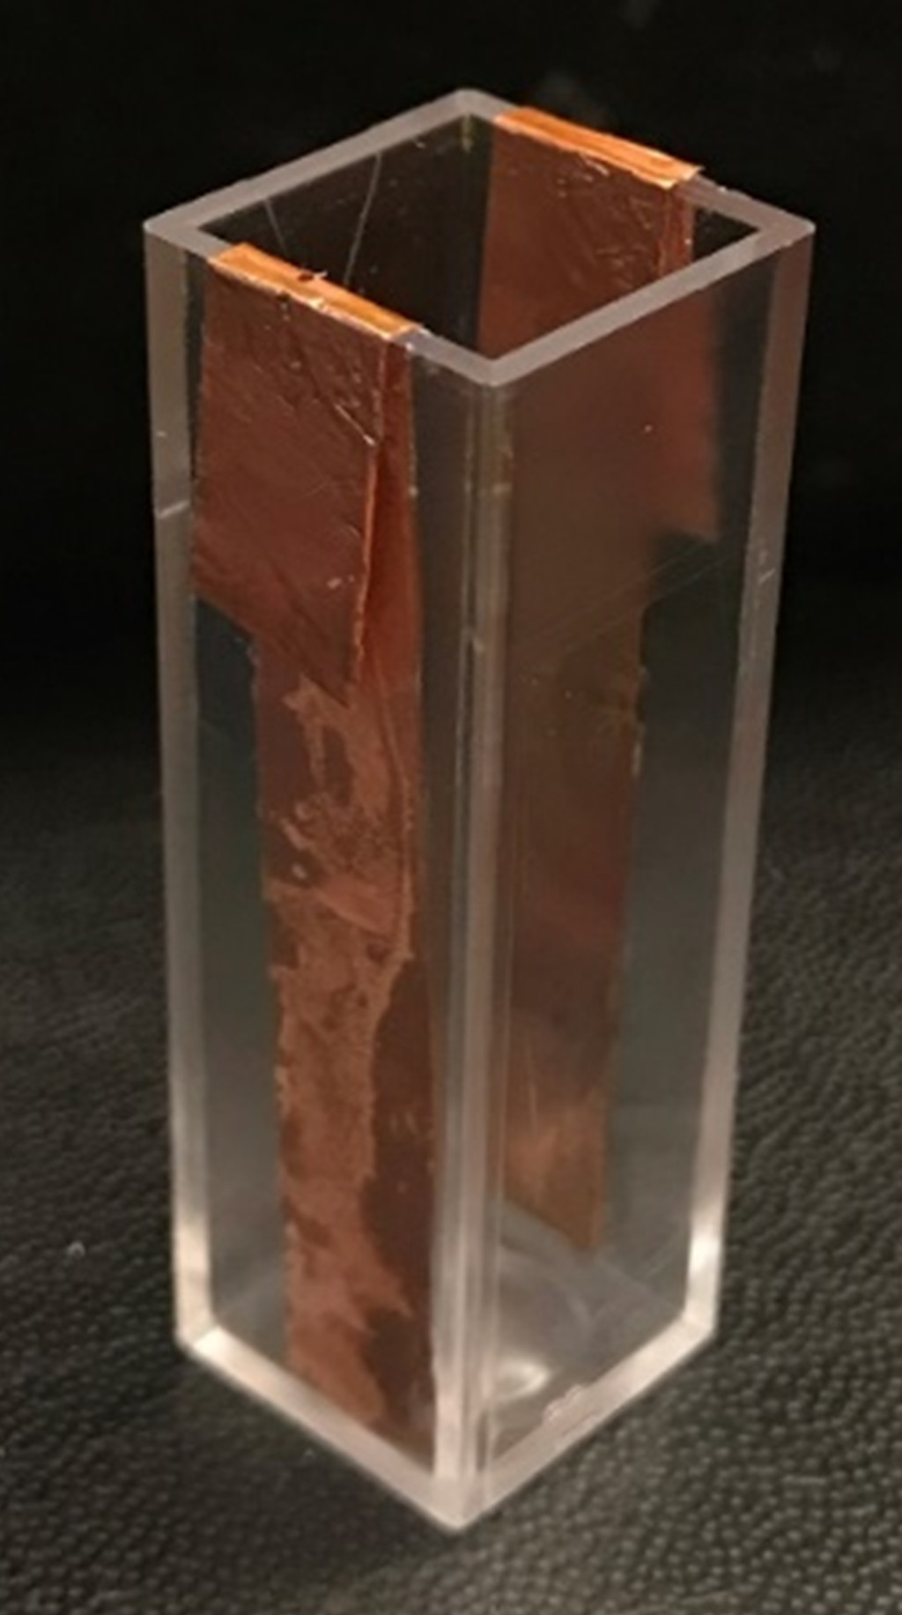
Monitoring Temperature Induced Poly(N-isopropylacrylamide) Aggregation Under Applied Voltage
Joelle LaFreniere¹, Emma J. Roberge², Tianyu Ren³, W. Rudolph Seitz³, and Jeffrey M. Halpern²
Surface Enhanced Electrochemical Diagnostic Sensors (SEEDS) Laboratory
¹Department of Mechanical Engineering, ²Department of Chemical Engineering, and ³Department of Chemistry, University of New Hampshire
Introduction
Poly(N-isopropylacrylamide), or pNIPAM, is synthesized by RAFT (Reversible Addition-Fragmentation Chain-Transfer) polymerization
pNIPAM-b-FMMA includes a ferrocene block, known to be reactive in an applied electric field.
Temperature responsiveness lends for
  Surface coatings
  Tissue engineering
  Regenerative medicine
  Biosensing
  Energy storage
Lower critical solution temperature (LCST) is found using dynamic light scattering to measure temperature induced coacervation.
We have found this LCST can shift, thermoresponsiveness is irreversible in a strong enough electric field.¹
Initial Published Data¹
Irreversible particle size changes on a temperature ramp with 1.0 V applied voltage
A shift in LCST in both pNIPAM with and without FMMA block
Zeta Potential of pNIPAM
pNIPAM-b-FMMA
pNIPAM
Investigation of Transition Voltage of pNIPAM
Dynamic Light Scattering and Aggregation
Dynamic Light Scattering (DLS) determines particle size
Heating
Temperature Increasing Past LCST
Shifting LCST
Polymer Particles (5-10nm)
Polymers Aggregated
(800-2000nm)
Monitoring Aggregation Under Applied Potential
A potential age is applied through the solution
An electrode lined cell is used
We created the cell by inserting copper tape to two sides of a DLS cell
The leads were connected to a voltage supply to generate an applied electric field across the light path
This technique was recently published by our group¹
The DLS was then run, with a temperature ramp up (Heating)
Followed by a temperature ramp down (Cooling)
Voltage was varied at 0 V, 0.2 V, 0.3 V, 0.4V, and 1.0 V to find the transition point of previously observed behavior¹
Temperature (⁰C)
Conclusion
Does not
Re-dissolve
Cooling
LCST shift was found to be reproducible.
Our results are comparable to published LCST values in an applied voltage of 0.3 V or less
A decrease in LCST during heating in the presence in of an applied voltage greater than 0.4 V
Upon cooling, polymers did not disaggregate in an applied voltage greater than 0.4 V
  The polymers were no longer thermosensitive.
This information could be used in polymer orientation and provide information on polarizability of a polymer with an applied voltage.
Temperature (⁰C)
This demonstrates that this irreversible solubility ability occurs between 0.3V and 0.4V
The LCST also shifts in the lowering of temperature.
Future Work
Investigate further why the shift in LCST occurs.
Monitor differences in experiments with pNIPAM and ferrocene block (pNIPAM+.FMMA)
Greater controllability in our pNIPAM sensors in development
Citations
¹Ren, Roberge, et al. (JoVE) The Application of Voltage in Dynamic Light Scattering (in press)
²Tarafdar & Adhikari Nanotechnology in Soil Science (2015)
Acknowledgements
Scott Greenwood, UNH Collaborative Research Excellence Pilot Research Project, SEEDS Laboratory, Dr. Jeffrey Halpern, Department of Chemical Engineering, Hamel Center for Undergraduate Research, UNH Honors Program, College of Engineering and Physical Sciences

