Slide 1

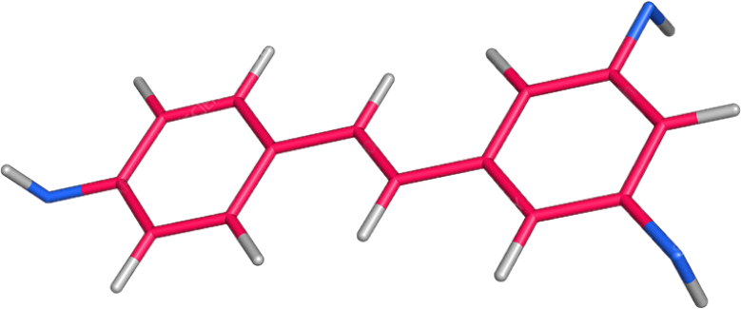
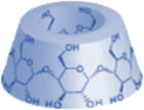
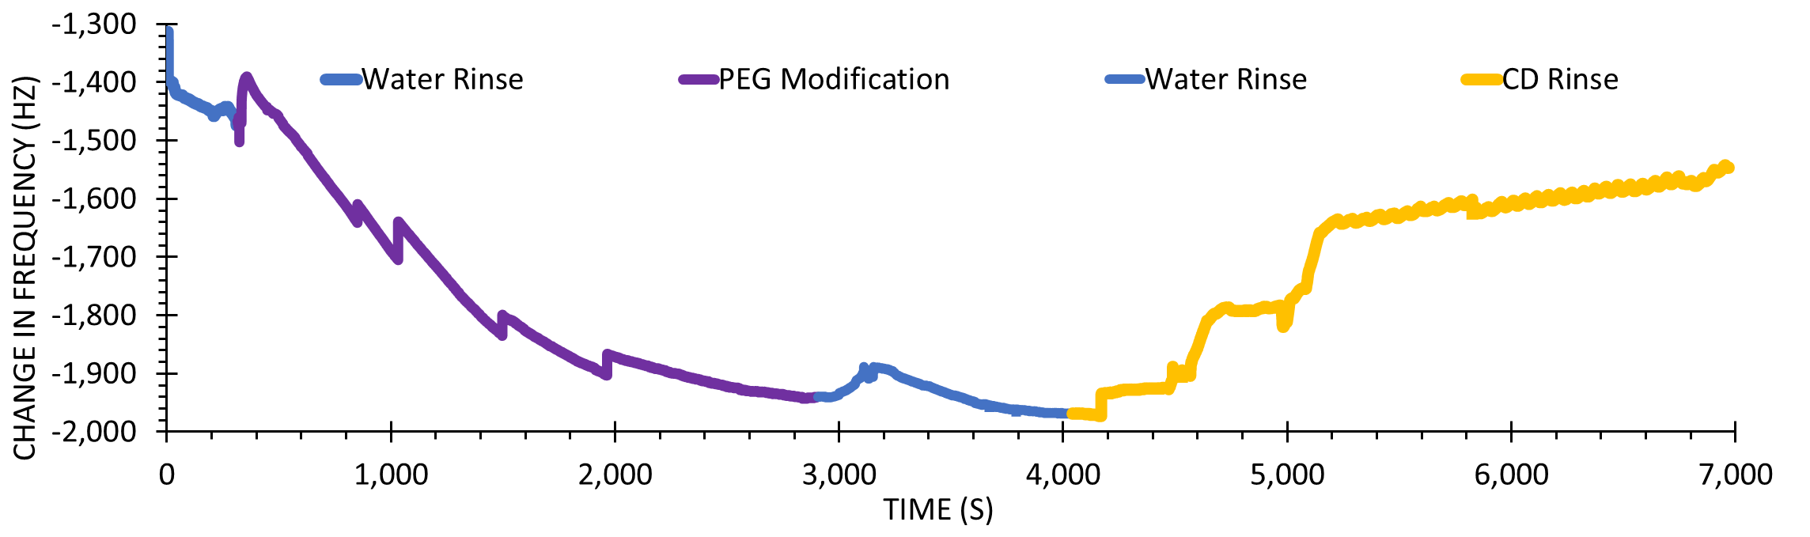
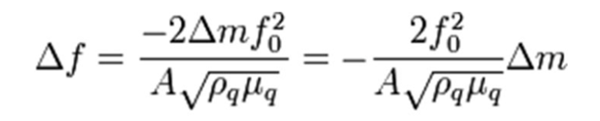
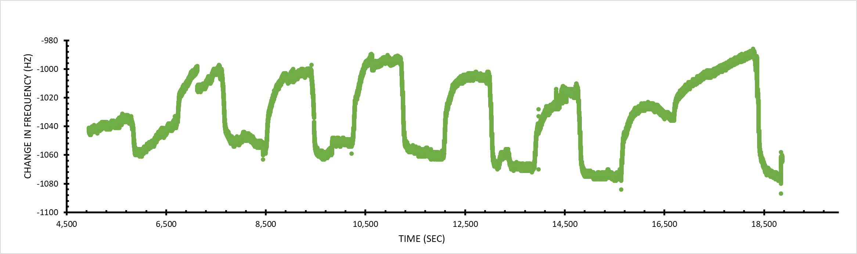
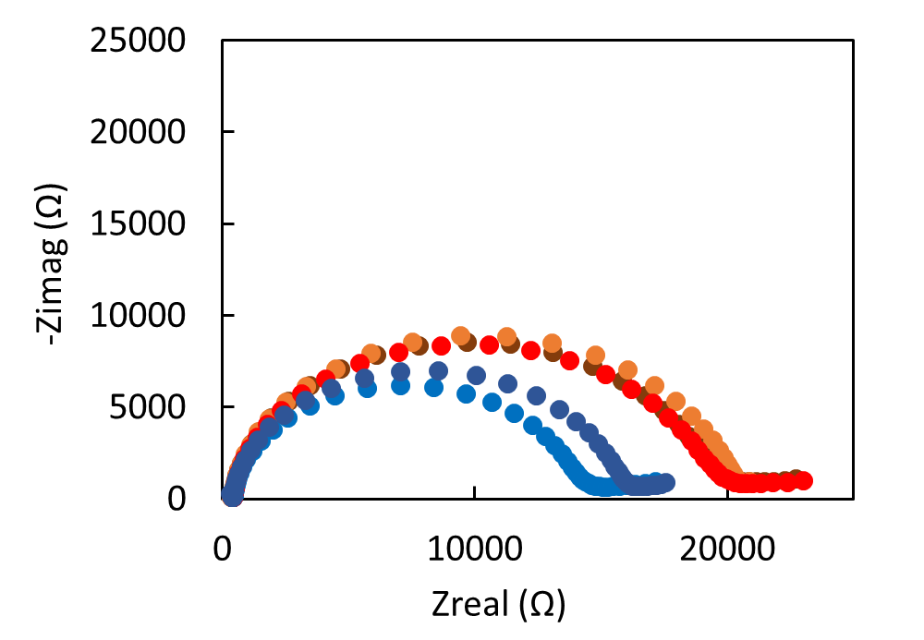


Quantifying Mass Changes at a PEG Surface Complexed with αCyclodextrin
Emma J. Roberge, Zahra Panahi, and Jeffrey M. Halpern
Contact: ejroberge@outlook.com or Jeffrey.Halpern@unh.edu
Chemical Engineering Department, University of New Hampshire
Background
Surface Modification
Cyclodextrin has a hydrophobic inner cavity and hydrophilic exterior
  The inner cavity can form inclusion complexes with hydrophobic molecules
αCyclodextrin (αCD) is used as a recognition element for single-use biosensors
  Recognizes hydrophobic molecules such as resveratrol
Resveratrol is a hydrophobic molecule found in red wine, grapes, and blueberries, and is an antioxidant
  Antioxidative and carcinogenic protection
  Reduce platelet aggregation and decrease coronary heart diseases
We have developed a reusable αCD Sensor
  We have quantified the sensor with EIS, XPS, and FTIR¹
We want to confirm our data using Quartz Crystal Microbalance
Gold surface
PEG Modification via thiol chemistry
αCD bonds to PEG
Resveratrol bonds with αCD, releasing αCD from PEG
FREQUENCY (HZ)
Quartz Crystal Microbalance (QCM)
Used to quantify mass changes in a system
Piezoelectric effect measures a natural frequency that can be correlated to mass changes with the Sauerbrey equation
We used gold coated quartz with a resonant frequency of 5 Hz
Modification Details
A decrease in frequency corresponds to successful surface modification of PEG
The surface stabilized and excess PEG was washed away with water
αCD was introduced to the system, washing away physiosorbed PEG, and eventually stabilized after an increase in frequency resulting in αCD:PEG inclusion complexes
0.5 mg/mL of CT-PEG-SH in water for 45 minutes
Water rinse for 20 minutes
5 mM αCD in Water for 45 minutes
Conclusions and Future Work
Resveratrol Response
Consistent response to resveratrol introduced to the system implies successful modification, and successful detection.
The use of mass changes as a monitoring tool for the PEG-CT/αCD system confirms our previous work.¹
Future work will include quantifying the viscoelastic layer of the system, and generating cleaner, reproducible data.
Resveratrol Increasing Dilution
CD reload
FREQUENCY (HZ)
Water
13.0 nM
0 nM
0.5 nM
1.5 nM
3.0 nM
5.0 nM
7.5 nM
10.0 nM
. ¹Check out our presentation on Monday 1:06-1:24 in Hyatt Regency Orlando - Celebration 10
(S)
Acknowledgements
Our group would like to acknowledge the financial support of an Institutional Development Award (IDeA) from the National Institute of General Medical Sciences of the NIH under grant number P20GM113131, the Hamel Center of Undergraduate Research, and the Honors Program at the University of New Hampshire. We also recognize the support from the Surface Enhanced Electrochemical Diagnostic Sensors (SEEDS) Laboratory

