Slide 1

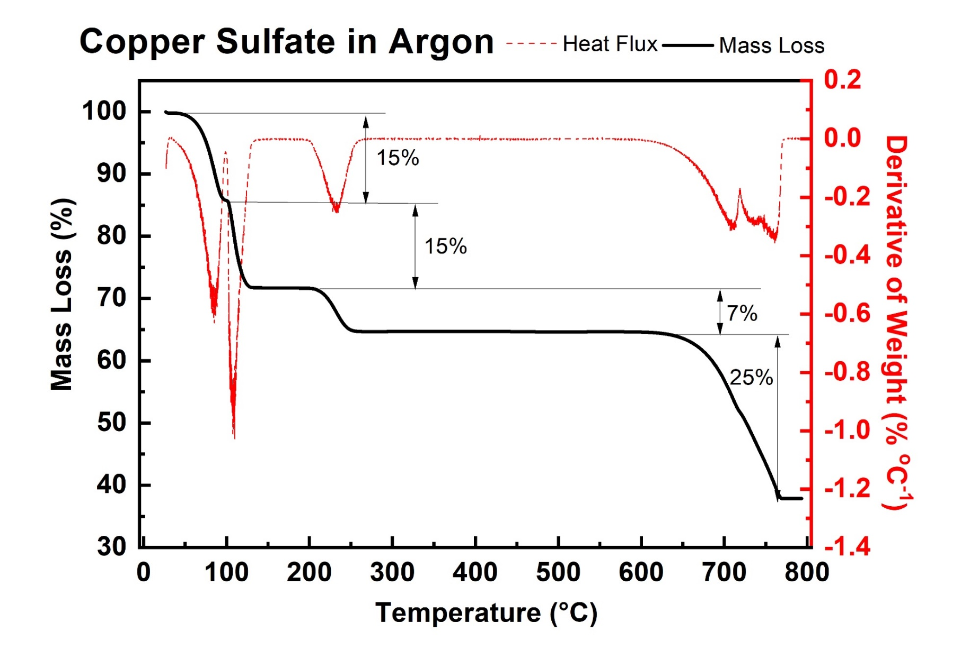
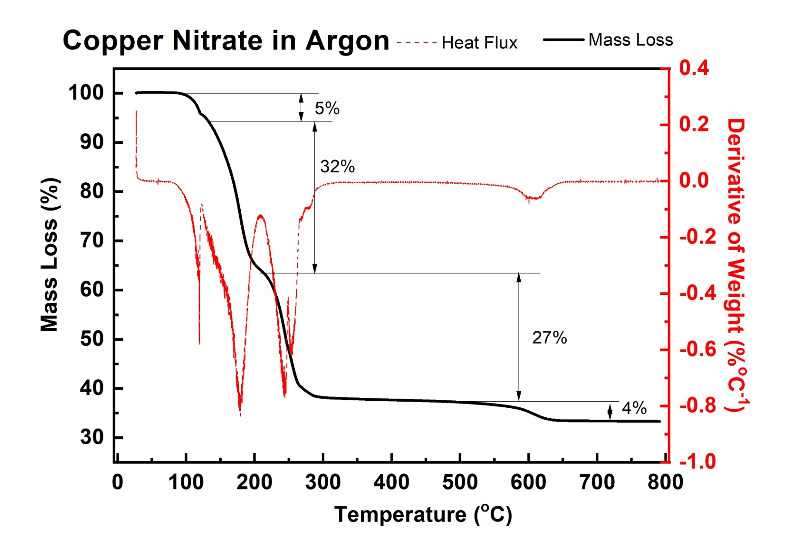
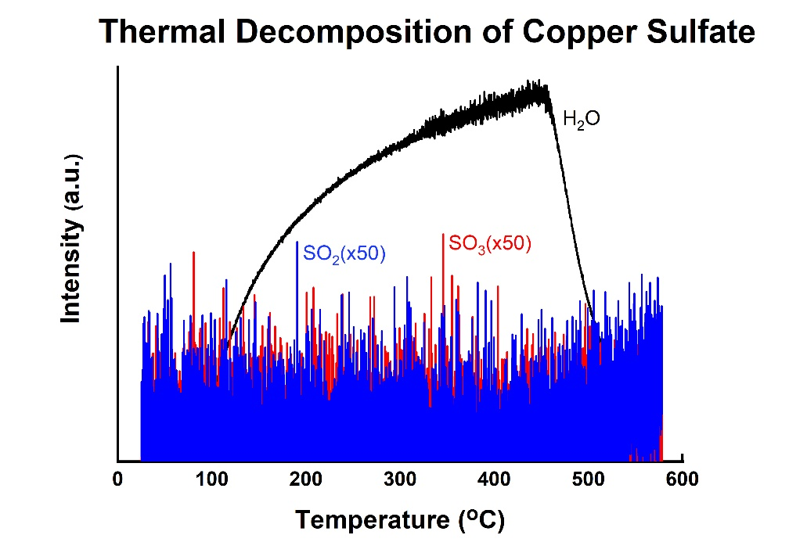
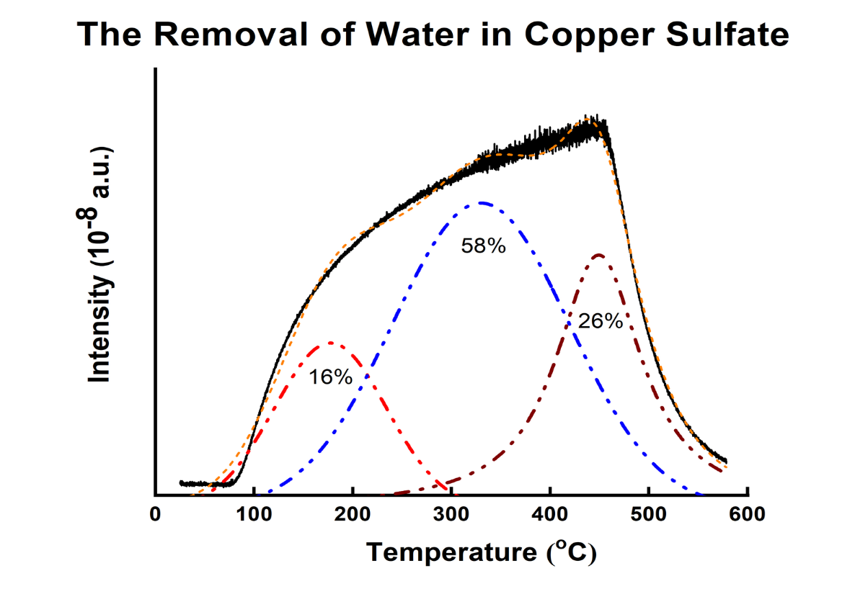
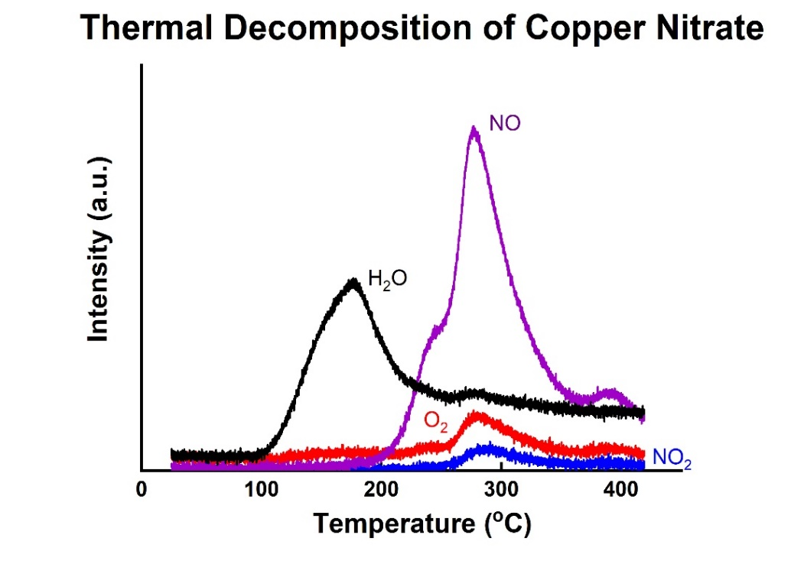
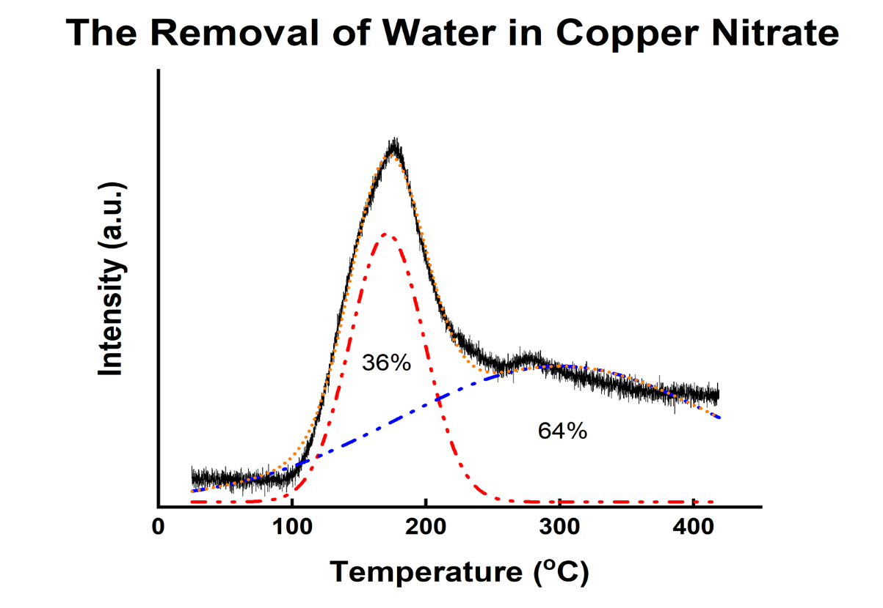
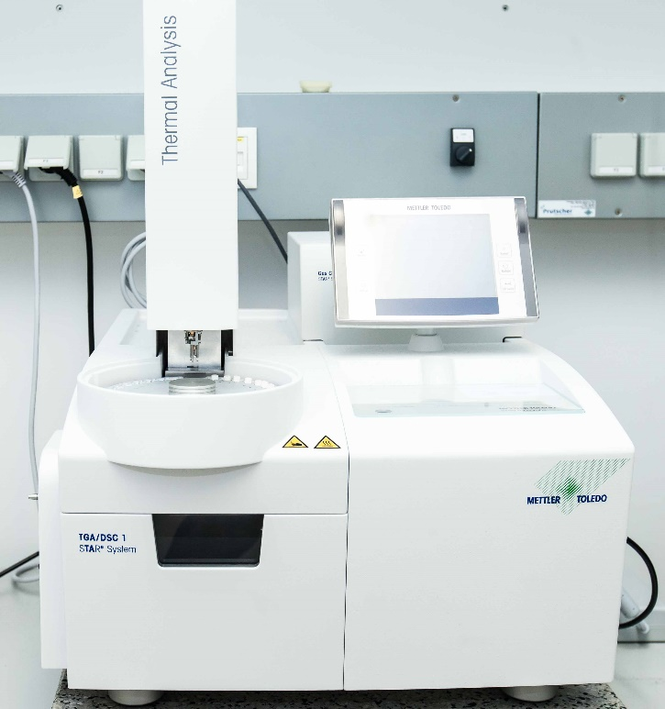
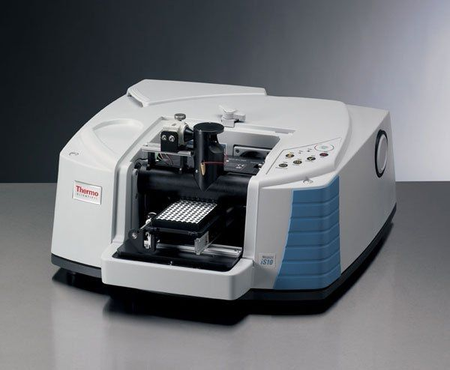
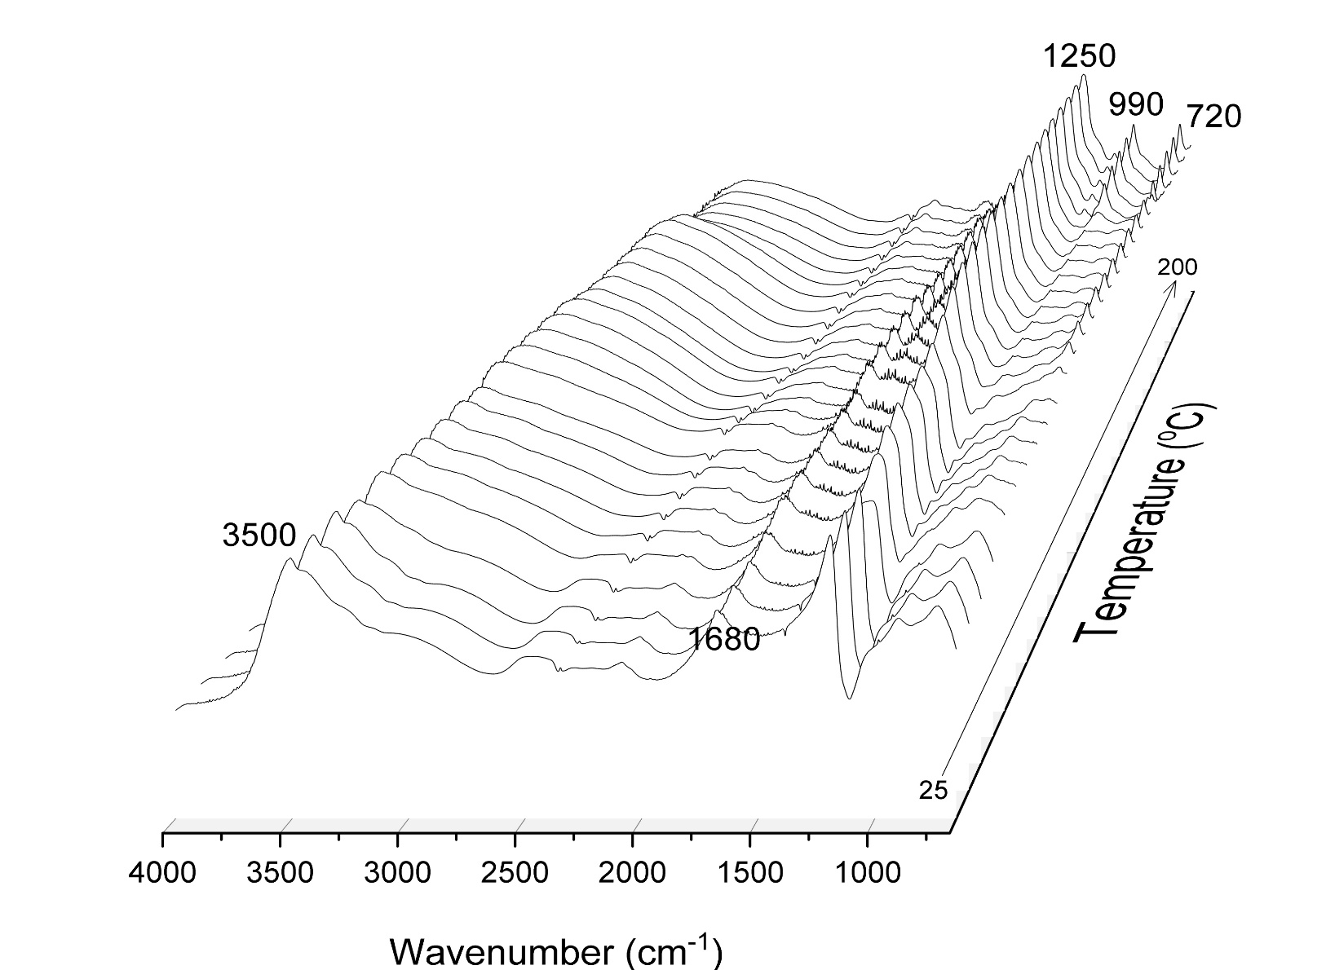
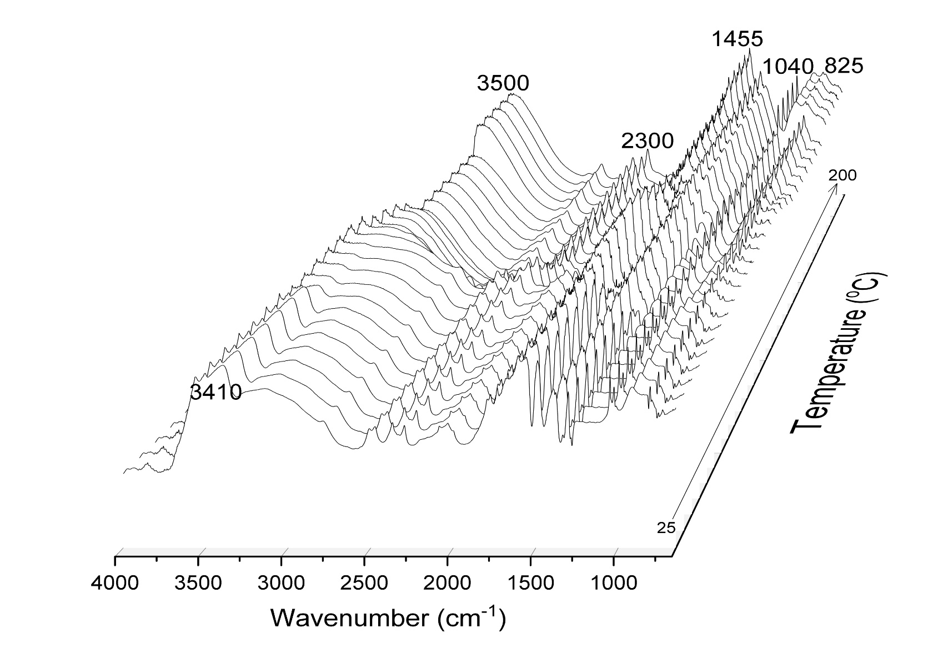
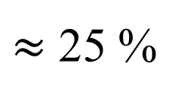
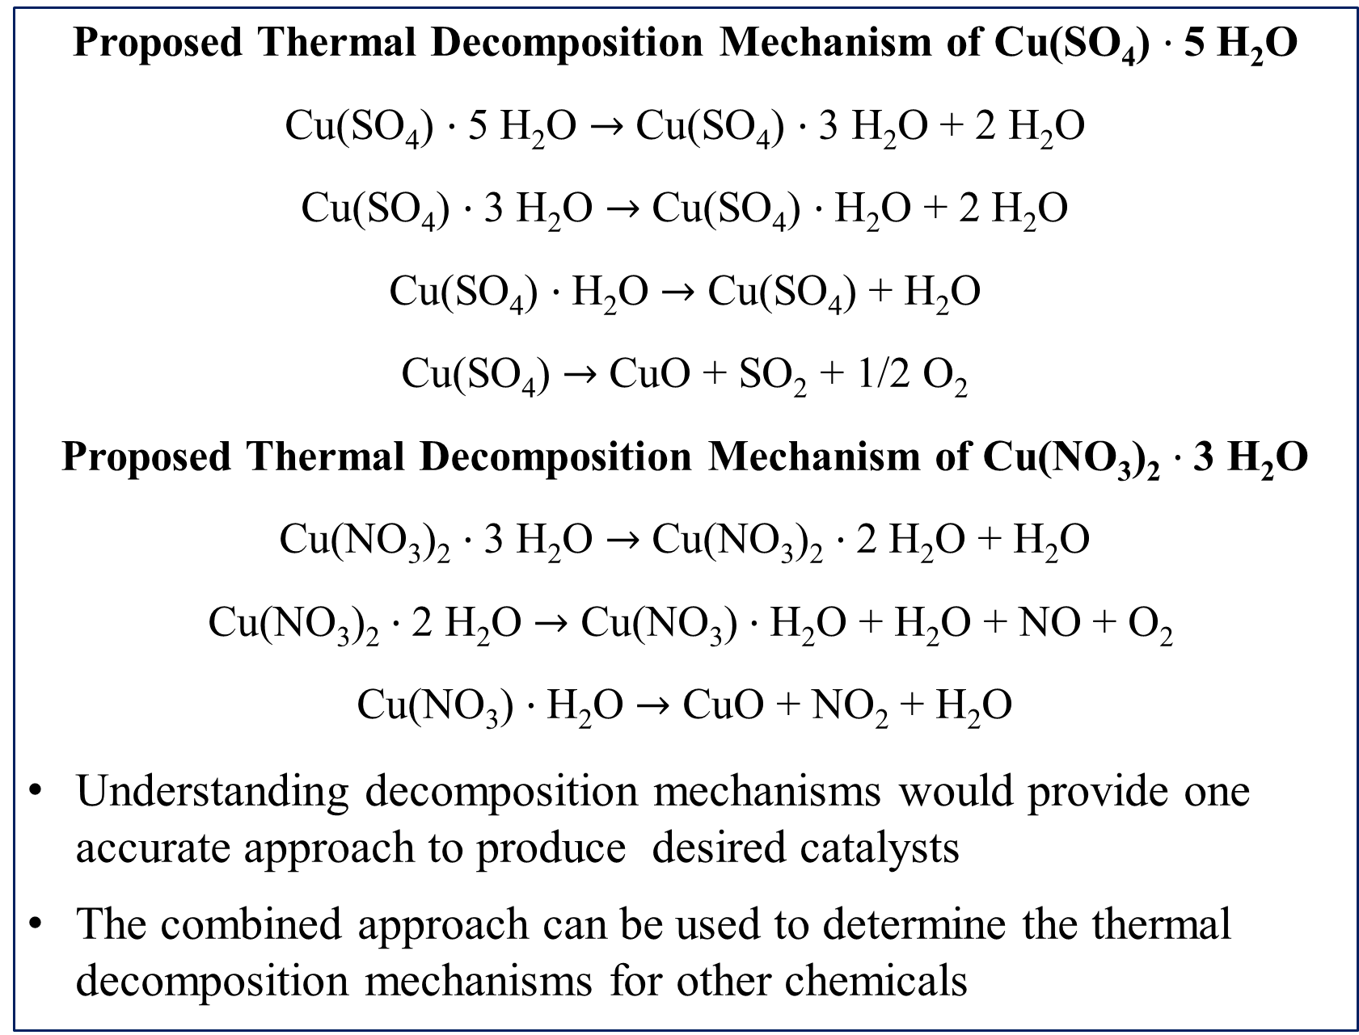
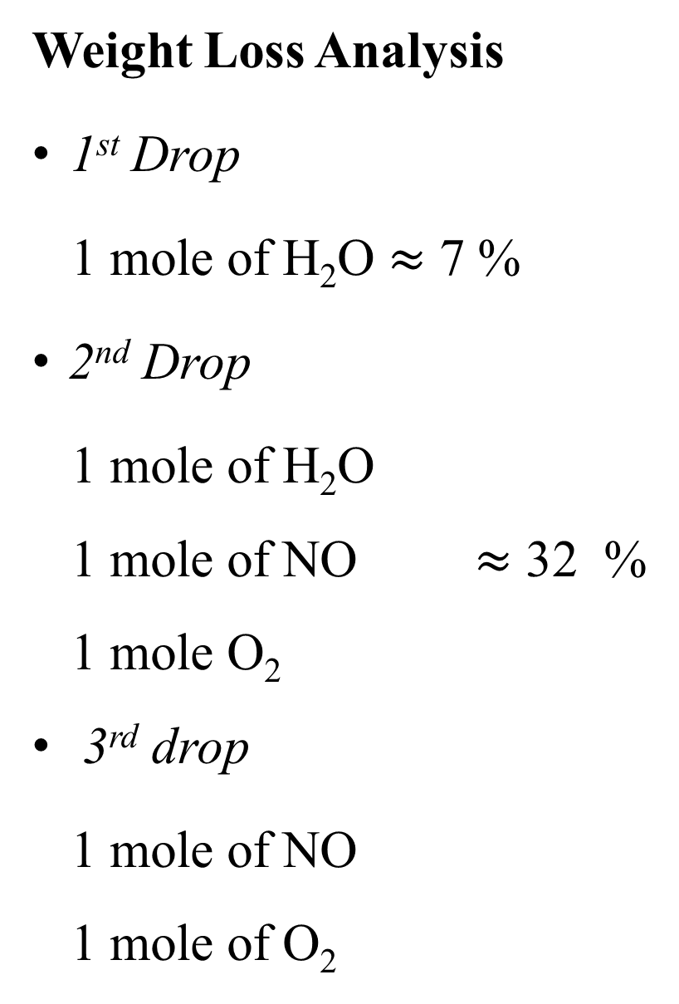
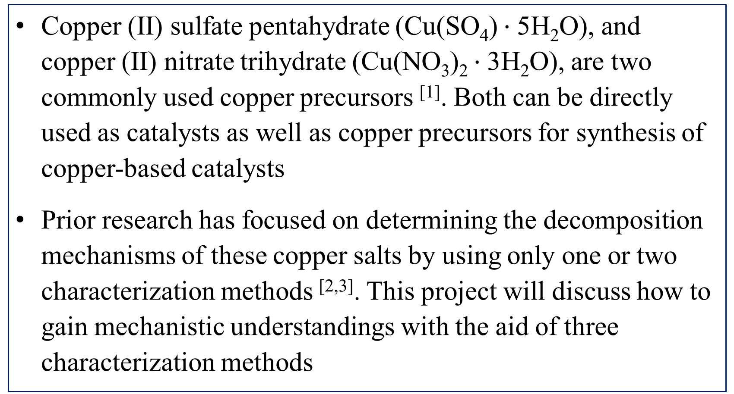
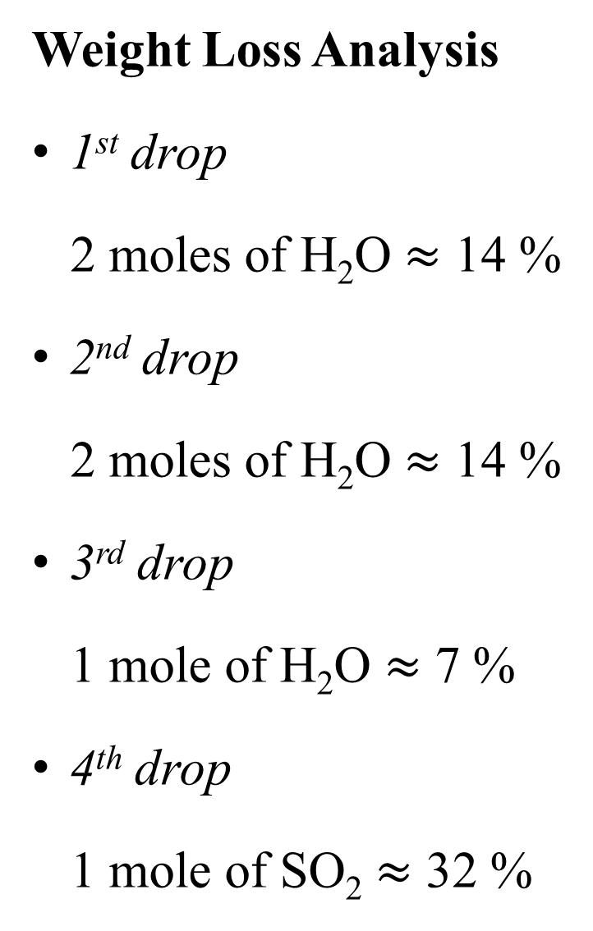
Mechanistic Studies of the Decomposition of Various Copper Salts
Nathaniel Nichols and Dr. Nan Yi
Department of Chemical Engineering, University of New Hampshire, Durham, NH 03824
Introduction
Decomposition of Copper Sulfate
Decomposition of Copper Nitrate
Copper (II) sulfate pentahydrate (Cu(SO₄) $·$5H₂O), and copper (II) nitrate trihydrate (Cu(NO₃)₂ $·$3H₂O), are two commonly used copper precursors ^{[1]}. Both can be directly used as catalysts as well as copper precursors for synthesis of copper-based catalysts
Prior research has focused on determining the decomposition mechanisms of these copper salts by using only one or two characterization methods ^{[2,3]}. This project will discuss how to gain mechanistic understandings with the aid of three characterization methods
Thermal Gravimetric Analysis
Weight Loss Analysis
1st Drop
1 mole of H₂O $≈$ 7 %
2nd Drop
1 mole of H₂O
1 mole of NO $≈$ 32 %
1 mole O₂
3rd drop
1 mole of NO
1 mole of O₂
Weight Loss Analysis
1st drop
2 moles of H₂O $≈$ 14 %
2nd drop
2 moles of H₂O $≈$ 14 %
3rd drop
1 mole of H₂O $≈$ 7 %
4th drop
1 mole of SO₂ $≈$ 32 %
Methodology
Characterization methods
Thermal Gravimetric Analysis (TGA)
Mass Spectroscopy
Fourier-Transform Infrared Spectroscopy (FT-IR)
To determine the decomposition mechanisms of copper sulfate
and copper nitrate
Figure 1. TGA/DTG profiles of copper sulfate
Figure 2. TGA/DTG profiles of copper nitrate
$≈$ 25 %
Mass Spectroscopy
Conclusions
Proposed Thermal Decomposition Mechanism of Cu(SO₄) $·$5 H₂O
Cu(SO₄) $·$5 H₂O $→$ Cu(SO₄) $·$3 H₂O + 2 H₂O
Cu(SO₄) $·$3 H₂O $→$ Cu(SO₄) $·$H₂O + 2 H₂O
Cu(SO₄) $·$H₂O $→$ Cu(SO₄) + H₂O
Cu(SO₄) $→$ CuO + SO₂ + 1/2 O₂
Proposed Thermal Decomposition Mechanism of Cu(NO₃)₂ $·$3 H₂O
Cu(NO₃)₂ $·$3 H₂O $→$ Cu(NO₃)₂ $·$2 H₂O + H₂O
Cu(NO₃)₂ $·$2 H₂O $→$ Cu(NO₃) $·$H₂O + H₂O + NO + O₂
Cu(NO₃) $·$H₂O $→$ CuO + NO₂ + H₂O
Understanding decomposition mechanisms would provide one accurate approach to produce desired catalysts
The combined approach can be used to determine the thermal decomposition mechanisms for other chemicals
Figure 3. Mass spectroscopy profile for copper sulfate
Figure 4. Peak deconvolution of water loss
Figure 5. Mass spectroscopy profile for copper nitrate
Figure 6. Peak deconvolution of water loss
The water desorption occurred in three distinct groupings which also corresponds with the TGA data
The majority of water was detected below 550 ºC
Only water is detected around 100 ºC
Around 300 ºC, NO, O₂, H₂O, and trace amounts of NO₂ are detected
The water desorption occurred in two steps
FT – IR Spectroscopy
The peaks at 3410 cm⁻¹ and 3500 cm⁻¹ can be attributed to water
The peaks from 825 cm⁻¹ to 2300 cm⁻¹ are all due to oxygen and nitrogen interactions indicating the loss of NO and NO₂
The peaks at 3500 cm⁻¹ and 1680 cm⁻¹ are attributed to water
References
[1] Gawande, Manoj B., et al. Chemical Reviews, 2016, 116 (6), 3722-3811.
[2] Heravi, Majid M., et al. Catalysis Communications, 2007, 8 (2), 211-214.
[3] Lin, Zhenkun, et al. Journal of Thermal Analysis and Calorimetry, 2012, 107 (2), 471-475.
Figure 7. FT-IR data for copper sulfate
Figure 8. FT-IR data for copper nitrate
Acknowledgements: Research Experience and Apprenticeship Program and Research Travel Grant from The Hamel Center for Undergraduate Research, Guoqiang Cao

