Slide 1

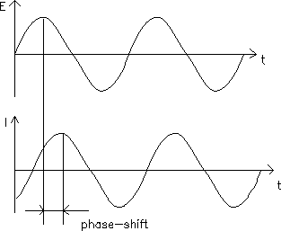
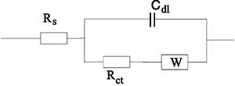
Drift in Repeated Electrochemical Impedance Spectroscopy Measurements
Emily Ziino, Sabrina Marnoto, and Jeffrey M. Halpern
Chemical Engineering Department, University of New Hampshire
Electrochemical Impedance Spectroscopy (EIS)
Problem and Approach
EIS is a common technique to evaluate surface state in batteries, biosensors, fuel cells
Drift and inconstant measurements can occur
We hypothesize that continued EIS runs increases the charging at the electrode surface and therefore decreases repeatability
Gamry Instruments. Basics of Electrochemical Impedance Spectroscopy. https://www.gamry.com/application-notes/EIS/basics-of-electrochemical-impedance-spectroscopy/ (accessed 11/7/2019).
Glassy carbon working electrode
20 mM Fe^{3-/4-}(CN)₆ (FFCN) is used to promote electron transfer
Charge transfer resistance values increase with each run
AC Voltage: 5 mV
DC Voltage: 0 V vs E_{oc}
Experimental Technique Improvements
Cleaner surface – better polishing technique
  Rinse electrode with methanol and deionized water before and after polishing
Threshold: 19 ± 5% Ohms (18.05-19.95 Ohms)
Used Bode plots to display data which graph Z_{mod} (Ohms) against Frequency (Hz) and Z_{phz} (°) against Frequency (Hz)
Increasing Run #
Using 1 mM FFCN
Threshold 370 ± 5% Ohms
Replacing buffer with
deionized water
    Threshold: 21 ± 5% Ohms
Removing auxiliary and reference electrode
Removing working electrode
Using 1 mM FFCN in PBS (Keeping All Electrodes) N=3
Variables Tested
Deionized Water with 20 mM (Keeping All Electrodes) N=3
Future Work and Conclusion
Starting experiments with a cleaner working electrode surface decreased drift
Lower concentration of FFCN resulted in larger drift and error
Removing the reference and auxiliary electrodes increased drift
Removing the working electrode showed the least amount of drift
Replacing the buffer with deionized water showed the most drift
Future testing:
  Electrode type
  N₂ purge of electrochemical cell
  Open circuit potential changes
  Double layer capacitance changes
Remove Auxiliary and Reference Electrode (FFCN in PBS) N=3
Remove Working Electrode (FFCN in PBS) N=3
ΔR_{ct}: 12 Ohms
ΔR_{ct}: 6 Ohms
Acknowledgements: Our group would like to acknowledge the financial support of an Institutional Development Award (IDeA) from the National Institute of General Medical Sciences of the NIH under grant number P20GM113131, the Hamel Center of Undergraduate Research, and the Honors Program at the University of New Hampshire. We also recognize the support from the Surface Enhanced Electrochemical Diagnostic Sensors (SEEDS) Laboratory.
Notes:
Reproducibility issues arise with repeated measurements using EIS
Charge transfer resistance values increase with each run
Could do 1mM FFCN or list out 6 rct values from over the summer

