Slide 1
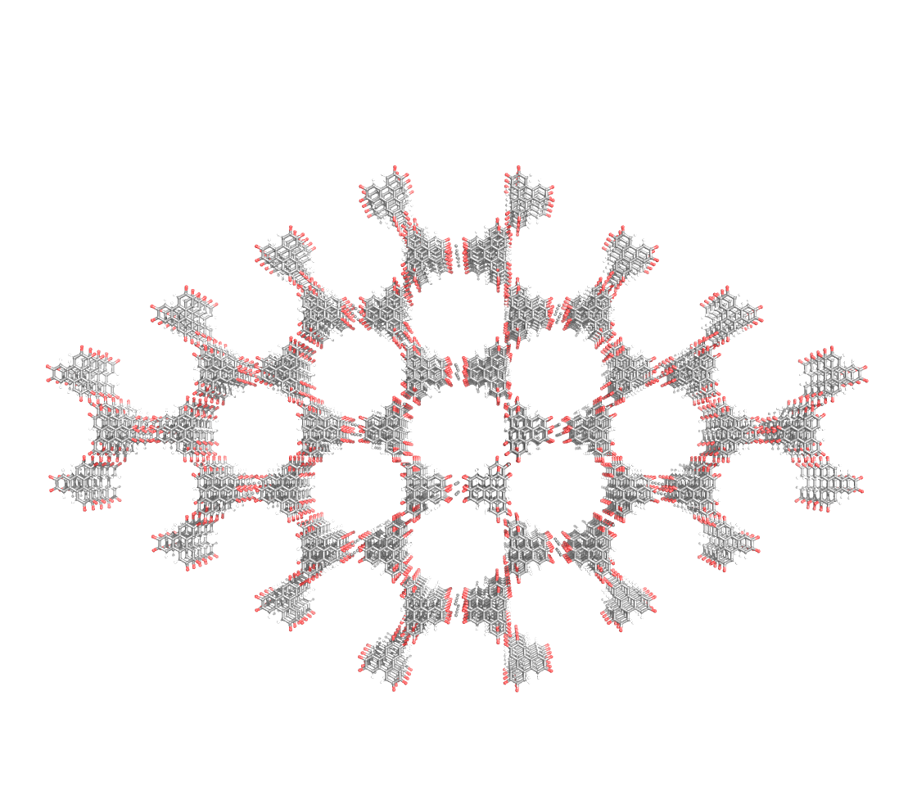


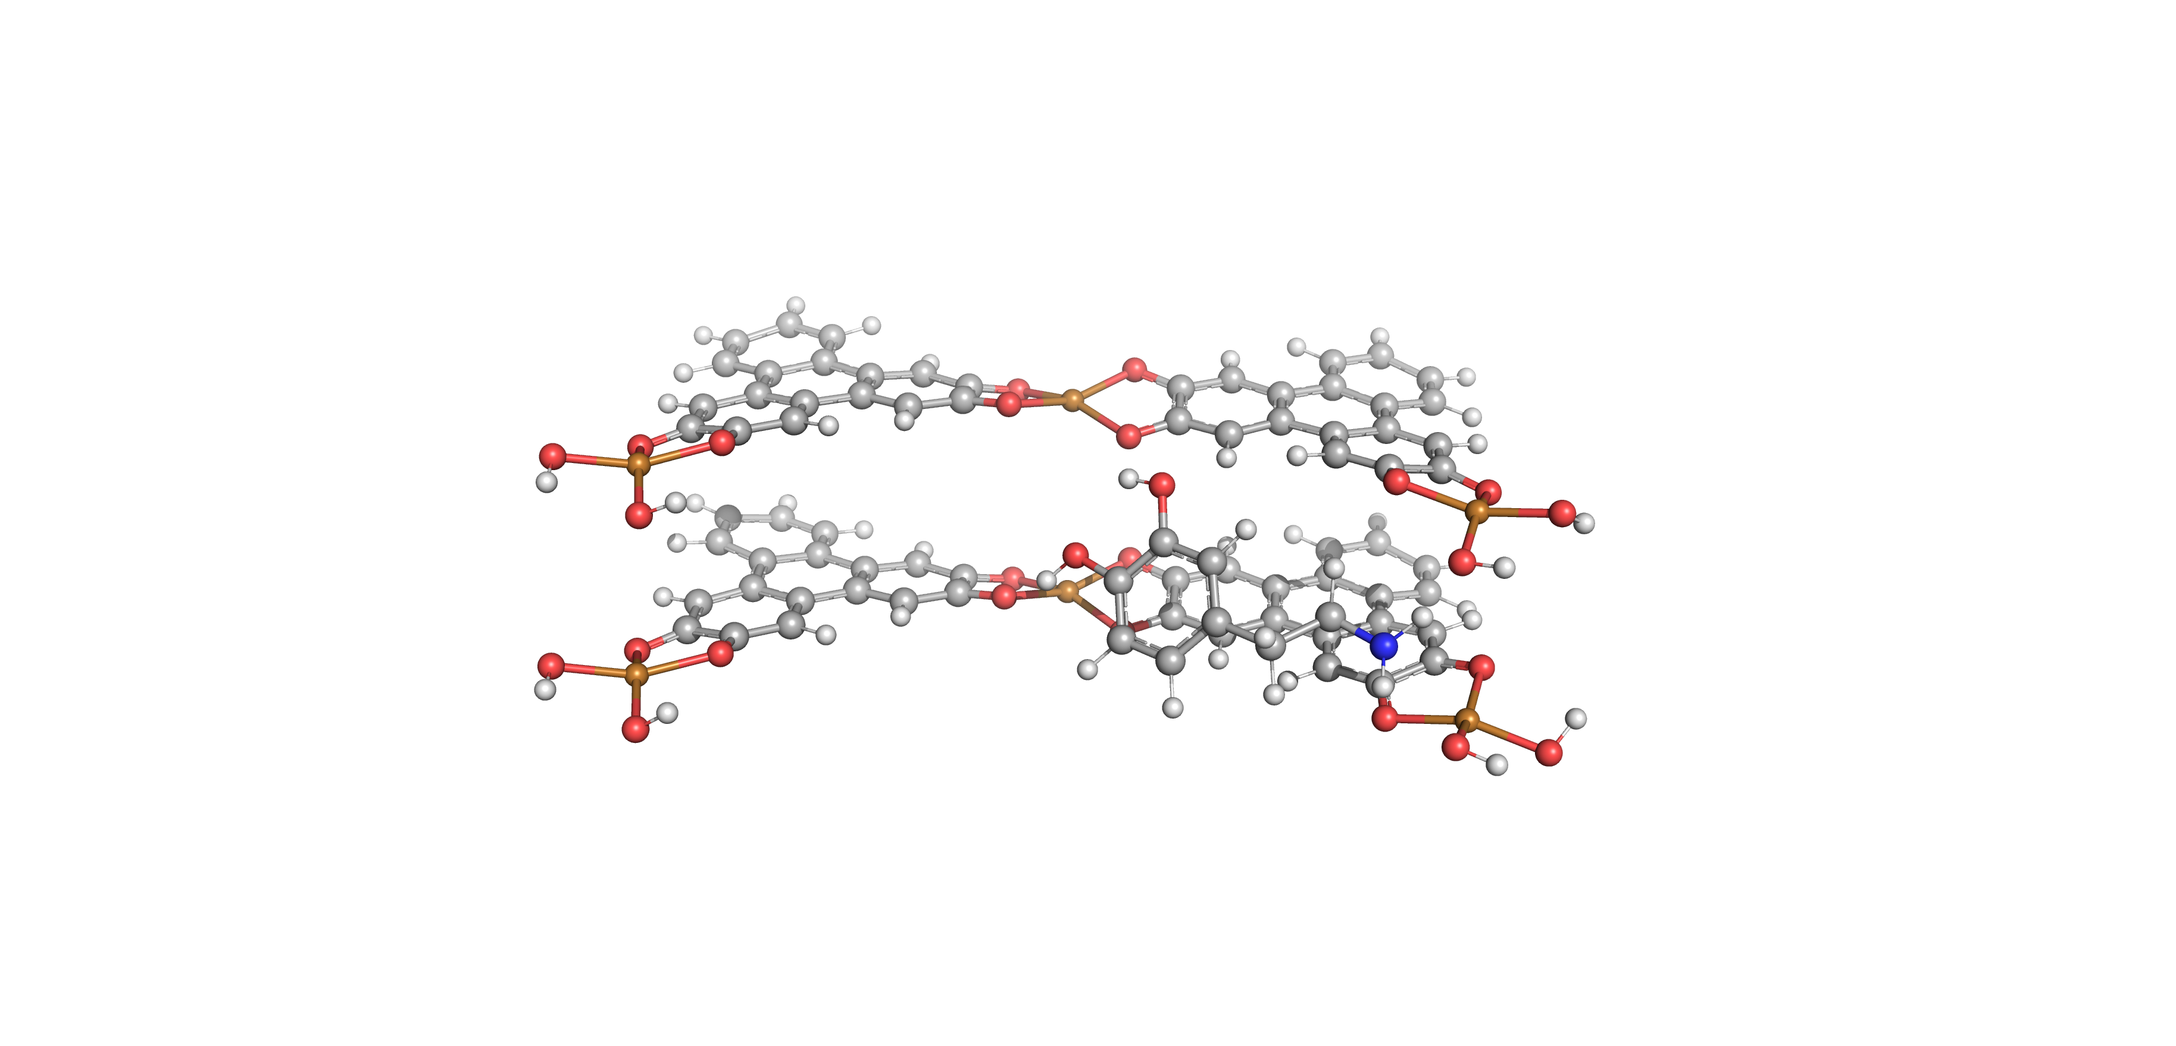
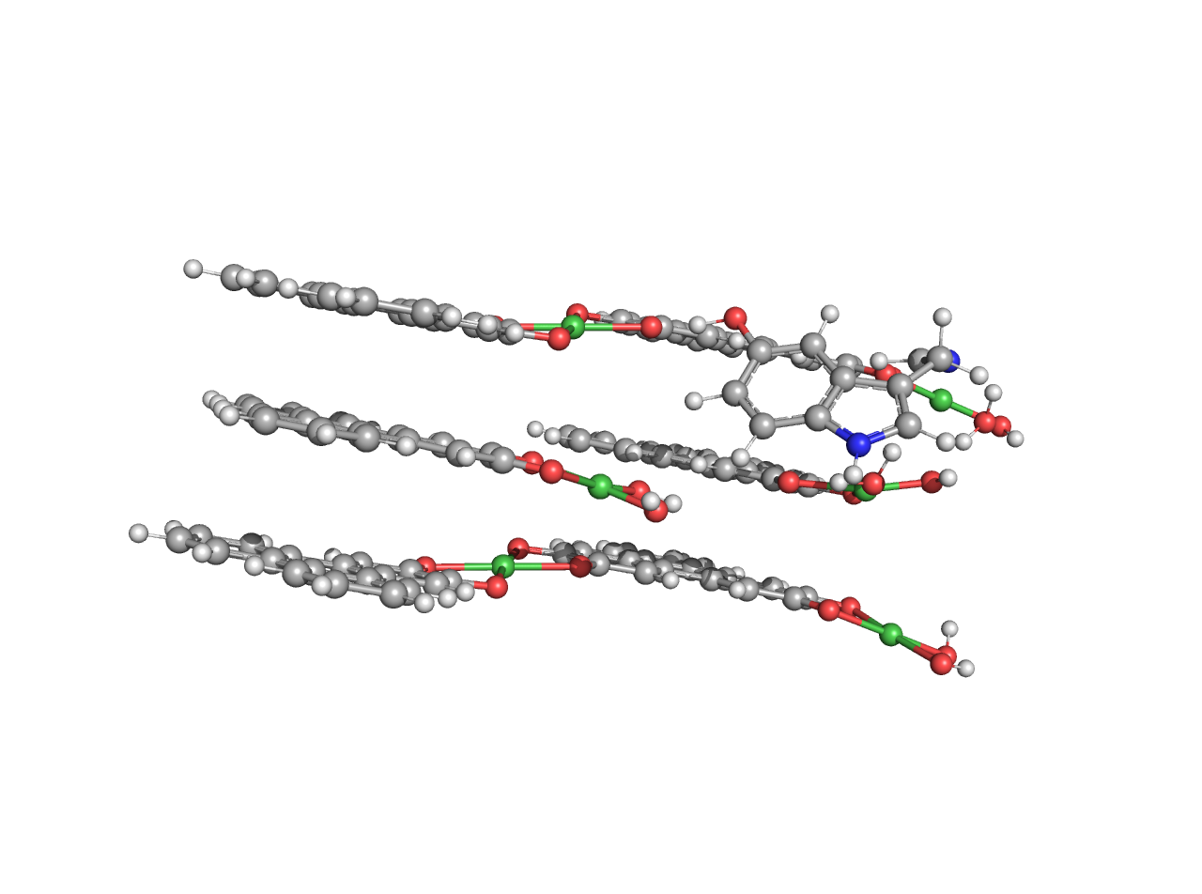
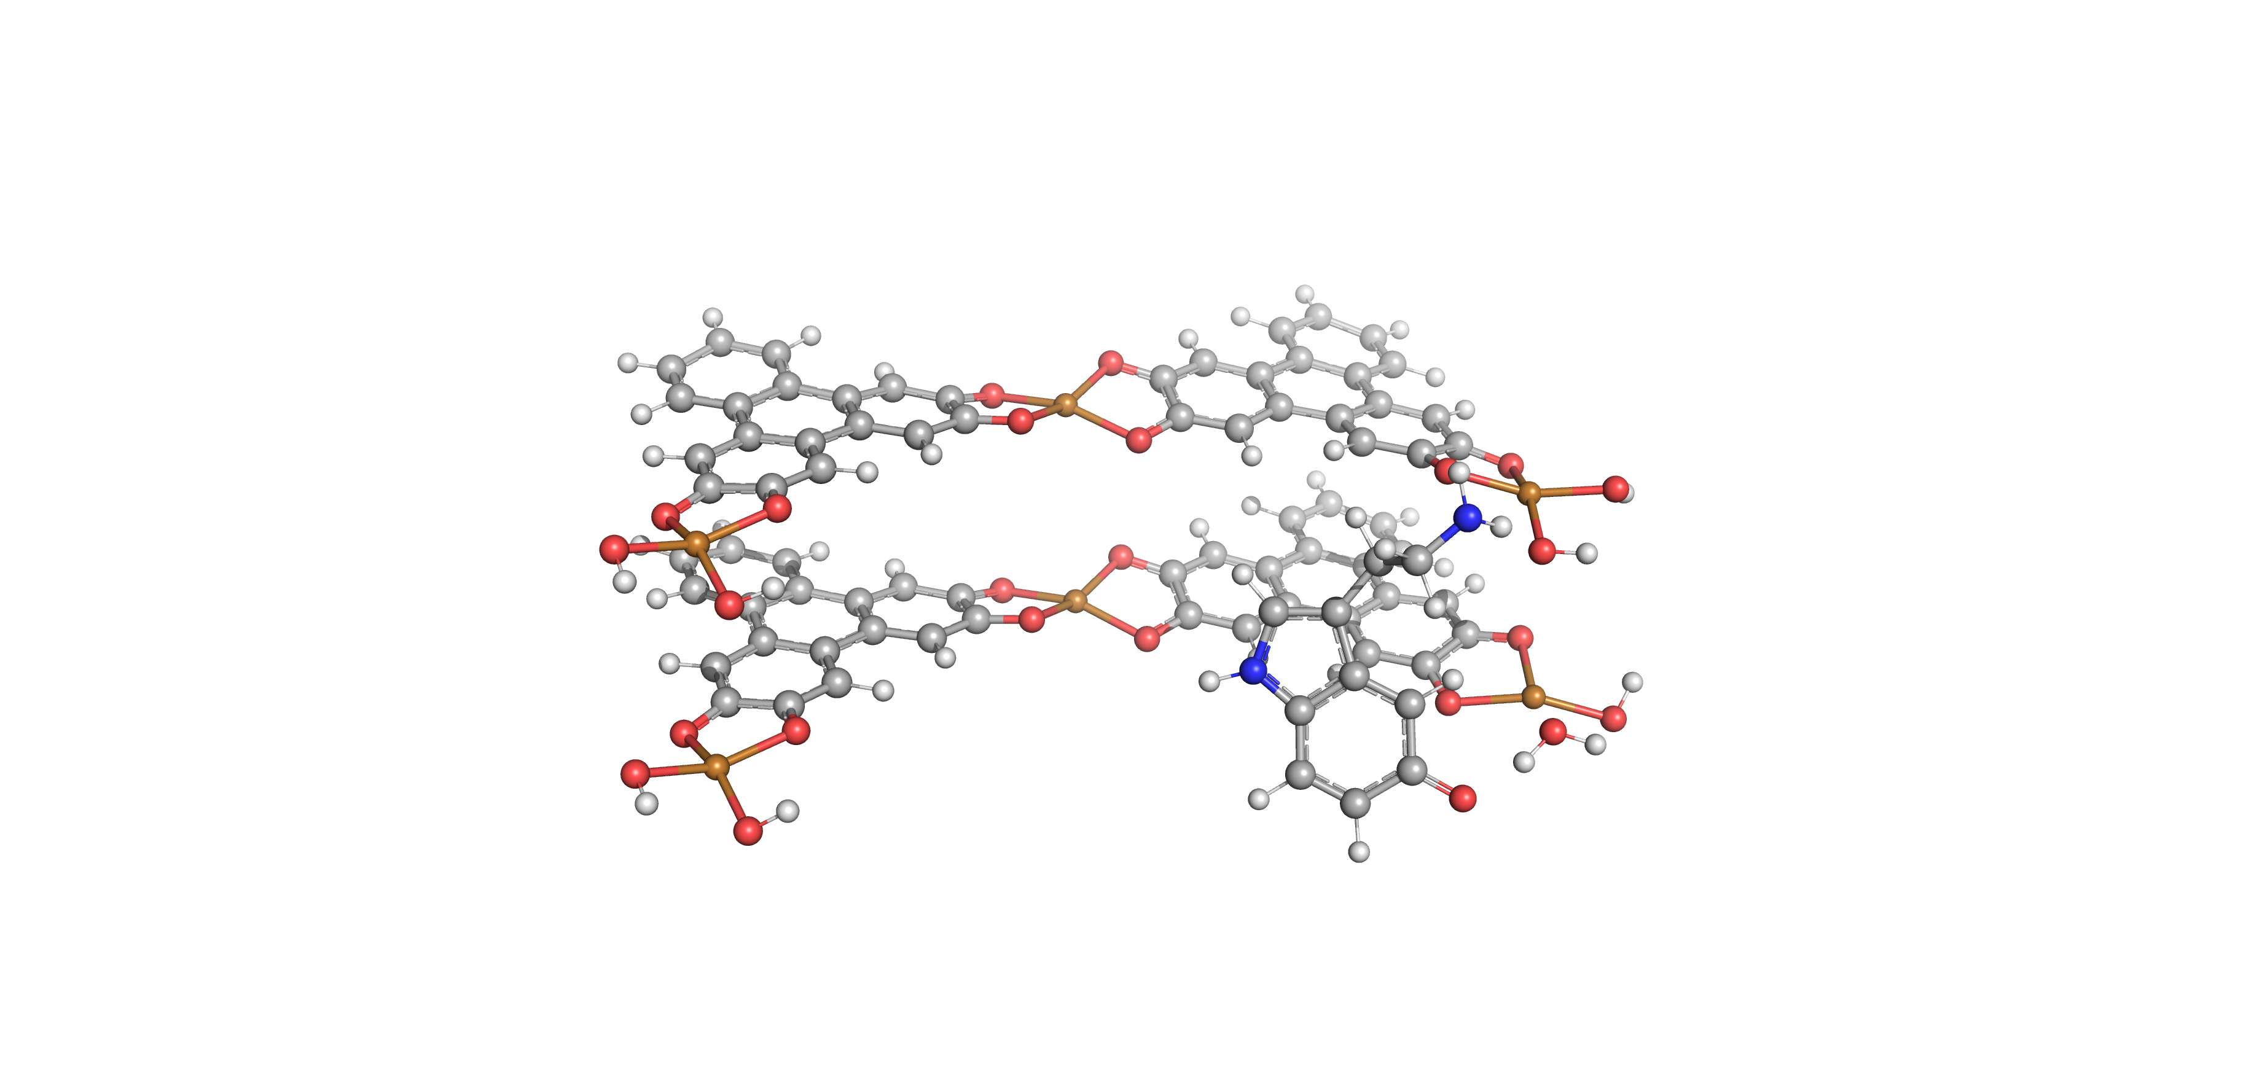
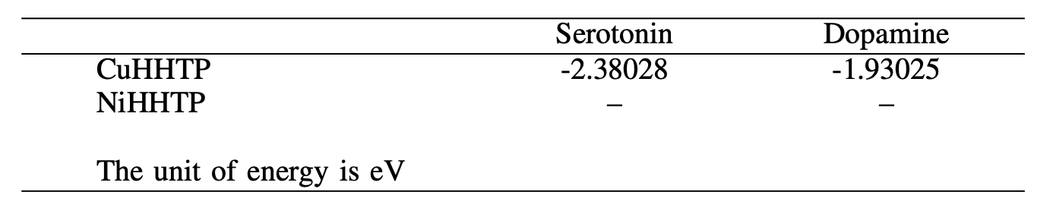
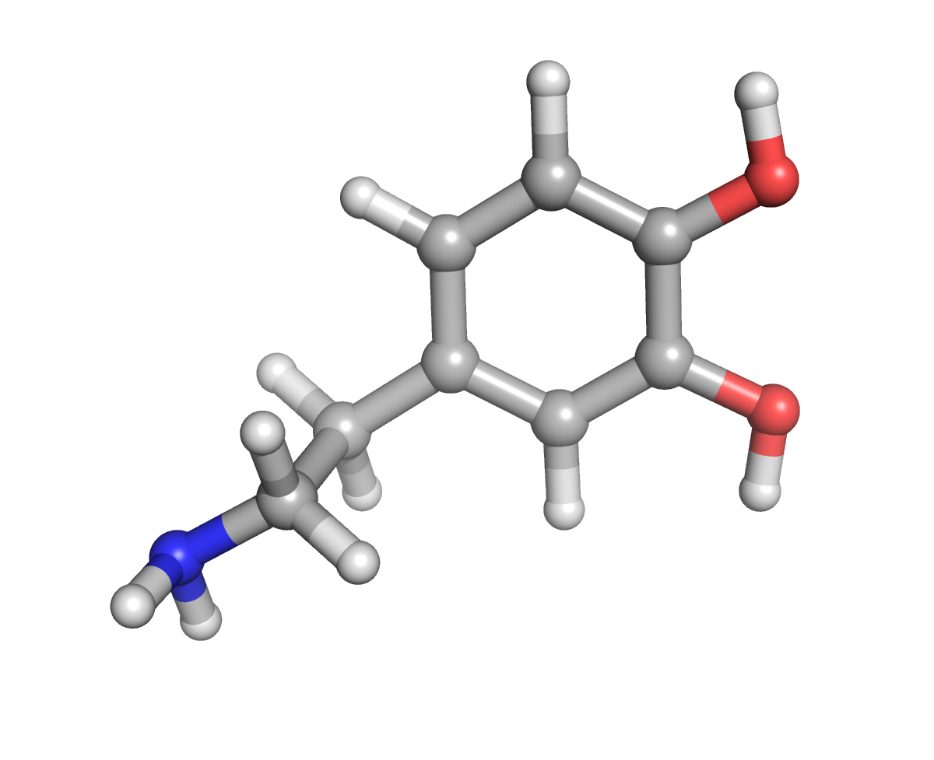
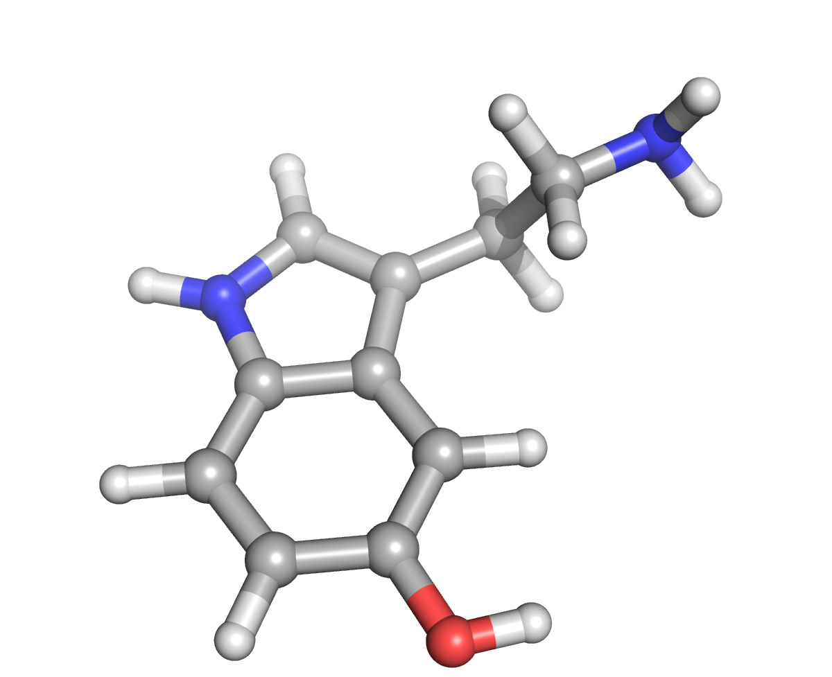
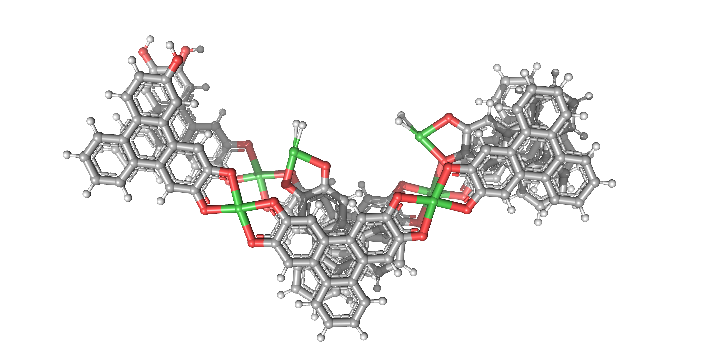
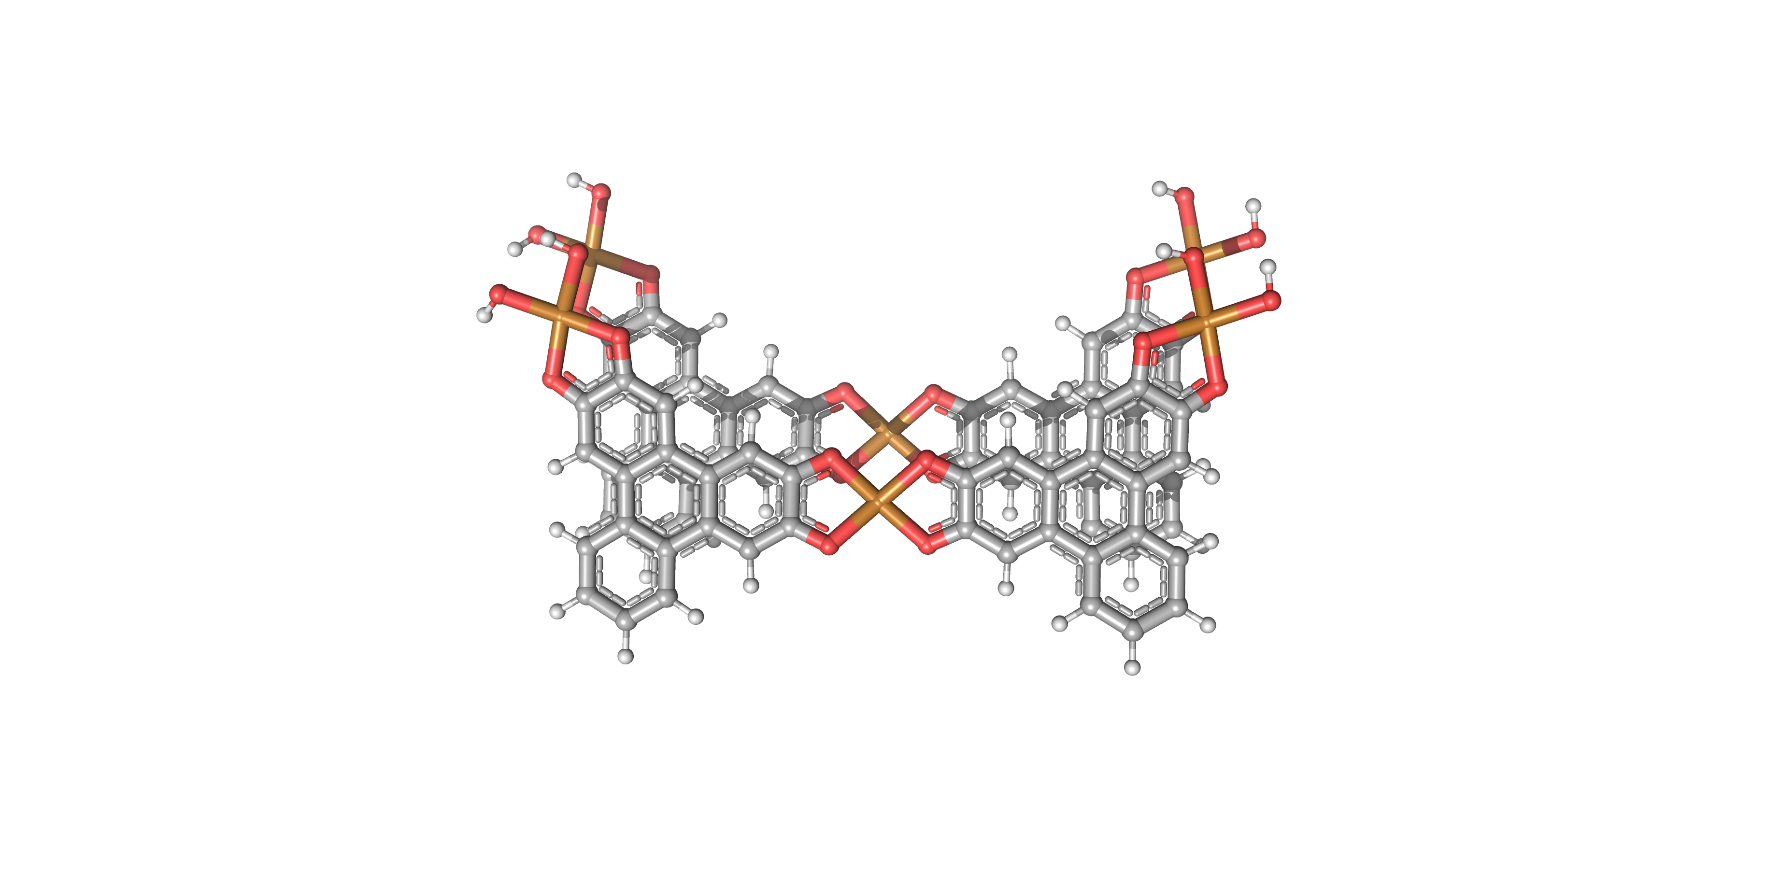



BioMade RT4: Porous Conductive Biosensors, Computational Modeling
Yibo Zhang, Kirk D. Badger, Craig T. Chapman
Department of Chemistry, University of New Hampshire, Durham, NH 03824
Introduction
Computational Details
We use density functional theory to investigate the quantum mechanical interactions between metal-organic-framework (MOF)-based biosensors and neurotransmitters. Our goal is to determine the underlying mechanism for selective sensing in 3D-printable MOF sensors.
Basis sets:
cc-pvdz, all light atoms
LANL2DZ-ECP (Cu, Ni)
Exchange-correlation functional:
Hybrid PBE0
Software:
NWChem ver. 6.8
Hardware:
BioMade cluster (maintained by RCC)
Dopamine@CuHHTP
Serotonin@NiHHTP
Modeling
Next Steps
MOF/target interactions are modeled using MOF fragments and single molecules. MOF is held fixed while small molecule explores binding sites
1. Define MOF fragment
  Multiple binding sites
  Multiple layers
2. Place molecule near MOF
3. Hold MOF fixed, allow target to find lowest energy binding site
Electron transfer studies
- Determine redox potential for each
MOF/target combination
Surface vs Edge binding sites
- Which are preferable for each target
Determine MOF/polymer interaction
- Will 3D printable polymer compete for
active sites on MOF
Serotonin@CuHHTP
Dopamine
Serotonin
Results
Acknowledgements
MOF-target binding occurs mainly through hydrogen bonding between the target OH & NH₂ groups and the MOF bridging oxo groups.
Interlayer separation and linker length can be tuned to enhance selective binding
CuHHTP binds serotonin more strongly than dopamine.
NiHHTP calculations still pending
Thanks to the Mirica group for helpful discussions on generating the MOF model.
This research is supported by a National Science Foundation EPSCoR award (#1757371).
NiHHTP
CuHHTP
sTAMD Simulations
Graphs, Etc… Here
Graph #1 Sub-Title Here
Graph #2 Sub-Title Here
Graph #1 Caption Here
Graph #2 Caption Here

