Slide 1
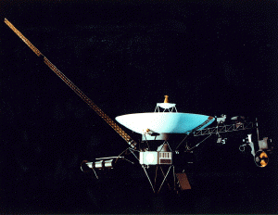

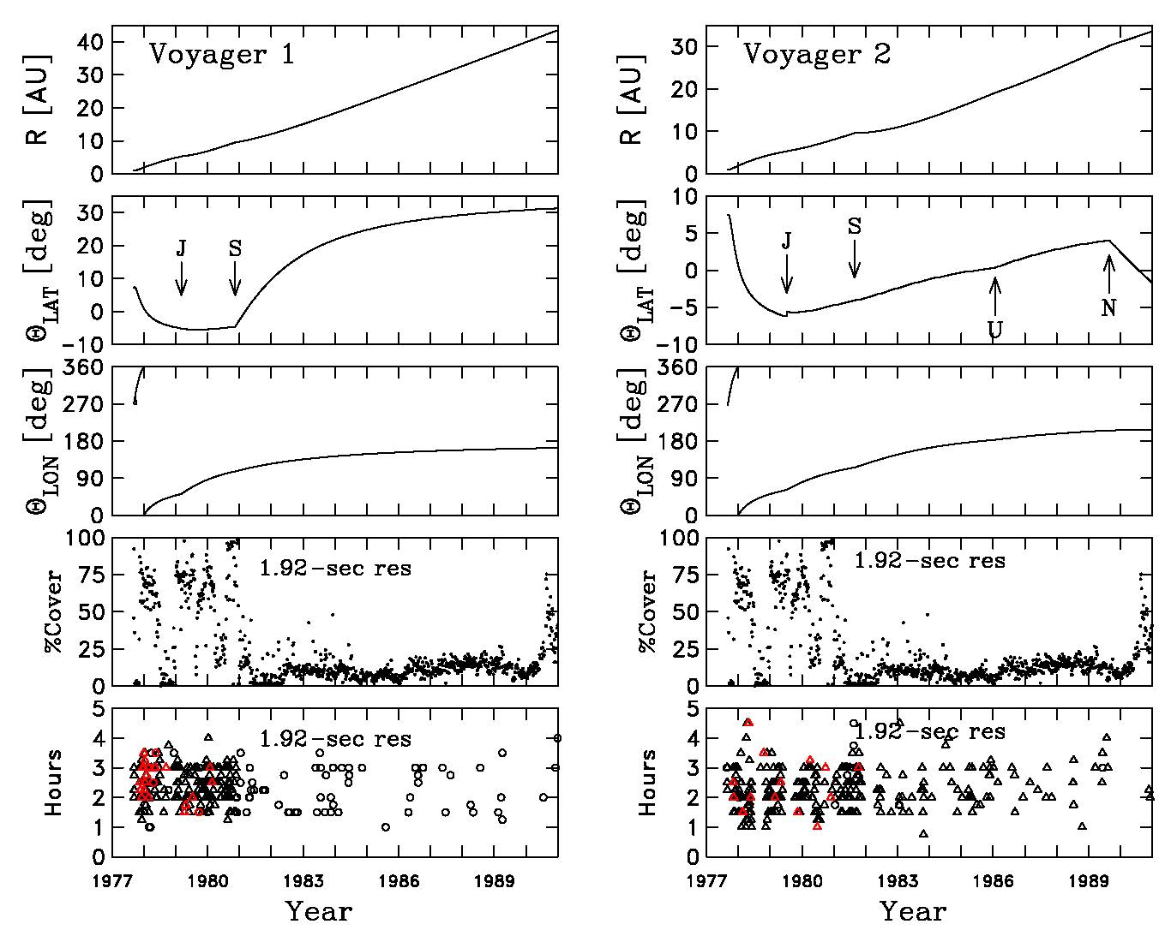
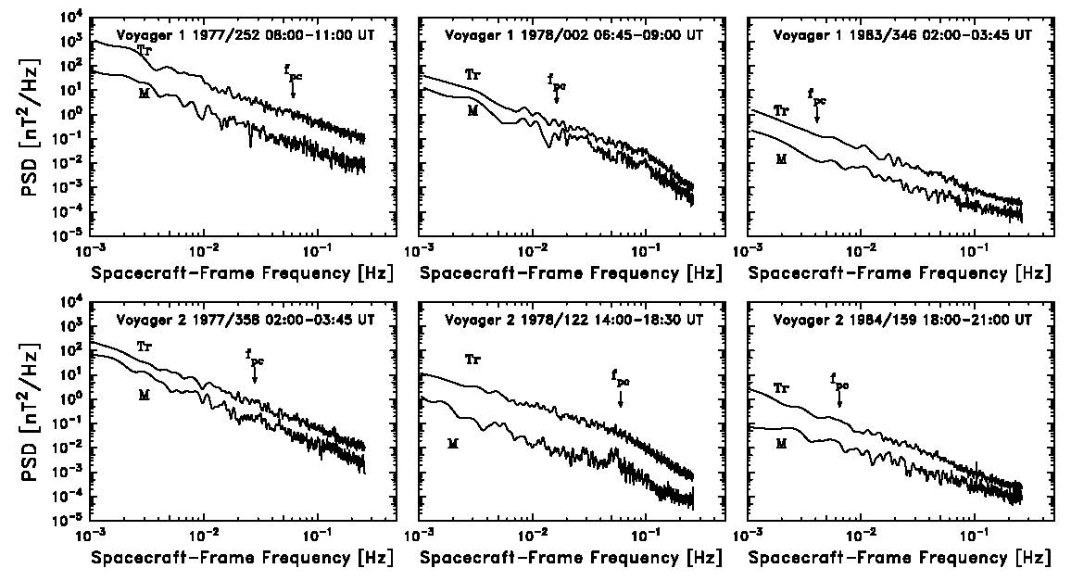
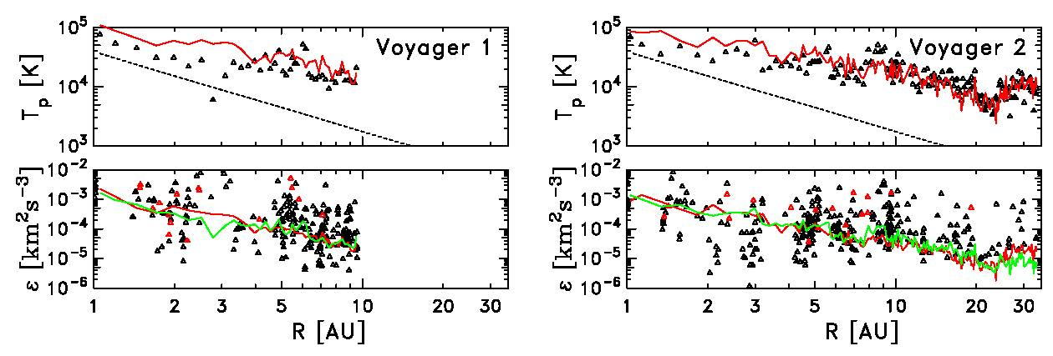
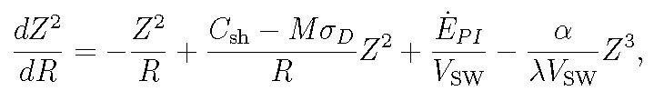
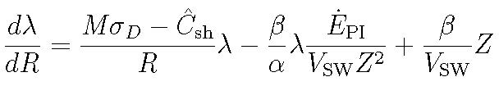

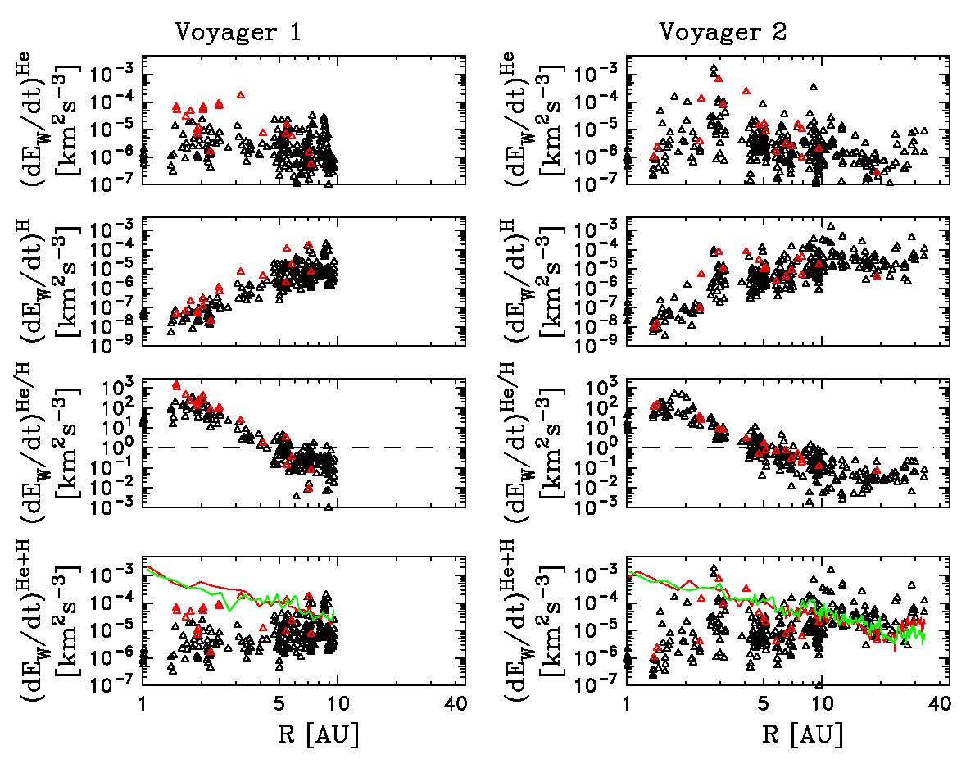
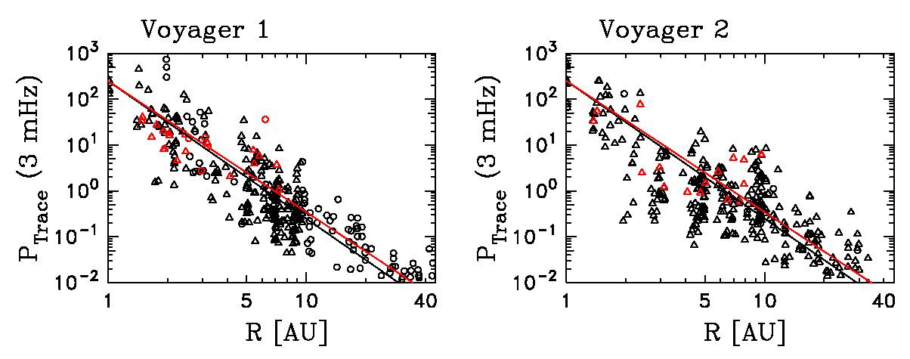
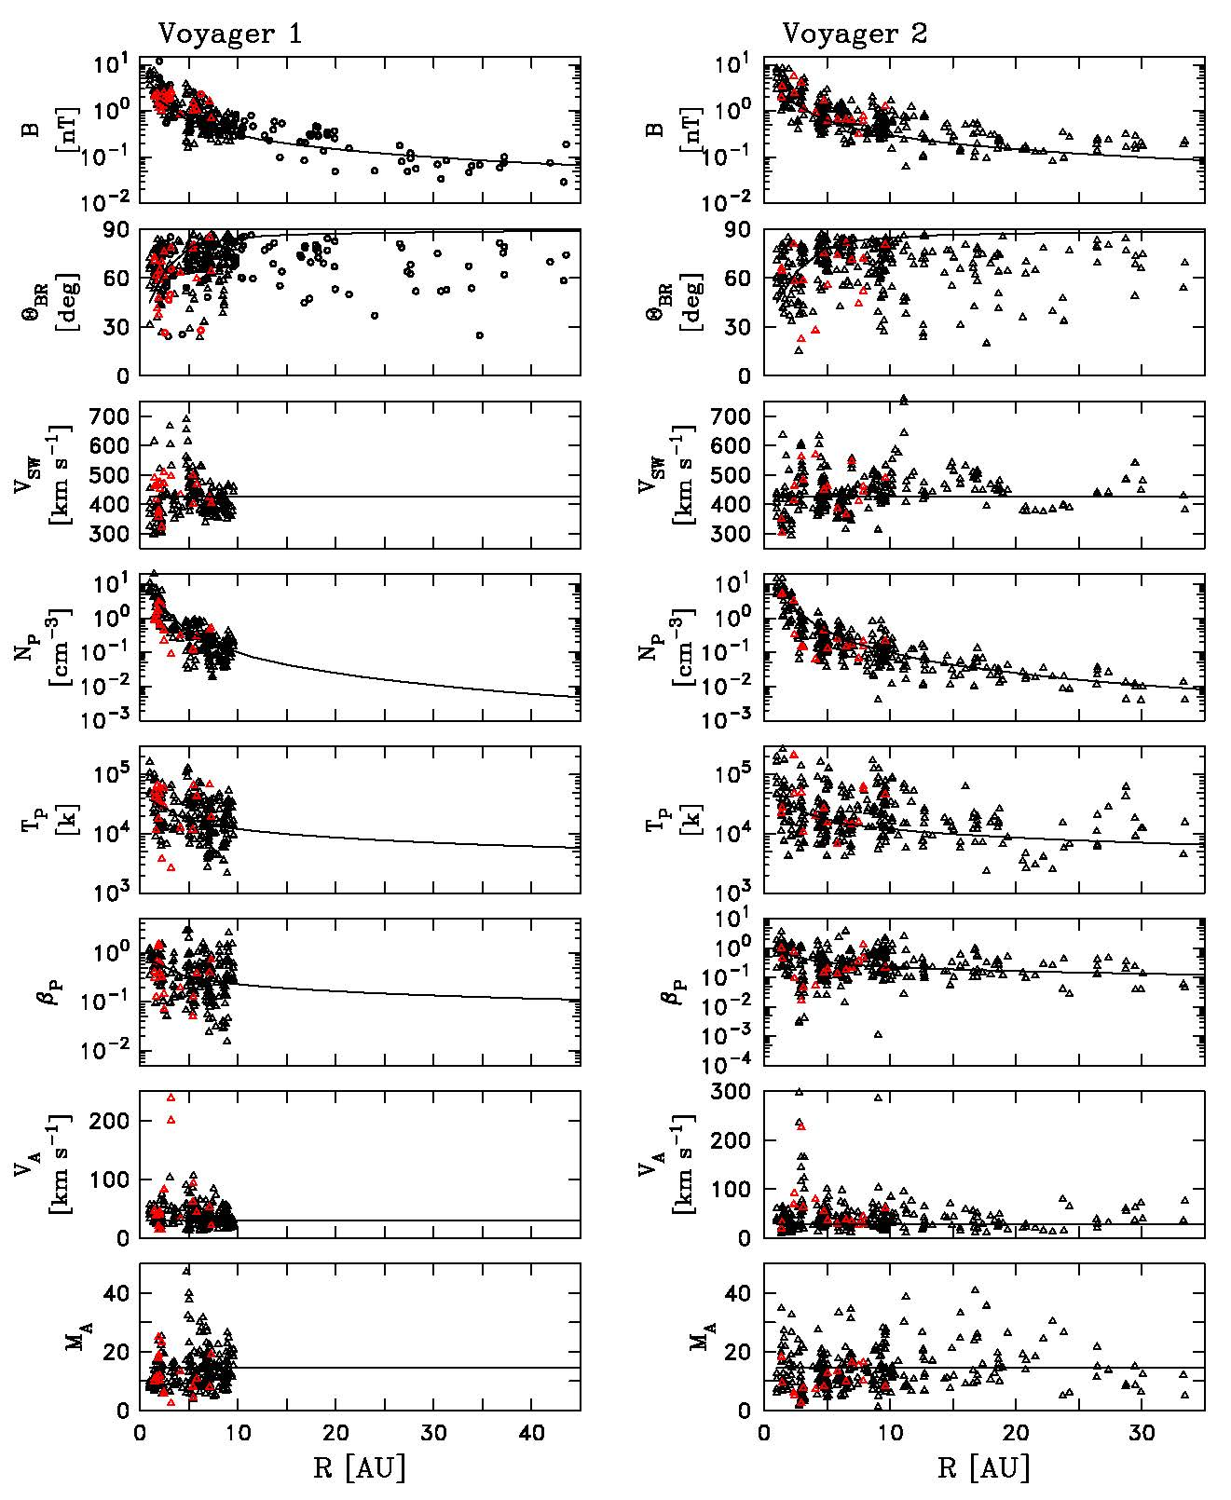
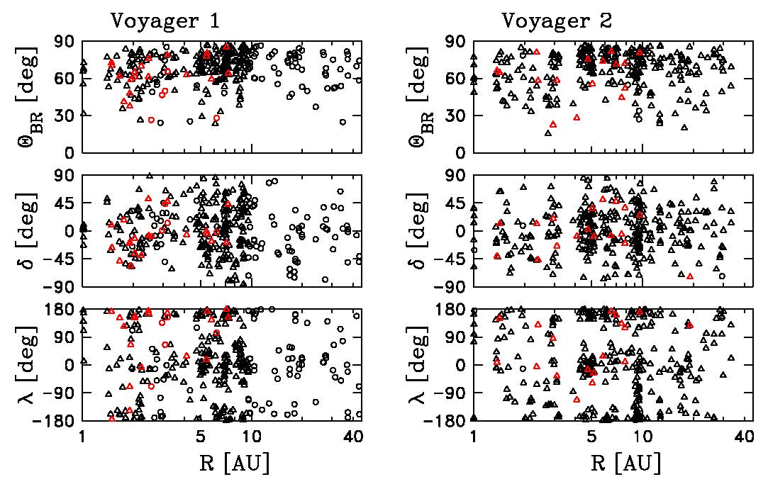
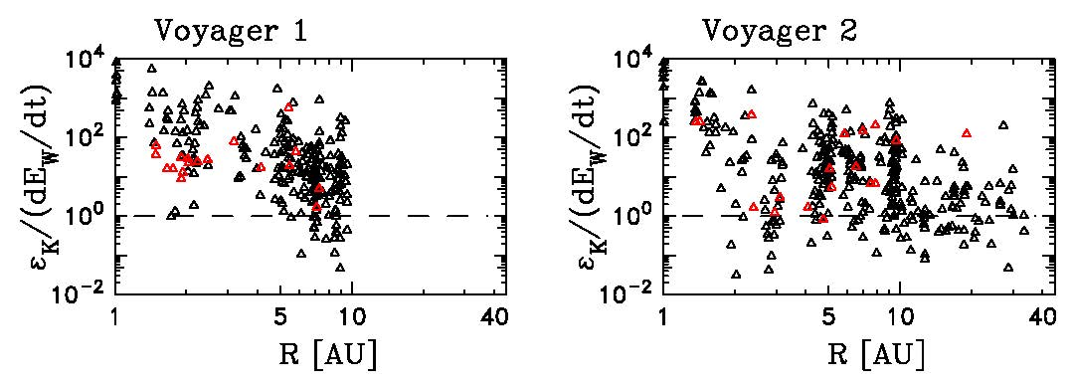
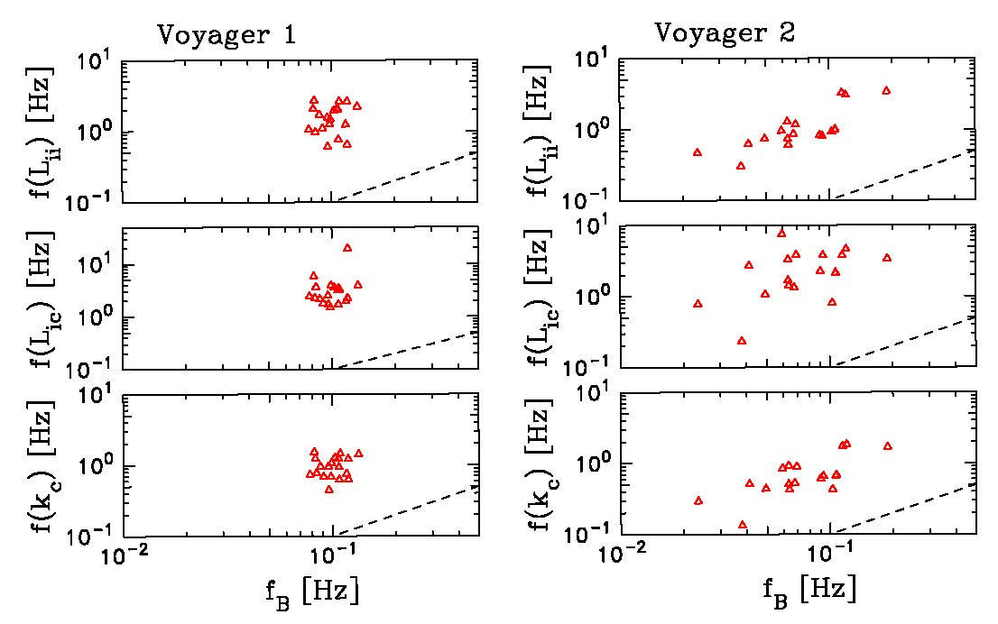
Voyager Observations of the Turbulent Transport and Heating of the Solar Wind: 1 to 35 AU
Charles W. Smith¹, Zackary B. Pine², Sophia J. Hollick³, Colin J. Joyce⁴, Matthew R. Argall¹, Bernard J. Vasquez¹, Philip A. Isenberg¹,
Nathan A. Schwadron¹, Justyna M. Sokol⁵, Maciej Bzowski⁵, Marzena A. Kubiak⁵, and Megan L. McLaurin⁶
¹Univ. New Hampshire, ²Boston University, ³Rensselaer Polytechnic Institute, ⁴Princeton University, ⁵Space Research Centre, Polish Academy of Sciences, ⁶Wolters Kluwer
We use 1.92 sec Voyager magnetic field data to test the predictions of turbulence theory driven by newborn interstellar pickup ions against the observed heating of solar wind protons.
(left) Trajectory and data coverage for the Voyager spacecraft. Red symbols denote times when spectral break due to dissipation is observed. Circles represent times of missing PLS data.
(right top) Examples of magnetic power spectra computed by the Blackman-Tukey method. Some examples show spectral break, some do not, and some show possible aliasing at high frequencies.
(right) Computed power at 3 mHz as a function of heliocentric distance. Black (red) line are WKB (transport theory) predictions of R⁻³ (R^{−20/7}).
(left) Average plasma parameters for each of the data intervals used along with nominal scaling plotted as a function of heliocentric distance.
(right) Angles describing the direction of the mean magnetic field for each data interval used: Θ_{BR} is angle between mean field and radial direction, δ is north-south deflection of the field, and λ is clock angle in the (R,T) plane. Note there commonly are significant deviations from the nominal spiral direction for data intervals of this length.
We adopt the MHD transport equations (Matthaeus et al., 1994; Smith et al., 2006):
where Z² is fluctuation energy, λ is the similarity scale, T_{P} is proton temperature, α=0.8, β=0.4, M=1/3, σ_{D}=−1/3, C_{sh}=1.4, Ĉ_{sh}=0, and λ_{1AU}=0.03AU.
(right top) Measured proton temperature (symbols) and prediction derived from theory using measured 1 AU boundary conditions (red curve). Also, turbulent heating rate ε determined from spectrum at 3 mHz (symbols), transport theory (red curve), and Vasquez et al. scaling (green curve).
(right) Comparison of wave energy excitation by interstellar pickup helium (He) and hydrogen (H) compared with heating rates from above.
(right) Ratio of heating rates computed from the spectrum and by wave excitation by pickup ions. Note that pickup ions become the dominant term by ~ 10 AU.
Conclusions: We find agreement between the results of transport theory that yield accurate predictions for the average solar wind proton temperature, the rate of proton heating as determined from transport theory allowing for expansion, the scaling predictions of Vasquez et al. (2007) that predict turbulent energy cascade rates as a function of wind speed and temperature, the rate of turbulent energy cascade as determined from the power spectra, and the rate of energy injection by newborn interstellar pickup ions.
(right) Observed frequency of the spectral break marking the onset of dissipation compared against the frequency associated with convection of the ion inertial and cyclotron scales. Dissipation onset occurs at 10x the ion inertial scale. This permits us to use 3 to 10 mHz to represent the inertial range in this study.
Acknowledgements: This work was supported by NASA grants NNX17AB86G, NNG06GD55G, 80NSSC17K0009, the IBEX mission, NSF grants AGS1357893, AGS1135432, and the Polish National Science Center grant 2015/19/B/ST9/01328.
The data used in this analysis are available from the NSSDC.

