Slide 1


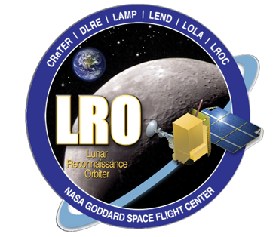
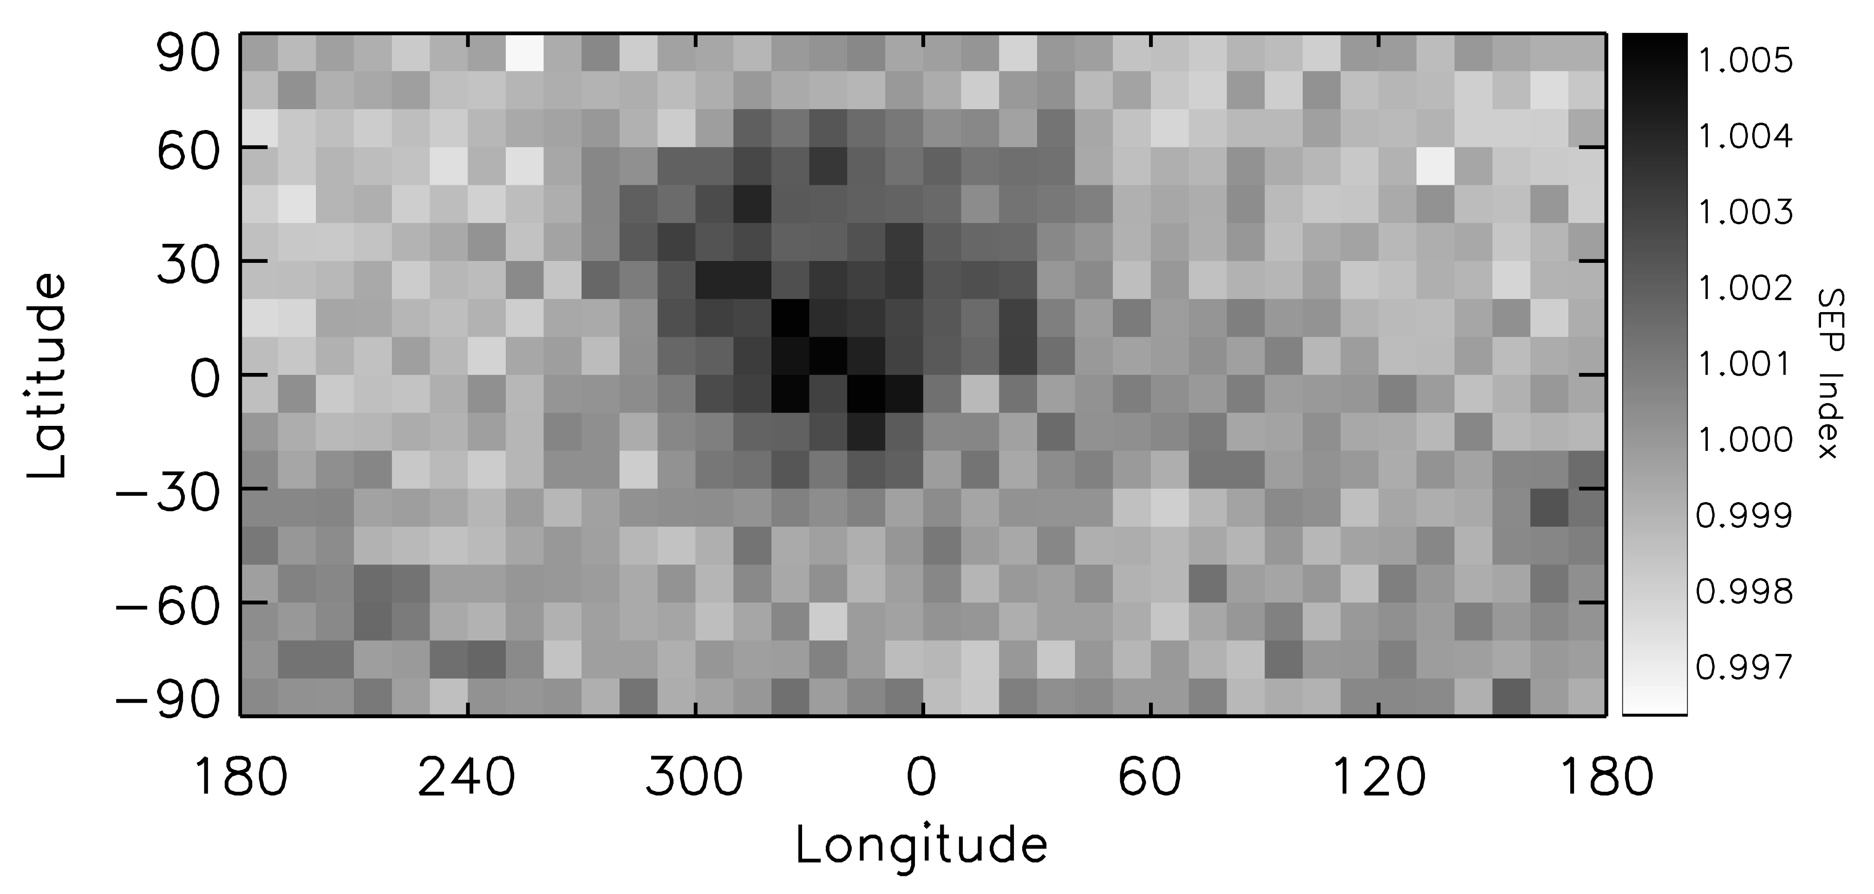
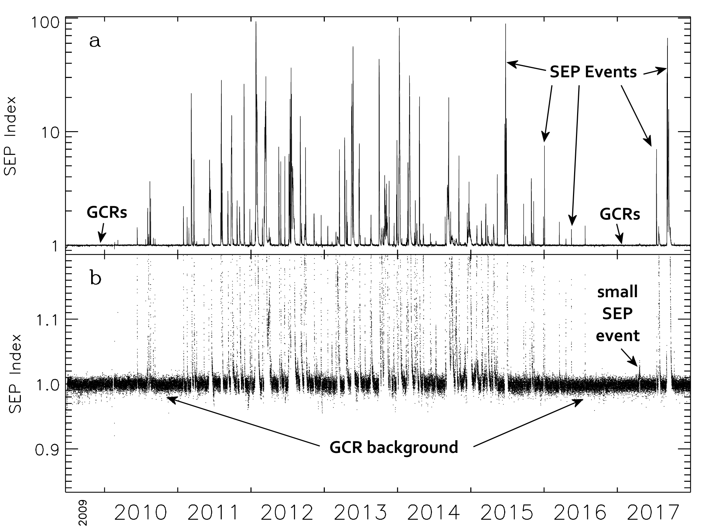
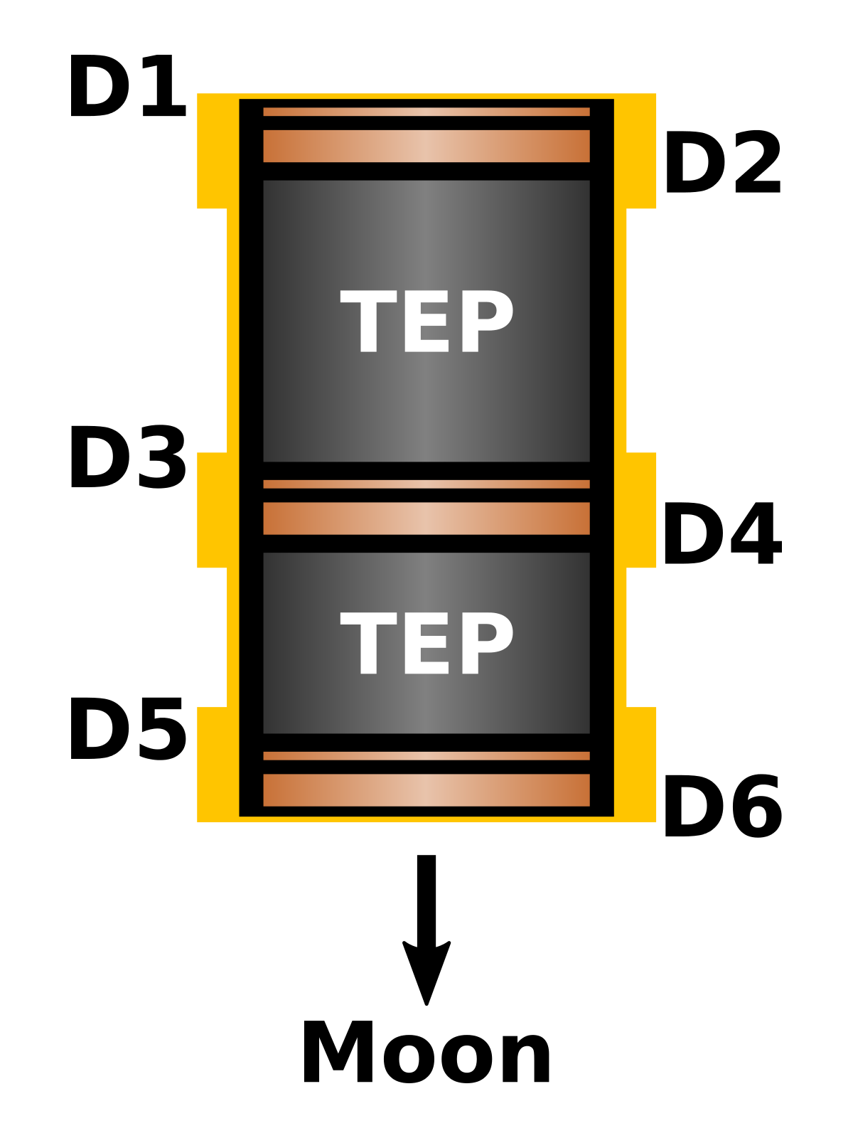
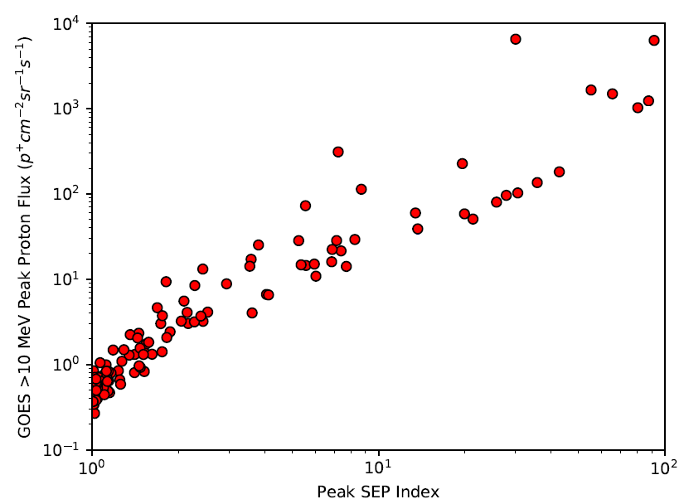
A Serendipitous New View of Lunar Albedo Radiation
J. K. Wilson^{1,2}, H. E. Spence^{1,2}, N. A. Schwadron^{1,2}, M. D. Looper³, A. W. Case⁴, A. P. Jordan^{1,2}, W. de Wet¹, J. Kasper⁵
¹Institute for the Study of Earth, Oceans, and Space, University of New Hampshire, Durham, NH (jody.wilson@unh.edu), ²Solar System Exploration Research Virtual Institute, NASA Ames Research Center, Moffet Field, California, ³The Aerospace Corporation, El Segundo, California, ⁴Harvard-Smithsonian Center for Astrophysics, Cambridge, MA, ⁵Michigan Institute for Research in Astrophysics, University of Michigan, Ann Arbor, Michigan.
Overview
We have discovered a new lunar radiation mapping method using data from the Cosmic Ray Telescope for the Effects of Radiation [1] (CRaTER) on the Lunar Reconnaissance Orbiter (LRO) that is simpler to implement while generating a cleaner signal than previous methods. The new map is an extension of a formula that precisely identifies solar energetic particle (SEP) events in CRaTER data; we refer to the method hereafter as the “SEP Index.” We find that SEP events cover ~20% of the LRO mission timeline from launch through the end of 2017, and we use the remaining ~80% of the data (solar quiet periods) to map the Moon.
New Lunar Radiation Map
Features of the SEP Index Map
When we sort quiet-time SEP Index values by location over the Moon instead of by mission time, we generate a type of radiation map of the Moon. The new map has a vastly improved signal-to-noise ratio over more complex mapping methods that targeted albedo protons [2,3,4,5] and it closely resembles lunar gamma ray maps for certain elements made by Lunar Prospector, particularly maps of KREEP terrain constituents such as titanium and thorium [6,7]. Figure 2 shows the new map with higher index values represented by darker shades. Given that detector D6 faces the Moon with minimal shielding, and that the D6 detection rate appears in the numerator of one term of the SEP Index, any “bright” or “dim” features that appear in a SEP Index map of the Moon are probably due to an enhancement or dearth, respectively, of lunar albedo particles or photons that can reach D6 more easily than the other three detectors in the SEP Index (D4, D3, and D1).
Solar Energetic Particle (SEP) Index
Figure 2. Lunar map of the SEP Index with 10°×10° binning, covering latitudes from 60° N to 60° S. The lunar maria on the Earth-facing hemisphere generally have a ~0.5% higher SEPI value than the highlands, and the South Pole Atkin Basin (lower left and lower right) is also slightly higher. Each pixel has an uncertainty of ~0.005, or ~8% of the map’s full dynamic range.
Next Steps
Using the features in the lunar map as a guide, we will generate LET spectra for different regions to search for variations in gamma rays, neutrons, or protons that identify large-scale elemental concentrations in the regolith. If the features are due to gamma rays, then the energy resolution of CRaTER’s detectors gives us the potential to produce spectra with up to 4 times the spectral resolution of Lunar Prospector. If the map features are albedo protons, then these are lower-energy protons (10-50 MeV) compared to previous proton maps (~100 MeV), and the two mapping methods together could provide depth resolution for elemental abundances in the lunar regolith.
In LRO’s ESM4 mission, CRaTER will conduct new observations of grazing-angle radiation over the poles and on the lunar night-side to search for additional signatures of surface hydration [5].
Candidate Particles in SEP Index Map
Albedo protons, neutrons, and gamma rays are the most likely contributors to the features in the lunar SEP Index map. Because the SEP Index uses the ratios of outer detector (D1, D6) rates to inner detector (D3, D4) rates, any enhanced signal in D6 which is correlated with a location on the Moon will appear as an enhancement in the SEP Index map, and we assume this is the case for the features seen in Figure 2. Most candidate albedo particles will to some degree generate a higher signal in D6 compared to the other detectors (Figure 3), but the peculiar SEP Index calculation results in a lower sensitivity to highly-penetrative particles like neutrons compared to other types of radiation like albedo protons and gamma rays.
Additional Result: Detecting Small SEP Events
Figure 1. Time history of the SEP Index. (a) The full range of SEP Index values through 2017. (b) The same plot magnified to show the details in the GCR background, which is remarkably flat on all time-scales. Very small SEP events stand out clearly from the background, which varies by only ~1% during solar quiet times.
Figure 3. Diagram of CRaTER Instrument showing nominal geometry relative to the Moon. CRaTER's six detectors can discriminate different elements in the galactic cosmic ray (GCR) population above ~10 MeV per nucleon and can also distinguish between GCRs arriving from deep space and albedo particles traveling up from the lunar surface. Between the three detector pairs are two pieces of tissue equivalent plastic (TEP) that absorb radiation in a manner similar to human tissue.
http://crater.sr.unh.edu/
SEP Index Description & Motivation
Unlike Wilson et al. [2,3] and Schwadron et al. [4,5], who used the energy deposited by each particle that registered in two or more detectors, the SEP Index uses only the total particle counting rates from four detectors and ignores (for now) any energy spectral information. The SEP Index takes advantage of unequal shielding within the CRaTER instrument, using the least-shielded detectors (D1 and D6) as proxies for the SEP flux, and the most-shielded detectors (D3 and D4) as proxies for the highly-penetrating background galactic cosmic ray (GCR) flux. We empirically derived the formula for the SEP Index for accurately detecting and quantifying the smallest solar energetic particle events and were surprised to find a form that varies by only ~1% during quiet periods over a span of more than 8 years.
Below-GOES threshold
“small” SEP events
References
[1] Spence et al. (2010), Space Sci. Rev, 150, 243-284. [2] Wilson et al. (2012) JGR, 117, (E12). [3] Wilson et al. (2014) AGU Fall Meeting. [4] Schwadron et al. (2016) Icarus, 273, 25-25. [5] Schwadron et al. (2018) Planet. Space Sci., 162, 113-132. [6] Feldman et al. (1999), Nuclear Instruments and Methods in Physics Research A, 422, 562-566. [7] Prettyman et al. (2002), 33rd LPSC, Abstract #2012. [8] Gurman (2017), [online] Available at: https://umbra.nascom.nasa.gov/SEP/
Figure 4. Comparison of SEP event magnitudes as determined by the maximum SEP Index values during each event (x-axis) and the GOES peak proton flux above 10 MeV during each event (y-axis, data from [8]). Blue lines indicate differences from the official GOES SEP event list and the calculated maximum GOES flux.
This work is supported by the NASA LRO mission and the NASA DREAM² program.

