Slide 1

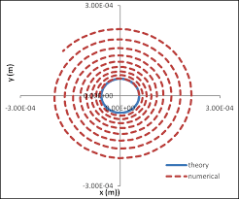
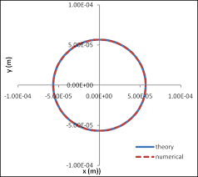
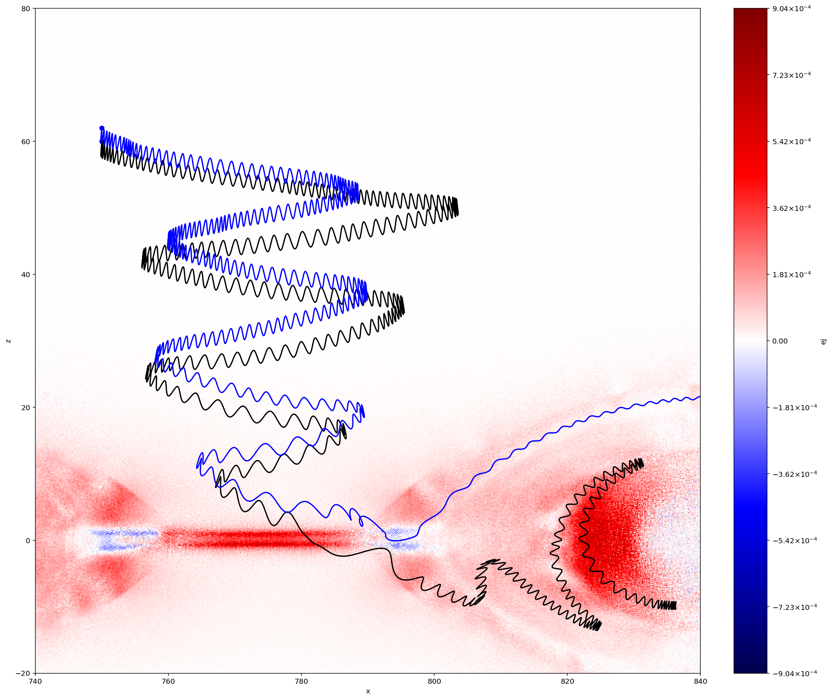
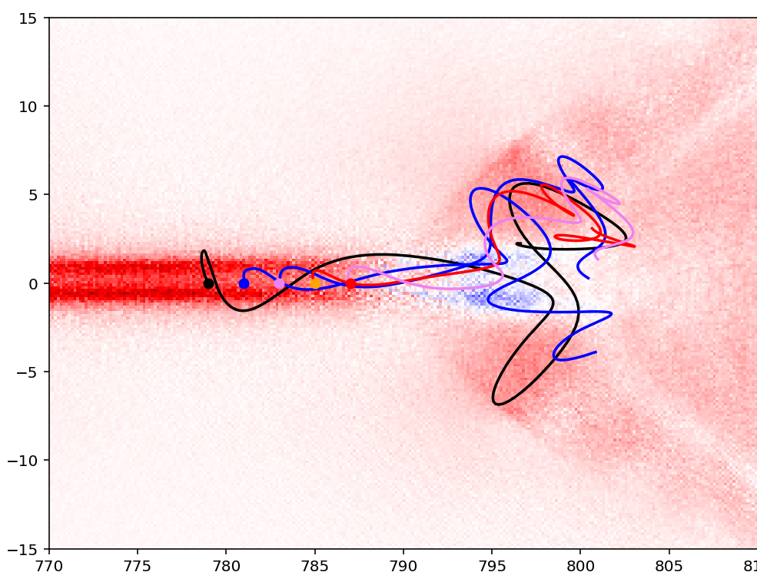
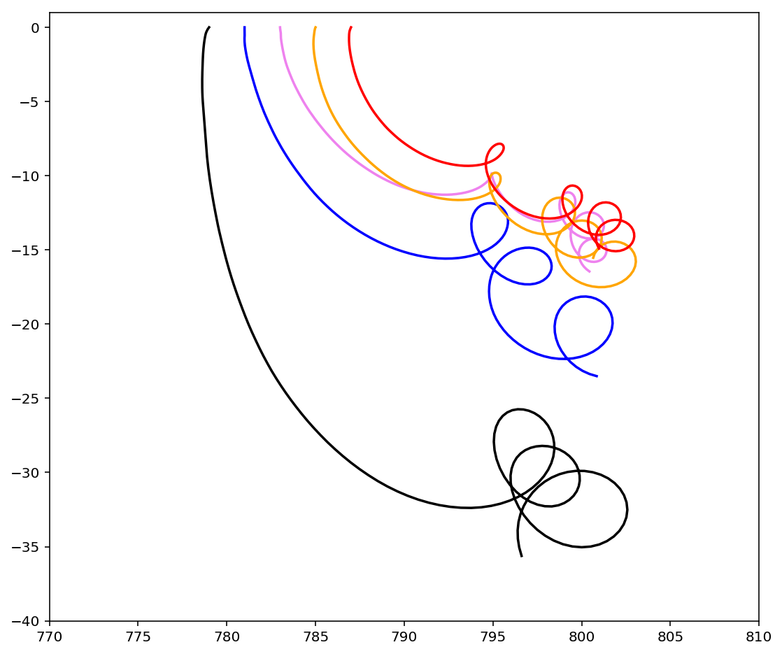
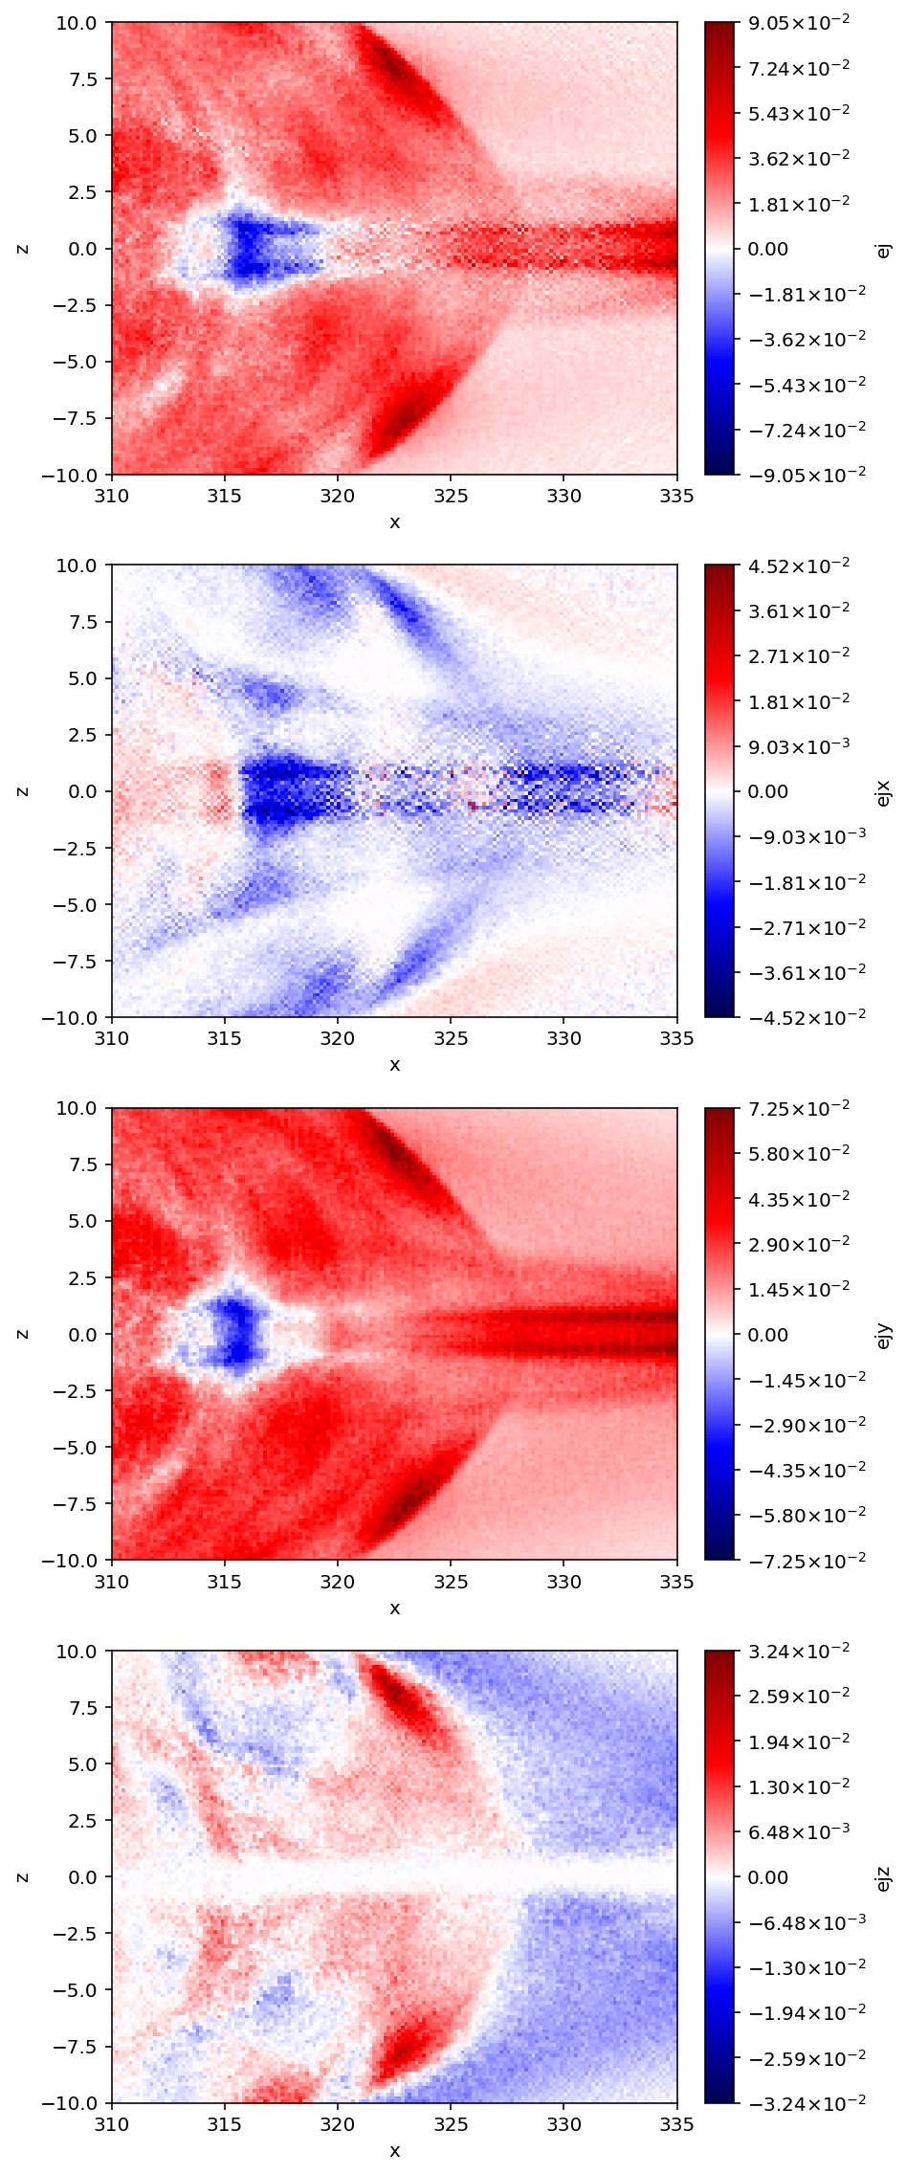
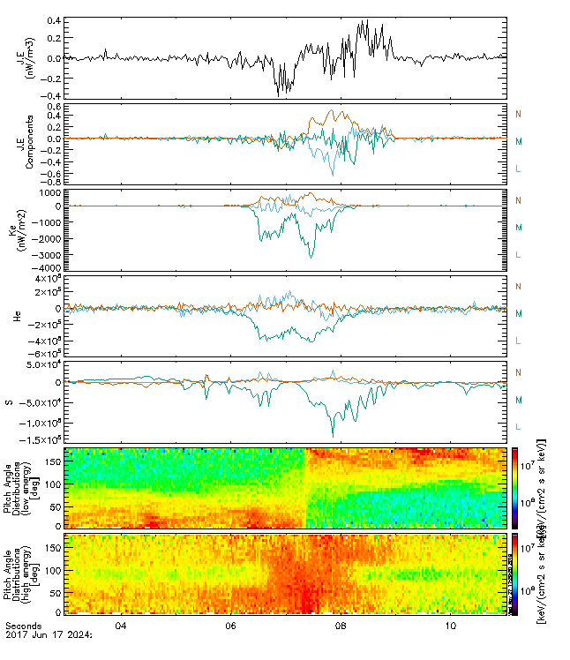
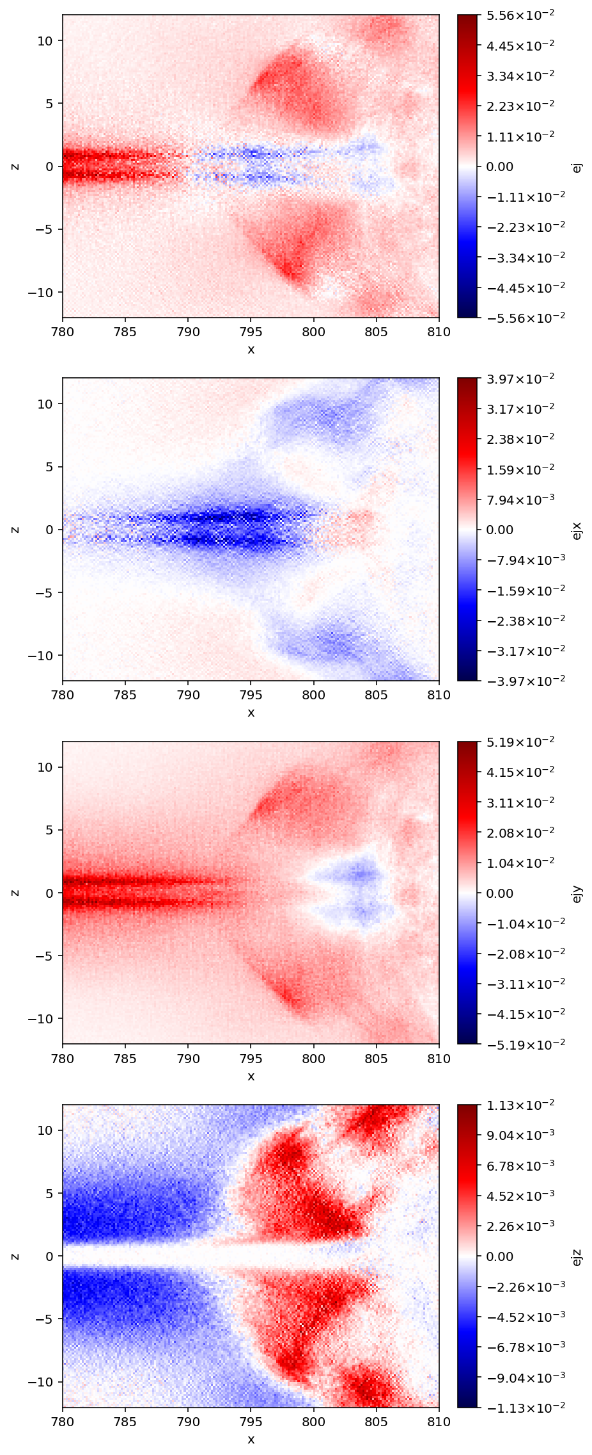
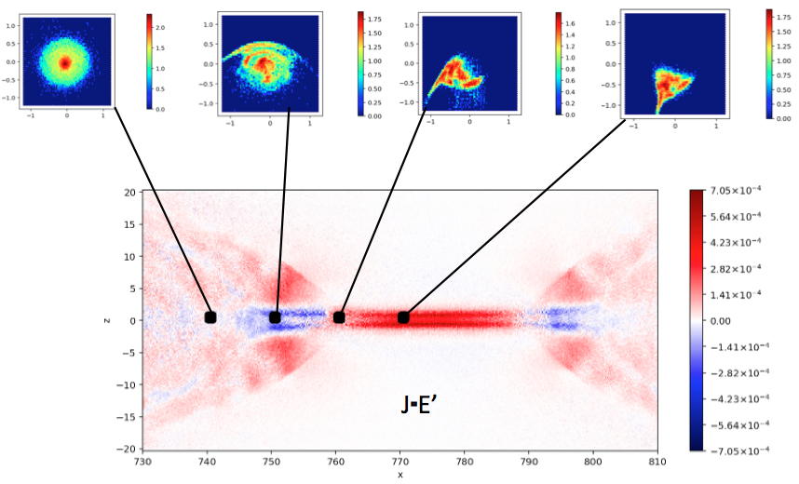











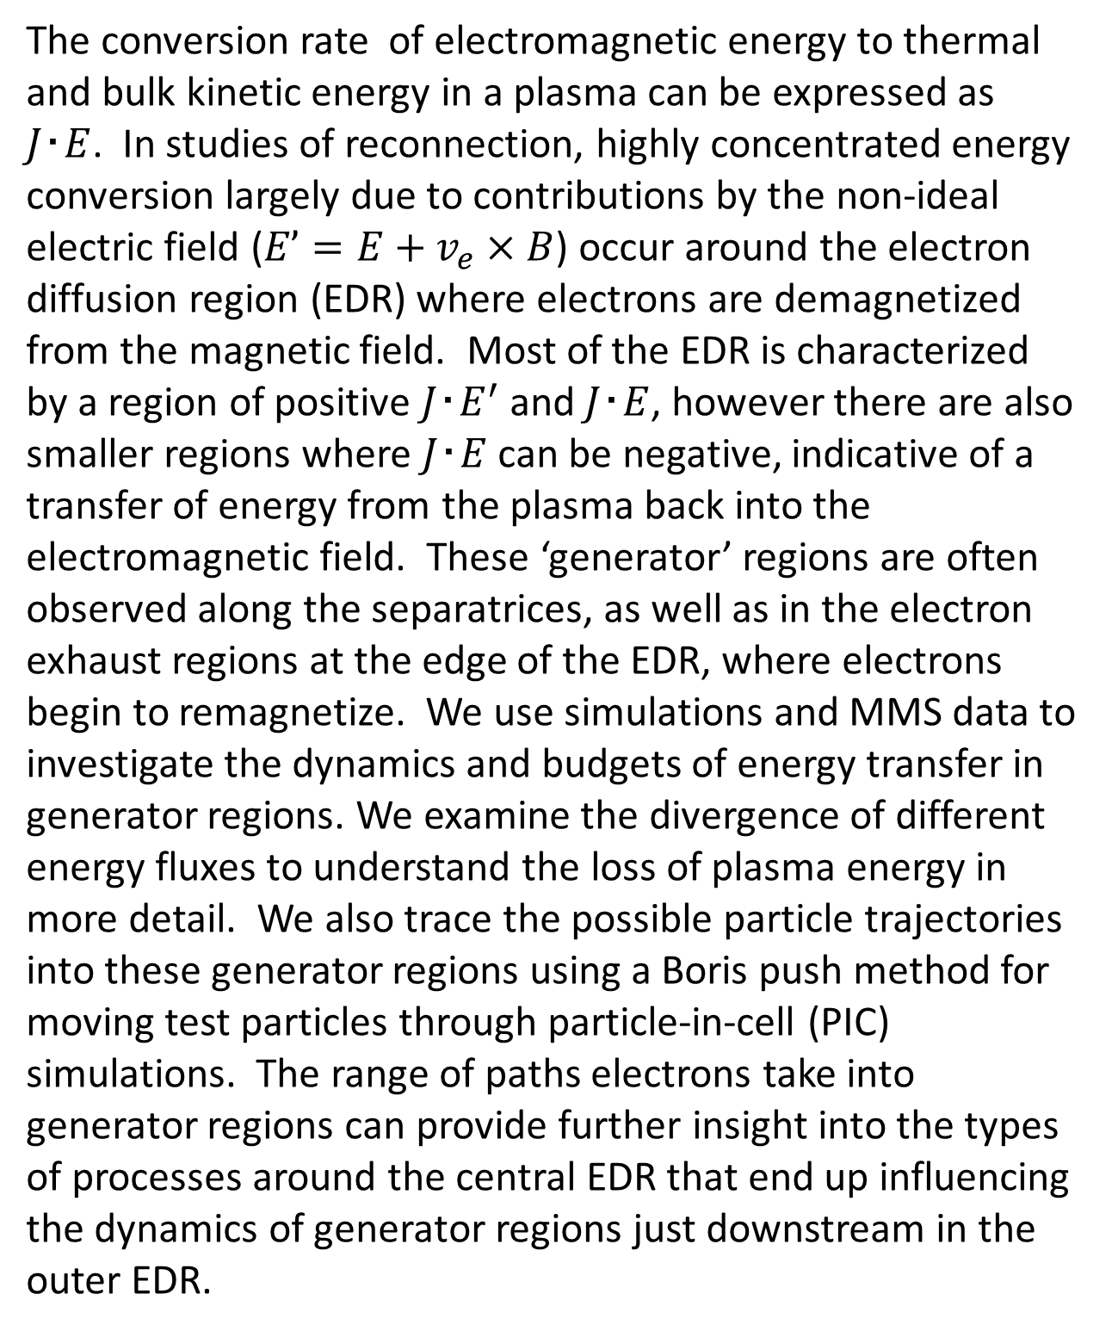
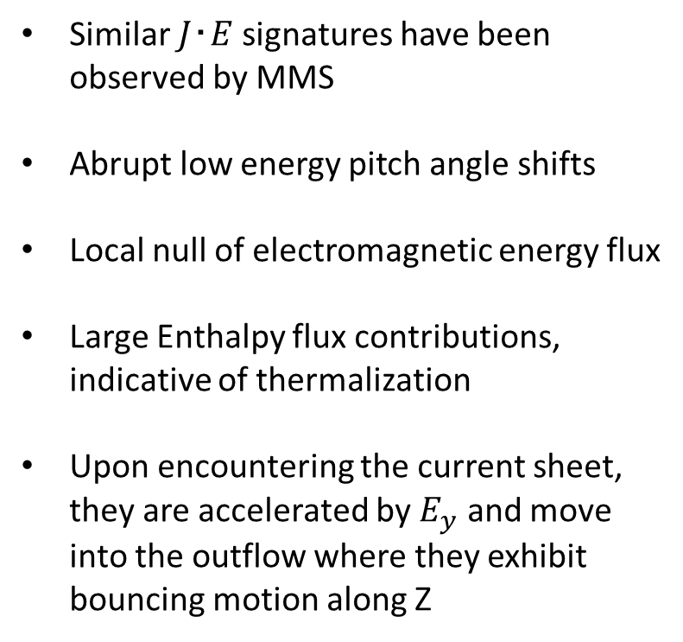
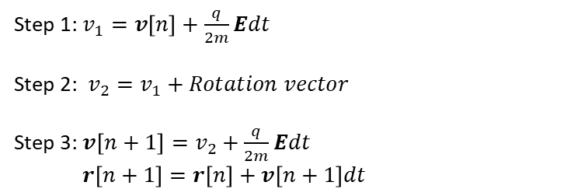


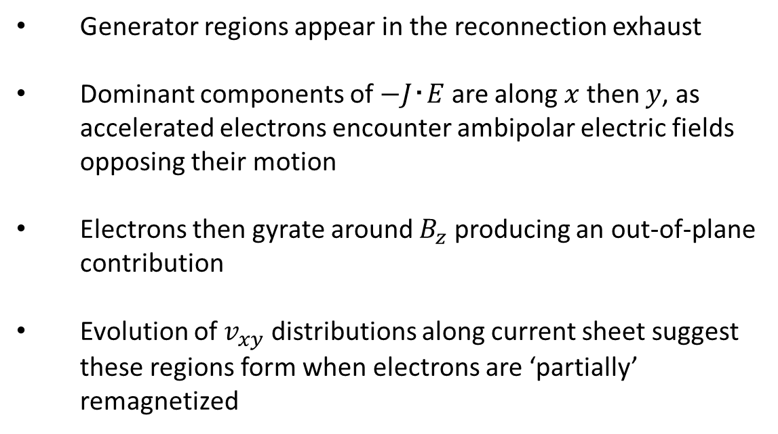














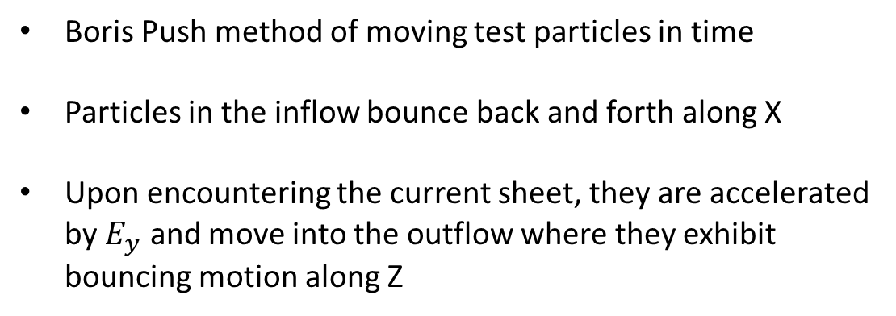




Dynamics of Energy Conversion in Generator Regions During Magnetic Reconnection
${D. Payne}^{1}$ , ${R. Torbert}^{1}$ , ${K. Germaschewski}^{1}$ , ${M. Argall}^{1}$ , ${K. Genestreti}^{1}$ , ${J. Burch}^{2}$ , ${J. Shuster}^{3}$ , ${P. Cassak}^{4}$ , ${B. Giles}^{3}$
1) University of New Hampshire, Durham NH; 2) Southwest Research Institute, San Antonio TX; 3) Goddard Spaceflight Center, Greenbelt MD; 4) West Virginia University, Morgantown WV;
Abstract
Particle Tracing & Boris Push
The conversion rate of electromagnetic energy to thermal and bulk kinetic energy in a plasma can be expressed as $J･E$. In studies of reconnection, highly concentrated energy conversion largely due to contributions by the non-ideal electric field ($E’=E+v_{e}×B$) occur around the electron diffusion region (EDR) where electrons are demagnetized from the magnetic field. Most of the EDR is characterized by a region of positive $J･E^{′}$ and $J･E$, however there are also smaller regions where $J･E$ can be negative, indicative of a transfer of energy from the plasma back into the electromagnetic field. These ‘generator’ regions are often observed along the separatrices, as well as in the electron exhaust regions at the edge of the EDR, where electrons begin to remagnetize. We use simulations and MMS data to investigate the dynamics and budgets of energy transfer in generator regions. We examine the divergence of different energy fluxes to understand the loss of plasma energy in more detail. We also trace the possible particle trajectories into these generator regions using a Boris push method for moving test particles through particle-in-cell (PIC) simulations. The range of paths electrons take into generator regions can provide further insight into the types of processes around the central EDR that end up influencing the dynamics of generator regions just downstream in the outer EDR.
dcv
https://www.particleincell.com/2011/vxb-rotation/
https://www.particleincell.com/2011/vxb-rotation/
Ordinary push in a constant magnetic field. Numerical error causes particle to gain energy!
Boris push in a constant magnetic field. Gyroradius is constant and energy is conserved!
$$z$$
$$\frac{dv}{dt}=\frac{q}{m}\left(E+v×B\right)$$
$$z$$
Lorentz acceleration:
$$θ_{v×B}$$
2nd Half of electrostatic push
Step 1: $v_{1}=v\left[n\right]+\frac{q}{2m}Edt$
Step 2: $v_{2}=v_{1}+Rotation vector$
Step 3:$v\left[n+1\right]=v_{2}+\frac{q}{2m}Edt$
$r\left[n+1\right]=r\left[n\right]+v\left[n+1\right]dt$
1st Half of electrostatic push
$$x$$
Boris Push method of moving test particles in time
Particles in the inflow bounce back and forth along X
Upon encountering the current sheet, they are accelerated by $E_{y}$ and move into the outflow where they exhibit bouncing motion along Z
$$x$$
$$y$$
Small differences in initial conditions of a test particle can lead to large differences in the trajectory.
$$x$$
Velocity Distributions in the Outer EDR
June 17th Exhaust
Generator regions appear in the reconnection exhaust
Dominant components of $−J･E$ are along $x$ then $y$, as accelerated electrons encounter ambipolar electric fields opposing their motion
Electrons then gyrate around $B_{z}$ producing an out-of-plane contribution
Evolution of $v_{xy}$ distributions along current sheet suggest these regions form when electrons are ‘partially’ remagnetized
$$J∙E$$
Similar $J･E$ signatures have been observed by MMS
Abrupt low energy pitch angle shifts
Local null of electromagnetic energy flux
Large Enthalpy flux contributions, indicative of thermalization
Upon encountering the current sheet, they are accelerated by $E_{y}$ and move into the outflow where they exhibit bouncing motion along Z
$$x$$
$$J∙E$$
$$y$$
$$z$$
$$J_{x}E_{x}$$
MMS
$$J_{x}E_{x}$$
Isotropized
Isotropic for lower energies only
PIC
$$J_{y}E_{y}$$
$$J_{y}E_{y}$$
Low energies completely remagnetized while high energies are scattered
$$v_{y}$$
$$v_{y}$$
$$v_{y}$$
$$v_{y}$$
$$v_{y}$$
$$v_{x}$$
$$v_{x}$$
$$v_{x}$$
$$v_{x}$$
$$J_{z}E_{z}$$
$$x$$
$$J_{z}E_{z}$$
Acknowledgements
$$z$$
This work would not be possible without the EDP, FPI, and FGM data and the teams responsible for the development, maintenance, and calibration of these instruments
We thank the MMS team for their wonderful data and NASA support via contract NNG04EB99C
We also thank those who maintain and operate the Trillian computer cluster at UNH, which was vital in producing the simulations in this presentation
I also thank all those in our research group with whom I’ve had illuminating conversations that inspired this work
$$J_{e}∙E$$
$$x$$
Email: dsp1007@wildcats.unh.edu Phone: 856-264-6185

