Slide 1


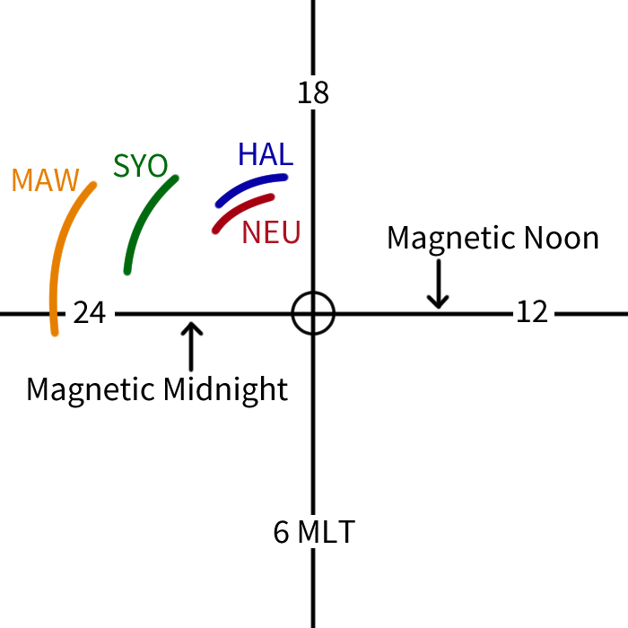
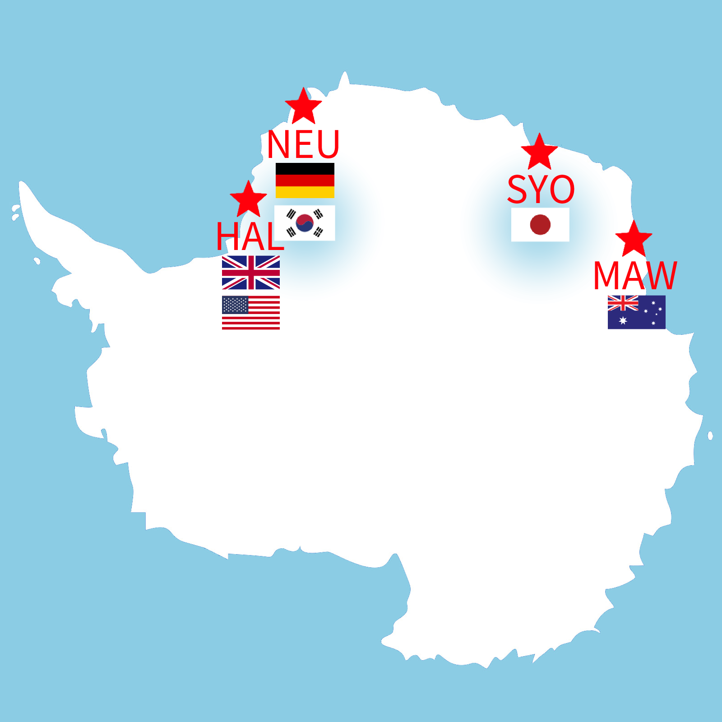
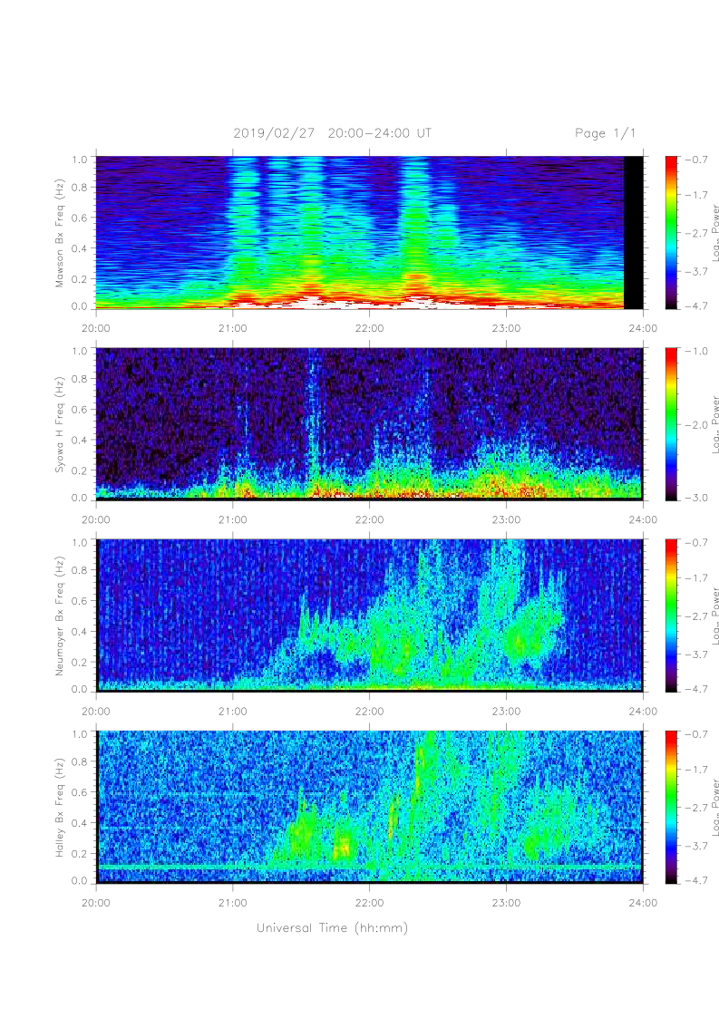
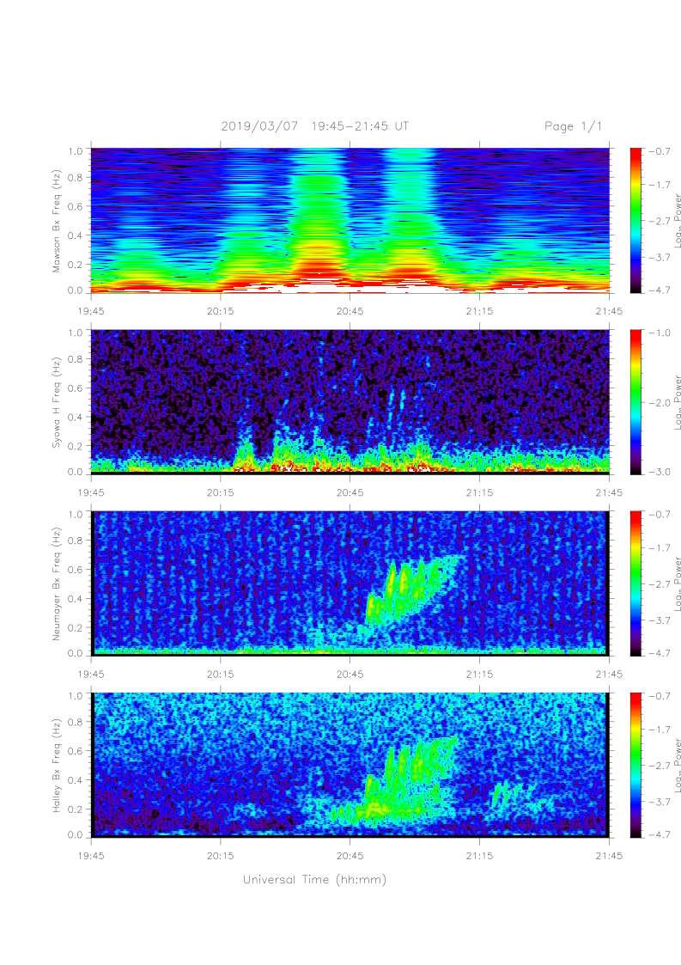
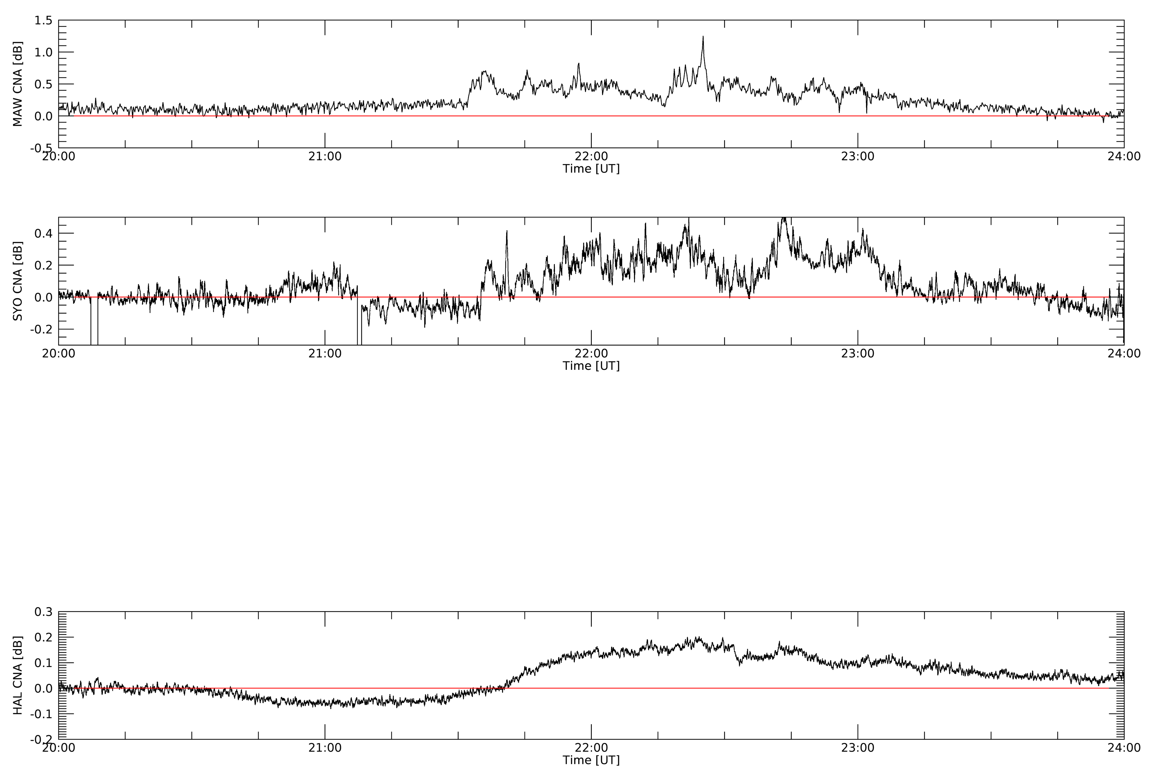
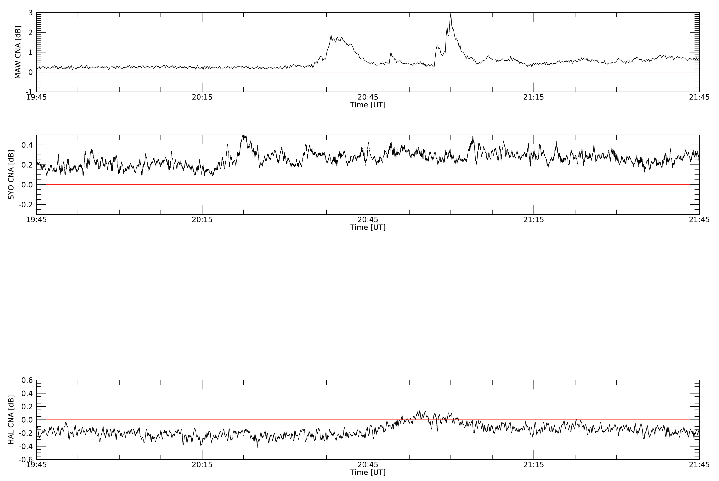
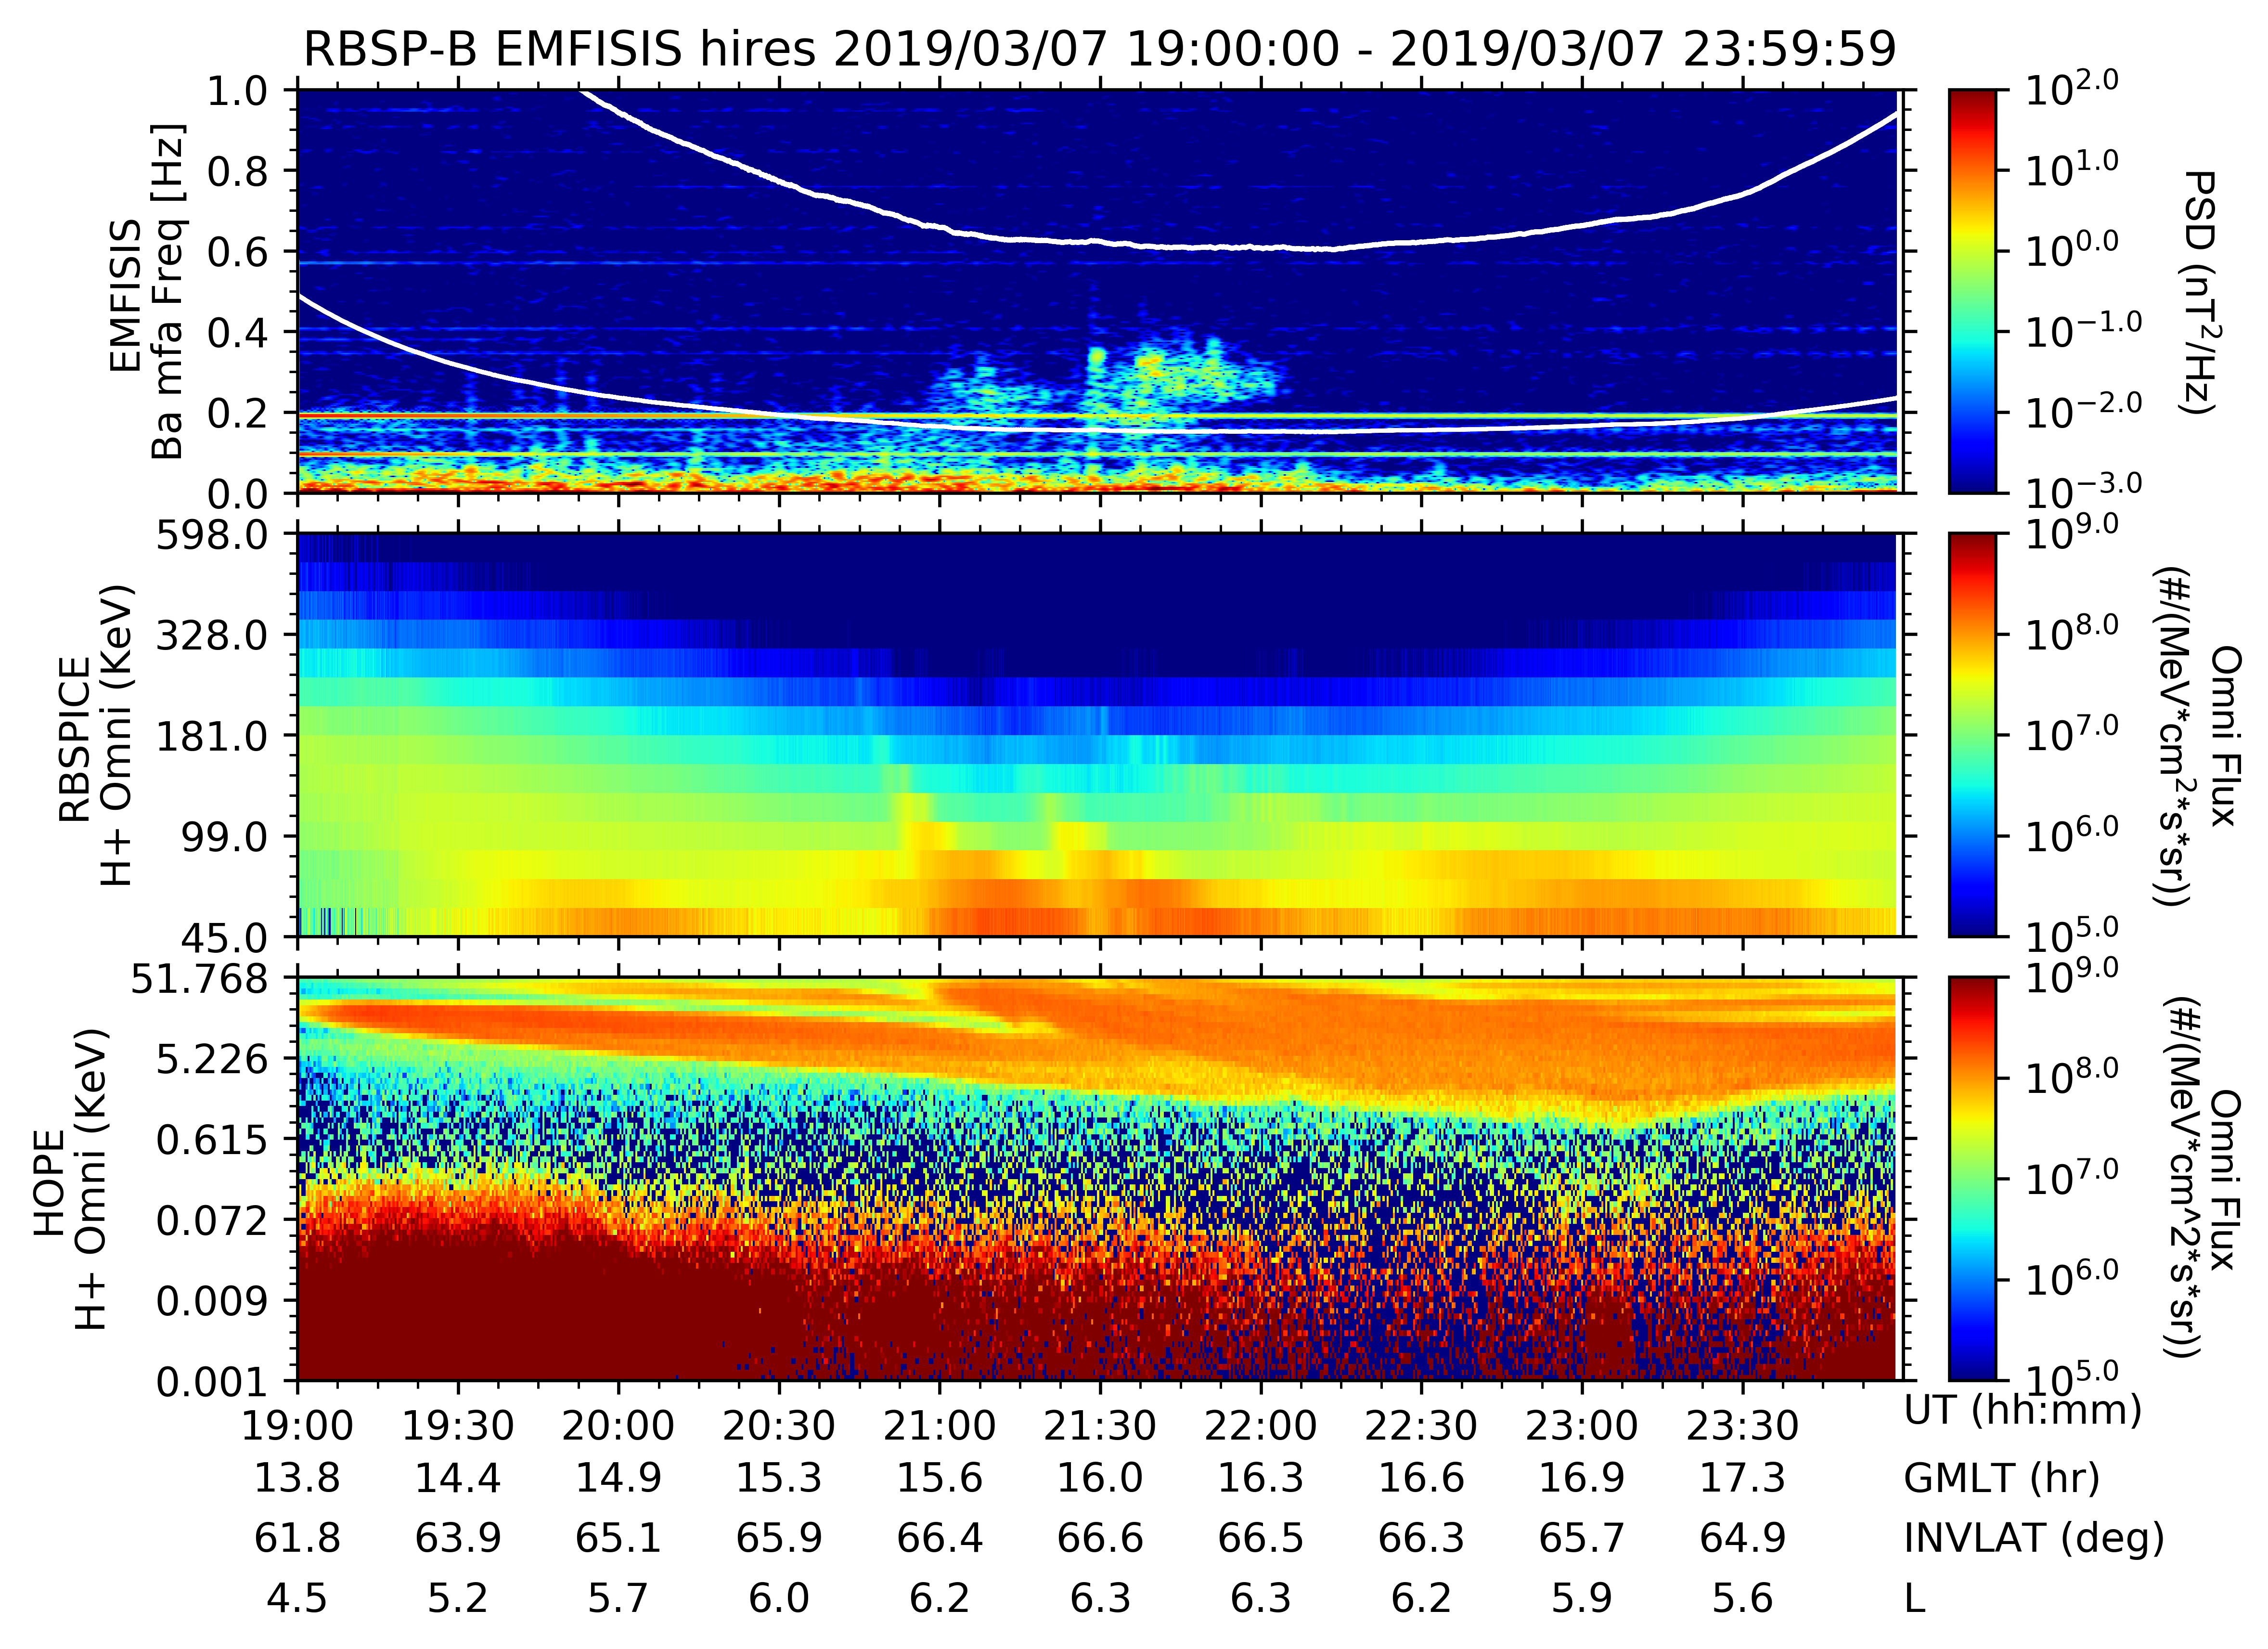
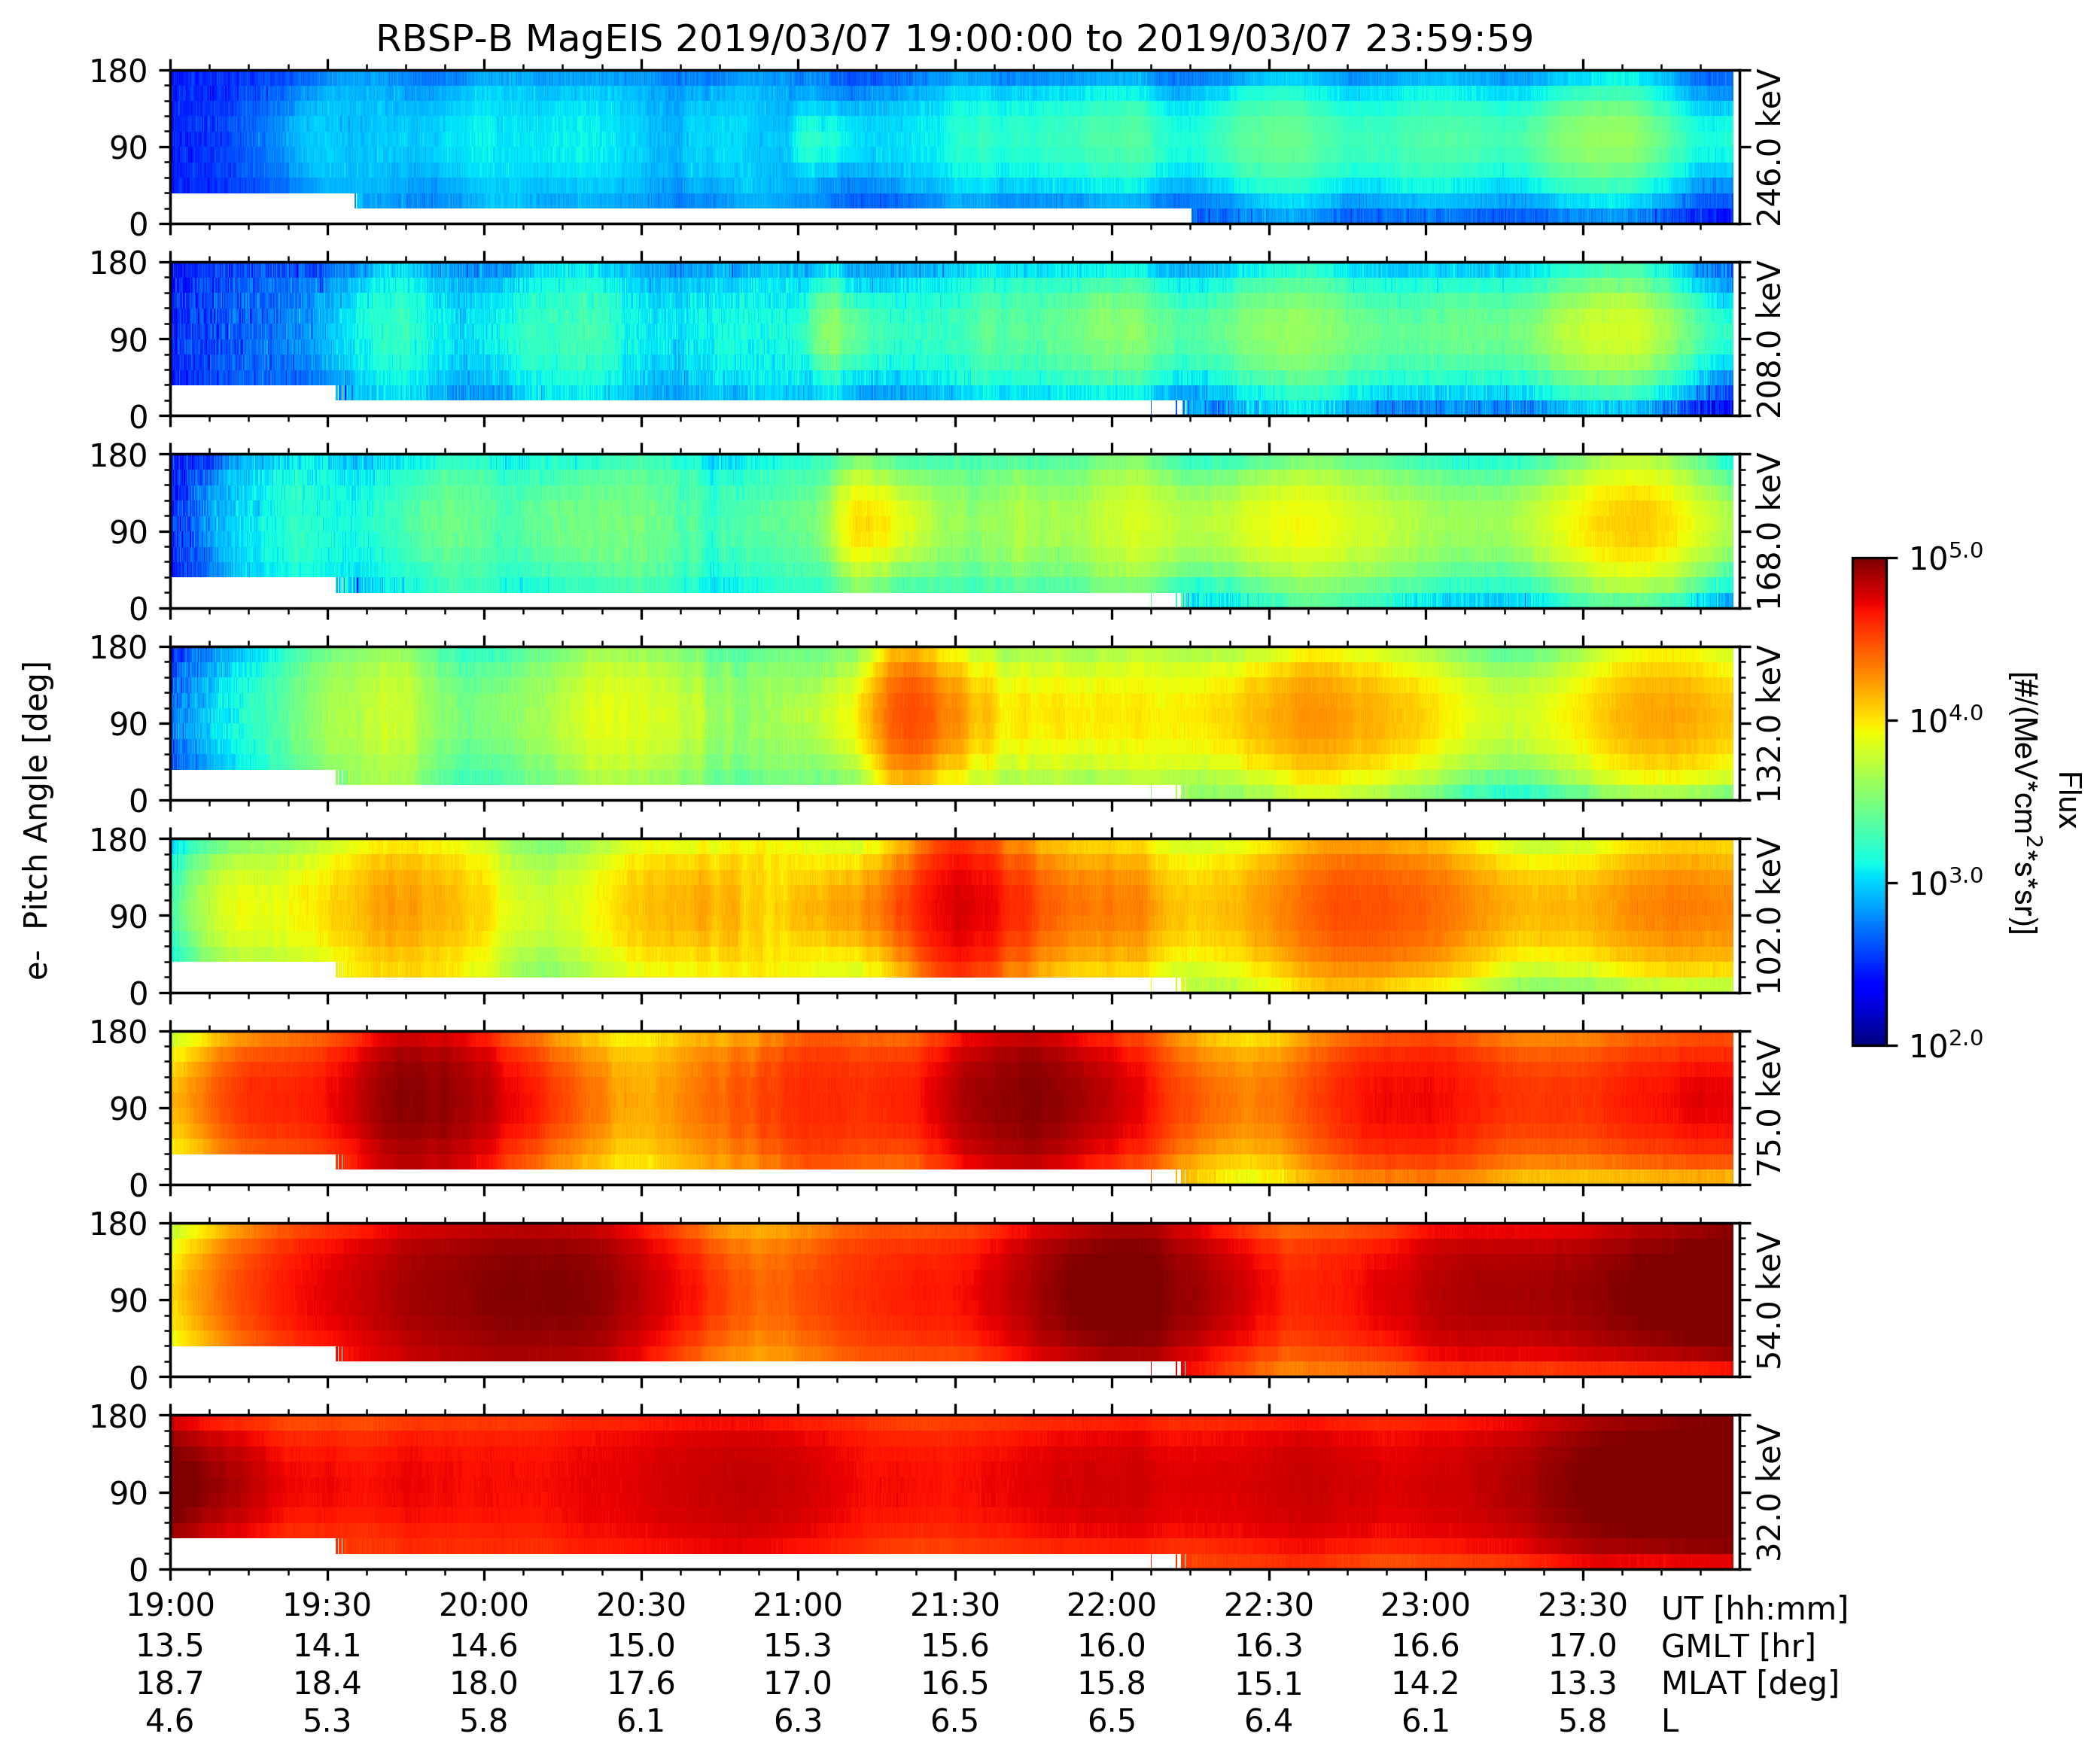
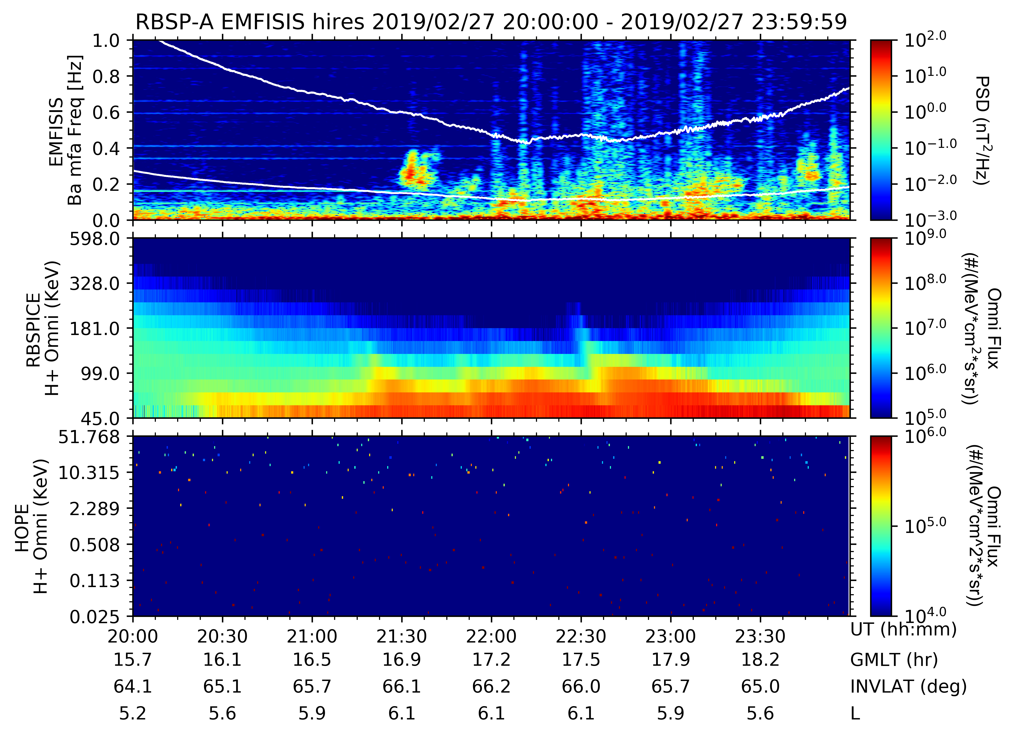
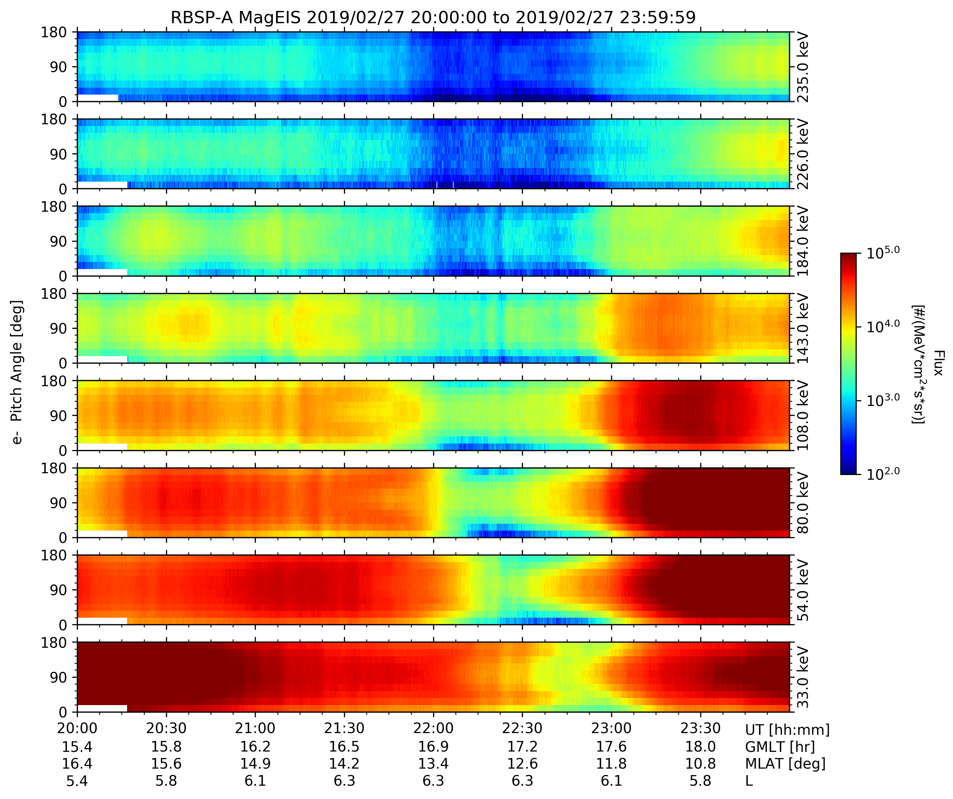
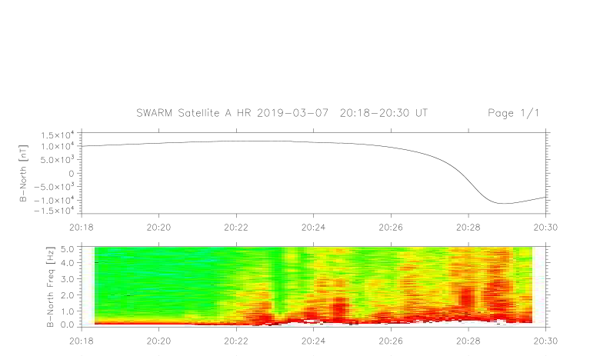
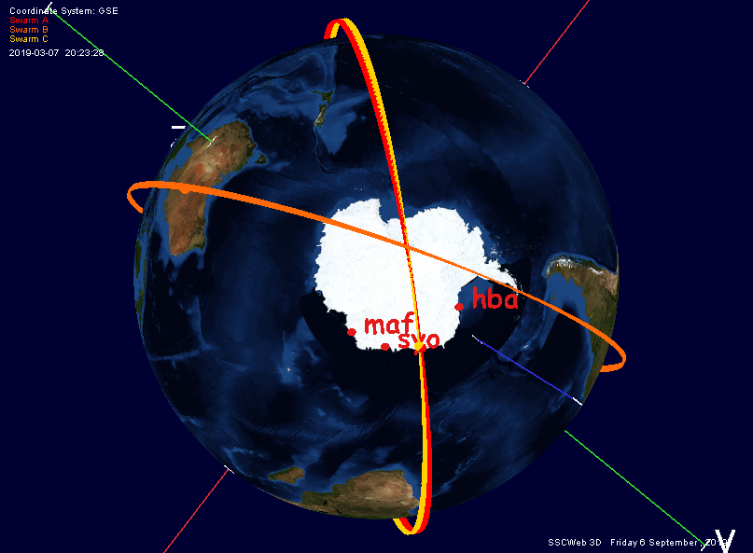
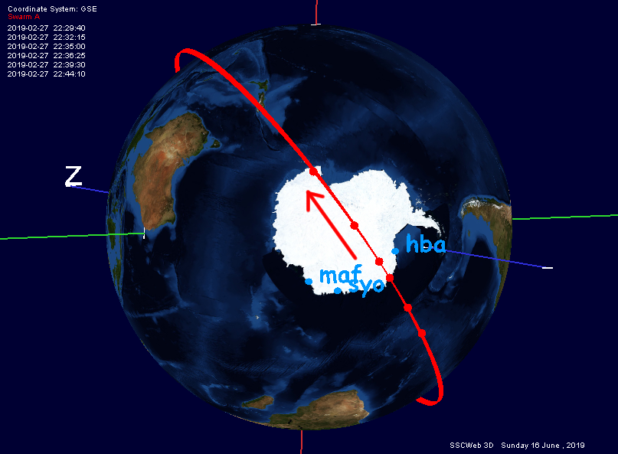
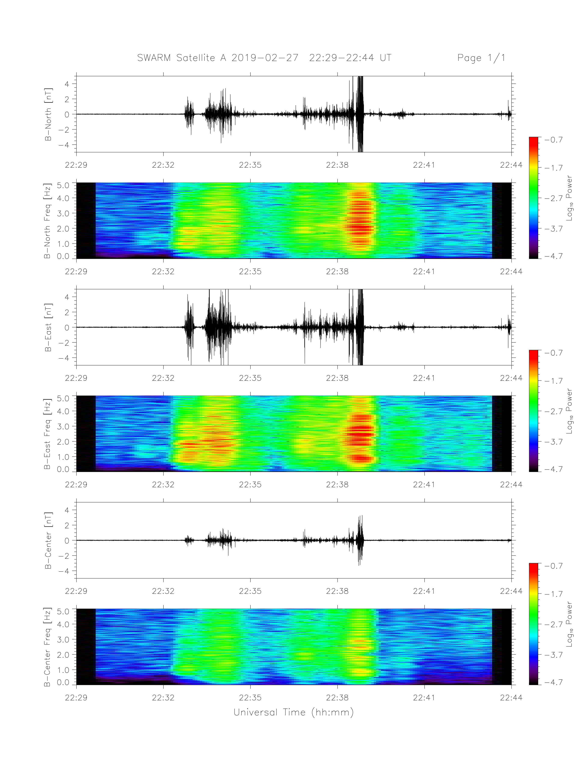
Two case studies of relations between Pi1B and IPDP-type EMIC waves
¹ Space Science Center, University of New Hampshire, Durham, NH., USA.
² Center for Solar-Terrestrial Research, New Jersey Institute of Technology, Newark, NJ., USA.
³ Physics Dept., Augsburg College, Minneapolis, MN., USA
⁴ British Antarctic Survey, Cambridge, United Kingdom
Michelle Salzano¹, Marc R. Lessard¹, Hyomin Kim², Mark J. Engebretson³,
Richard Horne⁴, Mark Clilverd⁴, Akira Kadokura⁵, Yoshimasa Tanaka⁵,
Khan-Hyuk Kim⁶, Jürgen Matzka⁷, Tajna Fromm⁸, Colin Waters⁹
⁵National Institute of Polar Research, Midori-cho, Tachikawa-shi, Japan
⁶School of Space Research, Kyung Hee University, Yongin-si, South Korea
⁷GFZ Potsdam, Potsdam, Germany
⁸Alfred Wegener Institut, Bremerhaven, Germany
⁹University of Newcastle, Callaghan, New South Wales, Australia
Introduction
What is an IPDP?
Instrumentation
Station | CGM Lat. | MM | L-Shell | SCM | Rio
HAL | -62.2 | 3:00 | 4.68
NEU | -60.6 | 2:15 | 4.25
SYO | -66.5 | 0:19 | 6.35 |  | *
MAW | -70.4 | -0:55 | 9.01
The relationship between Pi1B and IPDP type EMIC waves was first discussed in 1971 by R. R. Heacock in their paper, “Spatial and Temporal relations between Pi Bursts and IPDP Micropulsation events”. Per this paper, IPDPs appear at lower geomagnetic latitudes (60-65 degrees) than PiBs, which are more prominent at ~70 degrees.
In a 1983 paper by Ranta et al., “Development of an auroral absorption substorm: studies of substorm related absorption events in the afternoon-early evening sector”, PiB are observed at a higher geomagnetic latitude (63.7) than IPDPs (57.6). Ranta speculated that the IPDPs, thought by Heacock to be caused by substorm-injected protons at the plasmapause, may indicate that precipitation occurs near the plasmapause region. Heacock speculated that there may also be a longitudinal effect between IPDPs and PiBs, with PiBs occuring in the near-midnight sector after substorm onset and IPDPs following in the afternoon-evening sector.
Neither Heacock nor Ranta had a sufficiently large longitudinal array to investigate this further. Ranta did however use a longitudinally widespread (11 - 353 degrees) riometer array, which revealed westward propagating absorption onsets associated with PiB in the North and IPDPs in the South.
The research presented here picks up where these papers left off, equipped with a longitudinal searchcoil array spanning four hours in MLT, as well as as near-earth and radiation belt satellites.
IPDPs are a subgroup of EMIC waves. This acronym stands for Intervals of Pulsations with Diminishing Periods. These are ‘rising tone’ waves.
The following instruments are used in this study:
Searchcoil magnetometers located at Halley Research Station (HAL), Neumayer (NEU), Syowa (SYO), and Mawson (MAW)
Riometers in HAL and MAW
An imaging riometer at SYO
EMFISIS and MagEIS data from Van Allen probes A and B
Magnetometer data from SWARM
What is Pi1B?
As per the Jacobs et al. 1964 “Classification of Geomagnetic Pulsations”, Pi1 are ULF waves with periods between 1-40 seconds. Pi1B is a further distinction for broadband Pi1 waves. Pi1B waves that occur in the evening sector are well correlated with substorm onset.
Case Study 1: 2019-02-27
Case Study 2: 2019-03-07
Figure 1: Searchcoil magnetometer data from MAW, SYO, NEU, and HAL respectively. IPDP events can be seen at NEU and HAL (-60.6 and -62.2 CGM lat.) Near-simultaneous Pi1B events can be seen at MAW and SYO (-70.4 and -66.5 CGM lat.) This agrees with Heacock 1971.
Figure 2: Riometer data from MAW, SYO, and HAL respectively. There is an increase in cosmic noise absorption (CNA) that aligns with parts of the events. Increases in CNA correspond to increased particle precipitation, and as per Arnoldy’s 1979 paper, “Polarization of Pc I and IPDP Pulsations Correlated With Particle Precipitation”, we expect IPDPs to be left hand polarized when observed simultaneously with precipitation. Polarization analysis is necessary to proceed here.
Interestingly, we see very different CNA in case study 2. MAW sees more distinct spikes of absorption, while SYO sees little. HAL sees a spike below the quiet day curve.
Figure 1
Figure 2
02-27 | 1 | 0 | 1- | 1 | 3 | 3+ | 3 | 4
02-28 | 4+ | 3+ | 2 | 3+ | 4+ | 4- | 5- | 3
We see Pi1B in MAW (and potentially SYO– it is less clear) and an IPDP in NEU and HAL. This again matches the observations in Heacock 1971.
Table 1
03-07 | 0+ | 0+ | 0 | 0+ | 2+ | 3- | 3- | 3-
03-08 | 3- | 1- | 1 | 2- | 0 | 1- | 0+ | 1+
The Kp index shows increased geomagnetic disturbance during the event.
Table 1: The Kp Index, located above in three hour intervals, averages and characterizes geomagnetic disturbances. In a 2002 paper by Moldwin, et al., “A new model of the location of the plasmapause: CRRES results”, a calculation is discussed that shows increased Kp tends to erode the plasmapause more aggressively. It is unclear at this time if the eroded plasmapause is related to the events we discuss, but notably the Kp index for both events shows increased Kp during the events and leading into the following days.
The SWARM A magnetometer sees ULF activity when it is equatorward of a near-SYO conjunction. The quick flyover time implies the ULF activity after the red line is too far inland for relevance.
The Van Allen Probes data again sees increases in flux and spectrograms similar to EMIC waves around the time of the events in question.
Conclusions and Next Steps Steps
Acknowledgments
Heacock described temporal and spatial relations between IPDPs and Pi1B. He concluded that westward drift of quasi-trapped protons may account for the IPDPs. Here, we show comprehensive observations of what appear to be the same type of events. We conclude:
The Pi1B and EMIC waves discussed here appear to have a common source which is substorm onset — they take different pathways from the same source
Pi1B are already known to come from onset. The Van Allen Probes data links the EMIC waves with substorm injections.
Substorms occur frequently, as do Pi1B, but IPDPs are a much rarer phenomenon– under which conditions do we see the relations described here? More work is necessary to fully understand this and the implications of the Van Allen Probes and SWARM satellite data.
We would like to thank the following persons for their support:
Khan-Hyuk Kim of Kyung Hee University for providing the Neumayer searchcoil magnetometer
Jürgen Matzka of GFZ Potsdam for providing data management support for Neumayer
Tanja Fromm of AWI for supporting logistics for Neumayer
Yoshimasa Tanaka of the National Institute of Polar Research for providing the Syowa imaging riometer data
Akira Kadokura of the National Institute of Polar Research for providing the Syowa searchcoil magnetometer data
Richard Horne of the British Antarctic Survey for supporting the UNH searchcoil at Halley Research Station
Mark Clilverd of the British Antarctic Survey for providing the Halley riometer data
Colin Waters of the University of Newcastle for providing the Mawson searchcoil magnetometer data
Mark Chutter of the University of New Hampshire for his unending computational support
We would also like to thank the Australian Space Weather Service and the Australian Antarctic Division for providing the Mawson riometer data
Figure 3
Figure 4
Figure 3: Van Allen Probe A EMFISIS data. The top panel shows spectrograms of magnetic field data. At 21:30 there is what appears to be part of an EMIC wave, followed by Pi1B bursts while probe A is in rough conjunction with SYO. The bottom two panels show H+ fluxes for a range of energies. Of note are the spikes at 21:30 and 22:30.
Figure 4: Van Allen Probe A MagEIS electron pitch angles and fluxes for a range of energies.
Figure 5
Figure 6
Figure 5: SWARM A orbit via the SSC 4D Orbit viewer. At 22:35 SWARM A is in near conjunction with NEU.
Figure 6: SWARM A (a low earth R=1.07 RE orbiting satellite) magnetometer data. We expect a satellite above the ionosphere to see activity while it is equatorward of the ground station it is being compared to (as waves are typically ducted poleward in Antarctica, in the direction of the Poynting flux.) The red line in the above graph represents the moment SWARM A is in near-conjunction with NEU. To the left of this line it is equatorward of NEU.
This work was supported by NSF grant PLR 1745041

