Slide 1

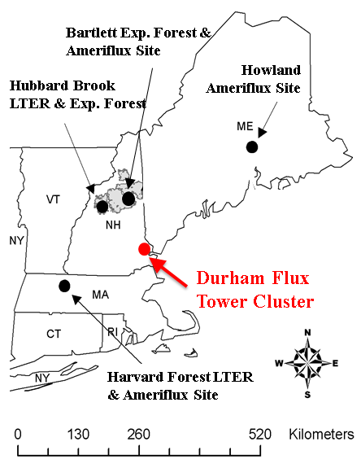
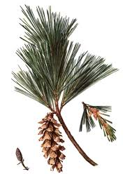
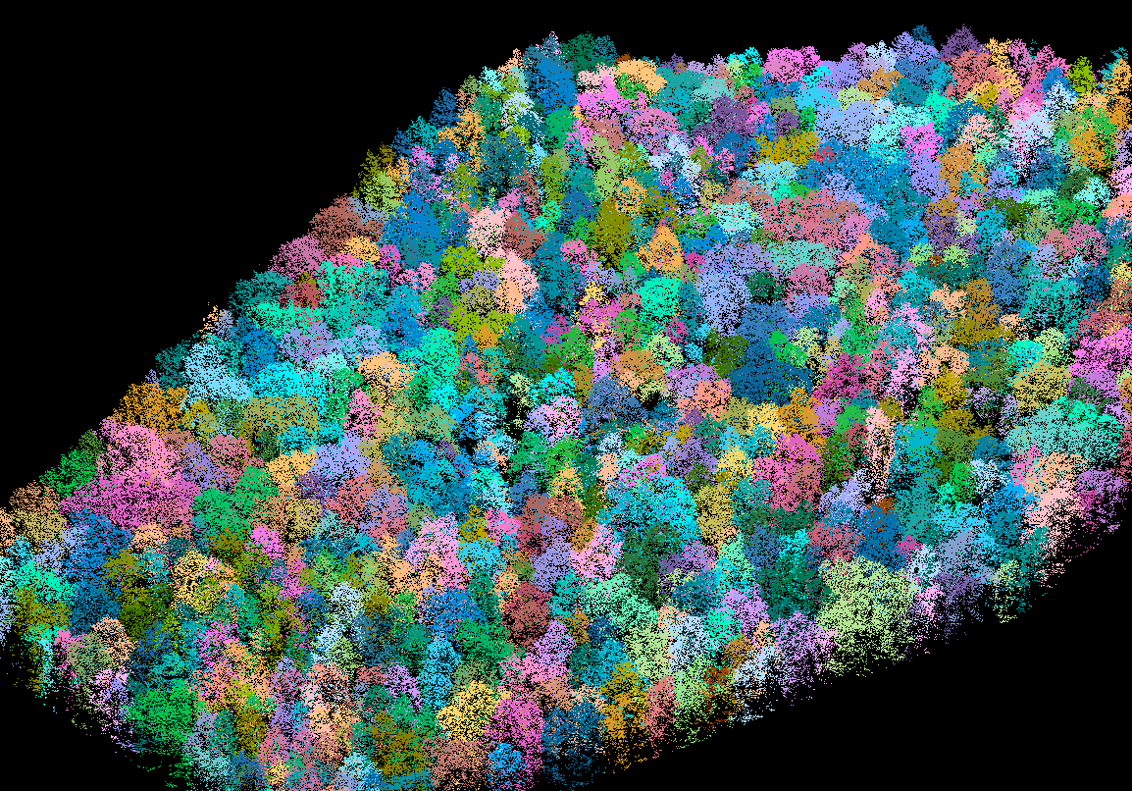
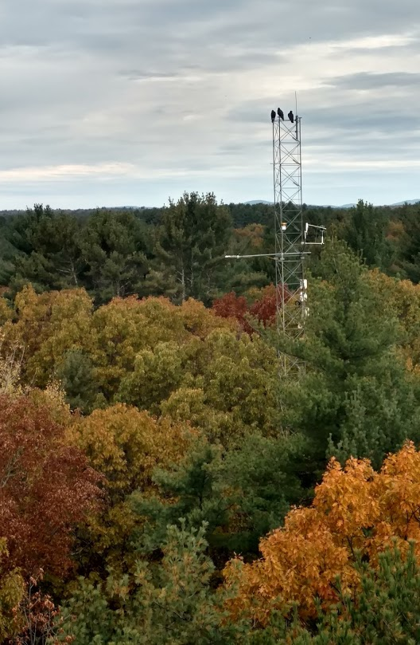
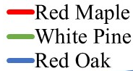
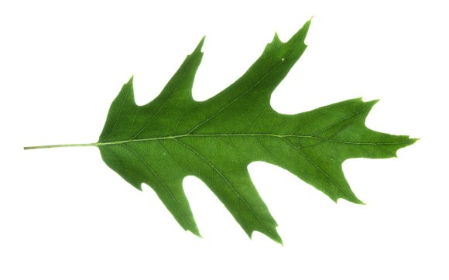
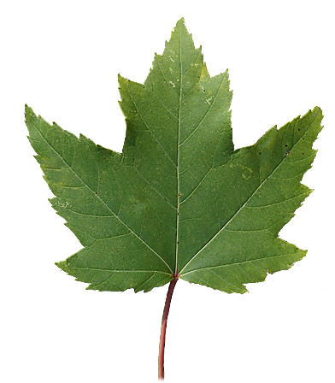
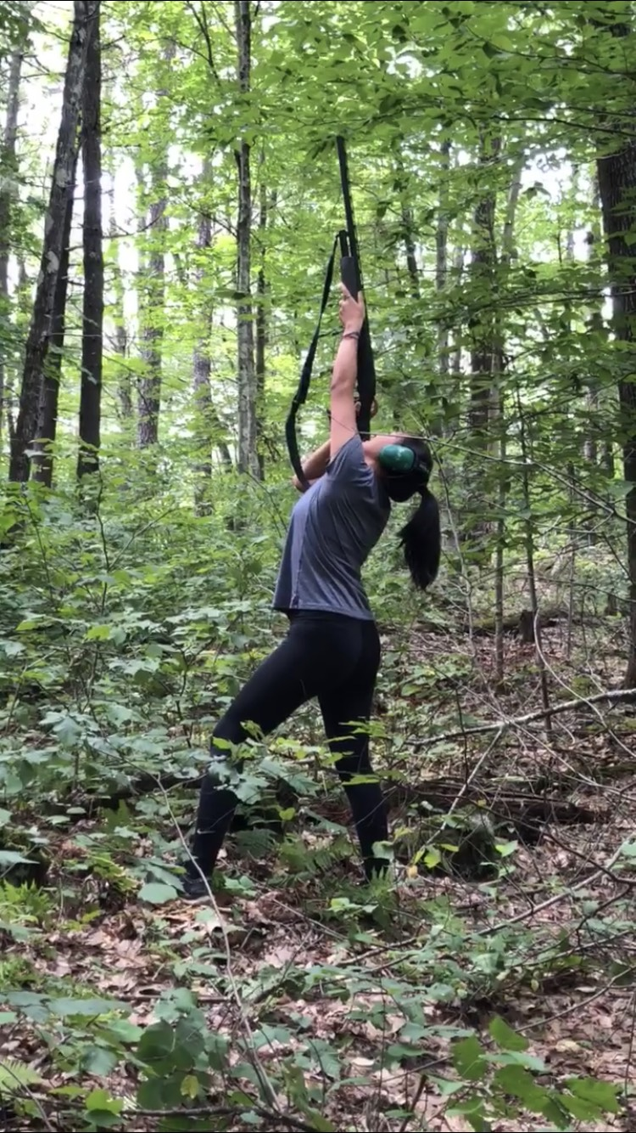
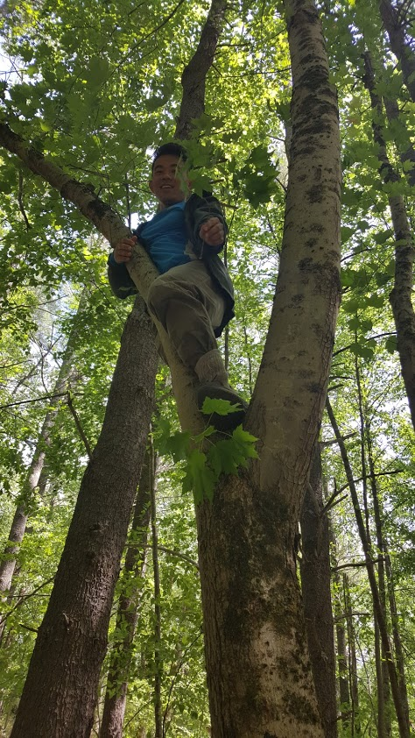




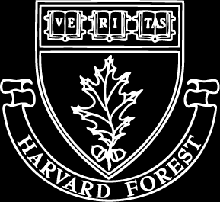
2019 AGU
Does Diversity in Species Specific Leaf Traits and Resource Use Promote Stability of Forest Ecosystem Carbon and Water Fluxes?
2392
Andrew P. Ouimette, Rebecca Sanders-DeMott, Jack Hastings, Kaitlyn Baillargeon, Zaixing Zhou, Scott V. Ollinger
University of New Hampshire, Earth Systems Research Center, Durham, NH
Andrew.Ouimette@unh.edu
Abstract
Species Phenology and Physiology
Differences in Resource-Use Efficiency
Numerous studies have demonstrated a positive relationship between diversity and productivity in terrestrial ecosystems. Because leaf functional traits exert strong controls on the exchange of carbon (C) and water between terrestrial ecosystems and the atmosphere, it is often assumed that diversity in leaf traits leads to an increase in ecosystem C fluxes. However, appropriate characterization of leaf functional traits to test this assumption in forests remains a challenge, because leaf traits vary across species as well as through time and space within forest canopies. To assess the influence of functional trait diversity on ecosystem carbon and water fluxes, we measured leaf structural, chemical, and physiological traits for three codominant species - Acer rubrum (ACRU), Quercus rubra (QURU), Pinus strobus (PIST) - in a temperate forest stand within the footprint of an eddy covariance flux tower in southern New Hampshire, USA. Leaf traits were measured vertically through the canopy and temporally across the growing season and used to construct a multispecies forest canopy model. Leaf structural and physiological traits varied across species, space, and time, and incorporating this information into a canopy model resulted in good agreement with estimates of C uptake from eddy covariance derived estimates of ecosystem C fluxes. However, when simulating C uptake with single versus multispecies stands, model results suggested that diverse stands would not lead to higher ecosystem productivity. Instead we identified tradeoffs in resource-use efficiency and are exploring differences in canopy structure, carbon allocation, and belowground traits that influence relationships between forest diversity and productivity.
Leaf Traits by Canopy Height
A
Nitrogen
B
A
Light Sat PSN
(mg C g⁻¹ s⁻¹)
B
Light
Water
Goal
Greenness index (gcc 90)
Phenology and Physiology
C
D
Quantify mechanisms that could explain a positive relationship between diversity and productivity.
C
D
Figure 4: (A,B) Simulated nitrogen-use efficiency across mixed and single species stands and (B) the rate of nitrogen uptake required to support a canopy with a leaf area index of 5 for each stand. Although QURU (red oak) stands are more productive (Fig 3) they require more nitrogen to do so. (C) Simulated light-use efficiency across species. (D) Measured changes in leaf level photosynthesis in response to changing VPD.
Study Site
Complementarity Belowground
Species distribution by height in the canopy
Tower
Crown Shape and Canopy Structure
Carbon Allocation
Belowground Traits
LAI m² m⁻²
E
F
High relative leaf area
Foliar area:basal area
N budget
Leaf Area Fraction
Red Maple
Red Oak
Depth of N uptake (cm)
White Pine
Other Species
Height (m)
Figure 5: (left) Crown delineation of trees within the eddy flux tower footprint at Thompson Farm using data collected from NASA’s G-LiHT platform; (center) species differences in leaf area vs. basal area fraction; (right) hypothetical depth of uptake of soil nitrogen for each species based on foliar and soil isotopes.
Figure 2: (A, B) Variations in leaf mass per area (LMA) and mass-based light-saturated photosynthesis through the canopy across species. (C) Seasonal changes in greenness index across species; (D) Seasonal trend in the ratio of QURU to ACRU nitrogen per area. (E, F) Seasonal variations in leaf-level dark respiration (E) and net carbon exchange (F). Note the large species differences in physiological phenology (N dynamics, C exchange).
Conclusions and Future Directions
The timing and rate of leaf-level carbon exchange varied by species, with red maple (ACRU) reaching peak photosynthetic capacity roughly 3 months prior to red oak (QURU). Photosynthetic rates parallel leaf physiological development (e.g. seasonal changes in leaf level nitrogen per area, etc).
Model simulations using measured differences in the rate and timing of leaf level carbon fluxes suggest that based on leaf-level photosynthesis alone, diverse stands are not as productive as single species red oak stands. This is consistent with leaf level measurements in which red oak had significantly higher photosynthetic rates under a range of incident light and atmospheric humidity.
Despite the higher productivity of red oak stands, it’s lower N-use efficiency requires higher N uptake rates to do so. Future model simulations will explore the role of nutrient availability, as well as canopy structure, carbon allocation patterns, and belowground traits in a diversity/productivity framework.
Figure 1: (left) photo of Thompson Farm study site and eddy flux tower, with inset map showing location relative to other flux towers in the northeastern US. (center) From top to bottom photos of the foliage of white pine, red oak, and red maple. (right) Species distribution of foliage by height within the canopy at Thompson Farm.
Modeling Results
Multispecies canopy model
Model simulations across stand types
Methods
Measurements of leaf-level (multiple heights) and stand-level physiology and structure including:
Acknowledgements
Near continuous: Canopy measurements of carbon, water, and energy exchange from eddy covariance, Phenocam
Biweekly: leaf area index, litterfall collection
Monthly: (at multiple canopy positions) leaf-level photosynthesis, percent nitrogen, stable isotopes, chlorophyll, leaf size, leaf mass per area, petiole length
Single collection: distribution of foliage across height in the canopy by species; hyperspectral reflectance and LiDAR measurements (G-LiHT).
Model: A multi-species canopy photosynthesis model was constructed and parameterized using leaf structural and physiological data collected through the canopy over time
This project is supported by NSF NH EPSCoR Program (EPS 11011245), USDA UNH Agricultural Experiment Station (Hatch NH00634), NASA Carbon Cycle Science (NNX14AJ18), NSF Macrosystems (1638688), and the Harvard Forest LTER.
We also are grateful Emily Perry, Emily Wilcox, Sarah Cantwell, Elizabeth Pederson (University of New Hampshire undergraduate students), Dr. Rakesh Minocha and Stephanie Long (USDA Forest Service) and visiting scientist Dr. Jie Wei for assistance in collecting field and laboratory data.
Figure 3: (left) Daily CO₂ uptake estimated using a multispecies canopy model parameterized using data collected above. Red maple (ACRU) dominates canopy C flux early in the growing season while red oak (QURU) dominates during the mid to late growing season. (right) Results of simulations comparing multispecies to single species stands. The most productive stand is not a multispecies stand but one with a single species - red oak.
UNH undergrad Emily Perry
Visiting scientist Jie Wei

