Slide 1


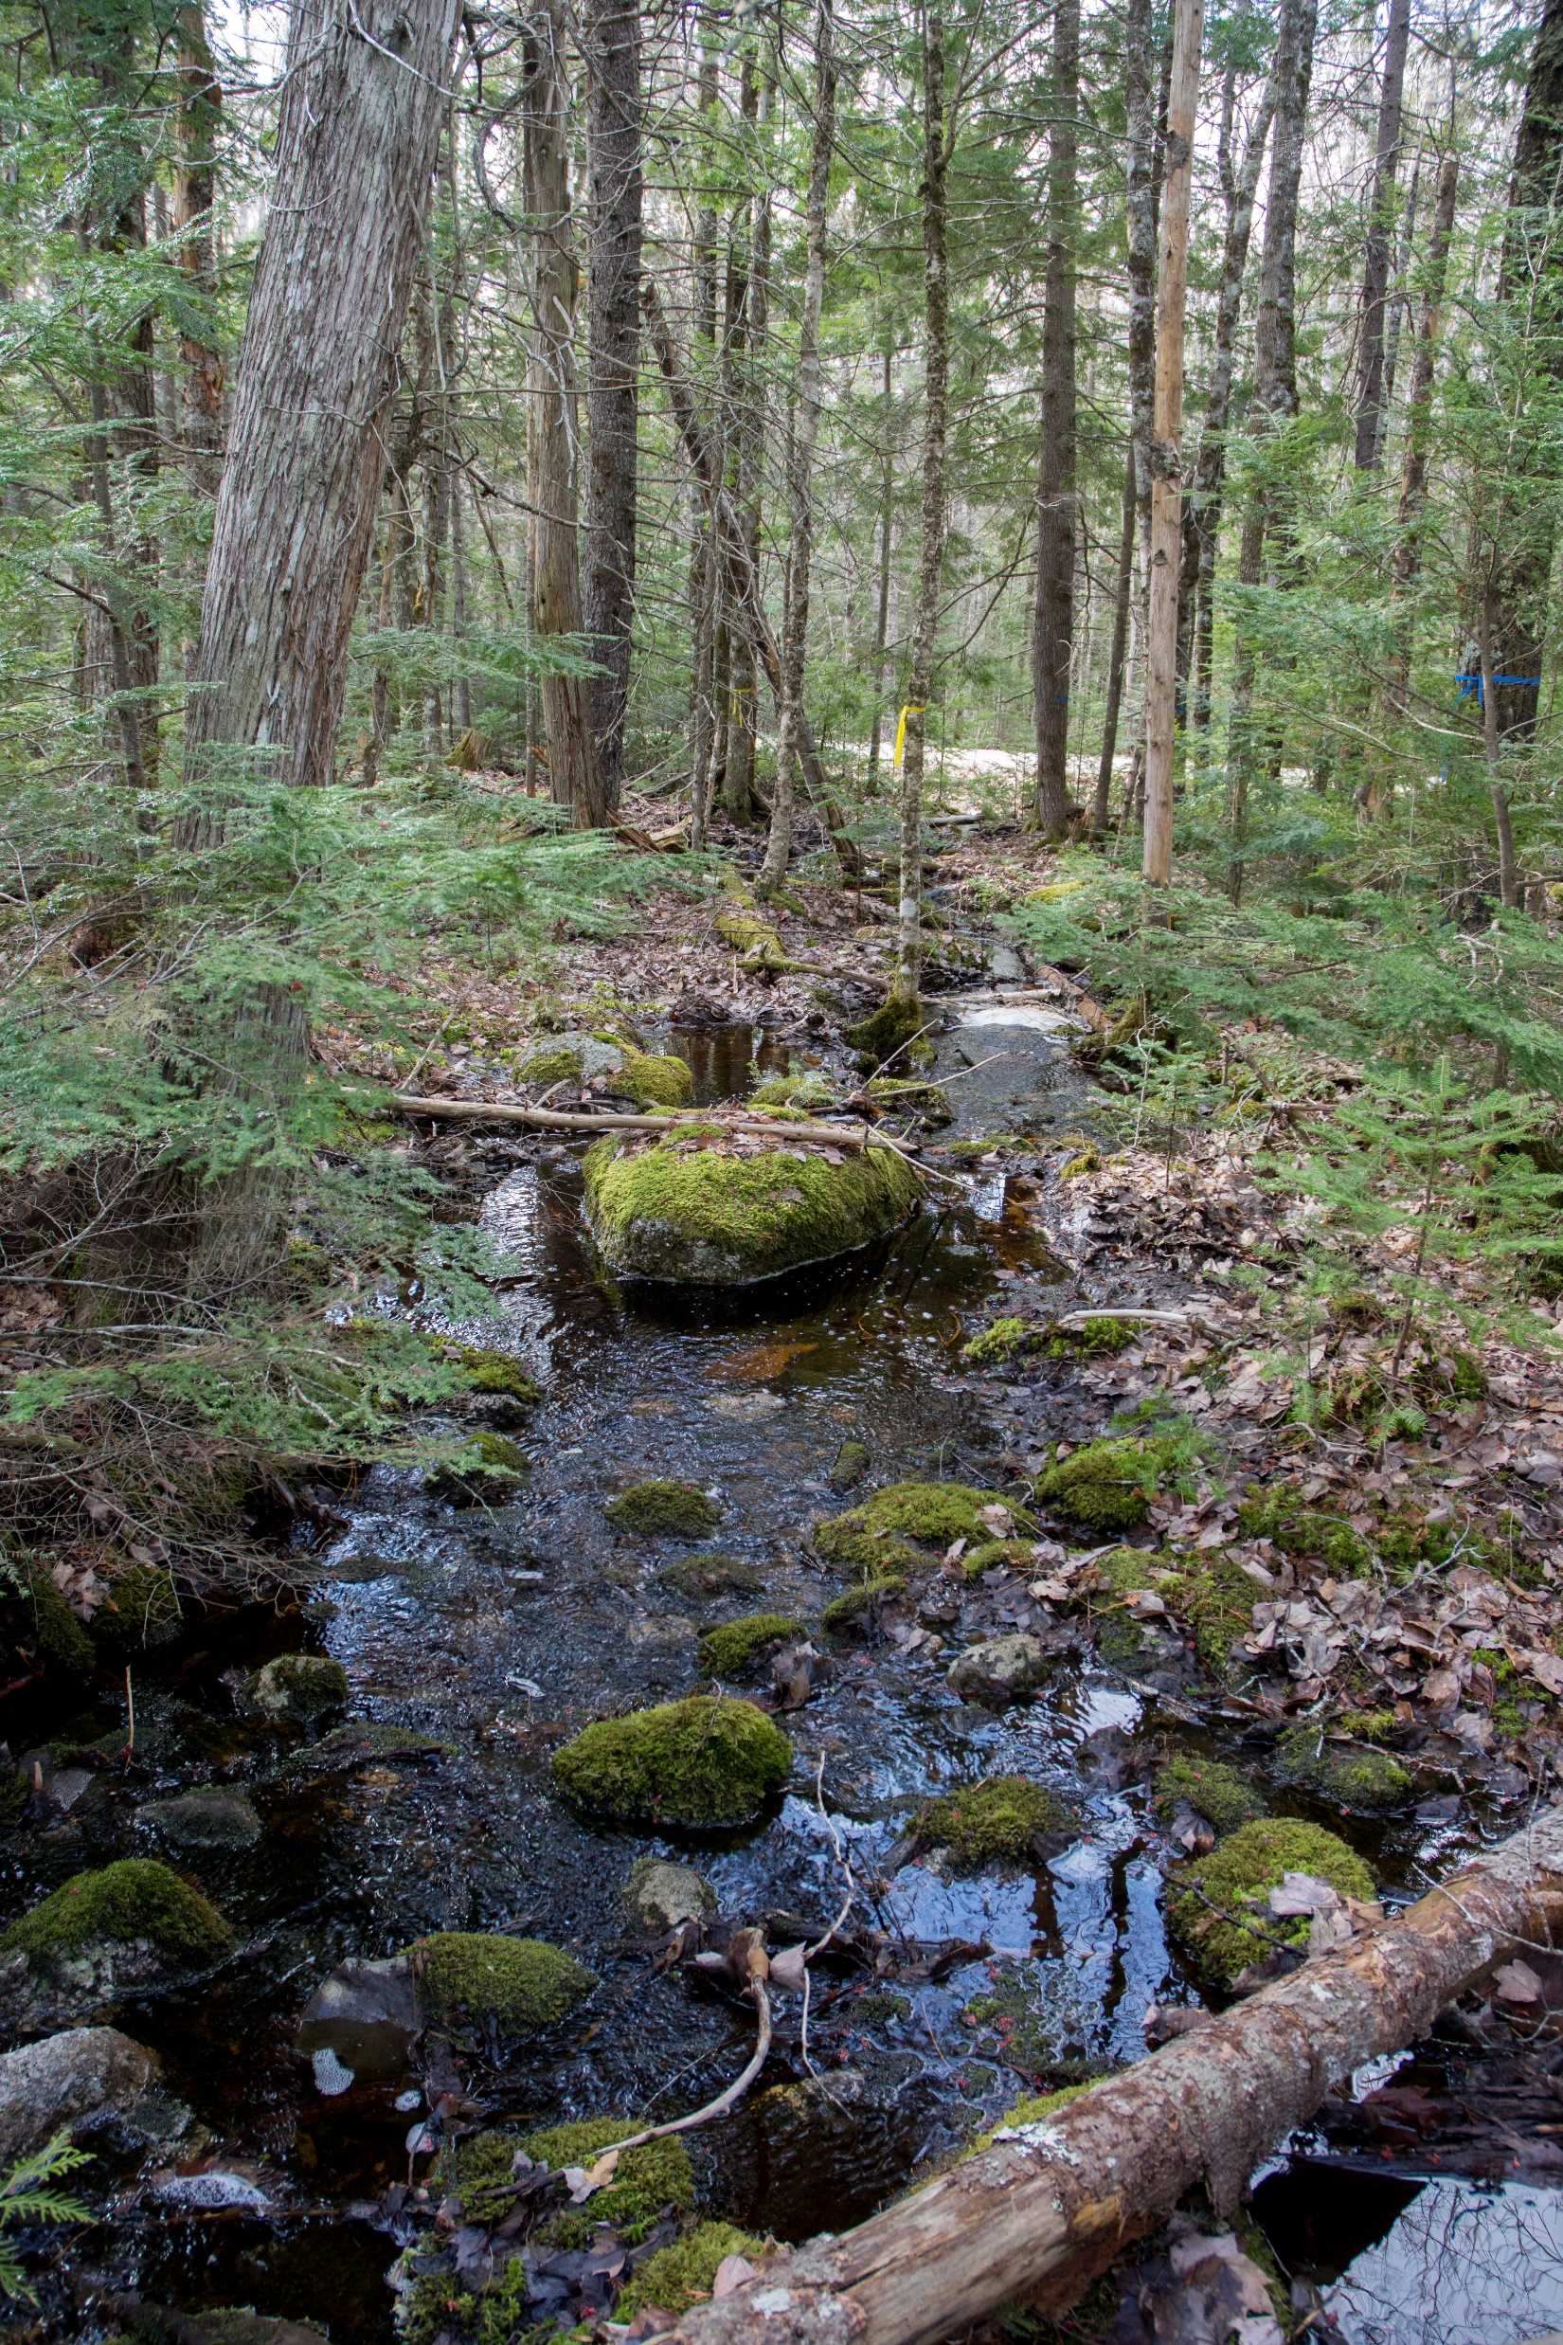
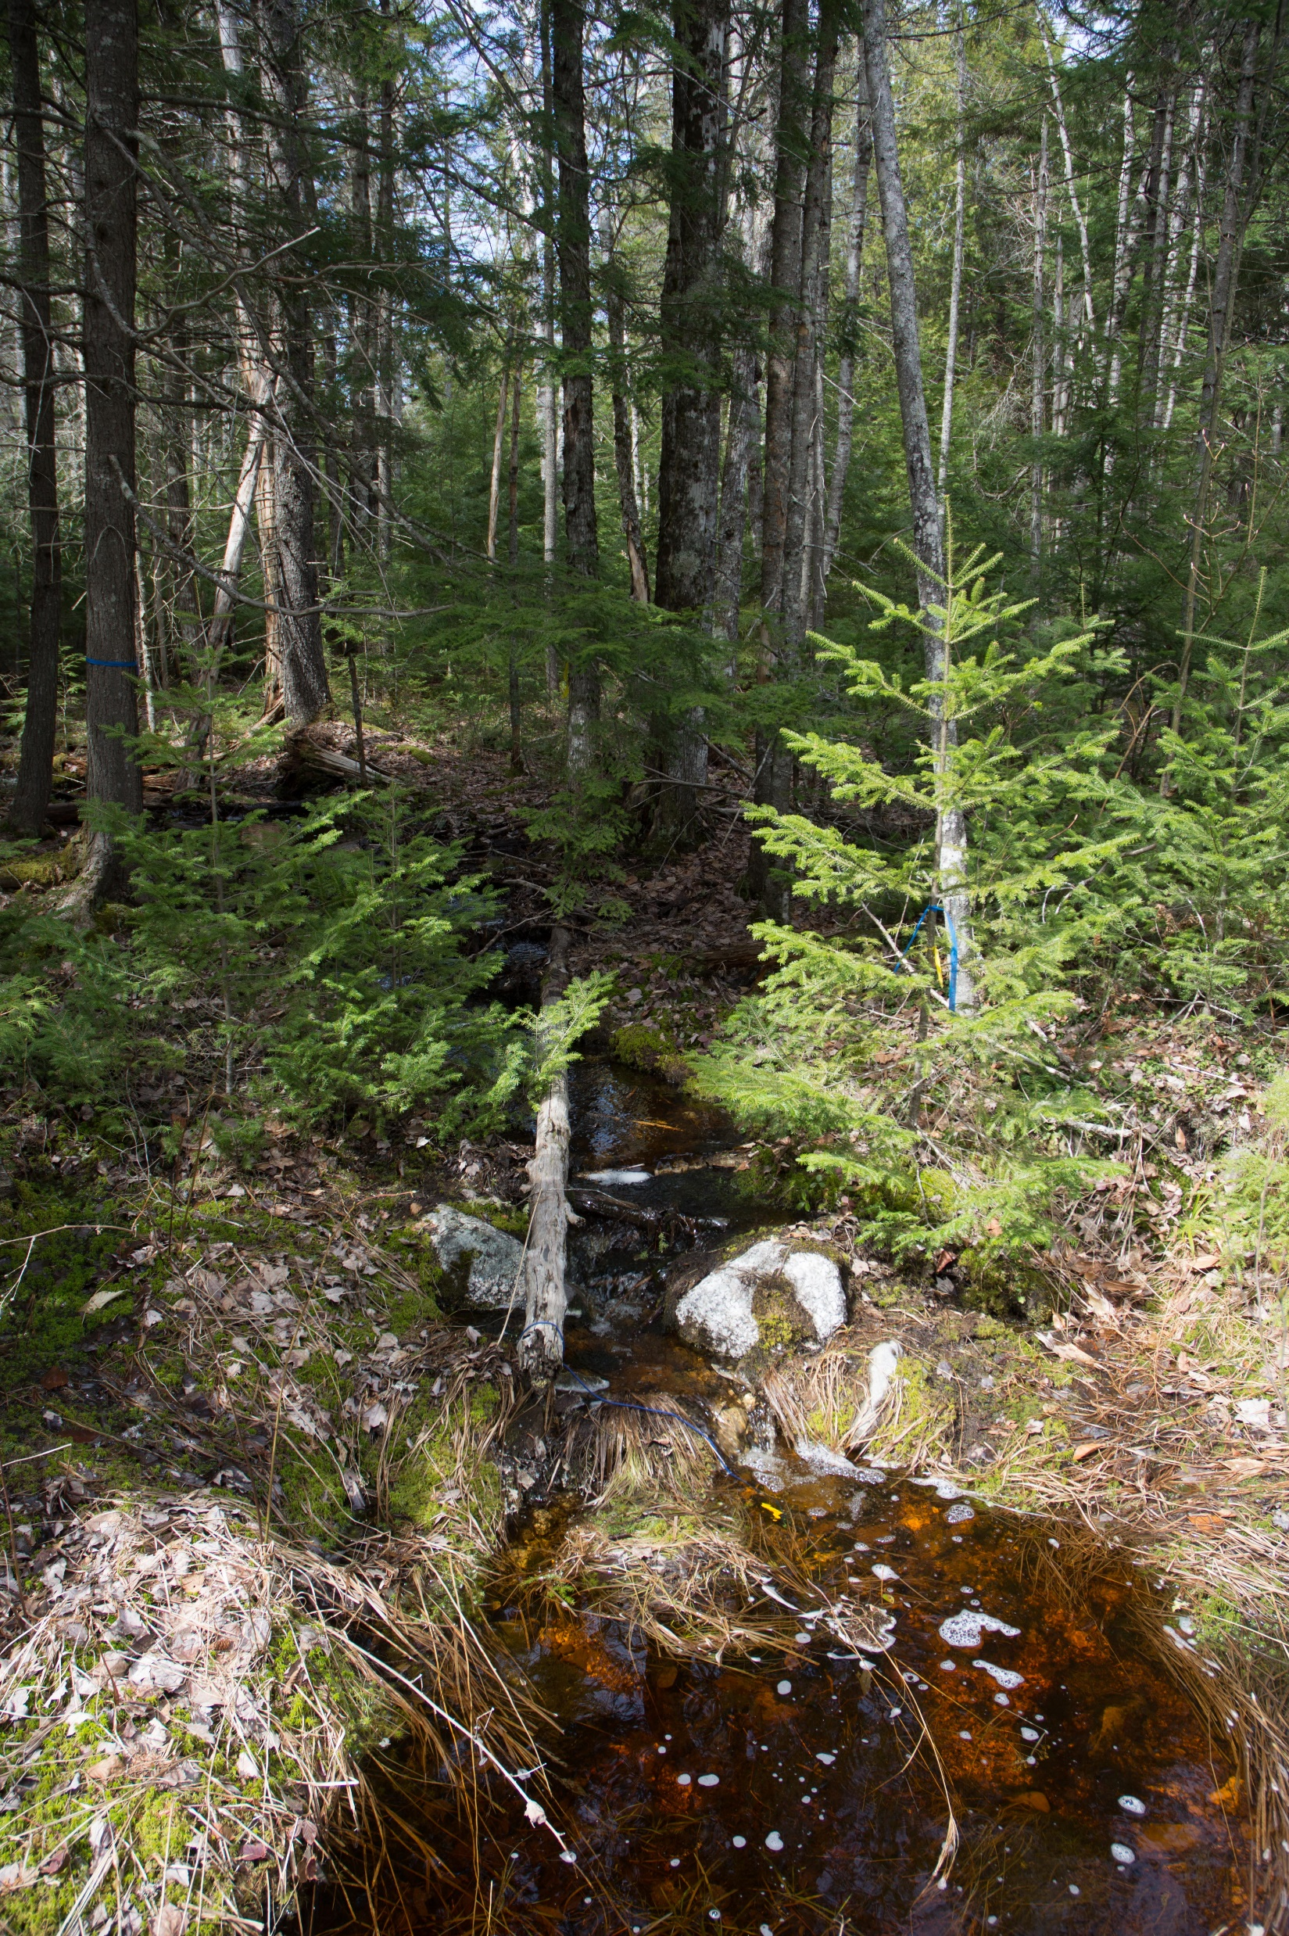
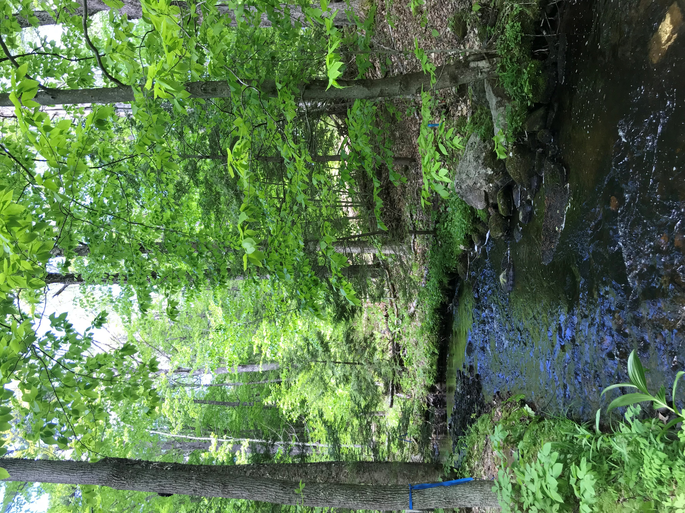
Ambient dissolved organic nitrogen pool response to in situ manipulation of organic solutes
Katherine X. Pérez-Rivera¹; Adam S. Wymore¹; William H. McDowell¹
¹ University of New Hampshire, Department of Natural Resources and the Environment
kxp1000@wildcats.unh.edu
Background
Results
Dissolved organic matter (DOM) serves as the major link between aquatic and terrestrial ecosystems. Inputs from the surrounding landscape (e.g. runoff, leaching from the soil, leaf matter) influence the concentration of solutes as well as ecological processes that take place within freshwater ecosystems. An important but understudied aspect of DOM are the ecological and biogeochemical controls on dissolved organic nitrogen (DON). DON is quantitively a significant source of nitrogen in aquatic ecosystems. Previous work shows that DON in streams can be consumed or produced by microbial processes, but the factors that control spatial variability in DON concentrations are poorly understood. Because DON comprises a wide range of individual organic compounds (e.g. amino acids, proteins, nucleic acids), it is virtually impossible to predict its behavior and ecological significance by tracing the fate of a specific individual compound. Instead, the whole DON pool must be considered in any assessment of its reactivity.
CRB-Acetate
CRB-Glycine
DCF- Acetate
A
A
A
B
B
B
Question and Hypotheses
How does the ambient pool of DON respond to changing availability of energy and alternative nitrogen sources?
Hypotheses:
Whole stream manipulations of acetate will stimulate nitrogen uptake from the ambient DON pool (DON concentrations decrease).
Glycine additions will reduce the uptake of ambient DON since glycine is a more easily assimilated form of DON as well as an energy source.
C
C
C
Methods
Field-based manipulations of labile DOC (acetate) and labile DON (glycine)
Quantify changes in concentration of DON and DOC to added solutes
Concentrations of DOC and DON were corrected for the number of C and N moles present in the added solutes to be able to assess their ambient concentration (DOC_{c} and DON_{c} )
Fig 1. Ambient DOC response to manipulated acetate (A). Ambient DON response to added acetate (B). Changes in the carbon and nitrogen fractions of DOM in response to elevated acetate concentrations (C).
Fig 2. Ambient DOC response to manipulated glycine (A). Ambient DON response to added glycine (B). Changes in the carbon and nitrogen fractions of DOM in response to elevated glycine concentrations (C).
Fig 3. Ambient DOC response to manipulated acetate (A). Ambient DON response to added acetate (B). Changes in the carbon and nitrogen fractions of DOM in response to elevated acetate concentrations (C).
Crawford Brook (CRB)
Ellsworth ,ME
Dowst Cate Forest (DCF)
Deerfield, NH
Synthesis
Acknowledgements
CRB
DON shows no response to the added acetate (Fig 1B, 3B)
The C-rich fraction of DOM is driving C:N ratios for acetate additions (Fig 1C, Fig 3C)
The N-rich fraction of DOM is driving C:N ratios for glycine
(Fig 2C)
`Glycine seems to be preferred over the bioavailable DOC
and DON (Fig 2A, 2B)
This work was funded and supported by the New Hampshire Agricultural Experimental Station and the Water Quality Analysis Laboratory. We would like to thank Jody D. Potter for his assistance in the lab and with the data as well as Bianca Rodríguez-Cardona, Allison Herreid, Anna Lowein, Eliza Balch and Sarah Bower for their assistance in the field.

