Slide 1





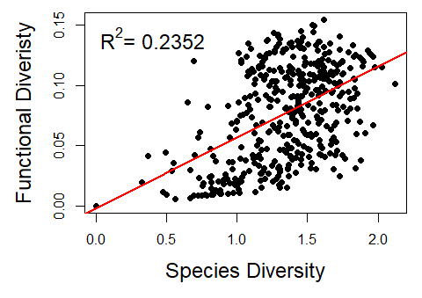
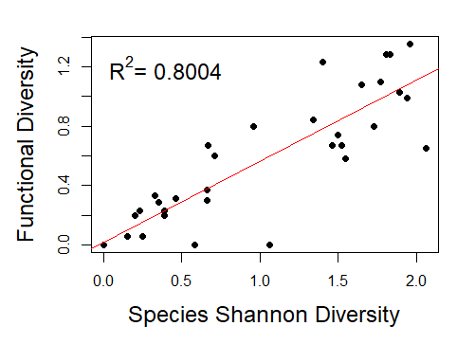
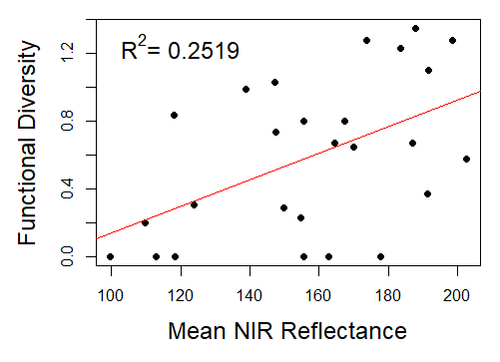
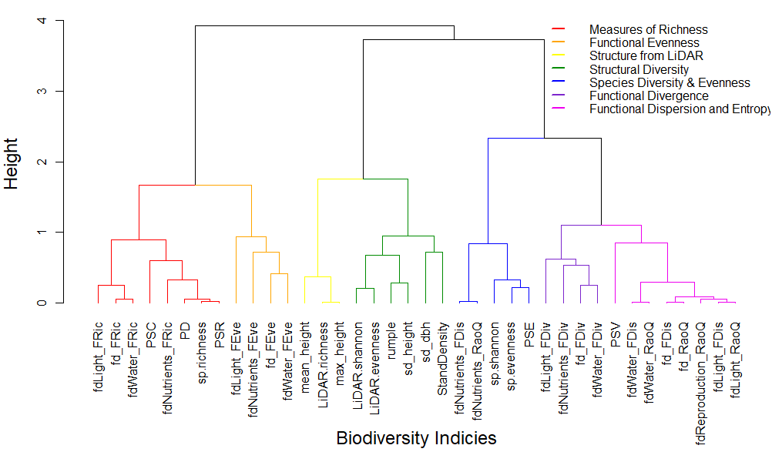
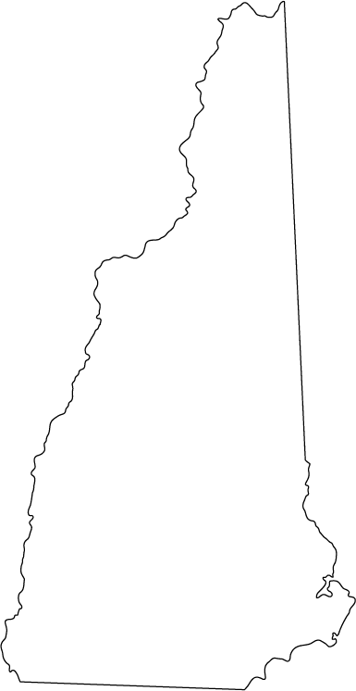
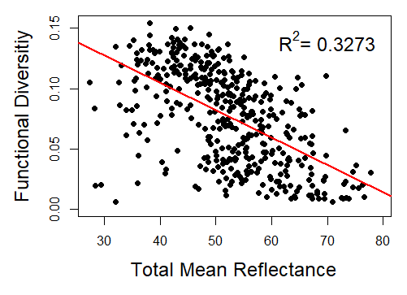
Measuring Forest Biodiversity on the Ground and in the Air: Comparing Biodiversity Estimates from Ground Based Surveys and Areal Imagery
Kaitlyn Baillargeon (kab2014@wildcats.unh.edu)
Scott V. Ollinger, Andrew Ouimette, Rebecca Sanders-DeMott, Franklin Sullivan, Olivia Bartlett
Department of Natural Resources and the Environment, University of New Hampshire, Durham, NH
Institute for the Study of Earth, Oceans, and Space and Department of Earth Sciences, University of New Hampshire, Durham, NH
B11F - 2399
Introduction
Relatedness of Biodiversity Indices
Relationships Compared at Larger Scales
Ecosystems are experiencing losses in biodiversity due to anthropogenic actives such as logging, agriculture, and urbanization
Biodiversity has been shown in some communities to help support the productivity and the stability of the ecosystem
The way in which biodiversity is quantified depends on the research topic. Most studies focus on estimating species richness, but biodiversity can also be characterized through the diversity of functional traits, phylogenetics, and structure.
Estimating biodiversity through field surveys is difficult as they can be costly and time consuming and many areas of interest are inaccessible
Some studies have shown that remote sensing can be used to estimate biodiversity with coarse spatial resolutions and over large areas, but few have looked at estimating biodiversity on small plot levels and fine spatial scales
Figure 2 (left): An example simple linear regression between RaoQ’s entropy index for functional diversity and Shannon’s index for species diversity. Overall, relationships between biodiversity metrics were found to be weakly correlated.
Figure 5: Linear regression between species and functional diversity across the United States using data from Fluxnet showing stronger relationships between metrics at broad scales.
Figure 6: Linear regression between mean NIR reflectance from NAP and functional diversity showing similar strength relationships between biodiversity and remote sensing at broad scales.
Figure 3 (below): Since the biodiversity indices used to calculate the four main metrics of diversity were similar, indices were grouped together based on the strength of their correlations. From there, an index from each group was selected to represent the other indices in future analyses.
Objectives
Influence of Canopy Structure and Function
Select Biodiversity Indices
with Total Reflectance
Select Biodiversity Indices and % Broadleaf Cover with Total Reflectance
Look at the different ways in which biodiversity can be quantified and test the similarity between the metrics.
Test the potential of estimating the different metrics of biodiversity from fine spatial resolution, hyperspectral imagery and Light Detecting and Ranging (LiDAR) data
Methods
Study Site
Bartlett Experimental Forest (BEF)
  Bartlett NH, USA (Figure 1)
1,052 hectare, northern-hardwood forest
Contains 400⁺, evenly spaced 32m by 32m inventory plots
Most recent publicly available species inventory was collected in 2001to 2003
SpecTIR hyperspectral imagery collected in 2014
  Spatial resolution = 5m
  Spectral resolution = 400 to 2500nm; 360 bands
2014 LiDAR collected from the National Ecological Observatory Network (NEON)
Source | Log Worth |  | PValue
StandDensity | 8.301 |  | 0.0000
fd_RaoQ | 7.564 |  | 0.0000
rumple | 5.295 |  | 0.0000
PSV | 3.578 |  | 0.0003
fd_FDiv | 2.184 |  | 0.0065
mean_height | 1.074 |  | 0.0843
fd_FEve | 0.975 |  | 0.1059
sp.richness | 0.698 |  | 0.2005
sp.shannon | 0.638 |  | 0.2299
Source | Log Worth |  | PValue
%broadleaf | 25.650 |  | 0.0000
StandDensity | 4.067 |  | 0.0001
rumple | 3.377 |  | 0.0004
sp.shannon | 2.419 |  | 0.0038
PSV | 0.984 |  | 0.1037
fd_FEve | 0.643 |  | 0.2278
mean_height | 0.474 |  | 0.3360
sp.richness | 0.311 |  | 0.4891
fd_FDiv | 0.218 |  | 0.6059
fd_RaoQ | 0.085 |  | 0.8226
Bartlett Experimental Forest
Estimating Biodiversity from Remote Sensing
Figure 4: Linear regressions were used to see how the biodiversity metrics could be estimated from the remote sensing analyses. All relationships were showed weak correlations, with the strongest correlation being between functional diversity and reflectance.
Figure 1: Approximate Location of Bartlett Experimental Forest in New Hampshire, USA
Figure 7: Standard least squares (SLS) analysis looking at the effect of the biodiversity metrics on reflectance.
Table 1: The effect summary of each for the biodiversity metrics showing each variable’s effect on reflectance
Biodiversity Indices
Remote Sensing Analyses
Hyperspectral
  Entropy of spectra
  Reflectance
  Vegetation indices
  Gray-Level Co-Occurrence Matrix (GLCM)
LiDAR
  Rumple
  Shannon Index of height profile
  Max and sd height
Figure 8: SLS analysis again but also accounting for the percent broadleaf coverage of the plots
Table 2: The effect summary of each for the biodiversity metrics
Species Diversity
  Shannon’s Index (sp.shannon)
  Richness (sp.richness)
  Peilou J Evenness (sp.evenness)
Functional Diversity
  Richness (FRic)
  Evenness (FEve)
  Divergence (FDiv)
  Dispersion (FDis)
  Rao’s Quadradic Entropy (RaoQ)
Phylogenetic Diversity
  Faith’s PD (PD)
  Variability (PSV)
  Richness (PSR)
  Evenness (PSE)
  Clustering (PSC)
Structural Diversity
  Standard deviation (sd) of DBH (sd_dbh)
  Stand density (StanDen)
Takeaways
Strength of relationships between biodiversity metrics improve as scale broadens.
Estimates from remote sensing at fine and broad scales both show weak correlations.
The influence of function and structure on reflectance suggests that both these variables are working together as drivers of reflectance
The influence of broad leaf coverage is an example of potential outside influences that aren’t accounted for when looking at diversity alone. Other influences looked at include management history and topography.
Colors represent groups made by the dendrogram in the next section
Acknowledgements: This material is based upon work supported by the National Science Foundation under Grant Number (1638688). Partial funding was also provided by the New Hampshire Agricultural Experiment Station, the Hubbard Brook Long Term Ecological Research program (NSF 1114804), the Harvard Forest Long Term Ecological Research program, and the University of New Hampshire graduate school. We also acknowledge the help and support of infrastructure and staff at Bartlett Experimental Forest. Inventory data of species compositions at BEF was collected by the University of New Hampshire. LiDAR data was obtained from the National Ecological Observatory Network and hyperspectral reflectance imagery was obtained from SpecTIR.

