Slide 1


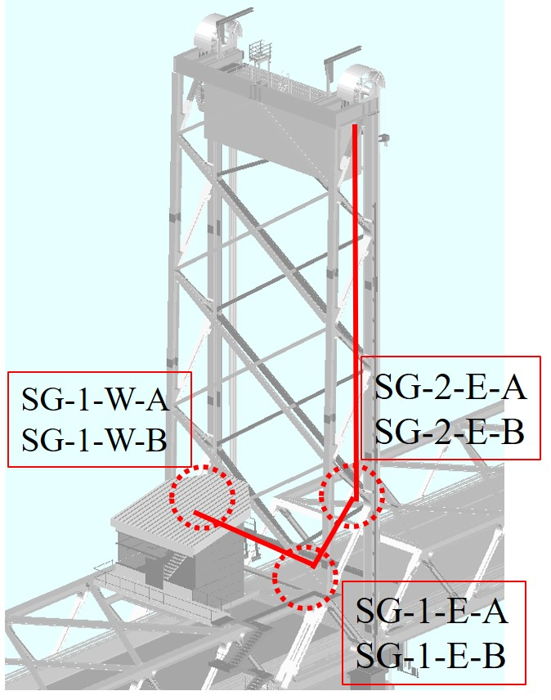
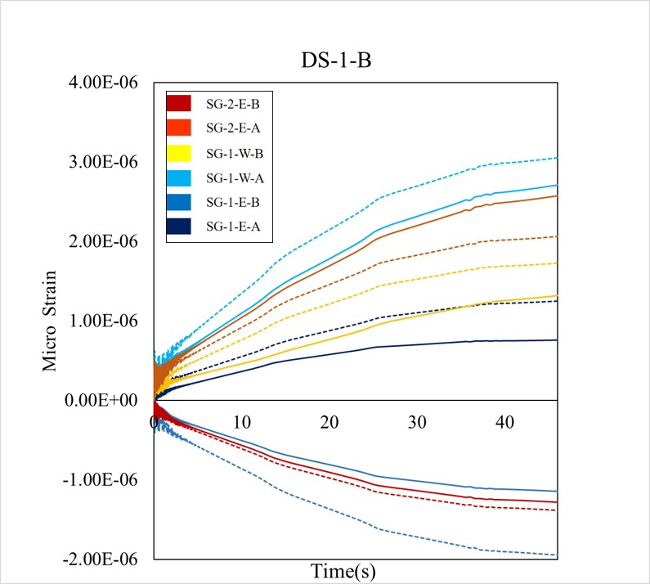
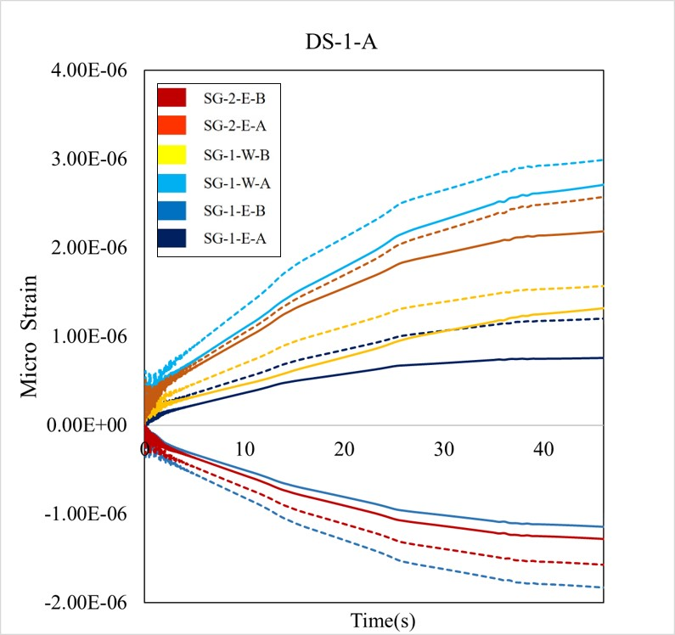
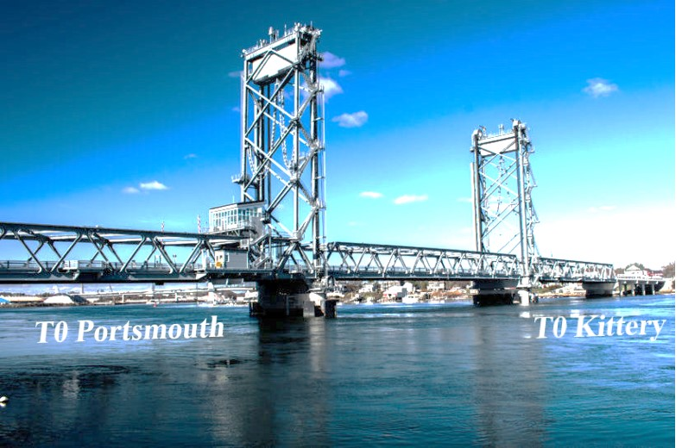
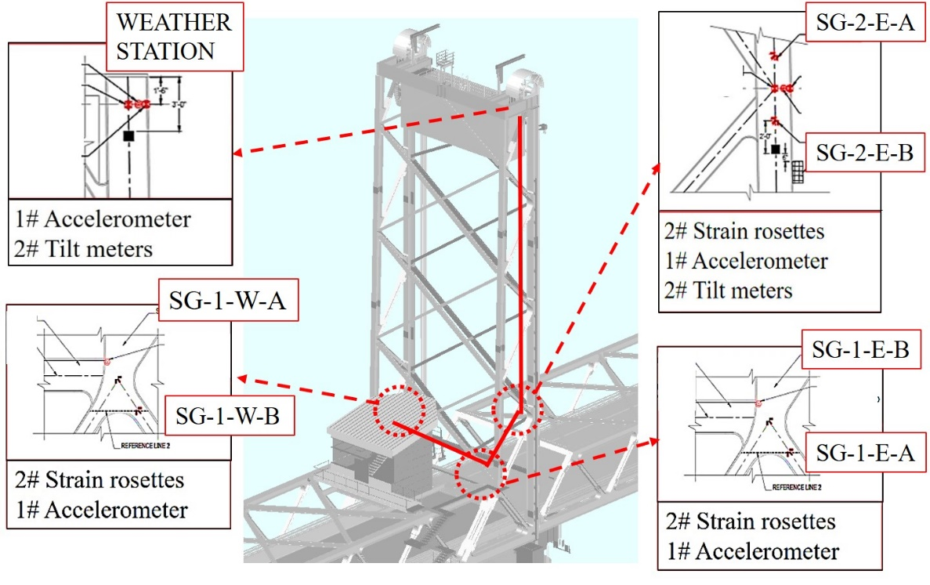
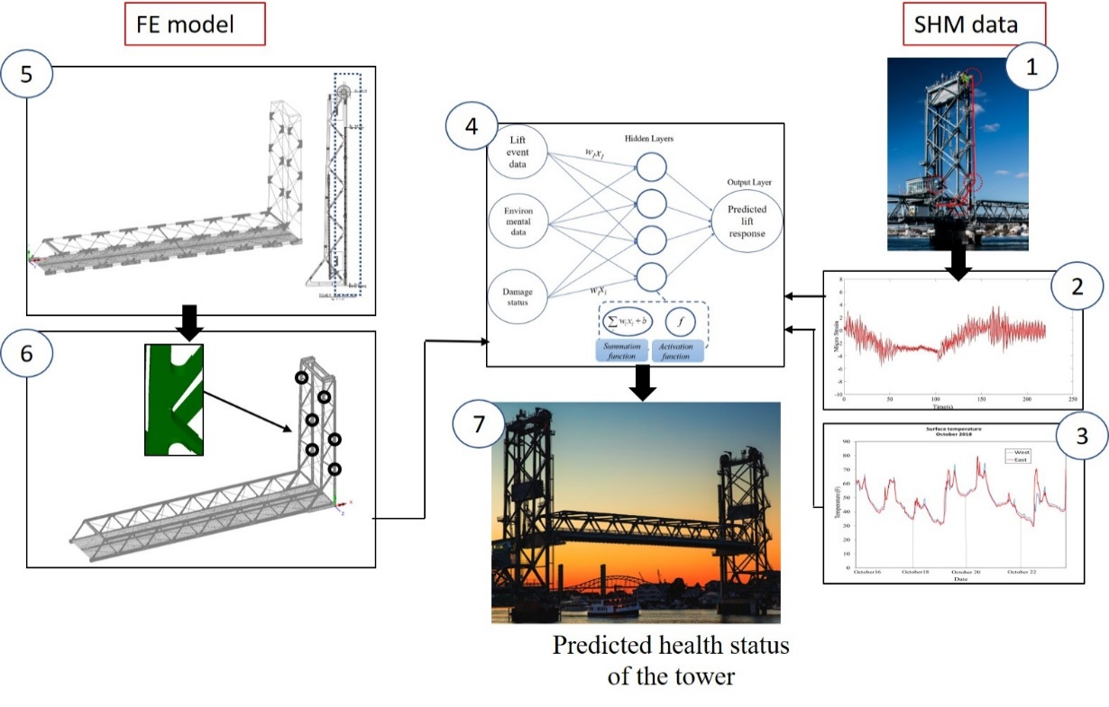
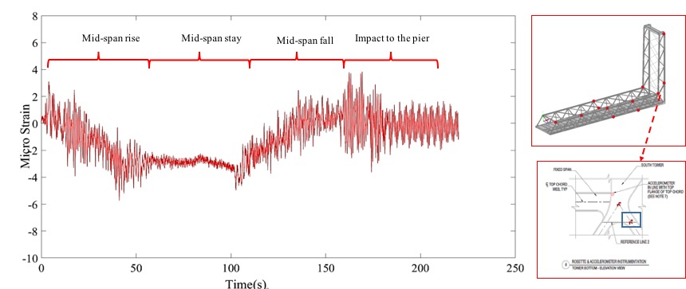
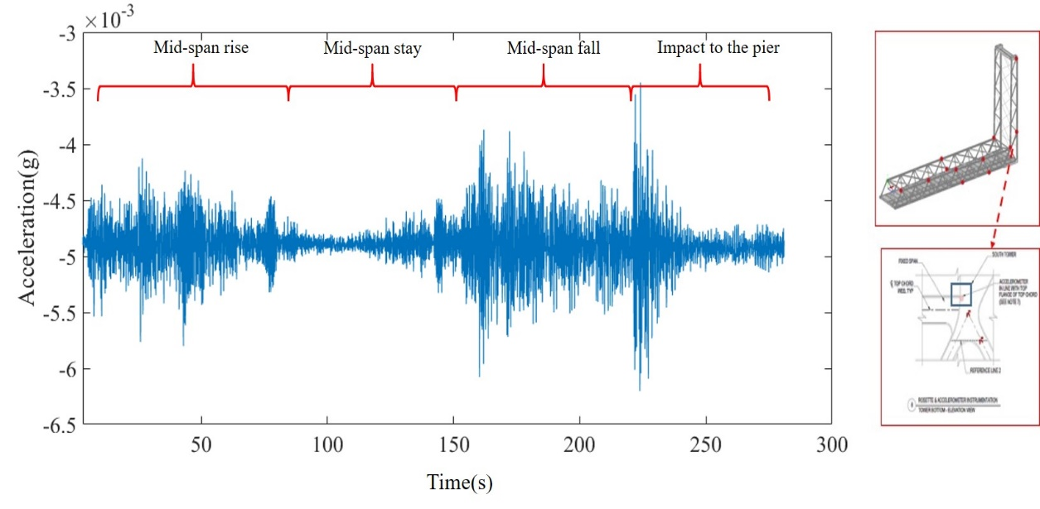
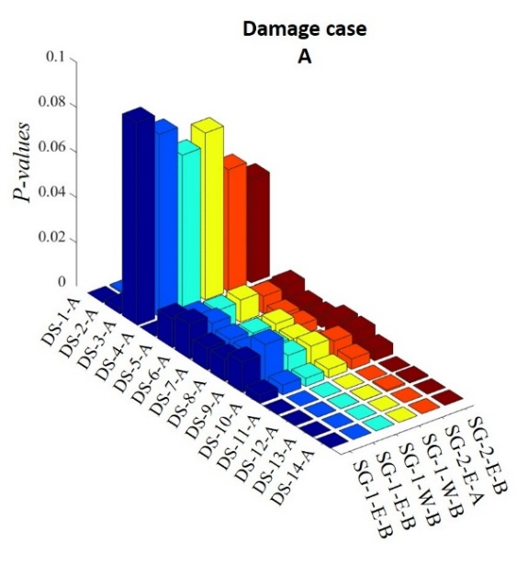
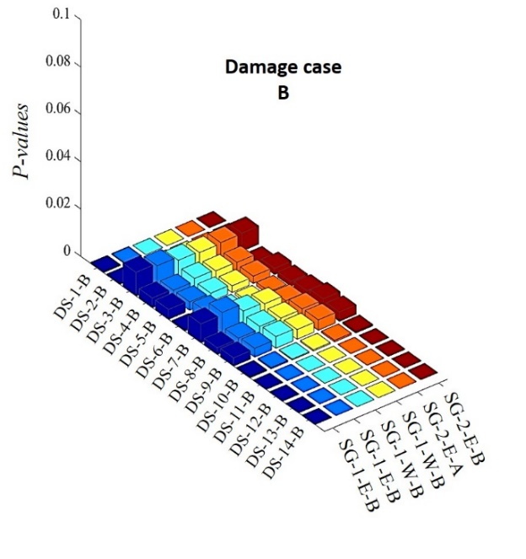
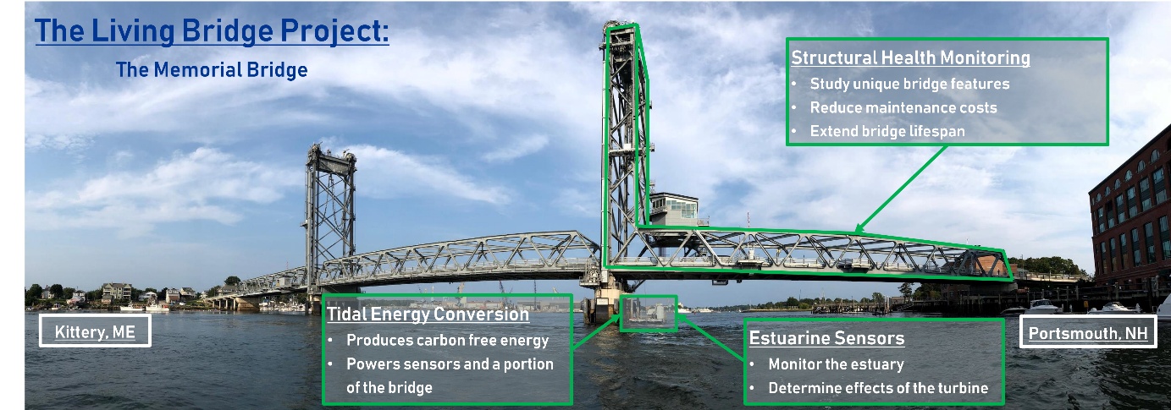
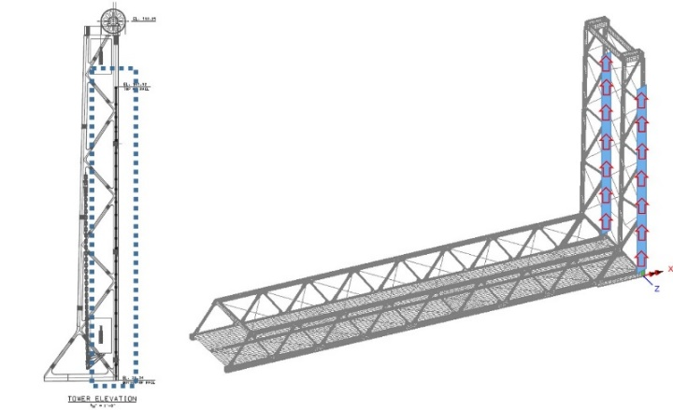
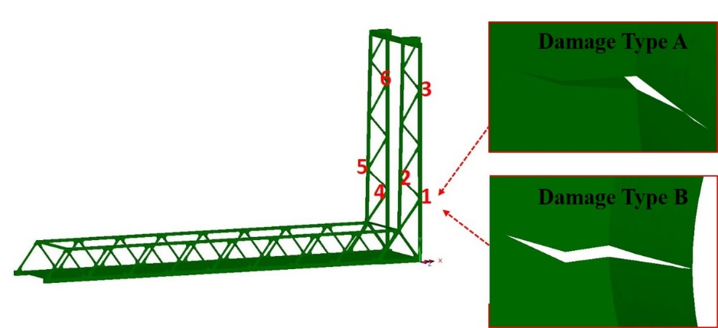



Condition assessment protocol of vertical lift truss bridges under the lift induced excitations using artificial neural network and analytical model
Maryam Mashayekhi, Erin Santini Bell, P.E.
University of New Hampshire, Durham, NH
Abstract
The Methodology
Results:
Vertical lift bridges are critical transportation infrastructure elements, which require a specialized design, assessment and maintenance considerations for a continued long-term performance. Structural health Monitoring (SHM) programs installed on vertical lift bridges create an opportunity for an automated condition assessment algorithm using the lift operation as a consistent, significant excitation. A protocol that can identify condition changes in key components of the lift tower is implemented for a case-study vertical lift bridge, the Memorial Bridge in Portsmouth, NH. The structural responses of the tower are collected over multiple bridge lift events, under a range of environmental conditions. The collected data sets are supplemented with numerical data of a validated finite element (FE) model of the bridge that include multiple simulated damage types. These data sets are utilized to train a mathematical model, to predict the structural response of the damaged lifting tower, using the Neural Network (NN) method.
.
Sensitivity Analysis: The structural responses of the concerning structural component (lift tower) is determined, that is sensitive to the lift event .
Collect the SHM data: Sufficient data samples of lift events are collected.
Collect additional information: External excitations, such as wind speed, temperature and lift height, are required to evaluate the variability of the structural response of the tower,
Develop the Neural Network: The data set including structural responses and external excitations are used to train the neural network,
Using the validated FE model: A validated FE model of the bridge is used to predict the structural response of the vertical tower during the lift event, under the healthy condition and a set of damage scenarios,
Train the Neural Network: The numerical healthy and damage-induced responses are input to train the neural network for damage detection.
Predict the damage: The protocol is applied to predict a possible damage through the determined damage-induced changes in the responses.
The healthy and damage-induced lift responses:
Damage detection using the trained neural network:
The computed p-values are evaluated significance level, α. The p-values that are below the α illustrates the rejection of H0. The p-values for the damage detection protocol in this study are evaluated with a significant level of 0.005. It can be observed that the p-values are considerably variable depending on the damage type and location. However, the damage scenarios that included damage case B could be more detected, due to higher damage-induced strain responses.
The numerical healthy (solid lines) versus the damaged (dotted lines) time-history strain responses are obtained for six strain gage locations, under the simulated lift event. The damage-induced changes in the strain responses can be variable, depending on the damage type and strain gage location. The damage detection may be less feasible through comparing the time-history responses, due to the small amplitude of strain responses during the lift event. Therefore, the change in the peak strain is applied as the criteria for the damage identification purpose.
NH
ME
The numerical healthy and damage-induced responses, as well as the environmental information, are input to the NN model. The damage prediction is performed using a t-test. The null hypnosis, H0, denotes the similar responses of damaged and healthy conditions. The parameter p-value shows the probability that the H0 is true, which varies from 0 to 1.
The Objectives
Finite element model of the Memorial Bridge
This study is part of a multi-disciplinary project “the Living Bridge project” which conducts SHM and condition assessment of the Memorial Bridge. The main objectives of this study include:
Develop an automated condition assessment protocol for the movable bridges, using a data-driven NN model.
Utilize the collected SHM data of the instrumented lift tower, during the lift events, to validate the numerical responses of an FE global model of the bridge under the simulated lift action.
Employ the validated FE model, to investigate the unhealthy structural response of the tower during the lift events. Multiple physical damage scenarios are implemented at different locations of the tower to obtain the damage-induced structural responses.
Integrate the numerical damaged-induced responses of the tower and field-collected SHM data to supplement the database for training and testing the Neural Network model.
Evaluate the efficiency of the proposed protocol in locating damage for the Memorial Bridge.
A global FE model of the bridge made of shell elements is created in LUSAS®, which is validated through a load test. The verified FE model of the bridge is utilized in this study to simulate the lift event. Using the FE model, the numerical lift induced responses at the instrumented and non-instrumented locations of the tower are obtained. The numerical lift induced strains of the model are validated via the field-collected lift responses of the bridge. In addition, the validated FE model of the bridge is applied to simulate some of the possible damages at the fracture-critical locations of the lift tower. For the case-study, the Memorial Bridge, there was not any reported damage by the inspection program of the bridge.
The three-dimensional shell elements of the FE model benefit to consider physical damages such as fatigue cracks in the model. Two damage types (A and B) are considered in the model, which are simulated in six different locations of the tower. The numerical lift-induced strain responses at the location of strain gages are utilized for training the Neural Network system. For each damage case, fourteen damage scenarios are defined that include single or multiple damaged locations of the tower.
Conclusion
The damage prediction results demonstrated that the probability of locating a damage is directly dependent on the damage severity and adequacy of sensors. The proposed protocol also, requires more inputs in terms of strain points to predict the damages along the lift tower. Additionally, increasing the input data using the numerical data may provide a more precise database for training the mathematical model to extract the features, which are associated with multiple types of damage. Therefore, numerical responses of a validated model can be utilized on non-instrumented locations of the tower to obtain more strain points for a more consistent damage prediction.
Acknowledgement
This material is based upon work partially supported by the National Science Foundation under Grant No.1430260,FHWA AID:DEMO Program and funding from the NHDOT Research Advisory Council. Any opinions, findings, and conclusions or recommendations expressed in this material are those of the author(s) and do not necessarily reflect the views of the National Science Foundation. Special thanks to BDI for instrumentation and HNTB for technical support.
erin.bell@unh.edu
www.livingbridge.unh.edu

