Slide 1


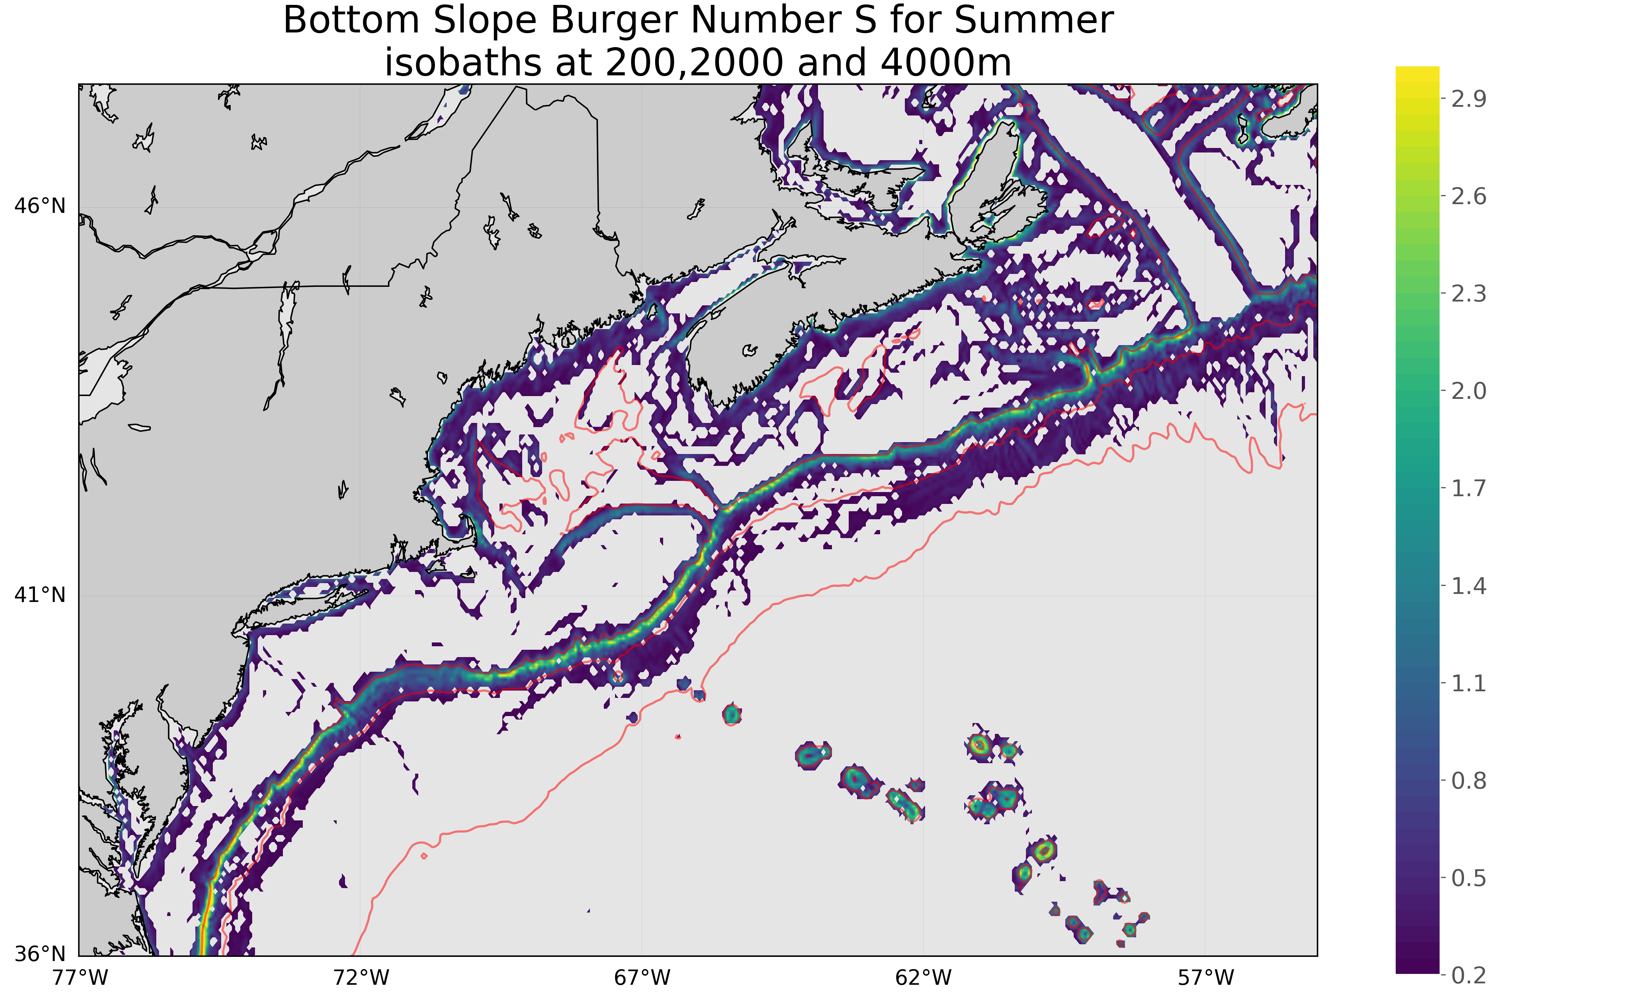
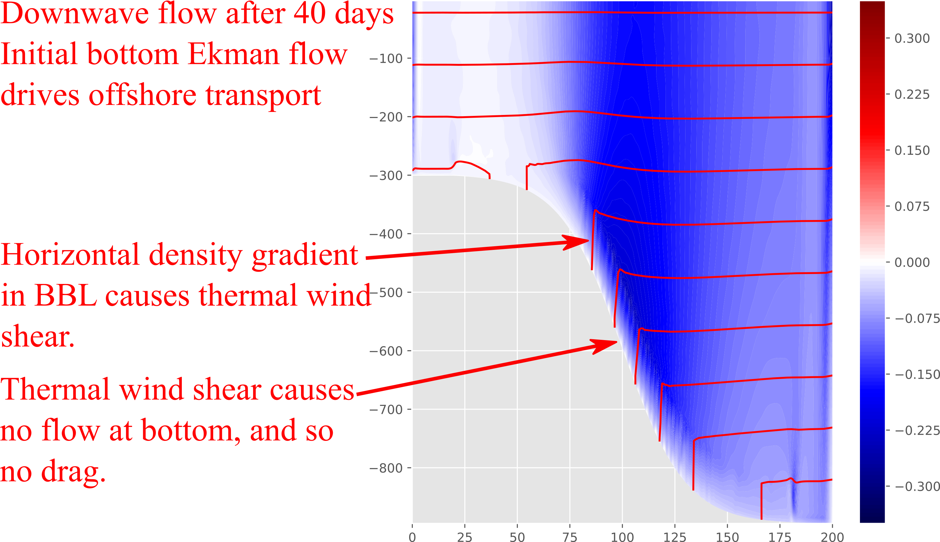
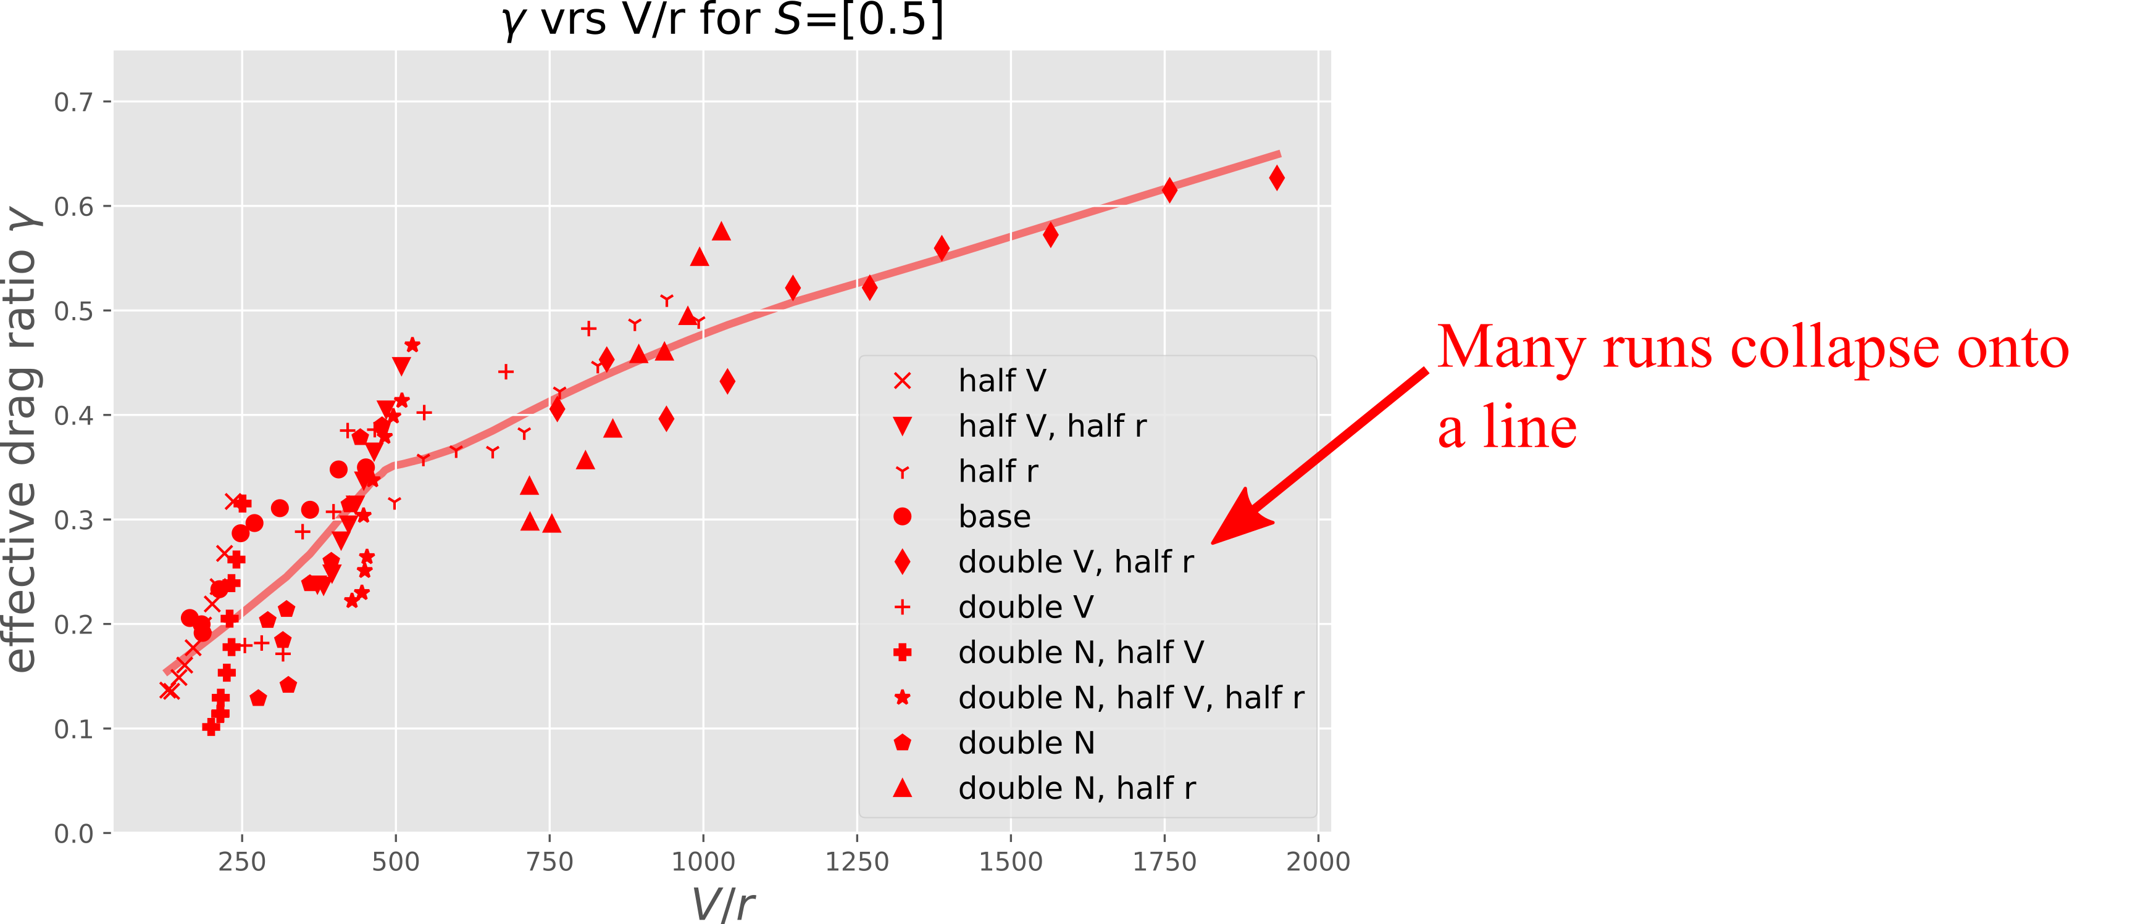
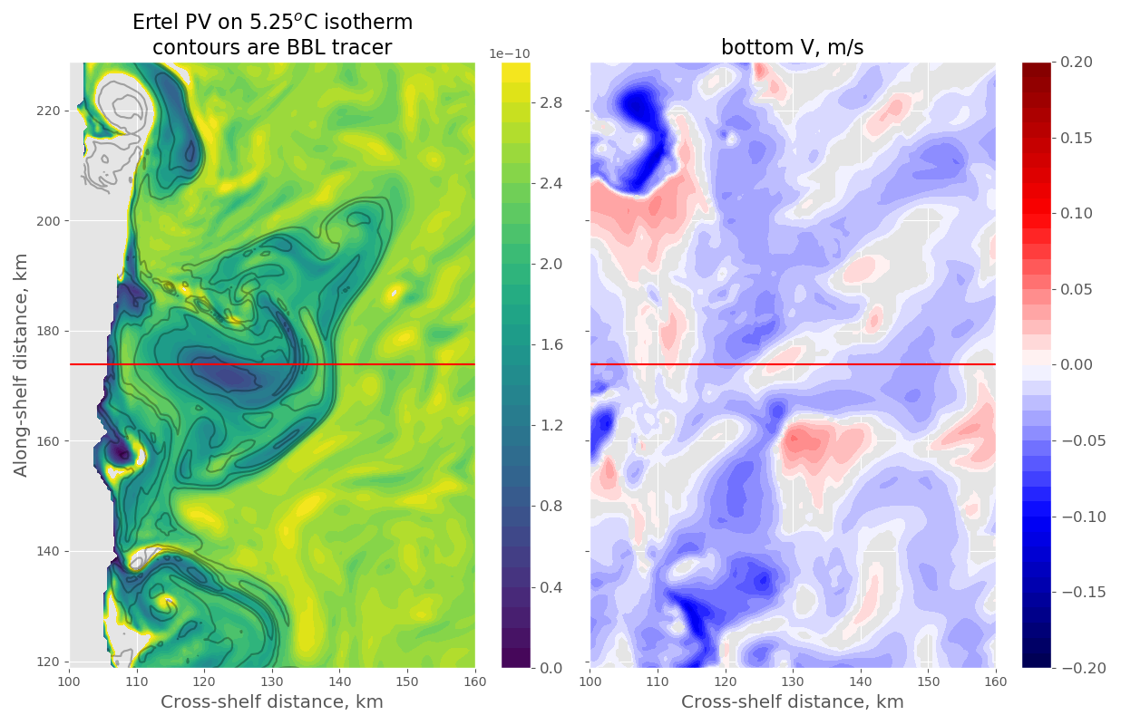
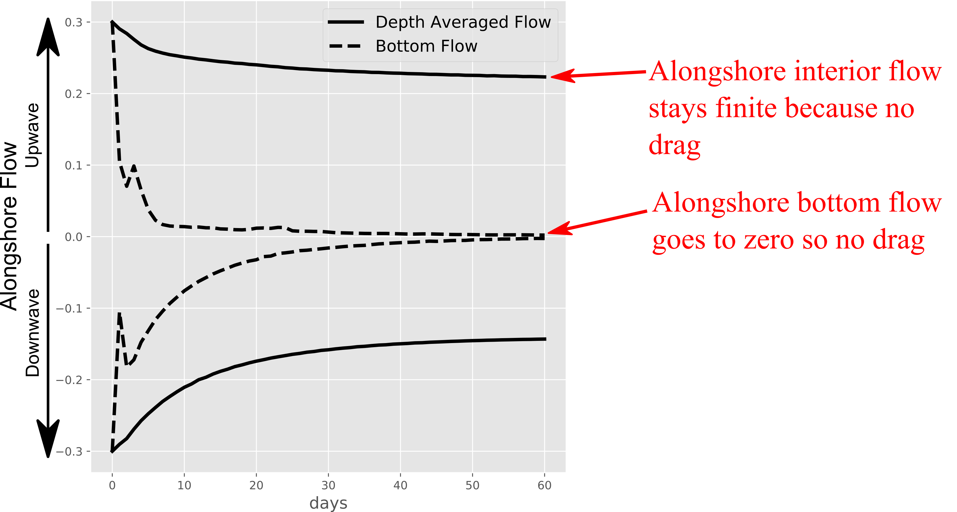
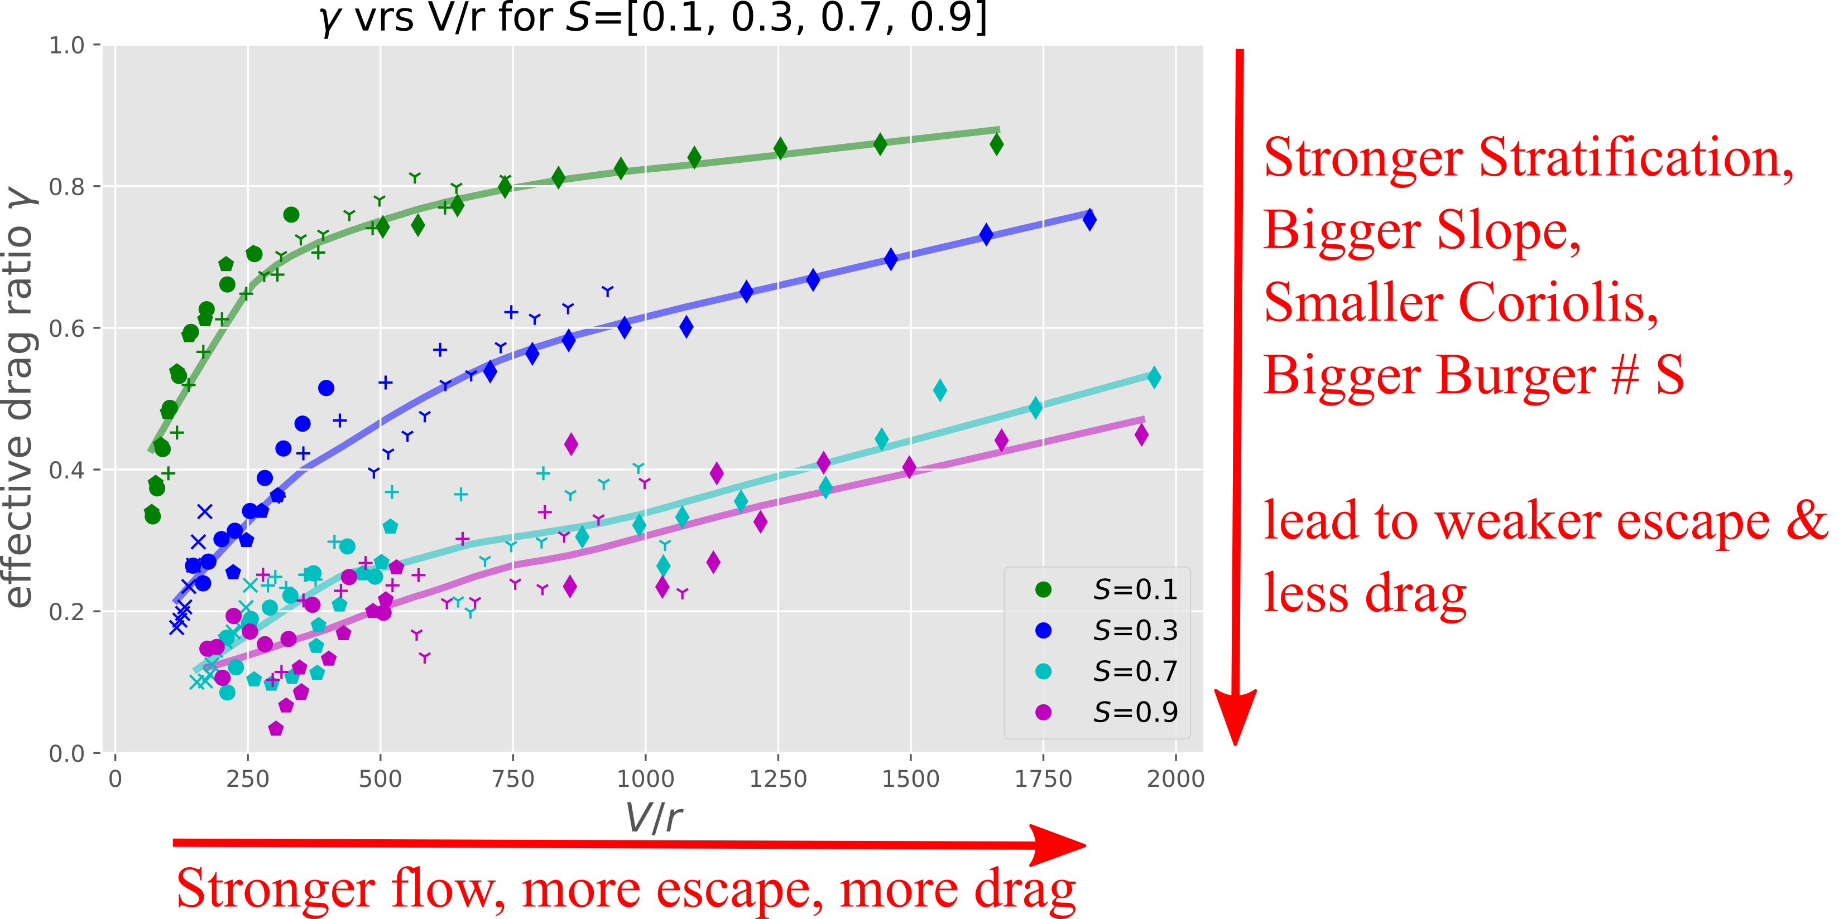
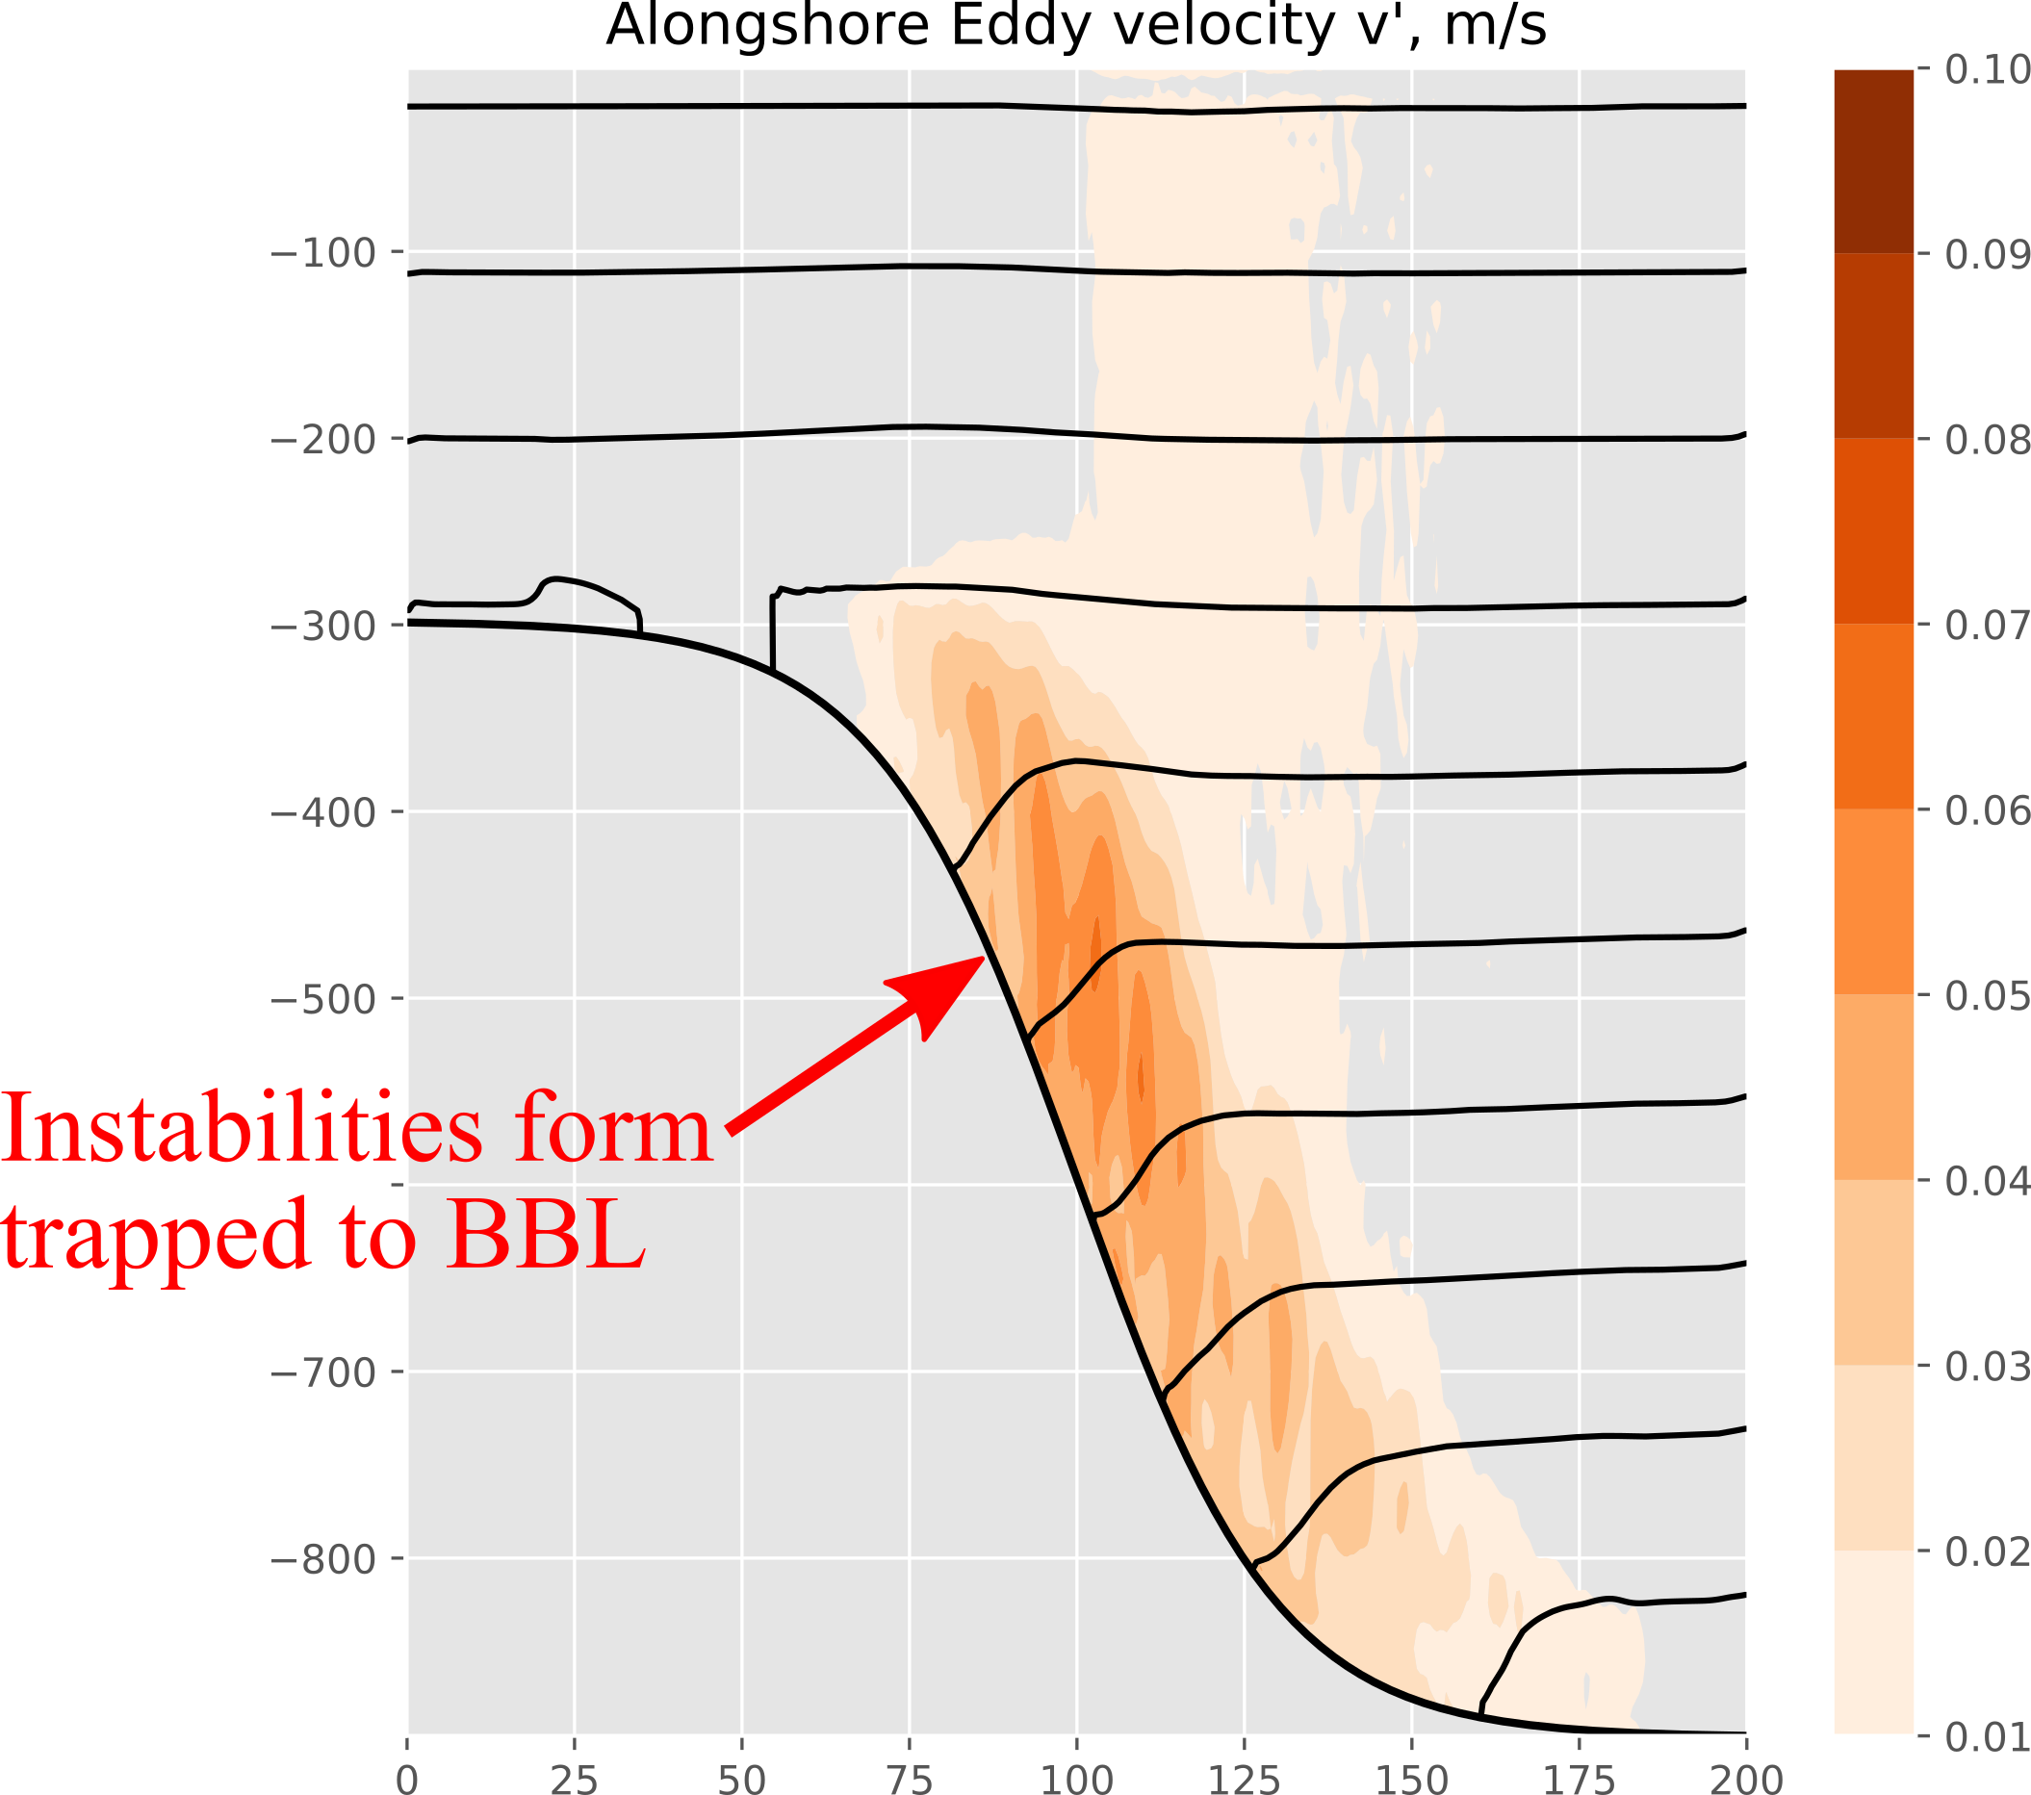
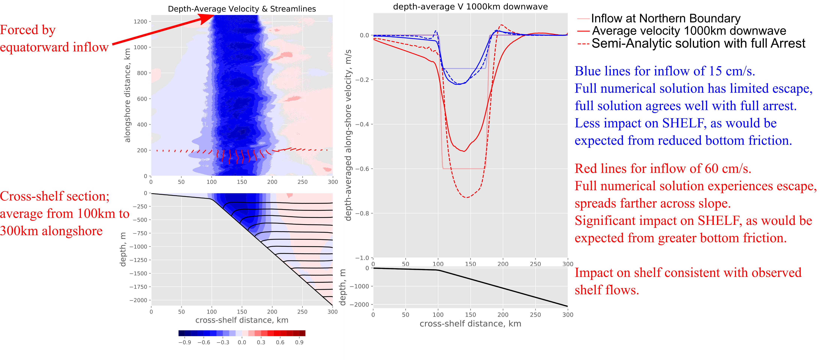
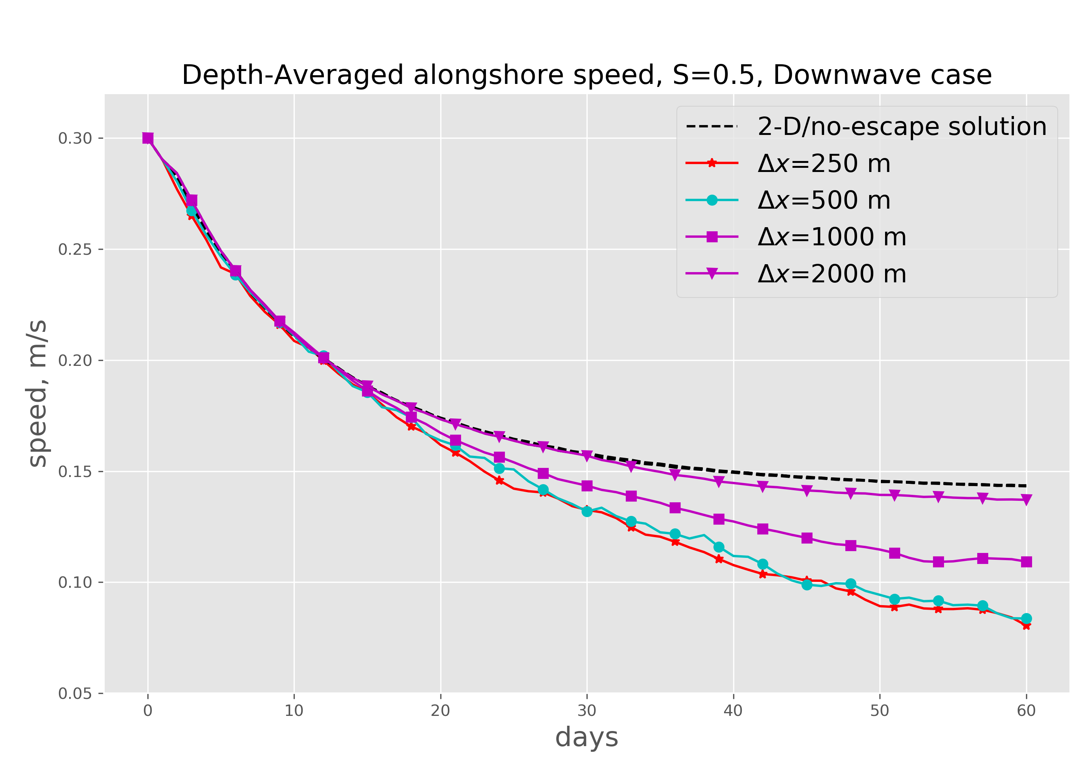
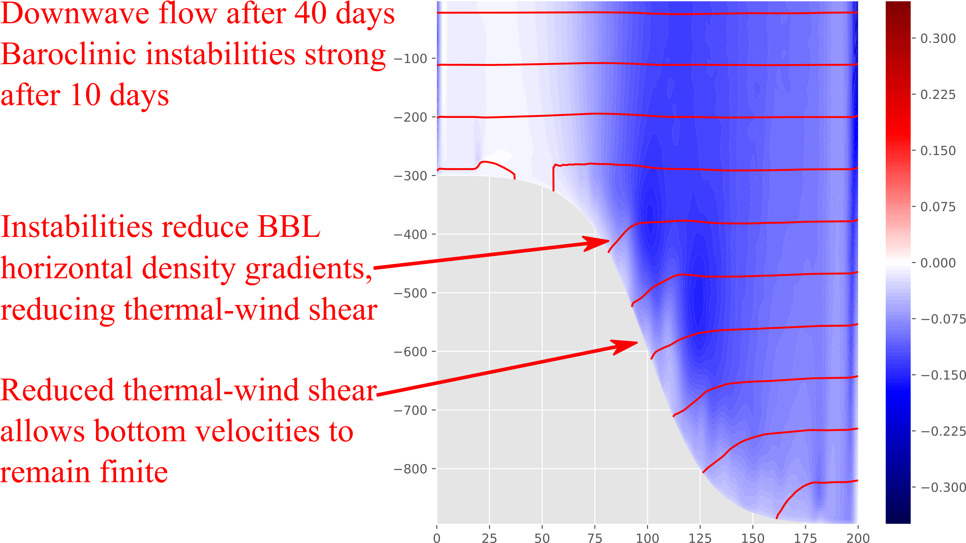
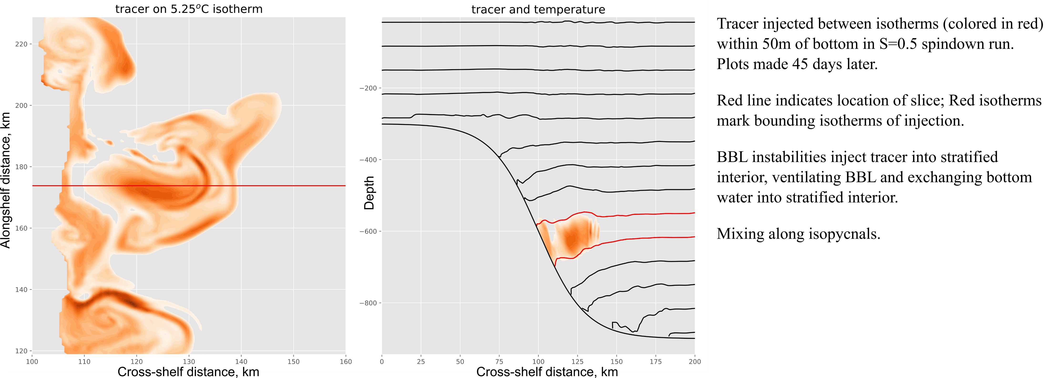
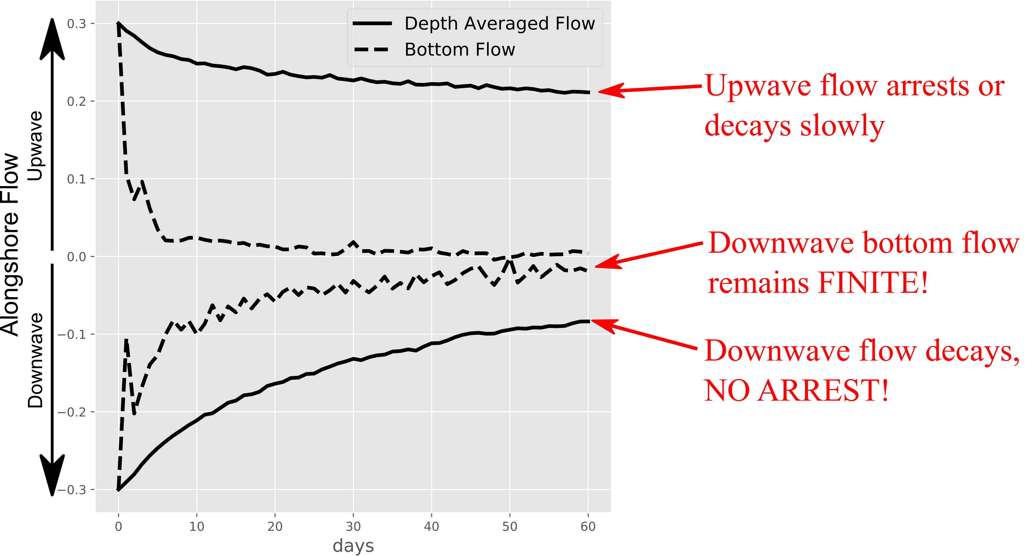
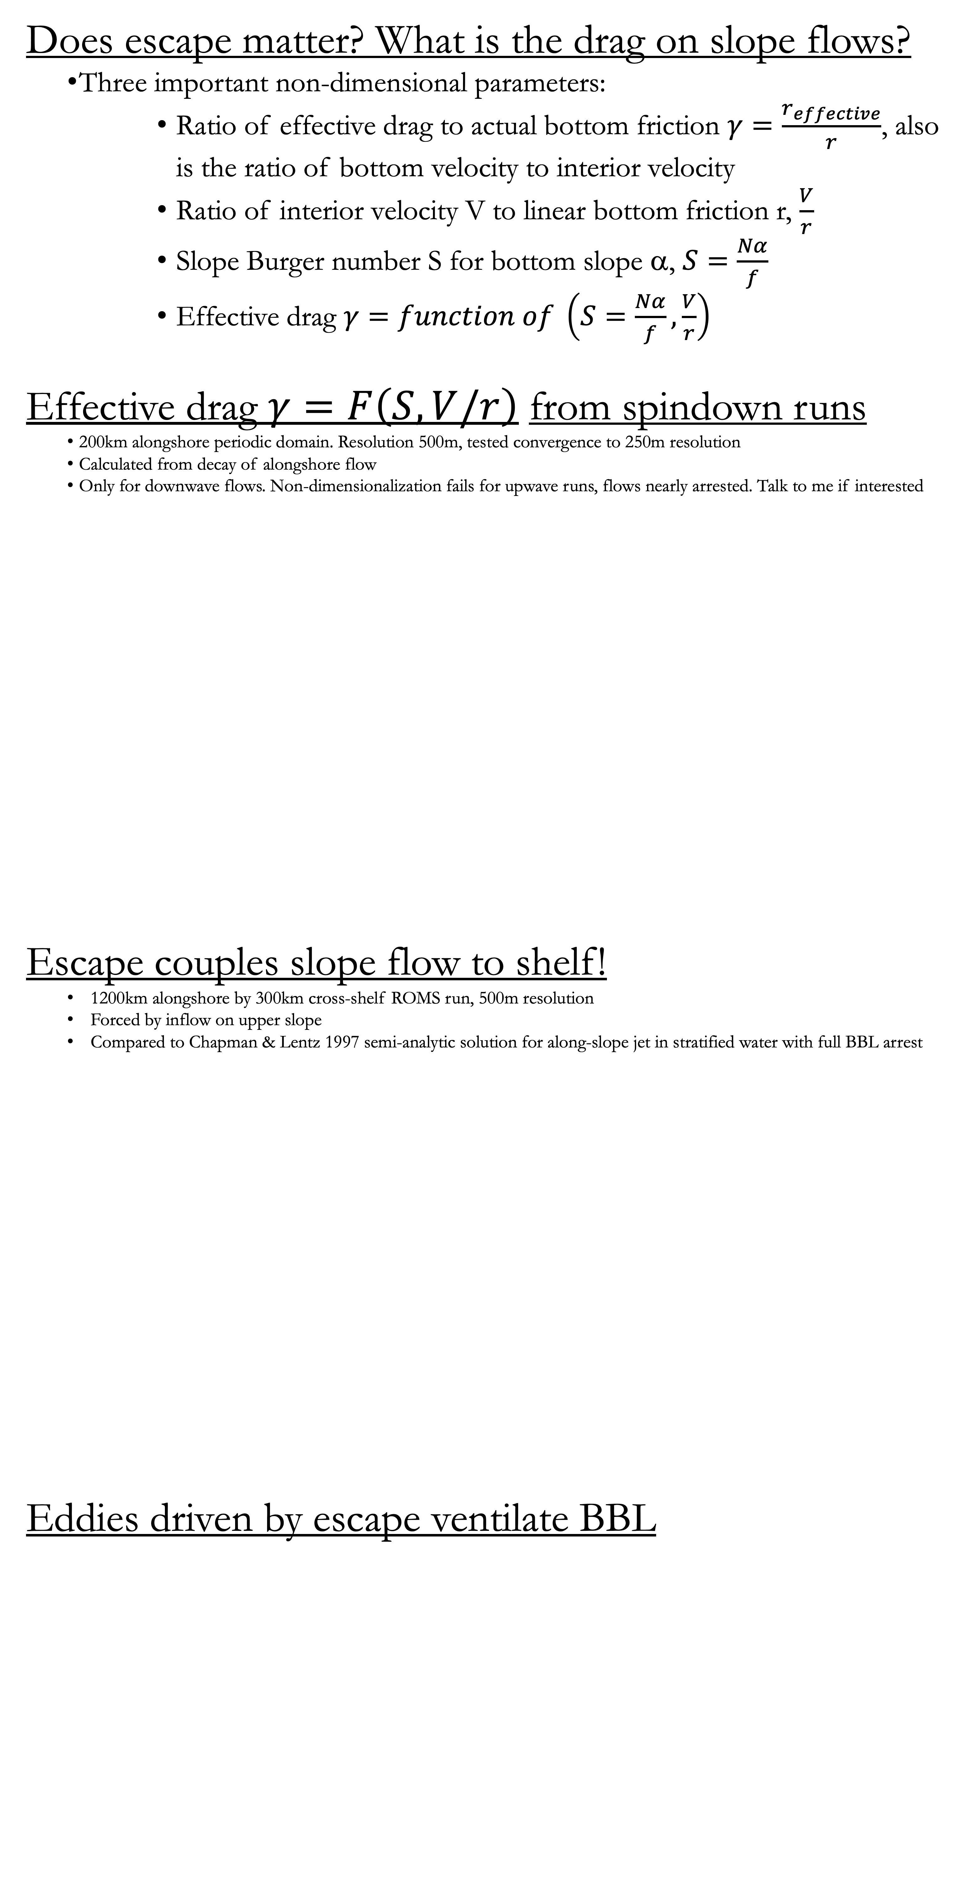
Bottom boundary layer instability couples equatorward western boundary currents to the shelf
circulation or Escape from BBL Arrest! (PS34A-2893)
James M. Pringle, University of New Hampshire, jpringle@unh.edu
What is BBL arrest?
  Along isobath flows over sloping bottoms will drive bottom Ekman flows which advect density to reduce flow near bottom
  The density advection will set up a horizontal density gradient
  The horizontal density gradient will reduce velocity near bottom to zero
  No velocity at bottom = no friction = arrest!
  Strength depends on Slope Burger Number S=Nα/f
  See Chapman & Lentz (1997) for overview of idea
Example of arrest
  Spindown of flow in infinite (periodic) along-slope channel
  Using ROMS, 500m resolution
  NO ALONGSHORE VARIATION, S=0.5
  What is escape from arrest?
  Same model as above, but with alongshore variation
  200km alongshore-periodic channel, S=0.5
Does escape matter? What is the drag on slope flows?
  Three important non-dimensional parameters:
    Ratio of effective drag to actual bottom friction $γ=\frac{r_{effective}}{r}$, also is the ratio of bottom velocity to interior velocity
    Ratio of interior velocity V to linear bottom friction r, $\frac{V}{r}$
    Slope Burger number S for bottom slope α, $S=\frac{Nα}{f}$
    Effective drag $γ=function of \left(S=\frac{Nα}{f},\frac{V}{r}\right)$
Effective drag $γ=F\left(S,V/r\right)$ from spindown runs
  200km alongshore periodic domain. Resolution 500m, tested convergence to 250m resolution
  Calculated from decay of alongshore flow
  Only for downwave flows. Non-dimensionalization fails for upwave runs, flows nearly arrested. Talk to me if interested
Escape couples slope flow to shelf!
  1200km alongshore by 300km cross-shelf ROMS run, 500m resolution
  Forced by inflow on upper slope
  Compared to Chapman & Lentz 1997 semi-analytic solution for along-slope jet in stratified water with full BBL arrest
Eddies driven by escape ventilate BBL
Where is escape likely?
What might you observe?
  Non-zero flow near bottom with short length scales
  Boluses of low PV/low strat water moving away from slope
  PV snapshot from same time as BBL tracer shown in bottom of middle column; contours are of tracer concentration
Problems in modeling!
  If not sufficiently resolved, escape goes away
  Instability length-scale depends on velocity, stratification
  Velocity spindown, S=0.5, as function of model resolution
Conclusions:
  For Downwave/Downwelling flows, BBL arrest will not be complete – especially for stronger flows
  Near bottom flows remain finite, causing bottom drag and spindown of downwave flows
  Friction allows alongshore flows to escape vorticity constraints and cross isobaths, coupling slope flows to shelf
  Boluses of low-PV, less-stratified, and bottom-influenced water injected into stratified interior, ventilating BBL
  Funded by NSF OCE-1459609
Bibliography
    Callies, J., 2018: Restratification of abyssal mixing layers by submesoscale baroclinic eddies. Journal of Physical Oceanography, 48, 1995–2010.
    Chapman, D. C., and S. Lentz, 1997: Adjustment of Stratified Flow over a Sloping Bottom. J. Phys. Oceanogr., 27, 340–356, https://doi.org/10.1175/1520-0485(1997)027<0340:AOSFOA>2.0.CO;2.
    Wenegrat, J. O., J. Callies, and L. N. Thomas, 2018: Submesoscale Baroclinic Instability in the Bottom Boundary Layer. J. Phys. Oceanogr., 48, 2571–2592, https://doi.org/10.1175/JPO-D-17-0264.1.
I am not the first to see
these instabilities. E.g.
Wenegrat et al. 2018,
Callies 2018

