Slide 1

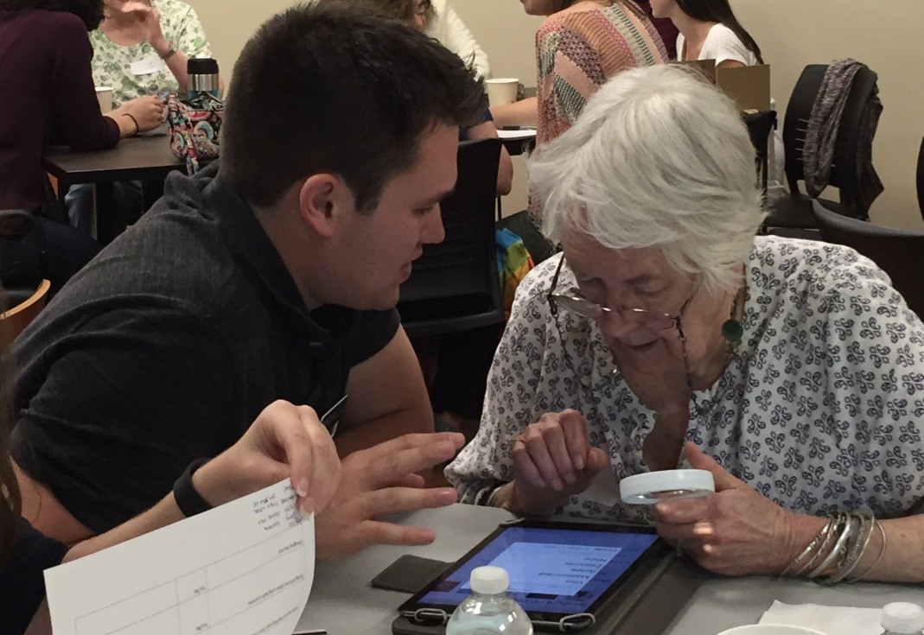
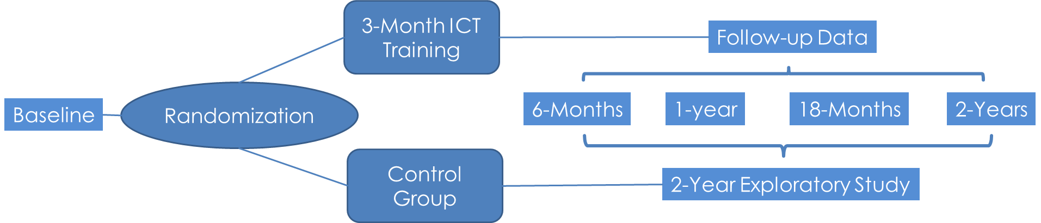
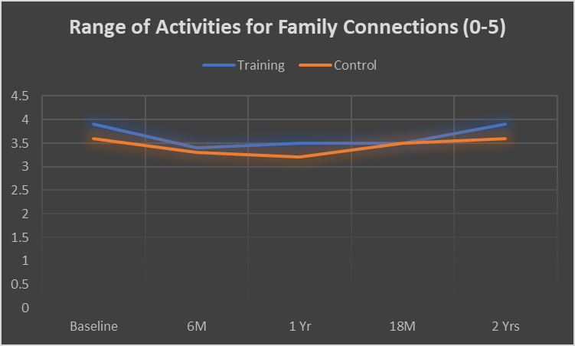
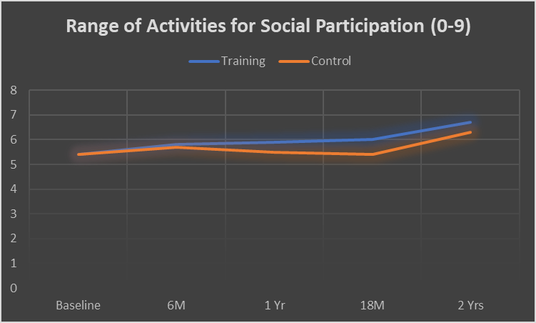
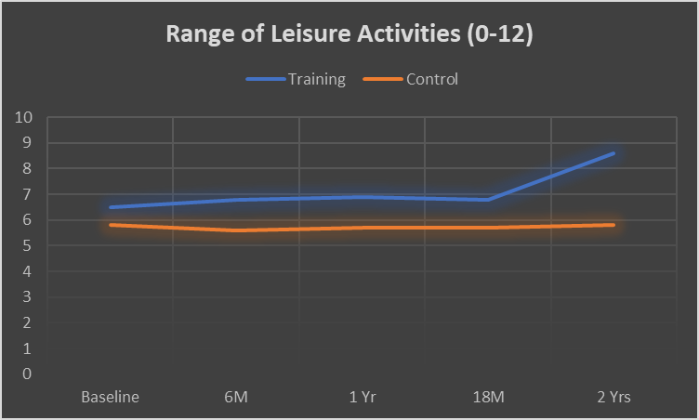
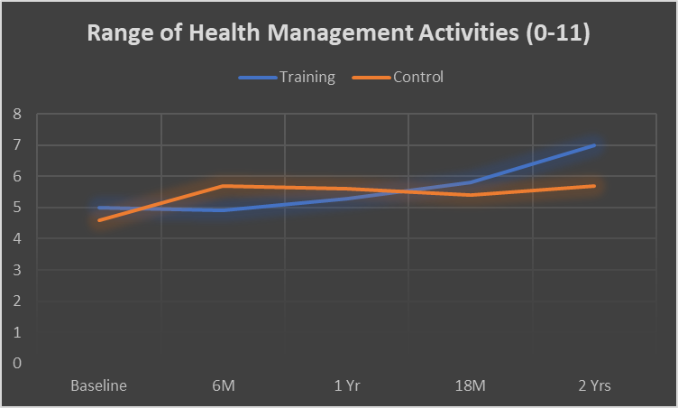
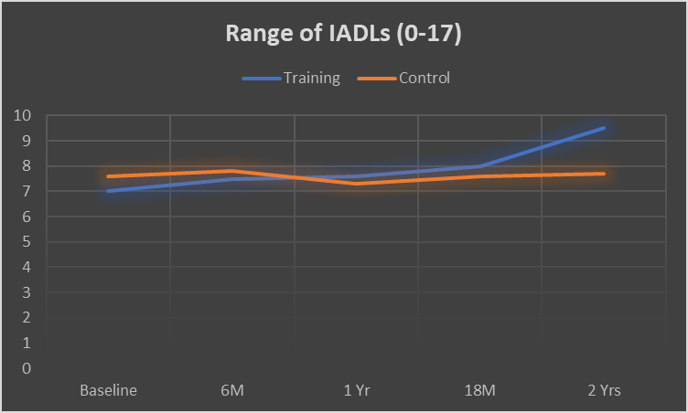
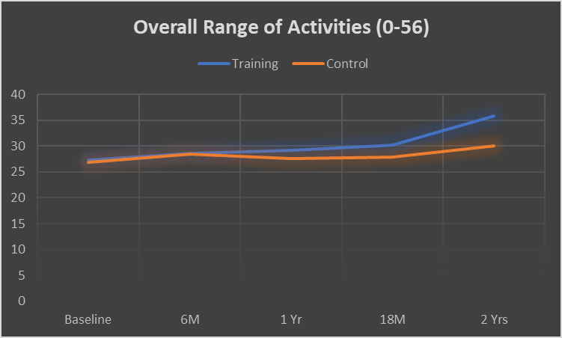
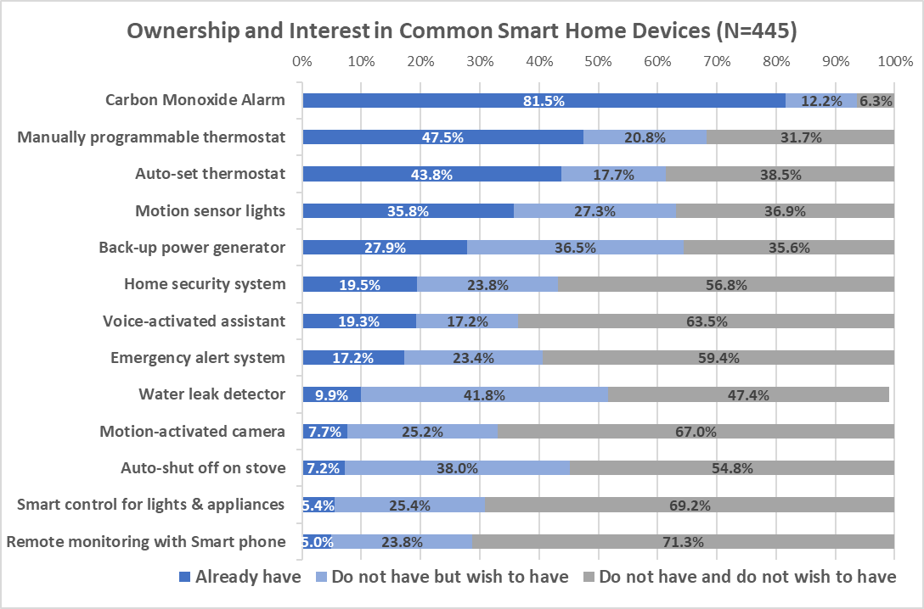
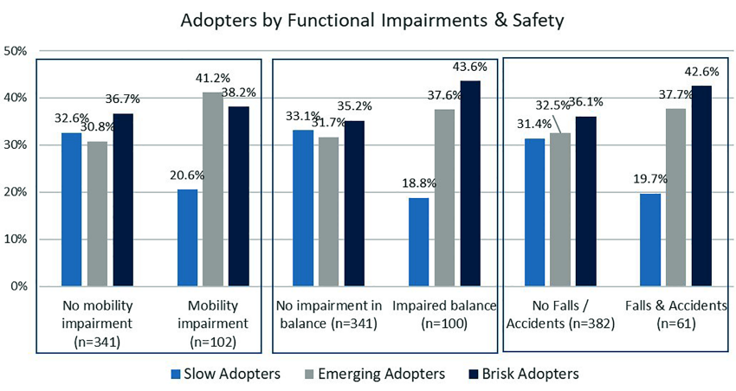
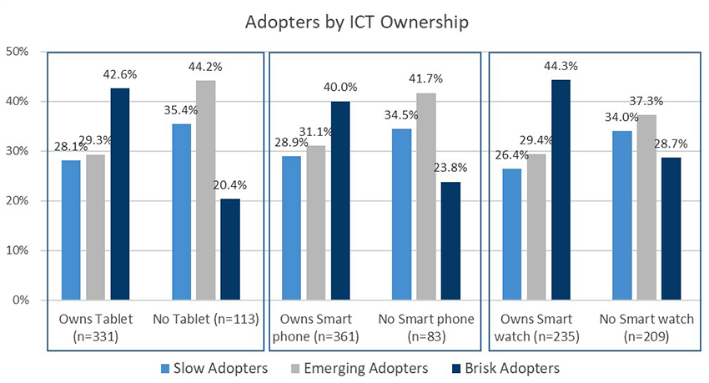
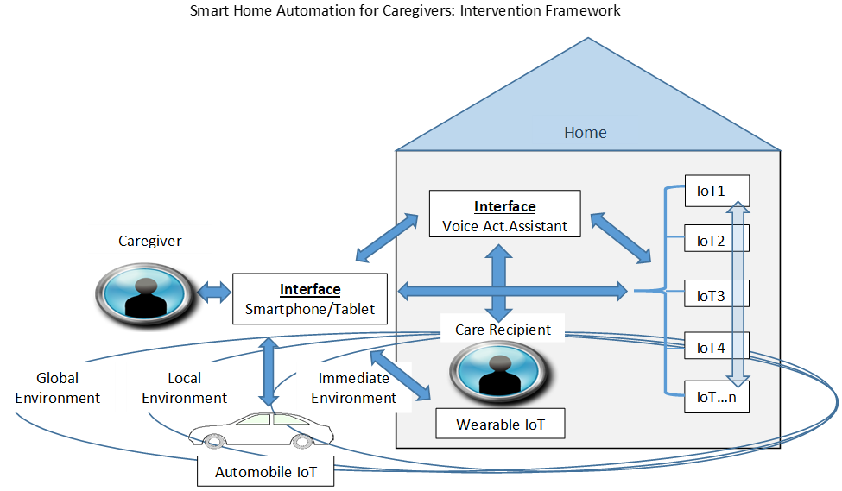
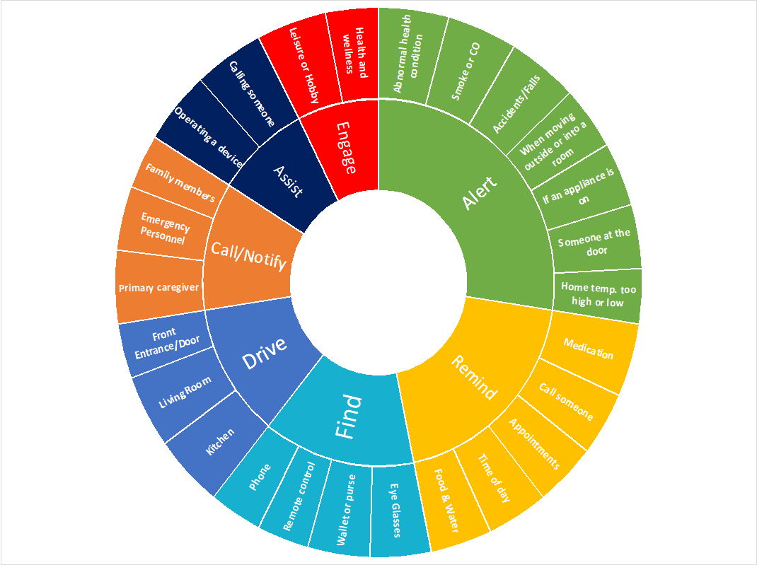
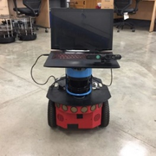
Research Program on Assistive Technology Implementation for Aging-in-place
Sajay Arthanat, Associate Professor, Department of Occupational Therapy, CHHS
Research Project 1: Information Communication Technology Training for Aging-in-place, Funded by UP-2-NIH and NIH R15 Grant (2015-2019)
Methodology: 2-year RCT to test the effect of an individualized community and home-based technology training program for “at-risk” older adults (N=85; n=43 & 42)
Key Findings:
Older adults in training group compared to those in the control group… [Group x time interaction- p<0.05]
  Performed 7/10 top performed 56 activities more frequently than those in control
  Reported increased acceptance on key indicators of ICT adoption- Satisfaction; Comfort; Encouragement; & Pleasure
  Reported higher perceived independence with ongoing and new leisure activities, online shopping, maintaining family connections, and social participation
Research Project 2: Role of Smart Home Automation for Aging-in-place, Funded by the England Faculty Fund
Methodology: Exploratory survey on adoption of home automation technology by older adults (N=456)
Key Findings:
Research Project 3: Smart Home Automation & Socially Assistive Robotics to Support Caregivers of Individuals with Alzheimer’s D/s & Dementia,
Funded by UNH CoRE [Pilot Research Partnership] and England Faculty Fund, Co-Is: Dr. Momotaz Begum, UNH-Comp.Science & Dr. Dain LaRoche, UNH-Kinesiology
Methodology: Project a) Intervention study on home automation technology for caregivers. Tracking adoption and outcomes through goal attainment scaling
Project b) Feasibility and acceptance of a home automation-linked socially assistive robot (SAR) by caregivers through qualitative grounded theory research
Key Findings:
Group time Interaction: F (4, 1)=0.36, p=0.8, η_{p}²=0.004
Group time Interaction: F (4, 1)=1.75, p=0.6, ηp2=0.007
Group time Interaction: F (4, 1)=2.6, p=0.04, ηp2=0.03
Group time Interaction: F (4, 1)=3.8, p=0.006, ηp2=0.04
Group time Interaction: F (4, 1)=3.4, p=0.01, ηp2=0.04
Group time Interaction: F (4, 1)=2.5, p=0.04, ηp2=0.03
Top functions and activities for the SAR

