Slide 1
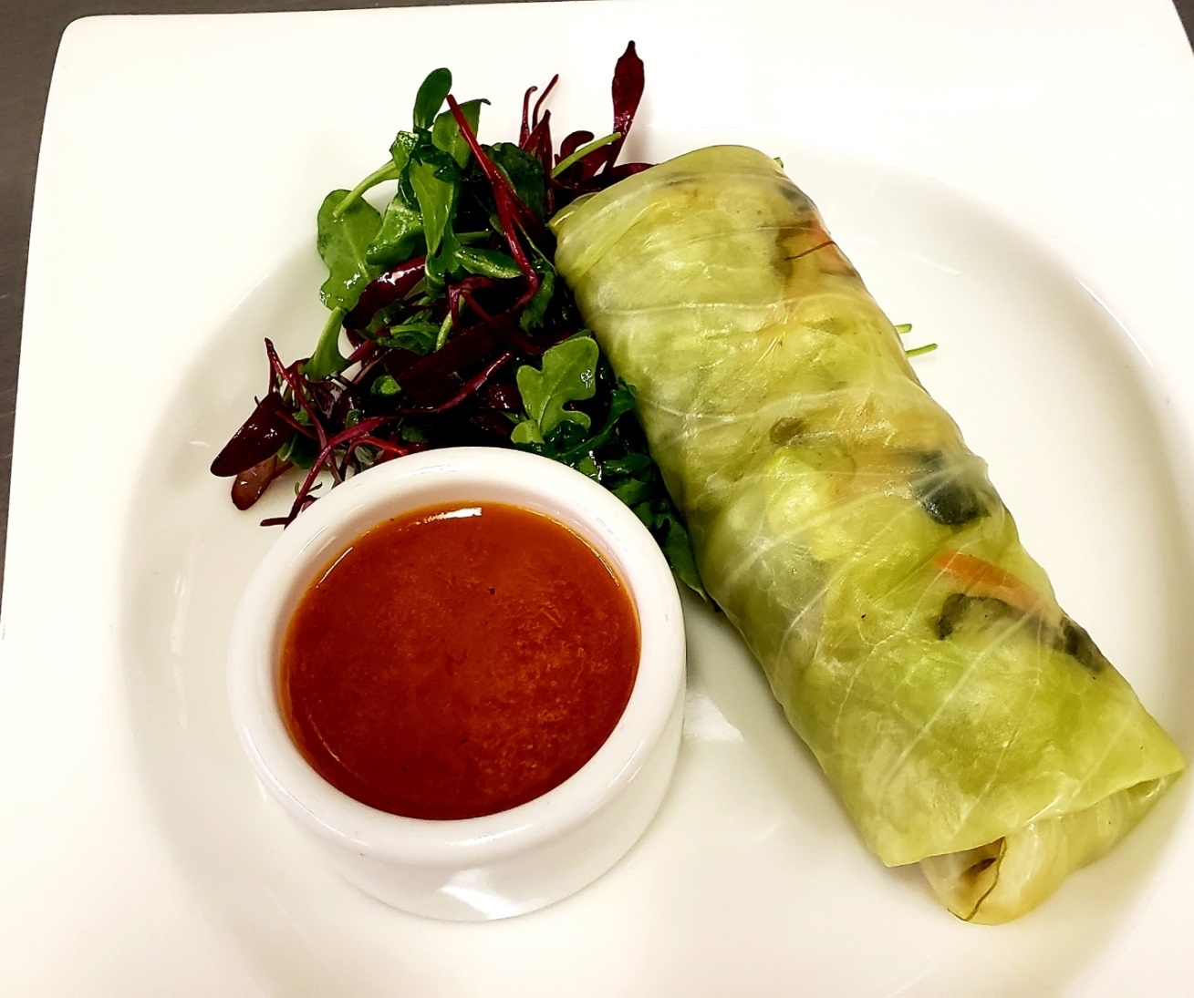
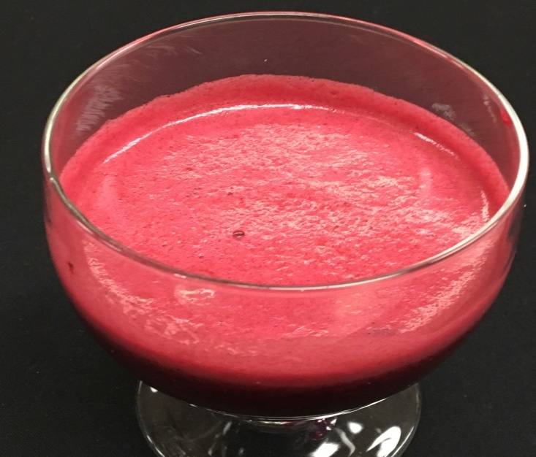
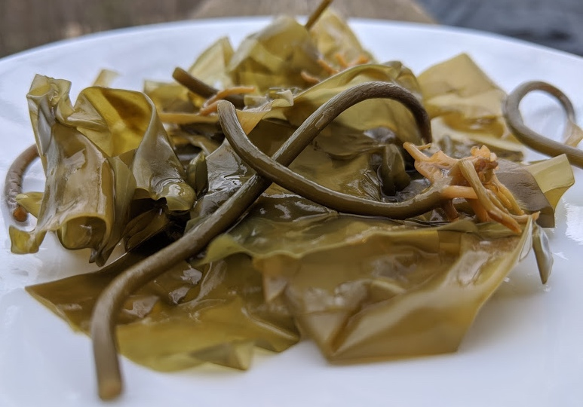
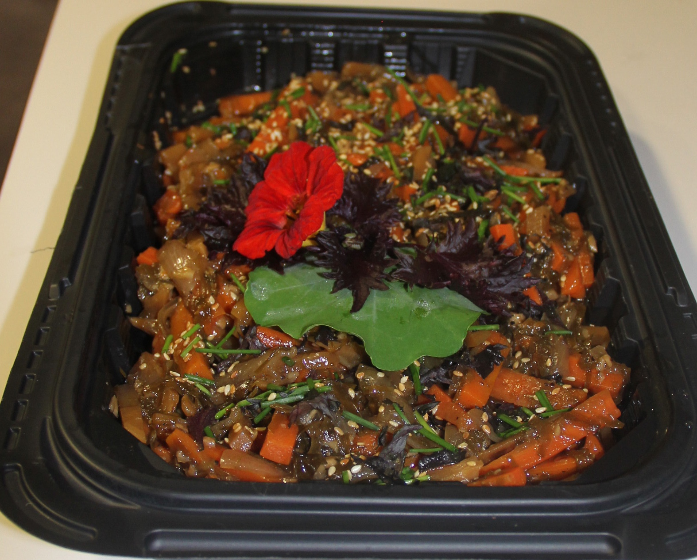
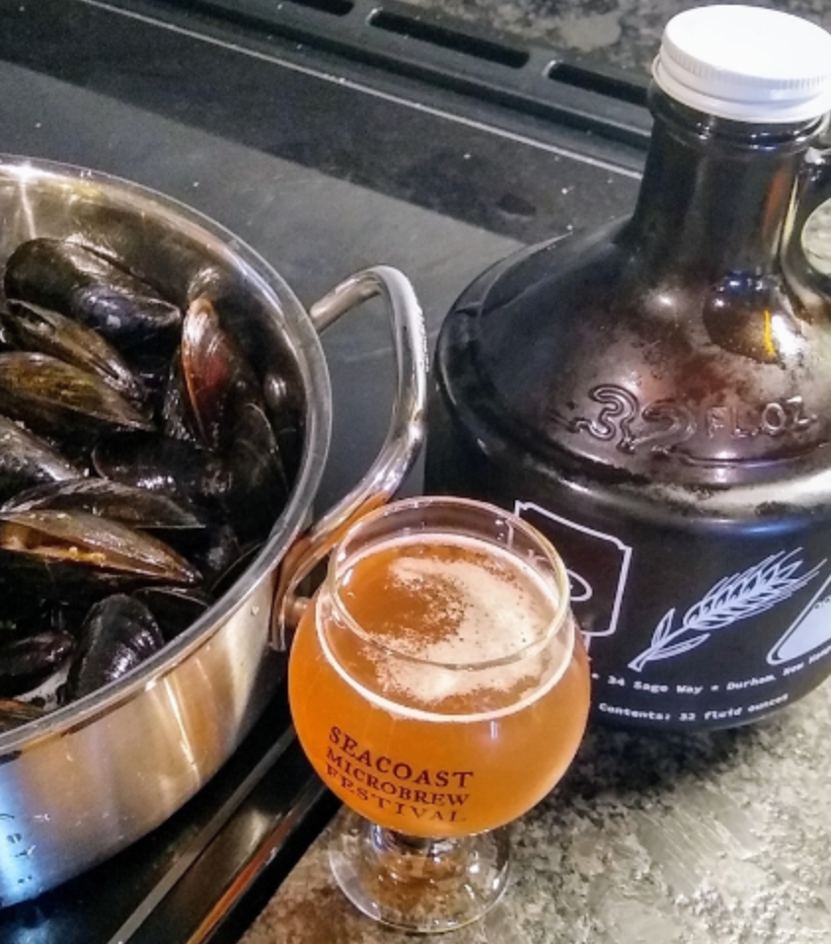
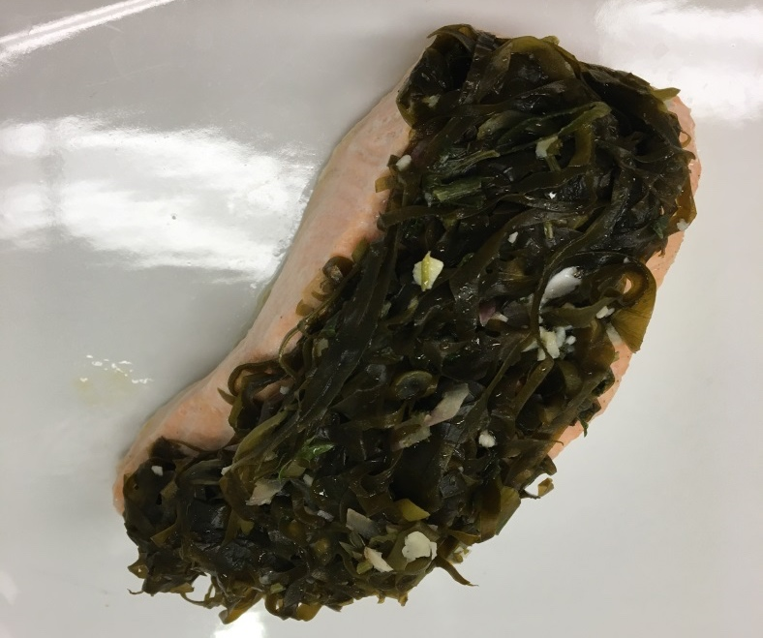
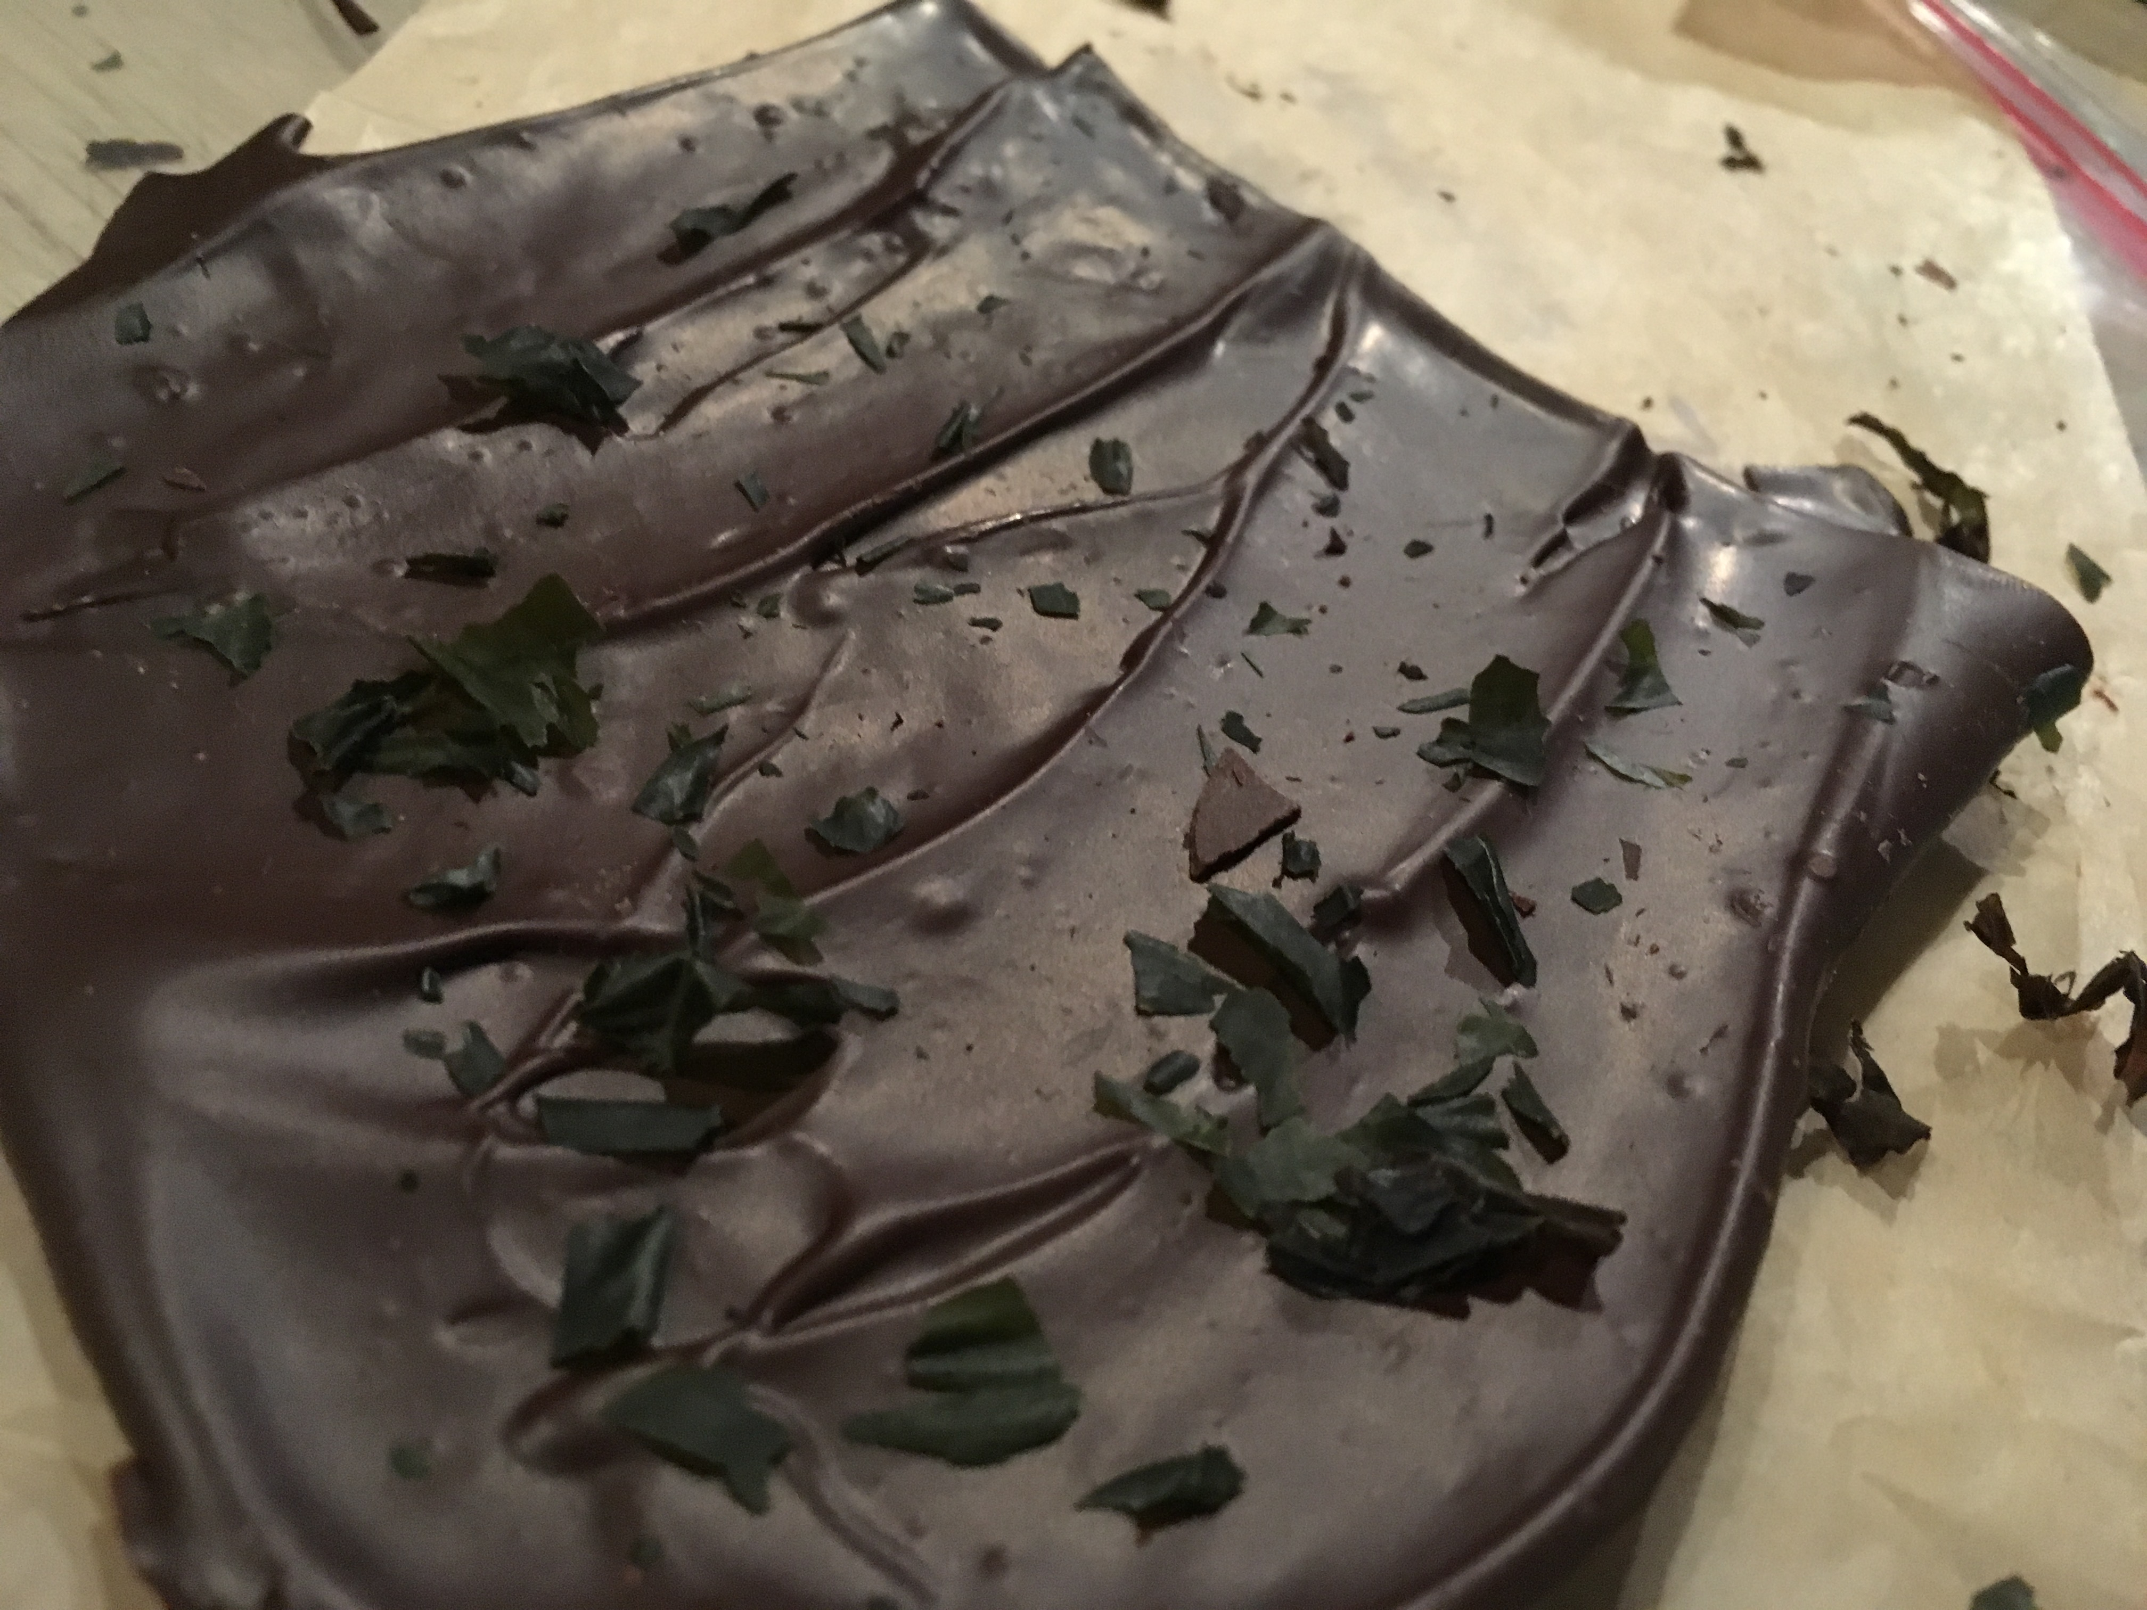
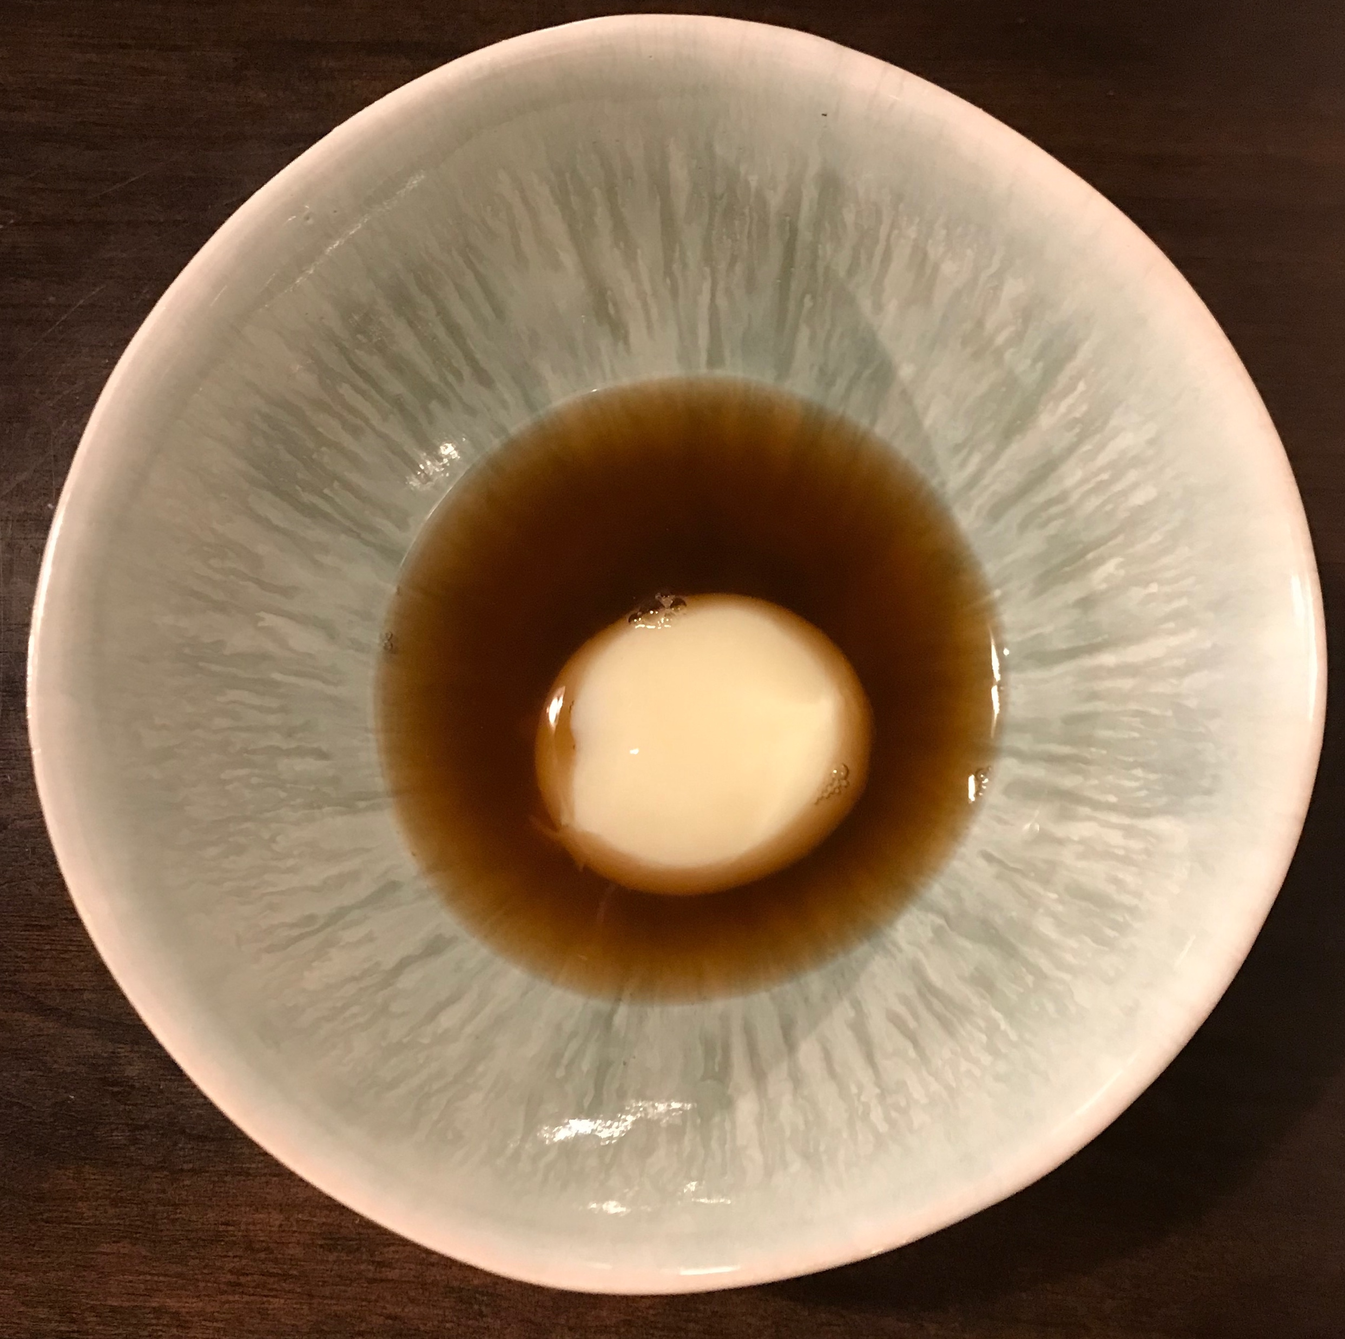



Recipes and Culinary Creations Using Sugar Kelp
Seaweed Stuffed Cabbage Roll
Ingredients:
Sugar kelp
Cabbage
Green pepper
Onion
Garlic
Parsnip
Oyster Sauce
Seaweed Juice
Ingredients:
6 pieces Sugar kelp- shred
12 ounces Beets
1 Cucumber
1 finger Ginger
2 Apple
2 Carrots
2 pints Strawberries
Method: Blend all ingredients until well mixed.
Pickled Sugar Kelp
Ingredients:
1 1/2 cups Water
1 cup White vinegar
3 tbsp Sugar
~ 6 oz. Young sugar kelp, cut 6-8” lengths
Dipping Sauce:
Ginger, fresh
Sweet chili sauce
Method: Simmer water, vinegar, and sugar for about 5 minutes. Let cool and pour over the kelp. Place in 32 oz. mason jar. Ready to eat within 48-72 hours. For a brighter green color, blanch kelp for 10-15 seconds .
Method: Julienne vegetables fine, mix with oyster sauce. Steam cabbage leaves, pull apart. Roll with filling. Serve with dipping sauce.
Recipe and image courtesy Thanh Thai
greencrabcafe.com
Recipe and image courtesy of CT Chefs Association
Recipe and image courtesy CT Chefs Association
Maple Glazed Kelp, Carrots & Onions
Ingredients:
1 1/3 cups Sugar kelp , chopped
2 ½ cups Water
2 cups Carrots, julienned
2 cups Onions, julienned
1 tbsp Toasted sesame oil
1 tbsp Ginger, minced
Seaweed Beer (Gose Style)
Ingredients:
German Pilsen Malt
White wheat malt
Acidulated malt
Rice hulls (optional)
Sugar kelp, fresh
3 tbsp Soy sauce
3 tbsp Maple syrup
1 tsp Apple cider vinegar
Pinch Sea salt
Pinch Ground black pepper
3 tbsp Toasted sesame seeds
Hallertau Hops
Irish Moss
SafaleUS-05 yeast
Fresh Maine Blueberries-juiced
Lemongrass tea
Method: Simmer kelp in water 8 minutes until softened. Remove kelp and reserve liquid. Over medium heat sauté carrots and onions in sesame oil for five minutes. Add kelp and ginger and sauté for five minutes. Add all remaining ingredients except sesame seeds and sauté for ten minutes or until pan is dry. Add the reserved liquid and cook until kelp is tender. Garnish with sesame seeds. Season to taste. Caution: Kelp is slippery when reconstituted and may cause your knife to bounce.
Method: There are several methods for making this recipe depending on if you want to use all grain or extract, and if you want to kettle sour or simply add citric acid to change the acidity of the beer in the secondary fermenter. The seaweed gives this Gose it’s slight saltiness and in this version, we add blueberries (juice only) and lemongrass tea to the secondary.
Visit https://www.brewersfriend.com/homebrew/recipe/calculator for a free homebrew calculator and make this recipe with your own twist!
Recipe courtesy CT Chefs Association, image courtesy J. Benson
CT SG
Recipe and image courtesy Cheryl Parker UNH Brew Lab
Seaweed Salmon
Ingredients:
Salmon
Topping:
Seaweed
Garlic
Shallots
Lemon juice
Scallion
Sugar Kelp Dark Milk Chocolate
Kelp Dashi with poached egg yolk
Ingredients:
Dried Sugar kelp-crumbled
93 % Honduras cacao
Honduras dark cocoa butter
Milk
Sugar
Ingredients:
1-2 Dried Sugar kelp strips
4 cups Water
Bonito flakes (optional)
1 duck egg yolk-poached
We are trying to reduce our paper use! If you like any of these recipes (or all) feel free to snap a picture!
Method: In 4 cups of water, simmer dried kelp strips for 10-30 minutes. Let cool. Strain and remove kelp strips. Add poached egg yolk .
Method:
Mix all ingredients, cover salmon, drizzle with olive oil, steam
Recipe and image courtesy of CT Chefs Association
Recipe courtesy of Enna Chocolate, image courtesy of G. Bradt
Recipe courtesy of Evan Hennessey image courtesy of C. Steingart
Seaweed Hub

