Slide 1


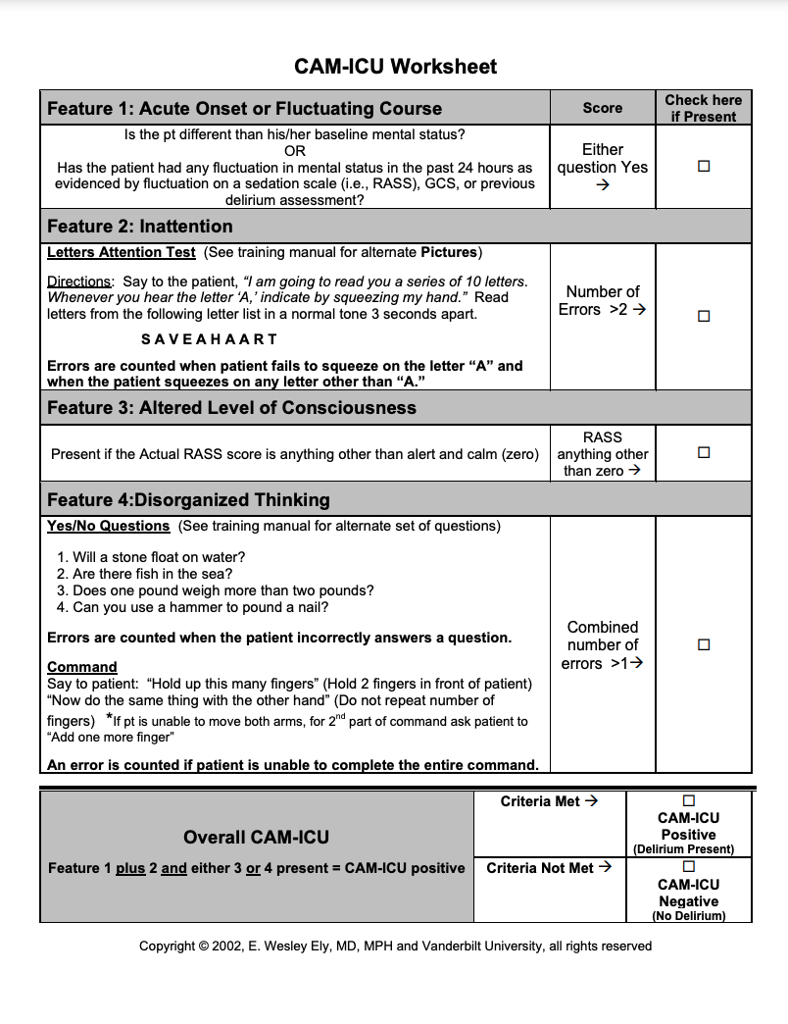
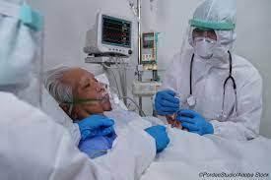
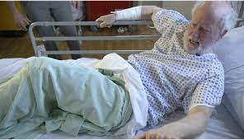
PREVENTION OF DELIRIUM IN COVID-19 ICU PATIENTS
Hannah McCall
UNH Senior Nursing Student
PROBLEM
CURRENT EVIDENCE
RECOMMENDATIONS/IMPLICATIONS
Background:
COVID-19 emerged as a public health threat in December 2019 and was declared a pandemic by the World Health Organization in March 2020 (CDC, 2020)
Most recent (March 15, 2021) data suggests almost 35,500 U.S. citizens remain in the hospital with COVID-19 and almost 10,000 of those patients being in intensive care units (Our World in Data, 2021).
It has been reported that nearly 90% of COVID-19 patients whose condition required admission to the intensive care unit need mechanical ventilation (Kotfis et al., 2020)
Acute brain dysfunction was highly prevalent and prolonged in critically ill COVID-19 patients (Pun et al., 2021).
Purpose: Raise awareness of ICU delirium in COVID-19 patients and how to better assess and prevent delirium
PICO Question:
"What best practices can ICU nurses implement to decrease the incidence of delirium in COVID-19 critically ill patients?”
Some of the most common, preventable harms that ICU patients experience are delirium, hospital-acquired weakness, device-related infections, deep vein thromboses, and pressure ulcers (Barr, 2018)
The American Psychiatric Association’s (APA) Diagnostic and Statistical Manual of Mental Disorders (DSM)-IV defines delirium as “a disturbance of consciousness and cognition that develops over a short period of time (hours to days) and fluctuates over time” (Girard et al., 2008)
COVID-19 destroys the respiratory tract and invades the CNS, which produces high-risk circumstances for acute and long-term brain dysfunction in patients infected with the virus (Kotfis et al., 2020)
Human isolation, extended time away from family and loved ones, and other elements of care that are limited due to precautionary protocols are highly correlational to delirium rates in COVID-19 patients (Joszt, 2020)
Society of Critical Care Medicine (SCCM) produced an ABCDEF bundle safety framework for ICU delirium management during SARS-CoV-2 pandemic (Kotfis et al., 2020)
ABCDEF Bundle (SCCM)
A-Assess, Prevent, and Manage Pain
B-Both SATs and SBTs
C-Choice of Sedation
D-Delirium: Assess, Prevent, and Manage
E-Early Mobility and Exercise
F-Family Engagement and Empowerment
Practice Recommendations:
  Following standardized ABCDEF Bundle produced by Society of Critical Care Medicine (Kotfis, 2020)
  Promoting alertness and orientation during daytime and practice sleep hygiene in night-time hours (Karon, 2017)
  Leadership and motivation by interdisciplinary team members to produce environmental changes limiting ICU delirium (Karon, 2017)
Clinical Implications:
Decrease morbidity and mortality
Shorten hospital stays
Lower health care costs
Limit long term cognitive and psychological effects of delirium
Limit incidences of depression, loss of employment, and difficulties with relationships related to history of delirium
Research Implications:
Current guidelines should be revised to reflect recent research and evidence
Continued research of ICU delirium in COVID-19 patients should remain a priority
POINTS TO REMEMBER
UPDATED GUIDELINES
Delirium Risk Factors:
-Increased age (60+)
-Over-sedation
-Mechanical ventilation
-ETOH or drug withdrawal
-Hx of dementia
-Use of benzodiazepines
-Poor sleep hygiene
-Uncontrolled pain
Types of Delirium:
-Hypoactive
-Hyperactive
-Mixture of the two
  Prevention of ICU Delirium
Early mobilization
Daily Awakening and Spontaneous Breathing Trials and RASS/SAS
Pain assessment and management
Regular CAM-ICU Assessment. If (+) determine any underlying causse and treat accordingly (Diseases, drug removal, environment change)
Orientation to environment
Adjusting sedation and discontinue potent medications when clinically safe
Support senses (hearing aides and glasses), monitor for loss of taste and smell
Provide visual and vocal contact to family and loved ones
Practice good sleep hygiene and cluster night-time care
Education and trainings regarding all aspects of delirium management
Utilizing more than one intervention to fit patient needs
  Education and Research
Education and training sessions regarding all aspects of delirium management
Utilizing more than one intervention; A bundle specific to each patient
Continued research on ICU delirium and implementation of strategies
CURRENT GUIDELINES
Early mobilization
Daily Awakening and Spontaneous Breathing Trials
Pain management
CAM-ICU Assessment
REFERENCES
Centers for Disease Control and Prevention (2020). Coronavirus Disease 2019 (COVID-19). Retrieved from www.cdc.gov/coronavirus/2019-nCoV/index.html.
Hayhurst, Christina J., Pratik P. Pandharipande, Christopher G. Hughes; Intensive Care Unit Delirium: A Review of Diagnosis, Prevention, and Treatment. Anesthesiology 2016; 125:1229–1241 doi: https://doi.org/10.1097/ALN.0000000000001378
Girard, T. D., Pandharipande, P. P., & Ely, E. W. (2008). Delirium in the intensive care unit. Critical care (London, England), 12 Suppl 3(Suppl 3), S3. https://doi.org/10.1186/cc6149
Joszt, Laura. “Risk of Developing Delirium in ICU Patients With COVID-19.” AJMC, 22 Oct. 2020, www.ajmc.com/view/risks-of-developing-delirium-in-icu-patients-with-covid-19.
Karon, Amy. “Simple Steps Help Prevent ICU Delirium.” ACP Hospitalist, 15 Nov. 2017, acphospitalist.org/archives/2017/11/simple-steps-help-prevent-icu-delirium.htm.
Kotfis, K., Williams Roberson, S., Wilson, J. E., Dabrowski, W., Pun, B. T., & Ely, E. W. (2020). COVID-19: ICU delirium management during SARS-CoV-2 pandemic. Critical care (London, England), 24(1), 176. https://doi.org/10.1186/s13054-020-02882-x
Pun, B. T., Badenes, R., Heras La Calle, G., Orun, O. M., Chen, W., Raman, R., Simpson, B. K., Wilson-Linville, S., Hinojal Olmedillo, B., Vallejo de la Cueva, A., van der Jagt, M., Navarro Casado, R., Leal Sanz, P., Orhun, G., Ferrer Gómez, C., Núñez Vázquez, K., Piñeiro Otero, P., Taccone, F. S., Gallego Curto, E., Caricato, A., … COVID-19 Intensive Care International Study Group (2021). Prevalence and risk factors for delirium in critically ill patients with COVID-19 (COVID-D): a multicentre cohort study. The Lancet. Respiratory medicine, S2213-2600(20)30552-X. Advance online publication. https://doi.org/10.1016/S2213-2600(20)30552-X
Ritchie, Research and data. “Coronavirus (COVID-19) Hospitalizations - Statistics and Research.” Our World in Data, 2021, ourworldindata.org/covid-hospitalizations.
“SCCM: Improving Value, Quality, and Safety in Your ICU with the ICU Liberation Campaign.” Society of Critical Care Medicine (SCCM), www.sccm.org/Communications/Critical-Connections/Archives/2018/Improving-Value,-Quality,-and-Safety-in-Your-ICU-w.

