Slide 1


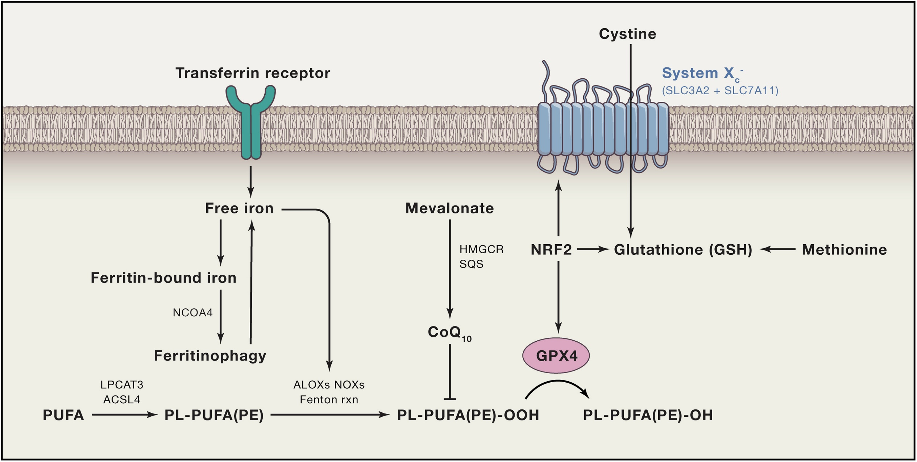
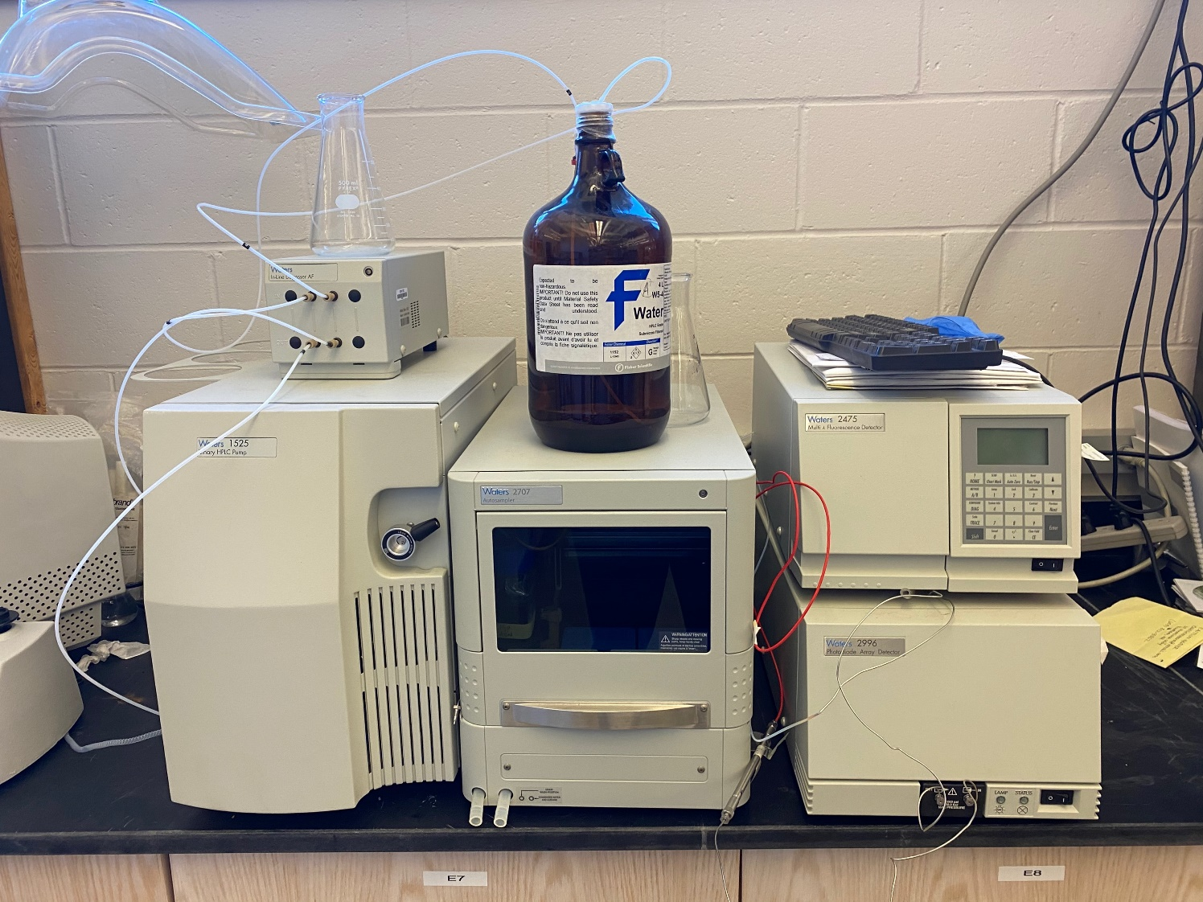
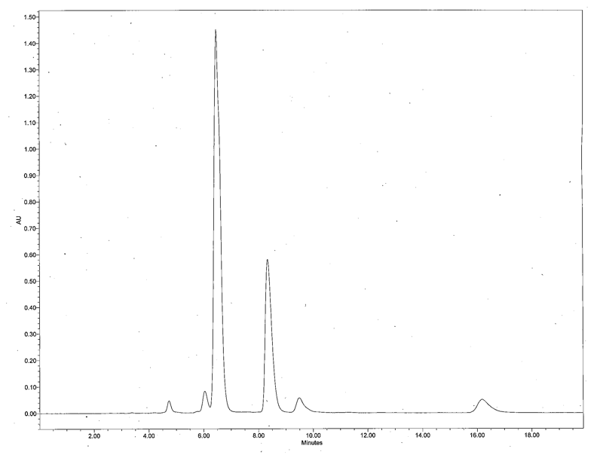
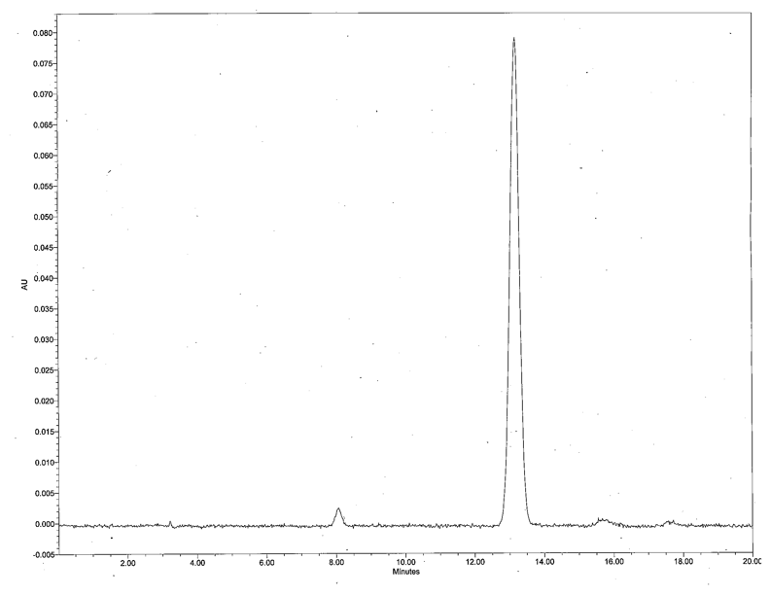
Iron Chelator and Fluorophore Peptide Bioconjugates for the Study of Cellular Iron Metabolism
Leonid Povolotskiy¹, Emily Andrews¹, Ryan Fitzgerald¹, Lia Tesfay², Ann Cowan², Suzy V. Torti², and Roy Planalp¹
¹ Department of Chemistry, University of New Hampshire, Durham NH 03824, USA
² Department of Molecular Biology and Biophysics, University of Connecticut Health Center, Farmington, CT, 06030, USA
E-mail: leonid.povolotskiy@unh.edu; emily.andrews@unh.edu
Background and Motivation
Analytical Analysis
We are pursuing the use of iron chelators to monitor and influence free iron concentration at the organelle level. As we have shown for the tachpyridine family, and others have shown for hydroxypyridinones and pyridoxal hydrazones, the ability to measure iron indicates metabolic abnormalities, and sequestering iron preferentially kills tumor cells.^{1,2} Here we describe recent progress toward developing targetable chelators and their application to the cell death pathway, Ferroptosis.³
Purity of the synthesized peptides is validated with an HPLC. System includes a Waters 1525 binary pump, 2707 autosampler, and 2996 PDA detector. Samples are run using a Waters XBridge Shield C18 RP 250 x 4.6 mm, 5 µm column with a pore size of 130 Å. Prior to analysis, solid samples are dissolved in a solution of 60:40 HPLC grade water:acetonitrile with 0.1% trifluoroacetic acid (TFA). Additional purification conducted with normal and RP flash chromatography.
D
E
A
B
Important pathways for ferroptosis.³
F
Structure of previously reported iron chelating mitochondrial probes (A)⁴, kinetic barrier to Fenton reaction observed with tripodal 8-hydroxyquinoline (B)⁵, and our target compound with projected ferrous and ferric interactions (C).
C
Initial analysis of the synthesized peptide F-r-F-Dap(LisRho) indicated the presence of impurities (D). Presence of the UV fingerprint for Rhodamine B in three of the four peaks suggested epimerization (E). The synthetic technique was adjusted utilizing symmetric anhydride loading, resulting in an enantiopure peptide (F).
hν
hν
Results and Outlook
The model peptide F-r-F-Dap(DNS) is successfully localized to the mitochondria in ovarian cancer cells.
Peptide Probe
Mitotracker RedTM
Merge
Acknowledgements
These research projects were made possible thanks to NIH grant NCI R01 CA188025 and flash chromatography with the Oldenhuis group at UNH.
Literature
¹Childers, M. L.; Cho, J.; Regino, C. A. S.; Brechbiel, M. W.; DiPasquale, A. G.; Rheingold, A. L.; Torti, S. V.; Torti, F. M.; Planalp, R. P., Influence of ligand structure on Fe(II) spin-state and redox rate in cytotoxic tripodal chelators. J. Inorg. Biochem. 2008, 102 (1), 150-156. ²Torti, S. V.; Torti, F. M., Iron and cancer: more ore to be mined. Nat Rev Cancer 2013, 13 (5), 342-55. ³Stockwell, B. R.; Friedmann Angeli, J. P.; Bayir, H.; Bush, A. I.; Conrad, M.; Dixon, S. J.; Fulda, S.; Gascón, S.; Hatzios, S. K.; Kagan, V. E.; Noel, K.; Jiang, X.; Linkermann, A.; Murphy, M. E.; Overholtzer, M.; Oyagi, A.; Pagnussat, G. C.; Park, J.; Ran, Q.; Rosenfeld, C. S.; Salnikow, K.; Tang, D.; Torti, F. M.; Torti, S. V.; Toyokuni, S.; Woerpel, K. A.; Zhang, D. D., Ferroptosis: A Regulated Cell Death Nexus Linking Metabolism, Redox Biology, and Disease. Cell 2017, 171 (2), 273-285. ⁴Abbate, V.; Reelfs, O.; Hider, Robert C.; Pourzand, C., Design of novel fluorescent mitochondria-targeted peptides with iron-selective sensing activity. Biochemical Journal 2015, 469 (3), 357-366. ⁵Serratrice, G.; Boukhalfa, H.; Béguin, C.; Baret, P.; Caris, C.; Pierre, J.-L., O-TRENSOX, a New Tripodal Iron Chelator Based on 8-Hydroxyquinoline Subunits: Thermodynamic and Kinetic Studies. Inorganic Chemistry 1997, 36 (18), 3898-3910.

