Slide 1
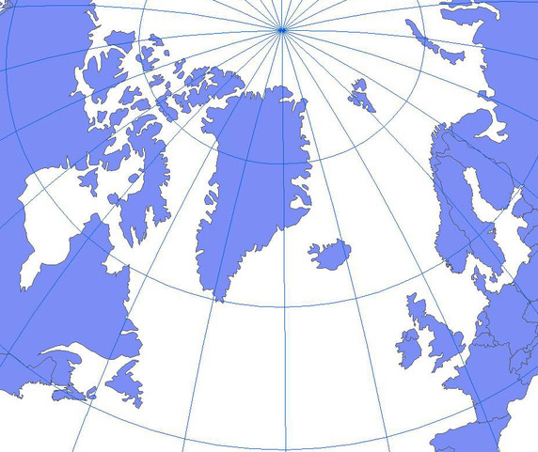
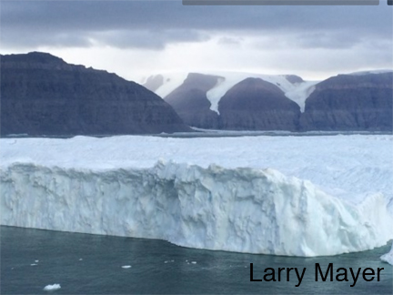
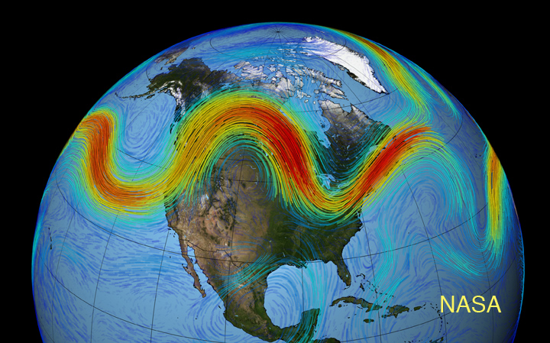
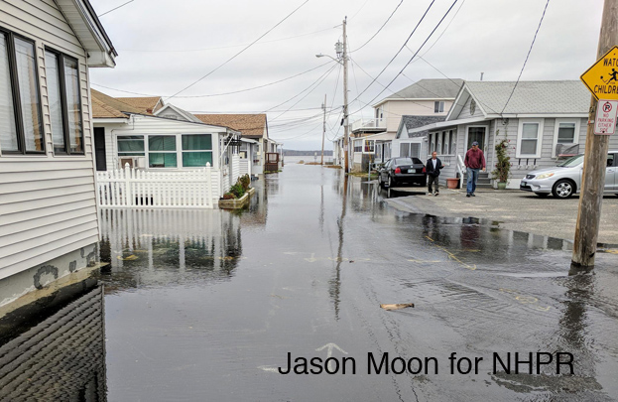

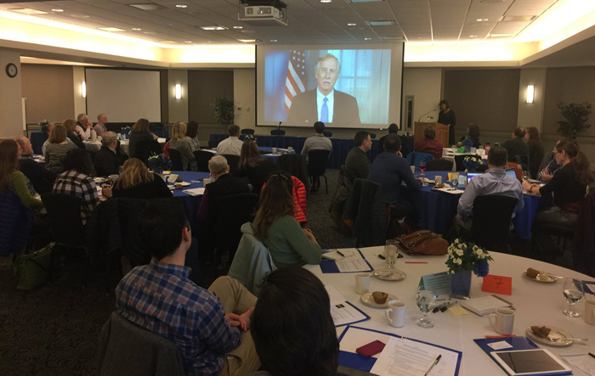
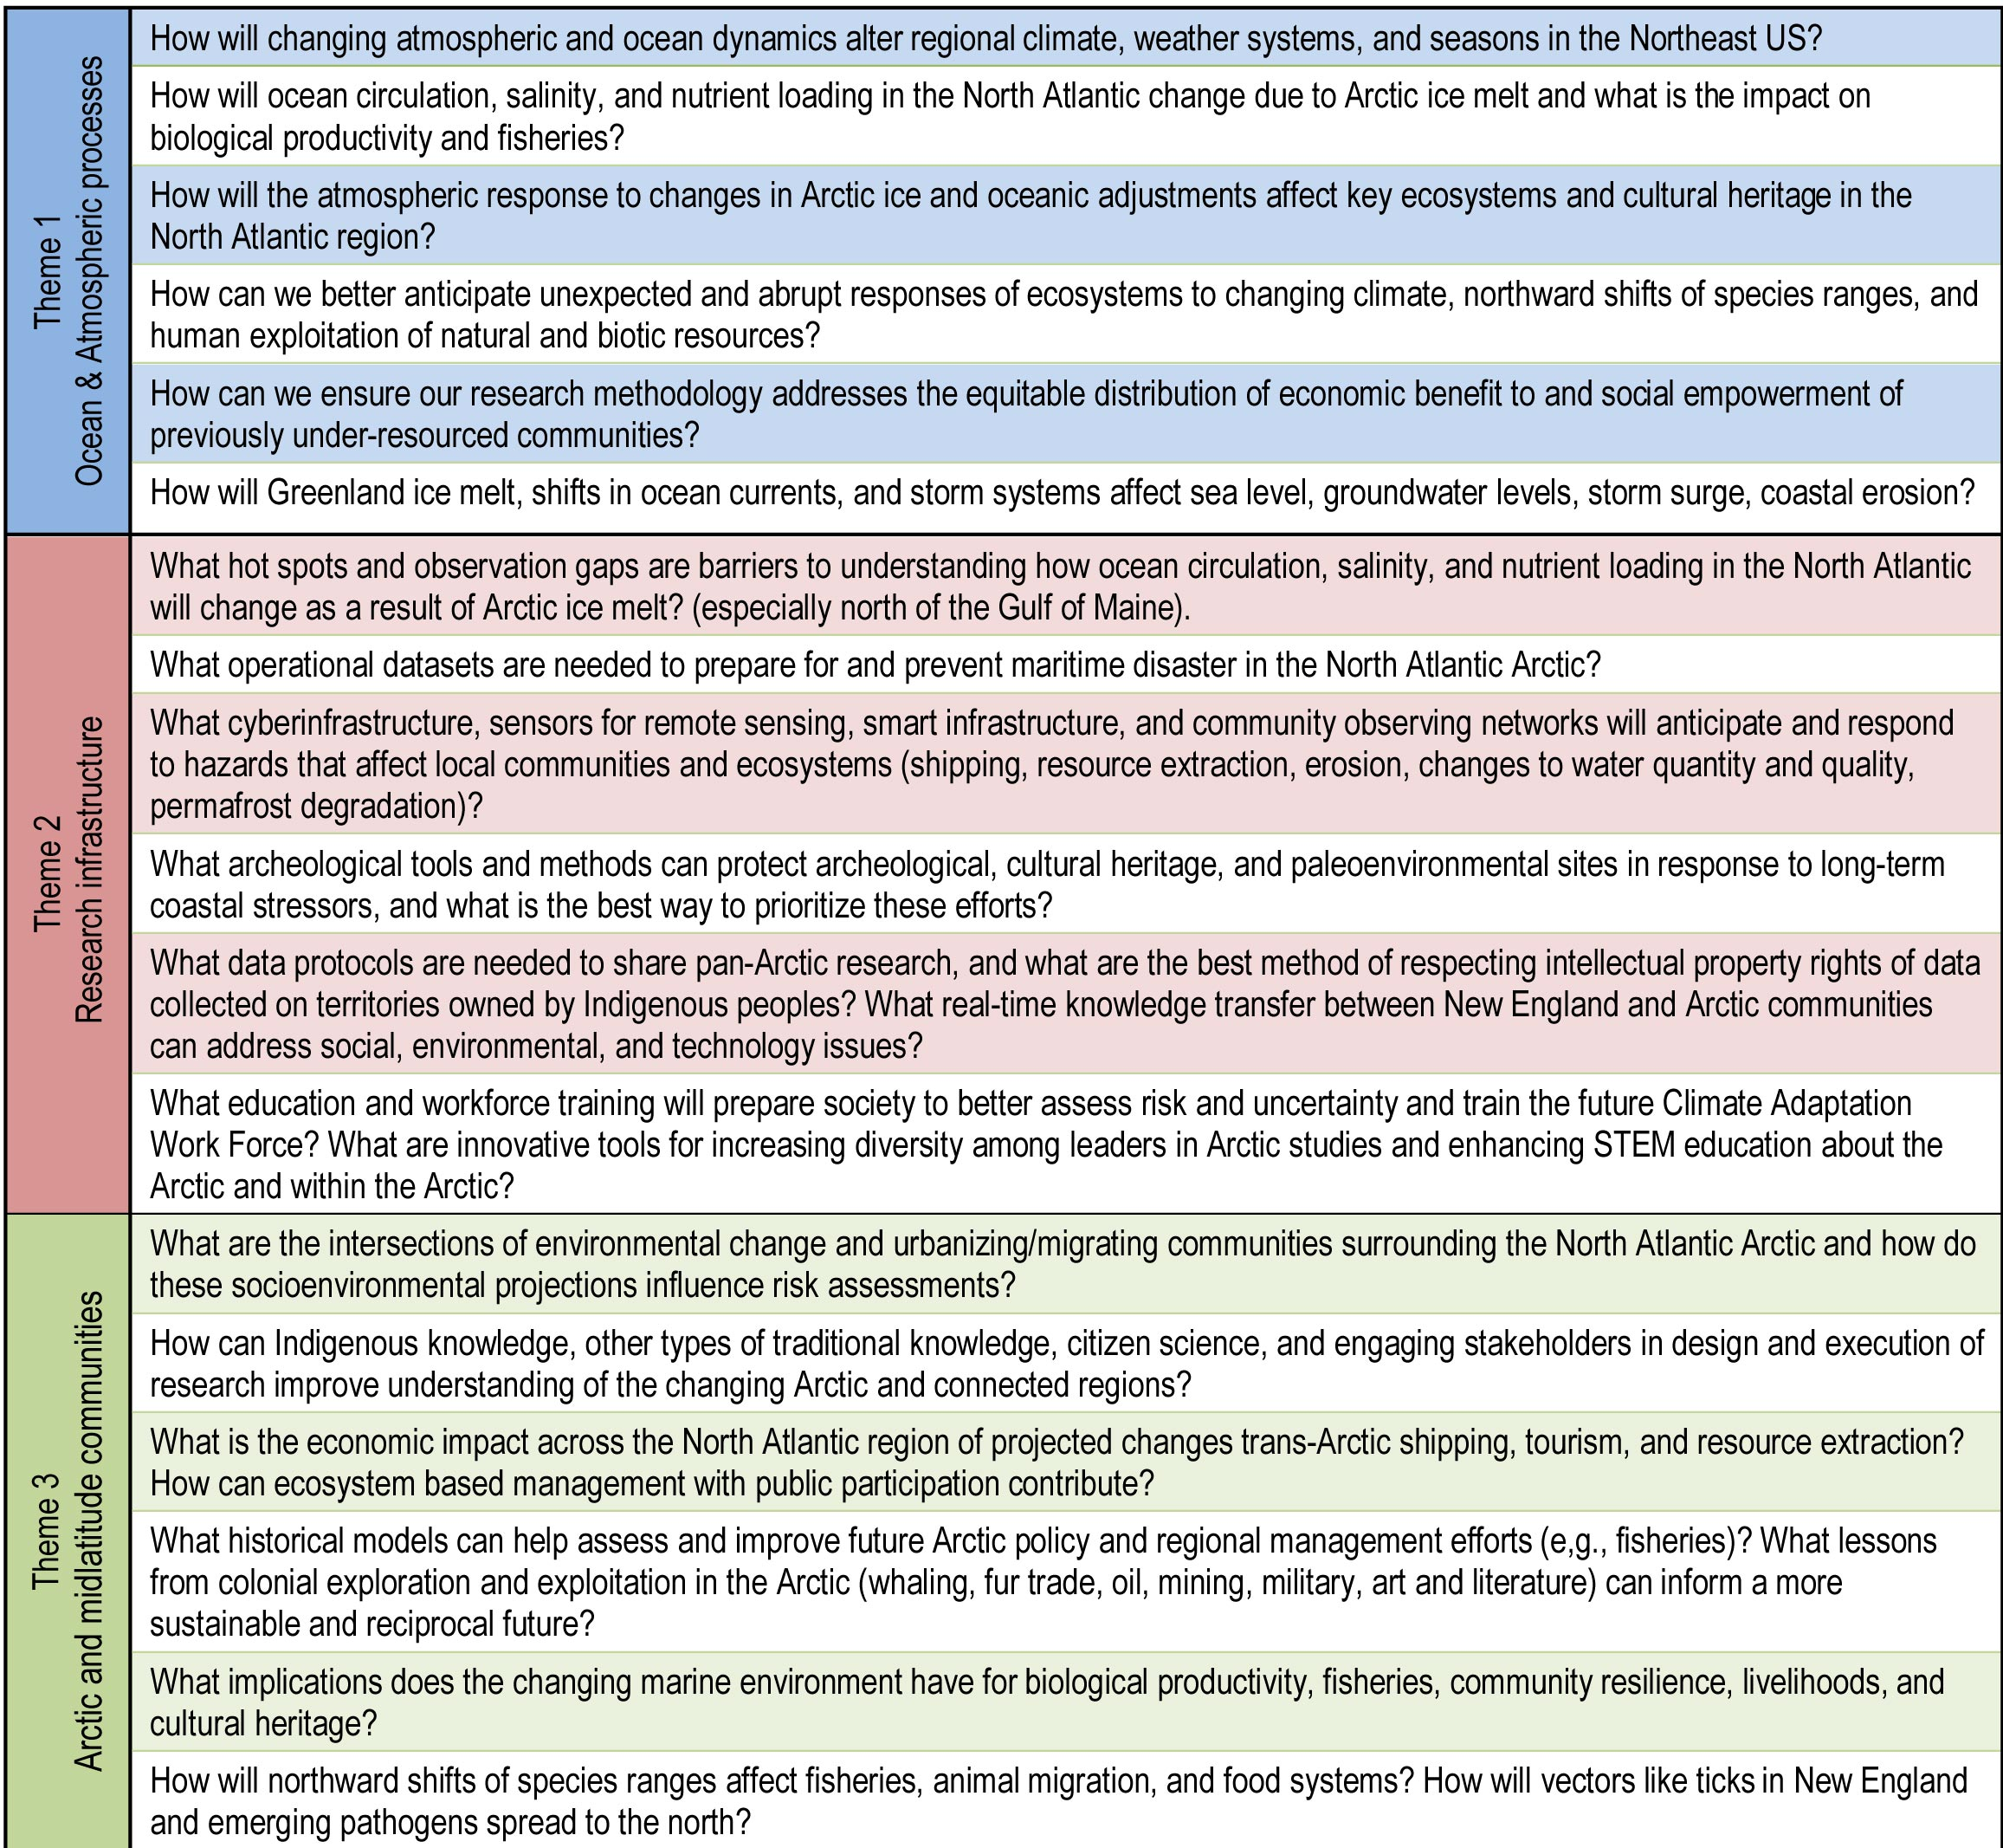
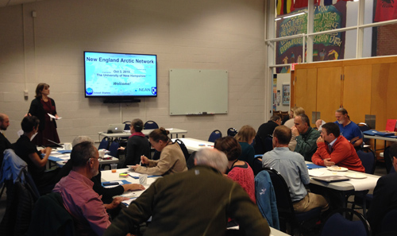
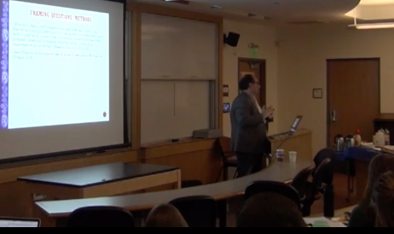
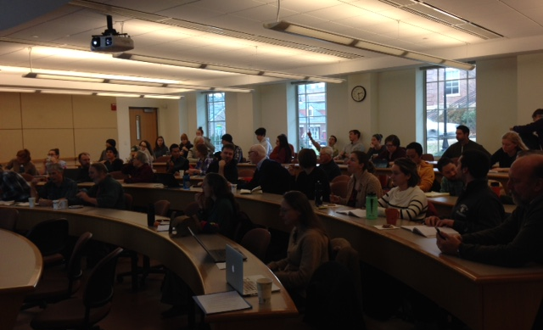

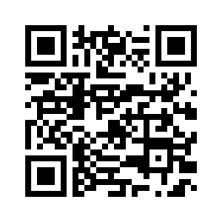

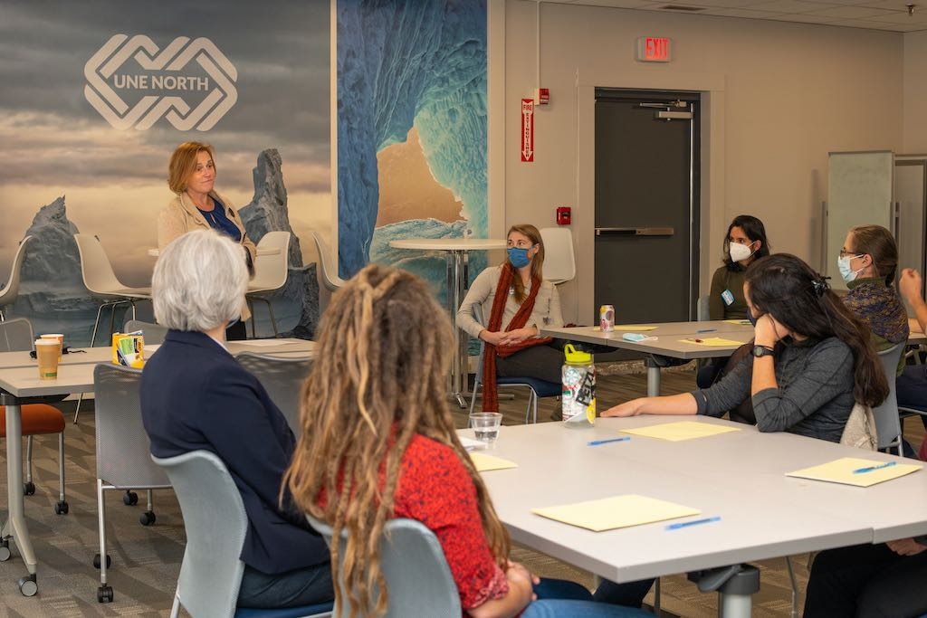


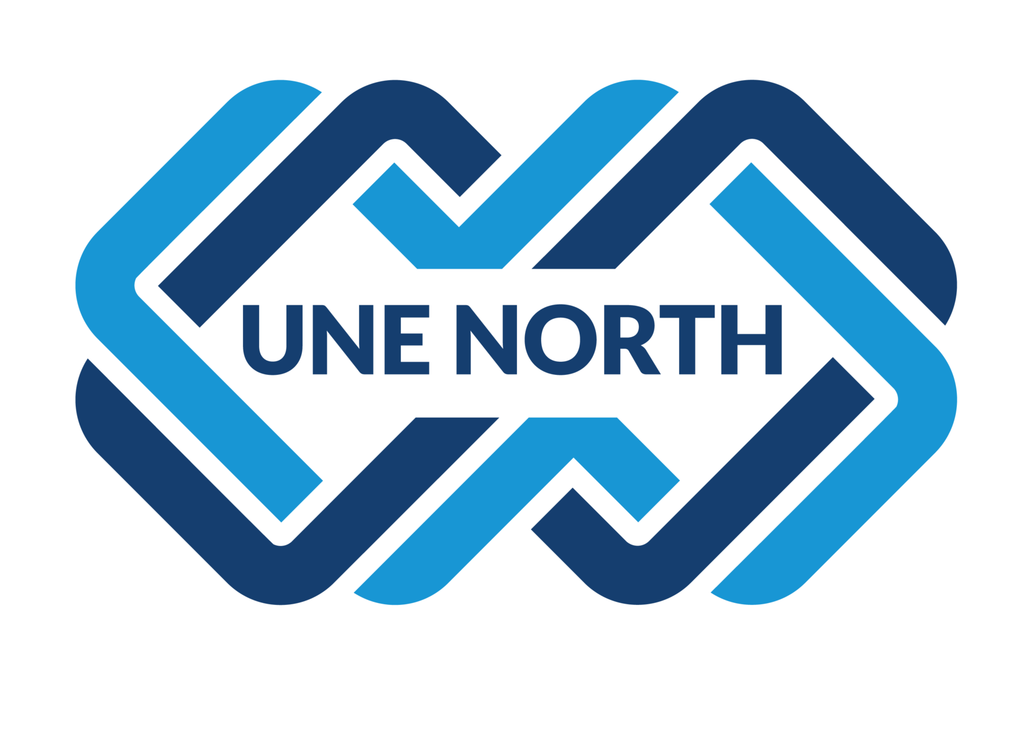
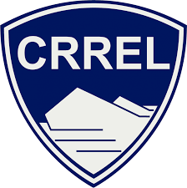


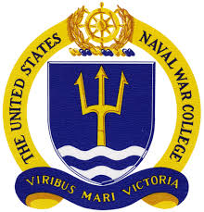
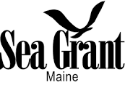

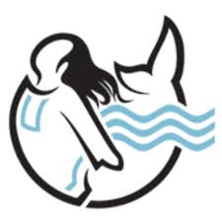
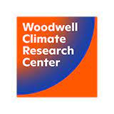




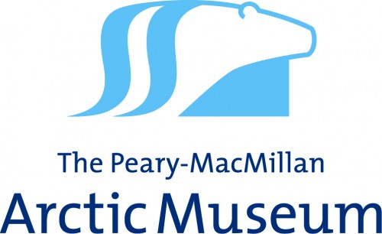




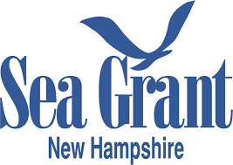


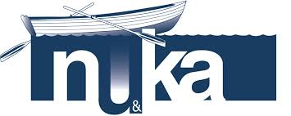

The New England Arctic Network
Katharine A. Duderstadt (UNH), Robyn A. Barbato (CRREL), Paul A. Berkman (Harvard, EvREsearch), Melody B. Burkins (Dartmouth), Cara J. Condit (USCGA), Jack Dibb (UNH),
Susan A. Kaplan (Bowdoin), Karl J. Kreutz (UMaine), Jake Kritzer (NERACOOS), Erich C. Osterberg (Dartmouth), Holly E. Parker (UNE), Firooza Pavri (USM),
Rebecca Pincus (USNWC), Kristin M. Schild (UMaine), Cameron P. Wake (UNH), Simone S. Whitecloud (CRREL).
GC55J-0537
Vision
The Role of New England in Navigating the New Arctic
Motivation
The New England Arctic Network (NEAN) is a regional, multi-institutional, inclusive collaboration that uniquely addresses links between Arctic change and the natural, social, and built systems within the North Atlantic sector of the Arctic.
The New England Arctic Network aims to:
Bring together researchers, stakeholders, and external partners from across New England with expertise in Arctic environmental, economic, and social issues.
Anticipate and respond to links between Arctic change and the eastern coast of North America.
There is an urgent need to strengthen research within
the North Atlantic sector of the Arctic and anticipate
impacts on the eastern coast of North America.
Events
NSF Convergence NNA: Preparing for a Northwest Passage: A Workshop on the Role of New England in Navigating the New Arctic
April 2018
What happens in the Arctic….doesn’t stay in the Arctic.
Current Objectives
Convergent Research Questions
Initiate and enhance cross-institutional research and educational opportunities that link universities, government institutions, private industry, and North Atlantic and Arctic communities.
Communicate with, educate, and learn from New England leaders, communities, and businesses about the importance of Arctic change and links with our region.
Identify cultural changes at institutions needed to support community-engaged research, including shifting norms for how research teams approach collaborations with Indigenous communities in projects involving Arctic change and implications for the North Atlantic region.
Charting the Course
for a
New England Arctic Network
October 2018
Speakers
&
Webinars
All Are Welcome!
Join the New England Arctic Network community
#neanconvergence
  Website: nearctic.net
  Email: info@neartic.net
  facebook.com/neanconvergence
  @neanconvergence
Lectures
&
Discussions
Annual Meetings
“Engaging North Atlantic communities on issues of Arctic change” at UNE-North
November 2021
Acknowledgements
The New England Arctic Network formed during a workshop supported by the National Science Foundation’s Growing Convergence Research at NSF and Navigating the New Arctic programs (NSF #1744346).
Participants in past NEAN events have come from the following institutions in New England…as well as many others throughout the nation and abroad.
EvREsearch

