Slide 1
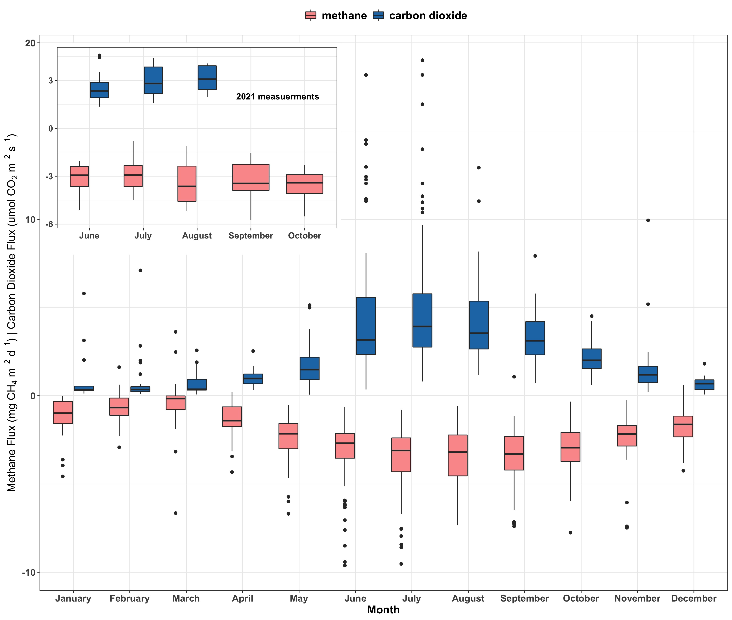
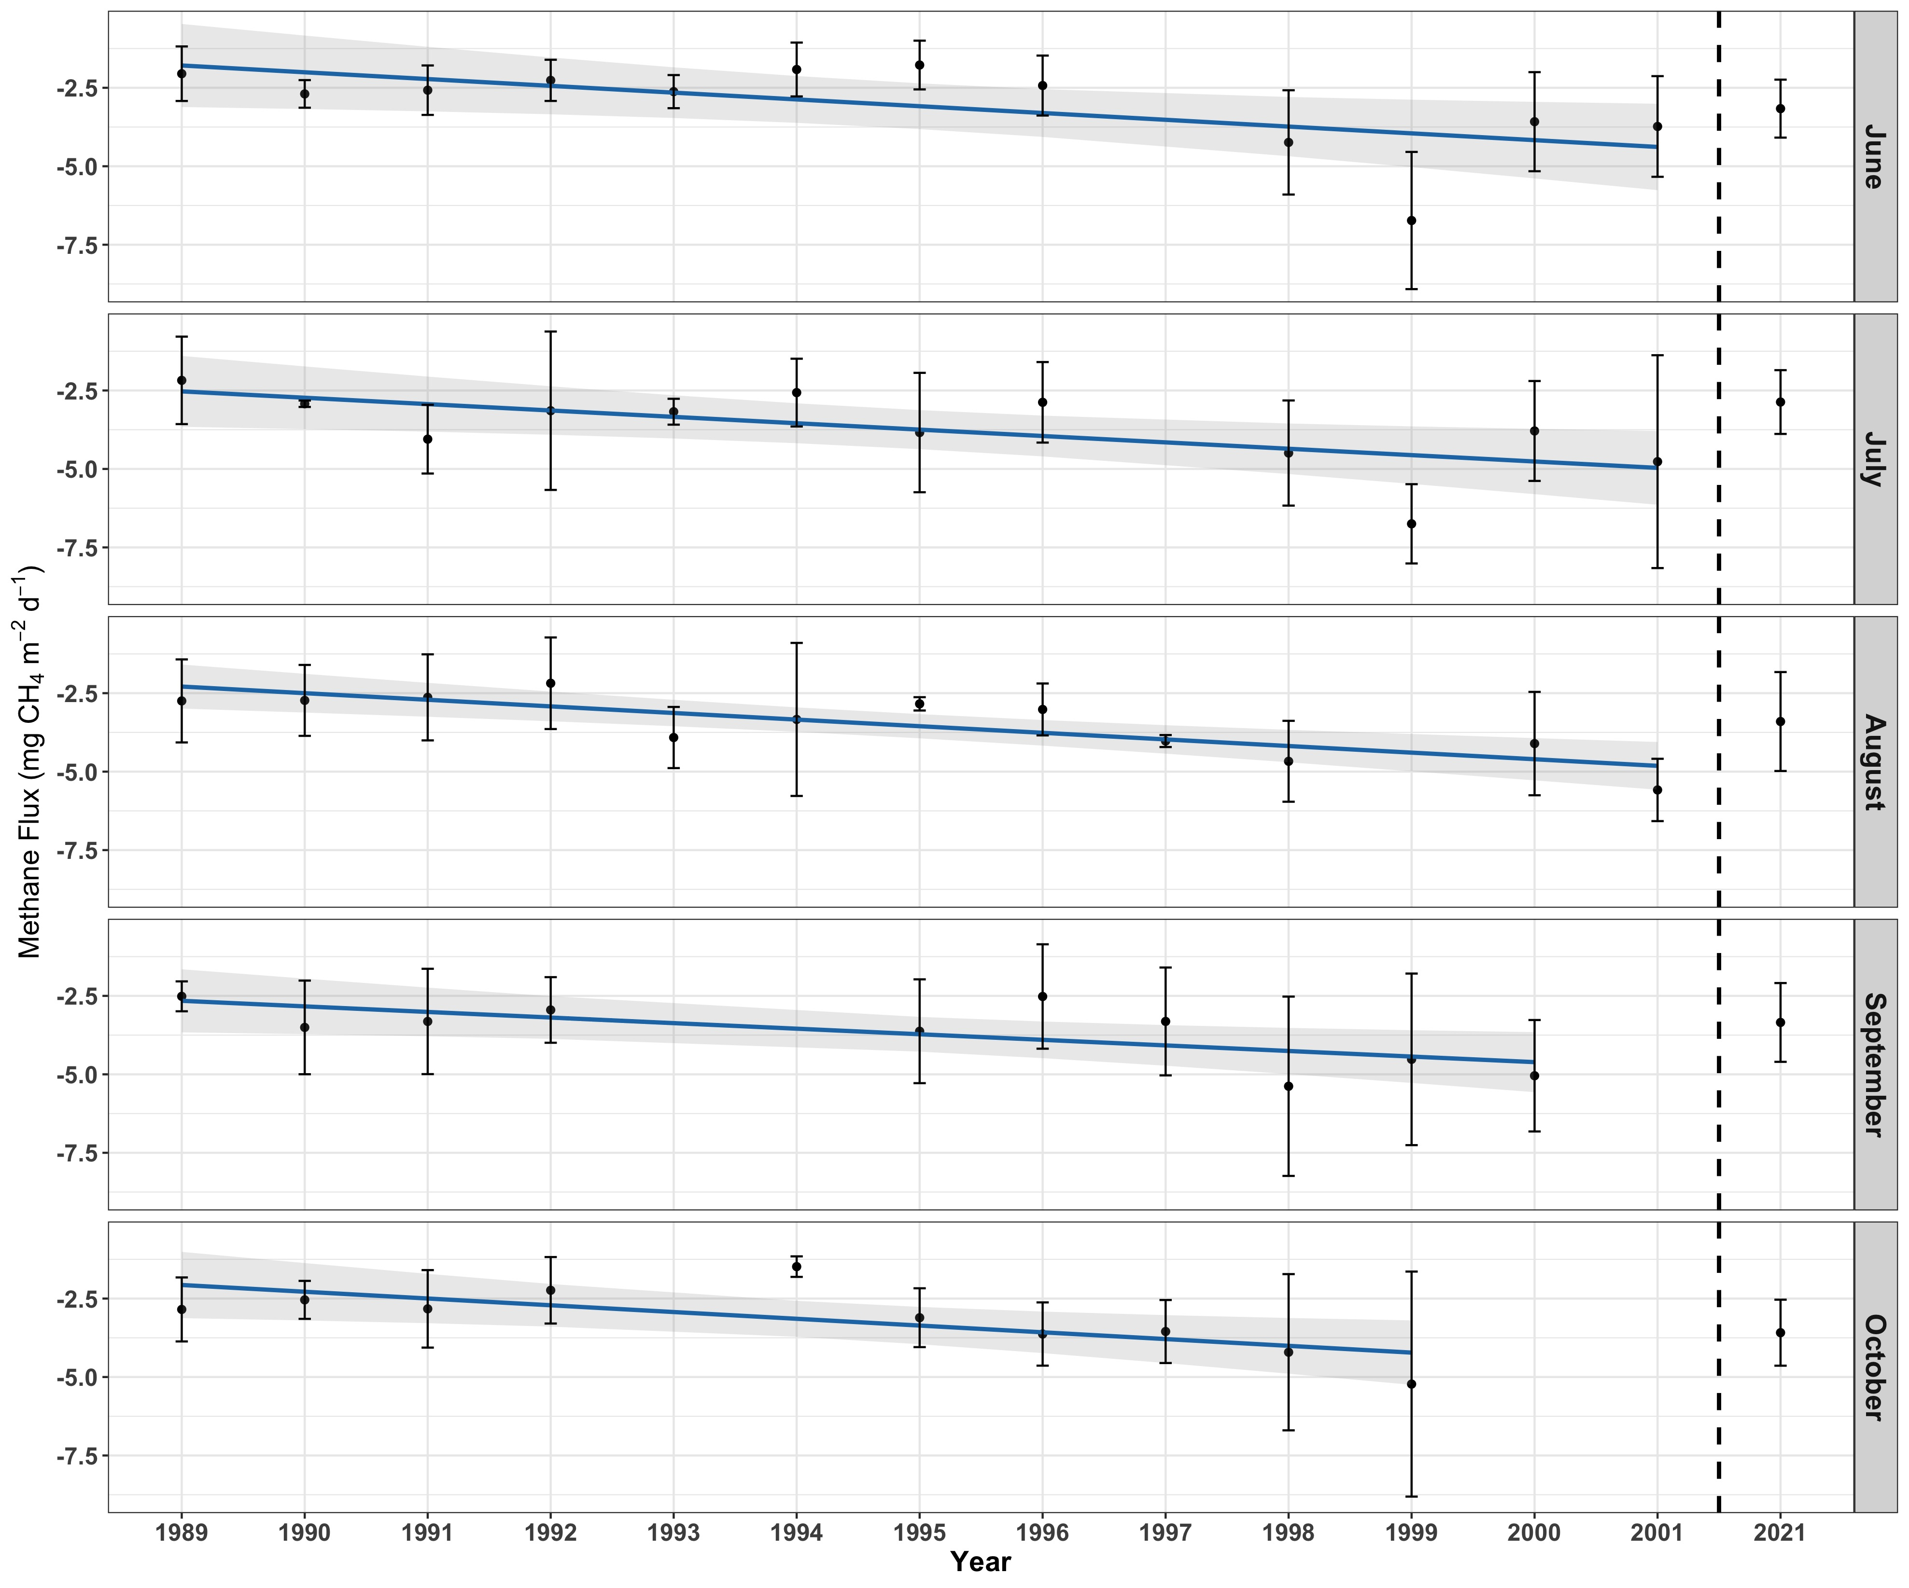
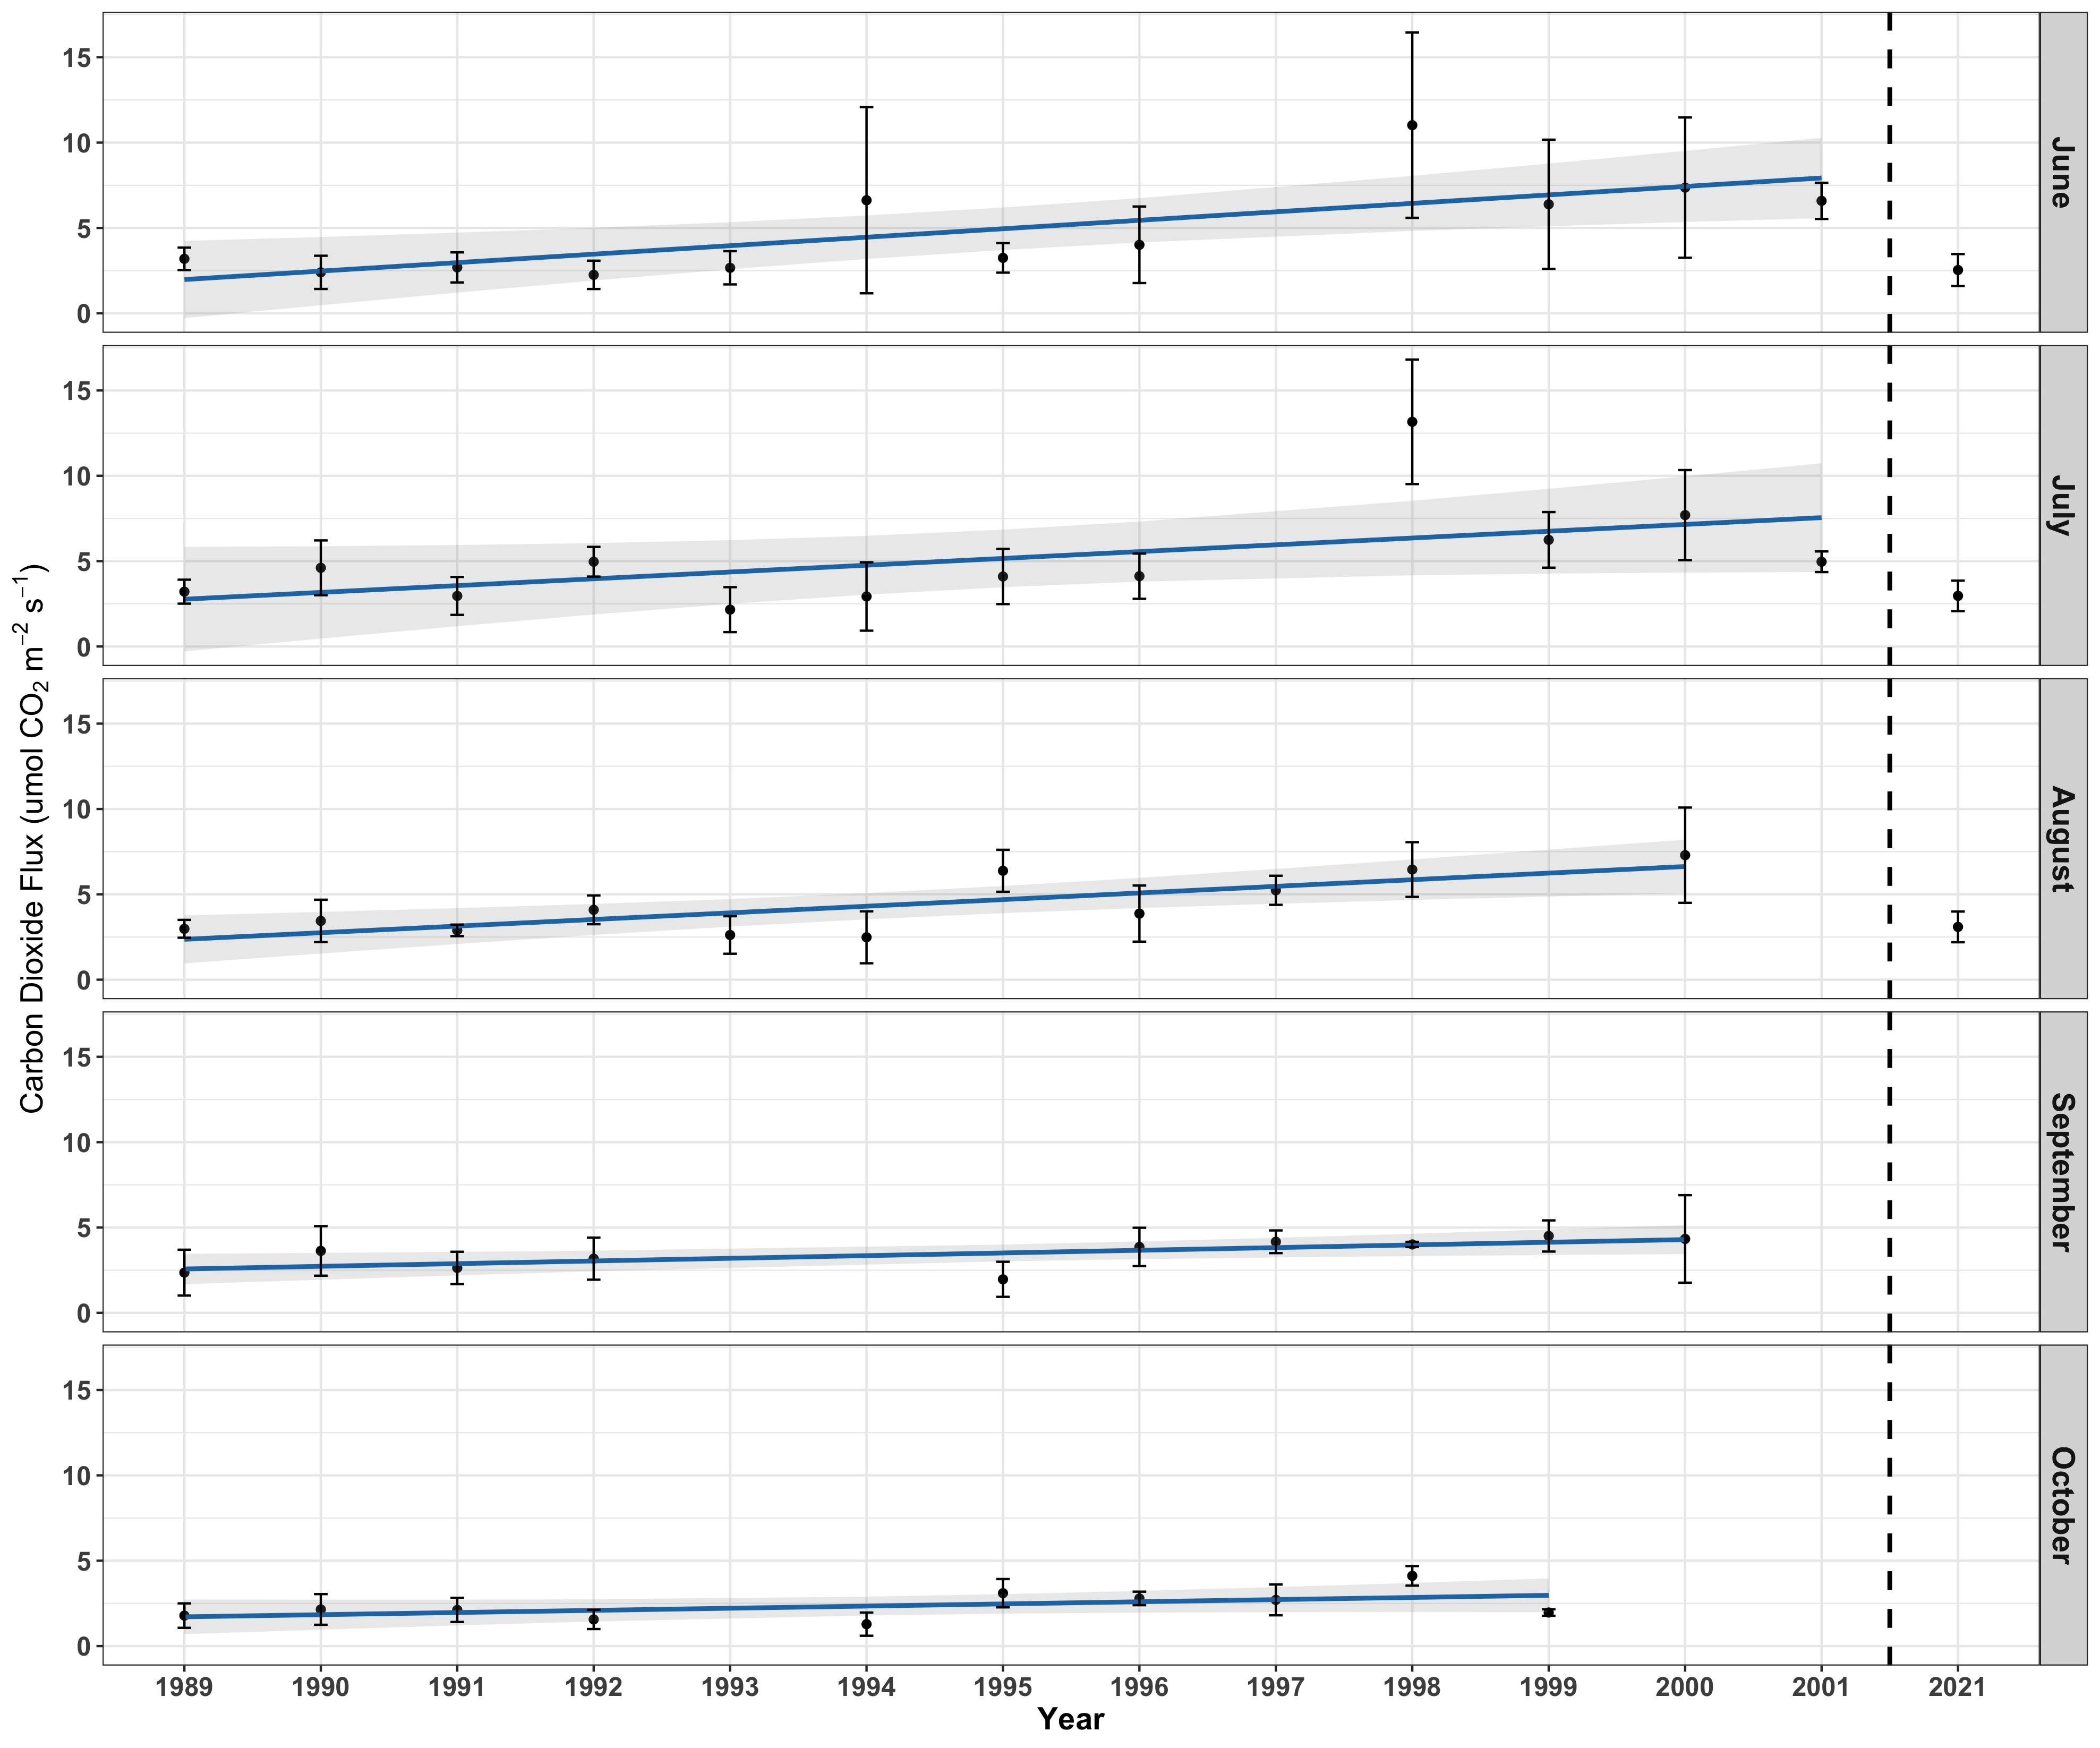
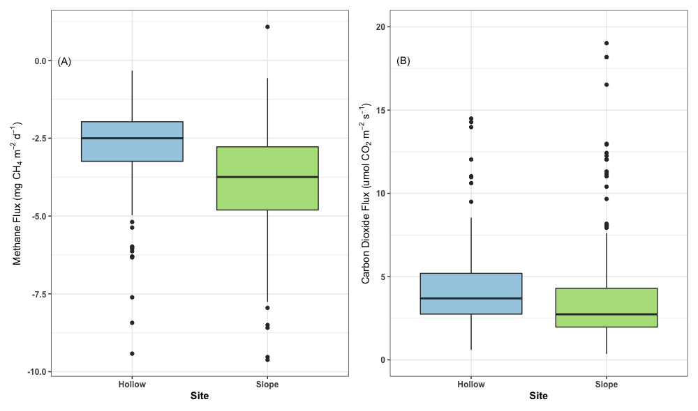
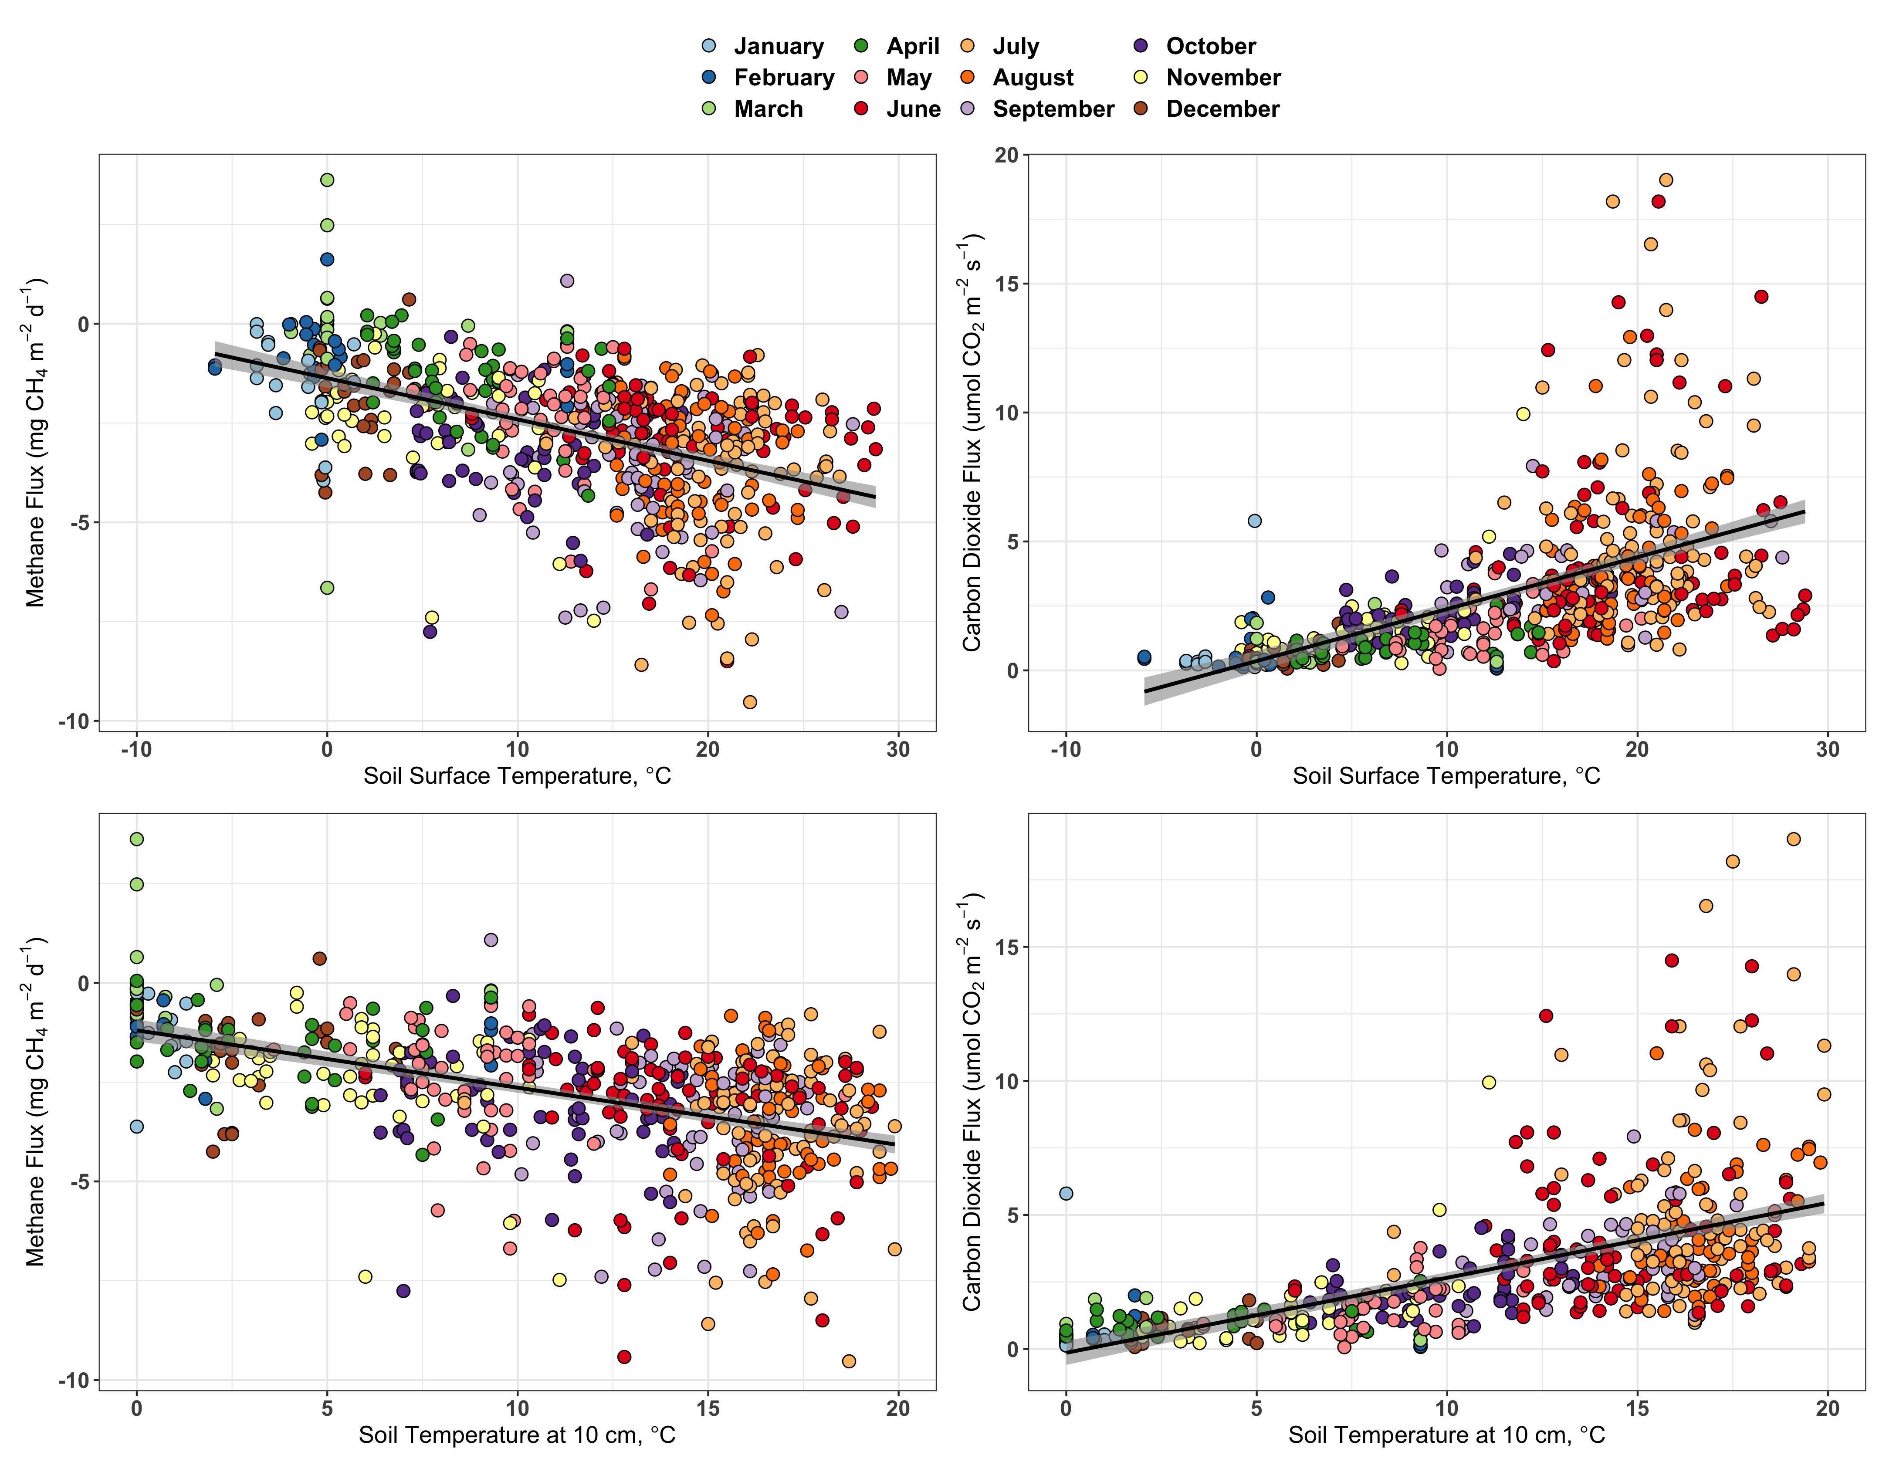
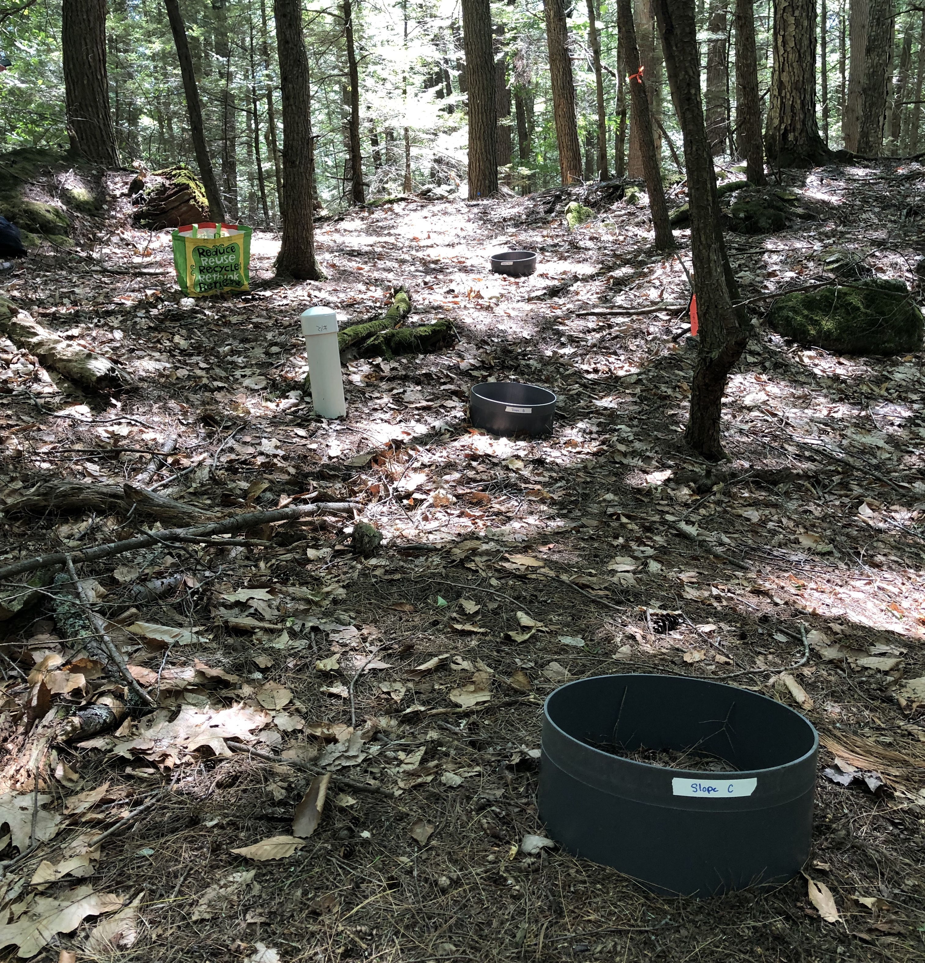
Historical and contemporary controls on methane fluxes in temperate forest soils
Natalie White¹, Clarice Perryman²,³, Angelica Dziurzynski²,⁴, Ruth Varner²,³
¹Department of Natural Resources, University of New Hampshire, Durham, USA, ²Department of Earth Science, University of New Hampshire, Durham, USA, ³Institute for the Study of Earth, Oceans, and Space, University of New Hampshire, Durham, USA , ⁴Department of Biological Sciences, University of New Hampshire, Durham, USA,
B35H-1509
INTRODUCTION
RESULTS AND DISCUSSION
Have carbon fluxes between June and October changed from 1989 to 2021?
Methane is a greenhouse gas with a warming potential 32 times that of carbon dioxide.¹
Upland forest soils take up atmospheric methane and serve as a major global methane sink.²
The primary controls on methane uptake and release from soils include soil moisture, soil temperature, water table depth, and vegetation.³
As climate change increases global temperatures, the roles of forests as methane sinks are changing. Increased temperatures may stimulate more CH₄ uptake while increased precipitation may prohibit CH₄ uptake.^{3,4}
What is the magnitude of monthly CH₄ and CO₂ flux at this site?
Figure 4: Average methane fluxes by month for the years 1998-2001 and 2021. Each of the five months show a trend of increasing methane consumption over time. 2021 average fluxes are at the small end of the range of fluxes between 1989 and 2001.
Figure 1: Timeseries showing monthly methane and carbon dioxide fluxes. Calculated with historical data and data from 2021 (see inset). Seasonal variation is represented in the changing fluxes by month. This is consistent with the expected fluxes in temperate New England forests.
STUDY SITE
College Woods,
Durham,
New Hampshire
43.135 °N, -70.944 °E
College Woods is a 250-acre hemlock-hardwood-pine forest located on the grounds of the University of New Hampshire. The soils in College Woods are in the Inceptisol order.⁵
Figure 5: Average carbon dioxide fluxes by month for the years 1989-2001 and 2021. Each of the five months show a trend of increasing CO2 emissions over the study period. The 2021 averages are at the small end of the range of flux values between 1989 and 2001.
Do CH₄ and CO₂ fluxes differ by site?
p < 0.05
p = 0.13
RESEARCH QUESTION
How do historic methane and carbon dioxide fluxes within College Woods compare to contemporary fluxes? What factors are driving these differences?
CONCLUSIONS
METHODS
Figure 2: Methane flux (left) and carbon dioxide flux (right) by site. Data were combined for June to October from 1989-2001 and 2021. Methane fluxes between sites are significantly different while carbon dioxide fluxes were not significantly different by collar location. There were no significant differences in environmental variables between the slope and hollow sites
Temperature influences CH₄ and CO₂ flux more than landscape position.
Trends in CH₄ fluxes between 1989-2001 disagree with findings of decreasing fluxes in contemporary studies of temperate forests as methane sinks.⁴
June, September, and October of 2021 were warmer than the respective 1989-2001 monthly averages. Warming temperatures lead to increased methanotrophic activity.
Aside from June, precipitation during the 5 sampled months was higher in 2021 than it was on average between 1989-2001. Interplay between the increased temperatures and increased precipitation control the size of both CH₄ and CO₂ fluxes. Future work should look further into precipitation and impacts on soil chemistry.⁹
Existing dataset:
  Study site was established in 1989 (Crill et al., 1991). Methane and carbon dioxide fluxes were monitored biweekly from 1989-2001 with the static chamber method. Collars were installed in a hollow and on a slope.^{6,7}
  Sampling sites were reestablished in 2021.
Flux measurements:
  Each collar was sampled approximately weekly between June and October 2021 using the static chamber method. 5 samples of chamber headspace were collected over a 20 minute period using 60 ml syringes.
Environmental measurements:
  Soil moisture, soil, air, and surface temperature, and weather at each sampling was recorded.
Flux analysis:
  20 mL of sample was run on
  Shimadzu GC-14A CG-FID to
  calculate CH₄ flux.
  3 mL of sample was run on IRGA
  LiCOR to calculate CO₂ flux.
  Excel, JMP, and R were used for
  statistical analysis. ⁸
Which factors potentially drive fluxes the most?
Figure 3: Surface and 10 cm temperature were found to be the two variables with the strongest relationship to both CH₄ and CO₂ fluxes. Graphs created with data from all months of all study years and color coded by month.
a
R² = 0.21
p = <0.0001
b
R² = 0.27
p = <0.0001
Acknowledgements: This study site and design for the 1989-2001 data was established by Dr. Patrick Crill and measurements were made over that period by many technicians and undergraduate students. For the 2021 measurements I would like to thank the Hamel Center for Undergraduate research for supporting this research through a Summer Undergraduate Research Fellowship grant and thanks to Alix Contosta for lending us equipment.
a
c
R² = 0.19
p = <0.0001
d
R² = 0.26
p = <0.0001
b
c
References:
¹Holmes et al. (2013), Atmospheric Chemistry and Physics; ²Dutaur (2007), Global Biogeochemical Cycles; ³Turetsky et al. (2014), Global Change Biology; ⁴Ni and Groffman (2018), PNAS; ⁵Mikhailova et al. (2021), Earth; ⁶Crill et al. (1988), Global Biogeochemical Cycles; ⁷Crill (1991), Global Biogeochemical Cycles; ⁸R Core Team (2020), R Project for Statistical Computing and Wickham H (2016), ggplot2: Elegant Graphics for Data Analysis. ⁹Topp and Pattey (1997), Canadian Journal of Soil Science;
Figure 1: Reestablished study site showing slope collars a, b, and c.

