Slide 1
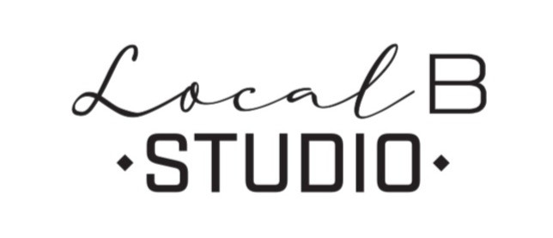
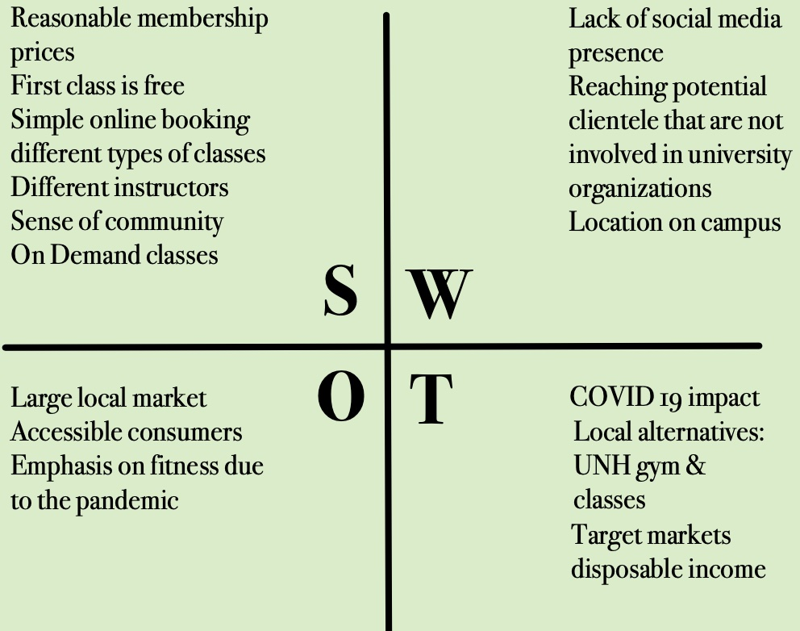

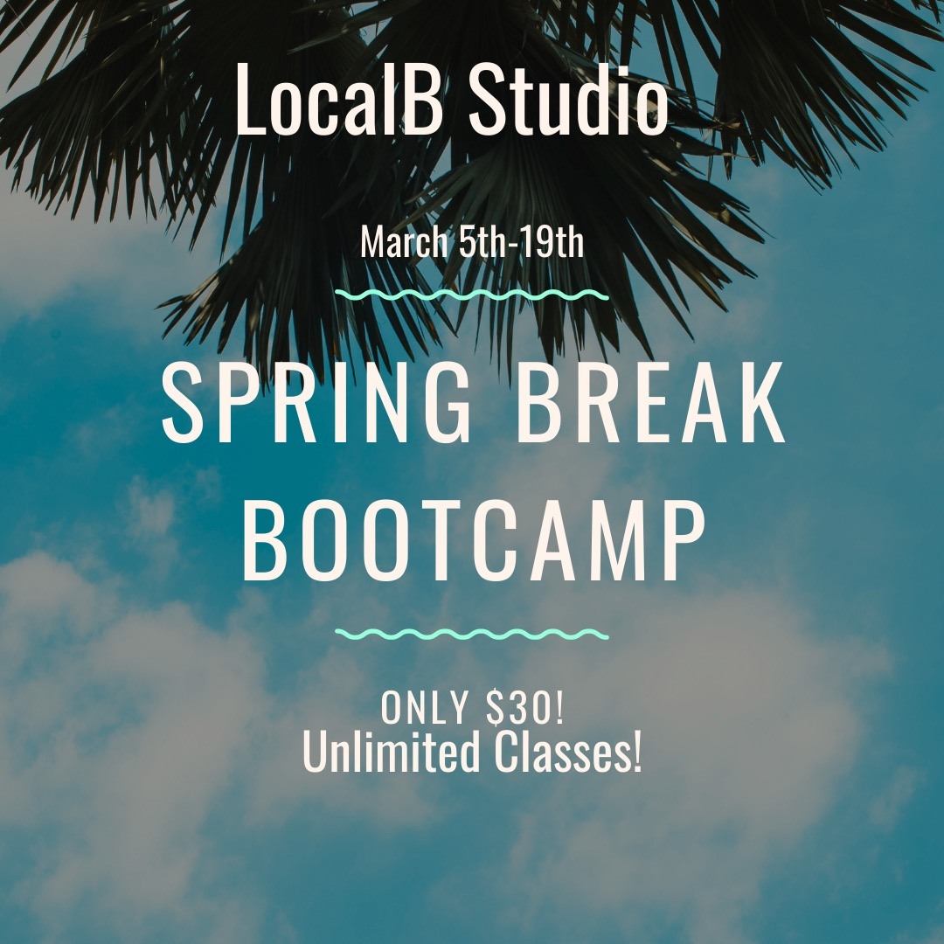

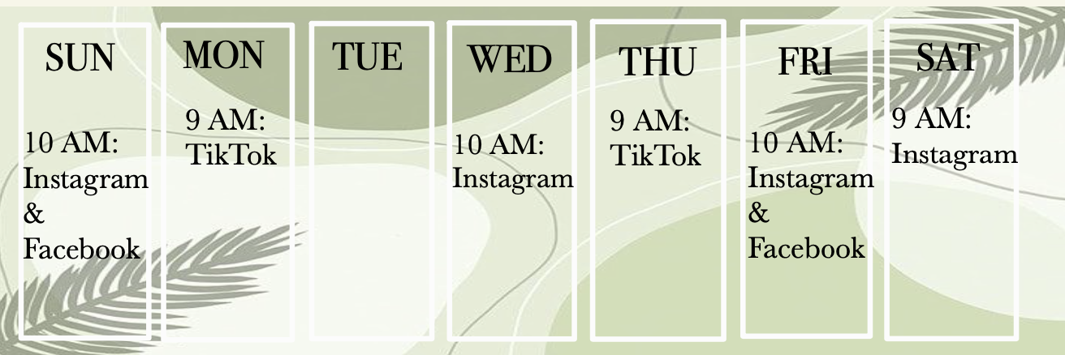
SWOT Analysis
Social Media
The owners of LocalB Studio wanted to expand their social media presence. We worked with them to plan ways to increase their following on Instagram and TikTok.
Durham, New Hampshire
Events & Offerings
Suggestions
We suggested that LocalB hire a social media intern. One of the main goals they gave us was to increase their Instagram following. We identified that they need a more cohesive theme throughout their Instagram. A social media intern would allow them to have a more consistent posting schedule and theme.
Spring Break Bootcamp
In order to try and keep classes full and running over the spring break, LocalB is offering unlimited classes that entire week for only $30. This would help bring in new customers to try workouts at a heavily discounted rate. The graphic below will be posted on their social media as well for promotion.
Campus Presence
We suggested that LocalB start using their TIkTok more often. Fitness videos and quick workouts are extremely popular now, and LocalB can benefit from expanding to these types of posts.
Student Ambassadors
We recommend that LocalB obtains at least two student ambassadors whose roles include:
Increasing brand awareness through promoting events on their personal social media accounts
Wearing LocalB merchandise around campus and the UNH gym to attract new members
Hanging flyers around approved downtown Durham locations
Posting Schedule
"Two for One" Student Deal
To further promote LocalB in the UNH community we have suggested they implement a student deal which includes:
A promo code during checkout that is available to specific dorms, apartment, organizations at a time
A student deal where two students can attend one singular class for the price of one
This would reach their target audience and incentivize UNH lowerclassmen to attend classes at LocalB
Online Classes for Members
To further promote membership sign ups, we recommend that LocalB offers an online option for classes. Online and in person offerings are gaining popularity since the pandemic and can benefit LocalB by expanding beyond the Durham community or for student members who move back and forth from home and school.
Social Media Accounts
Instagram: localbstudio
Facebook: Local B Studio
localbstudio.com
localbstudio@gmail.com
Notes:
SWOT Analysis- Ac
Social Media:
- Posting schedule-ac
- Marketing Intern
- Spring break post
- Tiktok account
Campus presence
Spring break bootcamp
Online classes w/ membership
GOAL: boost brand awareness
BOGO

