Slide 1
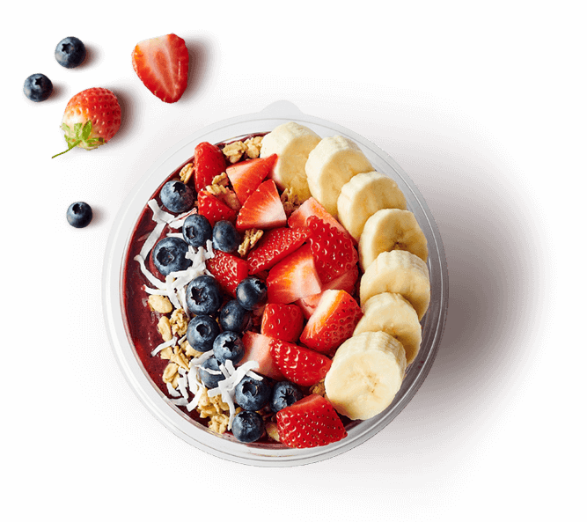
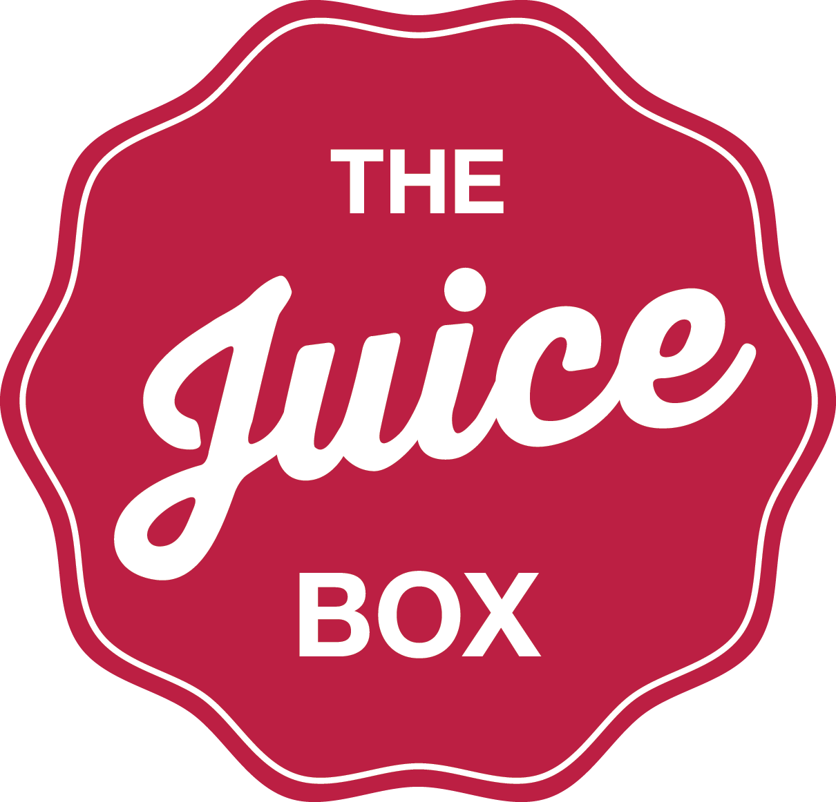
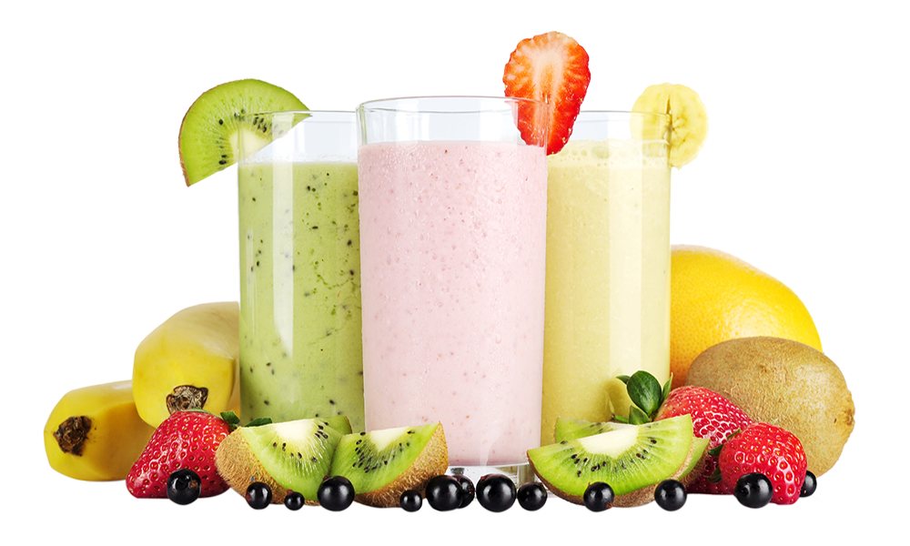
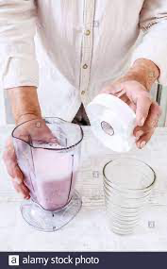
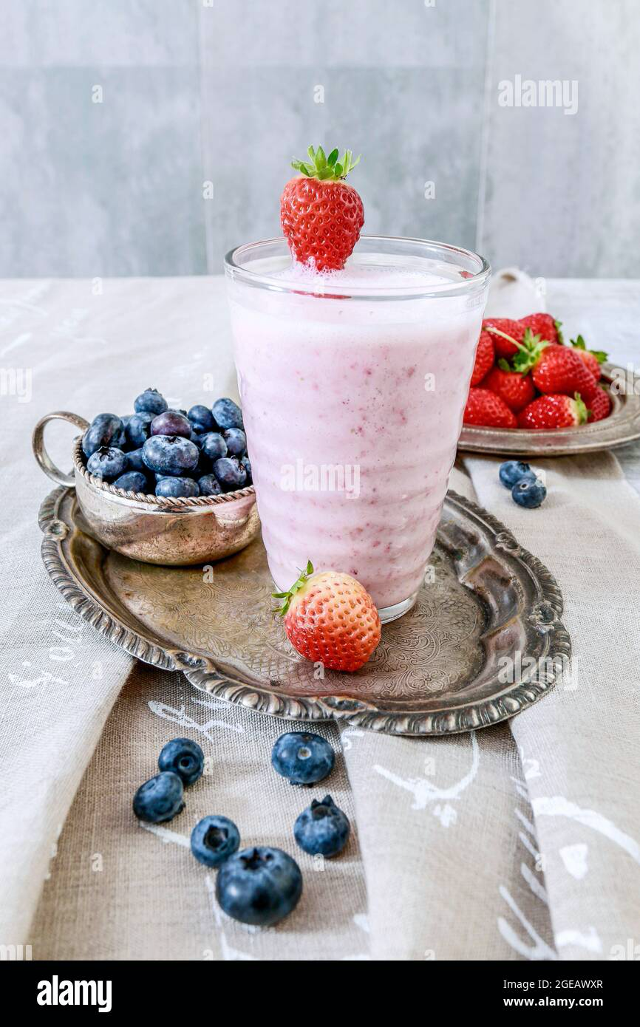




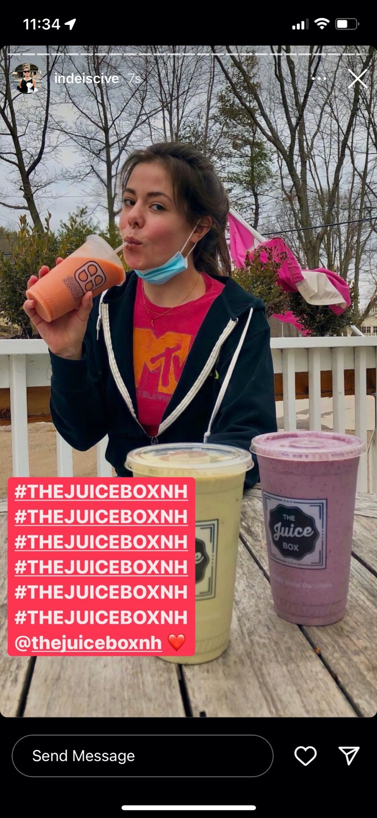
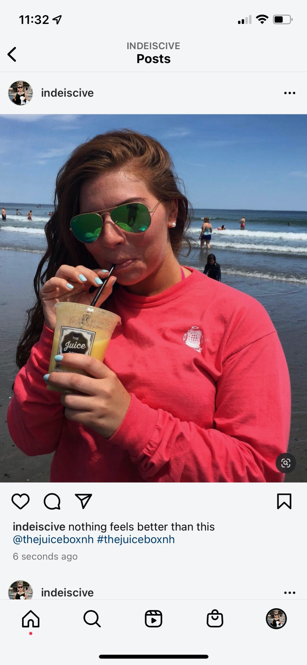
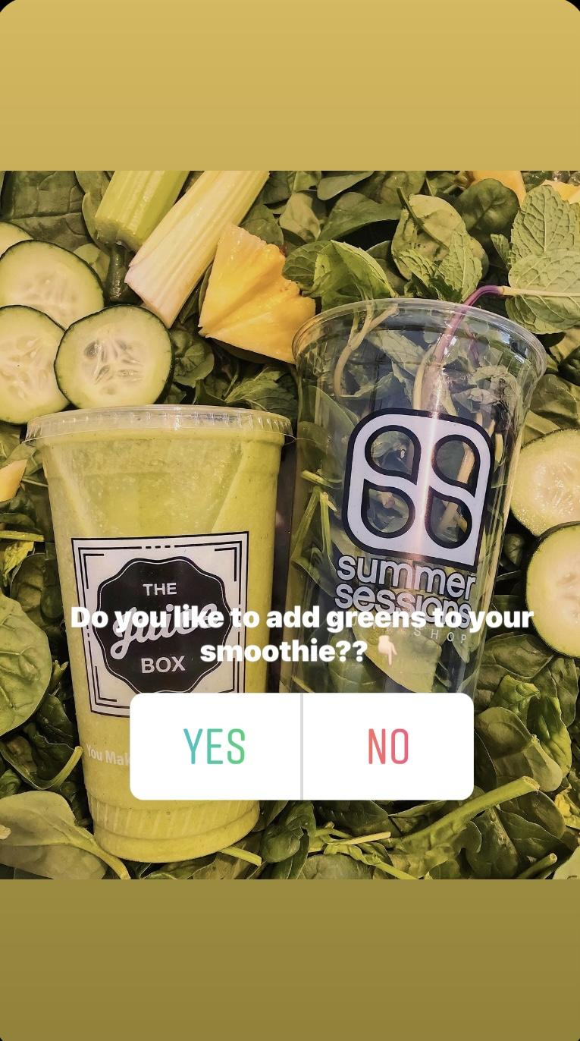
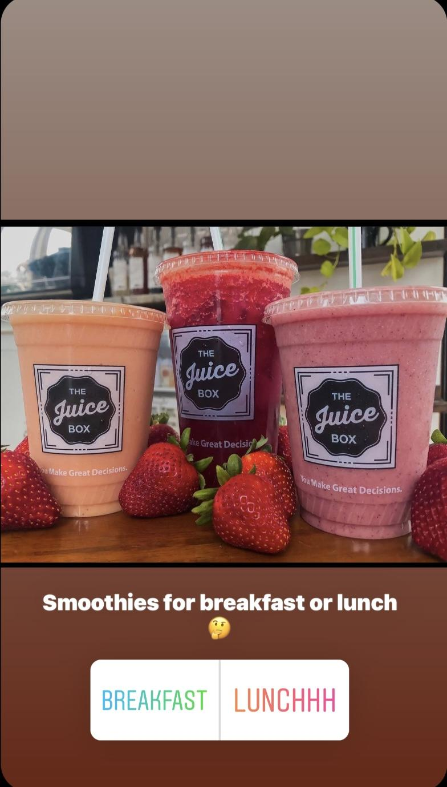

CHALLENGES
CONTENT IDEAS
The owner of The Juice Box is looking to increase social media engagement. The main platform we will focus on is Instagram. We have concluded that their target market spends most of their time on this platform., so advertising here will reach a majority of their consumers.
ENGAGING CAPTIONS
Offer a student discount on a certain day in the comments.
Use exciting photos of the most popular menu items; ask others their favorite!
CAPTION IDEAS
“Come in and try our smoothie of the week! While it lasts… #thejuiceboxnh”
“Start your day off healthy! Come
see us 7-5pm at our location or order on our website!☺”
DRINK OF THE WEEK
2-3 weekly specialty drinks that aren't on the normal menu
Advertise early that week on Instagram posts and a story inviting them to come try for a limited time!
With a storefront as cute as its name, The Juice Box has a lot to offer… Though the building is tiny, the menu is endless, and includes everything from fresh juices to protein-packed smoothies, as well as wraps and salads. The brand is located in North Hampton and is looking to grow and expand. After analyzing their strengths and weaknesses, we developed a set of goals to help them achieve success.
CONTENT CALENDAR
Devise a post calendar.
Why?
Increase higher engagement on a day to day basis, thus creating consistency.
How?
Connect Juice Box’s Instagram to a Planner app called “Later” to set post schedules as a reminder
Sun
Thur
Fri
Sat
Mon
Tue
Wed
GOALS
-9am
Insta
Post
& Story
-10am
Insta
Post
-9am
Insta
Post
& Story
-10am
Insta
Post
-9am
Insta
Reel
&
Story
-4pm
Insta
Reel
-4pm
Insta
Post
&
Story
INCREASE ENGAGEMENT
ATTRACT NEW CUSTOMERS
IMPROVE BRAND RECOGNITION
INCREASE REVENUE GROWTH
#THEJUICEBOXNH
@thejuiceboxnh
@thejuiceboxnh
INSTAGRAM REELS
Fun and captivating reels or boomerangs
of drinks being made, served, happy customers
Encourage customers to post pictures of their drinks and use this hashtag to aid in brand recognition.
Why?
To increase brand awareness!
STORY POLLS
Provides great feedback
Captures real time data
GIVEAWAY
Repost and tag us for 10% off your next purchase!
Require a story repost; using #thejuicebox
Monthly item giveaway
”What they lack in size, they make up for in flavor!”

