Slide 1

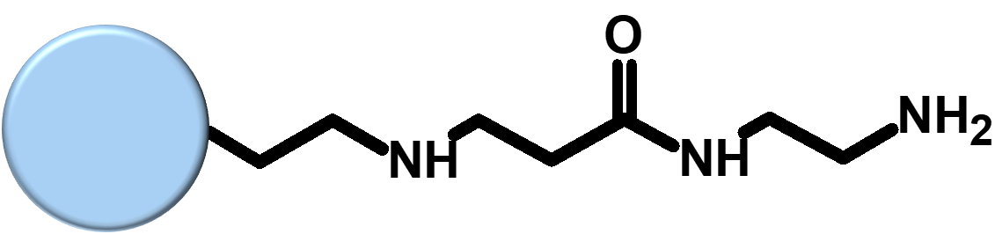
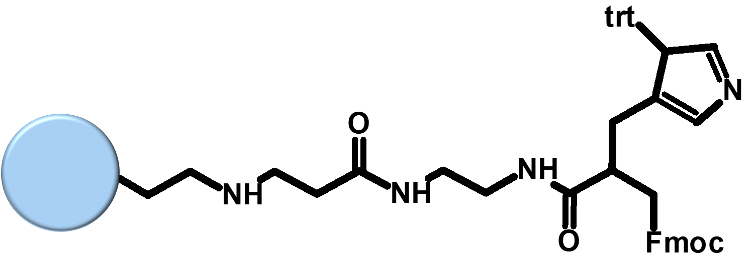
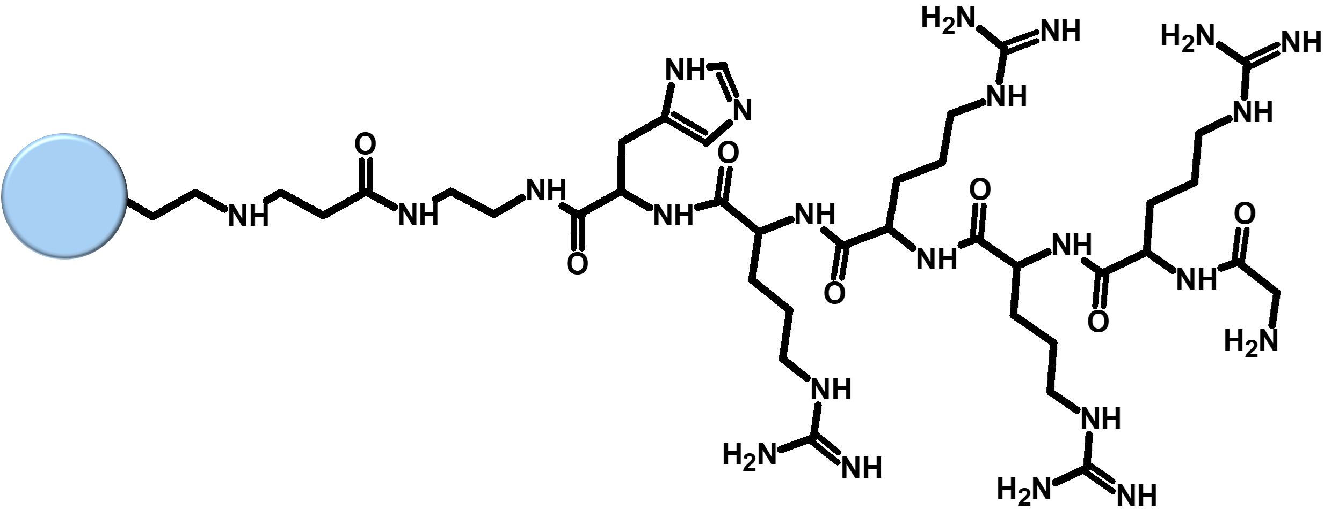
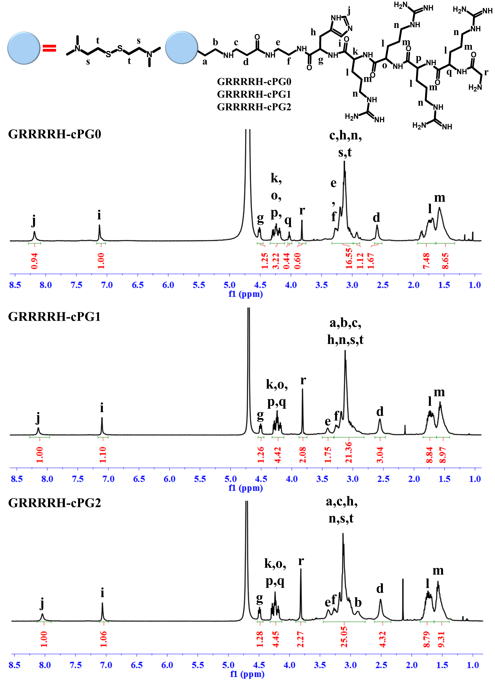
Non-viral Gene Delivery using Cystamine Core PAMAM Dendrimer Conjugated with the Nuclear Localization Signal Derived from Lactoferrin
Jeil Lee¹, Yong-Eun Kwon², Hwanuk Guim³ and Kyung Jae Jeong¹*
¹ Department of Chemical Engineering, University of New Hampshire, Durham, New Hampshire 03824, United States.
² Center for Scientific Instrumentation, Korea Basic Science Institute, Gwahak-ro, Yuseong-gu, Daejeon, 34133, Republic of Korea
³ Research Center for Materials Analysis, Korea Basic Science Institute, Gwahak-ro, Yuseong-gu, Daejeon, 34133 Republic of Korea
Abstract
Synthesis Scheme
Polyamidoamine (PAMAM) dendrimer consisting of biodegradable linkers is a cationic polymer for gene delivery and has received much attention as an alternative to polyethylenimine (PEI) because of relatively lower cytotoxicity. However, its low transfection efficiency compared to that of PEI limits its application as a carrier for gene therapy. In our previous studies, PAMAM dendrimer derivatives modified with nuclear localization signal (NLS) peptides showed similar or high transfection efficiency in various cells compared to PEI 25kDa. An addition of histidine residue to NLS peptides further reduced cytotoxicity of PAMAM derivatives modified with NLS peptides. In this study, we selected another NLS sequence (GRRRR) derived from lactoferrin protein and introduced it to cystamine core polyamidoamine (cPAMAM) generation 0, 1, and 2 to evaluate transfection efficiency and cytotoxicity as a function of the number of the conjugated NLS peptides using NIH 3T3 and human dermal fibroblasts (HDFs). The transfection efficiency of GRRRRH-modified cPAMAM G2 was the highest among the cPAMAM derivatives and similar or higher than PEI 25kDa. The cytotoxicity of cPAMAM derivatives was generation-dependent and lower than PEI 25kDa. Given its efficiency and toxicity, our study indicates that cPAMAM generation 2 conjugated with NLS is suitable for gene therapy application.
Fmoc-His(trt)-OH
HOBt
HBTU
DIPEA
cPG0
cPG1
cPG2
1.Fmoc-Arg(pbf)-OH
2.Fmoc-Arg(pbf)-OH
3.Fmoc-Arg(pbf)-OH
4.Fmoc-Arg(pbf)-OH
5.Fmoc-Gly-OH
Protected H-cPG0
Protected H-cPG1
Protected H-cPG2
Repeat
Fmoc deprotection
and conjugation
GRRRRH-cPG0
GRRRRH-cPG1
GRRRRH-cPG2
Scheme 1. Synthesis scheme of cPAMAM derivatives conjugated with nuclear localization signal.
Results
(A)
Figure 2. The complexation analysis of pCN-Luci with cPAMAM derivatives using PicoGreen reagent at various weight ratios
(B)
Figure 1. 1H NMR spectra of cPAMAM derivatives.
S and t are used instead of a and b in GRRRRH-cPG0.
Figure 3. Acid-base titration profiles of the polymers.
Figure 4. (A) Size and (B) ζ-potential analysis of cPAMAM derivatives/pCN-Luci polyplexes.
Figure 5. STEM (-in-SEM) images and EDS analysis of polyplexes.
pDNA
(Alexa Fluor546)
Nucleus
(DAPI)
Merged
(A)
(B)
(C)
(D)
Figure 6. Transfection efficiency of cPAMAM derivatives in NIH3T3 and HDF cells. Data are shown
as mean ± standard deviation (n=3). *p < 0.05, **p < 0.01, and ***p < 0.001 compared with that of PEI.
Figure 7. Cytotoxicity assay in NIH 3T3 cells and HDFs using alarmarBlue assay.
Figure 8. Confocal microscope images of polyplexes of (A) Cells only, (B) PEI,
(C) cPG2, (D) GRRRRH-cPG2 with pCN-Luci in NIH3T3 cells.
References
Conclusion
[1] Yang, J., Zhang, Q., Chang, H.; Cheng, Y. (2015). Surface-engineered dendrimers in gene delivery.
Chem. Rev. 2015, 115(11), 5274-5300.
[2] Wang, F.; Hu, K.; Cheng, Y. Structure–activity relationship of dendrimers engineered with twenty common amino acids in gene delivery. Acta Biomater. 2016, 29(1), 94-102
[3] Lee, J.; Jung, J.; Kim, Y.-J.; Lee, E.; Choi, J. S., Gene delivery of PAMAM dendrimer conjugated with the nuclear localization signal peptide originated from fibroblast growth factor 3.
Int. J Pharm. 2014, 459(1-2), 10-18.
In this study, we conjugated GRRRR sequence, the NLS derived from lactoferrin protein to cPAMAM dendrimers and demonstrated that the introduction of the NLS sequence increased transfection efficiency of cPAMAM dendrimers by several orders of magnitude for both cell lines and primary cells. Transfection efficiency and cytotoxicity were dependent on the cPAMAM generation. Our results indicate that GRRRRH-cPG2 has the potential as a gene carrier for various gene therapies.
Acknowledgment
This research was sponsored by the U.S. National Science Foundation and was accomplished under the Grant No. OIA-1757371.

