Slide 1
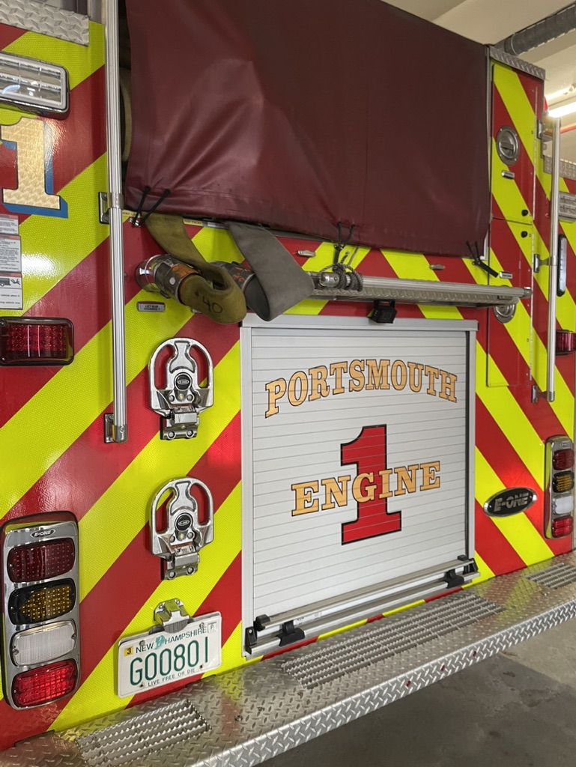
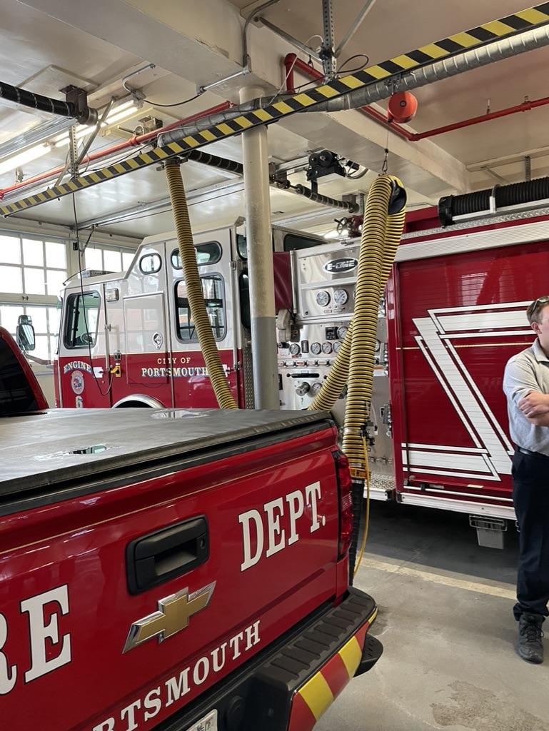
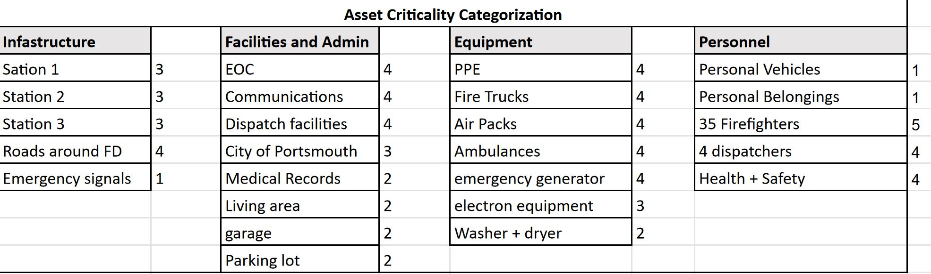
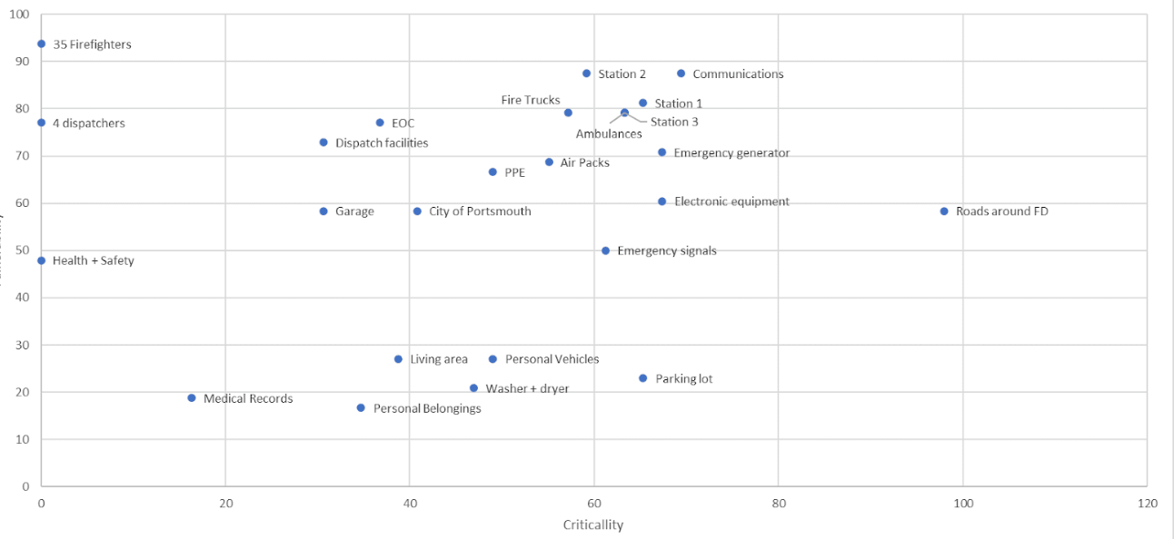
Risk Mitigation at the Portsmouth Fire Department
The Portsmouth Fire Department: Responds to a city of 21,775 people (2019) with three stations throughout the city and they also help surrounding cities and towns if needed.
Staffed by 32 Firefighters/EMTs, 1 Fire Chief, 1 Fire Marshal, 1 Training Captain, and 4 Dispatchers.
Overview: Identify the factors that put the Portsmouth Fire Department at risk by developing mitigation strategies that work for the organization.
At the conclusion of this project, the Portsmouth Fire Department will have the opportunity to implement our recommendations to decrease the severity and frequency of potential threats to the department.
Risk Assessment – SAIC Risk Analysis:
Asset identification and critically assessment
  Infrastructure, Faculties, Equipment & Personnel
Assess vulnerabilities of each asset
Assess consequences
Identify counter measures
Estimate countermeasure cost
Review operational security planning
Categories and Definitions of Vulnerabilities Factors:
Construction/Maintenance – the age and level of maintenance on each asset
Access and Security – the ease of access and level of security for their assets
Importance – the importance of each asse for both the fire department and the fire fighters themselves
Critical & Vulnerability
Final Recommendations:
3-year Net Present Value (NPV)
3 intervention strategies
No strict NPV because Portsmouth Fire Department is a city and state funded
We concluded the necessary budget, and the Portsmouth Fire Department will choose which risks to assess
Initial Impressions:
3 main doors have locks with a keypad
Main fire doors are kept open in the summer
Server room in the basement has an AC in the window (not secured)
No cameras in or around the building
Files and any other paperwork are out in the open
Fire trucks are left unlocked
Only items triple locked are narcotics on the ambulance
No designated IT
Doors are not always locked
Firefighters aren’t always in the building
Communication room is lowest in building, risk of flood damage
Risks:
Lighting in back parking lot
Locks on door
Communications / Backup for communications
Storage for personal belongings when on call (wallet, phone)
Southbound Spaulding Traffic Circle Bridge (saves 5 minutes in response time)
No Access Control system
Cyber Security Control System
Health and Safety Hazards
“Firefighter Cancers” and other sickness they are prone to
Countermeasures:
Garage doors have proper equipment to be opened from station 2
CCTV would allow station 2 to identify and allow in a neighboring station for station coverage.
Digital lock systems
George Bush Bridge
Two factor authentication for sensitive information
Backup dispatch
VPN
Up-to-date Cybersecurity system
Password security system, no autosave

