Slide 1



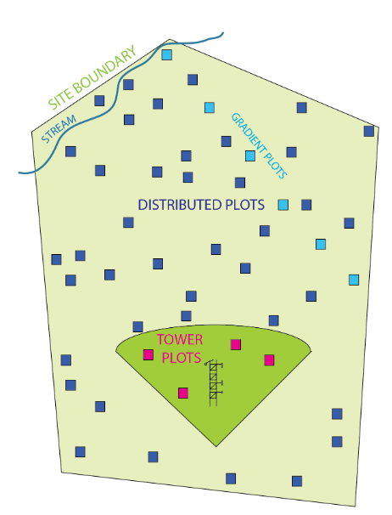
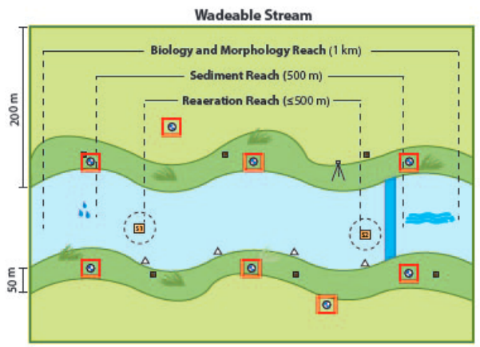
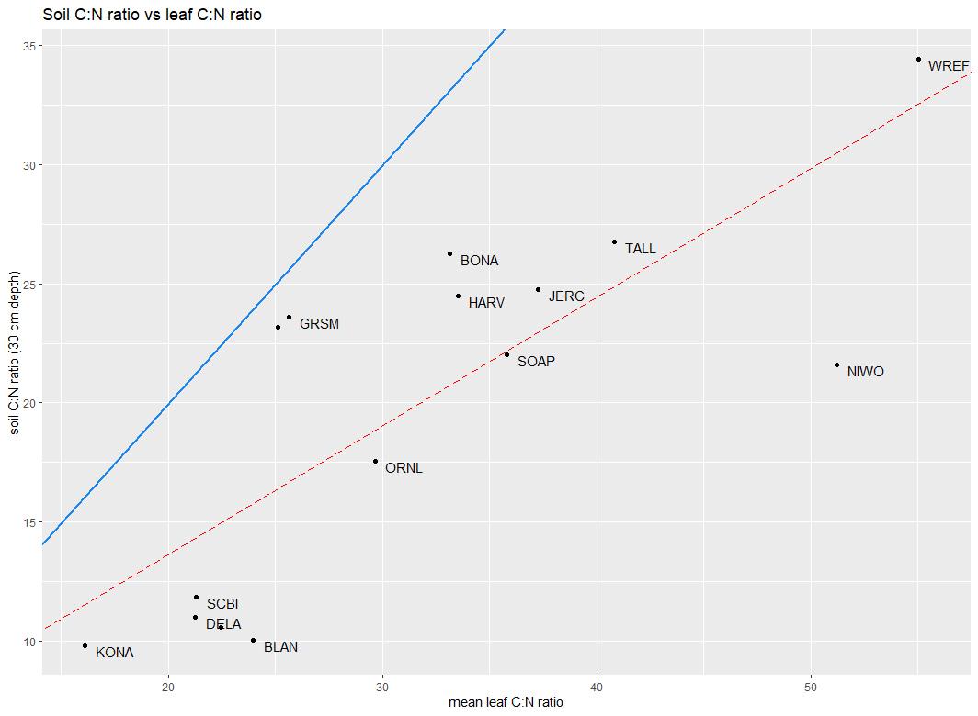
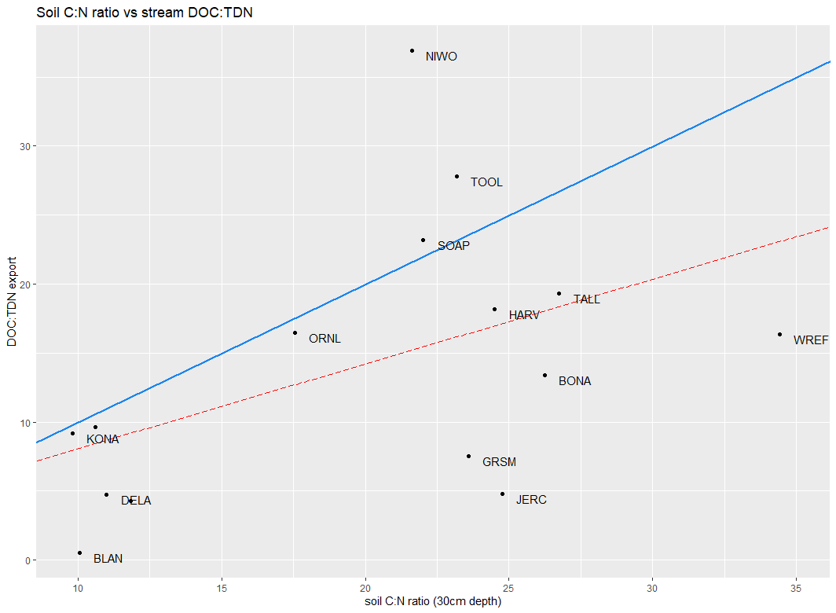
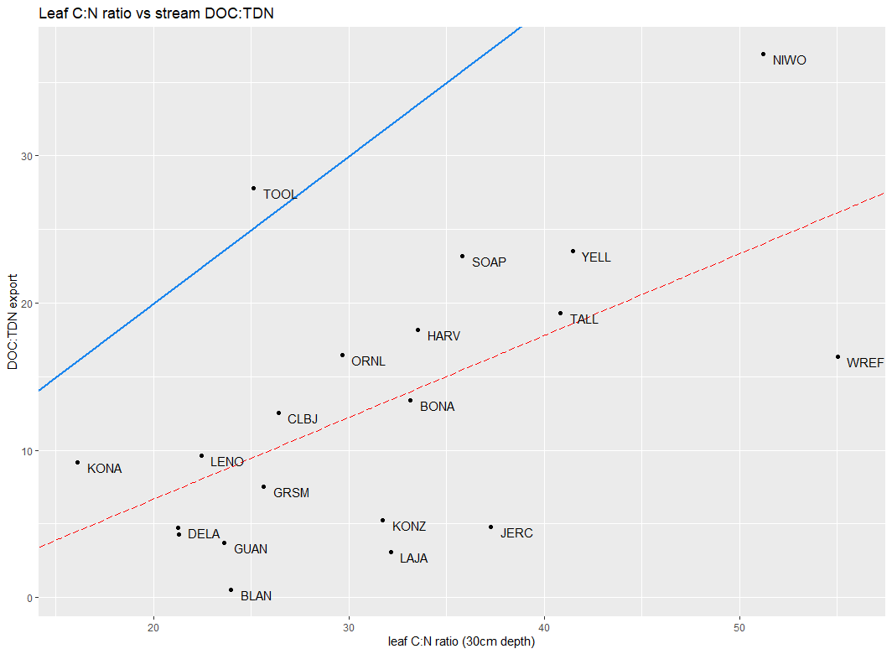
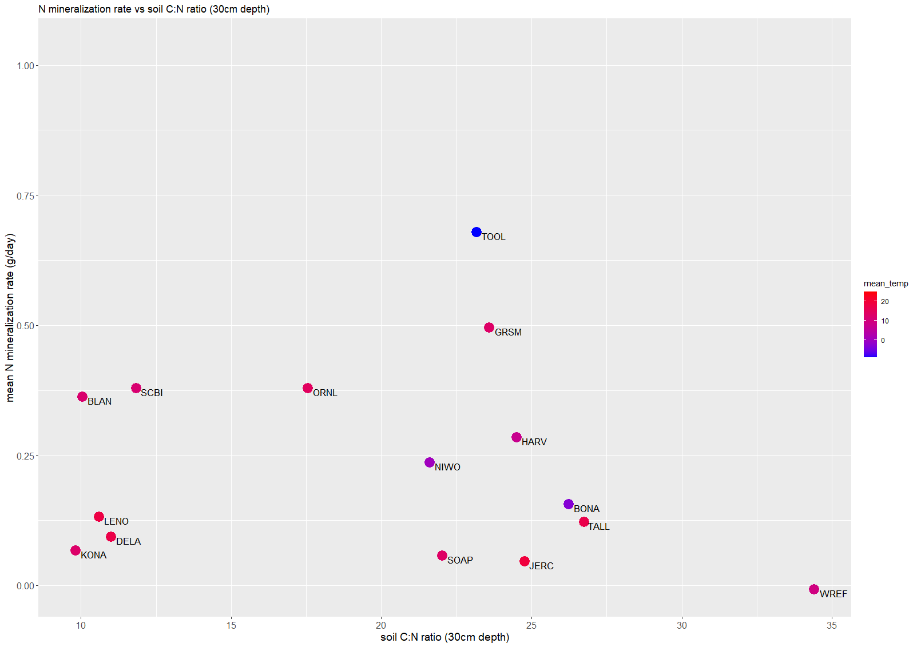
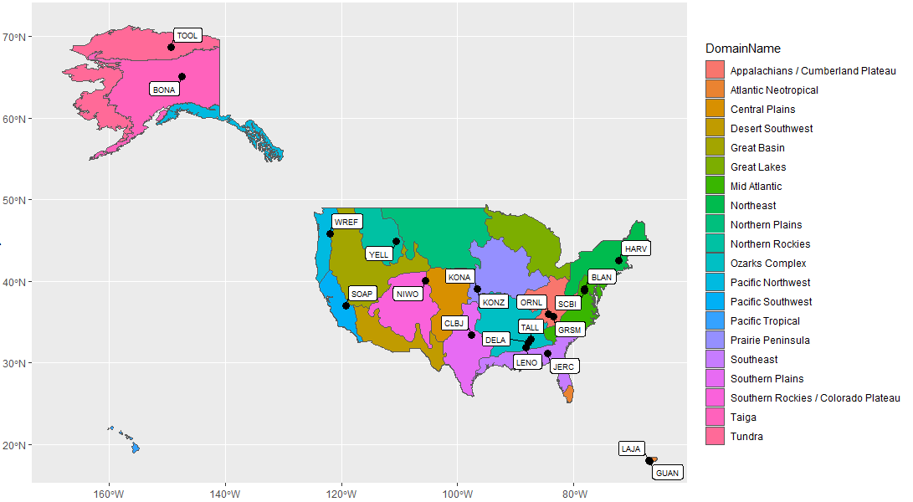
Environmental controls on carbon and nitrogen cycling across ecosystems in the U.S.
Lara Munro, Mark Green, Scott Ollinger, Wilfred Wollheim
Natural Resources and Earth Systems Science, University of New Hampshire
Rationale
- Carbon retention and assimilation by vegetation is limited by nitrogen availability, which means that the biogeochemical cycles for carbon and nitrogen are often tightly coupled.
- Environmental conditions like climate (temperature, precipitation & storm frequency & intensity) and plant characteristics (C:N ratios) affect both carbon and nitrogen cycles at a watershed level.
- Environmental disturbances (storms, fires, logging) can lead to the decoupling of the two cycles that can last for years.
- The strength of this biogeochemical coupling varies between ecoregions and environmental gradients; however, the relative influence of each environmental variable is not as well understood at a continental scale.
Methods
Terrestrial data
- Calculate mean soil C:N ratio for surface soils (top 30 cm) (NEON data product: DP1.10086.001)
- Calculate mean leaf C:N ratio (NEON data product: DP1.10026.001)
- Estimate nitrogen mineralization rates from incubation experiments (NEON data product: DP1.10086.001)
Aquatic data
- Calculate bi-weekly flow-weighted mean DOC, NO₃, and total dissolved nitrogen (TDN) concentrations and runoff (NEON data products: DP1.20093.001 and DP1.20033.001)
- Calculate mean annual DOC, NO₃, and TDN runoff
Figure 2: Sampling design of NEON terrestrial plots. Source: NEON 2022
Figure 3: Sampling design of NEON aquatic plots. Source: NEON 2022
Results
Varying C:N ratios from leaves to soil to streams:
Leaf C:N ratio is strongly correlated to surface soil C:N and stream DOC:TDN ratios across sites (p < 0.01) and soil C:N ratio is correlated to stream DOC:TDN ratios (p < 0.1).
Overall, stream C:N ratios are the most similar to soil C:N ratios. The relative proportion of nitrogen compared to carbon decreases as you move from trees to stream water, suggesting high carbon retention, relative to nitrogen across most sites.
Research question
Analyze environmental factors that influence nitrogen and carbon inputs and retention at a watershed scale.
Specific objective
Analyze linkages between inputs, plant and soil biogeochemistry, and stream export at a coarse temporal resolution across watersheds at a continental scale.
(a)
1:1
(b)
(c)
1:1
1:1
Sites and data source
Data collected from 2018—2021 by the National Ecological Observation Network (NEON) for 20 colocated terrestrial and aquatic sites. Sites were considered colocated when they were within 25 km of each other and located within 13 eco-climactic domains defined by NEON (figure 1).
Data collected from terrestrial sites include soil and leaf chemistry. Data collected from aquatic sites include continuous discharge and stream chemistry samples.
Figure 4: C:N ratios in different pools (a) soil C:N ratio relative to leaf C:N ratio (y = 0.5396x + 2.8734; R² = 0.6); (b) stream DOC:TDN ratio relative to soil C:N ratio (y = 0.6157x + 1.9314; R² = 0.2); (c) stream DOC:TDN ratio relative to leaf C:N ratio (y = 0.5557x—4.4152; R² = 0.3). Whole blue lines represent a 1:1 line between ratios and dashed red lines represent the linear regression between both ratios.
N mineralization and soil C:N ratio:
We expected a decrease in N mineralization rates compared to soil C:N ratios, with noticeably lower mineralization rates for soils with a C:N ratio above 25. However, mineralization rates are relatively constant across the range of soil C:N ratios observed at these sites.
This suggests that other environmental factors, such as temperature or precipitation, play an important role in regulating N mineralization rates at a continental scale, beyond soil properties.
Future directions:
- Increase model complexity by including other environmental variables into the relationship between nutrient exports and soil or leaf ratios.
- Comparative analysis of these relationships to those previously found at a site- or region-specific scales as well as those calculated in cross-ecosystem meta-analyses.
Mean annual temperature (C)
Acknowledgements and references:
Funding for this project is provided through the NSF Macrosystems biology program (award #1926591) and through a PGS-D fellowship granted to L. Munro by NSERC.
Data sources: NEON (National Ecological Observatory Network). Chemical properties of surface water (DP1.20093.001). https://data.neonscience.org (accessed April 8, 2022)
NEON (National Ecological Observatory Network). Continuous discharge (DP4.00130.001). https://data.neonscience.org (accessed April 8, 2022)
NEON (National Ecological Observatory Network). Plant foliar traits (DP1.10026.001). https://data.neonscience.org (accessed April 8, 2022)
NEON (National Ecological Observatory Network). Soil physical and chemical properties, periodic (DP1.10086.001). https://data.neonscience.org (accessed April 8, 2022)
Figure 1: Location of the 20 colocated terrestrial and aquatic sites used in this study. Colours designate individual domains, as defined by NEON.
Figure 5: Mean N mineralization rates relative to soil C:N ratio for surface horizons (30 cm depth). Mean annual temperature at each site is represented by colours.

