Slide 1

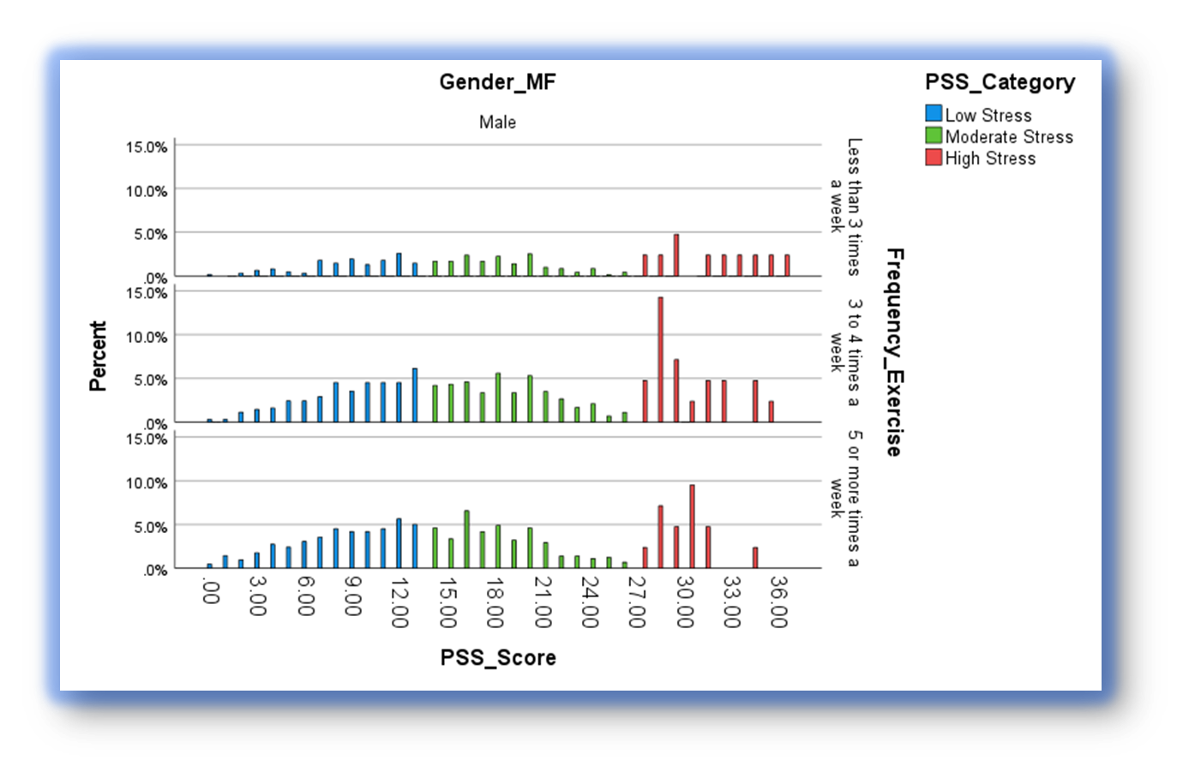
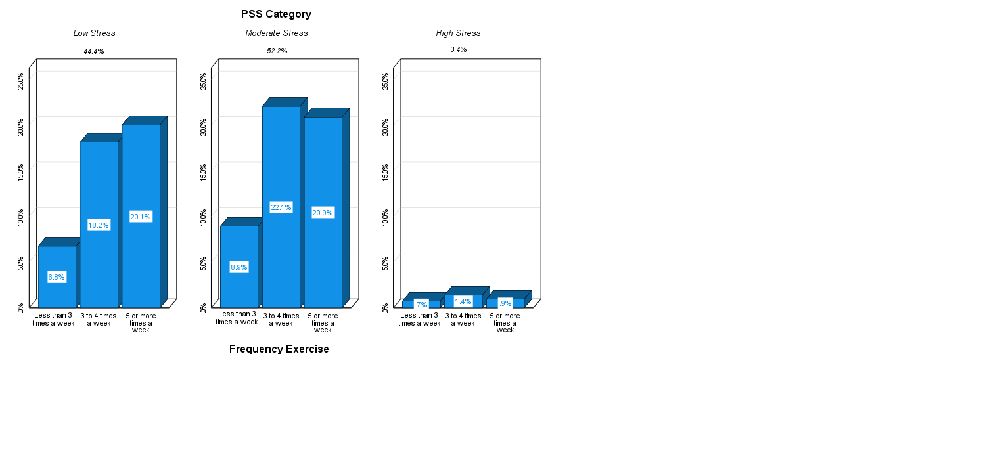
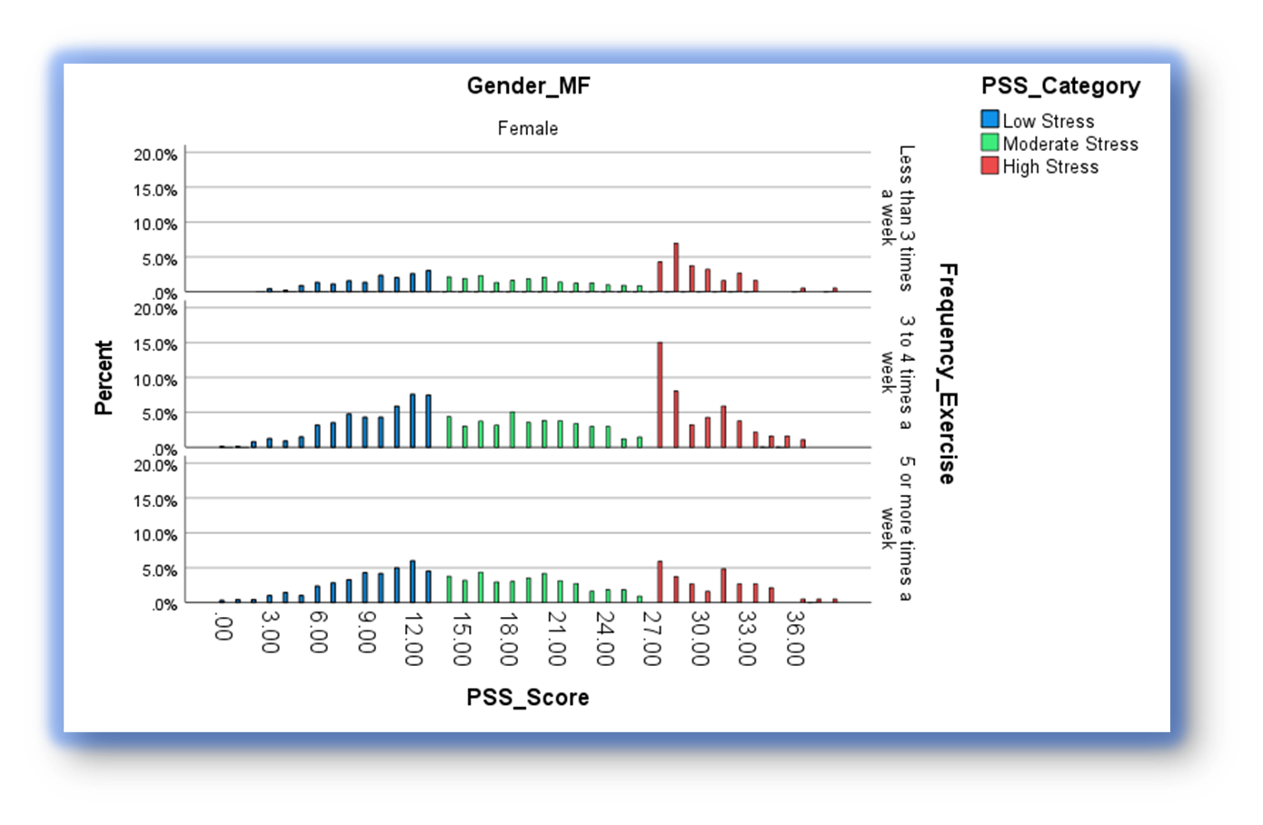
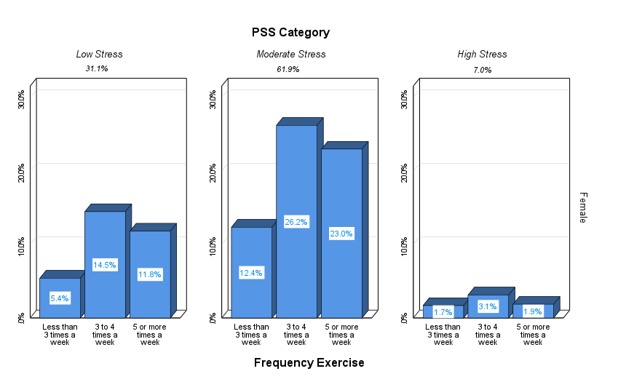




Examining the Relationship Between Exercise in College Students
And Reported Perceived Stress.
Stephen J Hunt MSK & Jesse Stabile Morrell PhD
Department of Agriculture, Nutrition, and Food Systems & Department of Kinesiology University of New Hampshire
Introduction
Male Results
Results
The relationship between exercise, stress, and mental health has been studied for decades, however more so in recent years. Research suggests there is a relationship between exercise and stress. ¹⁻²
The current literature shows a high rate of stress and sedentary time among college students. Stress along with time spent being sedentary can have significant physical and mental health consequences. ³⁻⁴
Research has also found that exercise is associated with overall lower levels of stress, and mental health consequences. ²⁻³
Developing exercise habits during an individual’s college years can promote future physical activity, overall wellness, and help prevent the development anxiety and depression into adulthood. ⁴⁻⁵
There is strong evidence that exercise has a protective effect in reducing stress and depression, however findings are varied and inconsistent regarding frequency of exercise (FE) or duration of exercise. ¹⁻³
Results:
Among females (n=3189), 31.1% were categorized as low stress, 61.9% moderate stress, and 7.0% high stress.
Among females, those in the high stress group were less likely to have a FE≥5x/week compared to those in moderate or low stress (28.0% vs. 37.3% and 37.3%, respectively, p<.05).
Further, those in the low stress group were least likely to report FE<3x/week compared to those in high stress group (17.1% vs. 25.3%, p<.01).
For males (n=1585) 44.4% were categorized as low stress, 52.2% moderate stress, and 3.4% high stress).
Among all males, 15.3% reported FE <3x/week, 41.4% 3-4x/week, and 43.3% % ≥ 5x/week; no differences in FE were observed according to stress level (p>.05).
Conclusions
Findings showed female college students frequently reported higher levels of stress than males. Further, among female students but not male students, exercise frequency declined with increased level of perceived stress.
Female Results
Objectives
Objective: To examine the frequency of exercise in male and female college students according to level of perceived stress.
Results may inform future research and help college educators and health professionals promote and tailor exercise recommendations for students interested in reducing stress, especially for females.
Methods
Future Implications
Methods:
Data were collected between 2012-2021 from the College Health and Nutrition Assessment Survey (CHANAS), an ongoing cross-sectional study at a public, New England university.
Participants (n=4774) reported their frequency of physical activity and exercise (FE, <3x, 3`-4x, ≥ 5x/week) via health history questionnaire and stress, as measured via the 10-item Cohen’s perceived stress scale (0-40) via online questionnaire. Perceived stress scores (PSS) were categorized as low (0-13), moderate (14-26), and high (27-40).
After excluding participants with missing data and stratifying by gender, differences were analyzed via chi-square analyses (SPSS v.27, p<.05). All participants provided consent (UNH IRB #5524).
Acknowledgements
Funding Sources: The New Hampshire Agriculture Experiment Station and USDA National Institute of Food and Agriculture Hatch Project 1010738.
References
Acharya, L., Jin, L., & Collins, W. (2019). College life is stressful today: Emerging stressors and depressive symptoms in college students. Journal of American College Health, 66(7), 655–664. doi:10.1080/07448481.2018.1451869
Bland, H.W., Melton, B.F., Bigham, L.E., & Welle, P.D. (2014). Quantifying the impact of physical activity on stress tolerance in college students. College Student Journal, 48(4), 559–568.
Bray, S.R., & Born, H.A. (2004). Transition to university and vigorous physical activity: Implications for health and psychological well-being. Journal of American College Health, 52(4), 181–188. PubMed ID: 15018429 doi:10.3200/JACH.52.4.181-188
Chekroud, S.R., Gueorguieva, R., Zheutlin, A.B., Paulus, M., Krumholz, H.M., Krystal, J.H., & Chekroud, A.M. (2018). Association between physical exercise and mental health in 1.2 million individuals in the USA between 2011 and 2015: A cross-sectional study. Lancet Psychiatry, 5(9), 739–746. PubMed ID: 30099000 doi:10.1016/S2215-0366(18)30227-X
Choi, K.W., Zheutlin, A.B., Karlson, R.A., Wang, M., Dunn, E.C., Stein, M.B.. Smoller, J.W. (2020). Physical activity offsets genetic risk for incident depression assessed via electronic health records in a biobank cohort study. Depression & Anxiety, 37(2), 106–

