Slide 1

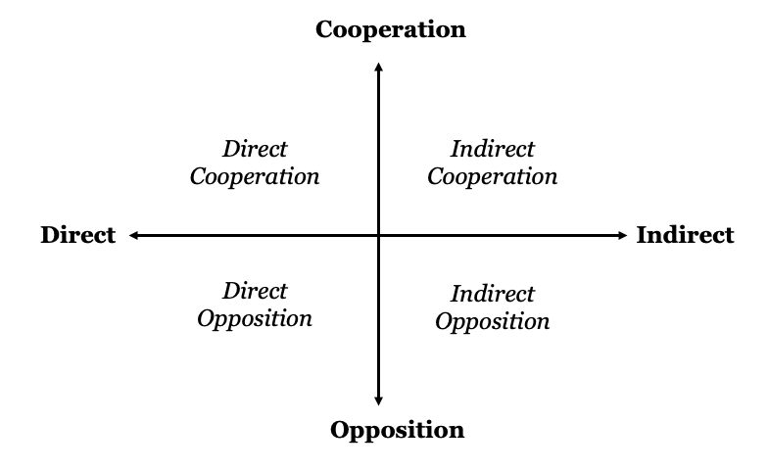
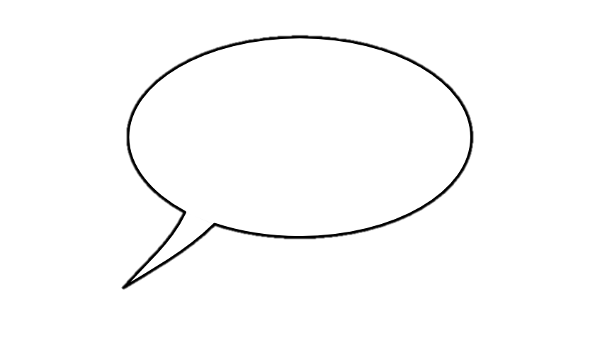
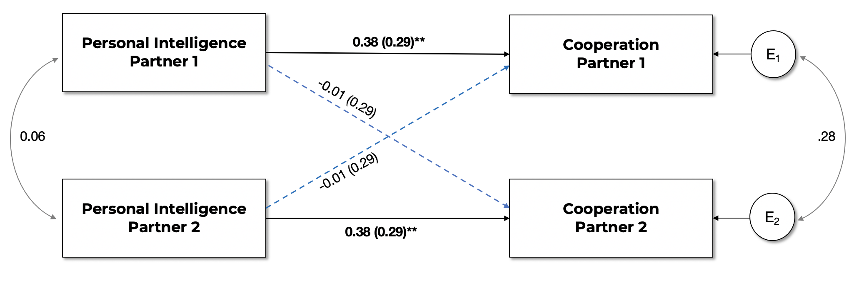

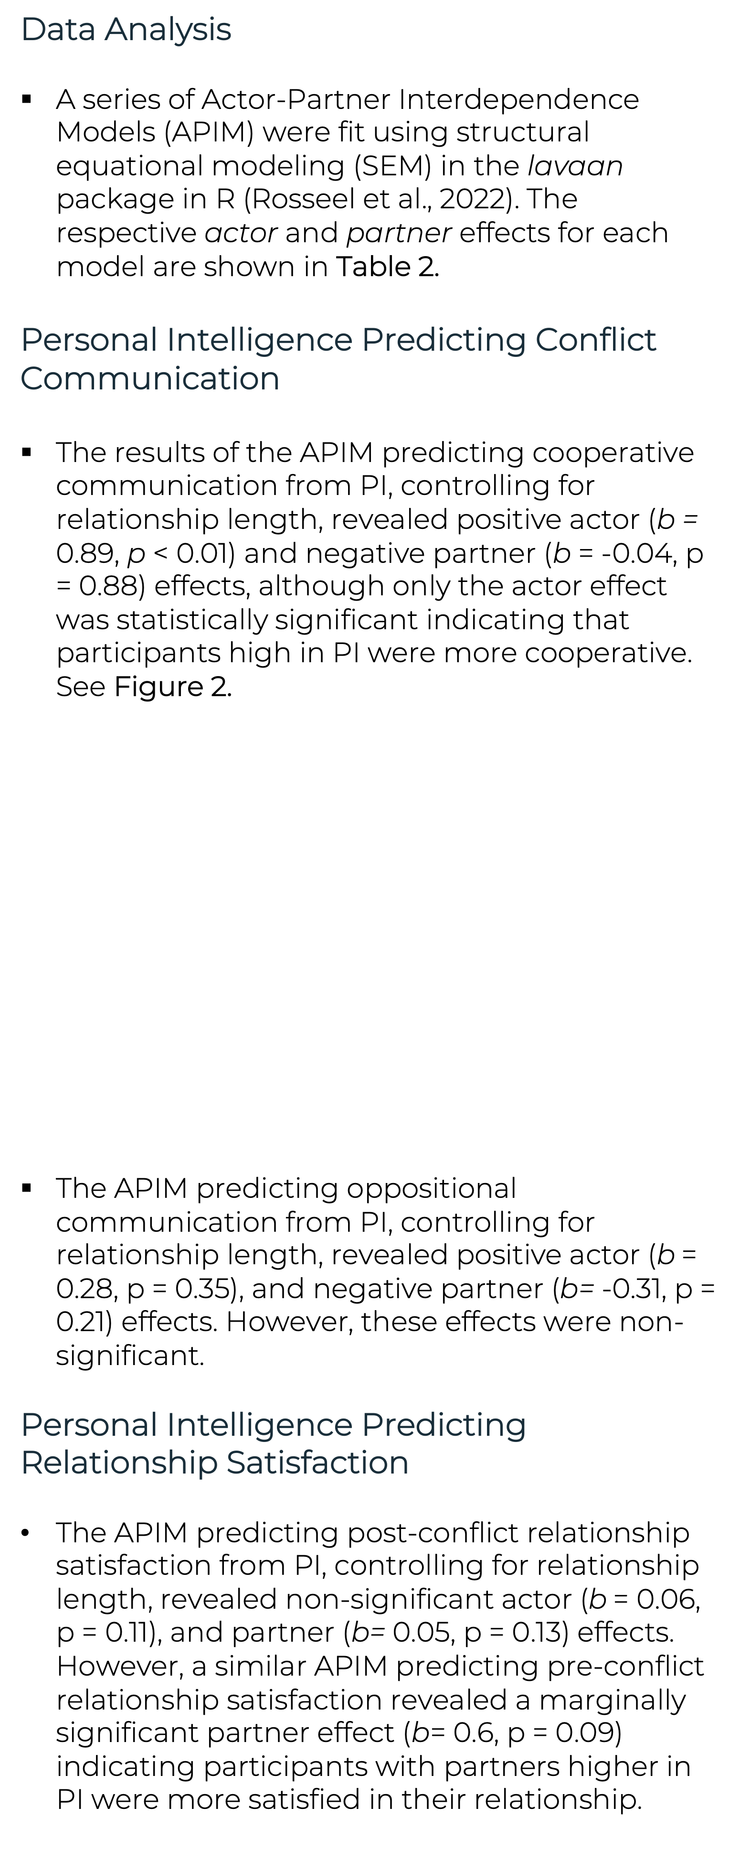
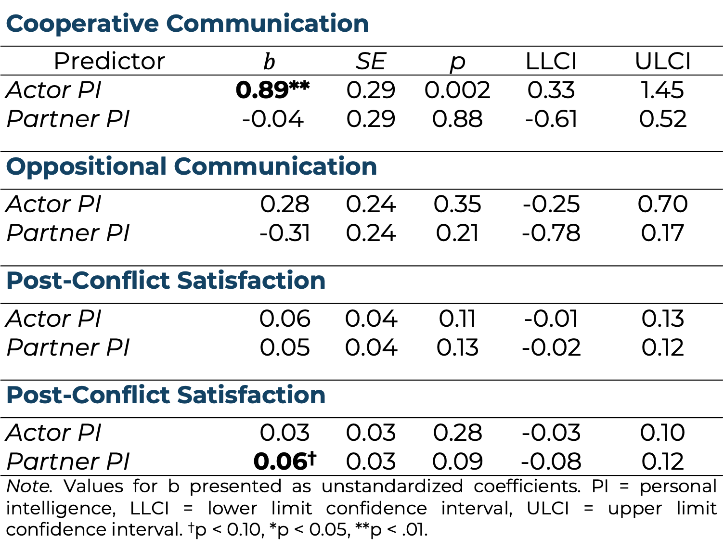
“They Just Get Me”: A Dyadic Exploration of Personal Intelligence in Conflict Communication
Victoria M. Bryan and John D. Mayer
University of New Hampshire Department of Psychology
INTRODUCTION
METHODS
RESULTS
Table 2. Actor and Partner Effects of PI on Observed Communication and Self-Estimated Relationship Satisfaction
Occasional conflict is an inevitable aspect of even the best relationships. The present study examines one possible personality factor—personal intelligence--related to handling such issues. Overall & McNulty (2017) organized conflict communication styles employed by couples along two broad dimensions (see Figure 1).
People show preferences for communication styles based on their personality (Antonioni, 1999; Bono et al., 2002). However, people’s default patterns may not always be the best choice for approaching conflict.
Personal Intelligence (PI) is a mental ability that includes the capacity to understand personality in the self and others (Mayer, 2008). People high in PI better understand the traits and motives that drive behavior. During conflict, people may draw on PI to inform their choice of conflict communication strategy.
Research Objectives
Identify the communication strategies employed by participants high (vs. low) in PI.
Explore whether PI predicts post-conflict relationship satisfaction.
Participants
The sample consisted of seventy-eight romantic couples (N = 156), recruited from the UNH Psychology Department participant pool, who had been in an exclusive and committed romantic relationship for at least two months. Couples had an average relationship length of 19.89 months (SD = 16.69). The average age of the sample was 19.24 years (SD = 1.58).
Procedure
We employed a dyadic interaction paradigm to explore the types of communication strategies used by participants. Partners independently completed a pre-discussion questionnaire on their personalities and relationship. Couples were then brought together and instructed to discuss a conflict in their relationship for approximately 5 to 7 minutes (see Simpson, Rholes & Phillips, 1996). Post-conflict, partners independently completed a post-conflict assessment of relationship satisfaction.
Measures
  Test of Personal Intelligence (TOPI 5G; Mayer, Caruso, & Panter, 2019). A 47-item ability-based measure of people’s capacity to reason about personality (α = .90).
  Relationship Assessment Scale (RAS; Hendrick et al., 1998). The RAS is a (α = .86). 7-item measure of relationship satisfaction. The scale was employed to assess both baseline and post-conflict relationship satisfaction.
  Cooperative and Oppositional Communication. 4 undergraduate research assistants rated each partner’s behavior during the conflict across 16 conflict communication items using a scale from 1 (not at all) to 7 (very much so). Ratings were used to create composite Cooperative (α = .72) and Oppositional (α = .77) scores. See Table 1 for details.
Data Analysis
A series of Actor-Partner Interdependence Models (APIM) were fit using structural equational modeling (SEM) in the lavaan package in R (Rosseel et al., 2022). The respective actor and partner effects for each model are shown in Table 2.
Personal Intelligence Predicting Conflict Communication
The results of the APIM predicting cooperative communication from PI, controlling for relationship length, revealed positive actor (b = 0.89, p < 0.01) and negative partner (b = -0.04, p = 0.88) effects, although only the actor effect was statistically significant indicating that participants high in PI were more cooperative. See Figure 2.
The APIM predicting oppositional communication from PI, controlling for relationship length, revealed positive actor (b = 0.28, p = 0.35), and negative partner (b= -0.31, p = 0.21) effects. However, these effects were non-significant.
Personal Intelligence Predicting Relationship Satisfaction
The APIM predicting post-conflict relationship satisfaction from PI, controlling for relationship length, revealed non-significant actor (b = 0.06, p = 0.11), and partner (b= 0.05, p = 0.13) effects. However, a similar APIM predicting pre-conflict relationship satisfaction revealed a marginally significant partner effect (b= 0.6, p = 0.09) indicating participants with partners higher in PI were more satisfied in their relationship.
Cooperative Communication
Predictor | $$b$$ | $$b$$ | SE | p | LLCI | ULCI
Actor PI | 0.89** | 0.89** | 0.29 | 0.002 | 0.33 | 1.45
Partner PI | -0.04 | -0.04 | 0.29 | 0.88 | -0.61 | 0.52
Oppositional Communication
Actor PI |  | 0.28 | 0.24 | 0.35 | -0.25 | 0.70
Partner PI |  | -0.31 | 0.24 | 0.21 | -0.78 | 0.17
Post-Conflict Satisfaction
Actor PI |  | 0.06 | 0.04 | 0.11 | -0.01 | 0.13
Partner PI |  | 0.05 | 0.04 | 0.13 | -0.02 | 0.12
Post-Conflict Satisfaction
Actor PI |  | 0.03 | 0.03 | 0.28 | -0.03 | 0.10
Partner PI |  | 0.06† | 0.03 | 0.09 | -0.08 | 0.12
Note. Values for b presented as unstandardized coefficients. PI = personal intelligence, LLCI = lower limit confidence interval, ULCI = upper limit confidence interval. †p < 0.10, *p < 0.05, **p < .01.
Figure 1. Conflict communication classified across two dimensions. (adapted from Overall & McNulty (2017).
CONCLUSIONS
Participants scoring high in PI used more cooperative communication strategies, as observed by independent raters. This finding replicates and extends previous research, which suggests participants with high PI self-report using more cooperative communication patterns when resolving conflict (Bryan, 2018).
Interestingly, participants with partners higher in PI reported higher global relationship satisfaction but not significantly higher post-conflict relationship satisfaction.
The influence of PI on relationship functioning may be cumulative, the result of many constructive and successful interactions over time.
Figure 2. APIM Predicting Cooperative Communication Ratings from Personal Intelligence
ACKNOWLEDGEMENTS
The first author would like to thank her dissertation committee members for their feedback and support. Funding for this work was provided by the UNH Department of Psychology and Psi Chi International Honor Society.
Table 1. Conflict Communication Ratings and Interrater Reliabilities
Item |  | ICC
Cooperative
 | … offer potential solutions to the conflict? | .80
 | … mention factors that led to disagreement? | .83
 | … negotiate or compromise with their partner? | .76
 | … minimize or downplay the issues? | .77
 | … use humor when discussing conflict? | .78
Oppositional
 | … seem to blame their partner? | .77
 | … make demands of their partner? | .66
 | … express anger, frustration, or annoyance? | .87
 | … make partner feel guilty or bad?* | .60
 | … emphasize hurt feelings?* | .79
 | Note. Two-way random, consistency intraclass correlation coefficients. * indicates items are reversed keyed. N = 40.
REFERENCES
Antonioni, D. (1999). Relationship between the Big Five personality factors and conflict management styles. International Journal of Conflict Management, 9(4), 336–355.
Bono, J.E., Boles, T.L., Judge, T.A., & Lauver, K.J. (2002). The role of personality in task and relationship conflict. Journal of Personality, 70, 311-344.
Bryan, V. M. (2018.). Does personal intelligence promote conflict resolution in romantic relationships? Unpublished Master's Thesis.
Hendrick, S.S., Dicke, A., Hendrick, C. (1998). The Relationship Assessment Scale. Journal of Social and Personal Relationships, 15, 137-142.
Mayer, J. D. (2008). Personal Intelligence. Imagination, Cognition and Personality, 27(3), 209–232.
Mayer, J.D., Caruso, D.R., & Panter, A.T. (2019). Advancing the measurement of personal intelligence with the Test of Personal Intelligence, Version 5 (TOPI 5). Journal of Intelligence, 7.
Overall, N. C., & McNulty, J. K. (2017). What type of communication during conflict is beneficial for intimate relationships? Current Opinion in Psychology, 13, 1–5.
Simpson, J.A., Rholes, W.S., & Phillips, D. (1996). Conflict in close relationships: An attachment perspective. Journal of Personality and Social Psychology, 71, 899-914.
Rosseel Y (2012). “lavaan: An R Package for Structural Equation Modeling.” Journal of Statistical Software, 48(2), 1–36.

