Slide 1


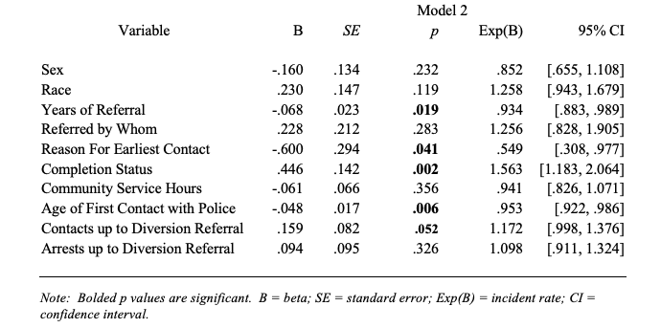
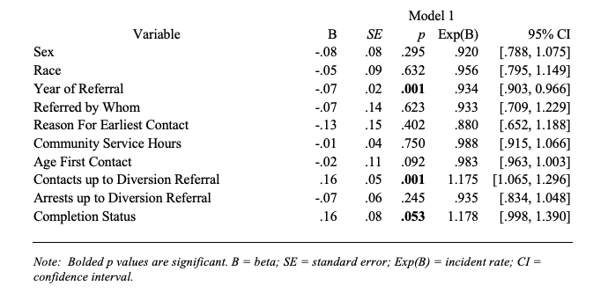
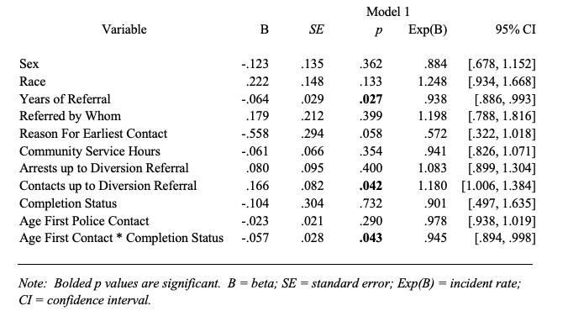
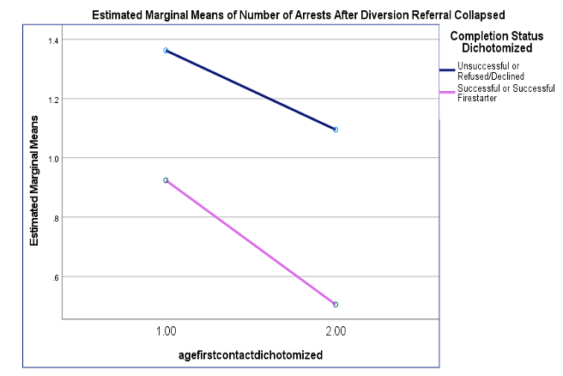
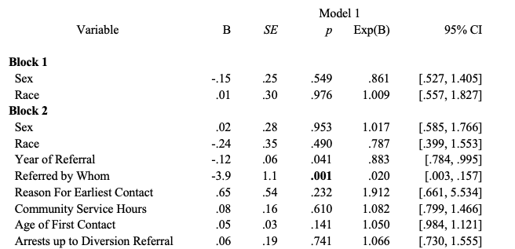
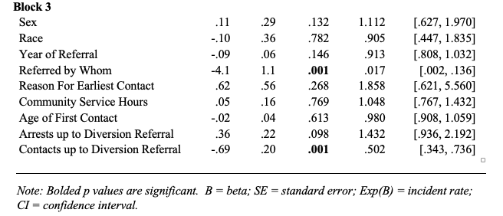

Factors that Predict Juvenile Diversion Success and Continued Contact with Law Enforcement
Matthew Brown¹, Caleigh Bousquin¹, Stephanie Schiller¹, Madison Truax¹, Hayden Harrington¹, Kristen Graham¹, Meghan Montgomery¹,
Donna Perkins, Ph.D^{.1,} Sgt. Det. Elizabeth Turner$2$
¹Department of Justice Studies University of New Hampshire, ²Rochester Police Department
Background
Hypothesis 1b: Hypothesis 2a:
Methodology
Juvenile diversion programs were introduced in the late 20th century as a response to criticism of the existing court system’s ineffectiveness in reducing crime and rehabilitation of juvenile offenders (Pogrebin, Poole, & Regoli, 1984).
Diversion is defined by the New Hampshire Juvenile Court Diversion Network Handbook (2005) as “an alternative to traditional court processing... that refers a youthful offender, who might otherwise be dealt with in juvenile court, to an alternative community-based program” (p. 5).
In a “wrap-around” approach, diversion programs seek to examine the reasons why the offenses were committed, resolve the problems resulting from the offenses committed, and identity the specific risks and needs of the juveniles.
Poisson Regression Predicting Number of Arrests After Diversion Referral from Number of Arrests Before Diversion Referral:
Regression Predicting Number of Police Contacts After Diversion Referral Based on Completion Status:
Participants
383 juveniles from Rochester, NH who participated in the Juvenile Diversion Program from 2010-2021
12-17 year old male and female juveniles
Measures
Control variables- sex, race, year of referral, referred by whom, reason for earliest contact, community service hours, age of first police contact
Predictor variables- number of police contact before referral, number of arrests before referral, completion status
Outcome variables- number of police contact before referral, number of arrests after referral, arrested before 18 (y/n), completion status
Procedures
De-identified information from Sgt. Det. Turney on excel spreadsheets
Case closure sheets and records management system
Hypothesis 3b:
Goals
Poisson Regression Predicting Number of Arrests After Diversion Referral Based on the Interaction between Age of First Police Contact and Completion Status
Conclusions
Specific Aims for Juvenile Diversion Programs
Reduce juveniles’ further involvement in the juvenile justice system
Restorative Justice v. Punitive Punishment
Benefit the juvenile offender, the community, the juvenile justice system, and the adult criminal justice system
Expected Outcome
Understand the role of diversion in continued involvement in the juvenile justice system
Understand factors that predict successful completion of diversion programs
This study provides useful insight into:
The role of diversion in continued involvement in the juvenile justice system
Factors that predict successful completion of diversion program
Important implications of these findings for professionals and other stakeholders who work with at-risk juveniles in NH
Findings suggest recent changes to the Juvenile Justice System in NH toward a more restorative justice focus, rather than strictly a punitive focus, has merit.
Figure 1: Interaction between between Age of First Police Contact and Completion Status on Number of Arrests After Diversion Referral
sTAMD Simulations
Hypothesis 4a:
Further Research
Binary Logistic Regression Predicting Completion Status from Number of Police Contact Before Diversion Referral:
Acknowledgements
Race/Sex
We propose the need for more research looking at whether the insignificant findings we had in correlation to the race and sex of juveniles may differ with a more diverse sample.
Parental/Guardian Involvement
We propose the need for more research examining the possible influence that parent/guardian participation in the diversion program may have on continued involvement with the juvenile.
We would like to thank the hardworking members of the Rochester NH Police Department. Specifically, we would like to acknowledge Sergeant Det. Elizabeth Turner, Nicole Rodler, Lt. Anne Gould and Chief of Police Paul Toussaint for their dedication to the youths of Rochester.
References
Behken, M., Bort, A., Borbon, M. (2017). “Race and Gender Recidivism Differences Among Juvenile Mental Health Court Graduates”. Juvenile & Family Court Journal. 68(2), 19-31.
Bernburg, J. G., & Krohn, M. D. (2003). “Labeling, life chances, and adultcrime: The Direct and Indirect Effects of Official Intervention in Adolescenceon Crime in Early Adulthood”. Criminology.41, 1287–1318.
Campbell, J. &Retzlaff, P. (2000). “Juvenile Diversion Interventions: Participant Description and Outcomes.” Journal of Offender Rehabilitation.32 (1-2),57-73.
Carney, M. &Buttell, F. (2003). “Reducing Juvenile Recidivism: Evaluating the Wraparound Services Model”. Research on Social Work Practice.13,551-568.
Cauffman, E., Beardslee, J., Fine, A., Frick, P. and Steinberg, L. (2021). “Crossroads in Juvenile Justice: The Impact of Initial Processing Decision on Youth 5 Years after First Arrest. Development and psychopathology”. 33(2), 700-713.
Champion, Dean John. 2006. Research Methods for Criminal Justice and Criminology.
Cocozza, J., Veysey, B., Chapin, D., Dembo, R., Walters,W., Farina, S.(2005). “Diversion from the Juvenile Justice System: The Miami-Dade Juvenile Assessment Center Post-Arrest Diversion Program”. 40 (7),935-95.
Conrad, S., Tolou-Shams, M., Rizzo,C., Placella, N., Brown, L. (2014). “Gender Differences in Recidivism Rates for Juvenile Justice Youth: The Impact of Sexual Abuse”. Law and Human Behavior. 38(4), 305-314.
Davidson, J. (2005). Evaluation Methodology Basics; The Nuts and Bolts of Sound Evaluation. Sage Publications Inc.
Moffitt, T., Caspi, A., Harrington, H., Milne, B. (2002). “Males on the Life-Course-Persistent and Adolescence-Limited Antisocial Pathways: Follow-up at Age 26 Years”. Development and Psychopathology. (14),179-207.
Pogrebin, M., Poole, E., Regoli, R. (1984). “Constructing and Implementing a Model Juvenile DiversionProgram”. Youth and Society 15,305-324.

Slide 2

This poster template provided courtesy of
UNH ESRC Poster Printing Services
Trust us to make your poster look GREAT!
Website: http://posters.unh.edu
Poster Guide: http://goo.gl/1E7TJY
DELETE THIS SLIDE BEFORE PRINTING

